Slide 1



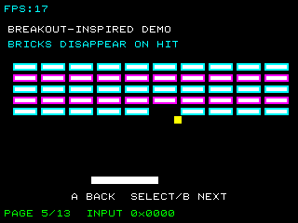
UNDERSTAND NOW
USE NOW
UNDERSTAND LATER
Lecture deck. The listings, the complete program and how to test it are in the code deck:
11-Computer_Architecture-Combinational_Machines-Lab.pptx
ARC12 COMPUTER ARCHITECTURE · LECTURE 11
Combinational Machines
Codes, decoders, multiplexers, comparators, parity: the circuits a RISC-V processor is assembled from
“...it's not my fault, the carrots touched the peas...”
Alan Turing as a boy, in the film The Imitation Game, 2014
Prof. Raffaele Montella, PhD
University of Naples “Parthenope” · A.Y. 2026/27
raffaelemontella.it · raffaele.montella@uniparthenope.it
Notes:
The previous lectures supplied gates and a method for combining them. This one is a catalogue of the standard combinational machines from which designers actually build systems: decoders, encoders, multiplexers, comparators, parity networks, and finally the arithmetic logic unit. For each, the lecture establishes what it computes, how it is constructed, and where it is located inside a RISC-V processor. The young Turing of the epigraph insists that his carrots and peas be kept apart; this lecture is likewise about keeping signals distinct and selecting among them.
Learning status: UNDERSTAND NOW, by the end of this lecture you explain it, trace it and apply it on your own; USE NOW, you follow and use the recipe today; how it works inside is explained later, or is not part of the course; UNDERSTAND LATER, recognise the name and what it is for; a later lecture explains it. A slide without a badge is context: a story, an example, a question, an exercise.
Learning status of this lecture. UNDERSTAND NOW: multiplexers; combinational machines; codes; decoders and encoders; comparators and parity; the ALU. USE NOW: the complete program, the PRG32 tools (used, not studied, in this course). UNDERSTAND LATER: finite-state machines (Lecture 13). A slide without a badge is context: a story, an example, a question, an exercise.
For the lecturer: The quotation is translated back from the Italian version used in the original deck. Spiral: a table lookup in assembly is a multiplexer; the lecture then builds the standard combinational blocks and shows where each one sits inside a RISC-V processor (the old course used the Motorola 68000 as reference).

Slide 2
What you will be able to do by the end
1
Tell a combinational machine from a sequential one
2
Compute how many bits a fixed-length code needs, and recognise incomplete and redundant codes
3
Design a decoder and an encoder, and say what a transcoder does
4
Explain what a multiplexer and a demultiplexer do, and build them from gates
5
Build a comparator and a parity network, and say what a parity check can and cannot detect
6
Point to each of these machines inside a RISC-V processor
Notes:
Six learning outcomes. Distinguishing a combinational machine from a sequential one. Computing the number of bits a code requires, and recognising incomplete and redundant codes. Designing a decoder and an encoder, and explaining what a transcoder does. Explaining multiplexers and demultiplexers and building them from gates. Building a comparator and a parity network, with a clear understanding of what a parity check can and cannot detect. And locating each of these machines within the processor.

Slide 3
A taxonomy of digital circuits
UNDERSTAND NOW · combinational machines
UNDERSTAND LATER · finite-state machines → Lecture 13
Combinational circuits
Sequential circuits
The value of the outputs at a given instant depends only on the value of the inputs at that same instant
No memory, no feedback loops
Completely described by a truth table
Examples: adders, decoders, multiplexers, the ALU
The outputs depend on the present inputs and on the past history of the inputs
They need the concepts of time and of state
Described by a state table or a state diagram
Examples: latches, flip-flops, registers, counters, the processor as a whole (Lecture 13)
Notes:
Digital circuits fall into two classes. In a combinational circuit the outputs at a given instant depend only on the inputs at that same instant: there is neither memory nor feedback, and a truth table describes the circuit completely. In a sequential circuit the outputs depend also on the history of the inputs, so the notions of time and state are required. Adders, decoders and multiplexers are combinational; flip-flops, registers and the processor as a whole are sequential, and they are the subject of Lecture 13.
UNDERSTAND NOW: combinational machines. UNDERSTAND LATER: finite-state machines (studied in Lecture 13).
For the lecturer: Reti combinatorie and reti sequenziali. The definition of a sequential circuit implies time and state: both are the subject of the next lecture.

Slide 4
Real gates take time
UNDERSTAND NOW · combinational machines
A gate does not answer instantly: its output settles after a propagation delay
The delay of a network is that of its slowest path from an input to an output: the critical path
delay
While the signals travel, the outputs can be temporarily wrong
every gate adds a little time; the slowest path through the network sets the speed of the whole machine
A combinational machine is correct only after it has settled: something must tell us when to look
That something is the clock, and it is where sequential machines begin
Notes:
A physical gate does not respond instantaneously: its output settles after a propagation delay, whose origin Lecture 10 explained. The delay of a network is that of its slowest path from an input to an output, the critical path. While signals propagate, the outputs may be transiently incorrect. A combinational machine is therefore correct only once it has settled, and some mechanism must indicate when its outputs may be sampled. That mechanism is the clock, and with it the study of sequential machines begins.
UNDERSTAND NOW: combinational machines.
For the lecturer: In a ripple-carry adder (Lecture 09) the critical path crosses all thirty-two full adders. The clock period of a processor must be longer than its longest critical path.

Slide 5
Codes of fixed length
UNDERSTAND NOW · codes
Code
A code maps every element of a source type T, of cardinality N, to a string of symbols of a code alphabet E with k symbols: the code word.
Fixed length: every code word has the same length m; there are k^m possible words
To encode N elements we need k^m >= N, so the minimum length is m = ceil(log_k N)
In binary: m = ceil(log2 N). The fourteen exam marks need 4 bits; the 32 RISC-V registers need exactly 5
Incomplete code: N is not a power of k, and k^m - N words are left unassigned
Notes:
A code associates each element of a set of N elements with a string of symbols, its code word. In a fixed-length code every word has the same length m. With an alphabet of k symbols there are k^m words, so m must be at least the logarithm to base k of N, rounded up. In binary, fourteen items require 4 bits, and the 32 registers of RISC-V require exactly 5, which is why each register field of an instruction is five bits wide. When N is not a power of two some words remain unused, and the code is incomplete.
UNDERSTAND NOW: codes.
For the lecturer: Codice a lunghezza fissa. The five bits of a register number are the fields rd, rs1 and rs2 of a RISC-V instruction (Lecture 02). Fourteen marks leave 16 - 14 = 2 unassigned words.

Slide 6
An incomplete code: binary-coded decimal
UNDERSTAND NOW · codes
Digit | BCD 8421 | Excess-3 | Digit | BCD 8421 | Excess-3
0 | 0000 | 0011 | 5 | 0101 | 1000
1 | 0001 | 0100 | 6 | 0110 | 1001
2 | 0010 | 0101 | 7 | 0111 | 1010
3 | 0011 | 0110 | 8 | 1000 | 1011
4 | 0100 | 0111 | 9 | 1001 | 1100
Four bits for ten digits: six code words are not assigned. They will be the don't-cares of our circuits.
Notes:
The classic incomplete code: decimal digits on four bits. In BCD 8421 each digit is simply its value in binary; in excess-3 the value is increased by three. Ten digits require four bits, and four bits give sixteen words, so six are never used: in BCD, the words from 1010 to 1111. The caption draws the design consequence: in a circuit that receives BCD digits, those six words are don't-care conditions, and exploiting them simplifies the circuit.
UNDERSTAND NOW: codes.
For the lecturer: Ten digits need ceil(log2 10) = 4 bits; six of the sixteen words are never used: in BCD 8421 they are 1010 to 1111. Unused words become don't-care conditions when we design a circuit (Lecture 09).

Slide 7
Redundant codes
UNDERSTAND NOW · codes
A redundant code uses more symbols than strictly necessary: its length is greater than the minimum m
Element | Code 1 | Code 2
A | 00 | 000
B | 01 | 011
C | 10 | 101
D | 11 | 110
Only some of the possible words are legal; the others cannot be produced by the encoder
If a word arrives that is not legal, something altered it on the way: the error is detected
Code 1 is not redundant: every 2-bit word is legal, so an altered bit turns one element into another without anyone noticing.
Code 2 adds a third bit that makes the number of 1s even. The words 001, 010, 100 and 111 are not legal: a single altered bit is always detected.
Redundancy is the price paid to detect, and sometimes to correct, errors
Notes:
A redundant code uses more bits than the minimum, so that only some of the possible words are legal. The arrival of an illegal word reveals that something altered it in transit, and the error is detected. The two codes of the table make the point. In Code 1 every 2-bit word is legal, so an altered bit turns one element into another and the error passes unnoticed. Code 2 adds a third bit that makes the number of 1s even, so any single altered bit produces an illegal word. Redundancy is the price paid for error detection.
UNDERSTAND NOW: codes.
For the lecturer: The original slide showed the same idea with a picture and a different choice of illegal words. Code 2 is Code 1 plus an even-parity bit: the parity machines come later in this lecture.

Slide 8
The decoded representation
UNDERSTAND NOW · decoders and encoders
A code in which the length of the word equals the cardinality N of the set: m = N
0 0 1 0
Every code word has exactly one bit at 1: one line per element
Simple to use, because the active line directly selects something, but costly in wires
one of four: the third line is asserted, so the third element is the one chosen
Compact code inside a word, decoded representation where a choice must be acted upon
Notes:
In the decoded representation there are as many bits as elements, and exactly one of them is 1: one line per element, a scheme also called one-hot. It is costly in wires but immediately usable, because the active line can directly enable the corresponding action. The design principle is stated in the last line: information is kept in a compact code inside a word, and decoded only at the point where a choice must be acted upon. The button word of Lecture 08 is an example of the decoded form.
UNDERSTAND NOW: decoders and encoders.
For the lecturer: Also called one-hot. The seven lamps of lab 06 are a decoded representation of the bit number; the 32 write-enable lines of the RISC-V registers are another.

Slide 9
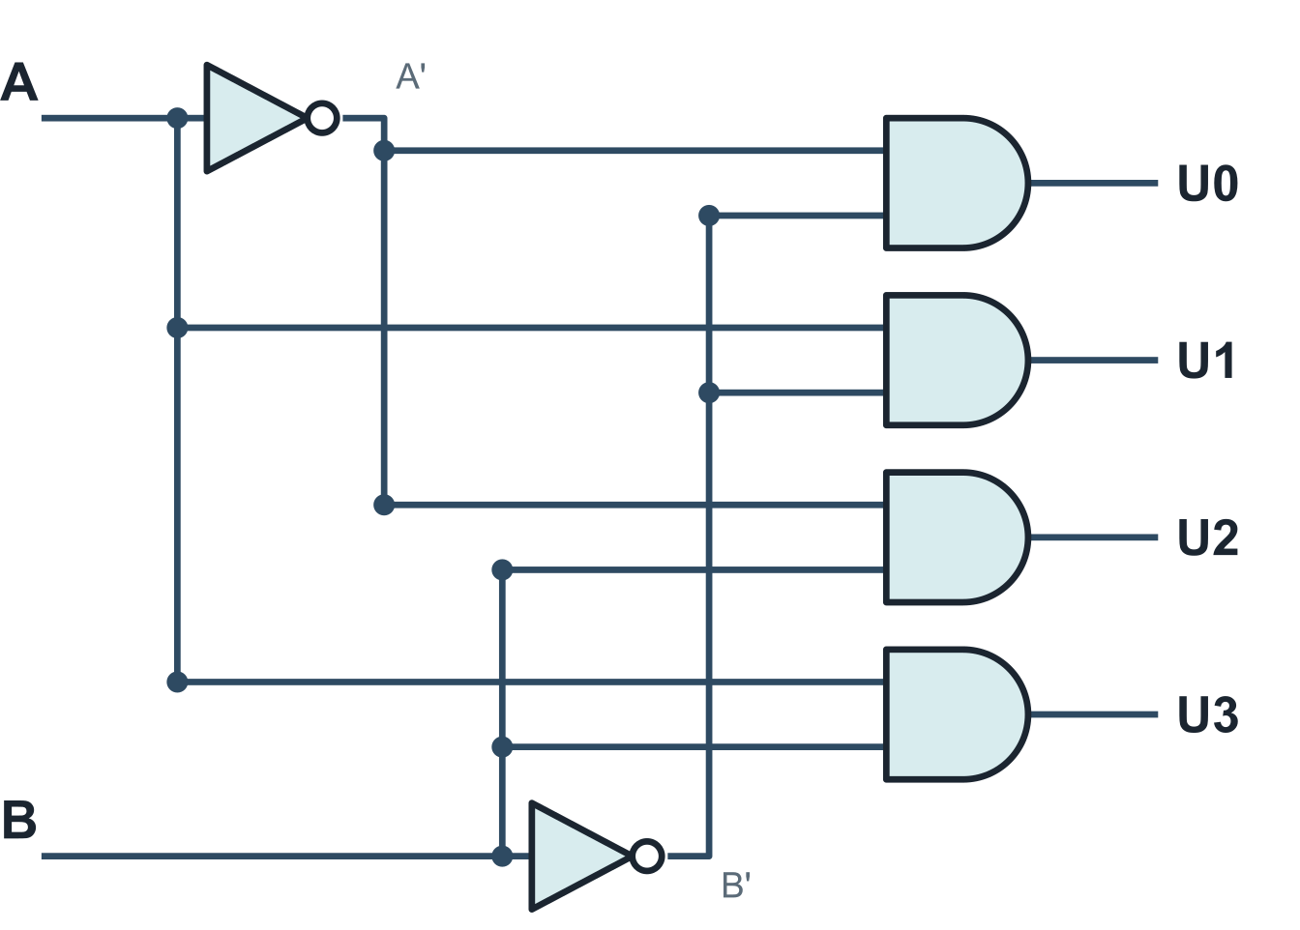
The decoder
UNDERSTAND NOW · decoders and encoders
Receives a code word of m bits and asserts the one output line, out of N = 2^m, that corresponds to it
Each output is a minterm of the inputs: a decoder generates all of them
With an enable input EN: when EN = 0 no output is asserted
B | A | U0 | U1 | U2 | U3
0 | 0 | 1 | 0 | 0 | 0
0 | 1 | 0 | 1 | 0 | 0
1 | 0 | 0 | 0 | 1 | 0
1 | 1 | 0 | 0 | 0 | 1
U0 = B'A'
U1 = B'A
U2 = B A'
U3 = B A
Notes:
A decoder receives an m-bit code word and asserts the single output, among 2^m, that corresponds to it. The table and the circuit show the 2-to-4 decoder: each output is a minterm of the two inputs, built from one AND gate and inverters where required. A decoder thus generates all the minterms of its inputs, and with an OR gate can therefore implement any function of them. An enable input, when 0, holds every output at 0; it is the key to composing small decoders into larger ones.
UNDERSTAND NOW: decoders and encoders.
For the lecturer: Synthesis of the 2-to-4 decoder (1 out of 4). A is the least significant bit. Decodificatore: the block symbol is a box marked 1/N.

Slide 10
The encoder
UNDERSTAND NOW · decoders and encoders
The inverse machine: it receives a decoded representation, N lines of which one is asserted, and outputs the corresponding code word of m = ceil(log2 N) bits
N to m
Each output bit is the OR of the input lines whose number has a 1 in that position
If several lines can be asserted together a priority encoder is needed
– it outputs the number of the asserted line with the highest priority
from one line among N to a code word of m bits: m = ceil(log2 N)
Example: a keypad with one wire per key becomes a compact key number
Notes:
The encoder is the inverse machine: it receives N lines, of which one is active, and produces the index of the active line as an m-bit code word. Each output bit is the OR of the input lines whose index has a 1 in that position. If several lines may be active simultaneously, a priority encoder is required, which outputs the index of the most important active line. The problem it solves, choosing among simultaneous requests, reappears in Lecture 19, where interrupts are ordered by priority.
UNDERSTAND NOW: decoders and encoders.
For the lecturer: Codificatore. For N = 4: C0 = U1 + U3, C1 = U2 + U3. Priority encoders appear again with interrupts: several devices ask for attention, one number reaches the processor.

Slide 11
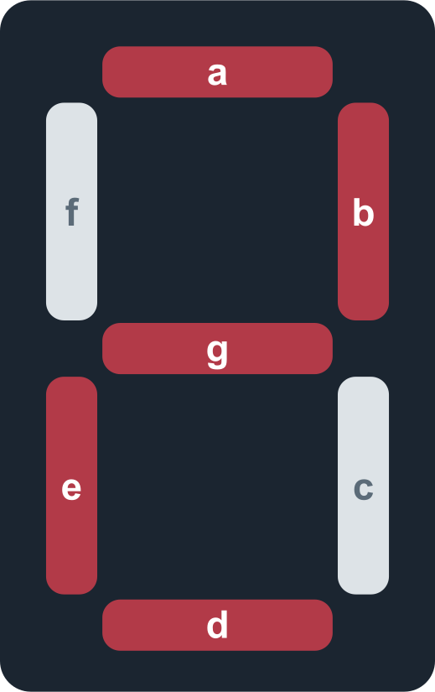
Transcoders: the seven-segment display
UNDERSTAND NOW · decoders and encoders
Digit | BCD | a | b | c | d | e | f | g
0 | 0000 | 1 | 1 | 1 | 1 | 1 | 1 | 0
1 | 0001 | 0 | 1 | 1 | 0 | 0 | 0 | 0
2 | 0010 | 1 | 1 | 0 | 1 | 1 | 0 | 1
3 | 0011 | 1 | 1 | 1 | 1 | 0 | 0 | 1
4 | 0100 | 0 | 1 | 1 | 0 | 0 | 1 | 1
5 | 0101 | 1 | 0 | 1 | 1 | 0 | 1 | 1
6 | 0110 | 1 | 0 | 1 | 1 | 1 | 1 | 1
7 | 0111 | 1 | 1 | 1 | 0 | 0 | 0 | 0
8 | 1000 | 1 | 1 | 1 | 1 | 1 | 1 | 1
9 | 1001 | 1 | 1 | 1 | 1 | 0 | 1 | 1
A transcoder turns each word of a code C1 into the corresponding word of a code C2 defined on the same set.
Here: from BCD to the seven lines that light the segments a to g. The digit 2 lights a, b, g, e and d.
Seven outputs: seven functions of four variables to synthesise.
Notes:
A transcoder converts a word of one code into the corresponding word of another. The example is the seven-segment display: the input is a BCD digit, and the outputs are the seven lines, a to g, that light the segments. The table gives, for each digit, the segments that are lit: the digit 2 lights a, b, g, e and d. There are seven outputs, hence seven functions of four variables to synthesise, each with six don't-care conditions that the Karnaugh maps of Lecture 09 can exploit.
UNDERSTAND NOW: decoders and encoders.
For the lecturer: Transcodificatore BCD - display a 7 segmenti. Each segment is an LED switched by a digital signal. The six unused BCD words are don't-cares for all seven functions.

Slide 12
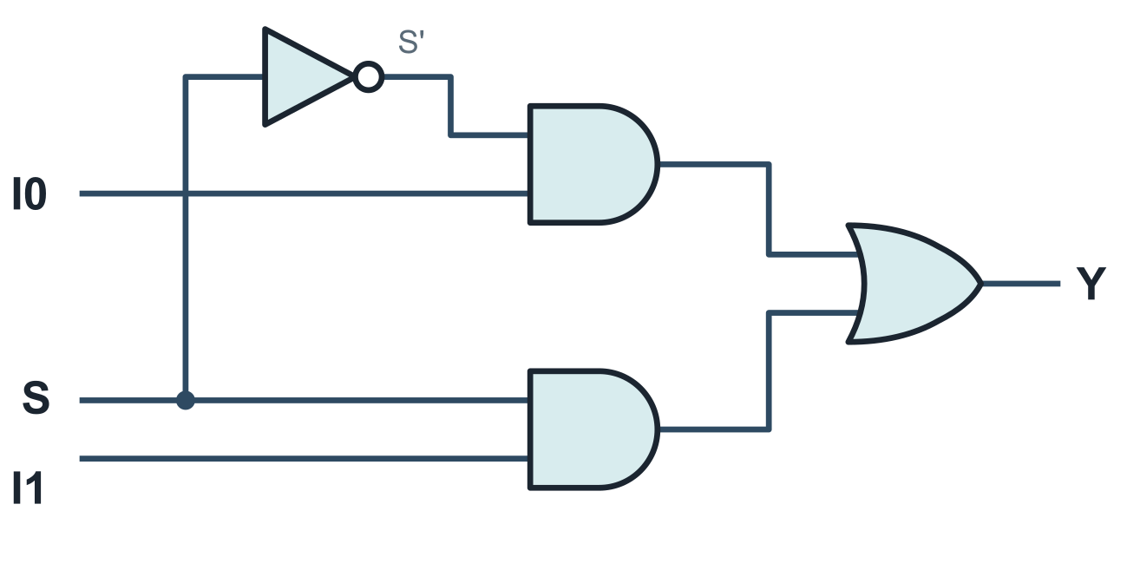
The multiplexer
UNDERSTAND NOW · multiplexers
A combinational circuit with 2^n data inputs, n selection lines and one output
It selects one of the 2^n input signals and transfers it to the single output line
Addressable: a decoder on the selection lines enables one AND gate; an OR collects the result. The datum is chosen by an address, not by a decoded line
2 inputs: Y = S' I0 + S I1
4 inputs: Y = S1'S0' I0 + S1'S0 I1
+ S1 S0' I2 + S1 S0 I3
A multiplexer with two inputs: when S = 0 the output is I0, when S = 1 it is I1
Each data input is multiplied by one minterm of the selection lines.
Notes:
A multiplexer has 2^n data inputs, n selection lines and one output: it routes to the output the input designated by the selection lines. The formula shows how: each data input is multiplied by one minterm of the selection lines, and the products are summed. With two inputs, Y = S'I0 + S I1: when S is 0 the first term passes I0, when S is 1 the second passes I1. The drawing realises this formula directly in gates. It is the machine that the warm-up implemented in software.
UNDERSTAND NOW: multiplexers.
For the lecturer: Multiplexer indirizzabile: a MUXL (one enable line per input) plus a decoder. A multiplexer also implements any function of its selection variables: put the truth table on the data inputs.

Slide 13
The demultiplexer
UNDERSTAND NOW · multiplexers
The inverse machine: one data input D, n selection lines, 2^n outputs
S1 | S0 | F0 | F1 | F2 | F3
0 | 0 | D | 0 | 0 | 0
0 | 1 | 0 | D | 0 | 0
1 | 0 | 0 | 0 | D | 0
1 | 1 | 0 | 0 | 0 | D
It routes the input to the output chosen by the selection lines; the other outputs stay at 0
Addressable demultiplexer: the enable signals come from a decoder on the selection lines
F0 = D S1'S0' F1 = D S1'S0
F2 = D S1 S0' F3 = D S1 S0
With D fixed at 1 a demultiplexer is exactly a decoder: D plays the role of the enable
A multiplexer followed by a demultiplexer carries many signals over one wire, one at a time: the idea behind every shared line.
Notes:
The demultiplexer is the inverse: one data input, n selection lines and 2^n outputs. The input is routed to the output designated by the selection lines, while the other outputs remain at 0. With the data input held at 1, a demultiplexer is precisely a decoder. A multiplexer at one end of a wire and a demultiplexer at the other allow many signals to share that wire, one at a time: the principle underlying every shared line, including the buses of Lecture 14.
UNDERSTAND NOW: multiplexers.
For the lecturer: Demultiplexer indirizzabile: Fi = D . Ui, where Ui are the outputs of the decoder.

Slide 14
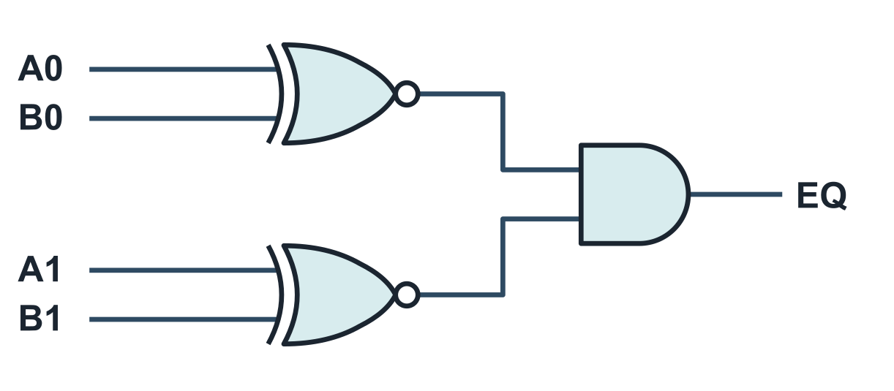
The comparator
UNDERSTAND NOW · comparators and parity
Two data A and B in input, one Boolean output EQ that is 1 when A = B
Two bits are equal when their XNOR is 1
Two words are equal when all their pairs of bits are equal: an AND of XNORs
In the processor: beq and bne
– the two registers are compared bit by bit, and the branch is taken or not according to EQ
EQ = (A0 xnor B0) . (A1 xnor B1) . ...
A comparator for words of two bits
Notes:
A comparator receives two words and produces a single bit, 1 when they are equal. Two bits are equal when their XNOR is 1; two words are equal when all corresponding pairs of bits are equal, so the comparator is an AND of XNORs. The drawing shows the two-bit case. In the processor the comparator decides the branches beq and bne: the two registers are compared, and the branch is taken or not according to the result.
UNDERSTAND NOW: comparators and parity.
For the lecturer: Comparatore. Many datapaths reuse the ALU instead: subtract and test whether the result is zero. Ordering comparisons (blt, slt) need the subtraction and the sign rules of Lecture 05.

Slide 15
Parity
UNDERSTAND NOW · comparators and parity
When data travel from a source to a destination, redundant codes allow errors to be checked
The simplest check is a single parity bit: legal code words have, for example, an even number of bits at 1
xor
A parity network computes the parity of the n bits at its input: a chain of XORs
– p = x0 xor x1 xor ... xor x(n-1) is 1 when the number of 1s is odd
the parity of a word is the XOR of all its bits
It is needed twice
– to compute the bit to add to a non-redundant code
– to verify the overall parity of the redundant code on arrival
Notes:
The simplest redundant code appends a parity bit to each word, chosen so that the total number of 1s is, for instance, even. The circuit that computes it is a parity network, a tree of XOR gates: the XOR of all the bits of a word is 1 when the number of 1s is odd, because XOR is addition modulo 2. The same network is used twice: by the sender, to compute the bit to append, and by the receiver, to verify the parity of what has arrived.
UNDERSTAND NOW: comparators and parity.
For the lecturer: Rete di parità. XOR is addition modulo 2, which is why a chain of XORs counts the 1s modulo 2.

Slide 16
The ALU is a set of machines and a multiplexer
UNDERSTAND NOW · the ALU
B
A
adder / subtractor
MUX
All the units compute at the same time, on the same two operands. The multiplexer lets one result through.
A decoder on the instruction bits drives the selection.
32 bits
each
AND, one gate per bit
OR, one gate per bit
result
XOR, one gate per bit
shifter
operation, decoded from the instruction
No memory anywhere: the ALU is one large combinational machine. Its slowest path, the carry chain of the adder, limits the clock of the processor.
Notes:
The ALU receives two words, A and B. Within it several units operate simultaneously on the same operands: an adder that also subtracts, a row of AND gates, a row of OR gates, a row of XOR gates, a shifter. Each produces a result, and a multiplexer passes one of them to the output, its selection lines driven by a decoder that reads the instruction. There is no memory anywhere: the ALU is one large combinational machine, and its slowest path, the carry chain of the adder, bounds the clock frequency of the processor. The catalogue of the lecture thus converges on the heart of the datapath.
UNDERSTAND NOW: the ALU.
For the lecturer: Unità aritmetico-logica. The adder is the ripple-carry adder of Lecture 09, with the complement-and-carry trick of Lecture 05 for subtraction. Comparisons (slt) reuse the subtractor.

Slide 17
Check your understanding
How many bits does a fixed-length binary code need for the 26 letters of the alphabet?
1
4
5
A
B
6
26
C
D
A decoder has 3 input lines and no enable. How many outputs does it have, and how many are 1 at any time?
2
3 outputs, one at 1
6 outputs, two at 1
A
B
8 outputs, one at 1
8 outputs, three at 1
C
D
Notes:
For the first question the fixed-length formula applies: the smallest m such that 2^m is at least 26. Four bits give sixteen words, which do not suffice; the result also leaves some words unused, making the code incomplete.
For the second, a decoder with m inputs has 2^m outputs, and its output is in decoded representation: exactly one line is active at any time.
For the lecturer: 1. Answer: B. ceil(log2 26) = 5, since 2^4 = 16 < 26 <= 32 = 2^5. Six words remain unassigned: the code is incomplete.
2. Answer: C. 2^3 = 8 outputs, and exactly one is asserted: the decoded (one-hot) representation of the input word.

Slide 18
Check your understanding
A multiplexer with 8 data inputs needs how many selection lines?
1
2
3
A
B
4
8
C
D
A word with one even-parity bit is received with two bits altered. The parity check:
2
detects the error and corrects it
detects the error but cannot correct it
A
B
does not detect the error
signals an error only if both bits were 1
C
D
Notes:
For the first question the relation is the inverse of the preceding one: n selection lines choose among 2^n inputs, and eight is 2^3.
For the second, one counts the 1s. A parity check knows only whether their number is even or odd. Altering one bit changes the parity; altering two bits changes it twice, restoring it. The check therefore detects every single-bit error and no double-bit error.
For the lecturer: 1. Answer: B. n selection lines choose among 2^n inputs: 3 lines for 8 inputs.
2. Answer: C. Two alterations leave the parity unchanged. A single parity bit detects only an odd number of errors.

Slide 19
Glossary: English and Italian
English | Italiano | English | Italiano
combinational network | rete combinatoria | decoder / encoder | decodificatore / codificatore
propagation delay | ritardo di propagazione | transcoder | transcodificatore
cardinality | cardinalità | multiplexer / demultiplexer | multiplexer / demultiplexer
code word | parola codice | enable | abilitazione
fixed / variable length | lunghezza fissa / variabile | comparator | comparatore
redundant code | codice ridondante | parity bit | bit di parità
Notes:
Twelve terms. Enable is the input that activates or deactivates a block. A code word is each string of a code. Multiplexer and demultiplexer retain their names in Italian. A transcoder converts between two codes. The parity bit is the redundant bit appended for the check.

Slide 20
Conclusions and reading
A code writes each element of a set as a string of symbols over an alphabet: its code word
Fixed-length codes need ceil(log2 N) bits; redundant codes spend more to detect errors
Encoding, decoding and transcoding are done by combinational machines
Multiplexers select a source, demultiplexers a destination; comparators and parity networks check
A RISC-V processor uses all of them: decoders on the instruction fields, multiplexers on the operands, and an ALU that is itself built from these blocks
Reading
– Patterson, Hennessy: Computer Organization and Design, RISC-V Edition, appendix A and section 4.1
– Bucci: Architettura dei calcolatori elettronici, chapters on combinational networks
– Stallings: Computer Organization and Architecture, chapter on digital logic
Notes:
Five conclusions. A code writes each element of a set as a string of symbols, its code word. A fixed-length binary code requires the ceiling of log2 N bits, and a redundant code spends additional bits to detect errors. Encoding, decoding and transcoding are performed by combinational machines. Multiplexers select a source, demultiplexers a destination, while comparators and parity networks verify. The processor employs every one of them. What these machines lack is memory: after Part 2 of Verm1, Lecture 13 supplies it.
Learning status, recap. UNDERSTAND NOW: multiplexers; combinational machines; codes; decoders and encoders; comparators and parity; the ALU. USE NOW: the complete program, the PRG32 tools (used, not studied, in this course). UNDERSTAND LATER: finite-state machines (Lecture 13). A slide without a badge is context: a story, an example, a question, an exercise.
For the lecturer: Next: Verm1, part 2: steering and food. Then sequential machines: what is missing here is memory.

