Slide 1
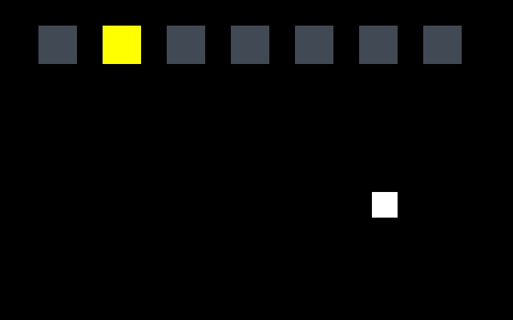
ARC12 COMPUTER ARCHITECTURE · LECTURE 05
Number Representation: Integers
Bases, natural numbers, two's complement and overflow
“I may count for little, it's true, said the One to the Zero, but what are you worth? Nothing: nothing at all.”
Trilussa, Nummeri, 1944
Prof. Raffaele Montella, PhD
University of Naples “Parthenope” · A.Y. 2026/27
raffaelemontella.it · raffaele.montella@uniparthenope.it
Notes:
This lecture begins the formal treatment of numbers. It opens with a small surprise on the machine, a marker that walks left past zero and shows FFFFFFFF, and it ends by explaining exactly why that happens. In between you learn to convert between bases, to say which numbers fit in a given number of bits, and to write negative numbers. The quotation by Trilussa, the One arguing with the Zero, is a reminder that in a positional system even a zero has its weight.
For the lecturer: Original quotation (Romanesco): «Conterò poco, è vero: - diceva l'Uno ar Zero - ma tu che vali? Gnente: propio gnente.» Spiral: the lecture opens with the marker of textbook lab 06 moving left past zero, and closes by explaining it.

Slide 2
What you will be able to do by the end
1
Convert integers and fractions between bases 2, 8, 10 and 16
2
Say which natural numbers fit in n bits and recognise an overflow
3
Encode and decode signed integers in sign and magnitude and in two's complement
4
Add, subtract and negate in two's complement, and detect overflow
5
Explain why 0 - 1 shows as 0xFFFFFFFF in a RISC-V register
6
Choose the right RISC-V instruction for signed and for unsigned data
Notes:
Six objectives. The first three are skills on paper: converting between bases 2, 8, 10 and 16, saying which naturals fit in n bits, and encoding signed integers in two ways. The fourth is arithmetic: adding, subtracting and negating in two's complement, and recognising an overflow. The last two return to the machine: explaining the FFFFFFFF of the warm-up, and choosing the RISC-V instruction that reads the same bits as signed or as unsigned.

Slide 3
01
Warm-up on the machine
A marker that walks off the left edge of the number line.
Notes:
As always, the lecture starts on the machine. A few lines move a marker to the left when you hold a button, and print its position. Run it before reading on, and write down what you expect to see when the position passes zero.

Slide 4
Hold LEFT and watch the number
steer_update:
...
call prg32_input_read # a0 = button mask
mv t0, a0
la t1, marker_x
lw t2, 0(t1) # t2 = marker_x, starts at 2
andi t3, t0, BTN_LEFT # is LEFT pressed?
beqz t3, 1f
addi t2, t2, -1 # one step to the left
1: sw t2, 0(t1)
...
# draw prints marker_x with prg32_console_hex32
1
Hold LEFT: the value shown goes 00000002, 00000001, 00000000 ...
2
... and then FFFFFFFF. Is it a bug?
3
Is 0xFFFFFFFF the number 4,294,967,295 or the number -1?
4
Both. It depends on how you read the bits: this lecture gives the rules
Notes:
The code reads the buttons, loads marker_x from memory, subtracts 1 if LEFT is pressed and stores it back: the load, modify, store of Lecture 02. Hold LEFT and the printed value goes 00000002, 00000001, 00000000, and then FFFFFFFF. Is it a bug? Is FFFFFFFF the number 4,294,967,295, or is it minus one? The fourth callout gives the answer in advance: both, depending on how the bits are read. The rest of the lecture is the set of rules behind that sentence.
For the lecturer: Adapted from textbook lab 06-asm-state-and-input (step2_move.S) with SPEED 1 and a console print. Where to look: on the board and in QEMU the console is drawn on the screen, as 0x00000002 ... 0xffffffff; PRG32-QT does not draw the console, it collects it in its log, as 00000002 ... FFFFFFFF. Run it live before any theory, and write the students' guesses on the board.

Slide 5
02
Bases and conversions
Notes:
The first part is about bases: what a positional system is in general, why bases 2, 8 and 16 are relatives, and two algorithms, one to convert the integer part of a number and one for the fractional part.

Slide 6
Positional systems: base 2, 8, 10 and 16
Base b | Digits | Name | Thirteen is written
2 | 0, 1 | binary | 1101
8 | 0, 1, ..., 7 | octal | 15
10 | 0, 1, ..., 9 | decimal | 13
16 | 0, ..., 9, A, ..., F | hexadecimal | D
N = d(n-1) x b^(n-1) + ... + d(1) x b + d(0), with every digit between 0 and b - 1.
Notes:
A positional system with base b uses b digits, from 0 to b minus 1, and the value of a number is the sum of each digit times the power of b that corresponds to its position: the formula in the caption. The table shows thirteen in four bases: 1101 in binary, 15 in octal, 13 in decimal, D in hexadecimal. It is always the same number: only its writing changes. Base 10 has no special status for a machine; it is the base of people with ten fingers.
For the lecturer: A number N is a string of digits d(n-1) ... d(1) d(0), each smaller than the base b. The value is the sum of each digit times the power of the base of its position.

Slide 7
Bases that are powers of two share the same bits
127 in base 10
0
1
1
1
1
1
1
1
groups of 4: hexadecimal
0111 = 7
1111 = F
= 0x7F
groups of 3: octal
01 = 1
111 = 7
111 = 7
= 177 octal
If each digit is written in pure binary, the bits of a number are the same in every base b = 2^k: group them from the right, k at a time. Example: 13 = 1101 in binary = 15 in octal = D in hexadecimal.
Notes:
Bases that are powers of two share the same bits. The slide takes 127, writes it in binary, and groups the bits from the right: in fours, each group is one hexadecimal digit, giving 7F; in threes, each group is one octal digit, giving 177. No division is needed, only a table lookup. Two details: always group from the right, the least significant end, and pad the leftmost group with zeros if it is incomplete.
For the lecturer: Group from the right (the least significant end) and pad with zeros on the left.

Slide 8
Converting an integer: repeated division
Divide N by the base r; the remainder is the next digit, starting from the least significant. Repeat on the quotient until it is zero.
r = 8
r = 16
r = 2
N | N / 8 | N mod 8
127 | 15 | 7
15 | 1 | 7
1 | 0 | 1
N | N / 16 | N mod 16
127 | 7 | 15 = F
7 | 0 | 7
N | N / 2 | N mod 2
127 | 63 | 1
63 | 31 | 1
31 | 15 | 1
15 | 7 | 1
7 | 3 | 1
3 | 1 | 1
1 | 0 | 1
127 = 0x7F
127 = 177 octal
Read the remainders from the bottom up: the last remainder is the most significant digit. The method follows from N = Q x r + R, applied again and again to the quotient.
127 = 1111111
Notes:
To convert an integer from base 10 to base r, divide by r repeatedly: each remainder is a digit, and the quotient is divided again until it becomes zero. The three tables do it for 127 with r equal to 8, 16 and 2. The yellow box holds the detail that is most often got wrong: the first remainder is the least significant digit, so the remainders must be read from the bottom up. Check: 177 in octal is 64 + 56 + 7 = 127.
For the lecturer: N = Q(n) r^(n+1) + R(n) r^n + ... + R(1) r + R(0). In C the two operations are / and %; in RISC-V (M extension) they are divu and remu.

Slide 9
Converting a fraction: repeated multiplication
For 0 <= N < 1, multiply by the base r: the integer part of the product is the next digit, starting from the most significant. Repeat on the fractional part.
0.875 in base 2: exact
0.8 in base 2: periodic
Multiply | Fraction | Digit
0.875 x 2 | 0.75 | 1
0.75 x 2 | 0.5 | 1
0.5 x 2 | 0 | 1
Multiply | Fraction | Digit
0.8 x 2 | 0.6 | 1
0.6 x 2 | 0.2 | 1
0.2 x 2 | 0.4 | 0
0.4 x 2 | 0.8 | 0
0.8 x 2 | 0.6 | 1 ...
0.875 = 0.111 in binary
0.8 = 0.1100 1100 1100 ...
A fraction that is finite in base 10 can be periodic in base 2. With a finite number of bits it must be cut: this is where the approximation errors of real numbers come from (Lecture 06).
Notes:
For a number between 0 and 1 the procedure is the mirror image: multiply by r repeatedly; each time the integer part of the product is a digit, starting from the most significant, and the fractional part is multiplied again. 0.875 gives 0.111 and stops, because the fraction becomes zero. 0.8 never stops: the same fractions return, and the digits 1100 repeat for ever. A number that is finite in base ten can be periodic in base two, and with a finite number of bits it must be cut. This is the origin of the rounding errors of Lecture 06.
For the lecturer: N = R(1) r^-1 + R(2) r^-2 + ... The source slides linked two online converters (fermimn.edu.it and fauser.edu); any modern calculator in programmer mode does the same.

Slide 10
03
Natural numbers and overflow
Notes:
The second part answers the question "which numbers fit?". It defines what a representation is, treats the natural numbers, states three useful properties of strings of bits, and introduces overflow, the central idea of the lecture.

Slide 11
Encoding strategies
A representation is a law X = R(x) that associates a number x with a string of bits X
X = R(x)
The number of bits depends on how many numbers we want to represent: usually a multiple of 8, typically 16, 32 or 64
R is chosen according to the kind of numbers: naturals, signed integers, rationals
x is the number we mean; X is the pattern of bits stored in the register
A good R makes arithmetic operations and comparisons simple to build as circuits
Notes:
A representation is a law, X = R(x), that associates a number x with a string of bits X. Keep the two letters apart for the whole lecture: small x is the number we mean, capital X is the pattern stored in the register. Different kinds of numbers call for different laws, and a good law is one that makes addition and comparison easy to build as circuits. This criterion, the simplicity of the circuit, will decide the winner among the representations of signed numbers.

Slide 12
Natural numbers on n bits
With n bits there are 2^n patterns: the naturals from 0 to 2^n - 1
Each number is associated with the string of bits that represents it in the binary positional system
Example: n = 4, range [0, 15]
0000
0001
0010
0011
0100
0101
0110
0111
1000
1001
1010
1011
1100
1101
1110
1111
0
1
2
3
4
5
6
7
8
9
10
11
12
13
14
15
Bits | Range | RISC-V | Maximum
8 | 0 ... 2^8 - 1 | byte (lbu) | 255
16 | 0 ... 2^16 - 1 | halfword (lhu) | 65,535
32 | 0 ... 2^32 - 1 | word, register | 4,294,967,295
Notes:
For natural numbers the law is the simplest possible: X is x written in binary. With n bits there are 2 to the n patterns, so the numbers go from 0 to 2 to the n minus 1: with four bits, from 0 to 15, as the strip shows. The table gives the cases you meet on RISC-V: a byte reaches 255, a halfword 65,535, a word 4,294,967,295. The last is the unsigned reading of FFFFFFFF: half of the answer to the warm-up.
For the lecturer: 4,294,967,295 is the unsigned reading of 0xFFFFFFFF: the first half of the answer to the warm-up.

Slide 13
Properties of binary strings
Extension on the left with zeros does not change the value
– 5 = 101 = 00101
# multiply by 4
slli t0, t0, 2
# divide by 2 (unsigned)
srli t0, t0, 1
# x * 10 = x*8 + x*2
slli t1, t0, 3
slli t2, t0, 1
add t0, t1, t2
Multiplying by 2^k is a shift left by k positions
– 00101 x 2 = 01010: five becomes ten
Integer division by 2^k is a shift right by k positions
– 00101 / 2 = 00010: five becomes two, the remainder is lost
Shifts are much cheaper than multiplications: compilers use them whenever they can
Notes:
Three properties of binary strings, each with a use. Adding zeros on the left does not change the value. Shifting left by k positions multiplies by 2 to the k: 00101, five, becomes 01010, ten. Shifting right by k divides by 2 to the k and discards the remainder. A shift is far cheaper for a circuit than a multiplication, and the code on the right shows the trick that compilers use: ten times x is eight times x plus two times x, two shifts and an addition.
For the lecturer: You used slli t1, t1, 2 in Lecture 04 to multiply an array index by four. Shifts are also the basis of fixed-point arithmetic (Lecture 06).

Slide 14
Overflow
Definition
An overflow occurs when the result of an operation is not contained in the finite subset of numbers that the available bits can represent.
Registers have a finite size and there is a finite number of them
Number sets are infinite: only a finite subset can be represented
Arithmetic operators are closed on the whole set, not on the finite subset
With 7 bits we encode [0, 127]: 100 and 38 are representable, their sum 138 is not
Notes:
The definition to remember. A register has a finite number of bits, so it represents a finite subset of an infinite set of numbers. The arithmetic operations are closed on the whole set, not on the subset: the sum of two representable numbers may fall outside. When this happens there is an overflow. The example uses seven bits, which cover 0 to 127: 100 and 38 are both representable, and their sum, 138, is not. Overflow is not a fault of the machine: it is a consequence of finiteness.

Slide 15
Arithmetic on four bits
Sum
Sum with overflow
Difference
Product
6 +
8 =
14
0110 +
1000 =
1110
14 +
3 =
17
1110 +
0011 =
1 0001
11 -
5 =
6
1011 -
0101 =
0110
5 x
3 =
15
0101 x
0011 =
000 1111
fits in four bits
a fifth bit is needed
borrow as in decimal
n x n bits give up to 2n bits
Binary arithmetic follows the same column-by-column rules as decimal arithmetic: 1 + 1 = 0 with a carry of 1
A processor signals a lost carry in different ways: many have a carry flag, RISC-V lets you compute it with a comparison
A product needs twice the bits: on RV32 mul gives the low 32 bits and mulhu the high 32
Notes:
Four calculations on four bits, done column by column as in decimal: 1 plus 1 is 0 with a carry of 1. Six plus eight fits. Fourteen plus three gives seventeen, which needs a fifth bit: an overflow. The difference borrows as in decimal. The product of two numbers of n bits may need 2n bits, which is why RISC-V has two instructions: mul for the low half of the product and mulhu for the high half. Redo the four calculations by hand, covering the results.
For the lecturer: The source slide said the overflow 'can be detected through the overflow bit': true of processors with a flags register, not of RISC-V. See the last section.

Slide 16
04
Signed integers
Three ways to write a minus sign with bits.
Notes:
So far the numbers had no sign. The third part presents the ways of writing negative numbers with bits, compares them, and shows why one of them, two's complement, is used by every processor.

Slide 17
Sign and magnitude
The most significant bit is the sign (1 = negative); the other n - 1 bits are the magnitude
X = |x| + 2^(n-1) s
Range: from -(2^(n-1) - 1) to +(2^(n-1) - 1)
Zero has two representations, +0 and -0: only 2^n - 1 numbers are represented
Arithmetic must work separately on sign and magnitude
– to add two numbers of opposite sign, find the larger magnitude and subtract the smaller from it
– the result takes the sign of the operand with the larger magnitude
the encoding law, where s = 1 if x is negative and 0 otherwise. On four bits: X = |x| + 8 s
Notes:
The most natural idea: use the leftmost bit for the sign and the remaining bits for the magnitude. It is easy for a person to read, and it has two defects. Zero has two representations, plus zero and minus zero. And arithmetic is awkward: to add two numbers of opposite sign the circuit must compare the magnitudes, subtract the smaller from the larger and choose the sign. A representation that makes addition complicated is a poor law in the sense of the previous section.
For the lecturer: Simple for people, awkward for circuits. It survives in the mantissa of IEEE 754 floating-point numbers (Lecture 06).

Slide 18
Two's complement
Non-negative numbers, 0 <= x < 2^(n-1), are represented by themselves: X = x
-2^31 ... 2^31 - 1
Negative numbers, -2^(n-1) <= x < 0, are represented by X = 2^n - |x|
Range: from -2^(n-1) to +2^(n-1) - 1; zero has a single representation
the range of a 32-bit RISC-V register read as a signed integer: about minus two billion to plus two billion
The most significant bit is 1 if and only if the number is negative
This is the representation every modern processor uses, RISC-V included
Notes:
Two's complement. Non-negative numbers are represented by themselves. A negative number x is represented by 2 to the n minus its magnitude: on four bits, minus 3 is 16 minus 3, that is 13, 1101. The range is not symmetric: from minus 2 to the n minus 1 up to 2 to the n minus 1, minus 1, so on four bits from minus 8 to plus 7. Zero has one representation only, and the leftmost bit is 1 exactly when the number is negative. For a 32-bit register the range is about minus two billion to plus two billion.
For the lecturer: Also called radix complement (complemento alla base). The asymmetry of the range (one more negative number) has a consequence: negating the most negative number overflows.

Slide 19
Four bits, three readings
Bits | Unsigned | Sign-magnitude | Two's compl.
0000 | 0 | +0 | 0
0001 | 1 | +1 | +1
0010 | 2 | +2 | +2
0011 | 3 | +3 | +3
0100 | 4 | +4 | +4
0101 | 5 | +5 | +5
0110 | 6 | +6 | +6
0111 | 7 | +7 | +7
Bits | Unsigned | Sign-magnitude | Two's compl.
1000 | 8 | -0 | -8
1001 | 9 | -1 | -7
1010 | 10 | -2 | -6
1011 | 11 | -3 | -5
1100 | 12 | -4 | -4
1101 | 13 | -5 | -3
1110 | 14 | -6 | -2
1111 | 15 | -7 | -1
non-negative: the three readings agree
most significant bit 1: the readings differ
The bits do not say which column is the right one. The program does, by choosing its instructions.
Notes:
The same sixteen patterns read in three ways. In the left table, where the leftmost bit is 0, the three readings agree. In the right table they differ: 1000 is 8 as unsigned, minus zero in sign and magnitude, and minus 8 in two's complement; 1111 is 15, minus 7 or minus 1. The sentence at the bottom is the key to the whole lecture: the bits do not say which column is right. The program says it, through the instructions it chooses.
For the lecturer: Highlighted: 1000 is minus zero in sign and magnitude but -8 in two's complement; 1111 is -7 or -1. One's complement and excess-8 are added to this table in Lecture 06.

Slide 20
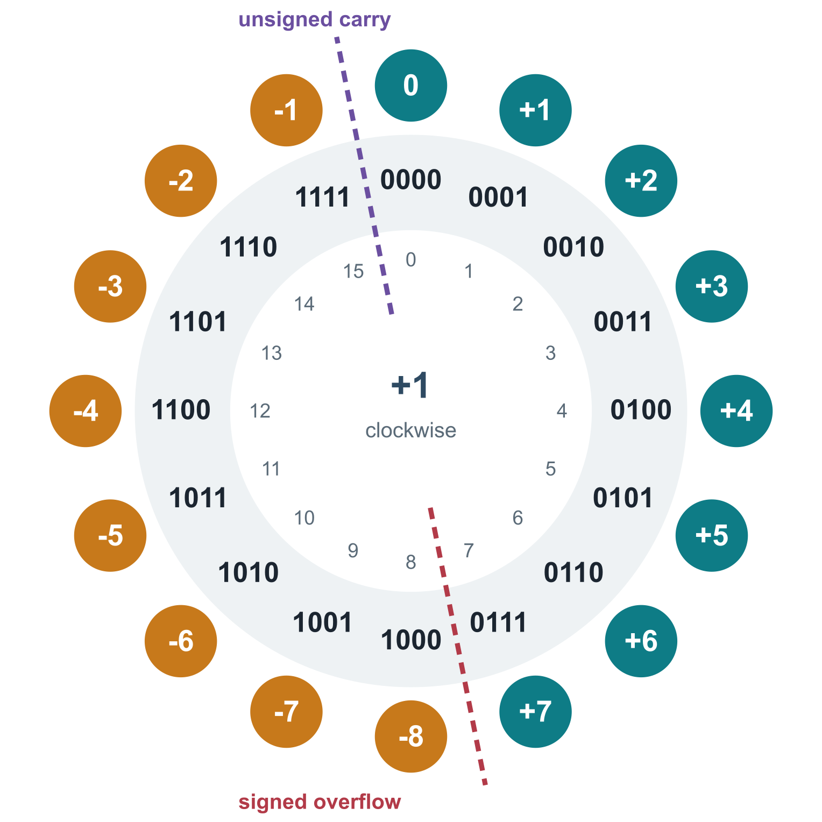
The number wheel
With n bits arithmetic is modulo 2^n: the number line closes into a circle
Adding 1 moves one step clockwise, whatever the reading
Unsigned reading: the wheel breaks between 1111 and 0000
– crossing it is a carry: 15 + 1 = 0
Two's complement reading: the wheel breaks between 0111 and 1000
– crossing it is a signed overflow: 7 + 1 = -8
One step back from 0000 is 1111: that is why 0 - 1 gives all ones
Notes:
With n bits the numbers form a circle: after the last pattern comes the first. Adding 1 moves one step clockwise. The inner ring gives the unsigned value, the outer discs the value in two's complement. The wheel "breaks" in two different places. For the unsigned reading the break is at the top, between 1111 and 0000: crossing it is a carry. For two's complement it is at the bottom, between 0111 and 1000: crossing it is a signed overflow. And one step back from 0000 is 1111: this is the FFFFFFFF of the warm-up.
For the lecturer: Inner ring: unsigned value. Middle: bits. Outer discs: two's complement value. The same adder serves both readings: only the place where the wheel 'breaks' changes.

Slide 21
Two's complement arithmetic
Opposite signs
Two negatives
Product
2 +
-6 =
-4
0010 +
1010 =
1100
-2 +
-3 =
-5
1110 +
1101 =
1 1011
2 x
-3 =
-6
0010 x
1101 =
001 1010
just add the patterns
the carry out is ignored (sum modulo 16)
keep the low four bits: 1010 = -6
Addition needs no knowledge of the signs: the adder for natural numbers already gives the right answer
The carry out of the most significant bit is simply discarded
The low n bits of a product are also correct, whatever the signs
Notes:
Three calculations that show the advantage of two's complement. To add 2 and minus 6, simply add the two patterns: 0010 plus 1010 is 1100, which reads minus 4. To add two negative numbers, add the patterns and discard the carry out of the leftmost position. Even the product works on the low four bits. The first row of bullets is the point: the adder does not need to know the signs. The circuit that adds natural numbers already gives the right answer for signed ones.
For the lecturer: Check of the product: 2 x 13 = 26 = 1 1010; the low four bits are 1010, which reads -6. This is why RISC-V has a single mul for signed and unsigned operands.

Slide 22
Negating a number
By definition -x is represented by 2^n - x
# neg t0, t1 is a pseudo-instruction:
sub t0, zero, t1
# the same thing by hand:
not t0, t1 # complement
addi t0, t0, 1 # plus one
Method 1: complement every bit, then add 1
– 6 = 0110, complement 1001, plus one: 1010 = -6
Method 2: starting from the right, copy the bits up to and including the first 1, complement all the others
– 5 = 0101 gives 1011 = -5; 1 = 0001 gives 1111 = -1
Negating twice returns the original number, with one exception: the most negative number has no positive partner
Notes:
To change the sign of a number there are two methods. First: complement every bit, then add 1; six, 0110, becomes 1001 and then 1010, minus six. Second, faster by hand: starting from the right, copy the bits up to and including the first 1, and complement all the others. The code shows that RISC-V does not even need an instruction for this: neg is a pseudo-instruction for sub from the register zero. One exception: the most negative number has no positive partner, and negating it returns the number itself.
For the lecturer: Why method 1 works: the complement of x is (2^n - 1) - x, so adding 1 gives 2^n - x. The source slide described method 2 'from the left'; the rule scans from the right.

Slide 23
Subtraction is addition.
y - x = y + (2^n - x), modulo 2^n. An adder and a complementer are the only components needed to build addition, subtraction, multiplication and division.
Notes:
The consequence that matters for hardware. To compute y minus x, add to y the two's complement of x. So a subtractor is not needed: an adder and a circuit that complements the bits are enough, and from addition come multiplication and division. This is the engineering reason for the choice of two's complement, and you will see the adder itself in the lectures on logic.
For the lecturer: This is the engineering reason for two's complement: one circuit, the adder of Lecture 09, does all the work. In the RISC-V datapath, sub is add with the second operand complemented and a carry-in of 1.

Slide 24
Detecting overflow
Unsigned, 8 bits
Signed, 8 bits
128 +
130 =
258
1000 0000 +
1000 0010 =
1 0000 0010
127 +
127 =
254
0111 1111 +
0111 1111 =
1111 1110
carry out: the register holds 2, the sum modulo 256
no carry out, but the result reads -2
Unsigned overflow: there is a carry out of the most significant bit
Signed overflow in two's complement
– two positive operands give a negative sum
– two negative operands give a positive sum
Adding two numbers of opposite sign can never overflow
The two conditions are independent: the same addition can trigger one, both or neither
Notes:
There are two overflows, and they are independent. For unsigned numbers, overflow is a carry out of the leftmost bit: 128 plus 130 on eight bits leaves 2 in the register. For signed numbers, overflow is a result with the wrong sign: 127 plus 127 produces no carry out, but the pattern reads minus 2. The rule: two positive operands that give a negative sum, or two negative ones that give a positive sum. Two operands of opposite sign can never overflow, because the result lies between them.
For the lecturer: Equivalent circuit rule for signed overflow: the carry into the most significant bit differs from the carry out of it.

Slide 25
05
Back to the machine
The same rules, as RISC-V implements them.
Notes:
The last part goes back to RISC-V. It explains the warm-up, shows how the processor distinguishes signed from unsigned, corrects the program of the marker, detects an overflow without flags, and ends with sign extension.

Slide 26
The warm-up, explained
marker_x held 0; addi t2, t2, -1 moved one step back on a wheel with 2^32 positions
The register now holds thirty-two ones: 0xFFFFFFFF
Read as unsigned it is 4,294,967,295; read in two's complement it is -1
– the adder did the same thing in both cases
prg32_console_hex32 prints the pattern, not an interpretation: it is neither right nor wrong
The marker disappears because prg32_gfx_rect is asked to draw at a huge x, or at -1: off the screen either way
Lab 06, step 2: seven lamps for the button bits and a marker
Notes:
Now the warm-up can be explained completely. The marker was at 0, and addi with minus 1 moved one step back on a wheel of 2 to the 32 positions: the register now holds thirty-two ones. Read as unsigned they are 4,294,967,295; in two's complement they are minus 1. The function that prints shows the pattern and takes no side. The marker disappears because it is drawn off the screen in both readings. It was never a bug of the processor: the program lacked a decision.
For the lecturer: Not a bug in the processor: a missing decision in the program. The fix is on the next slides.

Slide 27
Signed or unsigned? You choose with the instruction
Operation | Signed | Unsigned | Why they differ
add, subtract | add, addi, sub | the same | two's complement: one adder for both
multiply (low word) | mul | the same | the low 32 bits do not depend on the sign
compare | slt, slti | sltu, sltiu | is 0xFFFFFFFF less than 0? yes if signed
branch | blt, bge | bltu, bgeu | the same question, as a jump
shift right | sra, srai | srl, srli | copy the sign bit, or insert zeros
load a byte | lb | lbu | sign extension or zero extension
divide, remainder | div, rem | divu, remu | magnitudes are read differently
Notes:
RISC-V registers have no type: thirty-two bits are signed or unsigned only for the instruction that reads them. The table shows where the two readings need different instructions. Addition, subtraction and the low part of a product are the same. Comparisons, branches, right shifts, loads of a byte, and division come in pairs: slt and sltu, blt and bltu, sra and srl, lb and lbu, div and divu. The letter u in the name always means unsigned. Choosing the wrong member of a pair is a classic error.
For the lecturer: RISC-V registers have no type. The same 32 bits are signed or unsigned only in the eye of the instruction that reads them.

Slide 28
Keeping the marker on the screen
andi t3, t0, BTN_LEFT
beqz t3, 1f
addi t2, t2, -SPEED
1: andi t3, t0, BTN_RIGHT
beqz t3, 2f
addi t2, t2, SPEED
2:
bgez t2, 3f # x < 0 ? clamp to 0
li t2, 0
3: li t3, MAX_X # .equ MAX_X, 304
ble t2, t3, 4f # x > 304 ? clamp to 304
mv t2, t3
4:
sw t2, 0(t1) # one store, after all adjustments
1
bgez reads t2 as a signed number: it tests the sign bit
2
ble is a signed comparison too: -1 is less than 304. With bleu, 0xFFFFFFFF would be far greater
3
A game does not detect overflow after the fact: it keeps values inside a range where overflow cannot happen
4
-SPEED is an immediate: twelve bits in two's complement, from -2048 to +2047
Notes:
The corrected program keeps the marker on the screen. After the two possible steps, bgez asks whether the position is greater than or equal to zero, reading it as a signed number: if not, the position is set to 0. Then ble compares it with the maximum, 304, again as signed, and limits it. This is called clamping. Note the method: a game does not detect the overflow afterwards; it keeps its values inside a range where overflow cannot happen. One sw at the end stores the adjusted value.
For the lecturer: Source: textbook lab 06-asm-state-and-input, step3_clamp.S. Ask what happens with bgeu or bltu instead: an instructive bug to try.

Slide 29
Detecting overflow without flags
# unsigned: did the sum wrap around?
add t2, t0, t1 # t2 = t0 + t1 (modulo 2^32)
sltu t3, t2, t0 # t3 = 1 if the sum is smaller than
# an operand: a carry was lost
# signed: did the sign come out wrong?
add t2, t0, t1
slti t3, t1, 0 # t3 = 1 if t1 is negative
slt t4, t2, t0 # t4 = 1 if the sum is less than t0
bne t3, t4, overflow # they must agree
1
RISC-V has no carry flag and no overflow flag: fewer hidden states, a simpler processor
2
Unsigned: a sum that wrapped is always smaller than either operand
3
Signed: adding a negative number must make the sum smaller; adding a non-negative one must not
Notes:
Many processors have a carry flag and an overflow flag; RISC-V has neither, and an overflow is detected with a comparison. Unsigned: after add, if the sum is smaller than one of the operands, the sum has wrapped around; sltu tests it in one instruction. Signed: adding a negative number must make the sum smaller, adding a non-negative one must not; if the two facts disagree, there was an overflow. Compare with the wheel: the first test detects the crossing at the top, the second the crossing at the bottom.
For the lecturer: Both idioms are the ones suggested in the RISC-V specification. Compare with the wheel: sltu detects crossing the top, the signed test detects crossing the bottom.

Slide 30
Sign extension: the same number on more bits
-1 on 4 bits
1111
= -1
-1 on 8 bits
1111
1111
= -1
+5 on 4 bits
0101
= +5
+5 on 8 bits
0000
0101
= +5
To widen a two's complement number, copy its sign bit into all the new positions on the left
addi t2, t2, -1 stores -1 in twelve bits; the processor sign-extends it to thirty-two before adding
lb sign-extends the byte it loads; lbu fills with zeros: choose according to what the byte means
Notes:
How is a number moved to more bits without changing its value? For two's complement, copy the sign bit into all the new positions: minus 1 on four bits, 1111, becomes 1111 1111 on eight; plus 5, 0101, becomes 0000 0101. This is sign extension. The processor does it whenever a short value meets a long one: the twelve-bit constant of addi is sign-extended to thirty-two bits, and lb sign-extends the byte it loads, while lbu fills with zeros.
For the lecturer: Extending with zeros would turn 1111 (-1) into 0000 1111 (+15). Sign extension is the signed counterpart of the 'extension on the left' property seen for naturals.

Slide 31
Check your understanding
Which number does the 8-bit pattern 1111 1100 represent in two's complement?
252
-4
A
B
-3
-124
C
D
Notes:
The leftmost bit is 1, so the number is negative: discard 252, which is the unsigned reading. To find the magnitude, change the sign: complement, 0000 0011, and add one, 0000 0100, which is 4. The pattern is minus 4.
For the lecturer: Answer: B. Complement and add one: 0000 0011 + 1 = 0000 0100 = 4, so the pattern is -4. (252 is its unsigned reading.)

Slide 32
Check your understanding
On 8 bits, which addition produces a signed overflow?
100 + 27
100 + 28
A
B
-100 + 28
-1 + 1
C
D
Notes:
On eight bits in two's complement the range is from minus 128 to plus 127. Compute each sum and see whether it falls in the range. Remember that operands of opposite sign cannot overflow, which excludes two options at once.
For the lecturer: Answer: B. The range is [-128, 127]. 100 + 27 = 127 fits; 100 + 28 = 128 does not: two positives give a negative pattern (1000 0000 = -128).

Slide 33
Check your understanding
t0 holds 0xFFFFFFFF and t1 holds 1. After slt t2, t0, t1 and sltu t3, t0, t1:
t2 = 1, t3 = 1
t2 = 0, t3 = 0
A
B
t2 = 1, t3 = 0
t2 = 0, t3 = 1
C
D
Notes:
The same two registers, two instructions that differ by one letter. slt reads FFFFFFFF as minus 1, which is less than 1. sltu reads it as more than four billion, which is not. This question is the whole lecture in one line.
For the lecturer: Answer: C. Signed: -1 < 1 is true, so t2 = 1. Unsigned: 4,294,967,295 < 1 is false, so t3 = 0.

Slide 34
Check your understanding
How is 0.625 written in binary?
0.101
0.110
A
B
0.625
0.011
C
D
Notes:
Use repeated multiplication: 0.625 times 2 is 1.25, digit 1; 0.25 times 2 is 0.5, digit 0; 0.5 times 2 is 1.0, digit 1. Check with the weights: one half plus one eighth is 0.625.
For the lecturer: Answer: A. 0.625 x 2 = 1.25 (1); 0.25 x 2 = 0.5 (0); 0.5 x 2 = 1.0 (1): 0.101 = 1/2 + 1/8.

Slide 35
Exercises: paper first, then PRG32
TRY IT
1
Convert 2026 to binary, octal and hexadecimal; convert 0.1 to binary up to eight fractional bits
2
Write -100 on 8 bits in sign and magnitude and in two's complement
3
Compute on 8 bits in two's complement: 90 + 60, -90 - 60, 90 - 60. Which overflow?
4
In the clamp code replace bgez and ble with their unsigned versions, predict the behaviour, then run it
5
Write an update that adds 0x10000000 to a counter each frame and lights a red rectangle when the signed sum overflows
Expected result
On paper: 2026 = 0x7EA = 111 1110 1010. On PRG32: the red rectangle flashes once every sixteen frames, when the counter passes from 0x7... to 0x8...
Notes:
Five exercises, three on paper and two on the machine. Convert 2026 and the fraction 0.1; write minus 100 in two representations; compute three sums on eight bits and say which overflow. Then, in the clamp code, replace the signed branches with the unsigned ones and predict the behaviour before running: it is an instructive bug. Finally write an update that adds 0x10000000 at each frame and signals the signed overflow. The expected results are in the green box: cover it until you have your own.
For the lecturer: 2026 = 3752 octal. -100: sign and magnitude 1110 0100, two's complement 1001 1100. 90 + 60 = 150 overflows; -90 - 60 = -150 overflows; 90 - 60 = 30 does not. 0.1 = 0.00011001(1001...).

Slide 36
Glossary: English and Italian
English | Italiano | English | Italiano
base (radix) | base | two's complement | complemento a due (alla base)
natural number | numero naturale | sign and magnitude | segno e modulo
signed integer | numero relativo (intero con segno) | overflow | overflow (traboccamento)
most significant bit | bit più significativo | carry / borrow | riporto / prestito
remainder | resto | sign extension | estensione del segno
shift | scorrimento (shift) | to clamp | limitare a un intervallo
Notes:
Twelve terms. Signed integer is in Italian numero relativo or intero con segno. Carry and borrow are the digit carried in an addition and the one borrowed in a subtraction. Sign extension is the operation that widens a signed number. To clamp has no single Italian word: it means to limit a value to an interval.

Slide 37
Conclusions and reading
Every base has its advantages: base 2 for circuits, base 16 for people who read bits
n bits represent 2^n numbers: which ones depends on the encoding law
Two's complement turns subtraction into addition: one adder does everything
Overflow is the price of finite registers: detect it, or design it away
In RISC-V the bits have no type: the instruction chooses signed or unsigned
Reading
– Patterson, Hennessy: Computer Organization and Design, RISC-V Edition, sections 2.4 and 3.1-3.2
– Playing with RISC-V, chapter 6: State and Input
– Stallings: Computer Organization and Architecture, chapters on number systems and computer arithmetic
Notes:
Five conclusions. Each base has its use: two for circuits, sixteen for people who read bits. With n bits there are 2 to the n numbers, and the encoding law says which. Two's complement turns subtraction into addition. Overflow is the price of finite registers: detect it, or design it away as with the clamp. And in RISC-V the bits have no type: the instruction chooses. The next lecture completes the picture with the real numbers.
For the lecturer: Next lecture: one's complement, excess-k, fixed point and IEEE 754 floating point.

