Slide 1
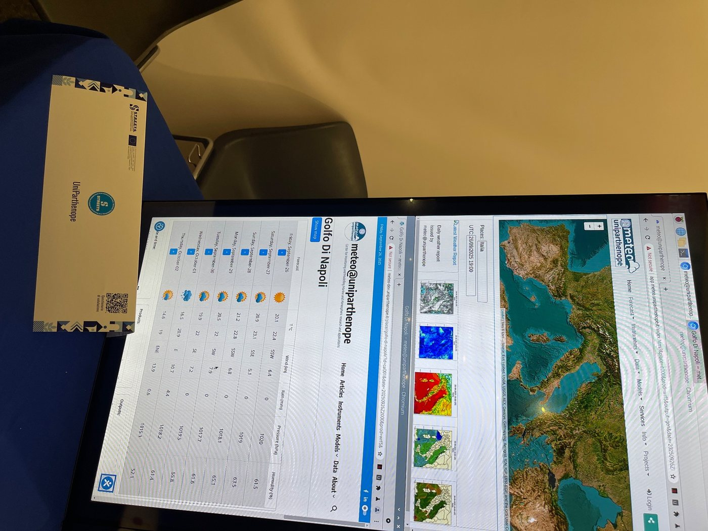
ARC12 COMPUTER ARCHITECTURE · LECTURE 24
Beyond One Core: Superscalar RISC-V, HPC, GPUs and FPGAs
The same instructions, on machines that execute many of them at once
“If you were plowing a field, which would you rather use: two strong oxen or 1024 chickens?”
attributed to Seymour Cray
Prof. Raffaele Montella, PhD
University of Naples “Parthenope” · A.Y. 2026/27
raffaelemontella.it · raffaele.montella@uniparthenope.it
Notes:
The last lecture looks beyond the kit. Everything you have learned was learned on a small processor that executes one instruction at a time. The machines that forecast the weather or train a neural network execute the same kind of instructions, in very large numbers at once. The lecture takes one small loop of Verm1 and follows it onto four kinds of machine. Cray's question about oxen and chickens will come back: it has no single answer. This lecture is an outlook, and is not part of the midterm test.
For the lecturer: Closing lecture and outlook, new in 2026/27: it has no Italian source. It starts from one loop of Verm1 and follows it onto four kinds of machine. It prepares the visit to the supercomputing systems of the Department. Not part of the midterm test. The RISC-V vector listings are tested on QEMU (tools/tests/vector_qemu.S); the CUDA and Verilog fragments are standard textbook forms that were not compiled for these slides. Figures for supercomputers are rounded and date from the TOP500 lists of 2022 to 2025: check the current list before class.

Slide 2
What you will be able to do by the end
1
Write the performance equation and say which factor each technique attacks
2
Explain how a superscalar, out-of-order processor executes several instructions per cycle, and name RISC-V cores that do
3
Read a loop written with the RISC-V vector extension
4
Describe a supercomputer, compute a speed-up with Amdahl's law, and say why energy is the limit
5
Say what a GPU and an FPGA are good at, and what each costs the programmer
Notes:
Five objectives. Write the performance equation and say which of its factors each technique attacks. Explain how a superscalar, out-of-order processor executes several instructions per cycle. Read a loop written with the RISC-V vector extension. Describe a supercomputer, compute a speed-up with Amdahl's law and say why energy is the limit. And say what a GPU and an FPGA are good at, and what each costs the programmer.

Slide 3
01
Warm-up on the machine
One loop of Verm1, and the question of how fast it could go.
Notes:
The warm-up is a loop you already wrote, and a question: how fast could it go?

Slide 4
The loop that empties the map
la t0, grid
li t1, COLS*ROWS
1: sb zero, 0(t0) # one byte per turn of the loop
addi t0, t0, 1
addi t1, t1, -1
bnez t1, 1b
1
From new_game of Verm1: 960 bytes set to zero
2
Four instructions per byte: 3 840 instructions in all
3
One byte at a time, one instruction at a time
4
How many ways are there to make this faster?
Notes:
The loop that empties the map in new_game: 960 bytes set to zero. Four instructions per turn: a store of one byte, the increment of the address, the decrement of the counter, the branch back. In all 3,840 instructions, one byte at a time, one instruction at a time. On the kit it takes about 24 microseconds, and nobody needs it faster. It is chosen because it is small enough to be followed onto every machine of today. In how many ways can it be made faster?
For the lecturer: The processor cycle of Lecture 19. At best one instruction per clock cycle, and 160 million cycles per second on the kit: about 24 microseconds. Nobody needs this loop to be faster; it is small enough to follow onto every machine of today.

Slide 5
Time = instructions x cycles per instruction x clock period
The time a program takes is the product of three numbers
Each can be attacked
– fewer instructions: better algorithms, richer instructions, vectors
– fewer cycles per instruction: pipelines, superscalar execution
– a shorter cycle: faster transistors, deeper pipelines
T = N x CPI x t
N instructions, CPI cycles per instruction, t seconds per cycle
And when one processor is not enough: more processors working together
Every machine of this lecture is a different answer to the same equation
Notes:
The time a program takes is the product of three numbers: the instructions executed, the clock cycles each needs on average, and the duration of a cycle. Each factor can be attacked. Fewer instructions: better algorithms, richer instructions, vectors. Fewer cycles per instruction: pipelines and superscalar execution. A shorter cycle: faster transistors. And when one processor is not enough, more processors. Keep this equation in view: every machine of the lecture is a different answer to it.
For the lecturer: The performance equation of Patterson and Hennessy. For the loop of the previous slide on the kit: 3 840 instructions, about 1 cycle each, 6.25 nanoseconds per cycle.

Slide 6
Why not simply a faster clock?
For thirty years each new generation of transistors was smaller, faster and no hotter per square millimetre
~2005
Around 2005 that stopped: smaller transistors still arrive, but a faster clock means more heat than a chip can shed
Clock frequencies have stayed at a few gigahertz ever since
the end of the free lunch: clocks stop at a few gigahertz, cores multiply
The extra transistors went elsewhere: wider processors, more cores, vector units, accelerators
Performance now comes from doing many things at once: from parallelism
Notes:
Why not simply raise the clock frequency? For thirty years each generation of transistors was smaller and faster without being hotter per unit of area. Around 2005 this stopped: a faster clock now means more heat than a chip can shed. Frequencies have stayed at a few gigahertz, and the additional transistors have been spent otherwise: wider processors, more cores, vector units, accelerators. Performance now comes from parallelism, from doing many things at once.
For the lecturer: Moore's law (more transistors) went on; Dennard scaling (constant power density) ended. The 160 MHz of the kit is slow by choice: it costs milliwatts.

Slide 7
02
Superscalar processors
More than one instruction per clock cycle.
Notes:
The first answer acts on the second factor of the equation: more than one instruction per clock cycle, inside a single processor.

Slide 8
From one at a time to many at once
Processor | How it works | Instructions per cycle | Example
Multi-cycle | one instruction completes before the next begins | less than 1 | the machine of Lecture 18
Pipelined | several instructions in flight, each in a different stage | at most 1 | the ESP32-C6 of the kit: four stages
Superscalar, in order | two or more pipelines side by side | up to 2 or more | small application cores
Superscalar, out of order | instructions run as soon as their operands are ready | up to 4, 6, 8 ... | laptops, phones, servers
Notes:
Four kinds of processor, in order of ambition. The multi-cycle processor completes one instruction before starting the next. The pipelined one has several instructions in flight, each in a different stage, and completes at most one per cycle: this is your kit. The superscalar in-order processor has two or more pipelines side by side. The superscalar out-of-order processor starts each instruction as soon as its operands are ready, and reaches four, six, eight instructions per cycle: it is in your laptop and in your phone.
For the lecturer: Lecture 19 introduced the pipeline and named superscalar processors in one line: this section opens that line. Width is the number of instructions the processor can start in one cycle.

Slide 9
Two pipelines side by side
 | Cycle 1 | 2 | 3 | 4 | 5 | 6 | 7
i1 | IF | ID | EX | MEM | WB
i2 | IF | ID | EX | MEM | WB
i3 |  | IF | ID | EX | MEM | WB
i4 |  | IF | ID | EX | MEM | WB
i5 |  |  | IF | ID | EX | MEM | WB
i6 |  |  | IF | ID | EX | MEM | WB
Six instructions in seven cycles, if nothing gets in the way.
Notes:
Two pipelines side by side. Read the table by rows: each row is an instruction, each column a cycle. Instructions enter in pairs: i1 and i2 are fetched together, then i3 and i4, then i5 and i6. Six instructions finish in seven cycles; a single pipeline would need ten. This is the ideal case, in which the instructions do not depend on each other.
For the lecturer: A two-wide processor with the five classic stages: six instructions complete in seven cycles; a single pipeline needs ten, and a processor without pipeline thirty. This is the ideal case: the next slide says why it is rare.

Slide 10
What gets in the way: dependences
add t0, t1, t2 # i1
add t3, t0, t4 # i2 needs the t0 of i1: it must wait
lw t5, 0(t6) # i3 is independent: it could go now
beqz t3, skip # i4: which way? known only after i2
addi t5, t5, 1 # i5: executed, or not?
skip:
1
i2 cannot run beside i1: it uses its result
2
i3 depends on nobody: why should it wait?
3
After a branch the processor does not know what comes next
4
Real code is full of such chains: width alone is not enough
Notes:
What gets in the way. The second instruction uses t0, which the first is still computing: it cannot run beside it. This is a data dependence. The third depends on nobody, and yet in an in-order processor it waits behind the second. The fourth is a branch: until it is resolved the processor does not know whether the fifth must be executed. This is a control dependence. Real programs are full of such chains, so width alone is not enough.
For the lecturer: Data dependences, control dependences. An in-order superscalar stalls at i2 and everything behind it waits. The remedy is to let i3 overtake.

Slide 11
Out-of-order execution
1
2
3
4
Fetch and decode, in order
Rename
Execute when ready
Commit, in order
Several instructions per cycle enter a window of tens or hundreds of instructions
Each result gets a fresh physical register, so that two uses of the name t0 no longer collide
An instruction starts as soon as its operands exist, whatever its position in the program
Results become official in program order: seen from outside, nothing ever overtook
Notes:
Out-of-order execution, in four stages. Instructions are fetched and decoded in order, several per cycle, into a window of tens or hundreds. Each result is given a fresh physical register: renaming. Each instruction executes as soon as its operands exist, wherever it is in the program. Finally the results are committed in program order, so that, seen from outside, nothing ever overtook. The model you learned, one instruction after another, is preserved exactly: only the timing changes.
For the lecturer: The algorithm is Tomasulo's, designed for the floating-point unit of the IBM System/360 Model 91 in 1967; the reorder buffer that commits in order came in the 1980s. The programmer's model, the one you learned, is preserved exactly: this is the contract of the instruction set.

Slide 12
Register renaming: thirty-two names, many registers
# as written # as executed, after renaming
lw t0, 0(a0) lw p41, 0(a0)
addi t0, t0, 1 addi p42, p41, 1
sw t0, 0(a0) sw p42, 0(a0)
lw t0, 4(a0) lw p43, 4(a0) # a new t0
addi t0, t0, 1 addi p44, p43, 1
sw t0, 4(a0) sw p44, 4(a0)
1
The second half reuses the name t0, not its value
2
Renamed, the two halves share nothing
3
They can run at the same time, on different registers
4
The 32 registers you know are names; the chip has many more
Notes:
Register renaming on an example. On the left the code as written: two halves, each loading a word, incrementing it and storing it back, and both using t0. The second half reuses the name, not the value: it is a false dependence. On the right, after renaming, each new value has its own physical register, and the two halves share nothing, so they can execute at the same time. The thirty-two registers you know are names; the chip has a few hundred registers.
For the lecturer: A false dependence: the same name for two unrelated values. p41 to p44 are invented numbers of physical registers. A big core has a few hundred of them.

Slide 13
Guessing the future: branch prediction
A wide processor meets a branch every few instructions: it cannot wait to know the outcome
959 : 1
It predicts the direction from the history of that branch, and goes on executing along the guess
A right guess costs nothing; a wrong one throws away the speculative work and starts again
bnez t1, 1b is taken 959 times and not taken once: a predictor learns it in the first turns
The loop of the warm-up branches back 959 times and falls through once: easy to predict
Modern predictors are right far more than nine times out of ten
Notes:
A wide processor meets a branch every few instructions and cannot wait to know its outcome. So it predicts: it guesses the direction from the history of that branch and continues along the guess. If the guess was right, nothing is lost; if it was wrong, the speculative work is thrown away. The loop of the warm-up jumps back 959 times and falls through once: a predictor learns it at once. Modern predictors are right far more than nine times out of ten.
For the lecturer: Speculative execution has a dark side: in 2018 the Spectre and Meltdown attacks showed that work thrown away can still leave traces in the cache that reveal secrets. Performance tricks are also security questions.

Slide 14
RISC-V goes superscalar
Core | From | Kind
HP core of the ESP32-C6 | Espressif | in order, four stages, one instruction per cycle: your kit
BOOM | University of California, Berkeley | out of order, open source, for research and teaching
XiangShan | Chinese Academy of Sciences | out of order, open source, high performance
XuanTie C910 | T-Head (Alibaba) | out of order, three-wide; released as open source
Performance P550 | SiFive | out of order, three-wide, thirteen stages; sold as a design
Veyron | Ventana Micro Systems | out of order, for data centres
Notes:
RISC-V processors of this kind exist. The first row is the core of your kit: in order, one instruction per cycle. The others are out-of-order cores: BOOM from Berkeley and XiangShan from the Chinese Academy of Sciences, both open source; the C910, the P550, Veyron, from companies. Because the instruction set is open, anyone may build such a core, and some are published as source code that you could read.
For the lecturer: BOOM is the Berkeley Out-of-Order Machine. Because the instruction set is open, anyone may build such a core, and several are published as source code that a student can read: this has no precedent among commercial architectures. The list ages quickly: update it.

Slide 15
One architecture, many microarchitectures
Architecture and microarchitecture
The architecture is the contract: instructions, registers, what each instruction does. The microarchitecture is one way to honour it: stages, width, predictors, caches.
The add you wrote for a 160 MHz microcontroller is the add of a server core
Verm1 would run unchanged on any of the cores of the previous slide, given a screen
This is why an instruction set learned once is knowledge that lasts
Notes:
A distinction that organises the whole course. The architecture is the contract: the instructions, the registers, what each instruction does. The microarchitecture is one way of honouring the contract: stages, width, predictors, caches. The add you wrote for a microcontroller is the same add on a server core. Verm1 would run unchanged on any core of the previous slide. This is why an instruction set, once learned, is knowledge that lasts.
For the lecturer: The distinction that organises the whole course: Lectures 02 to 22 taught the architecture; the kit is one small microarchitecture.

Slide 16
03
Vectors: one instruction, many data
The RISC-V vector extension.
Notes:
The second answer acts on the first factor: fewer instructions, because each instruction works on many data.

Slide 17
Flynn's taxonomy
Class | Instructions | Data | Example
SISD | one stream | one stream | the kit: one core, one datum at a time
SIMD | one stream | many at once | vector instructions; a GPU, to a first approximation
MISD | many | one stream | rare: redundant systems that vote
MIMD | many | many | multicore processors, clusters, supercomputers
Notes:
Flynn's taxonomy classifies machines by two questions: one stream of instructions or many, one stream of data or many. SISD is the kit: one core, one datum at a time. SIMD is one instruction applied to many data at once: vector instructions and, roughly, GPUs. MISD is rare. MIMD is many processors each with its own data: multicore chips, clusters, supercomputers.
For the lecturer: Michael Flynn, 1966. Crude, and still the first vocabulary of parallel computing.

Slide 18
The same loop, with vectors
la t0, grid
li t1, COLS*ROWS
vsetvli t2, t1, e8, m1, ta, ma # elements are bytes
vmv.v.i v0, 0 # a register full of zeros
1: vsetvli t2, t1, e8, m1, ta, ma # t2 = bytes of this turn
vse8.v v0, (t0) # store t2 bytes at once
add t0, t0, t2
sub t1, t1, t2
bnez t1, 1b
1
v0 is a vector register: many bytes wide
2
vsetvli asks: how many of the bytes left fit? The answer is in t2
3
vse8.v stores t2 bytes with one instruction
4
With 128-bit registers: 16 bytes per turn, 60 turns instead of 960
Notes:
The same loop with the vector extension. v0 is a vector register, many bytes wide, filled with zeros. In each turn vsetvli asks: of the bytes still to do, how many fit in a register? The answer goes in t2. vse8.v stores that many bytes with a single instruction, and the address and the counter advance by t2. With 128-bit registers a turn handles 16 bytes: 60 turns instead of 960. The code never states the width of the registers, so the same program works with any width.
For the lecturer: The V extension, ratified in 2021. Not on the kit: the ESP32-C6 is RV32IMAC. The code never says how wide the registers are: it is vector-length agnostic, and the same binary uses 128, 256 or 1024 bits. Tested on QEMU at 128, 256, 512 and 1024 bits by tools/tests/vector_qemu.S.

Slide 19
A sum, lane by lane
la t0, numbers
li t1, 16 # sixteen words to add
vsetvli t2, zero, e32, m1, ta, ma
vmv.v.i v1, 0 # v1 = partial sums, one per lane
1: vsetvli t2, t1, e32, m1, tu, ma
vle32.v v2, (t0) # load t2 words
vadd.vv v1, v1, v2 # add them, lane by lane
slli t3, t2, 2
add t0, t0, t3
sub t1, t1, t2
bnez t1, 1b
vsetvli t2, zero, e32, m1, ta, ma
vmv.s.x v3, zero
vredsum.vs v3, v1, v3 # add the lanes together
vmv.x.s a0, v3
1
vle32.v loads several words at once
2
vadd.vv adds register to register, lane by lane
3
At the end vredsum adds the lanes together
4
Sixteen numbers, 1 to 16: the result is 136
Notes:
A sum, lane by lane. A vector register holds several words, each in its own lane. vle32.v loads several words at once; vadd.vv adds two registers lane by lane, so that v1 accumulates as many partial sums as there are lanes. At the end vredsum adds the lanes together into one number. With the sixteen numbers from 1 to 16 the result is 136. It is the parallel sum you saw as a picture in Lecture 04, now as instructions.
For the lecturer: The parallel sum of Lectures 04 and 20, in RISC-V. tu, tail undisturbed, keeps the partial sums of the lanes that the last turn does not use. Tested on QEMU together with the previous listing.

Slide 20
04
High-performance computing
Thousands of processors on one problem.
Notes:
The third answer leaves the single processor: thousands of processors on one problem.

Slide 21
What is a supercomputer?
Not one enormous processor: thousands of ordinary computers, the nodes, working on the same problem
Each node has
– one or two processors with tens of cores
– often several GPUs
– a great deal of memory
A very fast network joins the nodes, and a parallel file system serves them all
Speed is measured in floating-point operations per second, FLOPS, on a standard problem: a huge system of linear equations
The TOP500 list has ranked the fastest machines twice a year since 1993
A small cluster: nodes, GPUs, a fast network
Notes:
A supercomputer is not one enormous processor: it is thousands of ordinary computers, the nodes, working on the same problem. Each node has one or two processors with tens of cores, often several GPUs, and much memory. A very fast network joins the nodes, and a parallel file system serves them all. Speed is measured in floating-point operations per second on a standard problem, and the TOP500 list has ranked the fastest machines since 1993. The picture is a small cluster with the same structure.
For the lecturer: The benchmark is HPL, High-Performance Linpack. The picture is the teaching cluster shown in Lecture 03: the same structure, in small.

Slide 22
Orders of magnitude
Machine | Where | Floating-point operations per second
ESP32-C6 | your kit | no floating-point unit: fixed point, as in Verm1
A laptop | your bag | about a hundred billion: 10^11
Leonardo (2022) | CINECA, Bologna | about 240 million billion: 2.4 x 10^17
Frontier (2022) | Oak Ridge, USA | over 10^18: the first exascale machine
El Capitan (2024) | Livermore, USA | about 1.7 x 10^18
JUPITER (2025) | Jülich, Germany | about 10^18: the first European exascale machine
Notes:
Orders of magnitude. The kit has no floating-point unit at all. A laptop performs about a hundred billion operations per second. Leonardo, in Bologna, about two hundred and forty million billion. Frontier, El Capitan and JUPITER exceed a billion billion, ten to the eighteenth: this is the exascale. Seven orders of magnitude separate a laptop from these machines, and they were obtained with parallelism, not with faster clocks.
For the lecturer: Rounded HPL figures from the TOP500 lists; the laptop figure is an order of magnitude. Exa is 10^18. Seven orders of magnitude separate a laptop from an exascale machine: about fifty years of Moore's law, bought with parallelism instead.

Slide 23
Amdahl's law
Speed-up with n processors
S = 1 / ((1 - p) + p / n), where p is the fraction of the work that can be done in parallel.
The serial fraction, 1 - p, does not shrink however many processors you add
With p = 0.9 the speed-up can never exceed 10, even with a million processors
Before buying processors, measure p
Notes:
Amdahl's law says how much parallelism can give. If a fraction p of the work can be done in parallel and the rest cannot, with n processors the speed-up is 1 divided by the serial part plus the parallel part divided by n. The serial part does not shrink however many processors are added. With p equal to 0.9 the speed-up can never exceed 10. The practical lesson: before buying processors, measure p.
For the lecturer: Gene Amdahl, 1967. The same law holds for any improvement that applies to only a part of the work: a faster GPU does not help the part that runs on the CPU.

Slide 24
Amdahl's law in numbers
Parallel fraction p | n = 10 | n = 100 | n = 1000 | n unlimited
0.50 | 1.8 | 2.0 | 2.0 | 2
0.90 | 5.3 | 9.2 | 9.9 | 10
0.99 | 9.2 | 50 | 91 | 100
0.999 | 9.9 | 91 | 500 | 1000
Speed-up. A thousand processors on a program that is 90% parallel: less than ten times faster.
Notes:
The law in numbers. Read the second row: a program that is 90% parallel goes 5.3 times faster with ten processors, 9.2 with a hundred, 9.9 with a thousand, and never more than 10. Now compare the rows: only when the parallel fraction approaches 1 do many processors pay off. Compute one cell yourselves, for example p = 0.9 and n = 100.
For the lecturer: Ask the students to compute one cell: p = 0.9, n = 100 gives 1 / (0.1 + 0.009) = 9.17. Gustafson's answer, 1988: with more processors people solve bigger problems, and in a bigger problem the parallel part usually grows faster than the serial one.

Slide 25
Two ways to share the work
Shared memory
Distributed memory
Several cores of one node see the same memory
The program runs as threads that read and write the same variables
Easy to start: OpenMP adds one line above a loop
The danger: two threads writing the same variable
Each node has its own memory; nothing is shared
The program runs as processes that send each other messages
MPI, the Message Passing Interface, is the standard
It scales to a million cores, and the programmer pays for it
Notes:
Two ways to share the work. With shared memory, several cores of the same node see the same memory, and the program runs as threads that read and write the same variables; it is easy to start, and the danger is two threads writing the same variable. With distributed memory each node has its own memory, and the program runs as processes that exchange messages, with the MPI standard; it scales to a million cores, at the programmer's expense. Real applications use both.
For the lecturer: Real applications use both: MPI between the nodes, threads and GPUs inside each node. The weather and marine models of the Department work this way.

Slide 26
The limit is energy
An exascale machine draws about twenty megawatts: the consumption of a small town
~20 MW
The electricity of its lifetime costs as much as the machine
So the figure that matters is operations per watt, and it has its own ranking: the Green500
for 10^18 operations per second: about 50 billion operations per joule
GPUs and other accelerators lead it: specialised hardware does more with each joule
The same reason puts a small RISC-V core in your kit: milliwatts
Notes:
The limit is energy. An exascale machine draws about twenty megawatts, the consumption of a small town, and the electricity of its lifetime costs as much as the machine. So the figure that matters is operations per watt, which has its own ranking, the Green500. Specialised hardware leads it, because it does more with each joule. The same reason, at the other end of the scale, puts a small RISC-V core in your kit.
For the lecturer: Frontier reached its exaflop at about 21 megawatts. Energy efficiency is the thread that ties a microcontroller to a supercomputer.

Slide 27
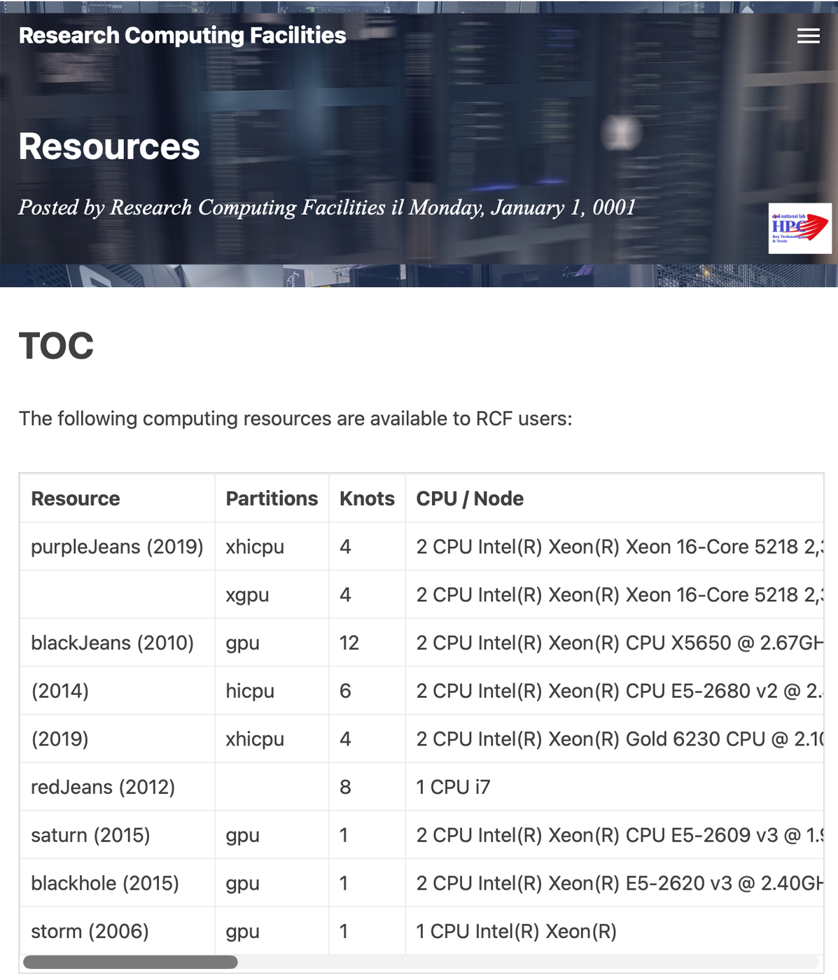
RISC-V and European supercomputing
Today's largest machines use x86 or Arm processors with GPU accelerators
Europe designs its own processors and accelerators on RISC-V: the European Processor Initiative, and DARE, the project named in the first lecture
Monte Cimone, at the University of Bologna with CINECA, 2022: a complete HPC cluster built on RISC-V processors
The Barcelona Supercomputing Center designs and fabricates RISC-V cores of its own
An open instruction set lets a continent build what it would otherwise have to buy
Research Computing Facilities of the Department
Notes:
RISC-V and European supercomputing. The largest machines of today use x86 or Arm processors with GPUs. Europe is designing processors and accelerators of its own on RISC-V, with the European Processor Initiative and with DARE, the project named in the first lecture. Monte Cimone, in Bologna, is a complete cluster built on RISC-V processors. An open instruction set lets a continent build what it would otherwise have to buy. The page shown is that of the computing facilities of the Department.
For the lecturer: DARE: Digital Autonomy with RISC-V in Europe. The Department's Research Computing Facilities are at rcf.uniparthenope.it: after the lecture, the visit.

Slide 28
05
GPU accelerators
Thousands of small cores for work that repeats.
Notes:
The fourth answer: accelerators. First the GPU, thousands of small cores for work that repeats.

Slide 29
Two ways to spend transistors
A CPU
A GPU
A few large cores: tens
Each one out of order, with predictors and big caches
Built to finish one task as soon as possible
At ease with branches and irregular data
Thousands of small, simple cores
All executing the same code on different data
Built to finish a million tasks per second
At ease with regular arrays: pixels, matrices, grids
Notes:
Two ways of spending the same transistors. A CPU has a few large cores, each out of order, with predictors and big caches: it is built to finish one task as soon as possible, and is at ease with branches and irregular data. A GPU has thousands of small simple cores that execute the same code on different data: it is built to finish a great many tasks per second, and is at ease with regular arrays. Oxen and chickens: the answer depends on the field.
For the lecturer: Lecture 20 told the story from the video card to GPGPU. Cray's oxen and chickens: the answer depends on the field. The GPU is not faster at any single thing; it does more things at once.

Slide 30
How a program uses a GPU
1
2
3
4
Prepare
Copy in
Launch
Copy out
The program on the CPU, the host, builds its arrays in main memory
The data travel to the memory of the GPU: a real cost, in time
One small function, the kernel, runs in thousands of threads, one per element of the data
The results travel back, and the host goes on
Notes:
How a program uses a GPU, in four steps. The program on the CPU, the host, prepares its arrays in main memory. The data are copied to the memory of the GPU, which costs time. A small function, the kernel, is launched in thousands of threads, one per element. The results are copied back. The GPU is a device like those of Lecture 21: the processor sends it data and commands.
For the lecturer: The GPU is a device, like those of Lecture 21: the CPU sends it data and commands through a driver. Programming models: CUDA, OpenCL, SYCL, and directives such as OpenACC and OpenMP offload.

Slide 31
The map of Verm1, one thread per cell
// the kernel: this function runs once in every thread
__global__ void clear(unsigned char *grid, int n) {
int i = blockIdx.x * blockDim.x + threadIdx.x; // who am I?
if (i < n)
grid[i] = 0; // my cell, and only mine
}
// on the host: 4 blocks of 256 threads cover the 960 cells
clear<<<(960 + 255) / 256, 256>>>(grid, 960);
1
There is no loop: there are 960 threads
2
Each thread computes its own index and does one store
3
Threads come in blocks; the last ones find nothing to do
4
For 960 bytes the copies cost far more than the work
Notes:
The map of Verm1 on a GPU. The function marked as kernel runs once in every thread. Each thread first computes who it is, its index i, from the number of its block and its position in the block; then, if the index is inside the map, it clears its own cell. There is no loop: there are 960 threads. The last line, on the host, launches four blocks of 256 threads. For 960 bytes the two copies cost far more than the work: this example shows the form, not a gain.
For the lecturer: CUDA C, in its usual textbook form; not compiled for these slides. The point of the last callout is serious: a GPU pays off when the data are large and the work per element is real. Ask: for which size of map would it be worth it?

Slide 32
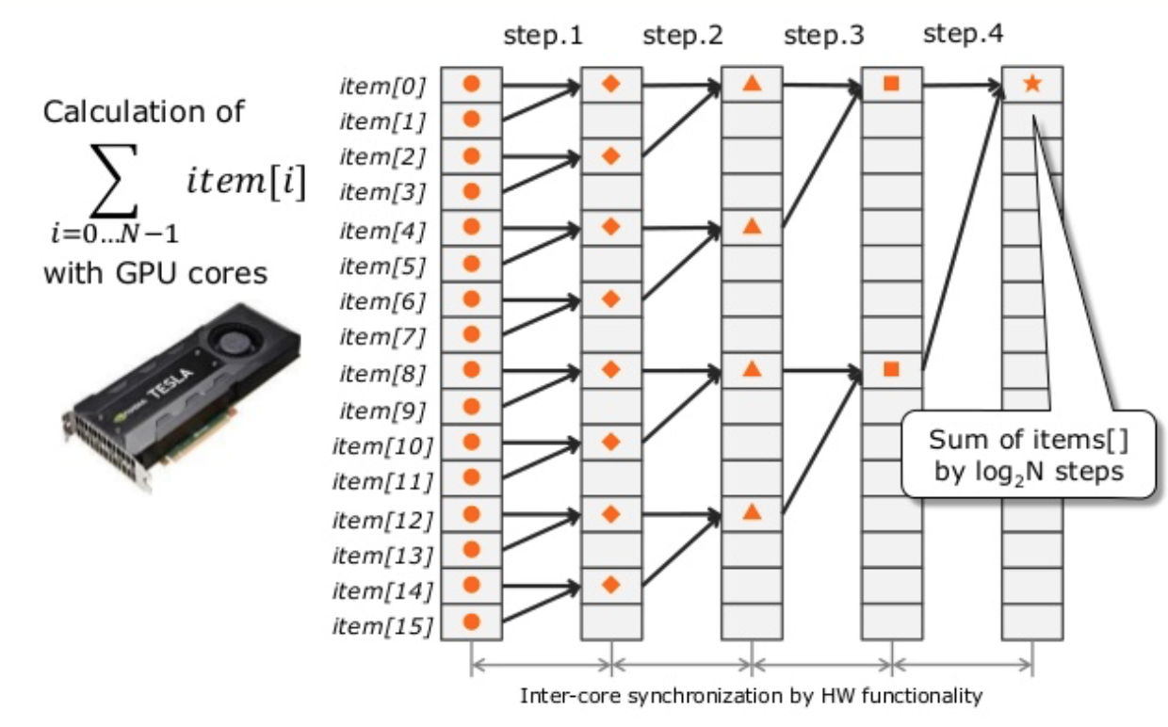
When does a GPU pay off?
When the same operation applies to very many data, independently: images, matrices, grids of a simulation, neural networks
When the data can stay on the GPU for many steps, instead of travelling at every one
Not when the work is a chain of decisions, each depending on the one before
Amdahl again: what stays on the CPU sets the limit
The training of today's neural networks is, almost entirely, matrix arithmetic on GPUs
A parallel sum: log2 N steps instead of N
Notes:
When does a GPU pay off? When the same operation applies to very many data independently: images, matrices, the grids of a simulation, neural networks. When the data can stay on the GPU for many steps instead of travelling each time. Not when the work is a chain of decisions, each depending on the previous one. And Amdahl applies again: what remains on the CPU sets the limit.
For the lecturer: A weather simulation updates every cell of a three-dimensional grid from its neighbours, millions of times: the same shape as the map of Verm1, a little larger.

Slide 33
06
FPGA accelerators
Hardware that you can rewrite.
Notes:
The last machine is the strangest: hardware that can be rewritten.

Slide 34
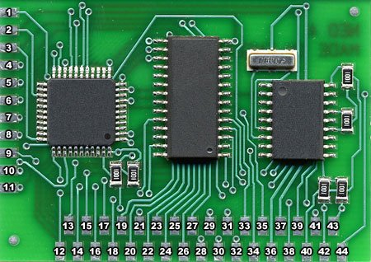
A chip that becomes the circuit you describe
FPGA: field-programmable gate array
Inside: a sea of small programmable blocks
– look-up tables, each able to be any function of a few inputs
– flip-flops, one beside each table
– wires and switches that can join any block to any other
A configuration file, the bitstream, sets every table and every switch
Load another bitstream and the same chip is another circuit
First sold in 1985; today from a few euros to boards for data centres
Programmable logic sits on boards like any other chip
Notes:
An FPGA, field-programmable gate array, is a chip that becomes the circuit you describe. Inside there is a sea of small blocks: look-up tables, each able to be any function of a few inputs; a flip-flop beside each table; and wires with switches that can connect any block to any other. A configuration file, the bitstream, sets every table and every switch. Load another bitstream and the same chip is a different circuit. It does not execute a program: it is a circuit.
For the lecturer: The Xilinx XC2064, 1985. An FPGA does not execute a program: it becomes a circuit. Nothing is fetched or decoded; all the gates work at the same time.

Slide 35
A look-up table is a truth table in memory
a | b | stored for AND | stored for XOR | stored for NOT a
0 | 0 | 0 | 0 | 1
0 | 1 | 0 | 1 | 1
1 | 0 | 0 | 1 | 0
1 | 1 | 1 | 0 | 0
The inputs are the address; four stored bits choose the function. Changing the bits changes the gate.
Notes:
A look-up table is a truth table kept in memory. The inputs a and b are the address; the stored bits are the outputs. Read the three columns on the right: with the bits 0, 0, 0, 1 the table is an AND; with 0, 1, 1, 0 an XOR; with 1, 1, 0, 0 it is NOT a. Changing the stored bits changes the gate. It is the ROM that implements any function, from Lecture 11, in miniature.
For the lecturer: Lecture 08 said that a truth table defines a function; Lecture 11 that a ROM addressed by the inputs implements any function. A LUT is that ROM, with four to six inputs, sixteen to sixty-four bits. The flip-flop next to it is that of Lecture 13. An FPGA is this course, repeated a hundred thousand times on one chip.

Slide 36
The U-turn rule of Verm1, as hardware
// Lecture 12: opposite directions differ in bit 1 only
module uturn (
input wire [1:0] dir, // direction of the last step
input wire [1:0] want, // direction asked by the player
output wire refuse // 1 = this would be a U-turn
);
assign refuse = (dir ^ want) == 2'b10;
endmodule
1
Verilog: a language that describes circuits, not steps
2
assign is a wire, always true: there is no before and after
3
Two XOR gates and an AND with one inverted input
4
On the kit this rule took three instructions and three cycles
Notes:
The rule of Verm1 that forbids the U-turn, written as hardware. Verilog is a language that describes circuits, not sequences of steps. The module has two inputs of two bits, the current direction and the one requested, and one output. The line with assign is a wire that is always true: the output is 1 when the XOR of the two directions equals binary 10. There is no before and after. On the kit the same rule took three instructions.
For the lecturer: A hardware description language: Verilog, or VHDL. Not synthesised for these slides. The xor, li, beq of Part 2 become gates that answer in a fraction of a nanosecond, continuously. Ask the students to draw the circuit: refuse = (d1 xor w1) and not (d0 xor w0).

Slide 37
From description to circuit
Describe
Simulate
Synthesise
Place and route
Configure
Verilog or VHDL; or C, with high-level synthesis
waveforms, as in Lecture 13
the description becomes tables and flip-flops
each one gets a place on the chip
the bitstream is loaded
Minutes to hours for each attempt: slower than building a cartridge, far faster than making a chip.
Notes:
From description to circuit in five stages. Describe, in Verilog or VHDL. Simulate, observing waveforms like those of Lecture 13. Synthesise: the description becomes tables and flip-flops. Place and route: each element gets a position on the chip and the connections are drawn. Configure: the bitstream is loaded. Each attempt takes from minutes to hours: slower than building a cartridge, much faster than manufacturing a chip.
For the lecturer: The same flow, with a factory at the end instead of a bitstream, produces an ASIC: a chip made for one purpose. FPGAs are where chips are tried before they are made.

Slide 38
A processor is a circuit too
A RISC-V core is a description in a hardware language: it can be loaded on an FPGA
The circle closes
Such soft cores are free to read and use: PicoRV32, VexRiscv, NEORV32, Rocket
From gates to a processor, and back: you now know every layer in between.
A core of the class of your kit's fits in a small, cheap FPGA
And beside it you can put a circuit of your own, for the one operation your program repeats most: a custom accelerator
RISC-V reserves room in its encoding for custom instructions, to reach such circuits
Notes:
A processor is a circuit too. A RISC-V core is a description in a hardware language, and it can be loaded on an FPGA: such soft cores are free to read and to use. A core of the class of your kit's fits in a small FPGA. Beside it you can place a circuit of your own, for the operation your program repeats most. Here the circle of the course closes: from the gates to a processor, and back.
For the lecturer: This closes the circle of the course: the gates of Lecture 08 build the adder of Lecture 09, the registers of Lecture 14, the processor of Lecture 18, and that processor is a file you can read. Networks, signal processing, finance and the first stages of AI inference use FPGAs where latency and energy matter.

Slide 39
Four ways to compute
 | CPU | GPU | FPGA | ASIC
What it is | a few complex cores | thousands of simple cores | a circuit you configure | a circuit made for one job
Programmed in | any language | kernels: CUDA, OpenCL, SYCL | Verilog, VHDL, HLS | the same, then a factory
Strong at | everything, moderately | regular data in bulk | streams, low latency | one thing, perfectly
Work per joule | low | high | high | highest
Effort to use | low | medium | high | very high
Change of mind | recompile | recompile | a new bitstream | a new chip
Notes:
Four ways to compute, compared. Read the table by rows. A CPU is a few complex cores, programmed in any language, good at everything in moderation. A GPU is thousands of simple cores for regular data in bulk. An FPGA is a circuit you configure, for streams and low latency. An ASIC is a circuit made for one job. From left to right the work done per joule grows, and so does the effort required. Generality is paid in energy, efficiency in effort.
For the lecturer: Generality is paid in energy; efficiency is paid in effort. A modern system on a chip has all four: your phone holds CPU cores, a GPU, and fixed circuits for video and radio.

Slide 40
07
Back to the machine
One loop, five machines.
Notes:
Back to the loop of the warm-up, now seen on five machines.

Slide 41
Emptying the map of Verm1: 960 cells
Machine | How | Steps in time
The kit: ESP32-C6 | one byte per turn, one instruction per cycle | 3 840 cycles
Out-of-order RISC-V core | the same binary; several instructions per cycle, the branch predicted | a fraction of those cycles
RISC-V with vectors, 128 bits | 16 bytes per turn | 60 turns
GPU | 960 threads, one per cell | one launch, plus two copies
FPGA | 960 flip-flops with a common reset | one clock cycle
The first three rows are the same instruction set. The first and the third were run for these slides.
Notes:
Emptying the 960 cells of the map. On the kit: one byte per turn, 3,840 cycles. On an out-of-order RISC-V core: the same binary, in a fraction of those cycles. With 128-bit vectors: 60 turns. On a GPU: one launch of 960 threads, plus two copies. On an FPGA: 960 flip-flops with a common reset, one clock cycle. The work is the same; what changes is how much of it happens at the same time, and what it costs to obtain it. The engineer's question is not which is fastest, but which is enough.
For the lecturer: The work is the same; what changes is how much of it happens at the same time. And the costs: the first row needs a two-euro chip and four lines of assembly; the last needs a hardware design. The engineer's question is never which is fastest, but which is enough.

Slide 42
Check your understanding
A program is 80% parallel. What is the largest speed-up that any number of processors can give?
4
5
A
B
8
80
C
D
Notes:
Use the last column of the table of Amdahl's law: with unlimited processors only the serial part remains.
For the lecturer: Answer: B. With n unlimited, S = 1 / (1 - p) = 1 / 0.2 = 5.

Slide 43
Check your understanding
What does register renaming remove?
branches
the need for a stack
A
B
false dependences between uses of the same register name
cache misses
C
D
Notes:
Think of the example with the two halves that both used t0: what prevented them from running together, and what did renaming change?
For the lecturer: Answer: C. Two unrelated values that share a name get different physical registers and can be computed at the same time.

Slide 44
Check your understanding
With 256-bit vector registers, how many turns does the vector loop need for the 960 bytes?
4
30
A
B
60
960
C
D
Notes:
How many bytes are 256 bits? Divide the 960 bytes by that number.
For the lecturer: Answer: B. 256 bits are 32 bytes per turn: 960 / 32 = 30. The code does not change.

Slide 45
Check your understanding
A two-input look-up table stores, for inputs 00, 01, 10, 11, the bits 0, 1, 1, 1. Which gate is it?
AND
OR
A
B
XOR
NAND
C
D
Notes:
Write the four stored bits as a truth table with inputs a and b, and recognise the function.
For the lecturer: Answer: B. The output is 1 whenever at least one input is 1: OR.

Slide 46
Exercises: paper first, then the machine
TRY IT
1
Fill in the Amdahl table for p = 0.95 and n = 10, 100, 1000
2
Draw the pipeline diagram of a three-wide processor for nine independent instructions with five stages
3
Rename the registers of the step-wrap code of Verm1, Part 2: which instructions could run in the same cycle?
4
Write the truth table stored in a four-input look-up table for refuse = (dir xor want) == 2
5
Build tools/tests/vector_qemu.S and run it on QEMU with vlen=128 and vlen=512: why does the same binary work?
Expected result
Amdahl, p = 0.95: 6.9, 16.8, 19.6. Nine instructions, three-wide: seven cycles. The look-up table has four ones out of sixteen entries.
Notes:
Five exercises. Fill in the Amdahl table for p = 0.95. Draw the pipeline diagram of a three-wide processor for nine independent instructions. Rename the registers of a fragment of Verm1 and say which instructions could run in the same cycle. Write the truth table of a four-input look-up table for the U-turn rule. And build the vector test and run it on QEMU with two different widths: why does the same binary work?
For the lecturer: QEMU: qemu-system-riscv32 -machine virt -cpu rv32,v=true,vlen=128; the build command is in tools/tests/README.md. The four ones of the table: (dir, want) = (0,2), (1,3), (2,0), (3,1).

Slide 47
Glossary
English | Italian | English | Italian
superscalar | superscalare | out-of-order execution | esecuzione fuori ordine
register renaming | ridenominazione dei registri | branch prediction | predizione dei salti
speed-up | accelerazione (speed-up) | node | nodo
shared memory | memoria condivisa | message passing | scambio di messaggi
accelerator | acceleratore | kernel (GPU) | kernel
look-up table | tabella di look-up | bitstream | bitstream
hardware description language | linguaggio di descrizione dell'hardware | soft core | soft core
Notes:
Fourteen terms of this lecture. Out-of-order execution is esecuzione fuori ordine; register renaming is ridenominazione dei registri; branch prediction is predizione dei salti. Shared memory and message passing are the two models of parallel programming. Several words, kernel, bitstream, soft core, are used in Italian as they are.

Slide 48

Conclusions and reading
One equation, three factors: every fast machine attacks one of them, or multiplies processors
Superscalar, out-of-order cores keep the contract of the instruction set and execute many instructions at once
Vectors, GPUs and clusters exploit data that can be processed independently; Amdahl's law says how far that goes
FPGAs turn a description into a circuit: the logic of this course, at scale
Reading
– Patterson, Hennessy: Computer Organization and Design, RISC-V Edition, chapters 4 and 6
– Hennessy, Patterson: Computer Architecture, A Quantitative Approach
– top500.org; the RISC-V vector specification at riscv.org
Patterson, Hennessy: RISC-V edition
Notes:
Four conclusions. One equation with three factors: every fast machine attacks one of them, or multiplies the processors. Superscalar out-of-order cores respect the contract of the instruction set and execute many instructions at once. Vectors, GPUs and clusters exploit data that can be processed independently, and Amdahl's law says how far that goes. FPGAs turn a description into a circuit. The course ends here: from a bit to a supercomputer, with a single instruction set.
For the lecturer: The course ends here: from a bit to a supercomputer, with one instruction set. Next: the visit to the Department's computing systems, and the presentation of the students' games.

