Slide 1




UNDERSTAND NOW
USE NOW
UNDERSTAND LATER
Lecture deck. The listings, the complete program and how to test it are in the code deck:
08-Computer_Architecture-Boolean_Algebra_1-Lab.pptx
ARC12 COMPUTER ARCHITECTURE · LECTURE 08
Elements of Boolean Algebra
Part 1: the computer as a logic machine; operators and their properties
“Oh dear! Oh dear! I shall be too late!”
Lewis Carroll, Alice's Adventures in Wonderland, 1865
Prof. Raffaele Montella, PhD
University of Naples “Parthenope” · A.Y. 2026/27
raffaelemontella.it · raffaele.montella@uniparthenope.it
Notes:
The second block of the course opens: logic. Having established what bits mean, the course turns to how they are combined. Boolean algebra has in fact been in use since the first weeks, every time a button was tested with andi; this lecture names that operation and constructs the algebra around it. The White Rabbit on the cover, always in a hurry, is an apt emblem: the processor too accomplishes everything through minute logical steps, billions of them per second.
Learning status: UNDERSTAND NOW, by the end of this lecture you explain it, trace it and apply it on your own; USE NOW, you follow and use the recipe today; how it works inside is explained later, or is not part of the course; UNDERSTAND LATER, recognise the name and what it is for; a later lecture explains it. A slide without a badge is context: a story, an example, a question, an exercise.
Learning status of this lecture. UNDERSTAND NOW: bit masks; the von Neumann architecture; analysis and synthesis; Boolean algebra; logic gates. USE NOW: the complete program, the PRG32 tools (used, not studied, in this course). UNDERSTAND LATER: minimisation, Karnaugh maps (Lecture 09). A slide without a badge is context: a story, an example, a question, an exercise.
Roadmap. Today's outcomes: (1) tell the analysis of a logic circuit from its synthesis; (2) apply the axioms and theorems of Boolean algebra, De Morgan's included; (3) set, clear and test bits with masks. Builds on: the von Neumann architecture (Lecture 03). Next: Lecture 09, Elements of Boolean Algebra.
For the lecturer: Spiral: the students have used andi to test a button since the first days. The lecture names what they did (a mask is an AND), then builds the algebra, then returns to the bitwise instructions.

Slide 2
What you will be able to do by the end
1
Describe a computer as processor, memory and input/output, connected by a bus
2
Explain the difference between the analysis and the synthesis of a logic circuit
3
Write the truth tables of AND, OR, NOT, XOR, NAND and NOR and recognise their symbols
4
Apply the properties of Boolean algebra, De Morgan's laws included, to simplify an expression
5
Use and, or, xor and not on RISC-V to test, set, clear and toggle single bits
Notes:
Five learning outcomes. Describing a computer as three subsystems connected by a bus. Distinguishing the two fundamental problems of logic design, analysis and synthesis. Writing the truth tables of six gates and recognising their symbols. Applying the properties of the algebra, De Morgan's laws included, to simplify an expression. And, returning to the machine, using the bitwise instructions of RISC-V to test, set, clear and toggle individual bits of a register.

Slide 3
The electronic computer: three subsystems and a bus
UNDERSTAND NOW · the von Neumann architecture
Processor (CPU)
control unit, ALU, registers
executes the instructions
Main memory
holds the instructions
and the data
Input / output
joystick, display, sound,
network, storage
Bus: address lines, data lines, control lines
The von Neumann model in today's terms: the units of 1945, connected by shared wires
Everything that travels on the bus is a pattern of bits
Notes:
A computer comprises three subsystems: the processor, which executes instructions; the main memory, which holds instructions and data; and the input/output subsystem, which connects the machine to the world. They communicate through a bus, a set of shared lines divided into address lines, data lines and control lines. This is the von Neumann model of Lecture 03 expressed in contemporary terms. Everything that travels on the bus is a pattern of bits. On the ESP32-C6 all three subsystems reside on a single chip.
UNDERSTAND NOW: the von Neumann architecture.
For the lecturer: Replaces the two pictures of the source deck (von Neumann model; architecture with bus). On the ESP32-C6 the three subsystems and the bus are all inside one chip.

Slide 4
The processor
UNDERSTAND NOW · the von Neumann architecture
The processing capability of the computer resides in the processor
It can execute a set of elementary actions, more or less complex: the instructions
fetch, execute, repeat
Instructions are explicit commands that
– govern the transfer of information inside the computer and between the computer and the I/O devices
– specify the arithmetic and logic operations to perform
the processor takes the instructions from memory and executes them, one by one
Main memory holds the input and output data of the computation, and the sequence of instructions
A sequence of instructions stored in main memory is a program
Notes:
The processor is where the capacity for computation resides. It executes instructions, explicit commands of two kinds: those that govern the transfer of information, within the computer and between it and its devices, and those that specify arithmetic and logical operations. Memory holds both the data and the sequence of instructions, and a sequence of instructions stored in memory is a program. The processor performs a single activity indefinitely: it fetches an instruction, executes it, and repeats. Lecture 19 examines this cycle in detail.
UNDERSTAND NOW: the von Neumann architecture.
For the lecturer: RV32I: about forty instructions. You have used addi, lw, sw, andi, beqz, call and ret: transfer, arithmetic, logic and control are all there.

Slide 5
What kind of system is an electronic computer?
UNDERSTAND NOW · the von Neumann architecture
1
Numeric
2
Automatic
It is a digital system: all the information it handles is expressed as strings of bits.
Once started it proceeds by itself, instruction after instruction, with no human intervention.
3
Stored-program
4
Electronic
The program is recorded in memory and can be replaced: the same machine does different jobs.
It is built from electronic circuits that store bits and process them.
Notes:
Four attributes characterise an electronic computer. Numeric, or digital: all information is represented as strings of bits. Automatic: once started, it proceeds without intervention. Stored-program: the program resides in memory and can be replaced, so the same machine performs different tasks. Electronic: it is built from circuits that store and process bits. Each attribute excludes something: an abacus is numeric but not automatic; a mechanical music box is automatic but its program is fixed.
UNDERSTAND NOW: the von Neumann architecture.

Slide 6
Logic circuits
UNDERSTAND NOW · analysis and synthesis
All the information handled by a numeric device is expressed by strings of bits
0 and 1
The electronic circuits that store bits and process them are called switching circuits, or logic circuits
A logic circuit forms a switching network; designing it is called logic design
two voltage levels on a wire, two states of a switch, two values of a Boolean variable
To describe the behaviour of logic circuits we use an algebra: a mathematical notation that simplifies the analysis and the synthesis of logic networks
Notes:
The circuits that store and process bits are called switching circuits, or logic circuits; interconnected, they form a switching network, and their design is called logic design. Describing their behaviour requires an algebra, which plays for circuits the role that ordinary algebra plays for quantities: a notation in which one can calculate rather than enumerate every case. The values are two, 0 and 1, corresponding physically to two voltage levels or two states of a switch, a correspondence that Lecture 10 makes precise.
UNDERSTAND NOW: analysis and synthesis.
For the lecturer: Switching circuits: circuiti di commutazione. The algebra is Boole's (1854), applied to switches by Nakajima and Shannon in the 1930s (Lecture 03).

Slide 7
Two problems, one algebra
UNDERSTAND NOW · analysis and synthesis
UNDERSTAND LATER · minimisation, Karnaugh maps → Lecture 09
Analysis
Synthesis
Given: the description of the STRUCTURE of a circuit (how it is made)
Find: its BEHAVIOUR (what it does)
Example: reading a schematic and deriving its truth table
Example: reading andi t3, t0, 1 and saying what ends up in t3
Given: the description of the BEHAVIOUR (what it must do)
Find: a STRUCTURE that realises it (how to build it)
Example: from the truth table of a sum to an adder circuit
Example: from 'move if LEFT or RIGHT is pressed' to a mask and a branch
Notes:
Two problems, addressed by one algebra. Analysis: given the structure of a circuit, how it is built, determine its behaviour, what it computes. Reading andi t3, t0, 1 and stating what t3 will contain is analysis. Synthesis proceeds in the opposite direction: from a specified behaviour to a structure that realises it, for example from the table of a sum to an adder. Analysis has a unique answer; synthesis in general has many, and choosing the least costly among them is the minimisation problem treated in Lecture 09.
UNDERSTAND NOW: analysis and synthesis. UNDERSTAND LATER: minimisation, Karnaugh maps (studied in Lecture 09).
For the lecturer: Synthesis usually has many solutions; choosing the cheapest is the minimisation problem of Lecture 09.

Slide 8
Boolean algebra
UNDERSTAND NOW · Boolean algebra
Definition
The algebra used to analyse and to synthesise logic circuits: variables that can take only two values, 0 and 1, and three basic operations.
Variables are binary and are usually written with letters: A, B, ... or x, y, ...
AND, the logical product: written x AND y, or x . y, or simply xy
OR, the logical sum: written x OR y, or x + y
NOT, the complement: written NOT x, or x', or x with a bar above it
Notes:
In Boolean algebra a variable takes only two values, 0 and 1, and there are three fundamental operations. AND, the logical product, written with a dot or by juxtaposition. OR, the logical sum, written with a plus sign. NOT, the complement, written here with a prime, as x', for ease of typing. The notation should not mislead: the plus sign does not denote arithmetic addition, as the truth table of OR immediately shows.
UNDERSTAND NOW: Boolean algebra.
For the lecturer: Conjunction, disjunction, negation: congiunzione, disgiunzione, negazione. In these slides the complement is written with a prime (x') so that it can be typed.

Slide 9
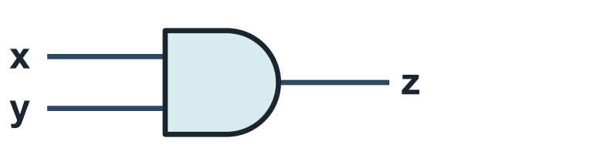
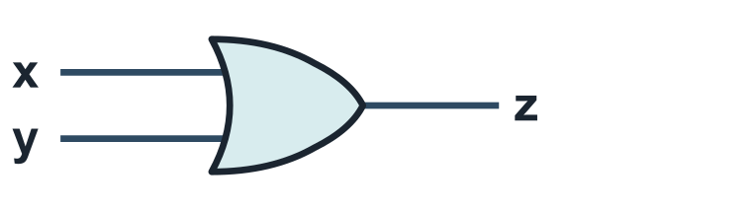
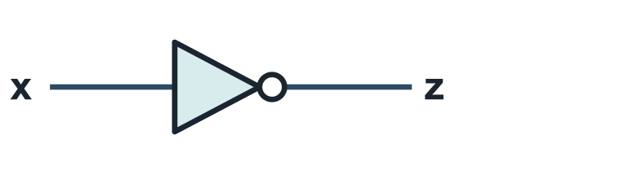
The three fundamental operations
UNDERSTAND NOW · logic gates
AND (conjunction)
OR (disjunction)
NOT (negation)
z = x . y
z = x + y
z = x'
x | y | z
0 | 0 | 0
0 | 1 | 0
1 | 0 | 0
1 | 1 | 1
x | y | z
0 | 0 | 0
0 | 1 | 1
1 | 0 | 1
1 | 1 | 1
x | z
0 | 1
1 | 0
Notes:
Each panel presents an operation in three forms: the symbol of the gate, the algebraic notation, and the truth table, which lists the output for every combination of inputs. AND yields 1 only when both inputs are 1. OR yields 0 only when both inputs are 0, so 1 OR 1 equals 1, not 2. NOT has a single input and inverts it. The three shapes should be learned: a flat back and rounded front for AND, a curved back and pointed front for OR, a triangle with a small circle for NOT.
UNDERSTAND NOW: logic gates.
For the lecturer: AND is 1 only when both inputs are 1; OR is 0 only when both inputs are 0; NOT inverts. A truth table lists the output for every combination of the inputs.

Slide 10
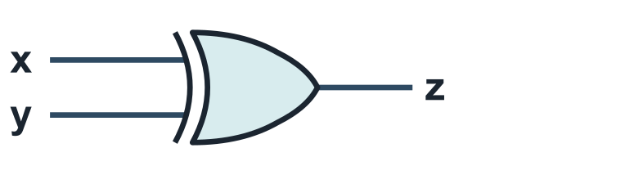
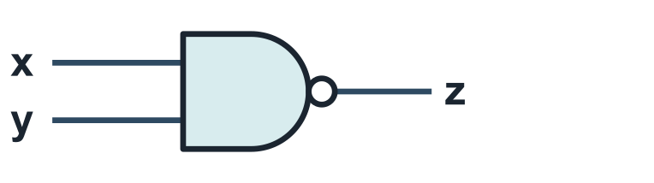

Three more gates you will meet everywhere
UNDERSTAND NOW · logic gates
XOR (exclusive or)
NAND (not and)
NOR (not or)
z = x'y + xy'
z = (x . y)'
z = (x + y)'
x | y | z
0 | 0 | 0
0 | 1 | 1
1 | 0 | 1
1 | 1 | 0
x | y | z
0 | 0 | 1
0 | 1 | 1
1 | 0 | 1
1 | 1 | 0
x | y | z
0 | 0 | 1
0 | 1 | 0
1 | 0 | 0
1 | 1 | 0
Notes:
Three further gates. XOR, the exclusive OR, yields 1 when its inputs differ; it is the sum bit of a one-bit addition, as the warm-up of Lecture 09 shows. NAND and NOR are AND and OR followed by negation, and the small circle at the output of a symbol always denotes NOT. NAND yields 0 only when both inputs are 1; NOR yields 1 only when both are 0. Their practical importance is that they are the gates most economically built from transistors, as Lecture 10 demonstrates.
UNDERSTAND NOW: logic gates.
For the lecturer: New slide. XOR is 1 when the inputs differ: it is the sum bit of an addition, and RISC-V has it as an instruction. The small circle on a symbol means negation.

Slide 11
Properties of Boolean algebra (1)
UNDERSTAND NOW · Boolean algebra
Property | AND form | OR form
Commutative | x . y = y . x | x + y = y + x
Associative | (x . y) . z = x . (y . z) | (x + y) + z = x + (y + z)
Idempotence | x . x = x | x + x = x
Absorption | x . (x + y) = x | x + (x . y) = x
By associativity AND and OR extend to any number of operands: x . y . z, x + y + z.
Notes:
The first four properties, each stated in a form for AND and a form for OR. Commutativity and associativity hold as in ordinary algebra, and the latter allows AND and OR to be extended to any number of operands. Idempotence is new: x AND x is x, and x OR x is x; repeating a variable contributes nothing. Absorption is the most useful for simplification: x OR (x AND y) equals x, because when x is 1 the result is 1 whatever y may be, and when x is 0 both terms are 0.
UNDERSTAND NOW: Boolean algebra.
For the lecturer: Because of the associative property AND and OR can be defined on more than two operands: x . y . z. Every property comes in a pair: swap AND with OR.

Slide 12
Properties of Boolean algebra (2)
UNDERSTAND NOW · Boolean algebra
Property | AND form | OR form
Distributive | x . (y + z) = x . y + x . z | x + y . z = (x + y) . (x + z)
Identity element | x . 1 = x | x + 0 = x
Null element | x . 0 = 0 | x + 1 = 1
Complement | x . x' = 0 | x + x' = 1
Involution | (x')' = x
Careful: OR distributes over AND too. This is false for ordinary sum and product.
Notes:
Five further properties. The first distributive law is the familiar one. The second, x + yz = (x + y)(x + z), has no counterpart in ordinary algebra: here OR also distributes over AND. Then the constants: 1 is the identity element for AND and 0 for OR; 0 annihilates an AND and 1 saturates an OR. The complement laws state that a variable combined with its negation gives 0 under AND and 1 under OR. Involution: double negation restores the variable. Two of these properties, identity and the null element, are precisely what makes a bit mask work.
UNDERSTAND NOW: Boolean algebra.
For the lecturer: The second distributive law has no counterpart in ordinary algebra. The source slide called involution 'convoluzione' and grouped identity and null element as 'minimum and maximum'; the complement laws are added here.

Slide 13
De Morgan's laws
UNDERSTAND NOW · Boolean algebra
(x . y)' = x' + y'
x | y | x . y | (x . y)' | x' | y' | x' + y'
0 | 0 | 0 | 1 | 1 | 1 | 1
0 | 1 | 0 | 1 | 1 | 0 | 1
1 | 0 | 0 | 1 | 0 | 1 | 1
1 | 1 | 1 | 0 | 0 | 0 | 0
(x + y)' = x' . y'
The complement of a product is the sum of the complements, and vice versa
The two highlighted columns are identical: the first law holds. The second is proved the same way.
Proof by perfect induction: check every row of the truth table
A NAND is an OR of the negated inputs; a NOR is an AND of the negated inputs
Notes:
De Morgan's laws relate the three operations: the complement of a product is the sum of the complements, and the complement of a sum is the product of the complements. The table proves the first by perfect induction: since each variable takes only two values, a law can be established by checking every row exhaustively, and the two highlighted columns are identical. In terms of gates, a NAND is an OR with inverted inputs. These laws will be used constantly, both on paper and in programs.
UNDERSTAND NOW: Boolean algebra.
For the lecturer: Augustus De Morgan, 1847. The laws generalise to any number of variables. The source deck showed the proof as a picture.

Slide 14
Duality and precedence
UNDERSTAND NOW · Boolean algebra
Duality principle: every identity stays true if you swap AND with OR and 0 with 1
– x . 1 = x becomes x + 0 = x; De Morgan's two laws are each other's dual
Precedence: NOT first, then AND, then OR, as with powers, products and sums
– x + y . z' means x + (y . (z'))
Parentheses change the order, exactly as in ordinary algebra
Two expressions are equivalent if they have the same truth table
Notes:
Two general principles. Duality: every identity remains valid when AND and OR are interchanged together with 0 and 1; this is why the properties appeared in pairs, and it halves the work of proving them. Precedence: NOT is applied first, then AND, then OR, just as exponentiation precedes multiplication and multiplication precedes addition; parentheses override the order. And a definition to retain: two expressions are equivalent when they have the same truth table.
UNDERSTAND NOW: Boolean algebra.
For the lecturer: Duality halves the work: prove one law of each pair and the other follows.

Slide 15
Simplifying with the algebra
UNDERSTAND NOW · Boolean algebra
Expression | Law applied
x . y + x . y' | the expression to simplify: three gates and an inverter
= x . (y + y') | distributive law, read from right to left
= x . 1 | complement law: y + y' = 1
= x | identity element: only a wire is left
In the same way: x + x' . y = (x + x') . (x + y) = 1 . (x + y) = x + y
Notes:
The algebra at work. The expression xy + xy' requires two AND gates, an OR gate and an inverter. Factoring x by the distributive law gives x(y + y'); the complement law reduces the parenthesis to 1; the identity law leaves x. Four gates have become a wire. Each line of the derivation names the law that justifies it, and this discipline should be adopted: in a simplification, every step must be attributable to a law. The caption shows a second simplification that will recur in Lecture 09.
UNDERSTAND NOW: Boolean algebra.
For the lecturer: Two literals and three gates become a wire. The identity in the caption (sometimes called the simplification theorem) uses the distributive law of OR over AND; it is used again in Lecture 09.

Slide 16
Check your understanding
For which inputs is x NAND y equal to 0?
1
x = 0, y = 0
x = 0, y = 1
A
B
x = 1, y = 1
never
C
D
By De Morgan, (a . b')' is equal to:
2
a' . b
a' + b
A
B
a + b'
a' + b'
C
D
Notes:
For the first question, NAND is AND followed by NOT. Starting from AND, one identifies the single row of its table whose output is 1; that is the only row in which NAND yields 0.
For the second, the first of De Morgan's laws is applied to the product of a and b': the complement becomes the sum of the complements, a' plus the complement of b'. Involution then simplifies the second term.
For the lecturer: 1. Answer: C. NAND is the complement of AND: it is 0 only when both inputs are 1.
2. Answer: B. (a . b')' = a' + (b')' = a' + b, using involution on the second term.

Slide 17
Check your understanding
t0 = 0x0000005A. What is in t1 after andi t1, t0, 0x0F?
1
0x0000005A
0x00000050
A
B
0x0000000A
0x0000000F
C
D
Which instruction turns bit 5 of t0 to 1 and leaves every other bit unchanged?
2
andi t0, t0, 0x20
ori t0, t0, 0x20
A
B
xori t0, t0, 0x20
addi t0, t0, 0x20
C
D
Notes:
For the first question, 0x5A is written in binary, 0101 1010, and the mask 0x0F as 0000 1111. The AND retains the bits where the mask has a 1, the low four, and clears the rest.
For the second, the four instructions are compared against the table of mask operations. AND with 0x20 would clear every other bit; XOR would invert the bit, turning a 1 into a 0; an arithmetic addition would work only if the bit were 0, and would otherwise propagate a carry. Only OR sets the bit while leaving all others unchanged.
For the lecturer: 1. Answer: C. 0x5A = 0101 1010; AND with 0000 1111 keeps the low nibble: 1010 = 0xA.
2. Answer: B. OR with a mask: x + 1 = 1 on bit 5, x + 0 = x elsewhere. xori would toggle it; addi would carry into bit 6 if the bit was already 1.

Slide 18
Glossary: English and Italian
English | Italiano | English | Italiano
logic circuit | circuito logico | truth table | tabella di verità
switching network | rete di commutazione | logic gate | porta logica
analysis / synthesis | analisi / sintesi | complement | complemento (negazione)
logical product (AND) | prodotto logico (congiunzione) | duality | dualità
logical sum (OR) | somma logica (disgiunzione) | mask | maschera
involution | involuzione | to set / clear / toggle | porre a 1 / azzerare / invertire
Notes:
Twelve terms. The truth table defines a function by exhaustive enumeration of its cases. Logical product and logical sum are AND and OR. To set, to clear and to toggle a bit mean to make it 1, to make it 0 and to invert it; Italian has no single verbs for these and uses short phrases.

Slide 19
Conclusions and reading
The von Neumann architecture represents a real machine in simplified form: processor, memory, input/output
Boolean algebra represents logic functions that can be implemented with electronic circuits
Three operations, a handful of properties and De Morgan's laws are enough to transform any expression
A bitwise instruction is the algebra applied to thirty-two bits at once; a mask is the identity law at work
Reading
– Patterson, Hennessy: Computer Organization and Design, RISC-V Edition, appendix A (The Basics of Logic Design)
– Playing with RISC-V, chapter 6: State and Input: Branches, Bitmasks, and Boundaries
– Bucci: Architettura dei calcolatori elettronici, chapters on Boolean algebra
Notes:
Four conclusions. The von Neumann architecture describes a real machine in simplified form. Boolean algebra describes the logical functions that electronic circuits implement. Three operations, a handful of properties and De Morgan's laws suffice to transform any expression. And a bitwise instruction is the algebra applied to thirty-two bits in parallel, with the mask as the identity and null-element laws at work. The next lecture passes from operators to functions: canonical forms and minimisation.
Learning status, recap. UNDERSTAND NOW: bit masks; the von Neumann architecture; analysis and synthesis; Boolean algebra; logic gates. USE NOW: the complete program, the PRG32 tools (used, not studied, in this course). UNDERSTAND LATER: minimisation, Karnaugh maps (Lecture 09). A slide without a badge is context: a story, an example, a question, an exercise. Closing thread: andi t3, t0, 1 is a row of 32 AND gates: Boolean algebra describes both the instruction and the circuit. Next: from a truth table to the smallest circuit. Exit ticket (two to four minutes, alone, on paper): 1. Analysis or synthesis? (a) Given a schematic, find its truth table. (b) Given 'the light is on when exactly one of two switches is up', build a circuit. (c) Read andi t3, t0, 1 and say what ends up in t3. 2. Write one instruction that sets bit 3 of t0 to 1 and leaves the other bits unchanged, and one that clears it.
For the lecturer: Next lecture: Boolean functions, canonical forms and minimisation.

