Slide 1




UNDERSTAND NOW
USE NOW
UNDERSTAND LATER
Lecture deck. The listings, the complete program and how to test it are in the code deck:
12-Computer_Architecture-Verm1_Part_2-Lab.pptx
ARC12 COMPUTER ARCHITECTURE · LECTURE 12
Verm1, Part 2: Steering, Food and a Score
The player enters the game: bits, masks, a rule in one XOR, a table that selects
“A game is a series of interesting choices.”
Sid Meier
Prof. Raffaele Montella, PhD
University of Naples “Parthenope” · A.Y. 2026/27
raffaelemontella.it · raffaele.montella@uniparthenope.it
Verm1 reference implementation contributed by Giuseppe Coviello
Notes:
The second tutorial of the project. At the end of Part 1 the head crossed the screen autonomously; today the player enters the game. Steering with the joystick is added, together with food that appears at random, a score and a sound. Everything rests on the four lectures of the logic block: a button is a bit selected by a mask, the rule forbidding the U-turn is a single XOR, and the movement is read from a table as a multiplexer would select it. Sid Meier's sentence on the cover names what is being added: meaningful choices.
Learning status: UNDERSTAND NOW, by the end of this lecture you explain it, trace it and apply it on your own; USE NOW, you follow and use the recipe today; how it works inside is explained later, or is not part of the course; UNDERSTAND LATER, recognise the name and what it is for; a later lecture explains it. A slide without a badge is context: a story, an example, a question, an exercise.
Learning status of this lecture. UNDERSTAND NOW: bit masks; codes; arrays in memory; pull-up inputs; Boolean algebra; fixed point; multiplexers; signed or unsigned instructions; comparators and parity; arguments in a0 to a7. USE NOW: the calling convention (Lecture 18) and, used without being studied in this course, the PRG32 tools, the PRG32 runtime calls, the PRG32-QT debugger. UNDERSTAND LATER: nothing. A slide without a badge is context: a story, an example, a question, an exercise.
Roadmap. Today's outcomes: (1) read the buttons with masks and refuse a U-turn with one XOR; (2) compare positions with XOR and OR to detect food; (3) keep and show a score. Builds on: bit masks (Lecture 08); codes (Lecture 11); arrays in memory (Lecture 04); pull-up inputs (Lecture 10); Boolean algebra (Lecture 08). Next: Lecture 13, Sequential Machines.
Bridge. In Lecture 07 a function that calls another saved ra in a frame of 16 bytes. Today the functions of Verm1 call each other more deeply: each saves ra once, on entry, and restores it before ret. Lecture 18 states the rules: which registers a call may change and which it must preserve. Recall: A function calls two other functions. How many times must it save ra, and where?
For the lecturer: Second project tutorial. It uses Lectures 08 to 11: Boolean operators and truth tables (08), XOR and equality, simplification (09), buttons as switches with pull-ups (10), comparators, multiplexers and ROM as a table (11). The students start from their working Part 1; the reference file is verm1/verm1_part2.S.

Slide 2
What you will have by the end
1
A worm's head that you steer with the joystick, in four directions
2
A rule that forbids the U-turn, written as one XOR and one comparison
3
Movement taken from two small tables instead of four branches
4
Food that appears at a random cell, is eaten, and appears again
5
A score, shown as marks in the title line, and a sound when the worm eats
Notes:
Five outcomes: a head steered in four directions; a rule forbidding the U-turn, written with one XOR and one comparison; movement taken from two small tables instead of four branches; food that appears in a random cell, is eaten and reappears; and a score, drawn as small marks beside the title, with a sound at each bite. Three of the five concern writing the program well rather than merely making it work, and this emphasis on the quality of a solution is deliberate.

Slide 3
What Part 2 takes from the lectures
From | Idea | Where it appears today
Lecture 08 | AND as a mask: keep one bit, clear the others | one button out of the word of buttons
Lecture 08 | truth tables: a code for each case | the four directions in two bits
Lecture 09 | XOR is 1 where two bits differ | the U-turn rule; the test for equality
Lecture 10 | a button is a switch to ground with a pull-up | why pressed arrives as 1 only after the runtime inverts it
Lecture 11 | comparator, multiplexer, ROM as a table | head on the food; dx and dy
Notes:
Each row links an idea from the logic lectures to a location in today's program. AND as a mask selects one button from the word of buttons. A truth table becomes the code of the four directions. XOR, which is 1 wherever two bits differ, provides both the U-turn rule and the test for equality. The pull-up of Lecture 10 explains why a pressed button arrives as 1. The comparator, the multiplexer and the ROM of Lecture 11 become the test "head on the food" and the tables dx and dy. The tutorial is thus an application of the whole block, not of any single lecture.
For the lecturer: Every row is something the students have seen as a circuit. Today the same ideas are instructions.

Slide 4
Start from a Part 1 that runs
Open your verm1.S of Part 1, build it and run it: the head must cross the screen
If it does not, copy the reference file verm1_part1.S and start from that
Today you change the file in three steps, and you run it after the second and the third
Slides marked CHANGED replace code you have; slides marked NEW add code
Keep the debugger of PRG32-QT open: step 4 uses it to watch a decision being taken
Verm1 at the end of Part 2
Notes:
The session begins from a Part 1 that runs: the file is opened and built, and the head is checked to cross the screen. If it does not, the reference file of Part 1 is used instead. Today the file changes in three steps, and is run after the second and after the third. The fourth line states the convention of every tutorial from now on: a slide marked CHANGED replaces code already present, and a slide marked NEW adds code.
For the lecturer: The reference files are in the verm1 folder of the course material. Keep a copy of each finished part: verm1_part1.S, verm1_part2.S and so on.

Slide 5
A code chosen with care: the four directions
UNDERSTAND NOW · codes
Direction | Code | Bit 1 | Bit 0 | dx | dy | Opposite
RIGHT | 0 | 0 | 0 | +1 | 0 | LEFT = 2
DOWN | 1 | 0 | 1 | 0 | +1 | UP = 3
LEFT | 2 | 1 | 0 | -1 | 0 | RIGHT = 0
UP | 3 | 1 | 1 | 0 | -1 | DOWN = 1
On the screen y grows downwards: DOWN is +1, UP is -1.
Notes:
The codes of the directions were chosen deliberately. Bit 0 records whether the movement is vertical; bit 1 whether it is "backwards", towards smaller coordinates. In consequence a direction and its opposite differ in bit 1 and only there: RIGHT is 00 and LEFT is 10, DOWN is 01 and UP is 11. The XOR of two opposite directions is therefore always 10, that is, 2. A well-chosen encoding reduces a rule to a single gate, a lesson of Lecture 11 applied directly. The caption recalls a convention of the screen: y increases downwards, so DOWN is +1.
UNDERSTAND NOW: codes.
For the lecturer: Bit 0 says vertical, bit 1 says backwards. A direction and its opposite differ in bit 1 and only there: code XOR opposite is always 10 in binary, 2. A good encoding turns a rule into one gate: the lesson of Lecture 09.

Slide 6
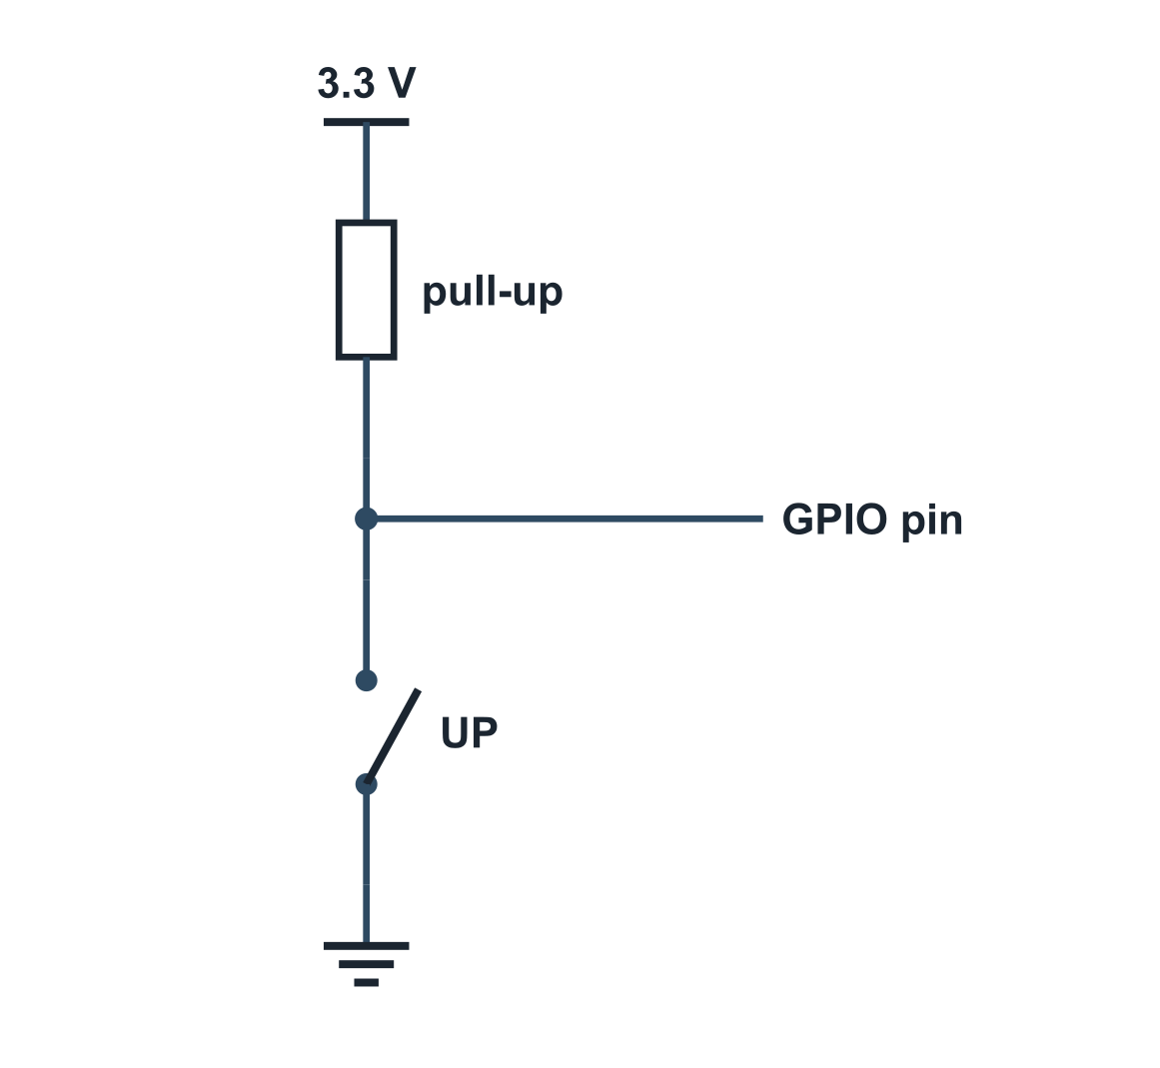
From finger to bit
UNDERSTAND NOW · pull-up inputs
Button | Pin | After the runtime | Mask
released | 1 (3.3 V) | bit = 0 | -
LEFT | 0 | bit 0 = 1 | 0x01
RIGHT | 0 | bit 1 = 1 | 0x02
UP | 0 | bit 2 = 1 | 0x04
DOWN | 0 | bit 3 = 1 | 0x08
The pin reads 0 when the button is pressed: active low (Lecture 10)
prg32_input_read inverts and packs: one word, one bit per button, 1 = pressed
UP and RIGHT together give 0x04 OR 0x02 = 0x06
a0 AND 0x04 is zero if and only if UP is not pressed
Notes:
The path of a button, recapitulated from Lecture 10. The pin is held at 3.3 V by a pull-up resistor; pressing the button connects it to ground, so the pin reads 0 when pressed. The runtime inverts the levels and packs all the buttons into one word, with 1 meaning pressed. The table gives the mask of each direction button. Two consequences are used immediately: UP and RIGHT pressed together give 0x04 OR 0x02, that is, 0x06; and a0 AND 0x04 is zero exactly when UP is not pressed.
UNDERSTAND NOW: pull-up inputs.
For the lecturer: The kit has internal pull-ups of about 45 kilohm; the switches go to ground. The cartridge never sees the electrical level: the runtime gives the same word on the board, on QEMU and on PRG32-QT.

Slide 7
The U-turn rule, as a truth table
UNDERSTAND NOW · Boolean algebra
dir | want | dir XOR want | = 2 ? | Decision
0 RIGHT | 0 RIGHT | 00 | no | go on
0 RIGHT | 1 DOWN | 01 | no | turn
0 RIGHT | 2 LEFT | 10 | yes | refuse: U-turn
0 RIGHT | 3 UP | 11 | no | turn
1 DOWN | 3 UP | 10 | yes | refuse: U-turn
3 UP | 2 LEFT | 01 | no | turn
Six of the sixteen rows. The rule is one XOR and one comparison with the constant 2.
Notes:
The rule expressed as a truth table, of which six of the sixteen rows are shown. With the head moving right, a request for RIGHT gives 00 and the head continues; a request for DOWN or UP gives 01 or 11, and the head turns; a request for LEFT gives 10, that is, 2, and is refused. The same holds for DOWN and UP. Completing the table and counting the refusals yields four, one per direction. With arbitrarily chosen codes the same rule would require four separate comparisons: the encoding has absorbed the complexity.
UNDERSTAND NOW: Boolean algebra.
For the lecturer: Sixteen rows in all: ask the students to complete the table and to count the refusals. There are four, one per direction. Without the careful encoding the rule would need four comparisons.

Slide 8
Catch the U-turn rule at work
USE NOW · the PRG32-QT debugger
1
Run the cartridge in debug mode and press Update: the listing shows verm1_update
2
Look at the telemetry while you hold a button: the input mask shows 0x04 for UP, 0x01 for LEFT
3
Find the instruction xor t3, t2, t1 and click in the gutter: a breakpoint
4
Hold LEFT while the head goes right, and press Resume: the program stops on the xor
5
Read the registers: t1 is 0, the direction; t2 is 2, the wish
6
Press Step: t3 becomes 2. Step twice more: the branch is taken and the sw is skipped
Notes:
The cartridge is run in debug mode with verm1_update displayed. First, the telemetry is observed while a button is held: the input mask reads 0x04 for UP and 0x01 for LEFT. A breakpoint is then set on xor t3, t2, t1. Holding LEFT while the head moves right and resuming, the program halts on the XOR. The registers read t1 = 0, the direction, and t2 = 2, the request. One step makes t3 equal to 2; two further steps show the branch taken and the sw skipped. The rule is thus observed operating on actual values.
USE NOW: the PRG32-QT debugger (used, not studied, in this course).
For the lecturer: Lower the speed of the debugger to 0.25x if you need time to press. Resume ignores the current breakpoint once: each Resume runs one frame. Without a button pressed t2 is the old wish and t3 is 0.

Slide 9
What you read in the registers
USE NOW · the PRG32-QT debugger
You hold | a0 (mask) | t1 = dir | t2 = want | t3 = t2 XOR t1 | Stored?
nothing | 0x00 | 0 | 0 | 0 | yes: 0
DOWN | 0x08 | 0 | 1 | 1 | yes: 1
LEFT | 0x01 | 0 | 2 | 2 | no: U-turn
UP | 0x04 | 0 | 3 | 3 | yes: 3
UP + RIGHT | 0x06 | 0 | 3 | 3 | yes: 3
Notes:
The expected register contents, with the head moving right. With nothing pressed, the request is the previous one and the XOR is 0. With DOWN it is 1, with UP 3, and both are stored. With LEFT it is 2, the U-turn, and nothing is stored. The last row reveals the priority among the tests: with UP and RIGHT together UP prevails, because it is tested last. a0 must be read at the first instruction after the call, since it is overwritten later in the frame, an instance of the caller-saved convention studied in Lecture 18.
USE NOW: the PRG32-QT debugger (used, not studied, in this course).
For the lecturer: All with the head going right. The last row shows the priority of the tests: UP is tested last and wins. a0 is overwritten later in the frame: read it at the first instruction after the call.

Slide 10

Read the variables in memory
USE NOW · the PRG32-QT debugger
After la t0, dir the register t0 holds the address of dir: type it in the Memory field
The variables follow each other, 4 bytes each, in the order of the file
From the address of dir
– +0 dir, +4 want, +8 step_q8
– +12 score, +16 food_x, +20 food_y
Eat once, pause, and read score: 01 00 00 00
Read food_x and food_y, and check them against the screen: column and row of the red cell
PRG32-QT: listing, registers, memory
Notes:
The variables can also be read in memory. After la t0, dir, t0 holds the address of dir, which is entered in the Memory field. The variables follow one another in the order of the file, four bytes each: dir, want, step_q8, score, food_x, food_y. After the worm has eaten once, the program is paused and the score read: 01 00 00 00, least significant byte first. The position of the food is then read and compared with the red cell on the screen, closing the loop between memory and display.
USE NOW: the PRG32-QT debugger (used, not studied, in this course).
For the lecturer: head_x and head_y are the two words before dir. Little-endian: the lowest byte comes first.

Slide 11
Check your understanding
The player holds DOWN and RIGHT together: prg32_input_read returns
1
0x02
0x08
A
B
0x0a
0x10
C
D
The worm goes UP (3). Which wish is refused?
2
RIGHT (0)
DOWN (1)
A
B
LEFT (2)
UP (3)
C
D
Notes:
For the first question: one bit per button, DOWN being 0x08 and RIGHT 0x02. Pressed together, both bits are 1, so the value is the OR of the two masks.
For the second, the rule is applied: the refused request is the one whose XOR with the current direction is 2. The direction is 3, 11 in binary; the question is which code differs from it in bit 1 alone.
For the lecturer: 1. Answer: C. 0x08 OR 0x02 = 0x0a: one bit per button.
2. Answer: B. 3 XOR 1 = 2: DOWN is the opposite of UP.

Slide 12
Check your understanding
Why slli t1, t1, 2 before adding to the address of dx?
1
to make the code positive
each entry of the table is 4 bytes
A
B
to clear bit 1
tables start at address 4
C
D
xor t1, t1, t4 gives zero exactly when
2
t1 is zero
t4 is zero
A
B
t1 and t4 are equal
t1 and t4 are opposite
C
D
Notes:
For the first question: the tables consist of words, and a word is four bytes. Entry k lies at 4k bytes from the start of the table, and a left shift by 2 multiplies by 4.
For the second: XOR yields 1 in each position where the two bits differ, so a result of all zeros means that no position differs, which is to say the two values are equal.
For the lecturer: 1. Answer: B. The entries are words: entry k is at offset 4k.
2. Answer: C. XOR is 1 where bits differ: no difference, all zeros.

Slide 13
Where we are, and what comes next
The player is in the game: a wish, a rule, a movement, a reward
Bits and masks, XOR as a comparator, a table as a selector: logic turned into instructions
Missing: the worm has no body, nothing can go wrong, and the game never ends
Lectures 13 to 16 give the tools: state machines, registers, memory as an array, what survives power-off
Part 3: a body that grows, collisions, a title screen and a game over
Notes:
The current position. The player is now in the game: a request, a rule, a movement, a reward. The logic of four lectures has become instructions: bits and masks, XOR as a comparator, a table as a selector. Yet the worm has no body, nothing can go wrong, and the game never ends. The next block, on state and memory, supplies the necessary concepts, and Part 3 adds a growing body, collisions, a title screen and a game-over screen.
Learning status, recap. UNDERSTAND NOW: bit masks; codes; arrays in memory; pull-up inputs; Boolean algebra; fixed point; multiplexers; signed or unsigned instructions; comparators and parity; arguments in a0 to a7. USE NOW: the calling convention (Lecture 18) and, used without being studied in this course, the PRG32 tools, the PRG32 runtime calls, the PRG32-QT debugger. UNDERSTAND LATER: nothing. A slide without a badge is context: a story, an example, a question, an exercise. Closing thread: Every rule of the game became a few logic instructions: a mask, an XOR, a comparison. Next: circuits that remember, and the states of a game. Exit ticket (two to four minutes, alone, on paper): 1. Directions are coded RIGHT 0, DOWN 1, LEFT 2, UP 3. The worm goes RIGHT and the player pushes LEFT. What does xor t3, t2, t1 give, and what does the code do with it?
For the lecturer: Reference file for this part: verm1/verm1_part2.S (231 lines).

