Slide 1




UNDERSTAND NOW
USE NOW
UNDERSTAND LATER
Lecture deck. The listings, the complete program and how to test it are in the code deck:
22-Computer_Architecture-Verm1_Part_4-Lab.pptx
ARC12 COMPUTER ARCHITECTURE · LECTURE 22
Verm1, Part 4: The Finished Game
The machine enters the game: division for the digits, levels, sound, and a screen drawn only where it changes
“Premature optimization is the root of all evil.”
Donald Knuth, 1974
Prof. Raffaele Montella, PhD
University of Naples “Parthenope” · A.Y. 2026/27
raffaelemontella.it · raffaele.montella@uniparthenope.it
Verm1 reference implementation contributed by Giuseppe Coviello
Notes:
The fourth and final tutorial completes Verm1. At the end of Part 3 the game was complete in its rules; today it becomes complete as a program. The score is written in decimal digits, the worm accelerates, there are two sounds, and the screen is redrawn only where it changes. Knuth's sentence on the cover justifies the order of the work: first the game was made correct, and only now, with a measurement in hand, is it made fast. Optimisation without measurement is guesswork, and the tutorial ends by measuring the effect of its own changes.
Learning status: UNDERSTAND NOW, by the end of this lecture you explain it, trace it and apply it on your own; USE NOW, you follow and use the recipe today; how it works inside is explained later, or is not part of the course; UNDERSTAND LATER, recognise the name and what it is for; a later lecture explains it. A slide without a badge is context: a story, an example, a question, an exercise.
Learning status of this lecture. UNDERSTAND NOW: quotient and remainder; characters and strings; fixed point; the calling convention; arrays in memory; finite-state machines; the frame buffer; the processor cycle. USE NOW: the PRG32 tools, the PRG32-QT debugger (used, not studied, in this course). UNDERSTAND LATER: nothing. A slide without a badge is context: a story, an example, a question, an exercise.
Roadmap. Today's outcomes: (1) turn a number into decimal digits with divu and remu; (2) draw only what changed, with a dirty flag; (3) finish the game: levels, sound, speed. Builds on: characters and strings (Lecture 04); fixed point (Lecture 06); the calling convention (Lecture 18); arrays in memory (Lecture 04); finite-state machines (Lecture 13). Next: Lecture 23, Verm1 on the Cartridge Store.
For the lecturer: Fourth project tutorial. It uses Lectures 18 to 21: the registers by convention, the stack, multiplication and division (18), the processor cycle and the cost of an instruction (19), the frame buffer and what drawing costs (20), input, sound and the runtime as the owner of the devices (21). The reference file is verm1/verm1_part4.S. Knuth's sentence is the right motto: the game was made to work in Part 3, and only now, with a measure in hand, do we make it fast.

Slide 2
What you will have by the end
1
The score and the best score written in digits, converted by your own division by ten
2
A worm that goes faster as the score grows, up to a limit
3
Two sounds: a short note for a meal, a long low one for the end
4
A draw function that touches a handful of cells per step instead of the whole screen
5
The finished Verm1, ready to be packaged in Lecture 23
Notes:
Five outcomes. The score and the best score displayed in digits, converted by a division by ten written by the student. A worm that accelerates as the score grows, up to a limit. Two sounds, one for a meal and one for the end of the game. A draw function that touches a handful of cells per step instead of the whole screen. And a finished game, ready to be packaged and published in the next lecture.

Slide 3
What Part 4 takes from the lectures
From | Idea | Where it appears today
Lecture 18 | the calling convention: a, t, s registers, ra, the stack | small functions with contracts; leaf functions
Lectures 05, 06 | divu and remu (unsigned), the M of RV32IMAC: quotient and remainder | the digits of the score
Lecture 19 | the processor cycle: every instruction costs time | the measure before and after step 4
Lecture 20 | the screen is memory: writing pixels is the cost | draw only what changed
Lecture 21 | devices belong to the runtime: we ask, it does | prg32_audio_note, with a duration
Notes:
The ideas of the last block of lectures, and where they appear today. The calling convention of Lecture 18 becomes small functions with explicit contracts, some of them leaves. The M extension, whose unsigned division and remainder divu and remu were met in Lectures 05 and 06, yields the digits. The processor cycle of Lecture 19 reminds us that every instruction costs time, hence the measurement. The screen as memory, from Lecture 20, suggests redrawing only what has changed. And from Lecture 21: the devices belong to the runtime, from which a note of a given duration is requested.
For the lecturer: Lecture 04 comes back too: a digit becomes a character by adding 48, the ASCII code of '0'.

Slide 4
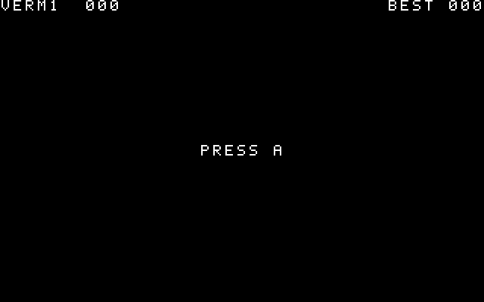
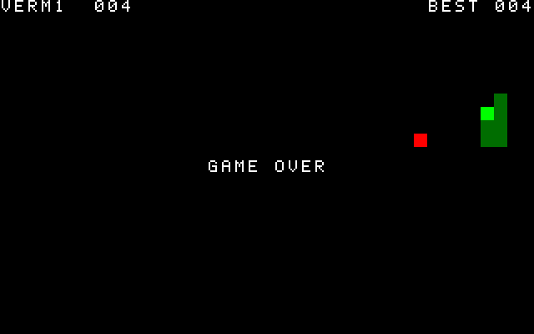
Where you are going
TITLE, with the best score
PLAY: the score in digits
OVER
Start from a Part 3 that runs; if yours does not, copy verm1_part3.S. Today has four steps, and the program runs after each one.
Notes:
The destination: the title screen with the best score, the game with the score in digits, and the game-over screen. The session begins from a working Part 3; a student whose file does not run copies the reference file. There are four steps of code today, and the program is run after each one.
For the lecturer: Screenshots produced by tools/tests/verm1_check.py with a scripted player.

Slide 5
A number is not its digits
UNDERSTAND NOW · quotient and remainder
score holds a binary number: 137 is 0x89, one byte
The screen wants three characters: '1', '3', '7', that is the bytes 0x31, 0x33, 0x37
137
Divide by ten, three times
– 137 / 10 = 13, remainder 7: the units
– 13 / 10 = 1, remainder 3: the tens
– 1 / 10 = 0, remainder 1: the hundreds
0x89 in memory; 0x31 0x33 0x37 on the screen
The digits come out from the right: store them from the last character to the first
A digit d becomes a character by adding 48: the ASCII code of '0'
Notes:
The variable score holds a binary number: 137 is the byte 0x89. The screen requires three characters, the bytes 0x31, 0x33 and 0x37. The conversion is the repeated division of Lecture 05: dividing by ten, the remainder is a digit, and the procedure is repeated on the quotient. The digits emerge from the right, units first, so they are stored from the last character to the first. A digit becomes a character by adding 48, the ASCII code of the character zero, as Lecture 04 established. The distinction between a number and its representation, a theme of the whole course, is here made operational.
UNDERSTAND NOW: quotient and remainder.
For the lecturer: The conversion of Lecture 05, done by the program instead of by hand. remu gives the remainder, divu the quotient: two instructions of the M extension.

Slide 6
The levels, in numbers
UNDERSTAND NOW · fixed point
Score | Speed (1/256 cell per frame) | Frames per step | Cells per second at 30 fps
0 | 32 | 8 | 3.75
4 | 48 | 5.3 | 5.6
8 | 64 | 4 | 7.5
12 | 80 | 3.2 | 9.4
16 and more | 96 | 2.7 | 11.25
Fractions of a frame are real: at 48/256 the steps come every 5 or 6 frames, 5.33 on average.
Notes:
The levels, quantified. For each score the table gives the speed, the frames per step, which is 256 divided by the speed, and the cells per second at thirty frames per second: from 3.75 cells per second at the start to 11.25 from sixteen points onwards. The frames per step are not always integers, and this is not a problem: at a speed of 48 the steps occur every five or six frames, 5.33 on average. This fine gradation is precisely what fixed-point representation provides, and no integer speed could achieve it.
UNDERSTAND NOW: fixed point.
For the lecturer: 256 divided by the speed gives the frames per step; the frame rate times the speed divided by 256 gives the cells per second. Ask the students for the row of score 2.

Slide 7
What does a frame cost?
UNDERSTAND NOW · the frame buffer
Part 3 clears 64 000 pixels and redraws the title, the score, the whole worm and the food: thirty times per second
64 000
Between two steps nothing on the screen changes, and a step changes very little
One step changes at most
– the cell the tail left: black
– the old head: now body
– the new head, and perhaps the food and the score
pixels per frame in Part 3; a few hundred per step in Part 4
So: remember what changed, and draw only that
The picture stays on the screen by itself: the frame buffer is memory
Notes:
What does a frame of Part 3 cost? It clears 64,000 pixels and redraws title, score, worm and food, thirty times per second. Yet between two steps nothing on the screen changes, and a step changes very little: the cell vacated by the tail, the old head that becomes body, the new head, and occasionally the food and the score. The solution is to record what changed and draw only that. It works because the frame buffer is memory, in which the picture persists by itself, the property established in Lecture 20.
UNDERSTAND NOW: the frame buffer.
For the lecturer: Lecture 20: the screen is an array of pixels that keeps its content. A worm of 200 cells costs 200 rectangles per frame in Part 3 and three per step in Part 4. This is what the old home computers did, because they had no choice.

Slide 8
Before and after, with numbers
UNDERSTAND NOW · the processor cycle
USE NOW · the PRG32-QT debugger
1
Run the finished game in debug mode and start a game
2
Read the telemetry during ten seconds of play: retired instructions, frames per second, late frames
3
Compare with the numbers you wrote down for Part 3 at the start of this lecture
4
Let the worm grow to twenty cells in both versions and read again: one number grows with the worm, the other does not
5
Put a breakpoint on the first instruction of draw_changes: it stops once per step, not once per frame
6
Write the four numbers in your notes: they go in the description of the game in Lecture 23
Notes:
Six actions. The finished game is run in debug mode and a game started. The telemetry is read for ten seconds and compared with the figures for Part 3 recorded at the start of the session. The worm is grown to twenty cells in both versions and the telemetry read again: in one version the cost grows with the length of the worm, in the other it does not. A breakpoint on draw_changes confirms that it halts once per step. The figures are recorded, since they belong in the description of the game, and they constitute the evidence that the optimisation was worthwhile.
UNDERSTAND NOW: the processor cycle. USE NOW: the PRG32-QT debugger (used, not studied, in this course).
For the lecturer: The telemetry counts the instructions of the cartridge, not those of the runtime that fills the rectangles, so the real saving on the board is larger than the count shows: there every pixel also travels over SPI to the display. Do not quote numbers to the students: let them measure.

Slide 9

Follow a call with the debugger
UNDERSTAND NOW · the calling convention
USE NOW · the PRG32-QT debugger
Break on call to_decimal inside draw_score and read a0, a1, ra and sp
Step once: the PC jumps into to_decimal, and ra now holds the address of the instruction after the call
Step through: only t registers and a0 change; sp never moves. A leaf function
At ret the PC takes the value of ra: you are back in draw_score
Now do the same with call draw_text: sp goes down by 16, ra is stored at 12(sp), and comes back
PRG32-QT: listing, registers, memory
Notes:
A procedure call followed in the debugger. Execution halts on the call to to_decimal, and a0, a1, ra and sp are read. One step: the PC jumps into the function and ra holds the address of the instruction following the call. Stepping on, only temporaries change and sp never moves, because the function is a leaf. At ret the PC takes the value of ra. The same procedure with draw_text shows the contrast: sp decreases by 16, ra is stored, and both are restored. The calling convention of Lecture 18 is thus observed instruction by instruction.
UNDERSTAND NOW: the calling convention. USE NOW: the PRG32-QT debugger (used, not studied, in this course).
For the lecturer: The calling convention of Lecture 18, watched instruction by instruction. In the listing call appears as jal, or as auipc followed by jalr, and ret as c.jr ra.

Slide 10
Check your understanding
to_decimal receives a0 = 205. Which bytes does it store, from offset 0 to 2?
1
02 00 05
32 30 35
A
B
35 30 32
cd 00 00
C
D
At which score does the worm take one step every 4 frames?
2
4
8
A
B
16
32
C
D
Notes:
For the first question 205 is converted into three digits, and each digit into its ASCII code by adding 0x30. The order matters: offset 0 holds the hundreds.
For the second: one step every four frames corresponds to a speed of 256 / 4. That value is substituted into the formula of the speed, and the equation solved for the score.
For the lecturer: 1. Answer: B. The characters '2', '0', '5': 0x32, 0x30, 0x35. The units are stored at offset 2.
2. Answer: B. One step every 4 frames is 64/256: 32 + 4 x score = 64, so score = 8.

Slide 11
Check your understanding
dirty is 0 when verm1_draw is called. How many machine instructions does it execute?
1
1
5
A
B
about 50
thousands
C
D
Why can to_decimal do without a stack frame?
2
it is short
it calls no function and uses only a and t registers
A
B
it has no arguments
frames are optional
C
D
Notes:
For the first question the instructions on the shortest path through verm1_draw are counted, remembering that la is a pseudo-instruction that expands into two.
For the second one asks what a stack frame is for: saving ra when a further call is made, and saving the callee-saved registers the function uses. The question is whether to_decimal requires either.
For the lecturer: 1. Answer: B. la is two instructions, auipc and addi; then lw, beqz and ret.
2. Answer: B. A leaf function that touches only caller-saved registers has nothing to save.

Slide 12
Where we are, and what comes next
Verm1 is finished: about six hundred lines of RISC-V assembly, all yours
It began as three functions that return, and grew one runnable step at a time
Every lecture of the course is in it: numbers, logic, state, memory, calls, pixels, devices
A program that only its author can run is half finished
Lecture 23: a name, an icon, credits, a bundle for two architectures, and the Cartridge Store
Notes:
Verm1 is finished: about six hundred lines of RISC-V assembly, every one written by the student. It began as three functions that merely return and grew one runnable step at a time, and every part of the course is present in it: numbers, logic, state, memory, procedure calls, pixels and devices. One thing remains: a program that only its author can run is half finished. The next lecture gives it a name, an icon and credits, and publishes it.
Learning status, recap. UNDERSTAND NOW: quotient and remainder; characters and strings; fixed point; the calling convention; arrays in memory; finite-state machines; the frame buffer; the processor cycle. USE NOW: the PRG32 tools, the PRG32-QT debugger (used, not studied, in this course). UNDERSTAND LATER: nothing. A slide without a badge is context: a story, an example, a question, an exercise. Closing thread: Verm1 is finished: every topic of the course has a line in it. Next: giving it a name, an icon and a place on the Store. Exit ticket (two to four minutes, alone, on paper): 1. to_decimal receives 205. Show how remu and divu by 10 give its three digits, and why it stores the bytes '2', '0', '5' rather than the numbers 2, 0, 5. 2. Why does verm1_draw redraw the map only when dirty is set? What would the player see if update forgot to set it after a step?
For the lecturer: Ask the students to bring their own variant to Lecture 23: the bundle they prepare should be of their game, not of the reference.

