Slide 1



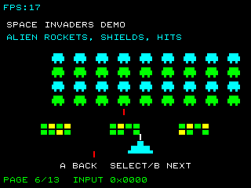
UNDERSTAND NOW
USE NOW
UNDERSTAND LATER
Lecture deck. The listings, the complete program and how to test it are in the code deck:
03-Computer_Architecture-History_of_Computing-Code.pptx
ARC12 COMPUTER ARCHITECTURE · LECTURE 03
History of Computing
From the abacus to an open processor you can program yourself
“printf("Hello, world!");”
Brian Kernighan and Dennis Ritchie, The C Programming Language, 1978
Prof. Raffaele Montella, PhD
University of Naples “Parthenope” · A.Y. 2026/27
raffaelemontella.it · raffaele.montella@uniparthenope.it
Notes:
Last time you ran a RISC-V program. This lecture asks where that machine comes from. It is not a list of dates to memorise: each stage of the story adds one idea, and every one of those ideas is still inside the chip of the PRG32 kit. The quotation on the cover is the most famous first program, from the book that introduced the C language: every programmer since has started by making a machine say hello, as you did with HELLO PRG32.
Learning status: UNDERSTAND NOW, by the end of this lecture you explain it, trace it and apply it on your own; USE NOW, you follow and use the recipe today; how it works inside is explained later, or is not part of the course; UNDERSTAND LATER, recognise the name and what it is for; a later lecture explains it. A slide without a badge is context: a story, an example, a question, an exercise.
Learning status of this lecture. UNDERSTAND NOW: what informatics is; the von Neumann architecture; RISC and an open ISA. USE NOW: the complete program, the PRG32 tools (used, not studied, in this course). UNDERSTAND LATER: Boolean algebra (Lecture 08). A slide without a badge is context: a story, an example, a question, an exercise.
For the lecturer: The students have already run a RISC-V program (Lecture 02). This lecture tells them where that machine comes from: every stage of the story adds one idea that is still inside the ESP32-C6.

Slide 2
What you will be able to do by the end
1
Define informatics and say why it is not the science of computers
2
Place the key machines and people on a timeline, from the abacus to the stored-program computer
3
Name the four units of the von Neumann architecture and find them in the machine you programmed last time
4
Explain what RISC means and why RISC-V is an open instruction set
5
Describe where informatics sits between science, engineering and the economy
Notes:
Five objectives. The first is a definition: what informatics is, and why it is not the science of computers. The second and third are historical: placing the main machines and people on a timeline, and naming the four units of the von Neumann architecture, which you will find again in the machine you programmed. The fourth explains the name of our processor: what RISC means, and why RISC-V is open. The fifth places the discipline between science, engineering and the economy.

Slide 3
A definition
UNDERSTAND NOW · what informatics is
Informatics
The applied science that deals with the treatment of information by means of automated procedures.
Italian informatica, from the French informatique: information automatique
In English: computer science, and increasingly informatics
The tool: elaboratore in Italian, ordinateur in French, computer in English
Notes:
The definition has three parts worth weighing. Applied science: it uses the results of the basic sciences to solve problems. Treatment of information: the object is information, not the machine. Automated procedures: the treatment is done by procedures that can be carried out without human judgement. The Italian word informatica says it directly, from the French information automatique. English prefers computer science, which puts the instrument in the name and creates a misunderstanding. A remark attributed to Edsger Dijkstra corrects it: computer science is no more about computers than astronomy is about telescopes.
UNDERSTAND NOW: what informatics is.
For the lecturer: « L'informatica non riguarda i computer più di quanto l'astronomia riguardi i telescopi. » The Italian form of a remark attributed to Edsger W. Dijkstra: computer science is no more about computers than astronomy is about telescopes.

Slide 4
Two souls, one discipline
UNDERSTAND NOW · what informatics is
Theoretical informatics
Applied informatics
The theoretical foundations of information
Computation at the logical level: what can be computed, and at what cost
Algorithms: a finite set of operations that describe the transformation from A to B
Enabling technologies and information systems
Pervasive: a driver of economic development and of the ICT sector
A STEM discipline at the heart of an industrial revolution
With a social cost to manage: the digital divide
Notes:
The discipline has two souls. Theoretical informatics studies the foundations: what can be computed at all, at what cost, and with which algorithms, where an algorithm is a finite set of operations that transforms A into B. Applied informatics builds the technologies and the information systems that run through the economy and society, with a cost to manage: the digital divide between those who have access and skills and those who do not. This course belongs to both: Boolean algebra is theory, a cartridge is application.
UNDERSTAND NOW: what informatics is.
For the lecturer: The word cloud of the original slide: design, analysis, languages, development, databases, networks, computing, multimedia, web, cloud, apps, IoT, AI, machine learning, mobile, algorithms, embedded, video games, graphics, programming.

Slide 5
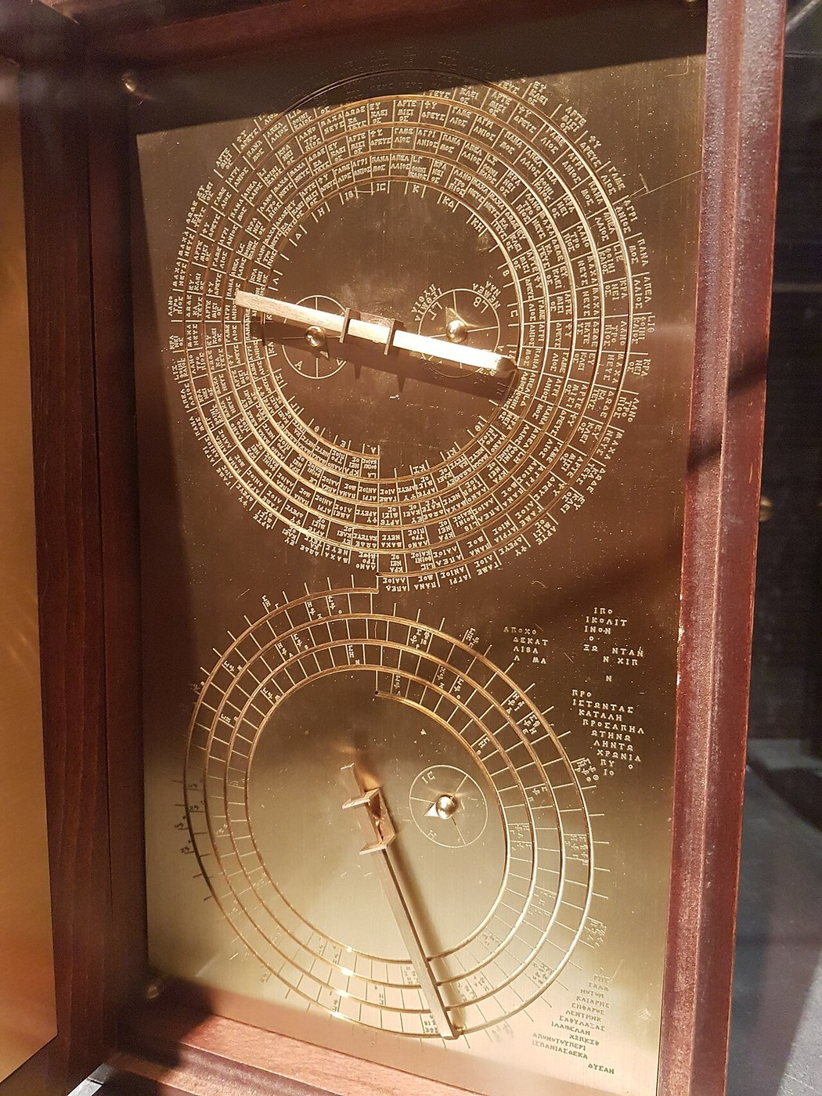
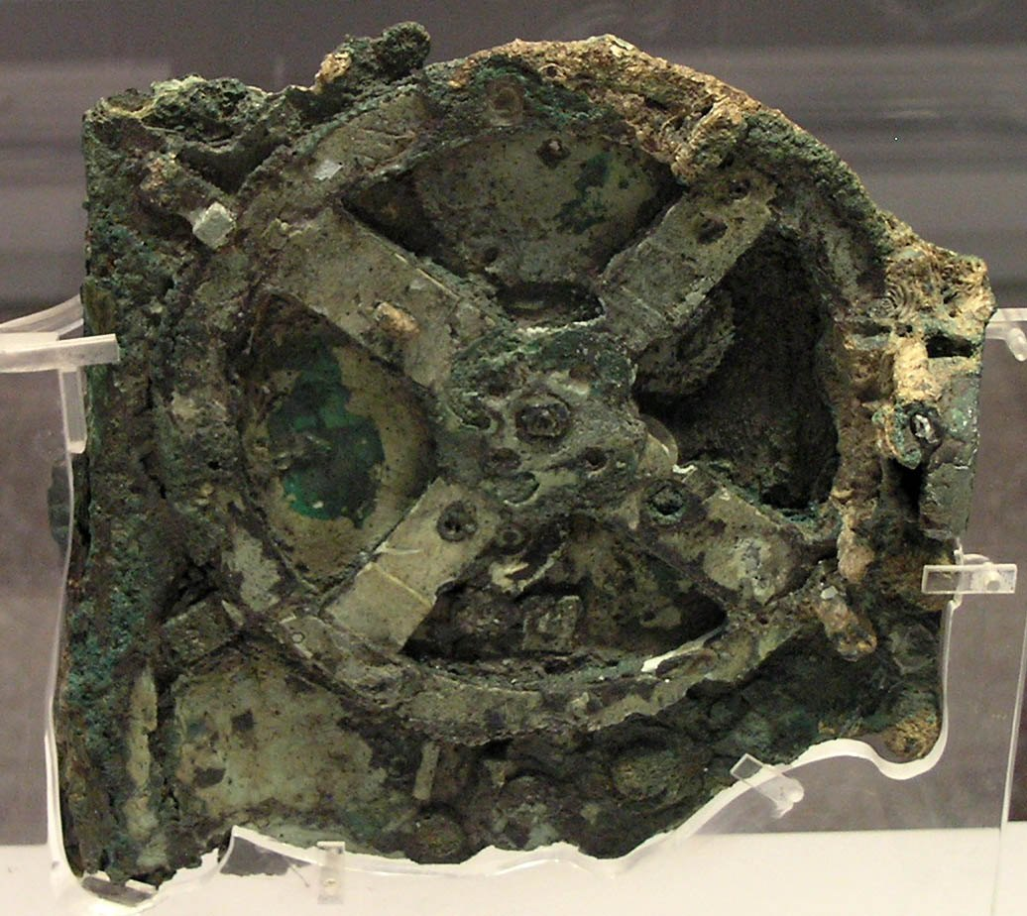
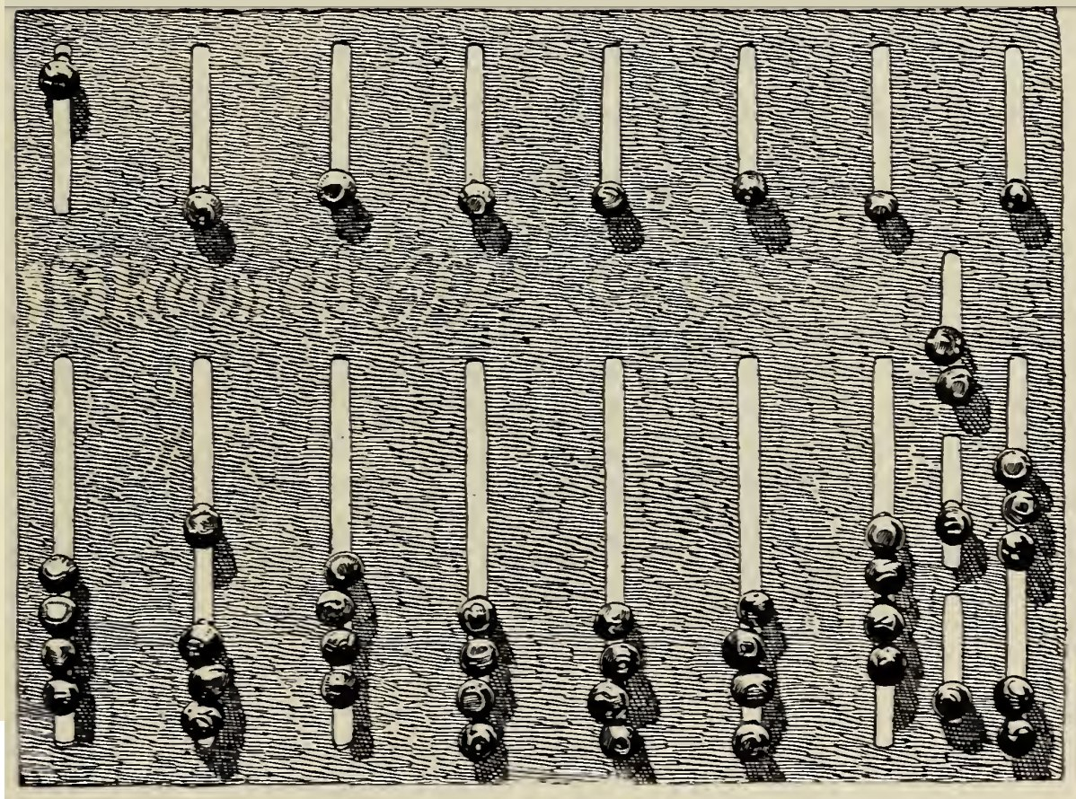
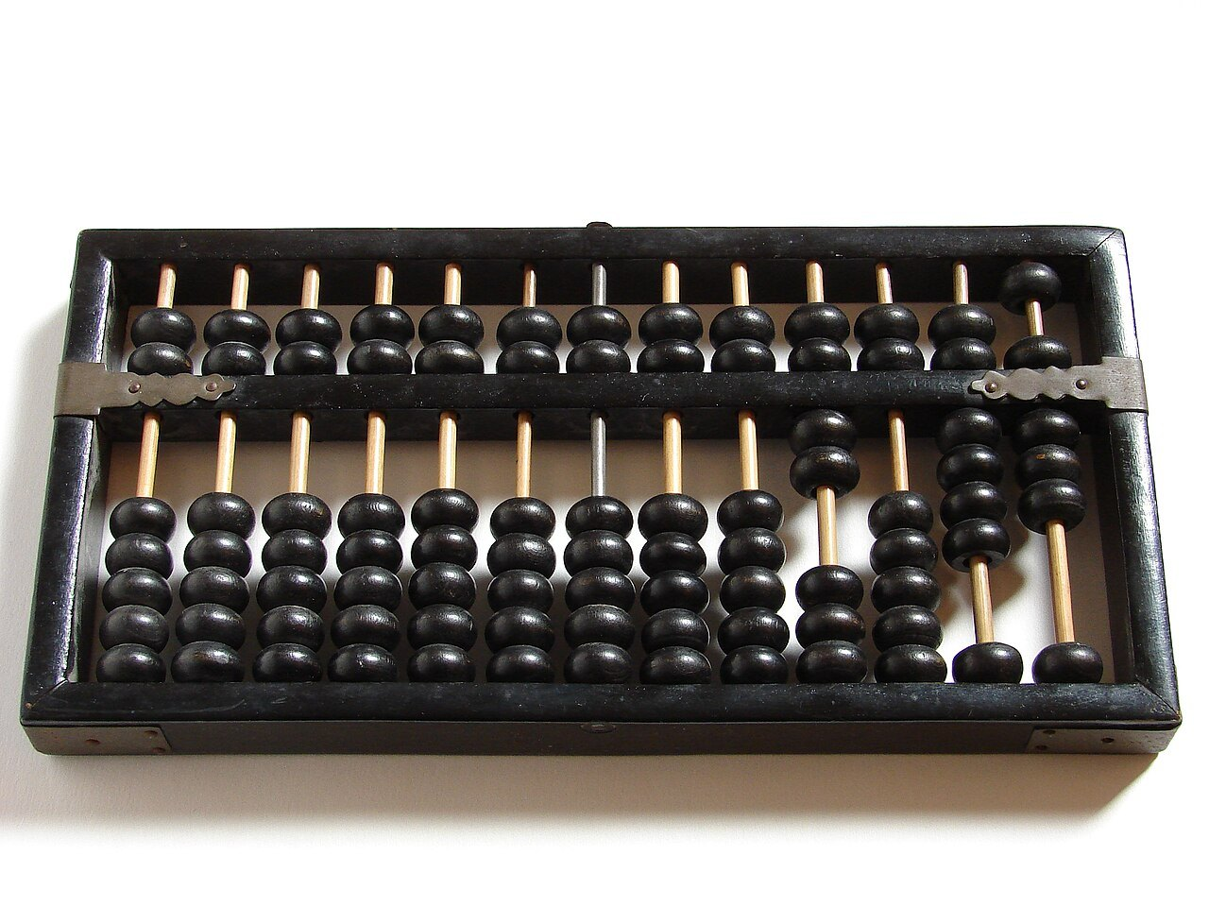
Origins: the abacus and the Antikythera mechanism
Roman hand abacus: a physical representation of data and operations
Chinese suanpan: Babylonians, Chinese, Greeks and Romans all used counting frames
Antikythera mechanism, 2nd-1st century BC: the oldest known geared calculator
A modern model: its dials computed astronomical positions and eclipses
A number becomes a position of beads or the angle of a gear: representation comes before calculation.
Notes:
Two ancient devices. In the abacus, Roman or Chinese, a number is a position of beads: the data are physically represented, and the operations are movements of the hand. The Antikythera mechanism, built in Greece around the second or first century BC, goes further: a train of gears computes the positions of the Sun and the Moon and predicts eclipses. A number is the angle of a wheel, and the calculation is built into the ratios of the gears. Keep the sentence under the pictures: representation comes before calculation.
For the lecturer: The dating of the Antikythera mechanism is debated: most estimates fall between about 205 and 60 BC.
Pictures: Number Stories, p51-illustration.png, David Eugene Smith, Public domain, Wikimedia Commons; Abacus 5.jpg, Loadmaster (David R. Tribble), CC BY-SA 3.0, Wikimedia Commons; NAMA Machine d'Anticythère 1.jpg, Marsyas, CC BY 2.5, Wikimedia Commons; Antikythera mechanism clockface, 1st-2nd century BC, Greece (model).jpg, Gts-tg, CC BY-SA 4.0, Wikimedia Commons.

Slide 6
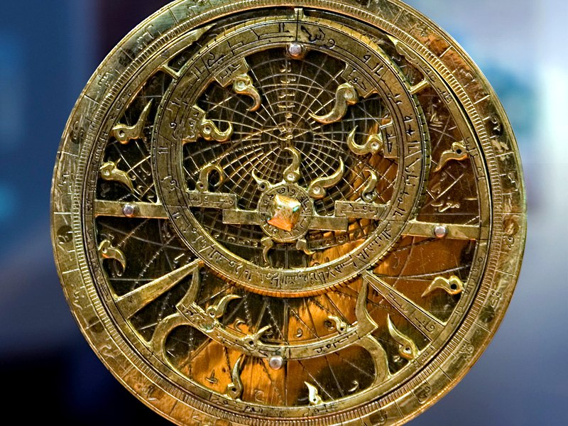
The medieval Islamic world (9th to 13th century)
Astronomical instruments
– the mechanical astrolabe; the torquetum
A contribution to cryptography
– cryptanalysis and frequency analysis (al-Kindi, 9th century)
Programmable machines
– the automatic flute player of the Banu Musa brothers
– the weight-driven clocks and automata of al-Jazari (1206)
The word algorithm comes from the name of al-Khwarizmi, as algebra comes from the title of his book
A brass astrolabe
Notes:
Between the ninth and the thirteenth century the Islamic world contributes instruments, methods and words. Instruments: the astrolabe and the torquetum, for astronomy. Methods: al-Kindi invents frequency analysis, the first systematic technique for breaking a cipher. Machines: the automatic flute player of the Banu Musa brothers and the automata of al-Jazari are driven by sequences that can be changed, an early form of program. And words: algorithm comes from the name of al-Khwarizmi, algebra from the title of his book.
For the lecturer: The source slide dated the period to the 11th-12th century; the people named here span the 9th to the early 13th.
Pictures: Astrolabe planisférique closeup800x600x300.jpg, Pom², CC BY-SA 3.0, Wikimedia Commons.

Slide 7
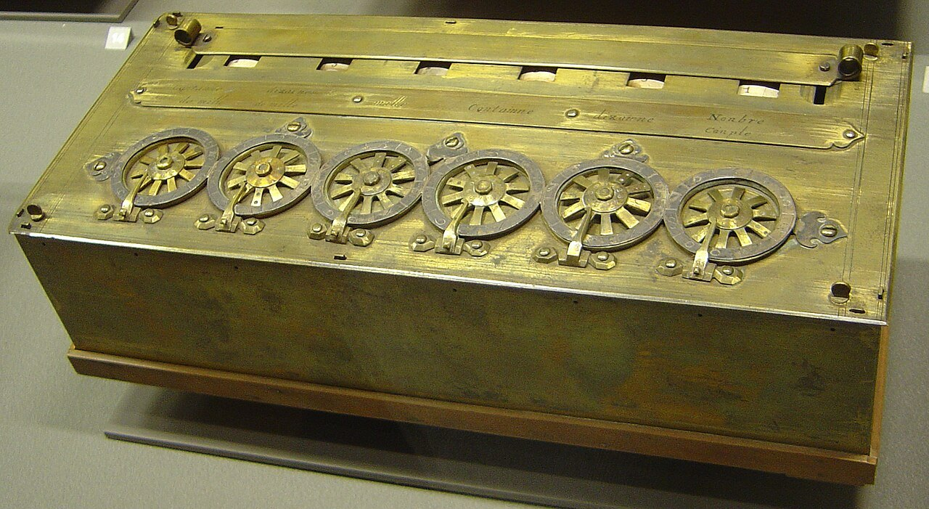
From 1600 to 1800: mechanical calculators and logic
The first mechanical calculators
– logarithm tables (Napier, 1614)
– Blaise Pascal's Pascaline (1642): addition with carry
– Leibniz's stepped reckoner (1673): the four operations
Logic and formal mathematics
– Leibniz describes binary arithmetic (1703)
– George Boole, The Laws of Thought (1854): logic becomes algebra
Programmable machines
– Jacquard's loom (1804): the pattern is stored on punched cards
A Pascaline: each wheel is one decimal digit
Notes:
Two lines of development run in parallel from 1600 to 1800. The first is mechanical calculation: Napier's logarithms, Pascal's machine that adds with an automatic carry, Leibniz's machine for the four operations. The second is logic: Leibniz describes binary arithmetic in 1703, and in 1854 Boole turns logic into an algebra, the one you will study in Lectures 08 and 09. A third thread appears in 1804: Jacquard's loom weaves a pattern stored on punched cards. Change the cards and the same machine does something else.
For the lecturer: Corrections to the source slide: Boole's Laws of Thought is 1854 (not 1864); Leibniz's paper on binary arithmetic was published in 1703.
Pictures: Arts et Metiers Pascaline dsc03869.jpg, David.Monniaux, CC BY-SA 3.0, Wikimedia Commons.

Slide 8
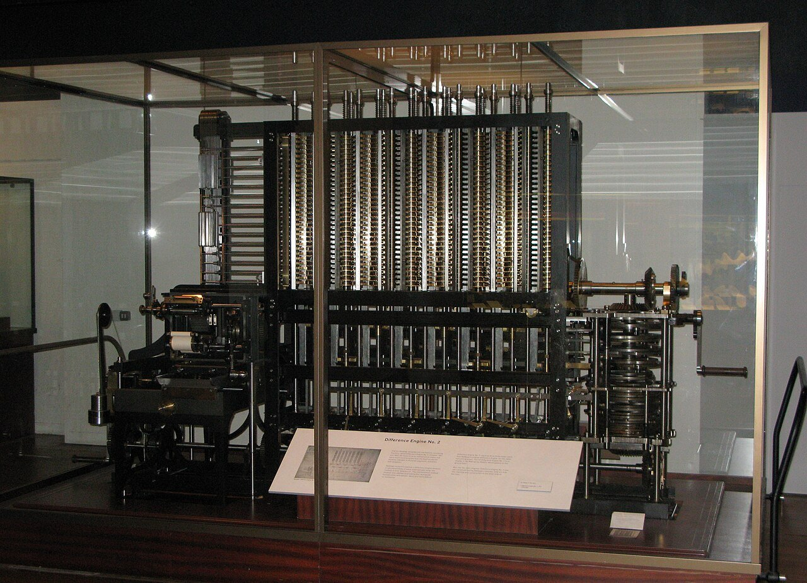
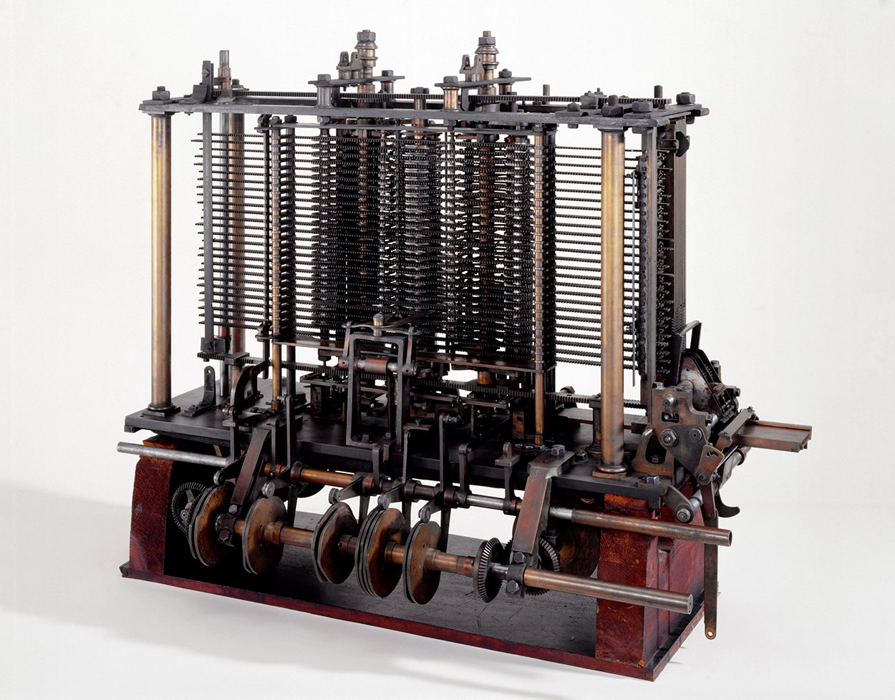
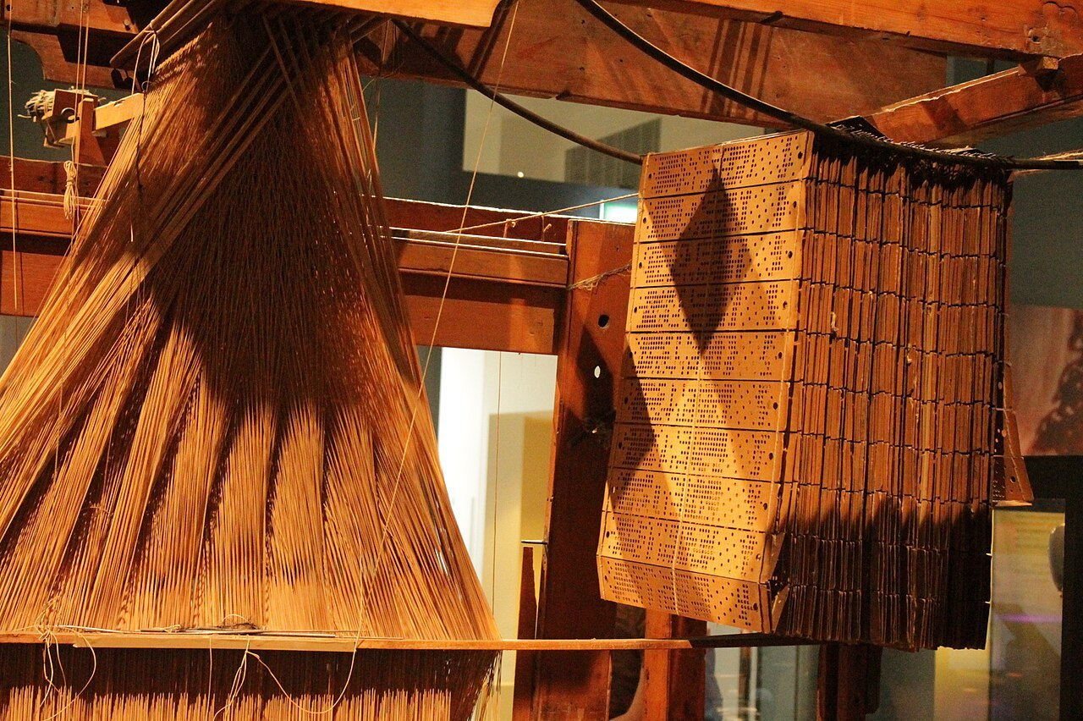
The 1800s: Charles Babbage and Ada Lovelace
Difference Engine: automatic computation of mathematical tables
Analytical Engine: a mill (arithmetic unit), a control unit, a store (memory) and an output device
Programs and data on punched cards, borrowed from the Jacquard loom
Ada Lovelace devised a method for programming the Analytical Engine: she is regarded as the first programmer in history.
Notes:
Charles Babbage designs two machines. The Difference Engine computes mathematical tables automatically. The Analytical Engine is far more ambitious, and its parts have names that should already sound familiar: a mill that does the arithmetic, a control unit, a store that holds numbers, an output device; programs and data arrive on punched cards, as in the loom. It was never completed. Ada Lovelace wrote for it a method to compute Bernoulli numbers, published in 1843: for this she is regarded as the first programmer in history.
For the lecturer: Ada Lovelace's notes on the Analytical Engine (1843) contain what is regarded as the first published program, for computing Bernoulli numbers.
Pictures: Babbage Difference Engine.jpg, geni, CC BY-SA 4.0, Wikimedia Commons; Babbages Analytical Engine, 1834-1871. (9660574685).jpg, Science Museum London / Science and Society Picture Library, CC BY-SA 2.0, Wikimedia Commons; A Jacquard loom showing information punchcards, National Museum of Scotland.jpg, Stephencdickson, CC BY-SA 4.0, Wikimedia Commons.

Slide 9
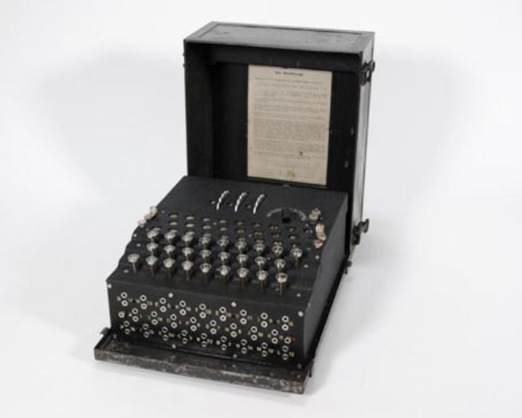
Theory first: Turing, Shannon and Nakajima
UNDERSTAND LATER · Boolean algebra → Lecture 08
Alan Turing
– 1936: an abstract universal machine defines what can be computed
– at Bletchley Park he works on breaking the German Enigma cipher
Akira Nakajima and Claude Shannon
– switching-circuit theory (1930s): Boolean algebra describes circuits of switches
– the principle on which all digital design rests
Konrad Zuse
– Z3 (1941): the first working computer controlled by a program
– shown in 1998 to be Turing-complete
– Z4: one of the first computers to be sold commercially
An Enigma cipher machine
Notes:
The theory comes before the machines. In 1936 Alan Turing defines an abstract machine that can carry out any computation, and with it the very notion of what is computable. In the 1930s Nakajima and Shannon show that Boolean algebra describes circuits made of switches: this is the bridge between logic and electronics on which all digital design rests, and it is the reason why you will study Boolean algebra. In 1941 Konrad Zuse completes the Z3, the first working computer controlled by a program.
UNDERSTAND LATER: Boolean algebra (studied in Lecture 08).
For the lecturer: The Boolean algebra of Lectures 08 and 09 is exactly the Nakajima-Shannon bridge between logic and circuits.
Pictures: Enigma I cipher machine Museum of Communication Berlin cropped.jpg, Museum für Kommunikation Berlin, CC BY 4.0, Wikimedia Commons.

Slide 10
John von Neumann: the stored-program computer
UNDERSTAND NOW · the von Neumann architecture
A hardware architecture for programmable digital computers (EDVAC report, 1945)
Memory
program and data
Program and data share the same memory: a program is data
Four essential units
– control unit: governs the sequence of operations
– arithmetic logic unit (ALU), with its accumulator register
– memory
– input and output
Control
unit
ALU
(accumulator)
Input
Output
The ESP32-C6 you programmed is still a von Neumann machine
Notes:
The central slide of the lecture. In 1945 von Neumann describes an architecture with one decisive idea: program and data are kept in the same memory, so a program is itself data. The diagram shows the four units: the memory, the control unit that governs the sequence of operations, the arithmetic logic unit with its accumulator, and input and output. Now look back at Lecture 02: the ALU executed addi, the memory held both counter and the instruction 0x00130313, the joystick and the display are input and output. The chip of the kit is still a von Neumann machine.
UNDERSTAND NOW: the von Neumann architecture.
For the lecturer: Find the four units in Lecture 02: the registers and the ALU executed addi; memory held counter and the instructions themselves (0x00130313); the joystick and the display are input and output.

Slide 11
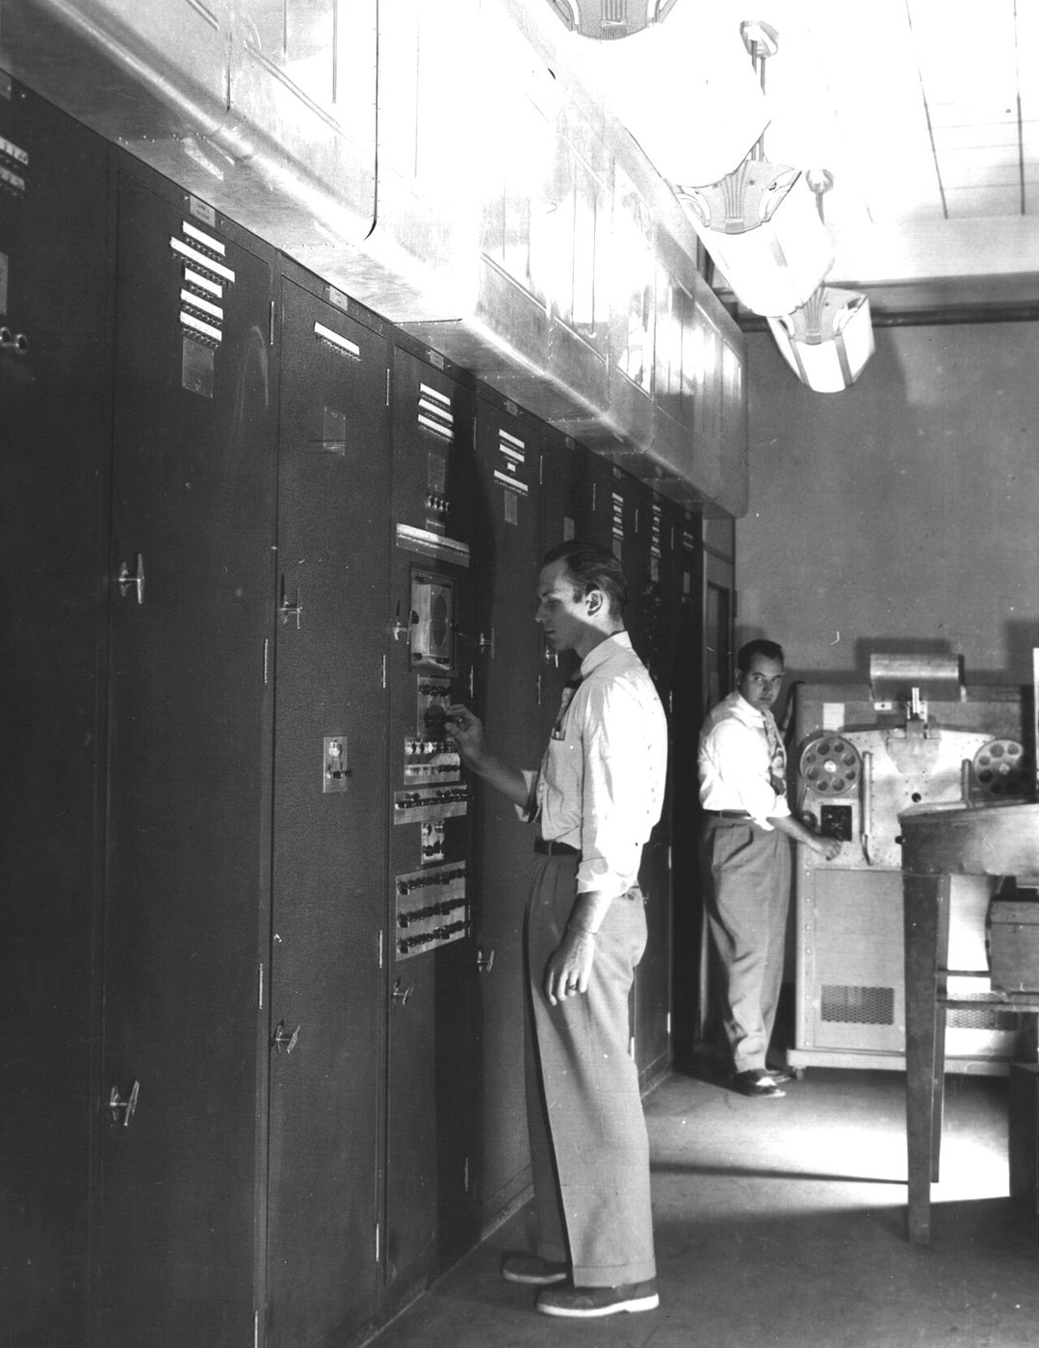
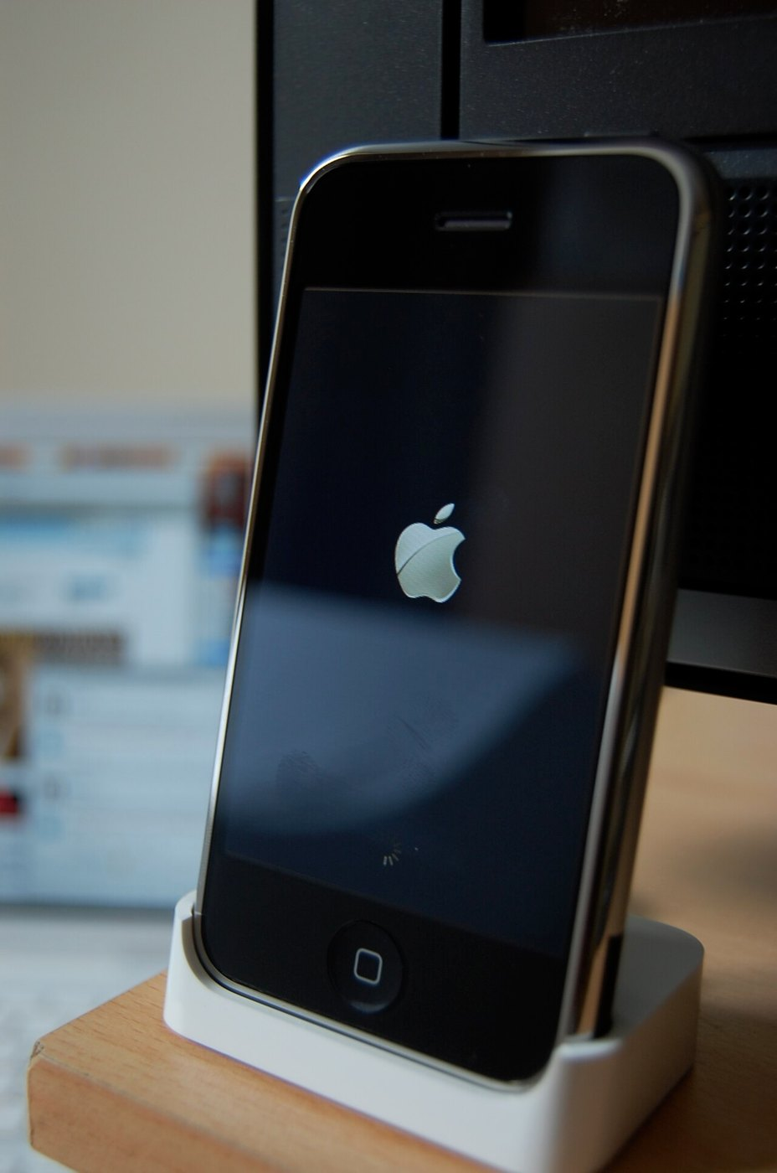
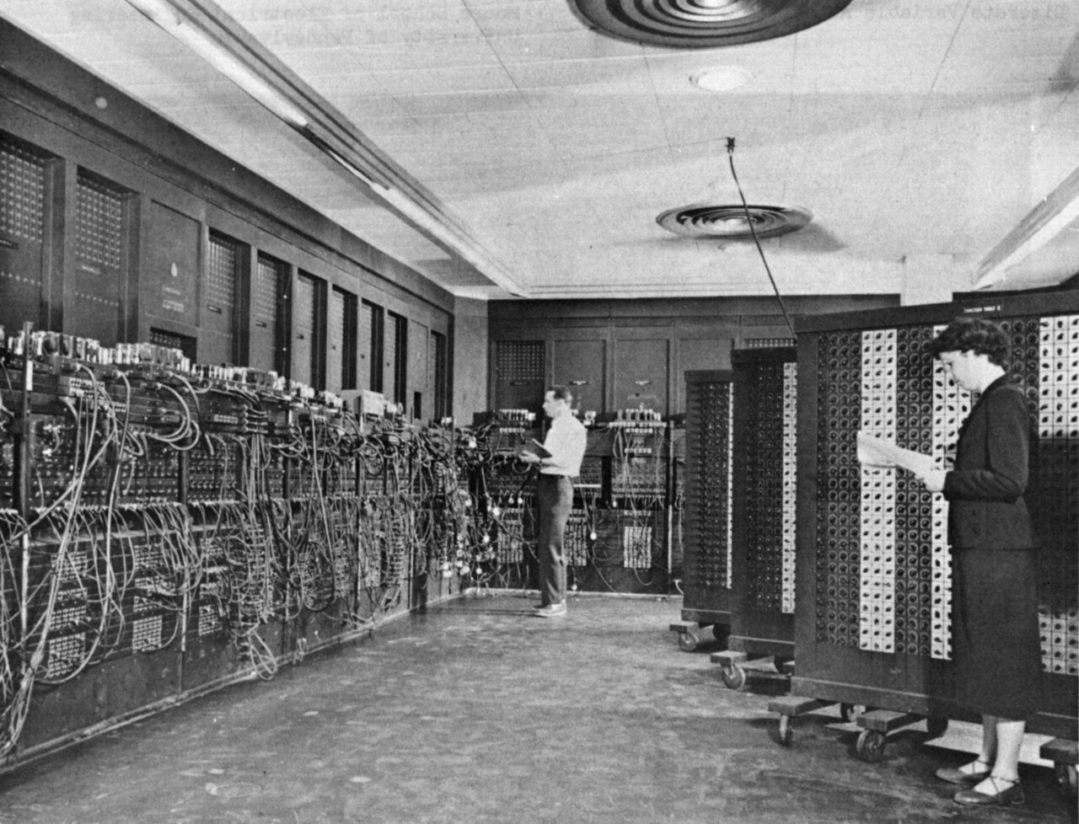
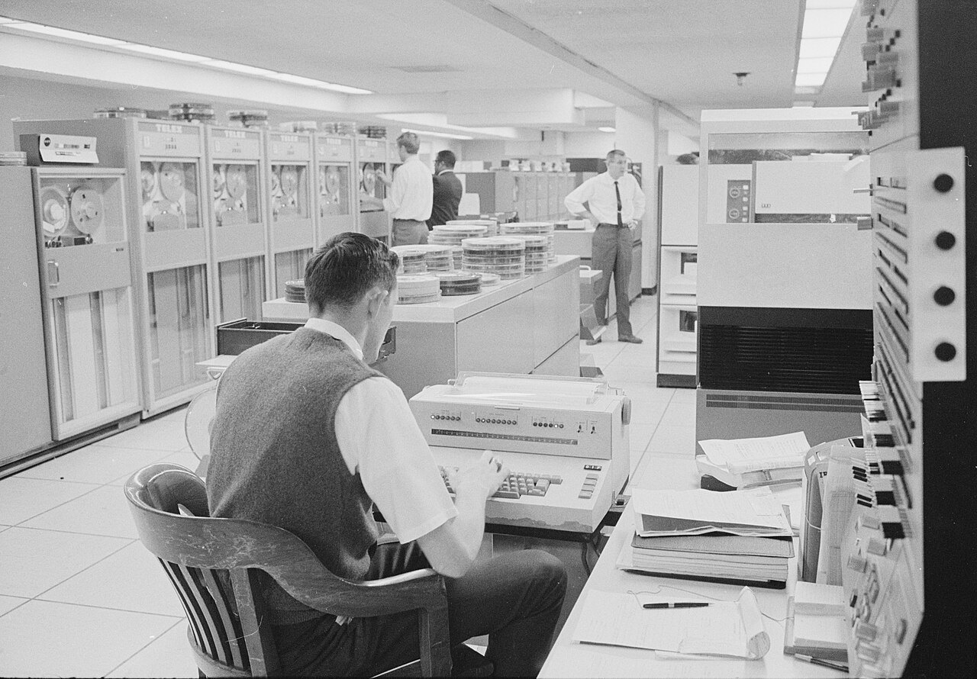
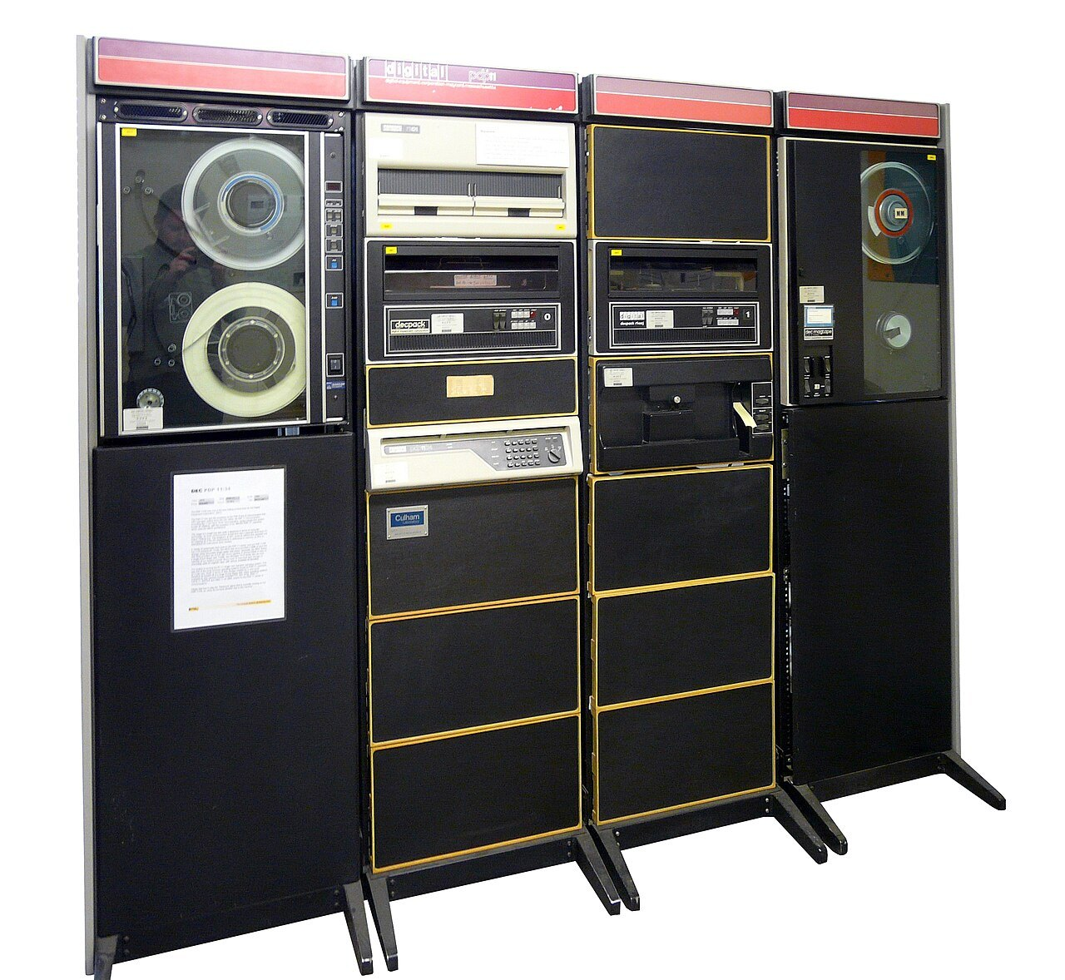
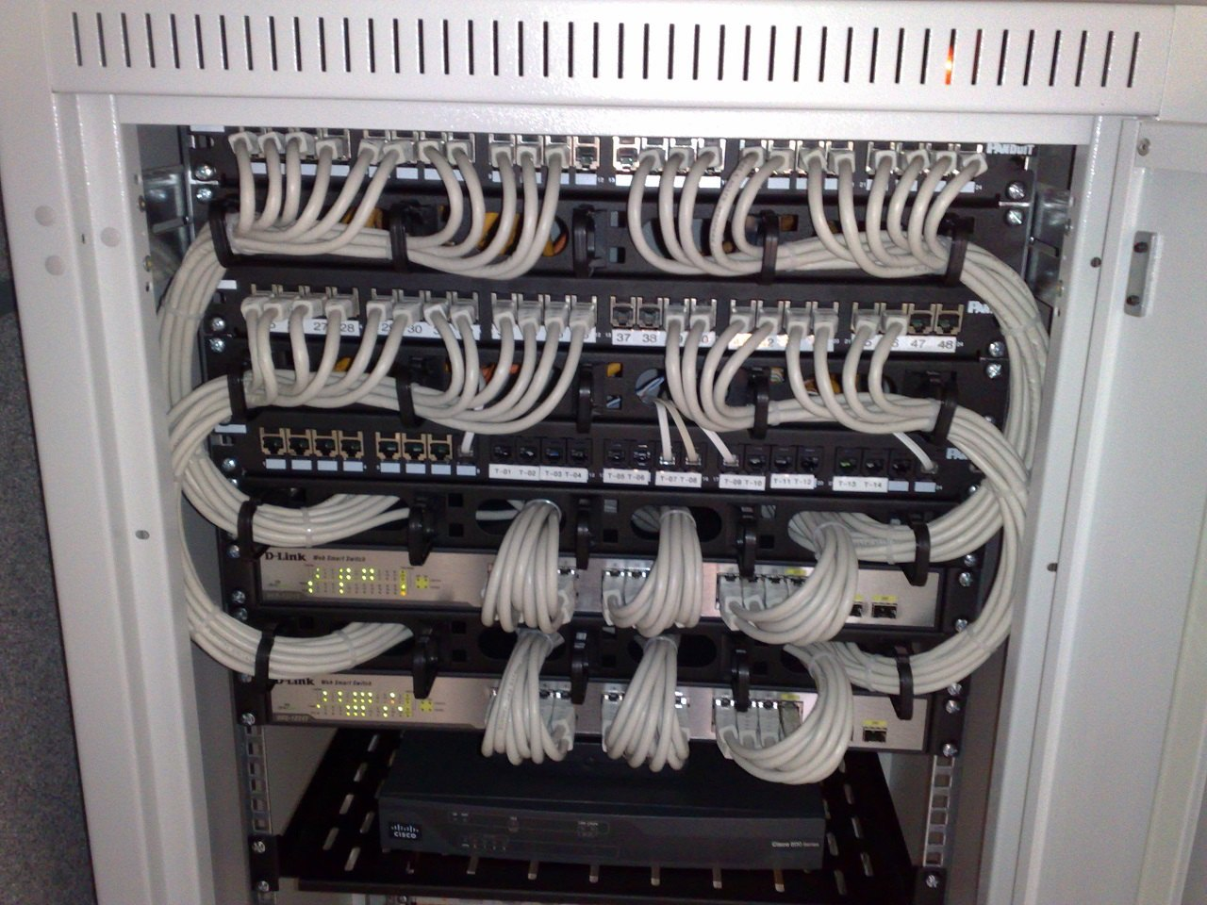
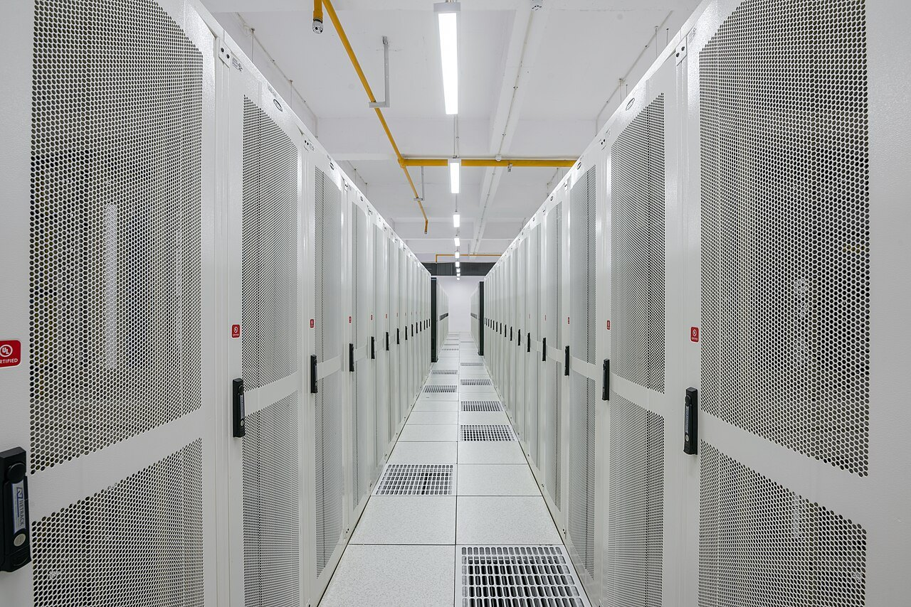
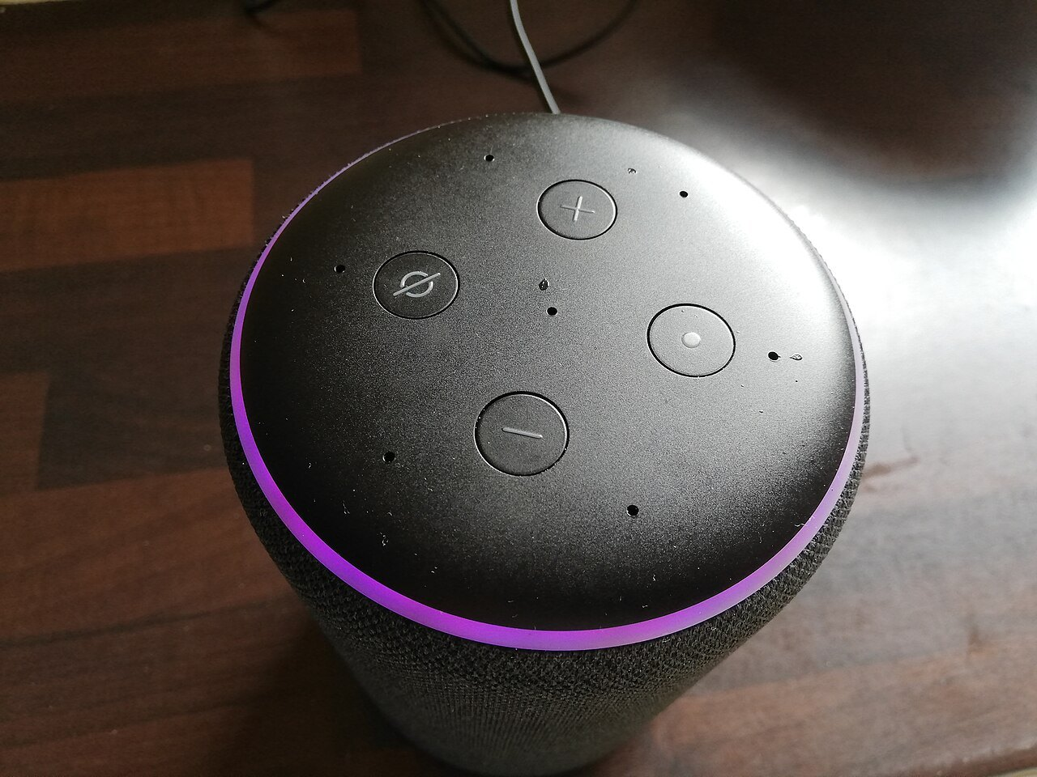
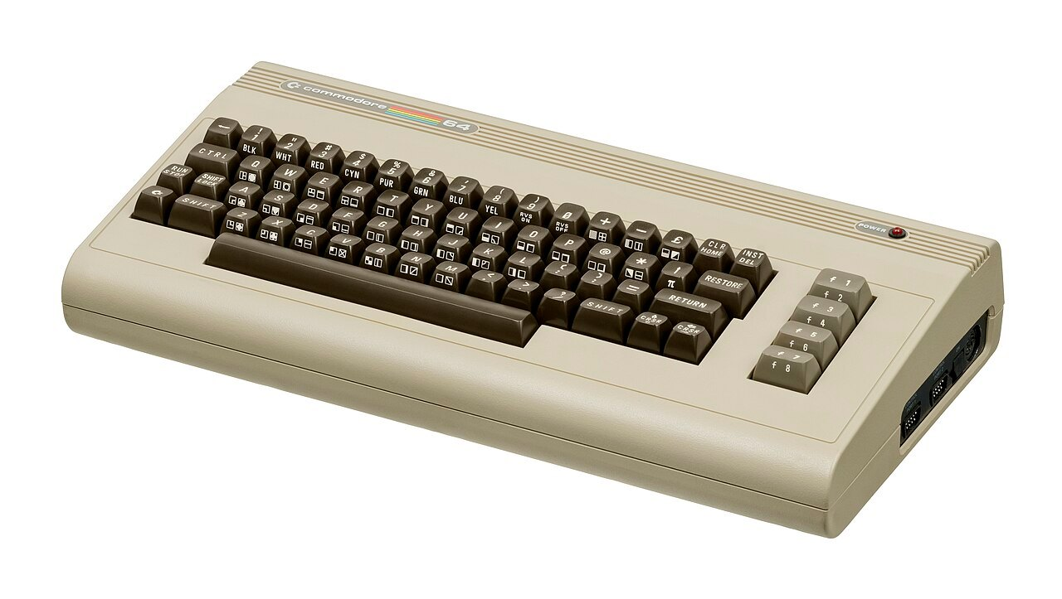
Eight decades of computers
'40
'50
'60
'70
'80
'90
'00
'10
'20
Wartime
Military and government
Mainframe computing
Minicomputers
Personal computing
The Internet
Smartphones and tablets
Cloud computing
IoT and AI
ENIAC, Colossus
EDVAC, 1949
one machine, many users
a computer per department
a computer per person
computers connect
a computer in the pocket
computing as a service
computers everywhere
Each decade made the computer smaller, cheaper and closer to people; none of them changed the stored-program idea.
Notes:
Eight decades in one picture, from the machines of the war to the computers hidden in everyday objects. Read the captions from left to right: one machine for a whole country, then for many users, then one per department, one per person, one in the pocket, and finally computers everywhere. Each decade made the computer smaller, cheaper and closer to people. The sentence at the bottom is the point: none of these steps changed the idea of the stored program.
For the lecturer: 1943-45: ENIAC (USA) and Colossus (UK). 1949: EDVAC (USA). The source slide also showed the Macintosh, the Amiga, the IBM PC, the iPad and a self-driving car: the pictures are in tools/assets if you want to add them.
Pictures: Glen Beck and Betty Snyder program the ENIAC in building 328 at the Ballistic Research Laboratory.jpg, U.S. Army, Public domain, Wikimedia Commons; Edvac.jpg, U.S. Army, Public domain, Wikimedia Commons; Dept of Agriculture Computer Room.jpg, Warren K. Leffler (U.S. News & World Report, Library of Congress), Public domain, Wikimedia Commons; DEC PDP-11 Minicomputer in extended variant (edited).jpg, Loz Pycock, CC BY-SA 2.0, Wikimedia Commons; Commodore-64-Computer-FL.jpg, Evan-Amos, Public domain, Wikimedia Commons; 19-inch rackmount Ethernet switches and patch panels.jpg, Dsimic, CC BY-SA 4.0, Wikimedia Commons; Original iPhone docked.jpg, Andrew from London, UK, CC BY-SA 2.0, Wikimedia Commons; Racks Amravati Data Center.jpg, PiDatacenters, CC BY-SA 4.0, Wikimedia Commons; Alexa Amazon Echo Smart Speaker - Flashing Purple Ring (Creative Commons) (51048330138).jpg, Smart Home Perfected, CC BY 2.0, Wikimedia Commons.

Slide 12
Microprocessors: from CISC to RISC to an open standard
UNDERSTAND NOW · RISC and an open ISA
Year | Milestone | Why it matters
1971 | Intel 4004 | the first commercial microprocessor: 2,300 transistors on one chip
1975 | MOS 6502 | a cheap 8-bit CPU: Apple II, Commodore 64, the home-computer era
1978 | Intel 8086 | the start of x86, a complex instruction set (CISC) still in today's PCs
1980-82 | Berkeley RISC and Stanford MIPS | few, simple, regular instructions run faster: the RISC idea
1985 | ARM1 | RISC for low power: today in nearly every phone
2010 | RISC-V starts at UC Berkeley | the fifth Berkeley RISC design becomes an open instruction set
2015-20 | RISC-V Foundation, then RISC-V International | a shared specification, governed from Switzerland
2023-25 | European Chips Act; the DARE project | RISC-V as a strategy for European technological sovereignty
Notes:
Read the table as a debate between two ways of designing a processor. The first microprocessors, and the x86 family born in 1978, follow the CISC approach: many instructions, some very complex. Around 1980 Berkeley and Stanford show that few, simple, regular instructions make faster machines: this is RISC, a reduced instruction set. ARM applies it to low power in 1985. In 2010 the fifth Berkeley design, RISC-V, takes the further step of making the instruction set an open standard, which Europe now treats as strategic.
UNDERSTAND NOW: RISC and an open ISA.
For the lecturer: RISC = Reduced Instruction Set Computer; CISC = Complex Instruction Set Computer. Patterson and Hennessy received the 2017 Turing Award for the RISC approach. This slide is new with respect to the Italian deck.

Slide 13
Moore's law in one number
1971: the Intel 4004 has 2,300 transistors
Today a laptop processor has tens of billions
x 10,000,000
For fifty years the number of transistors on a chip doubled about every two years
The physical limits are now close: progress comes from better architectures, specialised accelerators and open designs
the growth in transistors per chip from the Intel 4004 (1971) to a current laptop processor
This is why architecture, the subject of this course, matters more than ever
Notes:
In 1971 the Intel 4004 had 2,300 transistors; a laptop processor today has tens of billions, ten million times as many. For fifty years the number doubled about every two years. This is Moore's law, which is an observation about an industry and not a law of nature, and its physical limits are now close. When more transistors no longer come for free, progress must come from better architectures. That is why the subject of this course matters more today than twenty years ago.
For the lecturer: Gordon Moore's observation dates from 1965 (revised in 1975). Do not present it as a law of nature.

Slide 14
The home-computer spirit, on a modern open CPU
 | Commodore 64 (1982), MOS 6510 | PRG32 on ESP32-C6, RISC-V
Word size | 8 bits | 32 bits
Registers | A, X, Y (plus stack pointer, status, PC) | 32 general-purpose registers, x0 to x31
Clock | about 1 MHz | 160 MHz
Address space | 64 KB | 4 GB
Instruction set | 56 instructions, proprietary | about 40 base instructions plus extensions, open standard
Screen | 320 by 200 pixels, 16 colours | 320 by 200 viewport, 256-entry RGB565 palette
You program it by | typing on the machine itself | building a cartridge and uploading it
Same screen size, same immediacy: forty years apart. The 6502 is still fun to explore at skilldrick.github.io/easy6502
Notes:
A comparison across forty years. The Commodore 64 had an 8-bit processor with three registers, a clock of about 1 MHz and 64 KB of memory; the ESP32-C6 has 32 bits, thirty-two registers, 160 MHz and an address space of 4 GB. Yet the screen is the same size, 320 by 200 pixels, and so is the spirit: a machine small enough for one person to understand entirely. The difference that matters to you is in the row of the instruction set: proprietary then, an open standard now.
For the lecturer: The source deck ended with the easy6502 simulator (skilldrick.github.io/easy6502), still a pleasant visit. PRG32 keeps the same immediacy, 320 by 200 included, on the architecture the students will meet in industry.

Slide 15
Where informatics sits
Natural phenomenon
Basic sciences
Applied sciences
Engineering
Economy
a storm forms over the sea
physics and mathematics describe it with equations
informatics turns the equations into algorithms and simulations
supercomputers, networks and sensors run them reliably
forecasts and services reach people and create value
An example from this Department: the weather and marine forecasts of meteo.uniparthenope.it, computed every day on our own high-performance systems.
Notes:
Follow a storm from left to right. It is first a natural phenomenon. Physics and mathematics describe it with equations. Informatics turns the equations into algorithms and simulations. Engineering provides the supercomputers, networks and sensors that run them reliably. The economy receives forecasts and services that have value for people. Informatics is the link in the middle: without it the equations stay on paper. The example is real: the weather and sea forecasts of the Department are computed every day in this way.
For the lecturer: The source slide showed portraits and pictures for each stage (equations, forecast maps, a hurricane, the mobile app).

Slide 16
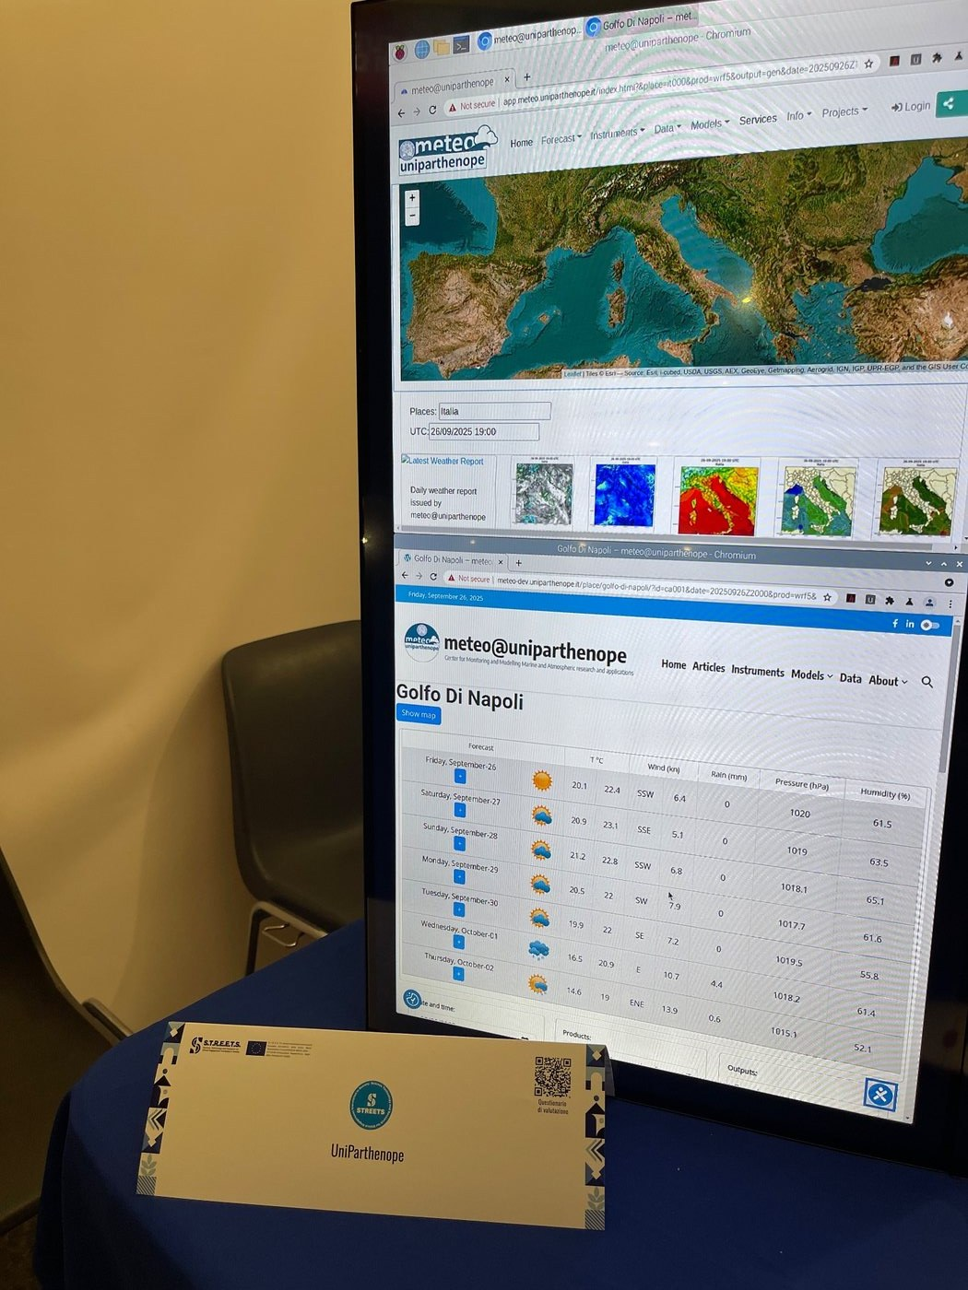
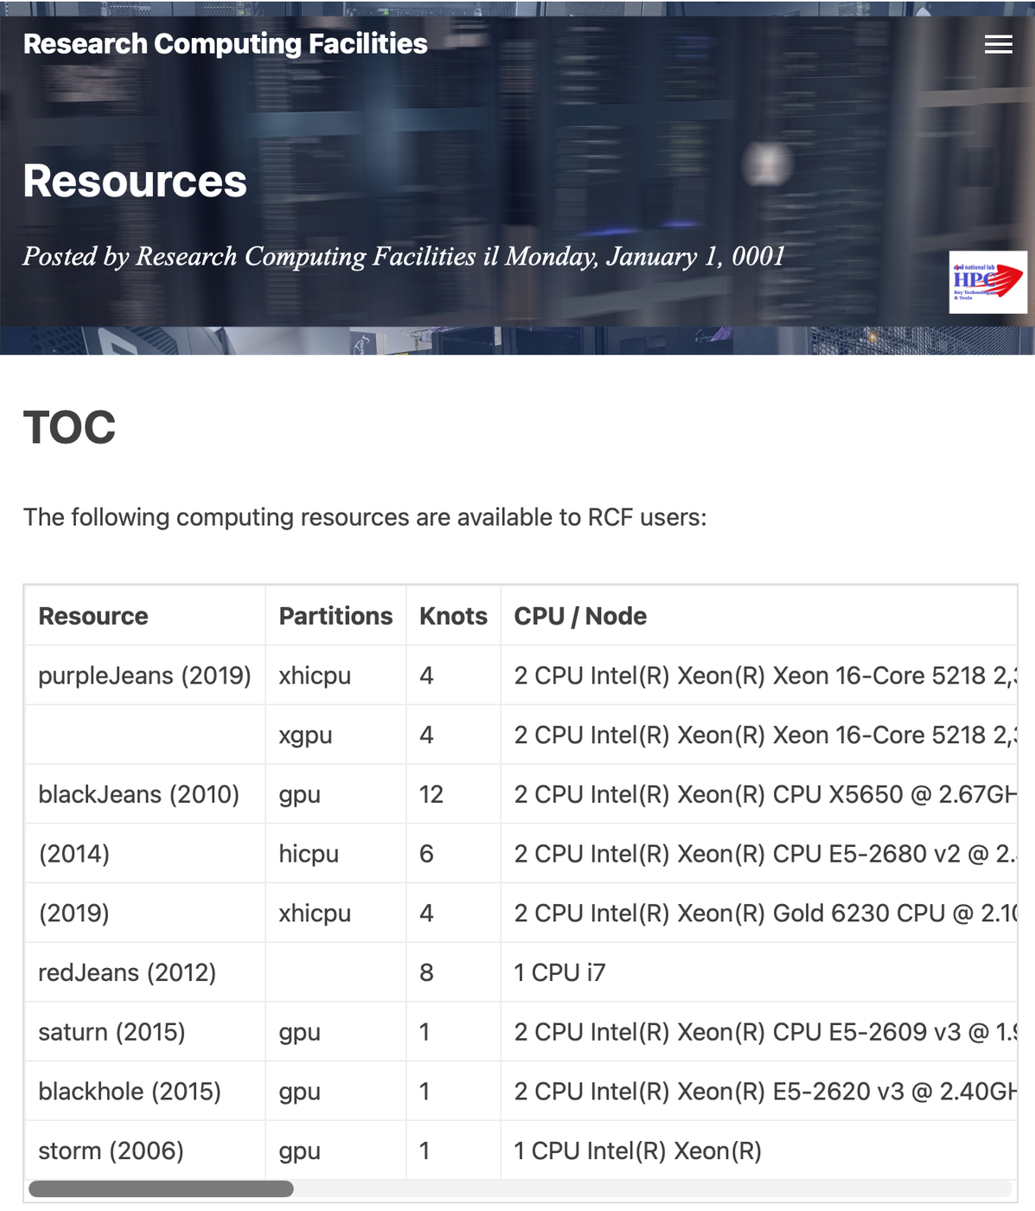
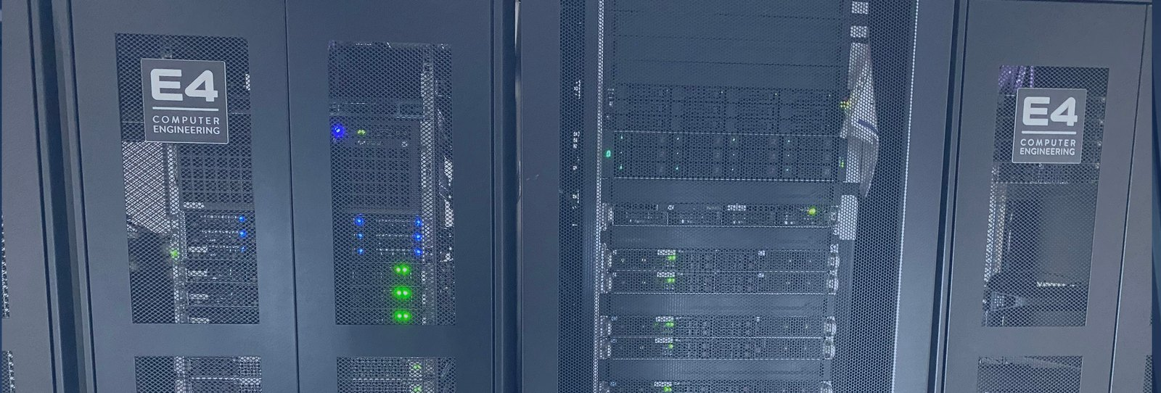
High-performance computing at Parthenope
The racks of the Research Computing Facilities of the University
What they compute every day: the forecasts of meteo@uniparthenope
Research Computing Facilities: rcf.uniparthenope.it
The same ideas you practise on a 160 MHz microcontroller scale up to clusters: registers, memory, instructions, only many more of them.
Notes:
The pictures show the racks of the Research Computing Facilities of the University, what they produce every day, the weather forecasts of meteo@uniparthenope, and the page that lists the machines. A cluster is many computers that work together on one problem. The ideas are those you practise on the kit: registers, memory, instructions, only in far greater number and with the added problem of making the parts cooperate. The last lecture of the course returns to these machines, and the closing event includes a visit to them.
For the lecturer: The closing event of the course includes a visit to the supercomputing systems of the Department.

Slide 17
Check your understanding
Which idea is the heart of the von Neumann architecture?
1
The processor has exactly four registers
Program and data are stored in the same memory
A
B
Every instruction takes one clock cycle
Input and output are optional
C
D
What makes RISC-V different from x86 and ARM?
2
It is the fastest instruction set
It was the first RISC architecture
A
B
Its instruction set is an open standard, free to implement
It works only on microcontrollers
C
D
Notes:
Look for the idea, not for a detail. The number of registers and the duration of an instruction vary from one processor to another, and input and output are one of the four units, not an option. What defines the architecture is that instructions are kept in the same memory as data, and are fetched and executed one after another.
Speed is a property of a particular chip, not of an instruction set, and RISC-V was not the first RISC: Berkeley RISC, MIPS and ARM came before. Nor is it limited to microcontrollers. What is new is the licence: the instruction set is an open standard that anyone may implement.
For the lecturer: 1. Answer: B. The stored-program concept: instructions are data in memory, fetched and executed one after another.
2. Answer: C. RISC-V is an open standard instruction set architecture; anyone may design and sell a RISC-V processor without an architecture licence. It was not the first RISC (Berkeley RISC, MIPS, ARM came earlier).

Slide 18
Check your understanding
Who is regarded as the first programmer in history?
Charles Babbage
Alan Turing
A
B
Ada Lovelace
Konrad Zuse
C
D
Notes:
All four names belong to the story, with different roles. Babbage designed the machine. Turing defined computation, a century later. Zuse built the first working programmable computer. The person who wrote a procedure for a machine, and published it in 1843, is Ada Lovelace.
For the lecturer: Answer: C. Ada Lovelace, for her 1843 notes on the Analytical Engine.

Slide 19
Glossary: English and Italian
English | Italiano | English | Italiano
computer science / informatics | informatica | stored program | programma memorizzato
computer | calcolatore, elaboratore | control unit | unità di controllo
punched card | scheda perforata | arithmetic logic unit | unità aritmetico-logica
loom | telaio | instruction set | insieme (set) di istruzioni
mainframe | mainframe, grande elaboratore | high-performance computing | calcolo ad alte prestazioni
Notes:
Ten terms. Note that Italian has two words for the machine, calcolatore and elaboratore, both older than the borrowed computer. Stored program is the idea of von Neumann. The control unit and the arithmetic logic unit, ALU, are two of the four units, and you will meet them again in the lectures on the processor. High-performance computing, HPC, is the field of the clusters you have just seen.

Slide 20
Conclusions and reading
Computing is older than electronics: representation and procedure came first
The stored-program computer of 1945 is still the machine we program today
RISC made processors simple enough to understand whole; RISC-V made them open
Informatics is pervasive: digital information belongs to every field, data are its currency, algorithms turn data into decisions
Reading
– Patterson, Hennessy: Computer Organization and Design, RISC-V Edition, chapter 1
– Playing with RISC-V, chapter 1: Why a Game, Why RISC-V, Why Now
– Charles Petzold: Code. The Hidden Language of Computer Hardware and Software
Notes:
Four conclusions. Computing is older than electronics: representation and procedure came first. The stored-program computer of 1945 is the machine we still program. RISC made processors simple enough to be understood whole, and RISC-V made them open. And informatics is everywhere, because information belongs to every field. The readings give the same story at greater length. The next lecture takes the first formal step: how information becomes bits.
Learning status, recap. UNDERSTAND NOW: what informatics is; the von Neumann architecture; RISC and an open ISA. USE NOW: the complete program, the PRG32 tools (used, not studied, in this course). UNDERSTAND LATER: Boolean algebra (Lecture 08). A slide without a badge is context: a story, an example, a question, an exercise.
For the lecturer: Next lecture: how information becomes bits.

