Slide 1



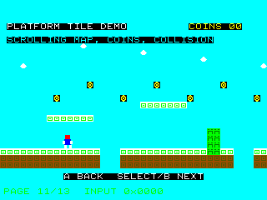
UNDERSTAND NOW
USE NOW
UNDERSTAND LATER
Lecture deck. The listings, the complete program and how to test it are in the code deck:
16-Computer_Architecture-Permanent_Memory-Code.pptx
ARC12 COMPUTER ARCHITECTURE · LECTURE 16
Permanent Memory
Non-volatile memories, the cache, and storage: magnetic, optical and solid-state
“...a datum does not exist unless it has been saved...”
Prof. Almerico Murli, 1990s
Prof. Raffaele Montella, PhD
University of Naples “Parthenope” · A.Y. 2026/27
raffaelemontella.it · raffaele.montella@uniparthenope.it
Notes:
The previous lecture dealt with the memory that forgets when the power goes. This one deals with the memories that do not: the chips that hold the firmware, the disks, the optical media, the tapes. Between the two it places the cache, a small fast memory that hides the slowness of a large one. The quotation is by a professor of numerical computing of this university, and every student learns its truth sooner or later: a datum does not exist unless it has been saved.
Learning status: UNDERSTAND NOW, by the end of this lecture you explain it, trace it and apply it on your own; USE NOW, you follow and use the recipe today; how it works inside is explained later, or is not part of the course; UNDERSTAND LATER, recognise the name and what it is for; a later lecture explains it. A slide without a badge is context: a story, an example, a question, an exercise.
Learning status of this lecture. UNDERSTAND NOW: ROM, flash, firmware; the von Neumann architecture; the cache; secondary memory. USE NOW: the complete program, the PRG32 tools (used, not studied, in this course). UNDERSTAND LATER: nothing. A slide without a badge is context: a story, an example, a question, an exercise.
For the lecturer: Spiral: a cartridge keeps its title string across a power cycle but loses its high score; the lecture explains where each lives, then covers ROM and flash, the cache, and mass storage.

Slide 2
What you will be able to do by the end
1
Name the functional units of a computer and recognise them on a motherboard and on the PRG32 kit
2
Distinguish ROM, PROM, EPROM, EEPROM and flash, and say what firmware is
3
Explain why a cache makes a computer faster, and what a cache miss is
4
Describe tracks, sectors and blocks of a magnetic disk and the components of its access time
5
Explain how an optical disk stores bits, and how a compact disc is read
6
Place flash, solid-state disks, hard disks and tapes in a multi-level storage system
Notes:
Six objectives. Name the functional units of a computer and find them on a motherboard and on the kit. Distinguish ROM, PROM, EPROM, EEPROM and flash, and say what firmware is. Explain why a cache makes a computer faster, and what a miss is. Describe tracks, sectors and blocks of a magnetic disk and the components of its access time. Explain how an optical disk stores bits, and how a compact disc is read. And place flash, solid-state disks, hard disks and tapes in a storage system with several levels.

Slide 3
Functional units of a computer
UNDERSTAND NOW · the von Neumann architecture
1
Processor
2
Main memory
3
Secondary memory
Executes the instructions. On the kit: the RISC-V core of the ESP32-C6.
Holds running programs and their data. On the kit: 512 KB of SRAM inside the chip.
Keeps programs and data when the power is off. On the kit: the flash chip that holds firmware and cartridges.
4
Input/output devices
5
Communication lines
6
One chip or many
Video card and monitor, keyboard, mouse, printer, storage. On the kit: display, joystick, amplifier.
The buses: data and address lines shared by all the units.
A PC spreads these units over a motherboard; a microcontroller puts almost all of them in one package.
Notes:
Six cards: the processor, the main memory, the secondary memory, the input and output devices, the communication lines, and a remark about packaging. Each card names the unit and then says where it is on the kit: the RISC-V core, the 512 KB of SRAM, the flash chip, the display with joystick and amplifier. The last card is the difference between a PC and a microcontroller: the first spreads the units over a motherboard, the second puts almost all of them in one package.
UNDERSTAND NOW: the von Neumann architecture.

Slide 4
Firmware: the BIOS and its heirs
UNDERSTAND NOW · ROM, flash, firmware
The BIOS is a program in a non-volatile chip specific to a given motherboard, used by the processor at power-on
boot
Its instructions and data can be divided into
– POST, power-on self test: checks that the devices work
– SETUP: configuration of the devices
– BOOT: starts the operating system
– DRIVERS: basic low-level functions for keyboard, disks and other devices
from the first instruction after reset to your program, through layers of permanent memory
Today's PCs use UEFI firmware, which does the same jobs
On the ESP32-C6: a boot program in ROM starts a bootloader in flash, which starts the PRG32 firmware, which loads the cartridge you choose
Notes:
Firmware is the basic software kept in a non-volatile memory. In a PC it was called BIOS and did four jobs: test the devices at power-on, configure them, start the operating system, and offer basic functions for keyboard and disks; today its heir is called UEFI. The kit has a similar chain: a small program in ROM starts a bootloader in flash, which starts the PRG32 firmware, which loads the cartridge you choose. Each stage finds, checks and starts the next.
UNDERSTAND NOW: ROM, flash, firmware.
For the lecturer: Each stage finds, checks and starts the next: a chain that ends with the first instruction of first_init.

Slide 5
From ROM to flash
UNDERSTAND NOW · ROM, flash, firmware
Memory | Written by | Erased | Typical use
ROM | the manufacturer, once and for all | never | start-up code, old game cartridges
PROM | the user, once | never | small production runs
EPROM | the user, many times | all at once, with ultraviolet light through a quartz window (about 15 minutes) | development, BIOS of early PCs
EEPROM | the user, in place | electrically, one byte at a time | configuration data
Flash | the user, in place | electrically, in blocks | firmware, USB keys, memory cards, solid-state disks
Notes:
Read the table from top to bottom as a history of convenience. A ROM is written by the manufacturer once and for all. A PROM can be written by the user, once. An EPROM can be erased, all at once, by exposing it to ultraviolet light through a small window, and written again. An EEPROM is erased electrically, one byte at a time, without removing it. Flash is erased electrically in blocks: less flexible than EEPROM, but much cheaper, and today it is everywhere.
UNDERSTAND NOW: ROM, flash, firmware.
For the lecturer: Read-only memory; programmable ROM; erasable PROM; electrically erasable PROM. Access time of the order of nanoseconds for reading. EEPROM and flash are slower and, per bit, once dearer than RAM; flash is today the cheapest semiconductor memory.

Slide 6
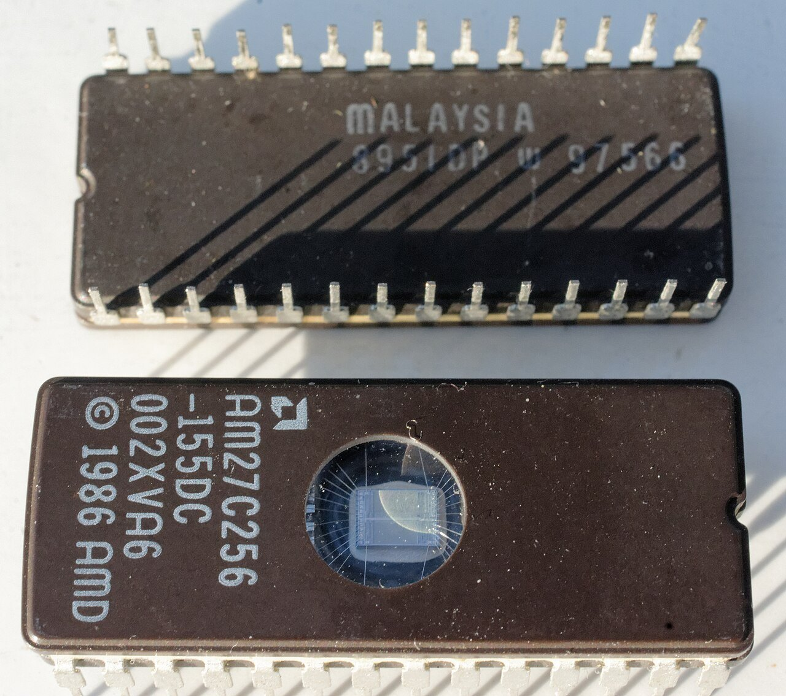
Flash memory
UNDERSTAND NOW · ROM, flash, firmware
The most recent kind of EEPROM: it can be reprogrammed in place, without removing it
Erased by blocks of bytes, not one byte at a time: erasing sets all the bits of a block to 1, writing can only turn 1s into 0s
Each block survives a limited number of erase cycles: the controller spreads the writes evenly
Reading is fast; writing and above all erasing are slow
The flash of the kit holds the firmware and your cartridges: uploading a cartridge erases and rewrites some of its blocks
An EPROM: the quartz window lets ultraviolet light erase the chip
Notes:
Three properties of flash explain how it is used. It is erased by blocks, not by single bytes: erasing sets all the bits of a block to 1, and writing can only turn 1s into 0s. Each block survives a limited number of erasures, so a controller spreads the writes evenly. And reading is fast, while writing and above all erasing are slow. This is why the best score of the warm-up is not simply written into the cartridge at every frame: flash is not a place for variables.
UNDERSTAND NOW: ROM, flash, firmware.
For the lecturer: This is why the best score of the warm-up is not simply written back into the cartridge at every frame: flash is not a place for variables.
Pictures: Pair of BIOS chips.jpg, Jud McCranie, CC BY-SA 4.0, Wikimedia Commons.

Slide 7
Why a cache?
UNDERSTAND NOW · the cache
During the clock cycles needed to read or write the memory the processor waits
The slower the memory, the more cycles are lost
wait
Why not build memories as fast as the registers of the processor?
– they would have to be on the same chip: a connection through a bus is slower
– they could not be very large, and the chip would grow in size and cost
what a processor does, for most of its time, when its memory is slower than it is
The compromise: a small, fast memory on the processor chip, and one or more larger, slower memories reached through the bus
Notes:
While the memory is being read or written the processor waits, and the slower the memory the more clock cycles are lost. Why not make all the memory as fast as the registers? Because it would have to be on the same chip as the processor, and it could not then be large. The compromise: a small, fast memory on the processor chip, and a larger, slower one reached through the bus.
UNDERSTAND NOW: the cache.
For the lecturer: Perché non costruire memorie veloci quanto i registri della CPU?

Slide 8
How a cache works
UNDERSTAND NOW · the cache
Cache, from the French cacher, to hide: a memory of small capacity but fast, placed between the processor and the RAM
processor
The processor looks in the cache first
every access
Hit: the content of the requested address is there, and arrives at once
cache
small, fast
Miss: it is not there, and must be copied from the RAM into the cache
– a fixed number of neighbouring locations is copied with it, because programs tend to use nearby addresses next
only on a miss
main memory
large, slow
The more hits, the shorter the average access time
Notes:
The cache sits between the processor and the main memory. At every access the processor looks in the cache first. If the content of the requested address is there, it is a hit and the datum arrives at once. If it is not, it is a miss: the datum is copied from the main memory into the cache, together with a number of neighbouring locations. The bet behind this is the principle of locality: a program that has just used an address will probably use it, or its neighbours, again soon. Loops and arrays are the reason.
UNDERSTAND NOW: the cache.
For the lecturer: The principle of locality: a program that has just used an address will probably use it again soon (temporal locality) and will probably use its neighbours (spatial locality). Loops and arrays are the reason.

Slide 9
Cache levels and typical machines
UNDERSTAND NOW · the cache
 | PC of 2002 | PC of 2020 | ESP32-C6 (the kit)
Processor | 1 core | 4 cores | 1 RISC-V core, 160 MHz
Cache L1 | 64 KB | 64 KB per core | none for the SRAM
Cache L2 | 512 KB | 512 KB per core | none
Cache L3 | none | 8 MB, shared by the cores | none
Main memory | 256 MB | 16 GB | 512 KB of SRAM
Storage | 40 GB hard disk | 1 TB + 1 TB, mirrored | a few MB of flash, read through a small cache
Notes:
Typical numbers. A PC has several levels of cache: a first level of tens of kilobytes inside each core, a second level of hundreds of kilobytes, and a third level of megabytes shared by the cores. The last column is the kit: no cache at all in front of its SRAM, because that memory is already as fast as the core needs; only the external flash is read through a small cache. Comparing the three columns also shows how main memory and storage have grown in twenty years.
UNDERSTAND NOW: the cache.
For the lecturer: First level (internal): keeps a continuous flow inside the processor. Second level: limits the slowdown due to the main memory. Third level (8 to 32 MB and more): shared by the cores of the same processor. Caches are built with SRAM. On the ESP32-C6 the SRAM is already as fast as the core needs; only the external flash sits behind a cache.

Slide 10
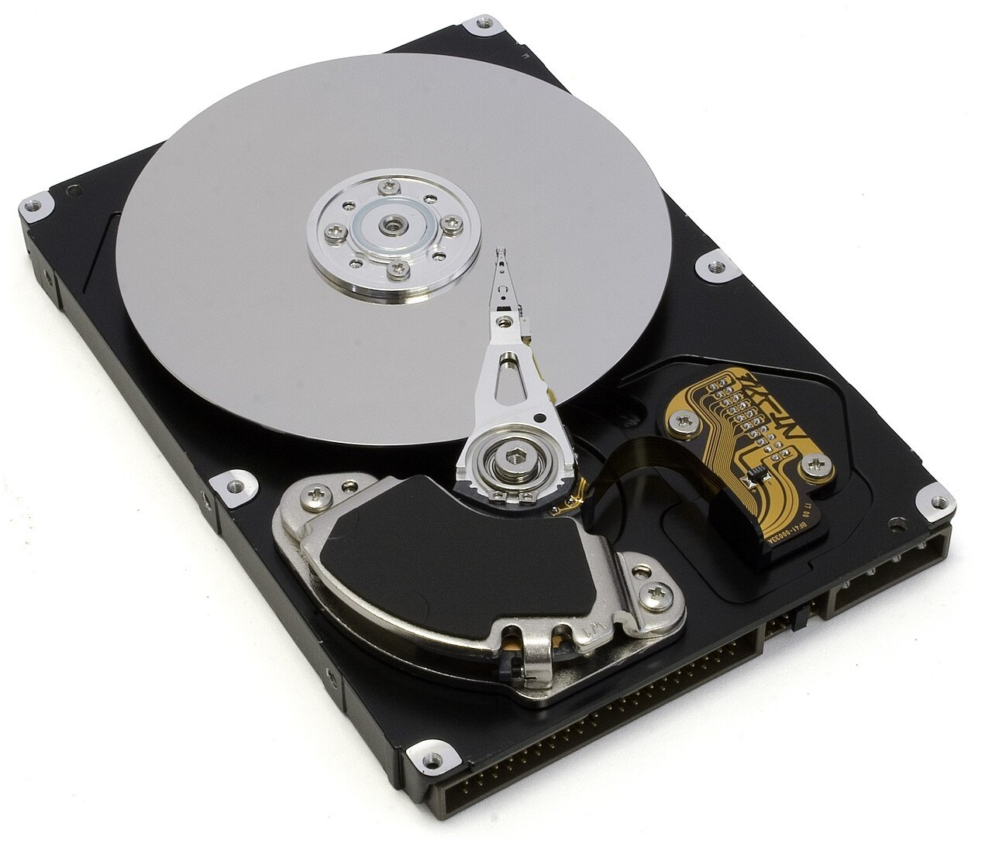
Characteristics of secondary memories
UNDERSTAND NOW · secondary memory
Non-volatile: the data are not lost when the computer is switched off
Large capacity: several orders of magnitude more than the main memory
Low cost per bit: several orders of magnitude less than the main memory
Slower access: some orders of magnitude slower than the main memory
Information is organised in blocks, usually of a kilobyte or more, not in single bytes
Some media allow direct access to any block; others only sequential access
An open hard disk: platter, arm and head
Notes:
Four properties define secondary memories with respect to the main memory. They are non-volatile. Their capacity is several orders of magnitude larger. Their cost per bit is several orders of magnitude lower. And their access is some orders of magnitude slower. Two more facts concern their organisation: information is stored in blocks, not in single bytes, and some media allow direct access to any block while others, like tapes, only sequential access.
UNDERSTAND NOW: secondary memory.
For the lecturer: The secondary memory stores and keeps all the programs and data of the computer; the main memory holds the programs being executed and the data they need.
Pictures: Open hard-drive.jpg, Zzubnik, Public domain, Wikimedia Commons.

Slide 11
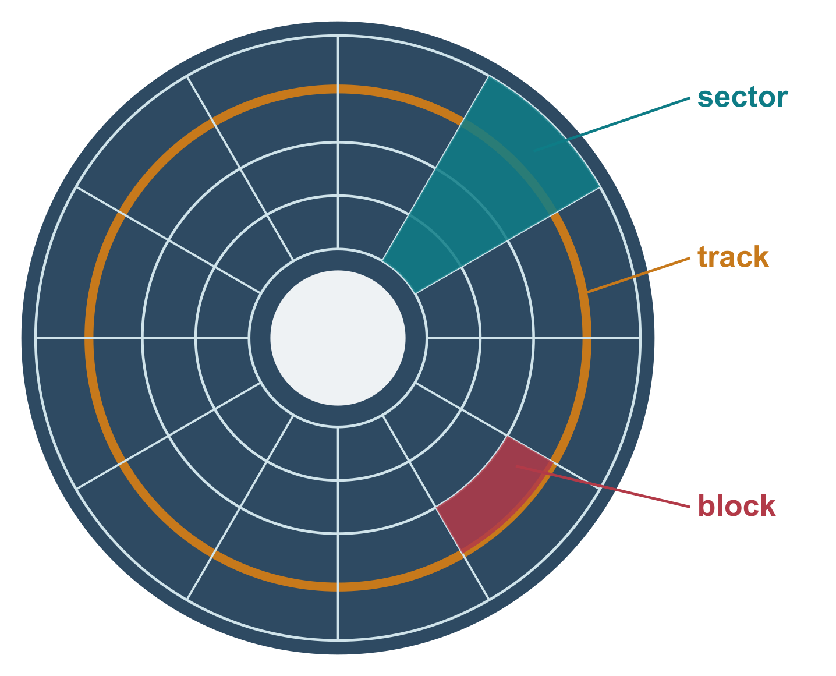
Magnetic disks: tracks, sectors, blocks
UNDERSTAND NOW · secondary memory
Platters coated with a magnetisable material, kept spinning at constant speed; heads read and write the information
The surface is divided into concentric tracks and into sectors, slices of the disk
A sector cuts each track into blocks: the block is the smallest addressable unit, identified by track number and sector number
Formatting: dividing the surface into tracks and sectors
Direct access: the head can be positioned on any block without passing over all the previous ones
Notes:
The geometry of a magnetic disk. Platters coated with a magnetisable material spin at constant speed, and heads read and write. The surface is divided into concentric tracks and into sectors, slices like those of a cake. A sector cuts each track into blocks, and the block, identified by its track and sector, is the smallest unit that can be addressed. Formatting is the operation that draws this division. Access is direct: the head goes to any block without passing over all the previous ones.
UNDERSTAND NOW: secondary memory.
For the lecturer: Dischi magnetici. Several sectors form a cluster; the tracks at the same radius on all the platters form a cylinder. The original picture had Italian labels and is redrawn.

Slide 12
Access time of a magnetic disk
UNDERSTAND NOW · secondary memory
To read or write a block the head must be brought to the right address; during the transfer the head is still and the disk moves
ms
Seek time
– the time to move the head radially to the right cylinder, and so to the right track
Latency
– the time to wait for the desired sector to pass under the head
milliseconds: the access time of a hard disk, a million times slower than RAM
Transfer time
– the time for the block to pass under the head
Hard disks: sealed against dust, capacities of terabytes, access times of milliseconds
Notes:
The access time of a disk is the sum of three times. Seek time: the time to move the head radially to the right track. Latency: the wait for the desired sector to pass under the head, which depends on the speed of rotation. Transfer time: the time for the block to pass under the head. The total is a matter of milliseconds: a million times slower than RAM. In the time of one disk access the processor of the kit could execute more than a hundred thousand instructions.
UNDERSTAND NOW: secondary memory.
For the lecturer: A millisecond is a million nanoseconds: during one disk access a 160 MHz processor could execute more than a hundred thousand instructions.

Slide 13
Hard disks and solid-state disks
UNDERSTAND NOW · secondary memory
Hard disk drive (HDD)
Solid-state disk (SSD)
Magnetic platters and moving heads
Access time of milliseconds, dominated by mechanics
The lowest cost per terabyte
Still the choice for large archives and backups
Flash memory and a controller: no moving parts
Access time of tens of microseconds
Connected through SATA or, faster, NVMe on PCI Express
The standard storage of laptops and phones; the same technology as the flash chip of the kit
Notes:
Two technologies for the same job. A hard disk has magnetic platters and moving heads: its access time is dominated by mechanics, but its cost per terabyte is the lowest, and it remains the choice for large archives and backups. A solid-state disk is flash memory with a controller and no moving parts: its access time is tens of microseconds, and it is the standard storage of laptops and phones. It is the same technology as the flash chip of the kit.
UNDERSTAND NOW: secondary memory.
For the lecturer: New with respect to the original deck, which listed SSDs only among the storage levels. The parallel ATA bus of older PCs gave way to Serial ATA and then to NVMe.

Slide 14
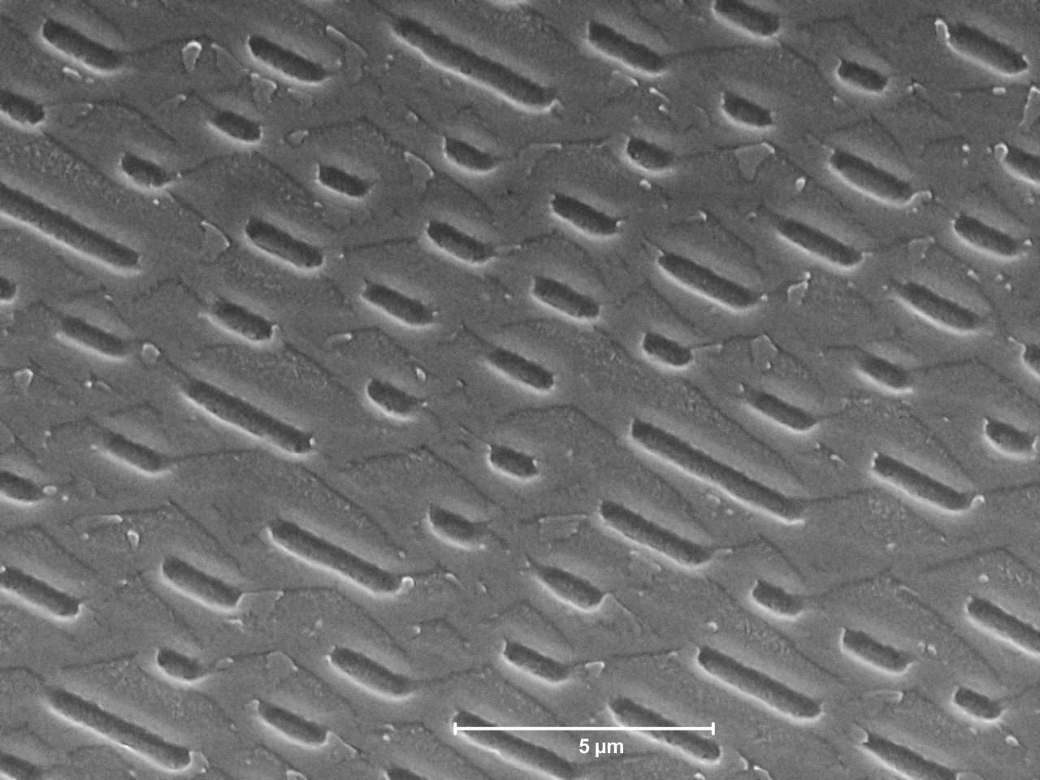
Optical disks
UNDERSTAND NOW · secondary memory
A rigid disk on which a laser beam of a few milliwatts is projected; the reflection changes between the pits and the surface, the land
0 and 1 are not pit and land
– 1 is a change, from pit to land or from land to pit
– 0 is no change
Usually written once, because the physical changes are irreversible: used to distribute programs and as archives that must not be modified
CD-Recordable: recording burns points in a dye layer; rewritable disks use a material that can change back
Pits and lands of a pressed CD-ROM, under an electron microscope
Notes:
An optical disk is read by a laser beam whose reflection changes between the pits and the flat surface, the land. The point that is always asked in the exam: 0 and 1 are not pit and land. A 1 is a change, from pit to land or from land to pit; a 0 is no change. Such disks are usually written once, because the physical modification is irreversible, which makes them suitable for distributing programs and for archives that must not be altered.
UNDERSTAND NOW: secondary memory.
For the lecturer: Encoding a 1 as a transition is a self-clocking idea used in many serial links as well.
Pictures: CD-ROM pressed pits.jpg, Tycho, CC0, Wikimedia Commons.

Slide 15
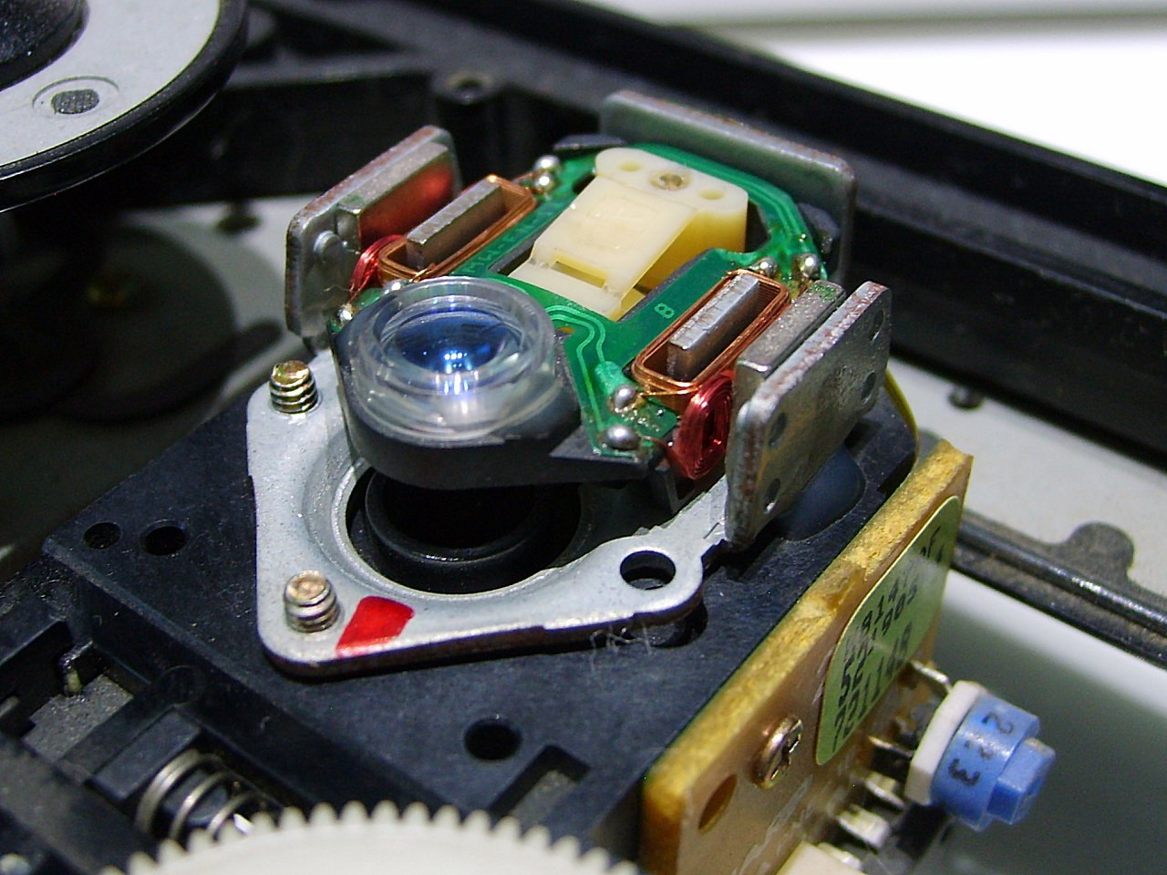
The compact disc
UNDERSTAND NOW · secondary memory
The information is stored on a single spiral track, with constant recording density
The distance between two successive turns of the spiral, the track pitch, is 1.6 micrometres
CLV, constant linear velocity
– the disk turns faster when reading near the centre: from 200 to 500 revolutions per minute
CAV, constant angular velocity
– constant revolutions; the number of bits per sector is constant, so the outer surface is under-used
The speed was set by the bit rate needed to play music
Inside a CD-ROM drive
Notes:
In a compact disc the information is on a single spiral track, with a distance of 1.6 micrometres between one turn and the next. The recording density is constant along the spiral, so to read at a constant rate the disk must turn faster near the centre and more slowly near the edge: this is constant linear velocity. The alternative, constant angular velocity, keeps the rotation constant and wastes the outer part of the disk. The speed was originally set by the needs of music.
UNDERSTAND NOW: secondary memory.
For the lecturer: 1x = 1.2 m/s. CD-Recordable: two layers of polycarbonate enclose a thin reflective sheet covered by a translucent dye.
Pictures: CD Player focusing lens assembly.jpg, Zim 256, CC BY-SA 3.0, Wikimedia Commons.

Slide 16
A multi-level permanent memory
UNDERSTAND NOW · secondary memory
RAM disk
Solid-state disk
Hard disk
Disk library
Tape library
a piece of main memory used as a disk: fastest, volatile
flash: fast, the working storage
magnetic: large and cheap
many disks, some switched on only when needed
robots that mount tapes: the cheapest per byte, for archives
A modern computing system has several levels of permanent memory, often managed automatically: data that are used often migrate towards the fast levels, the rest sinks towards the cheap ones.
Notes:
Five levels of permanent memory, from the fastest to the cheapest: a RAM disk, which is a piece of main memory used as a disk; solid-state disks; hard disks; disk libraries, in which some disks are switched on only when needed; and tape libraries, in which robots mount the tapes. The system moves the data automatically: what is used often migrates towards the fast levels, the rest sinks towards the cheap ones. It is the idea of the cache, applied to storage.
UNDERSTAND NOW: secondary memory.
For the lecturer: The same idea as the cache, applied to storage. The department's HPC storage works this way (visit at the end of the course).

Slide 17
Check your understanding
Which memory can be erased electrically, in blocks, without removing it from the board?
1
ROM
PROM
A
B
EPROM
Flash
C
D
What happens on a cache miss?
2
The program stops with an error
The datum is fetched from main memory and copied into the cache, with its neighbours
A
B
The cache is erased
The processor skips the instruction
C
D
Notes:
Go through the table of non-volatile memories asking two questions for each: how is it erased, and how much at a time? Only one is erased electrically and in blocks.
A miss is not an error. The program does not notice anything, except that this access takes longer: the datum is fetched from the main memory and kept in the cache together with its neighbours.
For the lecturer: 1. Answer: D. Flash is the block-erasable evolution of EEPROM. EPROM needs ultraviolet light; ROM and PROM cannot be erased.
2. Answer: B. The access is simply slower: the block containing the address is loaded into the cache, betting that nearby addresses will be needed soon.

Slide 18
Check your understanding
Which component of the access time of a hard disk depends on the rotation speed?
1
Seek time
Latency
A
B
Formatting time
Boot time
C
D
On an optical disk, a 1 is encoded as:
2
a pit
a land
A
B
a transition between pit and land
a double pit
C
D
Notes:
Which of the three times is a wait for the disk to turn? The movement of the arm does not depend on the rotation; formatting and booting are not components of the access time.
Recall the rule of optical disks: what counts is not the pit or the land, but the passage from one to the other.
For the lecturer: 1. Answer: B. Latency is the wait for the sector to arrive under the head; seek time depends on the movement of the arm.
2. Answer: C. A change of reflectivity, in either direction, is a 1; no change is a 0.

Slide 19
Glossary: English and Italian
English | Italiano | English | Italiano
motherboard | scheda madre | track / sector / block | traccia / settore / blocco
firmware | firmware | seek time | tempo di posizionamento
non-volatile | non volatile | latency | tempo di latenza
cache hit / miss | successo / fallimento di cache | solid-state disk | disco a stato solido
mass storage | memoria di massa | tape library | libreria a nastri
Notes:
Ten terms. The motherboard is the scheda madre. A cache hit and miss are a success and a failure in finding the datum. Seek time and latency are two components of the access time of a disk. Mass storage is the secondary memory as a whole. A tape library is a storage system with tapes handled by robots.

Slide 20
Conclusions and reading
Non-volatile memories usually hold the basic software of a machine: the firmware
The cache improves performance by keeping a copy of part of the main memory close to the processor
The same idea, a small fast level in front of a large slow one, is used again in storage systems
Permanent memories can be semiconductor (flash), magnetic or optical
A modern system has several levels of permanent memory, often managed automatically
Reading
– Patterson, Hennessy: Computer Organization and Design, RISC-V Edition, sections 5.1-5.4
– Stallings: Computer Organization and Architecture, chapters on cache and external memory
– Tanenbaum, Austin: Structured Computer Organization, chapter 2
Notes:
Five conclusions. Non-volatile memories usually hold the firmware, the basic software of a machine. The cache improves performance by keeping a copy of part of the main memory close to the processor. The same idea, a small fast level in front of a large slow one, is used again in storage. Permanent memories can be semiconductor, magnetic or optical. And a modern system has several levels, managed automatically. Next comes Part 3 of Verm1, which uses memory as it has never been used so far in the project.
Learning status, recap. UNDERSTAND NOW: ROM, flash, firmware; the von Neumann architecture; the cache; secondary memory. USE NOW: the complete program, the PRG32 tools (used, not studied, in this course). UNDERSTAND LATER: nothing. A slide without a badge is context: a story, an example, a question, an exercise.
For the lecturer: Next: Verm1, part 3: a body, rules and states. Then the processor.

