Slide 1



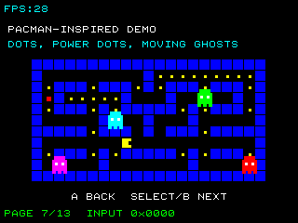
UNDERSTAND NOW
USE NOW
UNDERSTAND LATER
Lecture deck. The listings, the complete program and how to test it are in the code deck:
13-Computer_Architecture-Sequential_Machines-Code.pptx
ARC12 COMPUTER ARCHITECTURE · LECTURE 13
Sequential Machines
Time, state and finite-state machines; latches, flip-flops and the registers of a RISC-V processor
“Steve, every car has a steering wheel, but nobody tries to claim the steering wheel was their invention.”
Bill Gates, in the film Pirates of Silicon Valley, 1999
Prof. Raffaele Montella, PhD
University of Naples “Parthenope” · A.Y. 2026/27
raffaelemontella.it · raffaele.montella@uniparthenope.it
Notes:
The third block of the course begins: state and memory. The machines of Lecture 11 had no memory: the same inputs always gave the same outputs. A computer, however, remembers: a counter survives from one frame to the next, a game knows whether it is showing the title or the playfield. This lecture introduces time and state, the model that describes every circuit with memory, and the elementary memories, latches and flip-flops, from which the registers of the processor are built.
Learning status: UNDERSTAND NOW, by the end of this lecture you explain it, trace it and apply it on your own; USE NOW, you follow and use the recipe today; how it works inside is explained later, or is not part of the course; UNDERSTAND LATER, recognise the name and what it is for; a later lecture explains it. A slide without a badge is context: a story, an example, a question, an exercise.
Learning status of this lecture. UNDERSTAND NOW: finite-state machines; the clock; latches and flip-flops; registers as flip-flops. USE NOW: the complete program, the PRG32 tools (used, not studied, in this course). UNDERSTAND LATER: nothing. A slide without a badge is context: a story, an example, a question, an exercise.
For the lecturer: The quotation is translated back from the Italian version used in the original deck. Spiral: a game with a title screen is a finite-state machine written in assembly; the lecture then builds the theory (time, state, Mealy and Moore), the memory elements (latches and flip-flops), and returns to the registers and the program counter of RISC-V.

Slide 2
What you will be able to do by the end
1
Explain why a sequential circuit needs the concepts of time and of state
2
Define a finite-state machine and distinguish Mealy machines from Moore machines
3
Describe a machine with a state table and with a state diagram, and go from one to the other
4
Explain how an SR latch remembers one bit, and why S = R = 1 is not allowed
5
Distinguish latches from flip-flops, level triggering from edge triggering
6
Recognise registers, counters and the program counter of RISC-V as sequential machines
Notes:
Six objectives. Explain why a sequential circuit needs the concepts of time and of state. Define a finite-state machine and distinguish Mealy from Moore. Describe a machine with a state table and with a state diagram. Explain how an SR latch remembers one bit and why one combination of its inputs is forbidden. Distinguish latches from flip-flops, level from edge. And recognise registers, counters and the program counter as sequential machines.

Slide 3
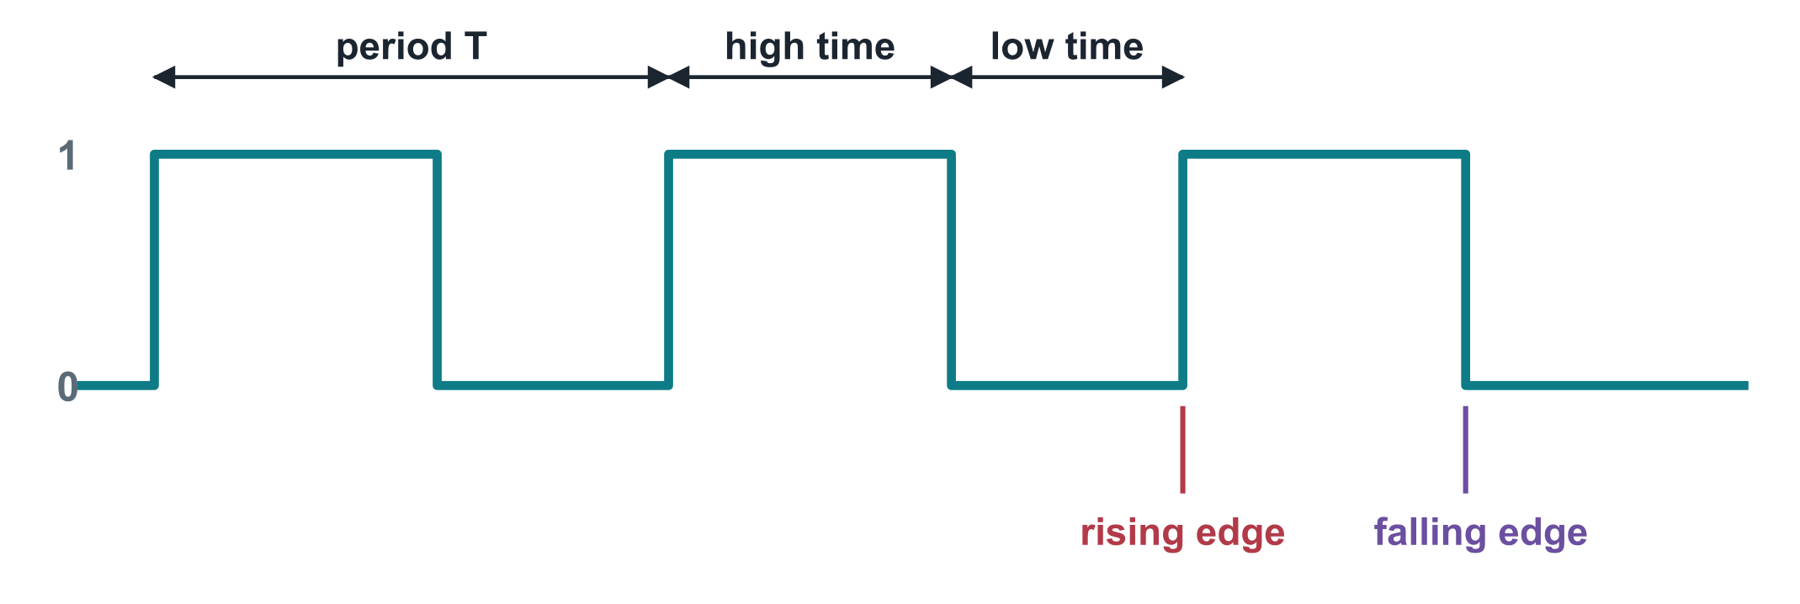
The clock
UNDERSTAND NOW · the clock
A periodic binary signal that marks the discrete instants
During one period it is 1 for the high time and 0 for the low time
Duty cycle: the ratio between the high time and the period
Frequency: the number of periods per second, f = 1 / T
Rising edge: the passage from 0 to 1. Falling edge: the passage from 1 to 0. Synchronous circuits change state on one of the two
The ESP32-C6 runs at 160 MHz: one period lasts 6.25 nanoseconds, and every combinational network inside it must settle within that time
Notes:
The clock is a signal that alternates regularly between 0 and 1. The drawing names its parts: the period T, the high time and the low time, the rising edge, where it passes from 0 to 1, and the falling edge. The frequency is the number of periods per second, one divided by T. Synchronous circuits change state on one of the two edges. For the kit: 160 MHz means a period of 6.25 nanoseconds, and every combinational network in the chip must settle within that time.
UNDERSTAND NOW: the clock.
For the lecturer: Fronte di salita, fronte di discesa, periodo TCK, TH and TL in the original slide. The link with Lecture 11: the period must exceed the critical path. In a PRG32 game the frame plays the role of a much slower clock.

Slide 4
The concept of state
UNDERSTAND NOW · finite-state machines
The outputs of a sequential circuit depend on the inputs and on the state: a summary of the whole previous history of the inputs
S(k) = f(S(k-1), I(k))
The state is held by a set of state variables
A transition function computes the next state from the present state and the present inputs
The state is updated at every instant of discrete time, that is, at every clock cycle
– the state at instant k depends on the inputs at instant k and on the state at instant k - 1
the next state is a function of the present state and of the input
To store the state we use memory elements called bistables: latches and flip-flops
Notes:
The state is a summary of the whole previous history of the inputs: everything the circuit needs to know about the past in order to behave correctly from now on. It is held by state variables. A transition function computes the next state from the present state and the present inputs, and the state is updated once per clock cycle. The formula on the right says it compactly. To store the state we need elements with two stable conditions: latches and flip-flops.
UNDERSTAND NOW: finite-state machines.
For the lecturer: In the warm-up: one state variable (the word state), the transition function is game_update, the clock is the frame.

Slide 5
The finite-state automaton
UNDERSTAND NOW · finite-state machines
Definition
The number of states of a physically realisable sequential network is necessarily finite. The model that describes its behaviour is the finite-state automaton; a sequential machine implements one.
A sequential machine is a quintuple (I, U, S, Ω, w)
I, the input alphabet, and U, the output alphabet: finite sets of symbols
S: the finite, non-empty set of states
Ω: the next-state function, from S x I to S. To each pair of state and input corresponds, if specified, one and only one next state
w: the output function, which generates the output symbol
Notes:
The formal definition. A sequential machine is made of five things: an input alphabet I and an output alphabet U, which are finite sets of symbols; a finite set of states S; a next-state function, which for each pair of state and input gives one next state; and an output function. Compare it with the warm-up: the input is "A pressed or not", the states are TITLE, PLAY and OVER, the next-state function is the code of game_update, and the output is the screen.
UNDERSTAND NOW: finite-state machines.
For the lecturer: Automa a stati finiti; macchina sequenziale. With k state variables there are at most 2^k states. The source slide wrote the functions with 'belongs to' signs: the correct arrows are used here.

Slide 6
Mealy machines and Moore machines
UNDERSTAND NOW · finite-state machines
Mealy machine
Moore machine
The output depends on the state and on the input
w: S x I -> U
The output is written on the transitions
It can react to an input in the same cycle
Often needs fewer states
The output is associated with the state alone
w: S -> U
The output is written inside the states
It changes only when the state changes: no glitches from the inputs
The warm-up game is one: each state has its screen
Notes:
There are two ways of defining the output. In a Mealy machine the output depends on the state and on the input: it is written on the transitions, and it can react to an input in the same cycle. In a Moore machine the output depends on the state alone: it is written inside the states and changes only when the state changes. The game of the warm-up is a Moore machine: each state has its screen. The two models are equivalent, though the number of states may differ.
UNDERSTAND NOW: finite-state machines.
For the lecturer: Every Mealy machine has an equivalent Moore machine and vice versa, possibly with a different number of states.

Slide 7
General architecture of a sequential machine
UNDERSTAND NOW · finite-state machines
combinational network
next-state function Ω
output function w
A combinational network computes the next state and the outputs
inputs
x1 ... xn
outputs
z1 ... zm
A register of flip-flops holds the present state
At each clock edge the next state becomes the present state
present state
y1 ... yk
next state
Y1 ... Yk
The loop is broken by the register: values go round once per cycle, never faster
state register
k flip-flops
clock
The whole of Lecture 11 lives in the upper box
Notes:
The general architecture of every sequential machine. A combinational network computes the next state and the outputs from the inputs and the present state. A register of flip-flops holds the present state. At each clock edge the next state becomes the present state. The loop from the network to the register and back is what makes memory possible, and the register is what keeps the loop under control: values go round once per cycle, never faster. Everything in Lecture 11 lives in the upper box.
UNDERSTAND NOW: finite-state machines.
For the lecturer: Rete combinatoria and registri di stato. The warm-up has exactly this shape: game_update is the upper box, the word state is the register, the frame is the clock.

Slide 8
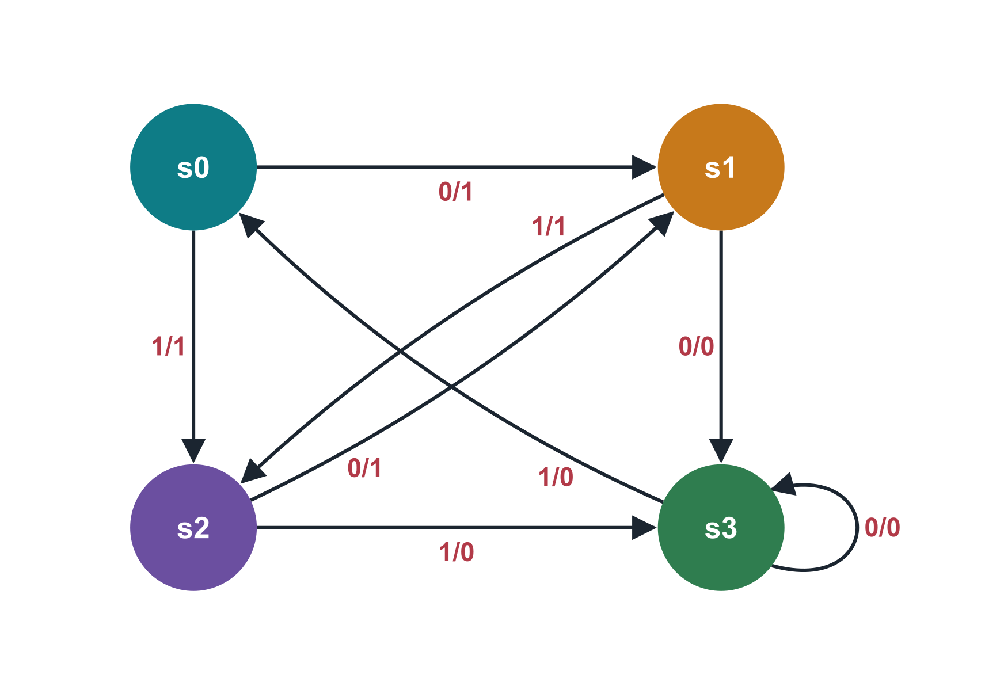
State table and state diagram: a Mealy machine
UNDERSTAND NOW · finite-state machines
Present state | Input 0 | Input 1
s0 | s1 / 1 | s2 / 1
s1 | s3 / 0 | s2 / 1
s2 | s1 / 1 | s3 / 0
s3 | s3 / 0 | s0 / 0
State table: one row per present state, one column per input symbol; each cell holds next state / output
State diagram: a directed graph; one node per state, one arc per transition, labelled input / output
The two descriptions are equivalent
Notes:
The two equivalent descriptions of a machine, for a Mealy example with four states. In the state table each row is a present state and each column an input symbol; the cell gives the next state and, after the slash, the output. In the state diagram each state is a node and each transition an arrow labelled input slash output. Practise going from one to the other: take the row of s0 and find its two arrows in the drawing.
UNDERSTAND NOW: finite-state machines.
For the lecturer: Tabella degli stati and diagramma degli stati: G(V, E, L) with V the nodes (states), E the arcs (transitions) and L the labels. The example is the one of the original deck.

Slide 9
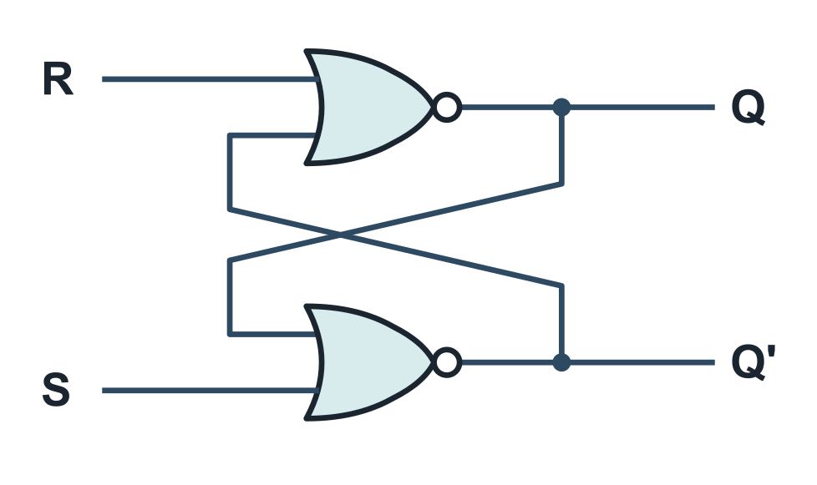
The SR latch
UNDERSTAND NOW · latches and flip-flops
Two NOR gates, each with its output connected to an input of the other: feedback
S (set) brings Q to the stable state 1; R (reset) brings Q to the stable state 0
With S = R = 0 the latch keeps the last value: it remembers which of the two inputs was 1 most recently
Because of the feedback Q depends on itself
– Q = R' . (S + Q), where the Q on the right is the value one propagation delay earlier
S | R | next Q
0 | 0 | Q: hold
0 | 1 | 0: reset
1 | 0 | 1: set
1 | 1 | not allowed
In a network with loops every variable is a waveform in time, not a single value
Notes:
The SR latch: two NOR gates, each with its output connected to an input of the other. S, for set, brings Q to 1; R, for reset, brings Q to 0. With both at 0 the latch keeps its last value: it remembers which input was 1 most recently. The table summarises the four cases, and the last one is forbidden. Because of the feedback Q depends on itself: in a circuit with a loop, a signal is a waveform in time and not a single value.
UNDERSTAND NOW: latches and flip-flops.
For the lecturer: Q = (R + Q')' and Q' = (S + Q)'. Breaking the feedback wire turns the latch into a plain combinational network of two NORs: that is how the original deck analysed it, case by case. The same latch can be built with two NAND gates and active-low inputs.

Slide 10
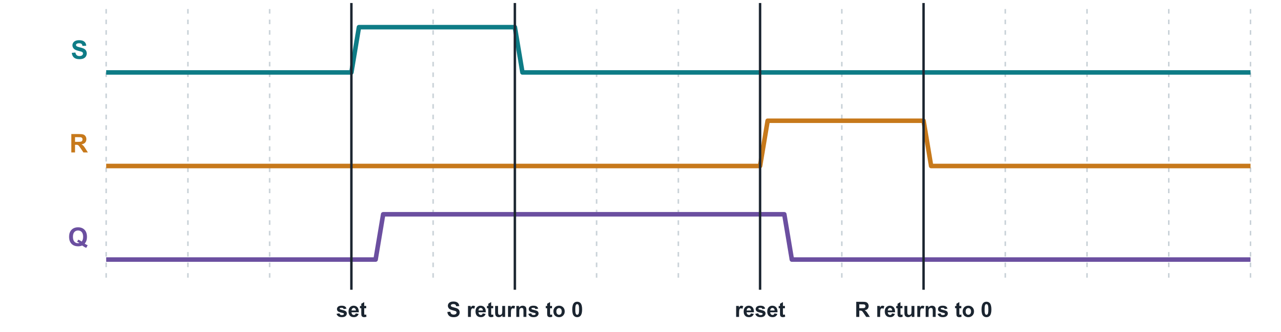
The SR latch in time
UNDERSTAND NOW · latches and flip-flops
Set: S goes to 1; after the delay of two gates Q becomes 1
S returns to 0 and nothing changes: the feedback keeps Q at 1. The latch remembers
Reset: R goes to 1 and, after the delay, Q becomes 0; when R returns to 0 it stays there
Notes:
The latch in time. S goes to 1, and after the delay of the gates Q becomes 1. Then S returns to 0 and nothing happens: the feedback keeps Q at 1. This flat stretch is the memory. Later R goes to 1, Q returns to 0, and it stays there when R returns to 0. Follow the four marked instants on the drawing with the circuit of the previous slide in front of you, working out the output of each gate.
UNDERSTAND NOW: latches and flip-flops.
For the lecturer: Diagramma temporale. The original deck traced each of these four steps gate by gate over a dozen slides; replay them on the board with the circuit of the previous slide. The latch is a Moore automaton: its output is its state.

Slide 11
Why S = R = 1 is not allowed
UNDERSTAND NOW · latches and flip-flops
With both inputs at 1 both NOR gates output 0: Q and Q' are no longer complementary
If S and R then return to 0 together, the two gates race: the final state depends on which is faster
S . R = 0
The output is unpredictable, and the latch may even oscillate
the condition every circuit that drives an SR latch must respect
S and R are called excitation inputs; the designer must guarantee that they are never 1 together
The JK and D elements exist to remove this problem
Notes:
With S and R both at 1, both NOR gates output 0, so Q and its complement are no longer complementary. Worse: if the two inputs then return to 0 together, the gates race against each other, and the final state depends on which is faster. The result is unpredictable, and the latch may even oscillate. Whoever uses an SR latch must guarantee that S and R are never 1 together. The JK and D elements were invented to remove this problem at the root.
UNDERSTAND NOW: latches and flip-flops.
For the lecturer: The conclusions of the original deck swapped set and reset on one slide: set gives Q = 1, reset gives Q = 0.

Slide 12
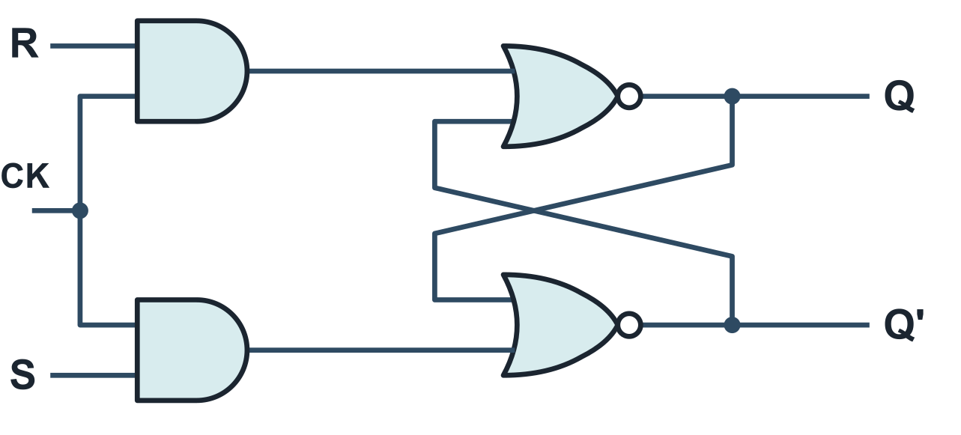
Synchronous latches: adding a clock
UNDERSTAND NOW · latches and flip-flops
Asynchronous systems: the outputs can change whenever an input changes
Synchronous systems: the instant at which the outputs can change is decided by the clock
In a synchronous SR latch, S and R are ANDed with the clock
– CK = 0: both AND gates output 0 and the latch cannot change state
– CK = 1: the latch is sensitive to S and R, exactly like the asynchronous one
A clocked SR latch: the excitation inputs pass through two AND gates controlled by CK
The clock decides when the inputs are listened to
Notes:
In an asynchronous circuit the outputs may change whenever an input changes. In a synchronous one the clock decides when. To make the SR latch synchronous, S and R pass through two AND gates together with the clock. When the clock is 0 both gates give 0 and the latch cannot change; when the clock is 1 it behaves like the plain latch. The clock decides when the inputs are listened to.
UNDERSTAND NOW: latches and flip-flops.
For the lecturer: Latch sincroni e asincroni. A simulator is suggested in the original deck: de-iitr.vlabs.ac.in/exp/truth-tables-flip-flops.

Slide 13
The JK and D latches
UNDERSTAND NOW · latches and flip-flops
Inputs | JK latch | Inputs | D latch
J = 0, K = 0 | hold: Q unchanged | D = 0 | Q becomes 0
J = 0, K = 1 | reset: Q becomes 0 | D = 1 | Q becomes 1
J = 1, K = 0 | set: Q becomes 1
J = 1, K = 1 | toggle: Q is inverted
JK: S = J . Q' and R = K . Q are never 1 together. D (delay): S = D and R = D', so the output simply repeats the input while the clock is active.
Notes:
Two improvements of the latch. In the JK latch the outputs are fed back to the input gates, so that the internal set and reset can never be 1 together; the combination J = K = 1, instead of being forbidden, inverts the output: it toggles. The D latch has a single input: D goes to set and its negation to reset, so the output simply takes the value of D while the clock is active. D stands for delay, or data.
UNDERSTAND NOW: latches and flip-flops.
For the lecturer: JK: the outputs are fed back to the input gates, S = J . Q' and R = K . Q; since Q and Q' are complementary, S and R can never both be 1. D: a single input goes to S and, through an inverter, to R, so only the cases S = 0, R = 1 and S = 1, R = 0 are possible.

Slide 14
The master-slave flip-flop
UNDERSTAND NOW · latches and flip-flops
Two latches in series, controlled by opposite levels of the clock
D
MASTER
D latch
active when CK = 0
Qm
SLAVE
D latch
active when CK = 1
Q
The master receives the inputs; the slave produces the outputs
They are never transparent at the same time: the input can never run straight through to the output
inverted
CK
The output changes only when the clock passes from 0 to 1: on the edge
(level 0) followed by (level 1) = (rising edge)
A flip-flop is edge-triggered: one operation per clock cycle, and no fluctuation of the output
Notes:
The master-slave flip-flop is made of two latches in series, controlled by opposite levels of the clock. When the clock is 0 the master is open and follows the input, while the slave is closed. When the clock passes to 1 the master closes, keeping what it had, and the slave opens and shows it. The two are never transparent together, so the input can never run straight through to the output. The effect is that the output changes only at the rising edge: the flip-flop is edge-triggered.
UNDERSTAND NOW: latches and flip-flops.
For the lecturer: Flip-flop master-slave. The original deck showed the JK version, built from two clocked JK latches; the D version is the one used in the registers of a processor.

Slide 15
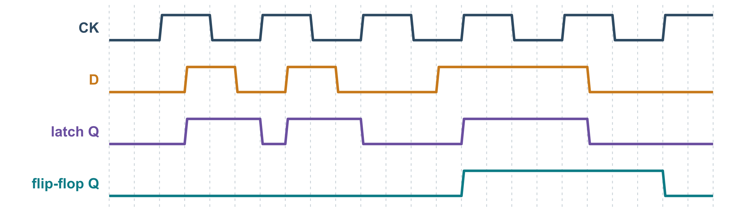
Latch or flip-flop? Watch the output
UNDERSTAND NOW · latches and flip-flops
The D latch follows D for the whole time the clock is high, and holds the last value when the clock goes low
The D flip-flop looks at D only on the rising edge: short pulses between two edges are ignored
The flip-flop output is steady for a whole period: this is what a state register needs
Notes:
The difference, seen on the waveforms. The clock and the input D are the same for both. The output of the latch follows D for the whole high phase of the clock: it changes in the middle of a phase. The output of the flip-flop changes only at the rising edges, taking the value that D has at that instant; short pulses of D between two edges are ignored. The flip-flop's output is steady for a whole period, which is exactly what a state register needs.
UNDERSTAND NOW: latches and flip-flops.
For the lecturer: Level-triggered versus edge-triggered. The waveforms are computed, not drawn by hand: the latch output changes in the middle of a high phase, the flip-flop output only at rising edges.

Slide 16
A register is a row of flip-flops
UNDERSTAND NOW · registers as flip-flops
D3
D2
D1
D0
A register is a device able to store a group of bits: one flip-flop per bit and a common clock
D flip-flop
D flip-flop
D flip-flop
D flip-flop
With a load-enable signal the register takes the new value only when asked; otherwise it keeps the old one
RISC-V has thirty-two registers of thirty-two bits
– 1,024 flip-flops, minus those of x0, which is wired to zero
Q3
Q2
Q1
Q0
CK
a register of four bits
The decoder of Lecture 11 drives the load enables: only the register named by rd changes at the clock edge
The multiplexers of Lecture 11 select which registers are read
Notes:
A register is a row of flip-flops with a common clock: one flip-flop per bit. With a load-enable signal it takes a new value only when asked, and otherwise keeps the old one. RISC-V has thirty-two registers of thirty-two bits: 1,024 flip-flops. Now the two machines of Lecture 11 find their place: the decoder driven by the field rd activates the load enable of one register only, and the multiplexers select which registers are read.
UNDERSTAND NOW: registers as flip-flops.
For the lecturer: Registro. The original deck used the 74273 (eight D flip-flops, one clock and a clear) as its example. Registers, shift registers, buses and three-state buffers are the subject of the next lecture.

Slide 17
Check your understanding
In a Moore machine the output depends on:
1
the present input only
the present state only
A
B
the present state and the present input
the next state and the input
C
D
An SR latch built with NOR gates has Q = 1. S and R are both 0. What happens?
2
Q becomes 0
Q oscillates
A
B
Q stays at 1
the state is undefined
C
D
Notes:
Recall where the output is written in the two kinds of diagram. In a Moore machine it is inside the nodes: it belongs to the state, and the input does not enter into it.
Look at the table of the SR latch: which row has both inputs at 0? It is the row of memory. The feedback keeps the stored value, whatever it was.
For the lecturer: 1. Answer: B. Moore: w maps S to U. In a Mealy machine the output depends on the state and on the input.
2. Answer: C. S = R = 0 is the hold condition: the feedback keeps the stored value.

Slide 18
Check your understanding
What distinguishes a D flip-flop from a D latch?
1
The flip-flop has two inputs
The flip-flop stores two bits
A
B
The flip-flop changes only on a clock edge
The flip-flop does not need a clock
C
D
How many flip-flops are needed for a finite-state machine with 10 states?
2
3
4
A
B
5
10
C
D
Notes:
Both elements store one bit and both have a clock. The difference is when they listen: the latch for the whole active level, the flip-flop only at the instant of an edge.
A machine with N states needs enough state variables to give each state a different code: the smallest k such that 2 to the k is at least N. It is the formula of the fixed-length codes of Lecture 11.
For the lecturer: 1. Answer: C. The latch is transparent for the whole active level of the clock; the flip-flop samples D only on the edge.
2. Answer: B. ceil(log2 10) = 4 state variables, with the minimum-length binary code of Lecture 11. Ten would be needed with a one-hot code.

Slide 19
Glossary: English and Italian
English | Italiano | English | Italiano
sequential network | rete sequenziale | latch / flip-flop | latch / flip-flop (bistabile)
finite-state machine | automa a stati finiti | feedback | retroazione
state table / diagram | tabella / diagramma degli stati | rising / falling edge | fronte di salita / di discesa
next-state function | funzione stato prossimo | level- / edge-triggered | sensibile al livello / al fronte
present / next state | stato presente / prossimo | register | registro
clock period | periodo di clock | program counter | contatore di programma
Notes:
Twelve terms. Feedback is retroazione. The rising and falling edge are the fronte di salita and di discesa. Level-triggered and edge-triggered say when a memory element listens. Present state and next state are the two values around a clock edge. Latch and flip-flop are not translated; the general Italian word is bistabile.

Slide 20
Conclusions and reading
Digital circuits are combinational or sequential; for sequential ones time and state matter
A sequential machine implements a finite-state automaton, described as a Mealy or a Moore machine
Latches and flip-flops are the elementary memories: feedback makes a circuit remember
The clock decides when: latches listen during a level, flip-flops only on an edge
Registers, counters, the program counter and the processor itself are sequential machines built around combinational networks
Reading
– Patterson, Hennessy: Computer Organization and Design, RISC-V Edition, appendix A (clocks, memory elements, finite-state machines)
– Bucci: Architettura dei calcolatori elettronici, chapters on sequential networks
– Playing with RISC-V, chapter 8: the assembly capstone game
Notes:
Five conclusions. Digital circuits are combinational or sequential, and for the second kind time and state matter. A sequential machine implements a finite-state automaton, of the Mealy or the Moore type. Latches and flip-flops are the elementary memories, and feedback is what makes a circuit remember. The clock decides when: latches listen during a level, flip-flops on an edge. Registers, counters, the program counter and the processor are sequential machines built around combinational networks.
Learning status, recap. UNDERSTAND NOW: finite-state machines; the clock; latches and flip-flops; registers as flip-flops. USE NOW: the complete program, the PRG32 tools (used, not studied, in this course). UNDERSTAND LATER: nothing. A slide without a badge is context: a story, an example, a question, an exercise.
For the lecturer: Next lecture: the elementary machines for the architecture: registers, shift registers, buses and three-state buffers.

