Slide 1




UNDERSTAND NOW
USE NOW
UNDERSTAND LATER
Lecture deck. The listings, the complete program and how to test it are in the code deck:
17-Computer_Architecture-Verm1_Part_3-Code.pptx
ARC12 COMPUTER ARCHITECTURE · LECTURE 17
Verm1, Part 3: A Body, Rules and States
Memory enters the game: a ring of bytes, a map of the world, a machine with three states
“Show me your tables, and I won't usually need your flowcharts; they'll be obvious.”
Fred Brooks, The Mythical Man-Month
Prof. Raffaele Montella, PhD
University of Naples “Parthenope” · A.Y. 2026/27
raffaelemontella.it · raffaele.montella@uniparthenope.it
Verm1 reference implementation contributed by Giuseppe Coviello
Notes:
The third tutorial turns Verm1 into a real game. Until now the worm was a single cell and nothing could go wrong. Today memory enters the project: the worm gets a body that follows the head and grows, biting itself ends the game, and the program acquires a title screen and a game-over screen. Brooks's sentence on the cover is the motto of the day: choose the data structures well, and the code almost writes itself. You will meet two of them, a ring and a map.
Learning status: UNDERSTAND NOW, by the end of this lecture you explain it, trace it and apply it on your own; USE NOW, you follow and use the recipe today; how it works inside is explained later, or is not part of the course; UNDERSTAND LATER, recognise the name and what it is for; a later lecture explains it. A slide without a badge is context: a story, an example, a question, an exercise.
Learning status of this lecture. UNDERSTAND NOW: arrays in memory; finite-state machines; .text, .rodata, .data; latches and flip-flops; fixed point. USE NOW: the calling convention (Lecture 18) and, used without being studied in this course, the PRG32 tools, the PRG32-QT debugger. UNDERSTAND LATER: nothing. A slide without a badge is context: a story, an example, a question, an exercise.
For the lecturer: Third project tutorial. It uses Lectures 13 to 16: finite state machines and edge detection (13), registers that hold the previous value (14), memory as an array of bytes, addresses and indices (15), what is kept in the cartridge file and what is lost at power-off (16). The reference file is verm1/verm1_part3.S. The quotation is the second half of Brooks's remark on flowcharts and tables: with 'data structures' for 'tables' it is the motto of this part.

Slide 2
What you will have by the end
1
A worm with a body that follows the head and grows by one cell at every meal
2
A game that can be lost: the worm must not bite itself
3
Three screens: a title, the game, a game over, linked by button A
4
Food that never appears on the worm
5
A best score, kept as long as the cartridge stays in memory
Notes:
Five results. A worm with a body that follows the head and grows by one cell at every meal. A game that can be lost. Three screens, title, game and game over, linked by button A. Food that never appears on the worm. And a best score, kept as long as the cartridge stays in memory. It is the largest step of the project: the file roughly doubles in length, so follow the steps and run the program every time a slide says so.

Slide 3
What Part 3 takes from the lectures
From | Idea | Where it appears today
Lecture 13 | a finite state machine: states, inputs, transitions | TITLE, PLAY, OVER
Lecture 13 | an edge is a change, not a level | A pressed now and not one frame ago
Lecture 14 | a register keeps a value for the next clock | prev_btn: the buttons of the last frame
Lecture 15 | memory is an array of bytes: address = base + index | the body, the map of the world
Lecture 16 | what stays in the file and what lives in RAM | .rodata and .data; the best score
Notes:
The ideas of the block on state and memory, and where they appear today. The finite-state machine of Lecture 13 becomes the three states of the game. The edge, a change and not a level, becomes "A pressed now and not one frame ago". The register that keeps a value for the next clock becomes prev_btn. Memory as an array of bytes becomes the body and the map of the world. And the difference between what stays in the file and what lives in RAM becomes .rodata, .data and the best score.
For the lecturer: The frame is the clock of our machine: update computes the next state from the present state and the inputs, exactly as in Lecture 13.

Slide 4
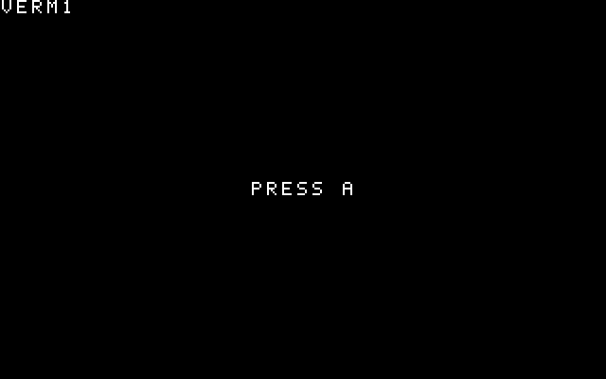
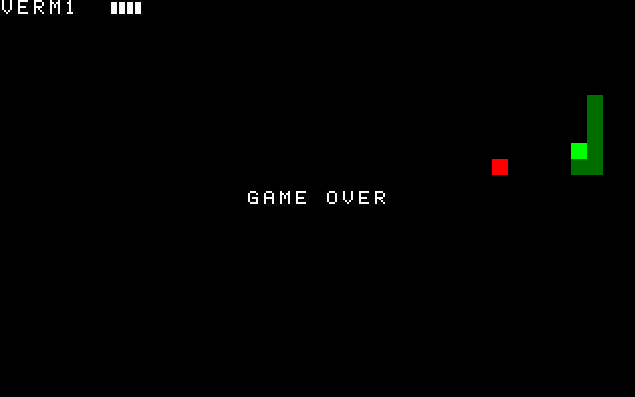
Where you are going
TITLE
PLAY: seven cells after four meals
OVER
Three screens, one program. Start from a Part 2 that runs; if yours does not, copy verm1_part2.S.
Notes:
The three screens you are going to build: the title with its invitation, the game with a worm of seven cells after four meals, and the game over. They are one program in three states. Start from a Part 2 that runs; if yours does not, copy the reference file of Part 2.
For the lecturer: Screenshots produced by tools/tests/verm1_check.py with a scripted player.

Slide 5
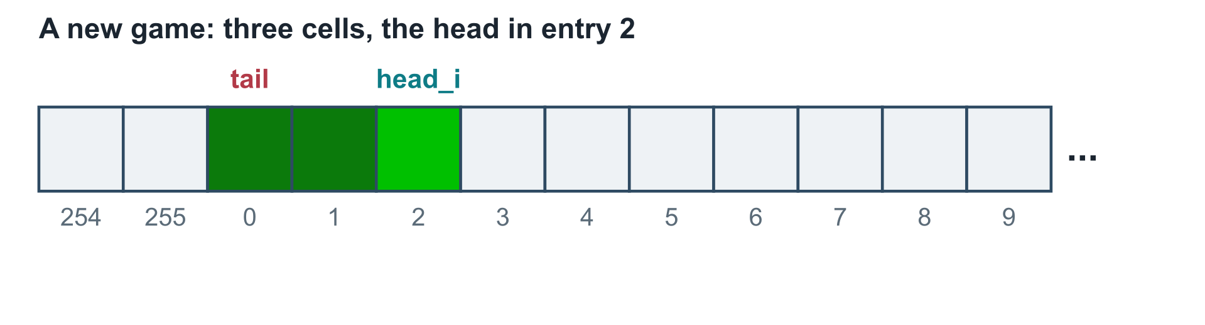
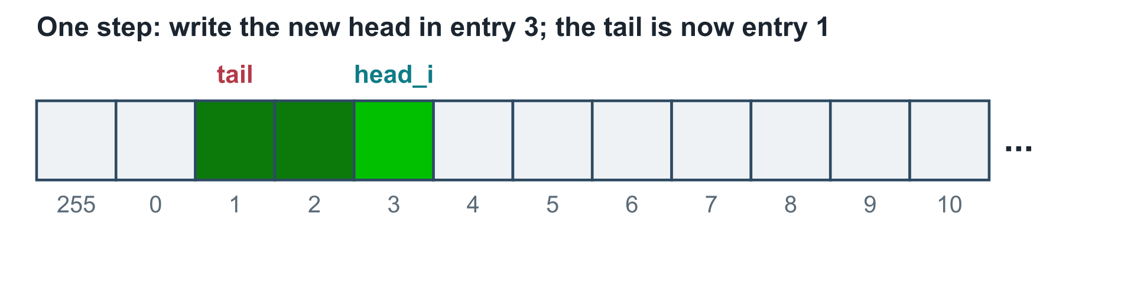
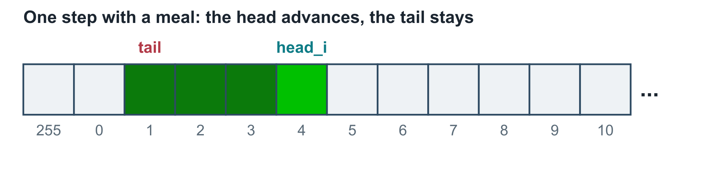
The body is a ring of 256 entries
UNDERSTAND NOW · arrays in memory
Two arrays of bytes, body_x and body_y: entry k holds the cell of one segment
Nothing is ever shifted: a step writes one new entry and moves an index
Two numbers describe the worm
– head_i: the entry of the head
– length: how many entries are in use
The tail is entry head_i - length + 1
After entry 255 comes entry 0: index AND 255. A ring
Notes:
The body is stored in two arrays of 256 bytes, body_x and body_y: entry k holds the column and the row of one segment. Nothing is ever shifted. Two numbers describe the worm: head_i, the entry of the head, and length, the number of entries in use; the tail is entry head_i - length + 1. A step writes one new entry after the head and advances head_i. If the worm has eaten the tail stays; otherwise it advances too. After entry 255 comes entry 0, which is an AND with 255: the array is a ring.
UNDERSTAND NOW: arrays in memory.
For the lecturer: A circular buffer, the structure behind every FIFO (first in, first out) queue; the address arithmetic is that of Lecture 15. Moving a worm of 200 cells costs the same as moving one of 3. The size 256 is chosen so that the wrap is one AND: a power of two.

Slide 6
The world is a map of 960 bytes
UNDERSTAND NOW · arrays in memory
Does the new head touch the body? Looking at every segment costs up to 255 comparisons
r x 40 + c
Instead keep a map: one byte per cell, 1 if a segment is there, 0 if not
The cell in column c of row r is byte number
– r x 40 + c, from 0 to 959
– its address is grid + r x 40 + c
A two-dimensional world in a one-dimensional memory: the address computation of Lecture 15
A step sets one byte, the new head, and clears one, the old tail
The collision test is a single load, whatever the length of the worm
Notes:
To know whether the new head touches the body, the program could compare it with every segment: up to 255 comparisons at each step. Instead it keeps a map of the world: one byte for each of the 960 cells, 1 if a segment is there and 0 if not. The cell in column c of row r is byte number r times 40 plus c. A step sets one byte and clears one, and the collision test becomes a single load. It is the classic exchange of memory for time. The price: map and ring must always agree.
UNDERSTAND NOW: arrays in memory.
For the lecturer: Memory for time: the classic exchange. The map and the ring say the same thing in two ways, and the program must keep them consistent: every write to one is paired with a write to the other.

Slide 7
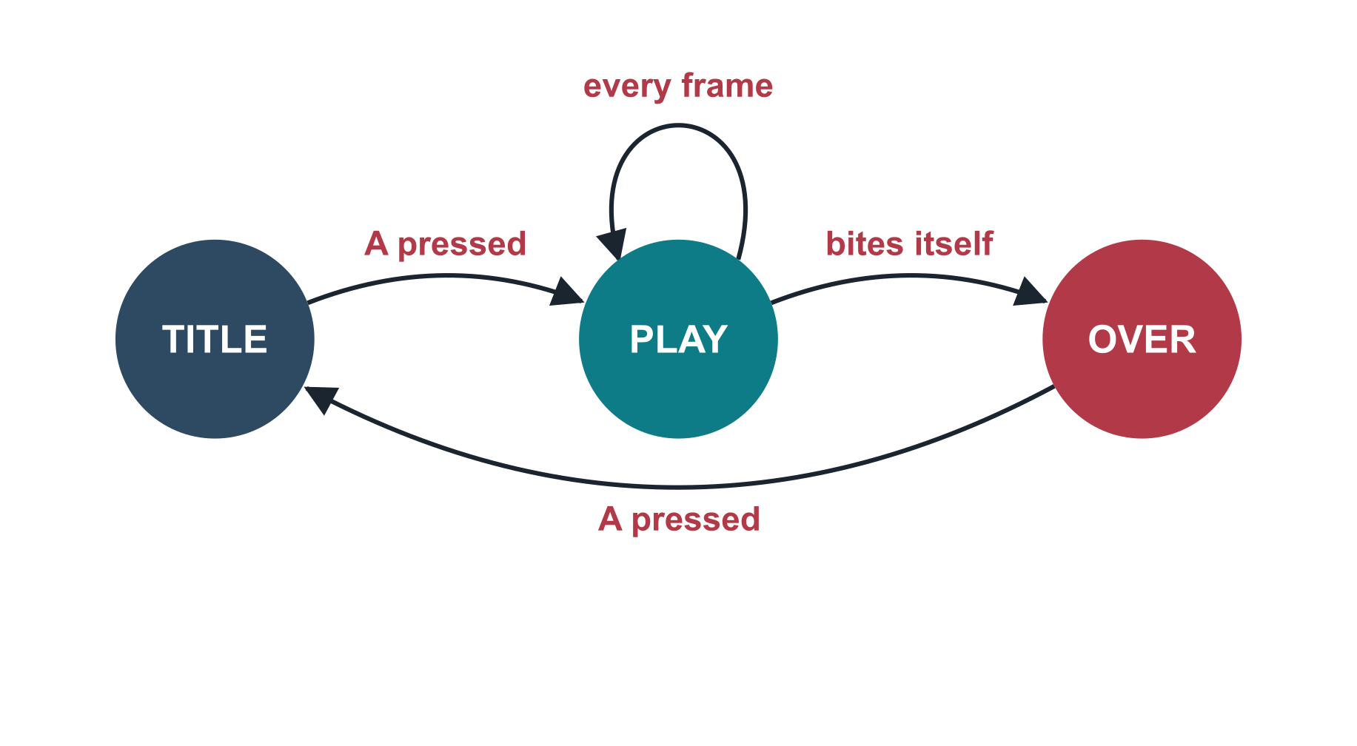
The game is a machine with three states
UNDERSTAND NOW · finite-state machines
The state is one word in memory
update looks at the state first, then at the inputs
A pressed means: down now, up one frame ago
Holding A must not skip the title: an edge, not a level
Present state | Input | Next state | Action
TITLE | A pressed | PLAY | new_game
PLAY | new head on the body | OVER | update the best score
OVER | A pressed | TITLE | -
Notes:
The state diagram of the game, as in Lecture 13: TITLE goes to PLAY when A is pressed; PLAY goes to OVER when the worm bites itself; OVER goes back to TITLE when A is pressed. The table adds the action of each transition. One detail decides whether the machine works: "A pressed" means down now and up one frame ago, an edge and not a level. Otherwise holding A would run through the states one per frame.
UNDERSTAND NOW: finite-state machines.
For the lecturer: The diagram and the table of Lecture 13, for our game. In every other case the state does not change. Draw it on the board before showing the code: the code is a transcription.

Slide 8
Watch the ring turn
USE NOW · the PRG32-QT debugger
1
Run in debug mode, press A to start a game, then pause
2
Press Update and put a breakpoint on the first instruction of step
3
Resume: the program stops once per step of the worm, not once per frame
4
Type the address of body_x in the Memory field: the bytes 03 04 05 of the start, then 06, 07 ... one new byte per step
5
Go down for a few steps: body_x repeats the same column, and body_y, 256 bytes further, counts the rows
6
Eat, and compare head_i and length before and after: both grow by one
Notes:
Put a breakpoint on the first instruction of step and resume: the program now stops once per step of the worm. Open the memory at the address of body_x: after the initial 03 04 05 a new byte appears at each step. Turn downwards: body_x repeats the same column, while body_y, 256 bytes further on, counts the rows. Eat, and compare head_i and length before and after: both have grown by one. The old bytes are never erased: the ring holds the history of the last 256 steps.
USE NOW: the PRG32-QT debugger (used, not studied, in this course).
For the lecturer: The bytes of the old positions are never erased: the ring keeps the whole history of the last 256 steps, and length says how much of it is still worm. After 256 steps the writing starts again from the first byte.

Slide 9
Catch the edge of button A
USE NOW · the PRG32-QT debugger
Frame | A is | s0 (now) | prev_btn | NOT prev | s1 = s0 AND NOT prev | Effect
n | up | 0x00 | 0x00 | 0xff...ff | 0x00 | -
n + 1 | down | 0x10 | 0x00 | 0xff...ff | 0x10 | transition
n + 2 | down | 0x10 | 0x10 | 0xff...ef | 0x00 | -
n + 3 | up | 0x00 | 0x10 | 0xff...ef | 0x00 | -
s1 is 0x10 in one frame only: the frame in which the button goes down.
Notes:
The edge of button A, frame by frame. While A is up everything is zero. In the frame in which A goes down, s0 is 0x10 and prev_btn is still 0: the AND with the negation gives 0x10, and the transition happens. In the following frames A is still down, but prev_btn is now 0x10 too, and the result is zero. One edge, one transition, however long the button is held.
USE NOW: the PRG32-QT debugger (used, not studied, in this course).
For the lecturer: Put a breakpoint on and s1, s0, t1 in verm1_update, hold A and press Resume three times: s1 is 0x10 in one frame only. The test of the reference file holds A for 28 frames and checks that exactly one transition happens.

Slide 10

Three questions for the debugger
USE NOW · the PRG32-QT debugger
Where is state? After la t0, state in verm1_update, t0 holds its address. Watch 00, 01, 02 as you play and lose
Is the map consistent with the ring? Pause, read the head from body_x and body_y, compute row x 40 + column, and look at that byte of grid
What did the fatal step see? Break on the lbu that follows the second mul in step: t1 is 1 exactly once, at the bite
A program is right when its memory is right: learn to read it
PRG32-QT: listing, registers, memory
Notes:
Three questions to answer with the debugger. Where is state, and what does it contain while you play and lose? Is the map consistent with the ring: does the byte at row times 40 plus column of the head contain 1? What did the fatal step see: at the lbu after the second mul in step, t1 is 1 exactly once, at the bite. The last line is a principle: a program is right when its memory is right.
USE NOW: the PRG32-QT debugger (used, not studied, in this course).
For the lecturer: The third question is the most instructive: s0 and s1 hold the cell the head wanted to enter, and the screen shows that it is part of the body.

Slide 11
Check your understanding
head_i = 1 and length = 4. Which entries of the ring hold the worm?
1
1, 2, 3, 4
0, 1, 2, 3
A
B
254, 255, 0, 1
253, 254, 255, 0
C
D
Which byte of grid describes the cell in column 7 of row 3?
2
byte 37
byte 127
A
B
byte 283
byte 307
C
D
Notes:
Compute the tail first: head_i - length + 1 is 1 minus 4 plus 1, minus 2. Masked with 255 it becomes 254. From there count four entries forward, wrapping after 255.
The formula of the map: row times 40 plus column. Do not swap the two: the option with 283 is 7 times 40 plus 3.
For the lecturer: 1. Answer: C. From the tail, head_i - length + 1 = -2, that is 254 after AND 255, up to the head: 254, 255, 0, 1.
2. Answer: B. 3 x 40 + 7 = 127.

Slide 12
Check your understanding
The player holds A down for two seconds on the title screen. What happens?
1
the game starts and ends at once
the game starts once
A
B
nothing, until A is released
the states cycle at every frame
C
D
Why is the tail's byte cleared before the head's byte is tested?
2
to save an instruction
so that the head can enter the cell the tail leaves
A
B
because sb is faster than lbu
the order does not matter
C
D
Notes:
Think in terms of edges. A is down for many frames, but only in the first of them is it "down now and up one frame ago".
In one step the tail leaves a cell and the head enters one. If they are the same cell, which of the two operations must be done first for the move to be legal?
For the lecturer: 1. Answer: B. Only the frame in which A goes down gives s1 = 0x10: one edge, one transition.
2. Answer: B. In the same step the tail moves away: that cell is free for the head.

Slide 13
Where we are, and what comes next
Verm1 is a game: it has a goal, a risk, a beginning and an end
A machine with three states, a ring of bytes, a map: sequential logic and memory, written as a program
Missing: it redraws the whole screen at every frame, the score is a row of marks, the speed never changes
Lectures 18 to 21 give the tools: how the processor executes, calls and division, how the video and the sound work
Part 4: the finished game
Notes:
Where you are. Verm1 is now a game, with a goal, a risk, a beginning and an end, and you can explain every line of it. It is sequential logic and memory written as a program: a machine with three states, a ring of bytes, a map. Three things are still rough: the whole screen is redrawn at every frame, the score is a row of marks, the speed never changes. The next four lectures open the machine that runs your code, and Part 4 finishes the game.
Learning status, recap. UNDERSTAND NOW: arrays in memory; finite-state machines; .text, .rodata, .data; latches and flip-flops; fixed point. USE NOW: the calling convention (Lecture 18) and, used without being studied in this course, the PRG32 tools, the PRG32-QT debugger. UNDERSTAND LATER: nothing. A slide without a badge is context: a story, an example, a question, an exercise.
For the lecturer: The students now have about 450 lines of assembly that they wrote and can explain. The next four lectures open the machine that runs them.

