Slide 1




UNDERSTAND NOW
USE NOW
UNDERSTAND LATER
Lecture deck. The listings, the complete program and how to test it are in the code deck:
21-Computer_Architecture-Input_Output-Code.pptx
ARC12 COMPUTER ARCHITECTURE · LECTURE 21
Input and Output
Displays, keyboards, mice and printers: how the machine meets the world, and how a program reads a button
“Need input!”
Number 5, in the film Short Circuit, John Badham, 1986
Prof. Raffaele Montella, PhD
University of Naples “Parthenope” · A.Y. 2026/27
raffaelemontella.it · raffaele.montella@uniparthenope.it
Notes:
This lecture is about the border between the machine and the world: the devices through which information enters and leaves. You will see how a picture is formed on a screen, what happens between a key and the processor, what a mouse says, how a laser printer works. The thread that ties them together is that each of these devices, inside, is made of machines you have already designed. And the lecture begins and ends on the kit, with the device you have used since the first laboratory: a button.
Learning status: UNDERSTAND NOW, by the end of this lecture you explain it, trace it and apply it on your own; USE NOW, you follow and use the recipe today; how it works inside is explained later, or is not part of the course; UNDERSTAND LATER, recognise the name and what it is for; a later lecture explains it. A slide without a badge is context: a story, an example, a question, an exercise.
Learning status of this lecture. UNDERSTAND NOW: polling, interrupts, DMA; CRT and LCD displays; keyboard and mouse; printers. USE NOW: the complete program, the PRG32 tools (used, not studied, in this course). UNDERSTAND LATER: nothing. A slide without a badge is context: a story, an example, a question, an exercise.
For the lecturer: Spiral: the students have read the joystick since the first labs; the lecture opens by asking what is behind prg32_input_read, then covers the classic devices and the three ways a processor can deal with them.

Slide 2
What you will be able to do by the end
1
Describe how a picture is formed on a CRT and on an LCD, and what a TFT active matrix adds
2
Explain the path of a key press: matrix, encoder, shift register, serial interface
3
Say what a mouse sends to the computer and how often
4
Describe the stages of laser printing
5
Explain how the PRG32 kit reads its joystick, and compare polling, interrupts and DMA
Notes:
Five objectives. Describe how a picture is formed on a cathode-ray tube and on a liquid crystal display, and what an active matrix adds. Explain the path of a key press: matrix, encoder, shift register, serial interface. Say what a mouse sends to the computer and how often. Describe the stages of laser printing. Explain how the kit reads its joystick, and compare three techniques: polling, interrupts and direct memory access.

Slide 3
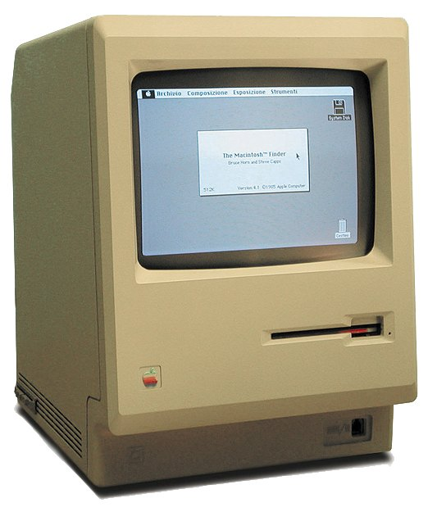
The video: an introduction
UNDERSTAND NOW · CRT and LCD displays
At first mostly character displays in black and white; today graphical and in colour
A graphical display is a matrix of points, the pixels, each lit with a different intensity
An image is composed by switching the pixels on and off
A different density of pixels gives a different resolution; colours go from 256 (8 bits) to 16 million (24 bits) and beyond
The size is measured in inches along the diagonal: a 14-inch display has a diagonal of 14 inches
A compact Macintosh: a 9-inch black-and-white CRT
Notes:
A graphical display is a matrix of points, the pixels, each lit with its own intensity; an image is composed by switching pixels on and off. The first displays showed only characters, in black and white. The density of the pixels gives the resolution, the bits per pixel give the number of colours, from 256 to sixteen million and more. The size is the length of the diagonal, in inches. The display of the kit measures 2.8 inches, with 320 by 240 pixels.
UNDERSTAND NOW: CRT and LCD displays.
For the lecturer: The display of the PRG32 kit: 2.8 inches, 320 by 240 pixels, 65,536 colours.
Pictures: Macintosh 128k transparency.png, Grm wnr, CC BY-SA 3.0, Wikimedia Commons.

Slide 4
The cathode-ray tube: a short history
UNDERSTAND NOW · CRT and LCD displays
Year | Who | What
early 1870s | William Crookes | the Crookes tube: the first cathode-ray tube, a laboratory instrument
1897 | Karl Ferdinand Braun | the Braun tube and the first cathode-ray oscilloscope: the first practical application
1907 | Boris Rosing | a CRT displays simple geometric shapes from a received video signal: the root of television
1934 | Telefunken | the first television set with a CRT on the market, in Germany
1970s-1990s | the computer industry | the CRT monitor: the display of every terminal and personal computer
Notes:
The cathode-ray tube has a history of more than a century. It was born as a laboratory instrument with Crookes, in the 1870s; Braun made it an oscilloscope in 1897, its first practical use; Rosing in 1907 used it to display shapes from a received signal, the root of television; in 1934 the first television set with a CRT reached the market. From the 1970s to the 1990s it was the display of every terminal and personal computer.
UNDERSTAND NOW: CRT and LCD displays.
For the lecturer: The last row summarises the era the original deck illustrated with pictures of an oscilloscope and of the Asteroids arcade cabinet (a vector display driven by a 6502).

Slide 5
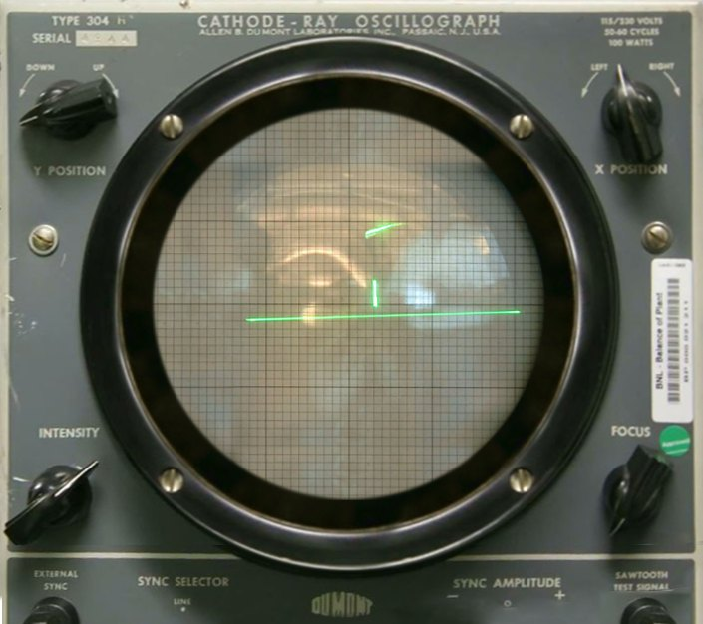
How a CRT works
UNDERSTAND NOW · CRT and LCD displays
The cathode is a small metal element heated to incandescence, which emits electrons by the thermionic effect
Inside the tube the electrons are directed into a beam by a high potential difference between cathode and anode
Other electromagnetic fields focus the beam
The beam, the electron brush, is deflected
– by magnetic fields (the Lorentz force), or by electric fields
It strikes a point on the inner surface of the screen, coated with phosphor, which lights up
Sweeping the beam line by line, many times per second, paints the picture
A cathode-ray oscilloscope used as a display
Notes:
How a CRT works. A cathode, heated to incandescence, emits electrons. A high voltage between cathode and anode accelerates them into a beam, which other fields focus. Magnetic or electric fields deflect the beam, which strikes a point of the screen: the inner surface is coated with phosphor, and the point lights up. By sweeping the beam line by line, many times per second, the whole picture is painted before the eye notices that the first points have faded.
UNDERSTAND NOW: CRT and LCD displays.
For the lecturer: The original schematic had Italian labels: grid, anode, deflection coil, heater, cathode, beam, focusing coil, fluorescent screen.
Pictures: Tennis For Two on a DuMont Lab Oscilloscope Type 304-A.jpg, Brookhaven National Laboratory, Public domain, Wikimedia Commons.

Slide 6
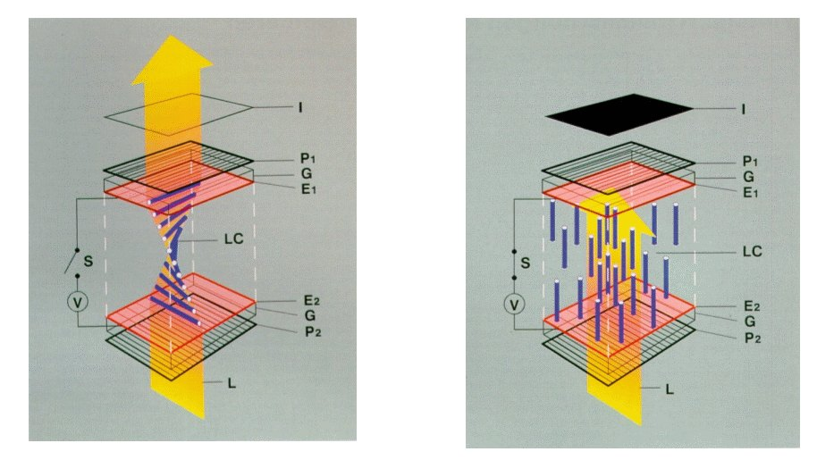
Liquid crystal displays
UNDERSTAND NOW · CRT and LCD displays
LCD monitors have almost completely replaced the cathode-ray tube
Advantages: a better picture; less bulk, weight and power; less eye strain
Liquid crystals are viscous organic molecules that flow like a liquid but have a spatial structure
An electric field changes the orientation of the molecules, and with it the optical properties of the crystal: the angle of polarisation of the light that crosses it
A crystal is a valve for light, opened and closed by a voltage
The layers of a liquid crystal display
Notes:
Liquid crystal displays have replaced the tube almost everywhere: better picture, less bulk, weight and power, less strain for the eyes. Liquid crystals are organic molecules that flow like a liquid but keep an ordered structure. An electric field changes their orientation, and with it the way they rotate the polarisation of the light that crosses them. The useful image is the last line of the slide: a crystal is a valve for light, opened and closed by a voltage.
UNDERSTAND NOW: CRT and LCD displays.
For the lecturer: LCD: liquid crystal display.
Pictures: TN-LCD-schematic-MS-208kB.png, see the file page, CC BY-SA 3.0, Wikimedia Commons.

Slide 7

Inside an LCD panel
UNDERSTAND NOW · CRT and LCD displays
The screen is made of many cells, often one per pixel, in which the liquid crystals are trapped
Each cell has electrical contacts, so that a field can be applied to the liquid it contains
The cells lie between two polarising filters whose axes are perpendicular to each other, with a light behind the rear one
Polarisation decides whether light passes
– crystals not driven: the light is rotated and crosses the front polariser
– crystals driven: the light is completely blocked
In a colour screen each cell is divided into three sections with a red, a green and a blue filter
Red, green and blue sub-pixels under the magnifier
Notes:
Inside a panel there are many cells, each with its contacts, placed between two polarising filters with perpendicular axes, and a light behind. When the crystals of a cell are not driven they rotate the light, which then passes the front filter; when they are driven the light is blocked. In a colour screen each cell is divided in three, with a red, a green and a blue filter: these are the sub-pixels in the photograph, and the three fields of an RGB colour end up there as three voltages.
UNDERSTAND NOW: CRT and LCD displays.
For the lecturer: Three sub-pixels per pixel: the R, G and B fields of the RGB565 colour of Lecture 04 end up here, as three voltages.
Pictures: Subpixel rendering LCD photo 3e composite.jpg, ALexL33, CC BY-SA 3.0, Wikimedia Commons.

Slide 8
Driving the cells: from segments to the active matrix
UNDERSTAND NOW · CRT and LCD displays
Segments and passive matrix
Active matrix: TFT
Calculators and digital watches: one electrical contact per segment
Impossible as the number of elements grows
Passive matrix: one group of contacts per row and per column, not per pixel
Only one pixel at a time is driven: the others must remember their state
Problems: persistence (trails behind moving objects) and crosstalk
Used for high-resolution screens
The panel contains a thin film of transistors, on a transparent semiconductor layer
The field is applied exactly where needed by a transistor in each cell
The transistor stores the electrical state of its pixel while the others are updated
Each pixel is, in effect, a one-bit analogue memory cell
Notes:
How are millions of cells driven? A calculator has one contact per segment, which is impossible for a screen. A passive matrix has contacts per row and per column: only one pixel at a time is driven, and the others must remember their state by themselves, which they do badly; hence trails and crosstalk. An active matrix puts a transistor in every cell, in a thin film on the glass: the transistor keeps the state of its pixel while the others are updated. This is TFT, the technology of the display of the kit.
UNDERSTAND NOW: CRT and LCD displays.
For the lecturer: TFT: thin-film transistor. The display of the kit is a TFT panel with an ILI9341 controller. New since the original deck: OLED displays, in which each pixel emits its own light and no backlight is needed.

Slide 9
The keyboard
UNDERSTAND NOW · keyboard and mouse
Derived from that of typewriters; the main character input device
Its keys are grouped
– alphanumeric keys
– special keys: enter, backspace, ...
– arrow keys and function keys
Keyboard and video are not directly connected to each other
It is the processor that reproduces on the video the information typed on the keyboard
Today's keyboards connect through USB, or wirelessly
Notes:
The keyboard derives from that of the typewriter and is the main device for entering characters. Its keys are grouped: alphanumeric, special, arrows and functions. Remember one fact, already met in the previous lecture: the keyboard and the video are not connected to each other. When a letter you type appears on the screen, it is because a program read a code from the keyboard and drew a character. Today keyboards are connected by USB or by radio.
UNDERSTAND NOW: keyboard and mouse.
For the lecturer: PS/2 was the standard connector before USB. The echo of a key on the screen is a program: read a code, draw a character.

Slide 10
The path of a key press
UNDERSTAND NOW · keyboard and mouse
Q
W
E
R
T
Y
encoder
row and column
to an n-bit code
shift register
n bits in parallel
to n bits in series
serial interface
for example
a USB controller
A
S
D
F
G
H
Z
X
C
V
B
N
rows and columns of switches
system bus
The keyboard is managed by a keyboard controller
The encoder turns a combination of row and column into a code of n bits: the encoder of Lecture 11
The shift register turns the n bits into a sequence, to be handled serially: the shift register of Lecture 14
The serial interface sends the code to the system bus in the proper way, and raises an interrupt
Notes:
The path of a key press, from left to right. The keys are switches arranged in rows and columns: pressing D closes one crossing. An encoder turns the combination of row and column into a code of n bits. A shift register turns those n bits in parallel into n bits in series. A serial interface, for example a USB controller, delivers the code to the system bus and raises an interrupt. The encoder is that of Lecture 11, the shift register that of Lecture 14: you have designed every block of this slide.
UNDERSTAND NOW: keyboard and mouse.
For the lecturer: Every block of this slide is a machine the students have already designed: this is the pay-off of Lectures 11 to 14.

Slide 11
The mouse
UNDERSTAND NOW · keyboard and mouse
Invented in the 1960s by Douglas Engelbart: the first pointing device in history
A wooden box with two wheels underneath and a wire leaving from the back, like the tail of a mouse
The two wheels detected the movements along the horizontal and the vertical axis; the electronics turned them into electrical signals
Mechanical mouse: a ball turns two rollers, each driving a counter
Optical mouse: a light source and a tiny camera measure the movement of the surface underneath
Notes:
The mouse was invented in the 1960s by Douglas Engelbart: a wooden box with two wheels underneath and a wire coming out of the back, like a tail. The two wheels measured the movement along the two axes. In the mechanical mouse a ball turns two rollers, each connected to a counter. In the optical mouse a light and a tiny camera observe the surface below and measure how it moves. In all three, movement becomes two numbers.
UNDERSTAND NOW: keyboard and mouse.
For the lecturer: The original deck dates the mouse to 1967, the year the patent was filed; the first prototype is of 1964 and the famous public demonstration of 1968. Counters: the sequential machines of Lecture 13.

Slide 12
What a mouse sends
UNDERSTAND NOW · keyboard and mouse
Every time it moves by a minimum distance, about a hundredth of an inch, called a mickey, the mouse sends three bytes
two counters
x and y movement
Byte 1: how many units it moved along x since the last report
shift register
three bytes, in series
Byte 2: the movement along y
Byte 3: the state of the buttons
serial interface
USB controller
The control software, the device driver, supervises the communication with the processor
dx
dy
buttons
Notes:
What a mouse sends. Each time it moves by a minimum distance, about a hundredth of an inch, it sends three bytes: the movement along x since the last report, the movement along y, and the state of the buttons. Note that it sends movements, not positions: it is the program that keeps the position of the pointer, by adding. Inside, as on the right: two counters, a shift register, a serial interface. The software that talks to the device is its device driver.
UNDERSTAND NOW: keyboard and mouse.
For the lecturer: The original deck says the first byte reports the movement 'in the last 100 milliseconds'; modern mice report up to a thousand times per second. The signed movement bytes are two's complement numbers (Lecture 05).

Slide 13
The printer
UNDERSTAND NOW · printers
An output device that prints information on paper
Printing speed: lines per minute, characters per second or pages per minute
Resolution, the print quality: dots per inch
Kinds
– daisy wheel and chain printers, now disused
– dot matrix: needles strike an inked ribbon
– ink jet: tiny drops of ink
– laser
A printer is also a small computer: it has its own processor, memory and firmware
Notes:
A printer is described by its speed, in lines or pages per minute, and by its resolution, in dots per inch. The technologies, in historical order: daisy wheel and chain printers, which struck whole characters and are disused; dot matrix, in which needles strike an inked ribbon; ink jet, with tiny drops of ink; laser. A printer is also a small computer, with its own processor, memory and firmware.
UNDERSTAND NOW: printers.
For the lecturer: Stampante a margherita, a catena, ad aghi, a getto di inchiostro, laser.

Slide 14
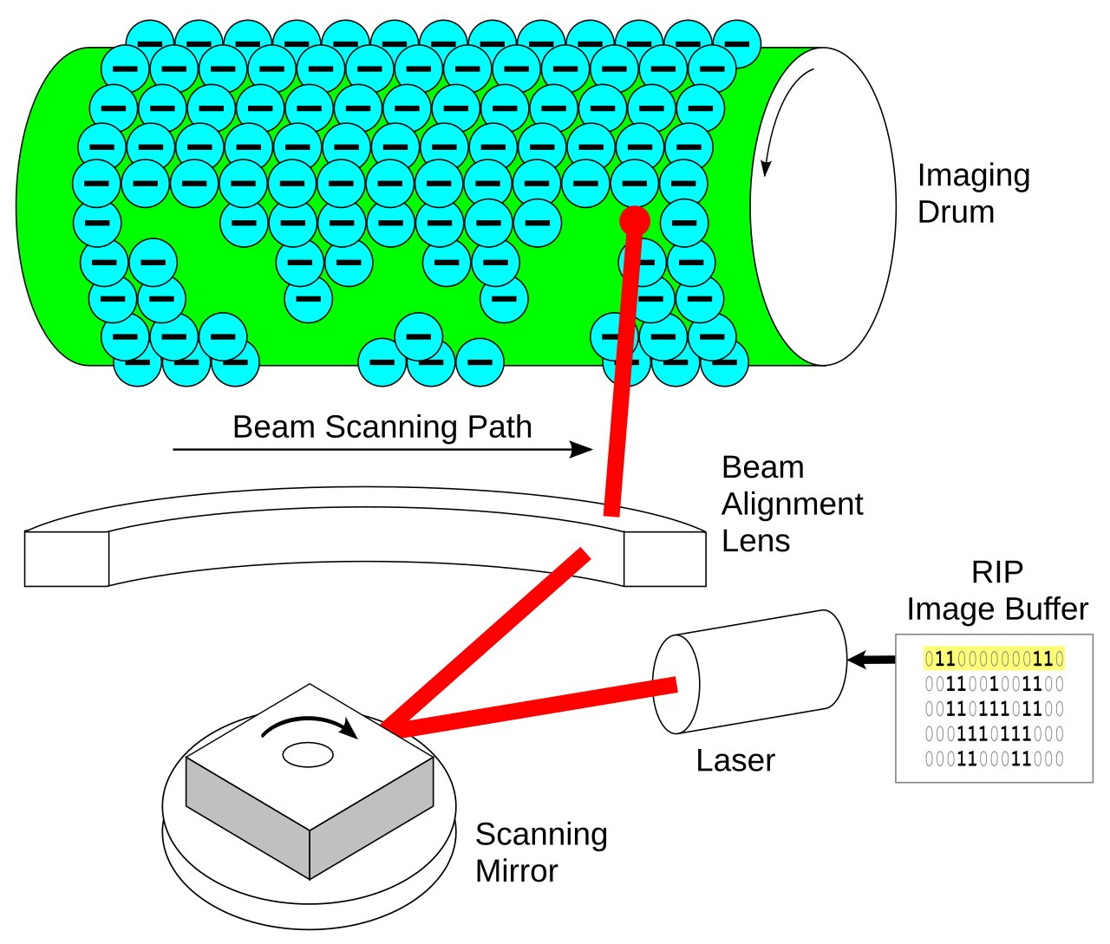
The laser printer
UNDERSTAND NOW · printers
It derives from the photocopier
A drum is charged electrically, to about 1,000 volts
A laser beam, reflected by a rotating mirror, scans the length of the drum; the beam is modulated to produce a pattern of light and dark points
The points struck by the beam lose their charge; after each line the drum turns a fraction of a degree
The toner is attracted by the points that are still charged: an image of the line is formed
The drum is pressed against the paper and transfers the toner; heated rollers fix it permanently; the drum is discharged and cleaned
The laser writes the page on the drum, line by line
Notes:
The laser printer derives from the photocopier. A drum is charged to about a thousand volts. A laser beam, reflected by a rotating mirror, scans the drum along its length, switched on and off to draw one line of points; the points it strikes lose their charge. The toner is attracted by the points still charged. The drum is pressed against the paper and transfers the toner, which heated rollers fix. Follow the path of the paper in the figure. The page exists first as a bitmap in the printer's memory.
UNDERSTAND NOW: printers.
For the lecturer: Three slides of the original are merged. The page is first built as a bitmap in the printer's memory: a frame buffer for paper.
Pictures: Laser printer-Writing.svg, DMahalko, traced by Stannered, CC BY 3.0, Wikimedia Commons.

Slide 15
The devices of the PRG32 kit
UNDERSTAND NOW · polling, interrupts, DMA
Device | Direction | How it is connected | How a cartridge uses it
joystick and buttons | input | one switch per input pin (GPIO) | prg32_input_read: one bit per button
display, 320 x 240 TFT | output | SPI serial bus, with DMA | prg32_gfx_* calls draw into the frame buffer
amplifier and speaker | output | I2S serial bus | prg32_audio_* calls: notes, samples, music
Wi-Fi radio | input and output | inside the chip | cartridge upload, the Store, multiplayer
USB serial port | input and output | USB | flashing the firmware, debug messages
Notes:
The devices of the kit in a table: for each, the direction, the connection and the functions with which a cartridge uses it. The joystick and the buttons are inputs, one switch per pin. The display is an output on an SPI bus. The amplifier with its speaker is an output on an I2S bus. The Wi-Fi radio and the USB port work in both directions. Notice that you have never touched any of these connections directly: the runtime does it, and offers you functions.
UNDERSTAND NOW: polling, interrupts, DMA.
For the lecturer: Hardware from the PRG32 README and docs/hardware. A switch bounces for a few milliseconds when pressed; sampling it once per frame, every few tens of milliseconds, hides the bounce.

Slide 16
Three ways to deal with a device
UNDERSTAND NOW · polling, interrupts, DMA
1
Polling
2
Interrupts
3
Direct memory access
The program asks the device, again and again, whether it has something. Simple, and what a game does once per frame; wasteful when nothing happens.
The device asks for attention when it needs it; the processor suspends what it is doing, serves the device and resumes. The subject of Lecture 19.
The device exchanges whole blocks of data with the memory by itself; the processor only starts the transfer and is told when it ends.
Notes:
Three ways to deal with a device. Polling: the program asks the device, again and again, whether it has something; simple, and wasteful when nothing happens. Interrupts: the device asks for attention when it needs it, as in Lecture 19. Direct memory access: the device exchanges whole blocks of data with the memory by itself, and the processor is only told when it has finished. On the kit all three are at work: you poll the joystick, the timer interrupts, the display and the sound are fed by DMA.
UNDERSTAND NOW: polling, interrupts, DMA.
For the lecturer: Programmed I/O, interrupt-driven I/O and DMA. On the kit all three are at work: your game polls the joystick, the timer that paces the frames interrupts, the display and the sound are fed by DMA.

Slide 17
Check your understanding
What does the encoder of a keyboard controller do?
1
It lights the key that was pressed
It turns a row and column combination into a key code
A
B
It sends the code to the monitor
It counts how long a key is held
C
D
In a colour LCD, a pixel is made of:
2
one cell that changes colour
three cells with red, green and blue filters
A
B
a phosphor dot hit by electrons
a transistor that emits light
C
D
Notes:
Think of the diagram of the key press: what goes into the encoder, and what comes out?
Recall the photograph of the pixels under the magnifier: how many coloured elements make up one pixel?
For the lecturer: 1. Answer: B. From a decoded position in the key matrix to a compact n-bit code, as the encoder of Lecture 11.
2. Answer: B. Three sub-pixels, each a liquid crystal cell behind a colour filter; a TFT in each stores its state.

Slide 18
Check your understanding
Why does a passive-matrix LCD show trails behind moving objects?
1
Its backlight is too weak
Its pixels are driven one at a time and must hold their state in between
A
B
It has too few colours
The video card is slow
C
D
A PRG32 game reads the joystick once per frame. This technique is called:
2
direct memory access
interrupt-driven input
A
B
polling
memory mapping
C
D
Notes:
The answer is in what a passive matrix lacks: something in each cell that keeps its state while the others are being driven.
Who takes the initiative, the program or the device? In the warm-up it is the program, once per frame.
For the lecturer: 1. Answer: B. Persistence: without a transistor per pixel, the cells respond slowly and keep their state badly while the others are scanned.
2. Answer: C. The program asks the device periodically. With interrupts the device would call the program.

Slide 19
Glossary: English and Italian
English | Italiano | English | Italiano
cathode-ray tube | tubo a raggi catodici | pointing device | periferica di puntamento
liquid crystals | cristalli liquidi | dot-matrix / ink-jet printer | stampante ad aghi / a getto d'inchiostro
backlight | retroilluminazione | drum / toner | tamburo / toner
active matrix | matrice attiva | polling | interrogazione ciclica
keyboard / key | tastiera / tasto | device driver | driver di periferica
Notes:
Ten terms. A cathode-ray tube is a tubo a raggi catodici; the backlight is the retroilluminazione. A pointing device is any device, like the mouse, that indicates a position. Dot-matrix and ink-jet printers are ad aghi and a getto d'inchiostro. Polling is interrogazione ciclica, though the English word is the one in use.

Slide 20
Conclusions and reading
Input/output devices are a fundamental component of computers
Display technology has made enormous progress, from the electron beam to a transistor behind every pixel
Keyboard, mouse and printer have changed little in form, and inside they are built from encoders, counters and shift registers
A device reaches the processor through a controller and a bus, and is handled by polling, by interrupts or by DMA
On the PRG32 kit the whole chain, from a switch to a pixel, can be followed instruction by instruction
Reading
– Tanenbaum, Austin: Structured Computer Organization, section 2.4 (input/output)
– Stallings: Computer Organization and Architecture, chapter on input/output
– Playing with RISC-V, chapter 6: State and Input
Notes:
Five conclusions. Input/output devices are a fundamental part of computers. Display technology has gone from an electron beam to a transistor behind every pixel. Keyboard, mouse and printer have changed little outside, and inside are made of encoders, counters and shift registers. A device reaches the processor through a controller and a bus, and is handled by polling, interrupts or DMA. And on the kit the whole chain, from a switch to a pixel, can be followed instruction by instruction. Next comes the last part of Verm1.
Learning status, recap. UNDERSTAND NOW: polling, interrupts, DMA; CRT and LCD displays; keyboard and mouse; printers. USE NOW: the complete program, the PRG32 tools (used, not studied, in this course). UNDERSTAND LATER: nothing. A slide without a badge is context: a story, an example, a question, an exercise.
For the lecturer: Next: Verm1, part 4: the finished game. Then its publication on the Cartridge Store.

