Slide 1




UNDERSTAND NOW
USE NOW
UNDERSTAND LATER
Lecture deck. The listings, the complete program and how to test it are in the code deck:
07-Computer_Architecture-Verm1_Part_1-Lab.pptx
ARC12 COMPUTER ARCHITECTURE · LECTURE 07
Verm1, Part 1: A Head That Crosses the World
The course project begins: a grid, a cell, a speed in fixed point
“The journey of a thousand miles begins with a single step.”
Laozi, Tao Te Ching
Prof. Raffaele Montella, PhD
University of Naples “Parthenope” · A.Y. 2026/27
raffaelemontella.it · raffaele.montella@uniparthenope.it
Verm1 reference implementation contributed by Giuseppe Coviello
Notes:
The course project begins here. This is a tutorial rather than a lecture: a program is written step by step, and at the end it runs. It draws exclusively on Lectures 02 to 06: registers and memory, colours and strings as numbers, comparisons and shifts, fixed point. The cover shows the state of the screen two hours from now: a title and a green square, the head of the worm, crossing the screen unaided. The purpose of the session is integration: concepts studied separately must now cooperate within one program. The reference implementation was contributed by Giuseppe Coviello.
Learning status: UNDERSTAND NOW, by the end of this lecture you explain it, trace it and apply it on your own; USE NOW, you follow and use the recipe today; how it works inside is explained later, or is not part of the course; UNDERSTAND LATER, recognise the name and what it is for; a later lecture explains it. A slide without a badge is context: a story, an example, a question, an exercise.
Learning status of this lecture. UNDERSTAND NOW: the Verm1 project; the init, update, draw contract; a colour is a number; arrays in memory; .text, .rodata, .data; address, value, load, store; why ra is saved; shifts as multiplications; fixed point; pseudo-instructions; little-endian byte order. USE NOW: the PRG32 tools, the PRG32-QT debugger (used, not studied, in this course). UNDERSTAND LATER: instruction formats (Lecture 19). A slide without a badge is context: a story, an example, a question, an exercise.
For the lecturer: First project tutorial. It uses only Lectures 02 to 06: registers, load and store, calls (02), strings and colours (04), integers, comparisons and wrap-around (05), fixed point (06), and a little history (03). The students type the program themselves; the reference file is verm1/verm1_part1.S. Everything on the code slides is read from that file, which is built and run automatically.

Slide 2
What you will have by the end
1
A cartridge of your own, verm1.prg32, built from one assembly file that you typed
2
A title, a grid of 40 by 24 cells, and the head of the worm drawn in one of them
3
The head moving by itself, one cell at a time, at a speed you control in fixed point
4
A world with no edges: past the last column the head comes back from the first
5
The habit of the working loop: edit, build, run, look, and stop the program in the debugger
Notes:
Five outcomes. A cartridge of the student's own, built from a single file typed by hand. A title, a grid of 40 by 24 cells, and the head drawn in one of them. The head moving autonomously, one cell at a time, at a speed expressed in fixed point. A world without edges, in which the head that leaves on the right re-enters on the left. And, more important than the program itself, a method: the working loop of edit, build, run and observe, with the debugger as an ordinary instrument rather than a last resort.

Slide 3

Verm1: a tribute to Snake
UNDERSTAND NOW · the Verm1 project
Verm1, read "vermone", the big worm: a worm that moves on a grid, eats, grows, and must not bite itself
A game with a long history
– Blockade, an arcade machine by Gremlin, 1976
– Snake on the Nokia 6110, 1997: one of the most played games ever
Small enough to write from scratch in assembly, rich enough to need every topic of the course
You write every line: no engine, no library beyond the PRG32 calls
This is where you are going: the picture on the right is the game of Part 4
Verm1 at the end of the course (Part 4)
Notes:
Verm1, pronounced "vermone", is a tribute to Snake: a worm moves on a grid, eats, grows, and must not collide with itself. The idea goes back to the arcade game Blockade of 1976 and achieved wide popularity on the Nokia phones of 1997. It was chosen because it is small enough to be written from scratch in assembly yet requires every topic of the course. Every line is written by the student, with no engine underneath. The picture on the right shows the destination, reached in Part 4.
UNDERSTAND NOW: the Verm1 project.
For the lecturer: Snake for the Nokia 6110 was written by Taneli Armanto. Verm1 is a tribute, not a copy: the name, the rules of detail and the look are ours. The reference implementation that the tutorials follow was contributed by Giuseppe Coviello.

Slide 4
The plan: four parts and a publication
UNDERSTAND NOW · the Verm1 project
Deck | You add | It uses Lectures
07 Part 1 | a grid, a head, automatic movement, wrap-around | 03 to 06: information and numbers
12 Part 2 | steering with the joystick, food, a score | 08 to 11: logic and circuits
17 Part 3 | a body that grows, collisions, title and game-over screens | 13 to 16: state and memory
22 Part 4 | fast drawing, a score in digits, levels, sound: the finished game | 18 to 21: the machine
23 The Store | a bundle with manifest, icon and credits, ready for review | all of them
Notes:
The plan of the project. Each row is a tutorial, what it adds and the lectures on which it draws. Part 1, today: a grid, a head, autonomous movement. Part 2, Lecture 12: steering, food and a score. Part 3, Lecture 17: a growing body and collisions. Part 4, Lecture 22: the finished game. Lecture 23 prepares the bundle for the Store. One rule applies to every part: never begin from a program that does not run. A student whose file is broken starts again from the reference file, so that every session builds on a working foundation.
UNDERSTAND NOW: the Verm1 project.
For the lecturer: Each part ends with a program that runs. Never start a part with a program that does not: if yours is broken, start from the reference file of the previous part.

Slide 5
What Part 1 takes from the lectures
From | Idea | Where it appears today
Lecture 02 | registers, la / lw / sw, call and the stack frame | everywhere
Lecture 03 | retro games as specimens | the choice of the game
Lecture 04 | colours as RGB565 numbers; strings ending with zero | GREEN, the title
Lecture 05 | shifts as multiplications; comparisons; wrap-around | cell to pixel; the edge of the world
Lecture 06 | fixed point: a fraction as a scaled integer | the speed of the worm
Notes:
Nothing in today's program is new: each idea is traceable to a lecture. Registers, la, lw, sw, procedure calls and the stack frame come from Lecture 02. Colours as RGB565 numbers and zero-terminated strings come from Lecture 04. Shifts as multiplications, comparisons and wrap-around come from Lecture 05. Fixed point, a fraction held as a scaled integer, comes from Lecture 06 and becomes the speed of the worm. The table should remain open throughout the session: when a line of code is puzzling, its third column indicates which lecture to revisit.

Slide 6
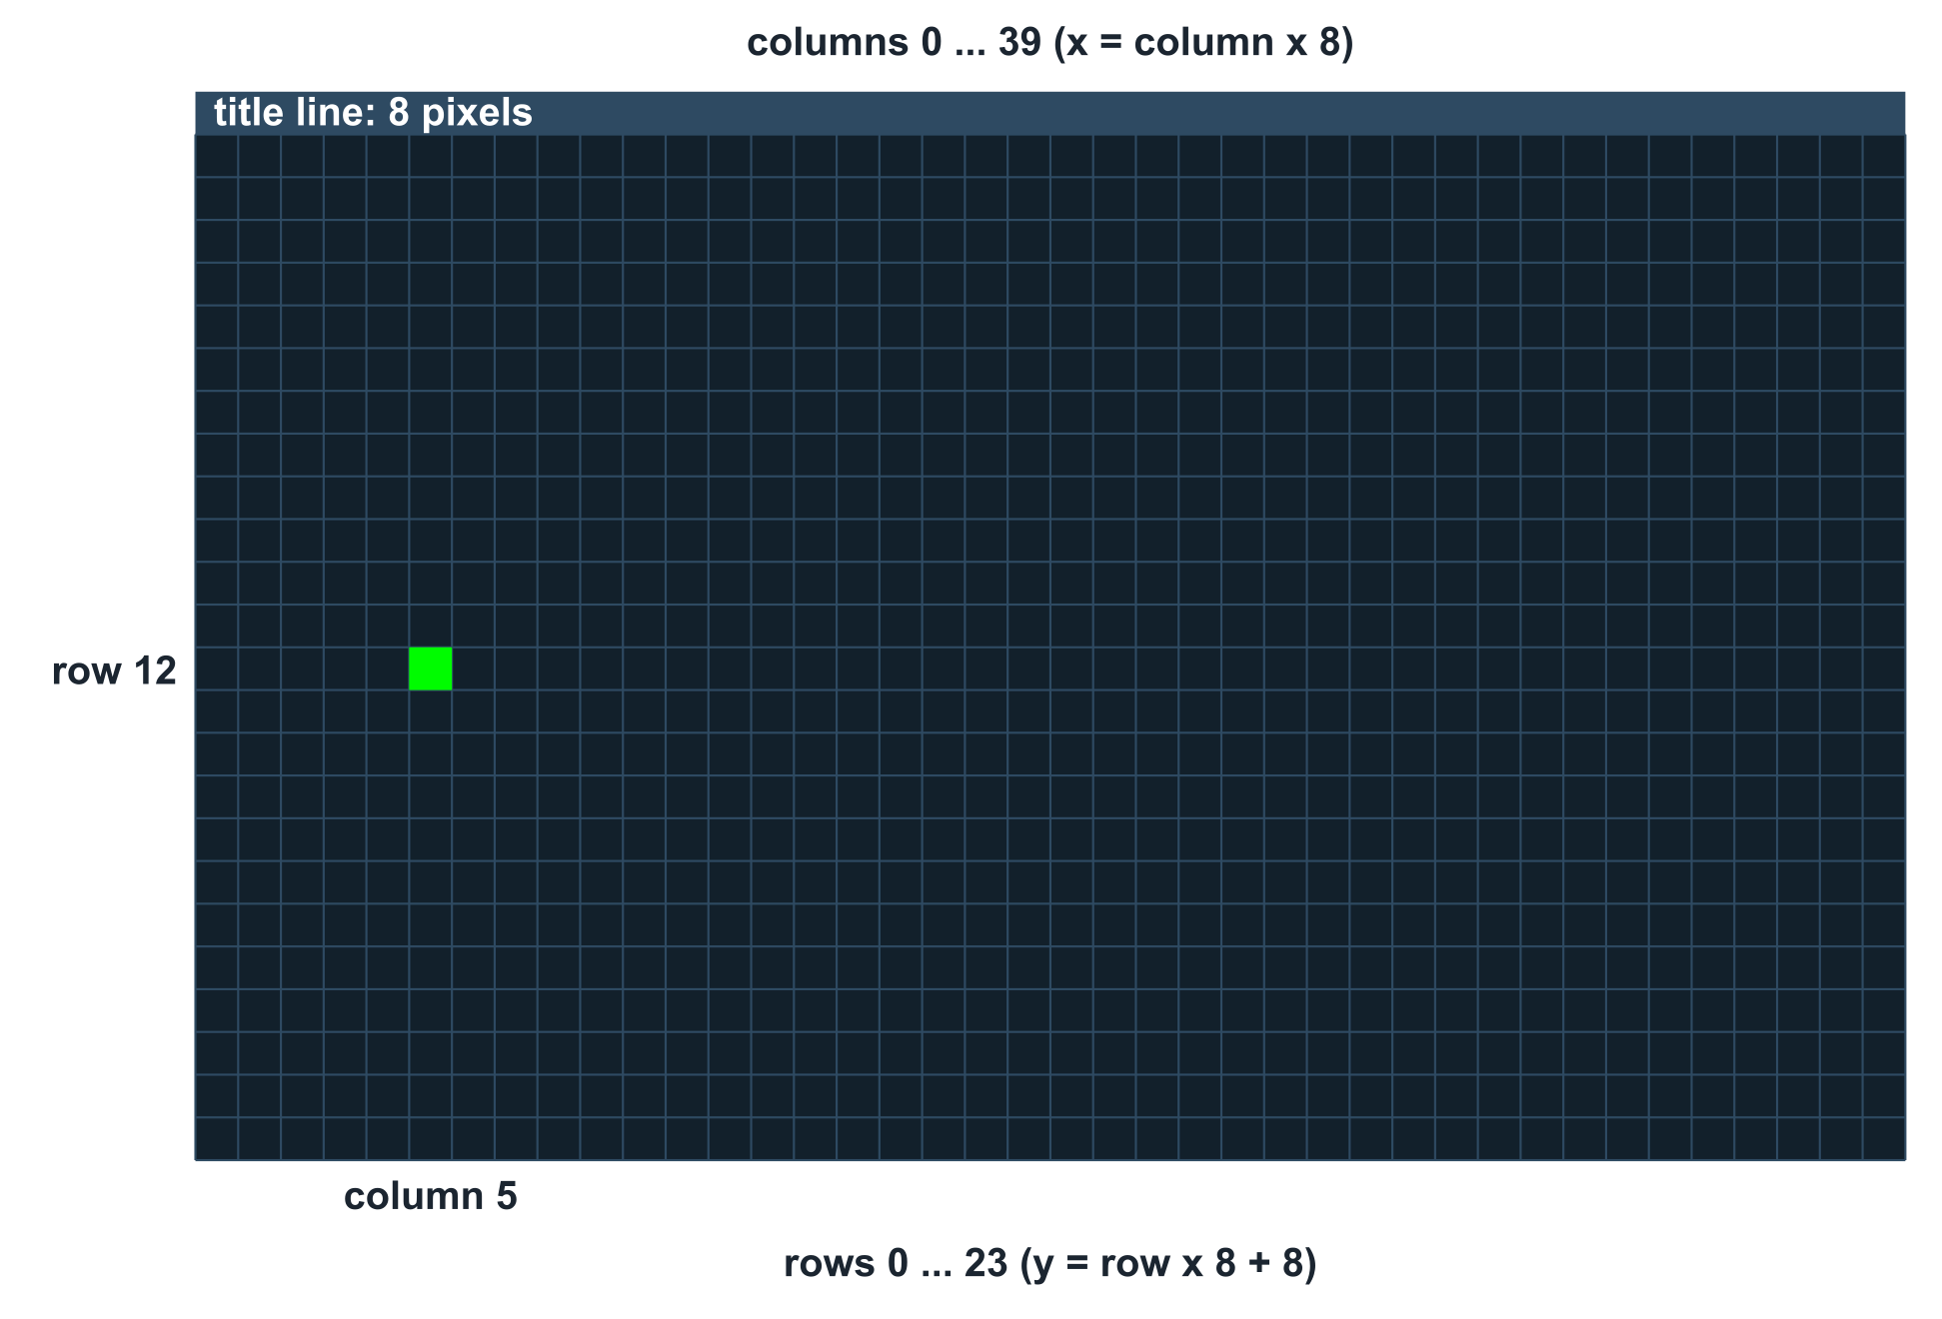
The world of Verm1
UNDERSTAND NOW · arrays in memory
The worm does not live in pixels: it lives in cells
A position is a column, 0 to 39, and a row, 0 to 23
To draw a cell, turn it into pixels
– x = column x 8: a shift left by 3
– y = row x 8 + 8: the title line comes first
The head starts in column 5 of row 12
Thinking in cells makes every later rule simple: moving is adding 1
Notes:
The worm inhabits cells, not pixels. A position is a column from 0 to 39 and a row from 0 to 23, and the head starts in column 5 of row 12, the highlighted cell. To draw a cell, its coordinates are mapped to pixels: x is the column times 8, a left shift by 3; y is the row times 8 plus 8, to leave room for the title line. This change of coordinate system is a modelling decision with lasting benefits: in cell coordinates every later rule is simple, since moving is adding 1 and two objects collide exactly when their cells are equal.
UNDERSTAND NOW: arrays in memory.
For the lecturer: Draw the grid on the board and ask for the pixel coordinates of a few cells: (0,0) is at (0,8); (39,23) is at (312,192).

Slide 7
How fast should a worm go?
UNDERSTAND NOW · fixed point
update runs about thirty times per second
One cell per frame would cross the screen in little more than a second: unplayable
40 / 256
We want a fraction of a cell per frame, and the processor of the kit has only integers
Fixed point, Q24.8: keep the fraction in 1/256 of a cell, and take a step each time a whole cell has accumulated
of a cell per frame: a step when the sum passes 256, and the remainder is not thrown away
SPEED_Q8 = 40 means 40/256 = 0.156 cells per frame: about one step every 6 frames
Notes:
update runs approximately thirty times per second. At one cell per frame the head would cross the forty columns in little more than a second, which is unplayable. A fraction of a cell per frame is required. The solution keeps an accumulator in units of 1/256 of a cell, adds the speed to it at every frame, and advances by one cell whenever a whole cell, 256 units, has accumulated. With SPEED_Q8 equal to 40, the head advances 40/256 of a cell per frame, one step roughly every six frames. Because the remainder is retained rather than discarded, the average speed is exact.
UNDERSTAND NOW: fixed point.
For the lecturer: This is the ball of Lecture 06, turned into a timer. The remainder is kept, so the average speed is exact: 256 frames give exactly 40 steps.

Slide 8
Trace it by hand
UNDERSTAND NOW · fixed point
Frame | step_q8 before | + 40 | Whole cell? | step_q8 after | head_x
1 | 0 | 40 | no | 40 | 5
2 | 40 | 80 | no | 80 | 5
6 | 200 | 240 | no | 240 | 5
7 | 240 | 280 | yes: 280 - 256 | 24 | 6
13 | 224 | 264 | yes: 264 - 256 | 8 | 7
64 | - | - | - | 0 | 15
The steps come every 6 or 7 frames: the remainder carries the difference, as in a leap year.
Notes:
A trace by hand, the most instructive exercise of the tutorial. At each frame 40 is added to the accumulator. During frames 1 to 6 the sum remains below 256 and the head does not move. At frame 7 it reaches 280: a whole cell has accumulated, 256 is subtracted, 24 remains, and the head moves from column 5 to column 6. Steps thus occur every six or seven frames, and the remainder absorbs the difference, much as the extra day of a leap year reconciles the calendar with the solar year. Frames 8 to 12 are left to be completed.
UNDERSTAND NOW: fixed point.
For the lecturer: After 64 frames the sum is 64 x 40 = 2560 = 10 x 256: ten steps, head in column 15, exactly what the screenshot shows. Ask the students to fill in frames 8 to 12.

Slide 9
Stop the program and read the machine
USE NOW · the PRG32-QT debugger
1
In PRG32-QT open Settings and enable: Run cartridges in RISC-V debug mode
2
Run your cartridge: the game is on the left, the debugger on the right
3
Press Update: the listing jumps to verm1_update. Click in the gutter to put a breakpoint on its first instruction
4
The program stops there at the next frame. Press Step and watch the registers change, one instruction at a time
5
After the two instructions of la, t0 holds an address: type it in the Memory field to see step_q8 in memory
6
Resume, and watch the bytes of step_q8 grow by 40 (0x28) at every stop
Notes:
A precise debugging procedure. Debug mode is enabled in Settings and the cartridge run. Update displays verm1_update in the listing; a click in the gutter beside its first instruction sets a breakpoint, at which the program halts on the next frame. Stepping one instruction at a time, the registers are observed. After the two instructions into which la expands, t0 holds an address; entering it in the Memory field reveals the bytes of step_q8. Each Resume executes one frame, and the value increases by 40, that is, 0x28.
USE NOW: the PRG32-QT debugger (used, not studied, in this course).
For the lecturer: From the PRG32-QT debugging guide: pause, resume, step; Init / Update / Draw / PC views; gutter breakpoints; a 128-byte memory view. Resume ignores the current breakpoint once, so each press of Resume runs one whole frame.

Slide 10

Reading memory: little-endian, live
UNDERSTAND NOW · little-endian byte order
The Memory view shows 128 bytes from the address you typed, in hexadecimal
step_q8 is a word of .data: its four bytes come lowest byte first
With step_q8 = 240 you read F0 00 00 00
head_x and head_y are the two words just before it in the file, and just before it in memory
Change nothing here: the debugger only observes. To change the program, edit, build, run
PRG32-QT: listing, registers, memory
Notes:
The memory view displays 128 bytes in hexadecimal from the address entered. A word occupies four bytes, least significant first: when step_q8 holds 240 the view shows F0 00 00 00. This is the little-endian order of Lecture 04, now observed directly. Variables appear in memory in the order in which the file declares them, head_x, head_y, step_q8, so the column of the head lies eight bytes before the accumulator. The debugger only observes; to change the program one edits, builds and runs again.
UNDERSTAND NOW: little-endian byte order.
For the lecturer: Byte order: Lecture 04. In the file the order is head_x, head_y, step_q8, each four bytes: if step_q8 is at address A, head_x is at A - 8.

Slide 11
Check your understanding
With SPEED_Q8 = 64, how many frames pass between two steps of the head?
1
2
4
A
B
64
256
C
D
Which pixel is the top-left corner of the cell in column 10, row 3?
2
(10, 3)
(80, 24)
A
B
(80, 32)
(88, 32)
C
D
Notes:
For the first question: 64 out of 256 is one quarter of a cell per frame, and the question is how many quarters make a whole cell. The two large numbers are distractors: 64 is the speed itself, and 256 is the size of a cell in the units of the accumulator.
For the second, the two grid formulas apply: x is the column times 8; y is the row times 8 plus the 8 pixels of the title line. The option that omits the title line represents the most common error.
For the lecturer: 1. Answer: B. 64/256 = 1/4 of a cell per frame: a whole cell every 4 frames.
2. Answer: C. x = 10 x 8 = 80; y = 3 x 8 + 8 = 32.

Slide 12
Check your understanding
Why does verm1_draw save ra and verm1_update does not?
draw is longer
draw calls other functions, which overwrite ra
A
B
update uses no registers
ra is saved automatically in update
C
D
Notes:
The answer does not depend on the length of the function. A call writes the return address into ra, so a function that makes calls must preserve its own ra on the stack. verm1_update is a leaf function: it calls nothing, so ra still holds the correct address when ret is reached, and no stack frame is needed.
For the lecturer: Answer: B. A call writes the return address in ra. A function that makes calls must keep its own ra safe on the stack; a leaf function need not.

Slide 13
Where we are, and what comes next
You have a cartridge that runs, built from a file you typed and understand line by line
State in memory, a rule that changes it at every frame, a function that draws it: the shape of every game
Missing: the player. The head goes where it wants
Lectures 08 to 11 give the tools: bits and masks to read the joystick, Boolean rules, tables that select
Part 2: steering, food and a score
Notes:
The current position. The student has a cartridge that runs and is understood line by line. It already exhibits the structure common to every game: a state in memory, a rule that transforms it at every frame, and a function that renders it. What is missing is the player: the head goes where it pleases. The next four lectures supply the means to read the joystick and to make decisions, namely bits, masks, Boolean rules and tables, and Part 2 applies them to add steering, food and a score.
Learning status, recap. UNDERSTAND NOW: the Verm1 project; the init, update, draw contract; a colour is a number; arrays in memory; .text, .rodata, .data; address, value, load, store; why ra is saved; shifts as multiplications; fixed point; pseudo-instructions; little-endian byte order. USE NOW: the PRG32 tools, the PRG32-QT debugger (used, not studied, in this course). UNDERSTAND LATER: instruction formats (Lecture 19). A slide without a badge is context: a story, an example, a question, an exercise.
For the lecturer: Reference file for this part: verm1/verm1_part1.S (78 lines). If a student's program does not work at the start of Part 2, they start from this file.

