Slide 1




UNDERSTAND NOW
USE NOW
UNDERSTAND LATER
Lecture deck. The listings, the complete program and how to test it are in the code deck:
10-Computer_Architecture-Electronics-Lab.pptx
ARC12 COMPUTER ARCHITECTURE · LECTURE 10
Introduction to Electronics and Digital Electronics
From volts and transistors to logic gates: what a 0 and a 1 are made of
“Any sufficiently advanced technology is indistinguishable from magic.”
Arthur C. Clarke, Profiles of the Future, 1973
Prof. Raffaele Montella, PhD
University of Naples “Parthenope” · A.Y. 2026/27
raffaelemontella.it · raffaele.montella@uniparthenope.it
Notes:
Until now a gate has been a symbol and a truth table; this lecture gives it a physical body. It follows a single bit, that of a button of the kit, from the finger that presses it to the register the program reads, explaining along the way what a volt is, what a transistor does, and how two transistors make a NOT gate. No prior knowledge of physics is assumed. The epigraph by Arthur C. Clarke names the impression the lecture sets out to dispel: a chip appears to be magic only until one sees what it is made of.
Learning status: UNDERSTAND NOW, by the end of this lecture you explain it, trace it and apply it on your own; USE NOW, you follow and use the recipe today; how it works inside is explained later, or is not part of the course; UNDERSTAND LATER, recognise the name and what it is for; a later lecture explains it. A slide without a badge is context: a story, an example, a question, an exercise.
Learning status of this lecture. UNDERSTAND NOW: pull-up inputs; voltage, current, Ohm's law; the transistor as a switch; from volts to bits; CMOS gates. USE NOW: the complete program, the PRG32 tools (used, not studied, in this course). UNDERSTAND LATER: the clock (Lecture 13). A slide without a badge is context: a story, an example, a question, an exercise.
For the lecturer: New lecture for 2026/27, placed between Boolean algebra and combinational machines. It gives the gates of Lectures 08 and 09 a physical body before Lecture 11 composes them into machines. Spiral: the button of the kit, read since the first labs, is followed from the finger to the bit. No previous knowledge of physics is assumed; numbers for the kit are from the ESP32-C6 datasheet (table 5-4) and from the PRG32 hardware documentation.

Slide 2
What you will be able to do by the end
1
Use voltage, current, resistance and power, and apply Ohm's law to a simple circuit
2
Size the resistor of an LED and compute a voltage divider
3
Explain what a transistor is and how a MOS transistor works as a switch
4
Say how voltages become logic values, and what a noise margin is
5
Draw the CMOS inverter, NAND and NOR, and count their transistors
6
Explain pull-up resistors, floating inputs and why a gate takes time and energy to switch
Notes:
Six learning outcomes. Applying the four electrical quantities and Ohm's law to a simple circuit. Sizing the resistor of an LED and computing a voltage divider. Explaining what a transistor is and how a MOS transistor operates as a switch. Stating how a voltage becomes a logic value, and what a noise margin is. Drawing the CMOS inverter, NAND and NOR and counting their transistors. And explaining pull-up resistors, floating inputs, and why switching a gate costs time and energy.

Slide 3
Four quantities
UNDERSTAND NOW · voltage, current, Ohm's law
Quantity | Symbol, unit | Water analogy | On the kit
voltage | V, volt (V) | the pressure that pushes the water | 3.3 V between the supply rail and ground
current | I, ampere (A) | the flow: litres per second | about 10 mA through a lit LED
resistance | R, ohm (Ω) | a narrow pipe that hinders the flow | 45 kΩ: the pull-up inside each input pin
power | P, watt (W) | the work the flow can do each second | at most 2.5 W from a USB 2.0 port (5 V, 0.5 A)
A voltage is always measured between two points. Ground (GND) is the common reference: 0 V by definition.
Notes:
Four quantities, introduced through the analogy of water in pipes. Voltage is the pressure that drives the flow; it is measured in volts and is always defined between two points. Current is the flow, in amperes. Resistance is the opposition to the flow, in ohms. Power is the work done per second, in watts. The last column relates each to the kit: a 3.3 V supply, about 10 mA through a lit LED, 45 kΩ inside each input pin. The caption fixes a convention: saying that a pin "is at 3.3 V" means 3.3 V with respect to ground, the common reference.
UNDERSTAND NOW: voltage, current, Ohm's law.
For the lecturer: Electric charge is carried by electrons; current is charge per second. A voltage is always between two points: when we say 'the pin is at 3.3 V' we mean with respect to ground, the common reference of the whole circuit. Prefixes: milli (m) 10^-3, micro (µ) 10^-6, kilo (k) 10^3, mega (M) 10^6.

Slide 4
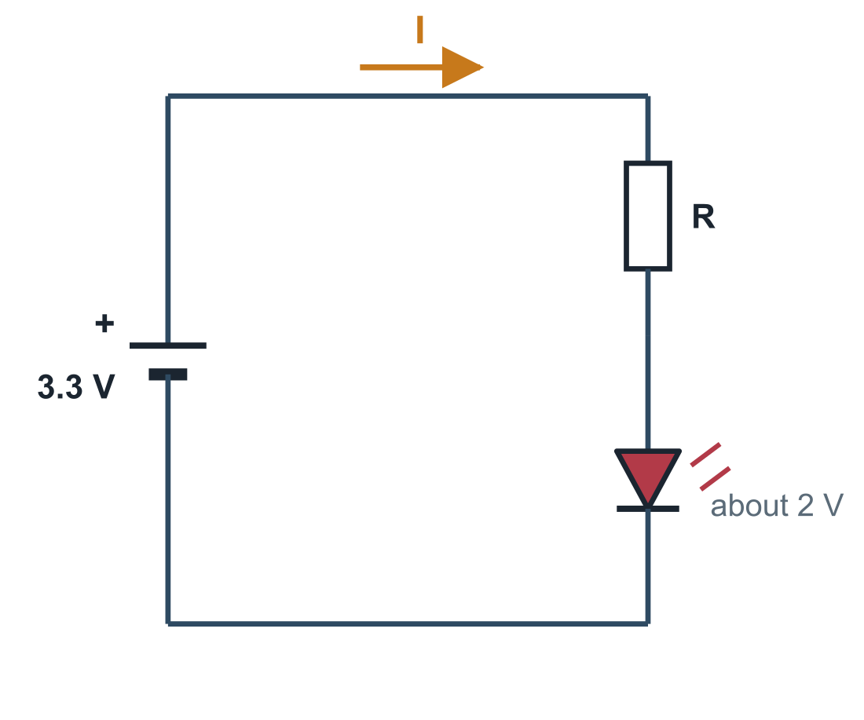
Ohm's law, and the resistor of an LED
UNDERSTAND NOW · voltage, current, Ohm's law
V = R x I
The current through a resistor is proportional to the voltage across it
A circuit is a closed loop: the current leaves the source, crosses the components and returns
An LED lights when current flows through it, and drops about 2 V; without a resistor the current would be far too large
The resistor takes what is left: 3.3 - 2 = 1.3 V
– for 10 mA: R = 1.3 / 0.010 = 130 Ω; the nearest common value is 150 Ω
Notes:
Ohm's law: the voltage across a resistor equals its resistance multiplied by the current through it. A circuit is a closed loop, and the drawing shows the simplest useful one: a supply, a resistor and an LED. The LED holds about 2 V across itself; the resistor takes the remaining 1.3 V and thereby determines the current. For 10 mA the resistance must be 1.3 / 0.010 = 130 Ω, and the nearest standard value is 150 Ω, which errs on the side of a smaller current. Without the resistor the current would be limited only by the supply and the LED would be destroyed.
UNDERSTAND NOW: voltage, current, Ohm's law.
For the lecturer: Georg Ohm, 1827. The forward voltage of an LED depends on its colour: about 1.8-2.2 V for red, about 3 V for blue and white. With 150 Ω the current is 1.3 / 150 = 8.7 mA.

Slide 5
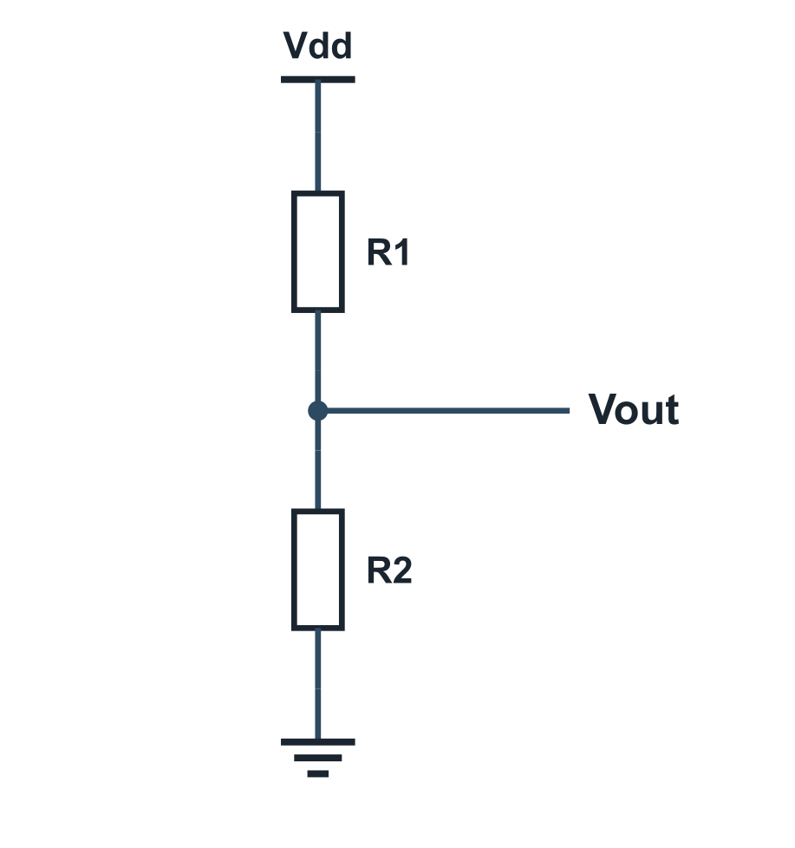
Series, parallel and the voltage divider
UNDERSTAND NOW · voltage, current, Ohm's law
Series: the same current crosses both resistors
– the resistances add: R = R1 + R2
Parallel: the same voltage is across both
– the current splits; the total resistance is smaller than either
Two resistors in series divide the voltage
– Vout = Vdd x R2 / (R1 + R2)
Equal resistors give half the supply; a much smaller R2 pulls Vout close to ground
Kirchhoff's rules: the currents entering a node add up to those leaving; the voltages around a loop add up to zero
Notes:
Two ways of combining resistors. In series the same current flows through both and the resistances add. In parallel the same voltage appears across both and the combined resistance is smaller than either. Two resistors in series form a voltage divider: the output, taken at their junction, equals the supply multiplied by R2/(R1 + R2). With equal resistors it is half the supply; if R2 is much smaller than R1, the output approaches ground. The divider should be kept in mind, because it explains the button circuit at the end of the lecture.
UNDERSTAND NOW: voltage, current, Ohm's law.
For the lecturer: The divider is the key to the pull-up circuit at the end of the lecture: a button is a resistor that is either infinite (open) or nearly zero (closed). Parallel: 1/R = 1/R1 + 1/R2.

Slide 6
The capacitor: why signals take time
UNDERSTAND NOW · voltage, current, Ohm's law
A capacitor stores electric charge, as a tank stores water; capacitance is measured in farads (F)
R x C
Its voltage cannot jump: it must be filled, or emptied, through a resistance
The time it takes is of the order of R x C
– 45 kΩ x 2 pF = 90 ns: the time an input pin of the kit needs to rise through its pull-up
resistance times capacitance is a time: the reason nothing in a circuit is instantaneous
Every wire and every transistor input is a small capacitor: this is where the propagation delay of a gate comes from
A charged or empty capacitor is also a way to store a bit: the DRAM cell of Lecture 15
Notes:
A capacitor stores charge as a tank stores water, and its voltage cannot change instantaneously: it must be charged or discharged through a resistance. The time required is of the order of R times C, the time constant; after one time constant the voltage has covered about 63% of its excursion. For an input pin of the kit, 45 kΩ times 2 pF gives 90 nanoseconds. Every wire and every transistor input behaves as a small capacitor, and this is the physical origin of gate delay. A capacitor that is charged or discharged is also a means of storing a bit, as the DRAM cell of Lecture 15 shows.
UNDERSTAND NOW: voltage, current, Ohm's law.
For the lecturer: RC is the time constant: after RC the voltage has covered about 63% of the way. Pin capacitance of the ESP32-C6: 2 pF typical (datasheet). Wiring and the button add more, so the real figure is larger.

Slide 7
Conductors, insulators, semiconductors
UNDERSTAND NOW · the transistor as a switch
Conductors, such as copper, let charge flow freely; insulators, such as glass, do not
Si
Semiconductors, above all silicon, lie in between, and their conduction can be controlled
Doping: adding a few atoms of another element
– n-type silicon has extra electrons, negative carriers
– p-type silicon has missing electrons, called holes, that behave as positive carriers
silicon: element 14, a semiconductor, the raw material of almost every chip
Where a p region meets an n region there is a junction: the building block of every device
A chip is a slice of silicon with billions of doped regions, connected by layers of metal
Notes:
Conductors permit the flow of charge; insulators prevent it. Semiconductors lie between the two, and their conductivity can be controlled. The control is achieved by doping: introducing a small number of atoms of another element. In n-type silicon there is an excess of electrons, which act as negative carriers; in p-type silicon there is a deficit of electrons, called holes, which behave as positive carriers. Where a p region meets an n region a junction is formed. A chip is a slice of silicon containing billions of such regions, interconnected by layers of metal.
UNDERSTAND NOW: the transistor as a switch.
For the lecturer: Silicon is the second most abundant element in the Earth's crust: sand. The whole industry rests on purifying it and doping it with extreme precision.

Slide 8
The transistor: a switch with no moving parts
UNDERSTAND NOW · the transistor as a switch
Year | Who | What
1947 | Bardeen, Brattain and Shockley, Bell Labs | the first transistor: it replaces the vacuum tube
1958-59 | Jack Kilby; Robert Noyce | the integrated circuit: several transistors on one piece of semiconductor
1959-60 | Atalla and Kahng, Bell Labs | the MOS transistor: small, simple to build, almost no control current
1963 | Wanlass and Sah, Fairchild | CMOS: pairs of complementary MOS transistors that draw power only when switching
1971 | Intel 4004 | 2,300 MOS transistors: a processor on a chip
today | the whole industry | tens of billions of CMOS transistors on a chip
Notes:
The history of the switch without moving parts, in six dates. The transistor of 1947 replaces the vacuum tube. The integrated circuit of 1958 places several transistors on a single piece of semiconductor. The MOS transistor of 1960 is small, simple to manufacture and requires almost no control current. CMOS, in 1963, combines two complementary types so that power is consumed essentially only during switching. In 1971 a complete processor fits on one chip with 2,300 transistors; a contemporary chip holds tens of billions.
UNDERSTAND NOW: the transistor as a switch.
For the lecturer: A transistor is a device with three terminals in which a small signal on one controls the current between the other two. Used as an amplifier it made the radio portable; used as a switch it made the computer. Vacuum tubes and relays did the same job in the first computers of Lecture 03, a million times larger and slower.

Slide 9
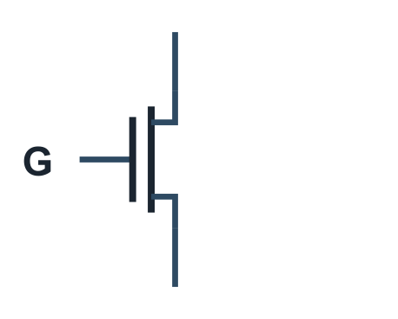
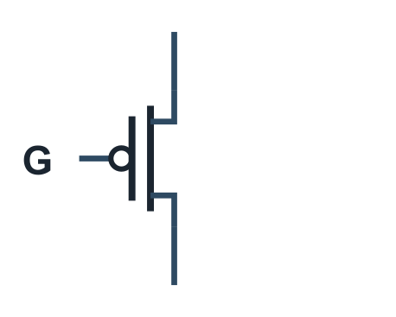
The MOS transistor as a switch
UNDERSTAND NOW · the transistor as a switch
nMOS
Gate voltage | nMOS | pMOS
high (1) | conducts: switch closed | blocks: switch open
low (0) | blocks: switch open | conducts: switch closed
Three terminals: the gate controls whether current can pass between the other two, source and drain
pMOS
The gate is insulated: it draws practically no current, only the tiny charge of its capacitance
The two types are complementary: what closes one opens the other
nMOS passes a good 0 (it connects to ground); pMOS passes a good 1 (it connects to the supply)
Notes:
A MOS transistor has three terminals: the gate controls whether current may pass between the other two, the source and the drain. There are two types, and the table contains everything needed: an nMOS conducts when its gate is high, a pMOS when its gate is low. They are complementary, since the voltage that closes one opens the other. The gate is insulated and draws practically no current. One further fact will be needed shortly: an nMOS is effective at connecting a node to ground, a pMOS at connecting it to the supply.
UNDERSTAND NOW: the transistor as a switch.
For the lecturer: MOS: metal, oxide, semiconductor, the three layers of the gate. The small circle on the pMOS gate means, as on logic symbols, 'active when low'. Input current of an ESP32-C6 pin: at most 50 nA (datasheet).

Slide 10
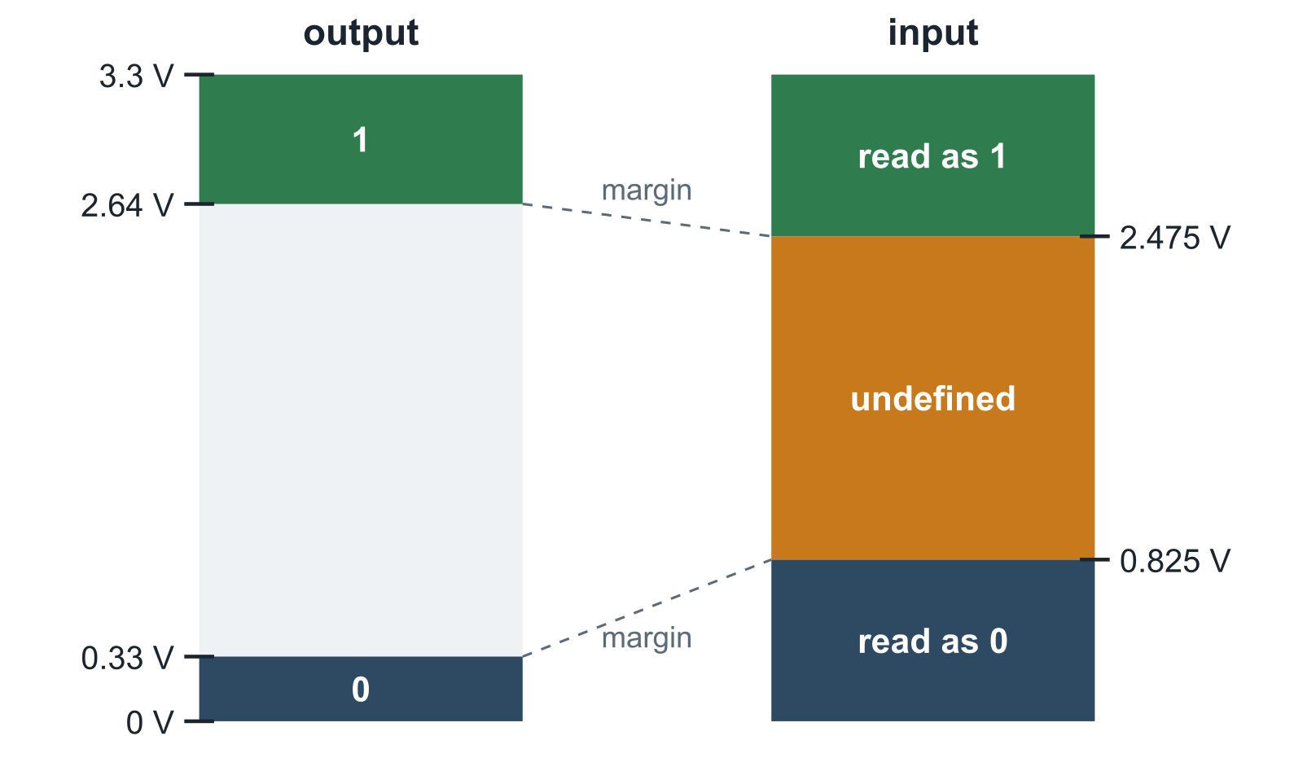
Logic levels: when is a voltage a 1?
UNDERSTAND NOW · from volts to bits
A digital circuit uses two ranges of voltage: low is 0, high is 1
An output guarantees clean levels
– on the kit: above 2.64 V for a 1, below 0.33 V for a 0
An input accepts wider ranges
– above 2.475 V it reads 1, below 0.825 V it reads 0
The difference is the noise margin: a disturbance smaller than that cannot change the bit
In between, the value is undefined: signals must cross that band quickly and never stay there
Notes:
A digital circuit does not use exact voltages but two ranges, shown in the figure for the kit. An output guarantees clean levels: above 2.64 V for a 1, below 0.33 V for a 0. An input is more tolerant: it reads 1 above 2.475 V and 0 below 0.825 V. The difference between what an output guarantees and what an input requires is the noise margin: a disturbance smaller than the margin cannot alter the bit. Between the two input thresholds the logical value is undefined, and signals must traverse that band quickly.
UNDERSTAND NOW: from volts to bits.
For the lecturer: ESP32-C6 datasheet, table 5-4, with VDD = 3.3 V: VOH min 0.8 VDD, VOL max 0.1 VDD, VIH min 0.75 VDD, VIL max 0.25 VDD. Noise margins: 2.64 - 2.475 = 0.165 V high, 0.825 - 0.33 = 0.495 V low. This is the threshold 'half of the supply voltage' of Lecture 13, made precise.

Slide 11
Why digital?
UNDERSTAND NOW · from volts to bits
Analog circuits
Digital circuits
The exact value of the voltage is the information
Every stage adds a little noise and distortion, and they accumulate
Copies get worse at every generation
Still indispensable at the edges: sensors, radio, sound
Only the range matters: high or low
Every gate restores the levels: noise does not accumulate
Copies are perfect, and errors can be detected and corrected (Lecture 11)
Two levels are easy to tell apart with fast, tiny, cheap transistors
Notes:
Why renounce the richness of analog signals? In an analog circuit the exact value is the information, so every stage adds a little noise and the noise accumulates: each copy is worse than its predecessor. In a digital circuit only the range matters, and every gate regenerates a fresh, clean level: noise does not accumulate, copies are perfect, and errors can even be detected and corrected, as Lecture 11 shows with parity. Analog circuits remain indispensable at the boundaries of a system, where it meets the physical world: sensors, radio, sound.
UNDERSTAND NOW: from volts to bits.
For the lecturer: The analog-to-digital story of Lecture 04, seen from the wire. The audio amplifier and the radio of the kit are the analog edges of an otherwise digital system.

Slide 12
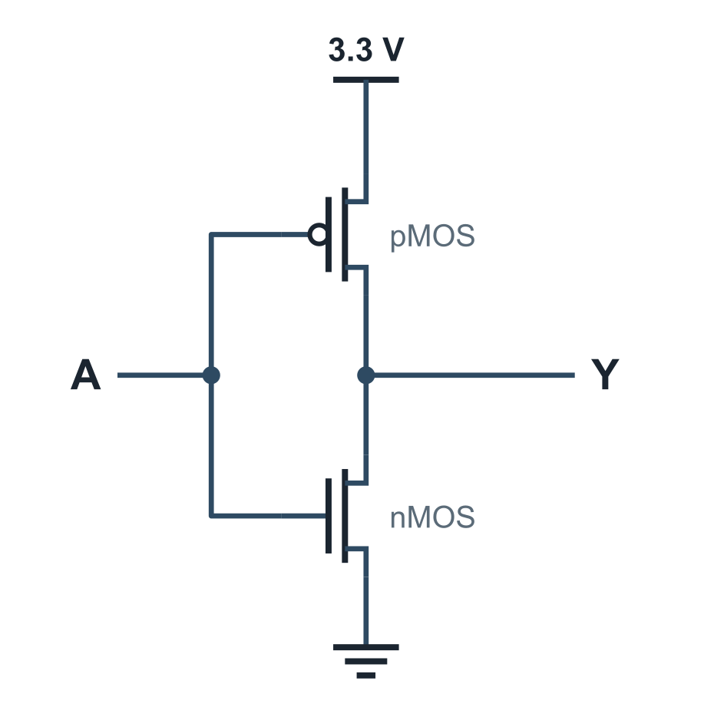
The CMOS inverter: a NOT gate from two transistors
UNDERSTAND NOW · CMOS gates
A | pMOS | nMOS | Y
0 | on | off | 1: joined to 3.3 V
1 | off | on | 0: joined to ground
One pMOS towards the supply, one nMOS towards ground, driven by the same input
Exactly one of the two conducts: the output is always connected to one rail, never to both
With the input still, no current flows from supply to ground: CMOS consumes almost nothing at rest
The output is a fresh, clean level whatever the quality of the input: the gate regenerates the signal
Notes:
The first gate. A pMOS connects the output to the supply, an nMOS connects it to ground, and both gates are driven by the same input. With the input at 0 the pMOS conducts and the output is 1; with the input at 1 the nMOS conducts and the output is 0. The circuit is a NOT. At any steady input exactly one of the two transistors conducts, so no current flows from supply to ground at rest: this is why CMOS consumes almost no static power, and the reason for its universal adoption.
UNDERSTAND NOW: CMOS gates.
For the lecturer: CMOS: complementary MOS. Y = A'. The pull-up network (pMOS) and the pull-down network (nMOS) are each other's dual, as in the duality principle of Lecture 08.

Slide 13
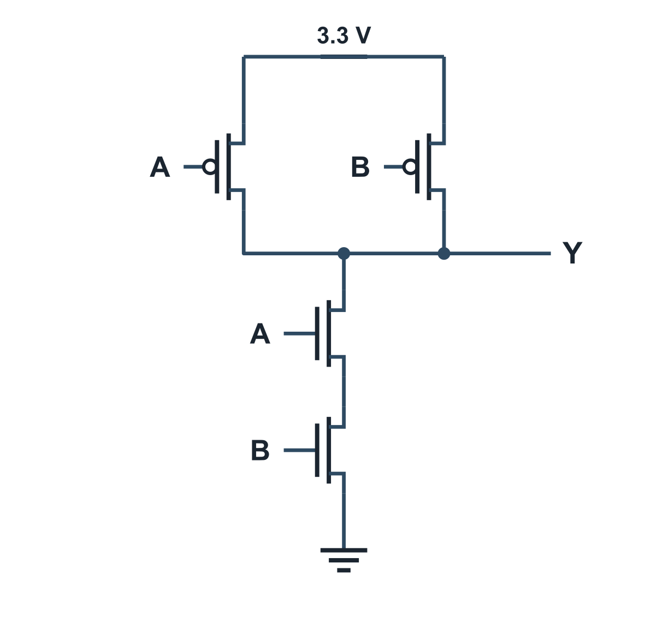
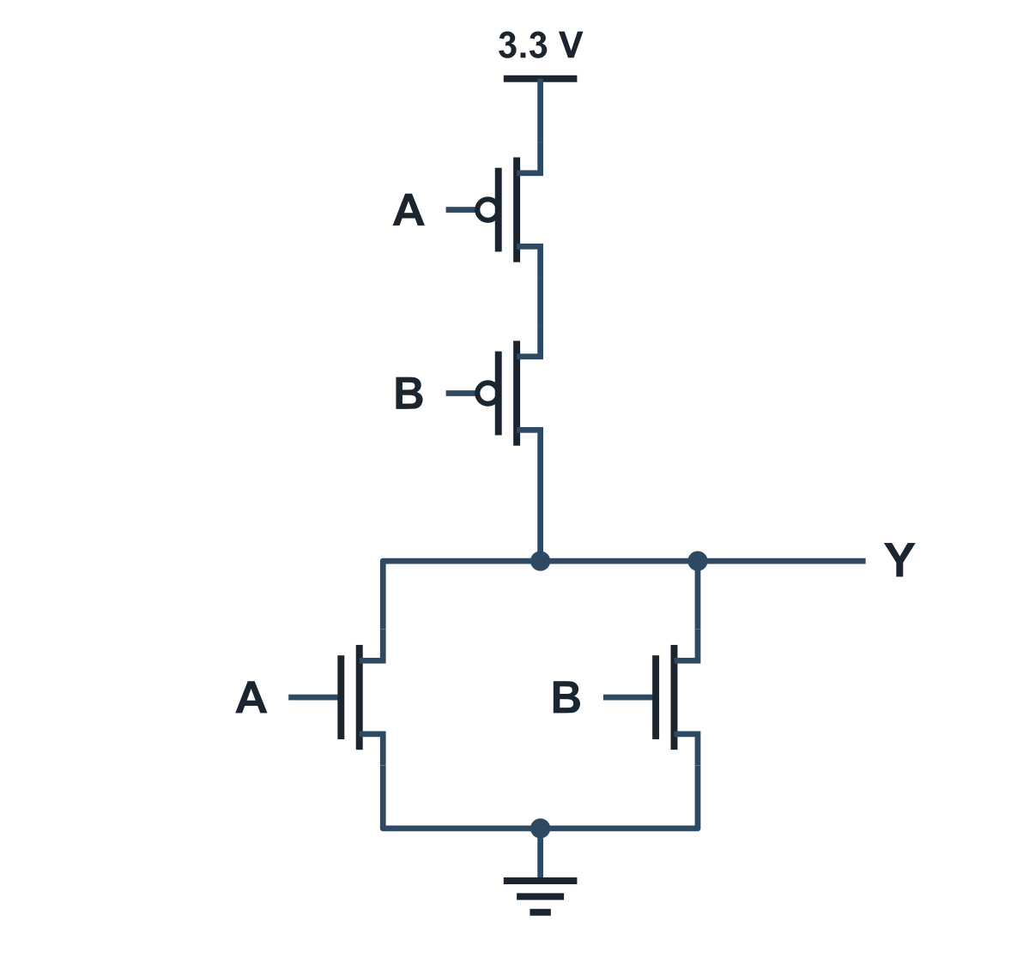
NAND and NOR in CMOS
UNDERSTAND NOW · CMOS gates
NAND: Y = (A . B)'
NOR: Y = (A + B)'
NAND: two nMOS in series reach ground only if A AND B are 1; two pMOS in parallel reach the supply if either is 0
NOR: the dual. Parallel becomes series and series becomes parallel, as De Morgan's laws exchange AND and OR
Notes:
Two inputs, four transistors. In the NAND the two nMOS are in series: the output is connected to ground only if A and B are both 1. The two pMOS are in parallel: the output is connected to the supply if either input is 0. Series realises AND, parallel realises OR. The NOR is the dual circuit, with series and parallel interchanged, exactly as De Morgan's laws interchange AND and OR. Both drawings should be checked for the four input combinations, marking which transistors conduct in each case.
UNDERSTAND NOW: CMOS gates.
For the lecturer: Series is AND, parallel is OR: the switching-circuit idea of Nakajima and Shannon (Lecture 03). Four transistors each. Ask the class to check the four input combinations on the drawing.

Slide 14
What gates cost, in transistors
UNDERSTAND NOW · CMOS gates
Circuit | Transistors | Remark
NOT | 2 | the CMOS inverter
NAND, NOR (2 inputs) | 4 | the natural gates of CMOS
AND, OR (2 inputs) | 6 | a NAND or a NOR followed by an inverter
XOR (2 inputs) | about 8 to 12 | depending on the design
full adder | about 28 | the classic static CMOS adder
SRAM cell, one bit | 6 | two inverters in a loop and two access transistors
D flip-flop | about 20 | two latches, master and slave
AND costs more than NAND: in CMOS the inverting gates come first. Minimising a function means saving transistors, area, energy and time.
Notes:
The cost of circuits measured in transistors. A NOT costs 2, a NAND or a NOR 4, an AND or an OR 6, because each is a NAND or NOR followed by an inverter. This reverses the intuition suggested by the algebra: in CMOS the inverting gates are the primitive ones, and an AND is more expensive than a NAND. A full adder requires about 28 transistors, a memory cell 6, a flip-flop about 20. The purpose of minimisation now becomes concrete: fewer literals mean fewer transistors, and hence less area, less energy and less delay.
UNDERSTAND NOW: CMOS gates.
For the lecturer: This is why NAND is the universal gate of Lecture 09 in practice as well as in theory: an AND costs more than a NAND. Counts are for conventional static CMOS and vary with the design style. Thirty-two full adders: about 900 transistors for the adder behind the add instruction.

Slide 15
Switching takes time and energy
UNDERSTAND NOW · CMOS gates
UNDERSTAND LATER · the clock → Lecture 13
The output of a gate drives the inputs of the next gates, which are small capacitors
To change level, the output must charge or discharge them through the resistance of its transistors: this is the propagation delay
C x V^2 x f
Every change of level costs energy
– the power spent in switching is about C x V^2 x f
Lowering the supply voltage saves the most: the reason chips moved from 5 V to 3.3 V to about 1 V inside
dynamic power: capacitance, the square of the voltage, and how often you switch
Raising the clock frequency raises the consumption in proportion: speed is paid for in heat
Notes:
The output of a gate drives the inputs of other gates, which are small capacitors. To change level it must charge or discharge them through the resistance of its own transistors, which takes time, the propagation delay, and energy, at every transition. The dynamic power is approximately C times V^2 times f: capacitance, the square of the supply voltage, and the switching frequency. Reducing the voltage yields the largest saving, which is why internal supply voltages fell from 5 V to about 1 V. Speed is paid for in heat. The propagation delay reappears in Lecture 11 as the critical path and in Lecture 13 as the reason for the clock.
UNDERSTAND NOW: CMOS gates. UNDERSTAND LATER: the clock (studied in Lecture 13).
For the lecturer: C the switched capacitance, V the supply, f the switching frequency. The propagation delay returns in Lecture 11 as the critical path, and in Lecture 13 as the reason for the clock. The ESP32-C6 has a 3.3 V supply for its pins and a lower internal voltage for its logic.

Slide 16
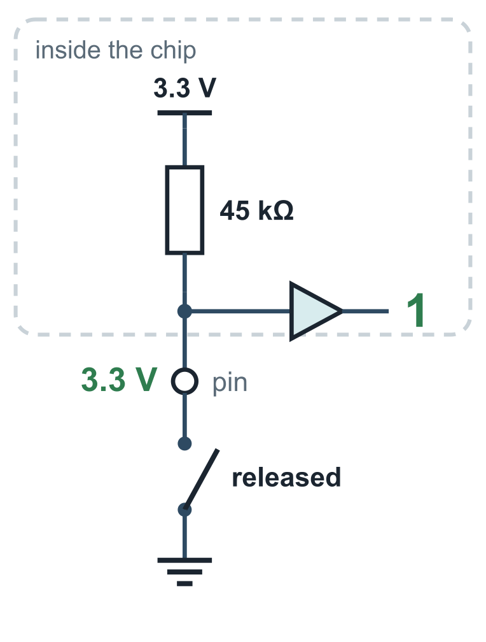
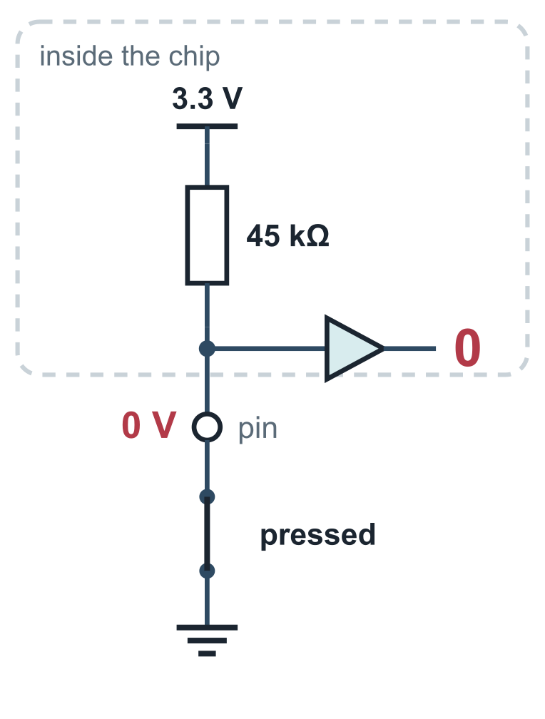
Pull-up: an input that is never left floating
UNDERSTAND NOW · pull-up inputs
An input connected to nothing is floating: it picks up noise and reads 0 or 1 at random
A pull-up resistor ties the pin to 3.3 V: released, no current flows, and the pin reads a clean 1
Pressed, the switch joins the pin to ground: 0 V, a clean 0
– a current of 3.3 V / 45 kΩ = 73 µA flows, too small to matter
It is a voltage divider whose lower resistor is either infinite or zero
The firmware inverts the bit, so that in your program pressed is 1
Notes:
An input connected to nothing is floating: it picks up noise and reads 0 or 1 unpredictably. The remedy is a pull-up resistor that ties the pin to 3.3 V. With the button released no current flows, and the pin reads a clean 1. With the button pressed the switch connects the pin to ground: 0 V, a clean 0, while a negligible current of 73 microamperes flows through the resistor. The circuit is a voltage divider whose lower resistance is either infinite or zero. The firmware then inverts the bit, so that in the program "pressed" reads as 1. The warm-up is thereby explained completely.
UNDERSTAND NOW: pull-up inputs.
For the lecturer: Internal weak pull-up of the ESP32-C6: 45 kΩ typical (datasheet). The firmware enables it on every button pin (prg32_input.c) and reads the pins inverted (prg32_controller.c). The triangle is the input buffer of the pin. This is called active-low logic.

Slide 17
Check your understanding
An LED drops 2 V and must carry 5 mA from a 3.3 V pin. Which resistor is needed?
1
26 Ω
260 Ω
A
B
400 Ω
660 Ω
C
D
In a CMOS inverter with the input at 0:
2
both transistors conduct
the pMOS conducts and the output is 1
A
B
the nMOS conducts and the output is 0
neither conducts and the output floats
C
D
Notes:
For the first question, Ohm's law is applied to the resistor alone, not to the whole circuit. The resistor sees the supply minus what the LED retains, 3.3 - 2 V, and that voltage is divided by the current expressed in amperes: 5 mA is 0.005 A.
For the second, one asks which of the two transistors has its gate at the level that makes it conduct when the input is 0. A pMOS conducts with a low gate, and it is the one connected to the supply. The two transistors never conduct together, and the output is never left unconnected.
For the lecturer: 1. Answer: B. R = (3.3 - 2) / 0.005 = 260 Ω.
2. Answer: B. A low gate closes the pMOS, which joins the output to the supply; the nMOS is open.

Slide 18
Check your understanding
How many transistors does a two-input AND need in static CMOS?
1
2
4
A
B
6
8
C
D
Why does the button input of the kit need a pull-up resistor?
2
To limit the current of the LED
To make the pin read a defined 1 when the button is released
A
B
To make the button faster
To protect the chip from 5 V
C
D
Notes:
For the first question: an AND is not built directly in CMOS but as a NAND followed by an inverter, so the transistors of the two are added.
For the second, one considers the released button: the pin is then connected to nothing. What would it read? The pull-up is unrelated to the LED, to speed or to protection: it gives the input a defined level when the switch is open.
For the lecturer: 1. Answer: C. A NAND (4) followed by an inverter (2).
2. Answer: B. Without it the released pin would float; the pull-up ties it to 3.3 V, and the pressed switch overrides it to ground.

Slide 19
Glossary: English and Italian
English | Italiano | English | Italiano
voltage | tensione | logic level | livello logico
current | corrente | noise margin | margine di rumore
resistor / resistance | resistore / resistenza | pull-up resistor | resistenza di pull-up
capacitor | condensatore | floating input | ingresso flottante
ground | massa | propagation delay | ritardo di propagazione
semiconductor, doping | semiconduttore, drogaggio | integrated circuit | circuito integrato
gate, source, drain | gate, source, drain | breadboard | basetta sperimentale (breadboard)
Notes:
Fourteen terms. Two false friends deserve note: voltage is tensione in Italian, and ground is massa. A capacitor is a condensatore. Gate, source and drain are not translated. The noise margin is the margine di rumore, and a floating input is an ingresso flottante.

Slide 20
Conclusions and reading
Voltage pushes, current flows, resistance hinders: V = R x I describes most of what a digital designer needs
A MOS transistor is a switch controlled by a voltage; nMOS and pMOS are complementary
A bit is a range of voltages; noise margins and regeneration are what make digital circuits reliable
CMOS gates are pairs of switch networks; the inverting gates NAND and NOR are the cheapest
Switching costs time (R x C) and energy (C x V^2 x f): the physical limits behind every clock
Reading
– Charles Petzold: Code, the chapters from the flashlight to logic gates
– Patterson, Hennessy: Computer Organization and Design, RISC-V Edition, sections 1.5, 1.7 and appendix A
– PRG32 repository: docs/hardware/hardware.md
Notes:
Five conclusions. Voltage drives, current flows, resistance opposes, and Ohm's law covers most of what a digital designer needs. A MOS transistor is a voltage-controlled switch, available in two complementary types. A bit is a range of voltages, made reliable by noise margins and by the regeneration of levels at every gate. CMOS gates are pairs of complementary switch networks, and the inverting gates are the cheapest. Switching costs time and energy. The next lecture builds functional machines from these gates.
Learning status, recap. UNDERSTAND NOW: pull-up inputs; voltage, current, Ohm's law; the transistor as a switch; from volts to bits; CMOS gates. USE NOW: the complete program, the PRG32 tools (used, not studied, in this course). UNDERSTAND LATER: the clock (Lecture 13). A slide without a badge is context: a story, an example, a question, an exercise.
For the lecturer: Next lecture: combinational machines, built from these gates.

