Slide 1
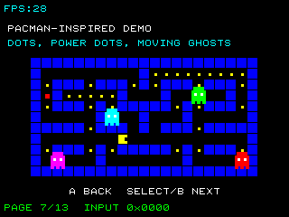
ARC12 COMPUTER ARCHITECTURE · LECTURE 13
Sequential Machines: the code
Code deck: every listing explained, the complete program, and how to test it on PRG32-QT, on QEMU and on the board
Prof. Raffaele Montella, PhD
University of Naples “Parthenope” · A.Y. 2026/27
raffaelemontella.it · raffaele.montella@uniparthenope.it
Notes:
This is the code deck of Lecture 13. The lecture deck holds the concepts; this one holds everything you type and run: the listings with their explanation, the complete program, what it shows, and the way to test it on each of the three hosts.

Slide 2
In this deck
1
The 1 listing of Lecture 13, one per slide: read the code, then the numbered remarks beside it
2
The complete program: code/l13.S, 65 lines, printed in full
3
What you should see when it runs, checked on the PRG32-QT headless runner
4
How to test it, step by step: on PRG32-QT, on QEMU, on the board
5
The exercises: change the program, predict, run
Notes:
What the deck contains, in the order of the slides. The program of the lecture is a file that you can build and run as it is: start from there, and come back to the listings to understand each part. The program of this lecture is ~/arc12/code/l13.S; tools/tests/cartridges/run.py builds it, runs it on PRG32-QT with scripted input and checks the pixels of the frame.
For the lecturer: Get the code once: git clone https://github.com/riscv-prg32/computer-architecture-with-prg32 ~/arc12. The program of this lecture is ~/arc12/code/l13.S; tools/tests/cartridges/run.py builds it, runs it on PRG32-QT with scripted input and checks the pixels of the frame. Every listing on these slides is read by the build from a tested file, or checked by tools/tests: see its README.

Slide 3
A game is a state machine
.equ TITLE, 0
.equ PLAY, 1
.equ OVER, 2
game_update:
...
call prg32_input_read # a0 = buttons: the INPUT
la t0, state
lw t1, 0(t0) # t1 = the present STATE
andi t2, a0, 0x10 # button A
li t3, TITLE
bne t1, t3, 1f
beqz t2, done # TITLE: stay until A is pressed
li t1, PLAY # TITLE --A--> PLAY
j store
1: li t3, OVER
bne t1, t3, done # PLAY is handled elsewhere
beqz t2, done # OVER: stay until A is pressed
li t1, TITLE # OVER --A--> TITLE
store:
sw t1, 0(t0) # the next state becomes the present state
done:
...
1
Pressing A starts the game from the title screen and returns to it from the game-over screen: the effect depends on the state
2
The state is one word in memory that survives from frame to frame
3
update computes the next state from the present state and the input
4
draw shows a different screen for each state: the output
Notes:
A game with a title screen, a playfield and a game-over screen. The variable state holds one of three values. game_update reads the button A and the present state: in TITLE, pressing A leads to PLAY; in OVER, pressing A leads back to TITLE; otherwise nothing changes. So the effect of A depends on the state. This is a state machine: update computes the next state from the present state and the input, the state survives in memory from frame to frame, and draw shows a screen for each state.
For the lecturer: Written for this lecture; the textbook capstone game has the same structure. Bug to discuss: holding A on the OVER screen goes to TITLE and, one frame later, to PLAY. Fixing it requires remembering the previous value of the button: one more bit of state.

Slide 4
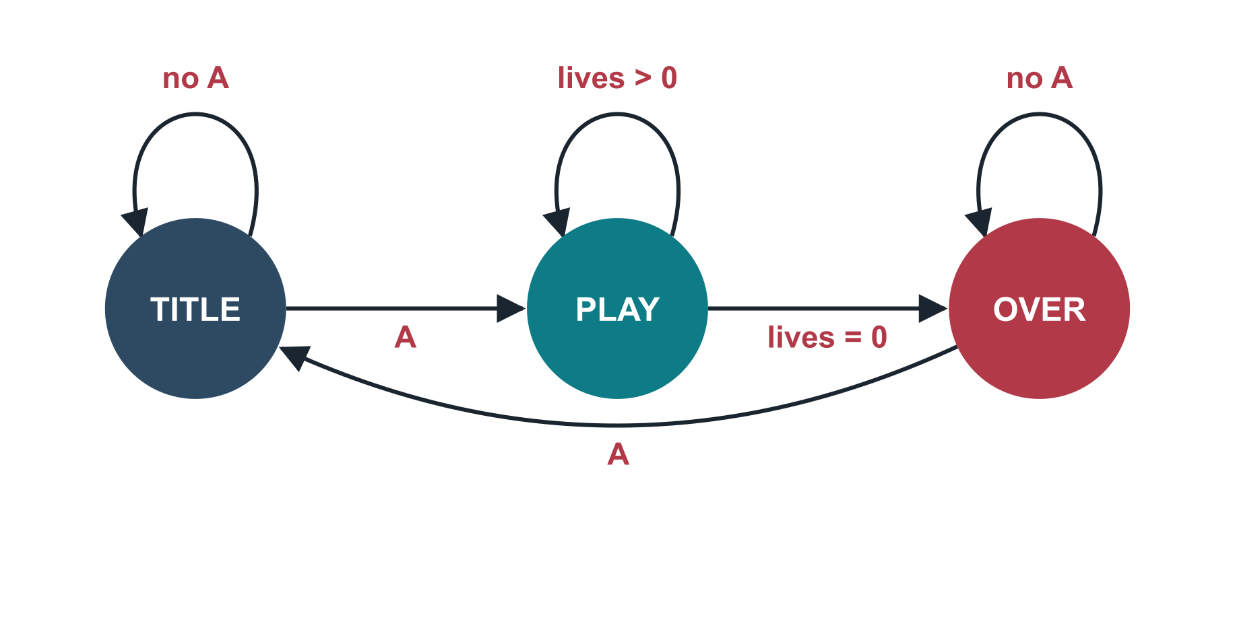
The warm-up as a state diagram
Present state | Input that changes it | Next state | Output (draw)
TITLE | A pressed | PLAY | the title screen
PLAY | lives = 0 | OVER | the playfield
OVER | A pressed | TITLE | the final score
Notes:
The game of the warm-up drawn as a diagram: three states, with A leading from TITLE to PLAY and from OVER to TITLE, and the end of the lives leading from PLAY to OVER. The loops on each state are the cases in which nothing changes. The table below lists, for each state, the input that changes it, the next state and the output drawn. Draw the diagram before writing the code: for a game it is the most useful design habit there is.
For the lecturer: A Moore machine with three states: two bits of state would be enough, the program uses a whole word. Drawing the diagram before writing the code is the single most useful design habit for a game.

Slide 5
The program counter: a register in a loop
The PC holds the address of the instruction being executed: it is the state that says where the program is
clock
adder
+ 4
MUX
PC
register, 32 bits
Next state: PC + 4 for a normal instruction, or the branch target when a branch is taken
Present state, combinational network, next state, clock: exactly the general architecture
branch target
from the ALU
branch taken?
With only the + 4 path it is a counter: the simplest finite-state machine
next PC
first_update of Lecture 02 was the same machine in software
Notes:
The program counter, PC, is the register that holds the address of the instruction being executed. Its next value is computed by a small network: an adder gives PC plus 4, the address of the following instruction, and a multiplexer chooses between that and the target of a branch. At each clock edge the next value becomes the present one. It has exactly the shape of the general architecture. With only the plus 4 path it is a counter, the simplest of all state machines.
For the lecturer: The comparator of Lecture 11 produces 'branch taken?' for beq and bne. Instructions are 4 bytes apart; with the compressed extension the adder adds 2 for 16-bit instructions.

Slide 6
The processor is a sequential machine
State
Input
Next-state network
Clock edge
the program counter, the thirty-two registers, the memory
the instruction at the address in the PC, and the data it reads
decoders, multiplexers and the ALU compute the new values
the registers named by the instruction take their new values
Executing a program is nothing but a long walk through the states of a very large finite-state machine, one clock edge at a time. Single-stepping in PRG32-QT shows that walk one state after another.
Notes:
The whole processor is a sequential machine. Its state is the program counter, the thirty-two registers and the memory. Its input is the instruction found at the address in the PC, with the data it reads. The next-state network is made of decoders, multiplexers and the ALU. At the clock edge the registers named by the instruction take their new values. Running a program is a walk through the states of a very large state machine, and single-stepping in PRG32-QT shows that walk one state at a time.
For the lecturer: This is the bridge to the lectures on the processor: datapath (the combinational part and the registers) and control (itself a finite-state machine in multi-cycle and microprogrammed designs).

Slide 7
The complete program: l13.S (1 of 3)
# ARC12 Computer Architecture - Lecture 13: Sequential Machines
# l13.S: a game is a state machine
#
# On the screen: one colour per state. Blue is TITLE: press A and the screen turns
# green, PLAY. (OVER, red, is reached only when a game ends: this warm-up has no game
# yet. Hold A on the red screen and you meet the bug discussed in the lecture.)
# Build: python3 -m prg32 cartridge build l13.S --portable \
# --entry-prefix l13 --name l13 --out l13.prg32
.option norelax
.equ TITLE, 0
.equ PLAY, 1
.equ OVER, 2
.section .text
.global l13_init
.global l13_update
.global l13_draw
l13_init:
ret
Notes:
One page of the complete program, exactly as it is in the repository. Read it from the top: the header says what the program shows and how to build it; the three functions init, update and draw follow, then the data. Lines that you met in the listings of the lecture have the same comments here.
For the lecturer: code/l13.S, as built and run by the tests. The comments are part of the program: read them with the code.

Slide 8
The complete program: l13.S (2 of 3)
l13_update:
game_update:
addi sp, sp, -16
sw ra, 12(sp)
call prg32_input_read # a0 = buttons: the INPUT
la t0, state
lw t1, 0(t0) # t1 = the present STATE
andi t2, a0, 0x10 # button A
li t3, TITLE
bne t1, t3, 1f
beqz t2, done # TITLE: stay until A is pressed
li t1, PLAY # TITLE --A--> PLAY
j store
1: li t3, OVER
bne t1, t3, done # PLAY is handled elsewhere
beqz t2, done # OVER: stay until A is pressed
li t1, TITLE # OVER --A--> TITLE
store:
sw t1, 0(t0) # the next state becomes the present state
done:
lw ra, 12(sp)
addi sp, sp, 16
ret
Notes:
One page of the complete program, exactly as it is in the repository. Read it from the top: the header says what the program shows and how to build it; the three functions init, update and draw follow, then the data. Lines that you met in the listings of the lecture have the same comments here.
For the lecturer: code/l13.S, as built and run by the tests. The comments are part of the program: read them with the code.

Slide 9
The complete program: l13.S (3 of 3)
l13_draw:
addi sp, sp, -16
sw ra, 12(sp)
la t0, state
lw t1, 0(t0)
la t0, colours # the OUTPUT depends on the state only:
slli t1, t1, 2 # a Moore machine
add t0, t0, t1
lw a0, 0(t0)
call prg32_gfx_clear
lw ra, 12(sp)
addi sp, sp, 16
ret
.section .rodata
colours: .word 0x001f, 0x07e0, 0xf800 # TITLE blue, PLAY green, OVER red
.section .data
state: .word TITLE
Notes:
One page of the complete program, exactly as it is in the repository. Read it from the top: the header says what the program shows and how to build it; the three functions init, update and draw follow, then the data. Lines that you met in the listings of the lecture have the same comments here.
For the lecturer: code/l13.S, as built and run by the tests. The comments are part of the program: read them with the code.

Slide 10

Run it: what you should see
On the screen
– one colour per state. Blue is TITLE: press A and the screen turns green, PLAY. (OVER, red, is reached only when a game ends: this warm-up has no game yet. Hold A on the red screen and you meet the bug discussed in the lecture.)
What to press
– press A
The frame written by the automatic test on PRG32-QT
Notes:
What the program shows when it runs, and what to press. Predict before you run: if the screen differs from this picture, the difference is information. The picture was written by the automatic test, not drawn by hand.
For the lecturer: The picture is the frame that the headless runner of PRG32-QT produced in the test of this program. On QEMU and on the board the game area is the same 320 by 200 pixels, between the two status bands.

Slide 11
Test it on PRG32-QT
# 1. start PRG32-QT on this computer (it listens on port 8080)
# 2. in the PRG32 folder, with ESP-IDF active: build the cartridge
python3 -m prg32 cartridge build ~/arc12/code/l13.S --portable \
--entry-prefix l13 --name l13 --out l13.prg32
# 3. send it to PRG32-QT and start it
python3 -m prg32 esp32c6 upload-and-run l13.prg32 \
--url http://localhost:8080 --slot cart0
# 4. look, press, compare with the previous slide
1
PRG32-QT must be running: it answers on port 8080, like a board
2
Build once, from the PRG32 folder, with ESP-IDF active in the terminal
3
upload-and-run stores the cartridge in slot cart0 and starts it
4
Enable debug mode in Settings to stop the program and read registers and memory
Notes:
The quickest way: PRG32-QT on your own computer. Four steps, each with its command. PRG32-QT behaves like a board on port 8080, which is why the upload command says esp32c6. With debug mode enabled you can stop at any instruction and read registers and memory.
For the lecturer: Run by the tests: the cartridge of this slide is built with this command and executed on the headless runner of PRG32-QT. Without the toolchain: import the .prg32 file in PRG32-QT and choose Run Cartridge. Keys: arrows or WASD for the joystick, Z or J for A, X or K for B, Enter for Start, Escape to go back to Setup.

Slide 12
Test it on QEMU
# 1. once: build the firmware for QEMU (several minutes)
python3 -m prg32 qemu build
# 2. build the cartridge for the emulated chip
python3 -m prg32 cartridge build ~/arc12/code/l13.S --portable \
--entry-prefix l13 --name l13 --architecture qemu \
--out l13-qemu.prg32
# 3. with QEMU closed, stage the cartridge into its flash image
python3 -m prg32 qemu upload l13-qemu.prg32
# 4. start the emulator; on Setup choose Run Cartridge, then cart0
python3 -m prg32 qemu run
1
The emulator runs the real firmware on an emulated chip: build it once
2
The cartridge is built for the architecture qemu: the same source, another file
3
Stage the cartridge with QEMU closed, then start it and choose Run Cartridge
4
The keys go to the terminal: arrows or WASD, Z or J for A, X or K for B
Notes:
The same program on the emulator. QEMU runs the real firmware on an emulated chip, so the cartridge must be built for the architecture qemu. Stage the cartridge while QEMU is closed. The firmware opens on the Setup menu: choose Run Cartridge and the slot. Remember that the keyboard is read by the terminal, not by the window with the picture.
For the lecturer: Checked by the tests up to the staging: the cartridge is built for the architecture qemu and accepted into the flash image of the emulator. What the emulator then shows is not checked automatically: Espressif QEMU needs its window. Since October 2026 the firmware starts on Setup: choose Run Cartridge, then cart0.

Slide 13
Test it on the board
# 1. once per board: write the firmware through the USB cable
python3 -m prg32 esp32c6 build-and-flash
# 2. join the Wi-Fi network of the board: PRG32, password prg32game
# 3. build the cartridge for the board
python3 -m prg32 cartridge build ~/arc12/code/l13.S --portable \
--entry-prefix l13 --name l13 --architecture esp32c6 \
--out l13-esp32c6.prg32
# 4. send it over Wi-Fi and start it
python3 -m prg32 esp32c6 upload-and-run l13-esp32c6.prg32 \
--url http://192.168.4.1 --slot cart0
1
The firmware is written once per board, through the USB cable
2
The board creates the Wi-Fi network PRG32: join it with your computer
3
The same upload command as for PRG32-QT, with the address of the board
4
A black screen: check the wiring of the display against the firmware
Notes:
The same program on the kit. The firmware is written once, through USB; after that cartridges travel over Wi-Fi. The upload command is the one used for PRG32-QT with the address of the board. This is the only host that the automatic tests do not run: try it, and report what you see.
For the lecturer: Not run by the tests: there is no board on the test machine. The cartridge for the architecture esp32c6 is built by the tests; the steps are those of the PRG32 documentation. If the serial port is not found pass it explicitly. To use the Wi-Fi of the classroom: python3 -m prg32 wifi set --ssid NAME --password PASSWORD --mode sta.

Slide 14
If it does not work
You see | It means | Do this
missing entry point | the prefix is not the one in the source | --entry-prefix l13; check the three .global lines
idf.py: command not found | ESP-IDF is not active in this terminal | run export.sh, or open the ESP-IDF PowerShell
upload: connection refused | the host is not listening at that address | start PRG32-QT; use the address on its Setup screen
a black screen, or the menu again | a function does not return, or ra was not saved | debug mode: step through init, update, draw
QEMU ignores the keys | the keyboard goes to the terminal | click the terminal that launched QEMU
Notes:
The five most common symptoms, what each means, and what to do. Read the message before changing anything: it nearly always names the cause.
For the lecturer: The first three rows cover most cases. When asking for help, paste the command and the whole message as text. docs/usage/troubleshooting.md of the PRG32 repository has the complete list.

Slide 15
Exercises: paper first, then PRG32
TRY IT
1
Draw the state diagram of a machine that outputs 1 when the last two inputs were both 1; write it as a Moore and as a Mealy machine
2
Complete the timing diagram of an SR latch for a given sequence of S and R, marking where it holds
3
Synthesise a counter modulo 3 (0, 1, 2, 0, ...) with two D flip-flops; what happens in the unused state?
4
Add a PAUSE state to the warm-up game, entered and left with the SELECT button, and draw the new diagram first
5
Fix the warm-up so that A must be released and pressed again: store the previous button state and react only to a 0 to 1 change
Expected result
On PRG32: four screens, and a held button that causes exactly one transition. The last exercise is edge detection in software: the program behaves like a flip-flop instead of a latch.
Notes:
Five exercises. Design a machine that outputs 1 when the last two inputs were both 1, as a Moore and as a Mealy machine, and compare the number of states. Complete a timing diagram of an SR latch. Synthesise a counter modulo 3 with two D flip-flops, and think about the unused fourth state. Add a PAUSE state to the game of the warm-up, drawing the diagram first. And make the button A work only when it is pressed again: this is edge detection in software.
For the lecturer: Exercise 1: Moore needs three states (no 1 seen, one 1 seen, two or more), Mealy two. Exercise 3: D1 = Q0, D0 = Q1'Q0' with state 11 as a don't-care, or designed to return to 00. Exercise 5: keep prev in memory; pressed_now = buttons AND NOT prev; then store buttons in prev.

