Slide 1

ARC12 COMPUTER ARCHITECTURE · LECTURE 15
Memory
From magnetic cores to RAM: words, addresses, byte order and the dialogue between processor and memory
“...computers and the programs will start thinking and the people will stop.”
Dr. Walter Gibbs, Tron, Steven Lisberger, 1982
Prof. Raffaele Montella, PhD
University of Naples “Parthenope” · A.Y. 2026/27
raffaelemontella.it · raffaele.montella@uniparthenope.it
Notes:
You have used memory since the second lecture: every lw and sw reads or writes it. This lecture explains what a memory is, how it is organised, and what actually happens between the processor and the memory when a load is executed. The picture on the cover is the debugger of PRG32-QT, whose memory view will serve as your microscope. The quotation from Tron is a joke with a serious side: a machine with memory can keep a state, and with a state it can do almost anything.
For the lecturer: Spiral: lw and lbu on the same word show byte addresses and byte order on a real RISC-V machine; the lecture then explains what a memory is, how it is organised and how the processor talks to it. The original deck used the MC68000 (big-endian, no misaligned words) as its example: RISC-V takes its place.

Slide 2
What you will be able to do by the end
1
Classify memories: volatile or persistent, on-line or off-line, and place them in the memory hierarchy
2
Describe how SRAM and DRAM store a bit, and why they are used for different jobs
3
Explain what words, addresses and byte-addressable memory are
4
Tell little-endian from big-endian order, and say which one RISC-V uses
5
Describe step by step how the processor reads and writes a word
6
Explain memory-mapped input/output and what DMA is for
Notes:
Six objectives. Classify memories as volatile or persistent, on-line or off-line, and place them in a hierarchy. Describe how SRAM and DRAM store a bit and why they have different uses. Explain words, addresses and byte-addressable memory. Tell little-endian from big-endian order. Describe step by step how the processor reads and writes a word. And explain what memory-mapped input/output and DMA are.

Slide 3
Memory
Definition
The memory is the element of a computer, or of one of its subsystems, dedicated to the persistence of data and of the instructions of programs.
Memories are the components of a computer able to store information: data, programs and results
Volatile: the information is kept only as long as the computer is powered
Persistent: the information is kept even when the computer is switched off
On-line: the data are always accessible. Off-line: the medium must be mounted before the data can be reached
Notes:
Memory is the part of a computer dedicated to keeping data and the instructions of programs. Two distinctions classify it. Volatile memories keep the information only while the machine is powered; persistent ones keep it when it is switched off. On-line means that the data are always accessible; off-line means that a medium must first be mounted, like a tape taken from a shelf.

Slide 4
The memory hierarchy
registers
inside the processor
faster,
more expensive
per bit
For the same size, cost decreases from top to bottom
cache
SRAM, on the processor chip
Performance increases from bottom to top
main memory
DRAM
The upper levels are volatile; the lower ones are persistent
solid-state and magnetic disks
persistent, on-line
No single technology is fast, large and cheap at once: a computer combines several
tapes and removable media
persistent, off-line
larger,
cheaper
per bit
Notes:
The memory hierarchy. At the top the registers, inside the processor; then the cache, the main memory, solid-state and magnetic disks, and finally tapes and removable media. Going up, memories are faster and more expensive per bit; going down, larger and cheaper. The upper levels are volatile, the lower ones persistent. The last line explains why the hierarchy exists: no single technology is fast, large and cheap at once, so a computer combines several.
For the lecturer: Tipologie di memoria. Typical access times: registers and cache below a nanosecond to a few nanoseconds; DRAM tens of nanoseconds; SSD tens of microseconds; magnetic disks milliseconds; tape seconds to minutes.

Slide 5
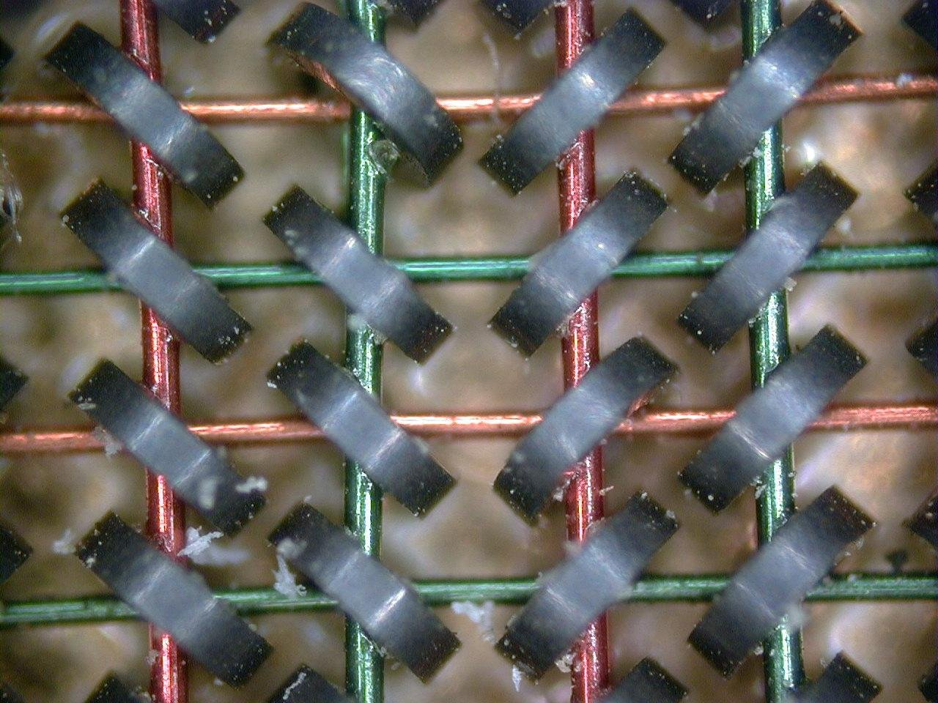
Magnetic-core memory
Small magnetic rings of ceramic store the digital information: a bit is the direction of the magnetic field of a ring
A static memory: it keeps its contents without power
Used in the first computers, before semiconductor memories became widespread
First research by An Wang and Way-Dong Woo at Harvard, 1949
Jay Forrester at MIT, early 1950s: the Whirlwind computer, a flight simulator
Ferrite cores threaded by the X, Y and sense wires
Notes:
In a magnetic-core memory each bit is a small ring of ferrite, and its value is the direction of the magnetic field in the ring. It was the main memory of the computers of the 1950s and 1960s, and it kept its content without power. The research began with An Wang at Harvard in 1949; Jay Forrester at MIT made it practical for the Whirlwind computer. Look at the photograph: every ring is threaded by wires, and one ring is one bit.
For the lecturer: Memorie a nuclei di ferrite. Wang's pulse transfer controlling device used a magnetic field to control an electromechanical system.

Slide 6
Reading and writing a core
Reading is destructive
Writing
Two address lines, X and Y, select one core
The selected bit is set to 0
If it contained 1, a pulse appears on the sense line; otherwise nothing
Wang's solution: every read is followed by a write that stores the datum again
All the bits start at 0
X and Y select the core, which is set to 1
If the bit must be 0, the inhibit line prevents the change
Forrester's contribution: fewer connections to manage a large number of cores
Notes:
How a core is read and written. Two wires, X and Y, select one ring. Reading sets the selected bit to 0: if it contained a 1 a pulse appears on the sense wire, otherwise nothing. So reading destroys the content, and every read is followed by a write that stores the datum again. Writing sets the selected core to 1, unless an inhibit wire prevents it. Keep the idea of the destructive read followed by a rewrite: it returns in today's DRAM.
For the lecturer: Sense and inhibit share one wire (S|I). Destructive read followed by rewrite returns today in DRAM.

Slide 7
SRAM and DRAM
SRAM: static RAM
DRAM: dynamic RAM
Each bit is held by a bistable circuit, as in a D flip-flop
The cells are arranged in a matrix and reached by row and column
Keeps its contents as long as it is powered
Fast and expensive: used for cache memories
The main memory of a microcontroller such as the ESP32-C6 is SRAM
Each bit is a charge in a tiny capacitor, behind one transistor
The capacitor discharges: the contents must be refreshed periodically, by a circuit inside the memory
Cheap and dense: used for the main memory of laptops, phones and servers
SDRAM: synchronous DRAM, whose access is governed by a clock
Notes:
The two kinds of RAM. In static RAM each bit is held by a bistable circuit like those of Lecture 13: it keeps its value as long as there is power, it is fast, and it needs several transistors per bit, so it is expensive: it is used for caches. In dynamic RAM each bit is a charge in a tiny capacitor behind one transistor: it is dense and cheap, but the charge leaks away, so the content must be refreshed periodically: it is the main memory of laptops and phones. The chip of the kit has only SRAM.
For the lecturer: DDR4 and DDR5 are generations of SDRAM. The ESP32-C6 has 512 KB of SRAM and no DRAM at all.

Slide 8
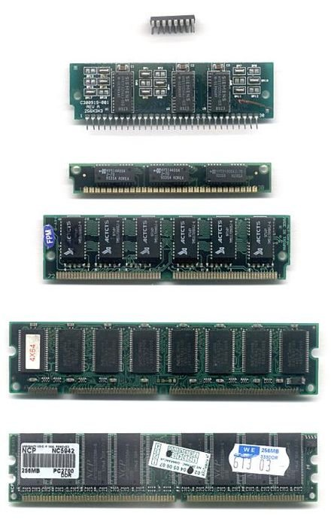
Other memories
FeRAM, ferroelectric RAM: keeps its state without power
Flash: persistent, erased in blocks; the memory of USB keys, phones and solid-state disks
The program of a microcontroller lives in flash and its variables in SRAM
Memory modules through the years
– SIMM, SDRAM PC100 and PC133, Rambus, DDR: tens to hundreds of megabytes each
– today: DDR5 modules of 16 to 64 GB
Memory modules of different generations
Notes:
Other technologies. Ferroelectric RAM keeps its state without power. Flash memory is persistent and is erased in blocks: it is the memory of USB keys, phones and solid-state disks. One line concerns your kit directly: in a microcontroller the program lives in flash and the variables in SRAM. That is why your cartridges have a section of constants and a section of variables. The memory modules of a PC have gone, over the years, from a few megabytes to tens of gigabytes each.
For the lecturer: The module pictures of the original deck (SIMM EDO, SDRAM PC100 32 MB, PC133 64 MB, Rambus PC800 128 MB, DDR PC2100, ECC registered 256 MB) are summarised here. Flash and solid-state disks are treated in the next lecture.

Slide 9
Words and addresses
The main memory is an array of words; a word is a string of m bits
The processor accesses the m bits of a word with a single read or write operation
N = 2^n
Each word is identified by an address: an integer between 0 and N - 1, represented on n bits, with N = 2^n
n address bits select one of N locations: the address is a code word, the memory decodes it
Random access memory, RAM: the access time does not depend on the position of the datum
Word processors access memory with a parallelism equal to the word length: 16, 32 or 64 bits
Notes:
The main memory is an array of words, each a string of m bits that the processor reads or writes in a single operation. Each word has an address, a number from 0 to N minus 1 written on n bits, with N equal to 2 to the n. The address is a code word, and the memory decodes it. Random access means that the access time does not depend on the position: every word is reached equally fast. Thirty-two address bits give four gibibytes of addresses.
For the lecturer: Thirty-two address bits give 2^32 addresses: 4 GiB. The decoder of Lecture 11 and the small memory of Lecture 14, scaled up.

Slide 10
Byte-addressable memory
address
A+0
A+1
A+2
A+3
A+4
A+5
A+6
78
56
34
12
48
45
4C
...
one word: .word 0x12345678
three bytes: "HEL..."
In a byte-addressable memory the byte is the smallest unit that has an address
A word of 32 bits occupies four consecutive addresses; its address is that of its first byte
Consecutive words are 4 addresses apart: this is why the program counter advances by 4, and why an array index is multiplied by 4 (Lecture 04)
RISC-V has separate instructions for each size: lb and sb for bytes, lh and sh for halfwords, lw and sw for words
Notes:
In a byte-addressable memory the smallest unit with an address is the byte. A word of 32 bits therefore occupies four consecutive addresses, and its address is that of its first byte. The strip shows the word of the warm-up followed by three characters. Two consequences that you have already met: the program counter advances by 4 from one instruction to the next, and the index of an array of words is multiplied by 4. RISC-V has loads and stores for each size: bytes, halfwords and words.
For the lecturer: Each cell is one byte of eight bits, from the most significant (bit 7) to the least significant (bit 0).

Slide 11
Big-endian and little-endian
the word 0x10A3E6FF stored at address 1000
1000
1001
1002
1003
little-endian
RISC-V, x86, ARM
FF
E6
A3
10
1000
1001
1002
1003
big-endian
Motorola 68000, network order
10
A3
E6
FF
The two names indicate how the bytes of a word are arranged in memory
Little-endian: the least significant byte at the lowest address. Big-endian: the most significant byte first
RISC-V is little-endian, like almost every processor in use today; data that cross a network are still sent big-endian
Notes:
The two orders of the bytes of a word. Little-endian: the least significant byte at the lowest address. Big-endian: the most significant byte first. The same word, 0x10A3E6FF, is shown stored in the two ways. RISC-V is little-endian, like almost every processor in use today; network protocols, for historical reasons, send data big-endian. You notice the difference when you look at memory byte by byte, or when two different machines exchange binary data.
For the lecturer: The original deck contrasted the MC68000 (big-endian) with Intel x86 (little-endian); the example values are the same. Also called diretto (little) and inverso (big).

Slide 12
Parameters of a memory
Capacity: the number N of registers and the length in bits of each
– 1 MB = 2^20 registers of 8 bits; 16 kW of 32 bits = 16 x 2^10 registers of 32 bits
512 KB
Access time: the time to carry out a read or a write
– the time to select the location, plus the time for the read or write itself
the main memory of the ESP32-C6: eight Commodore 64s, or one thirty-thousandth of a laptop
The ESP32-C6: 512 KB of SRAM for data, 320 KB of ROM, and an external flash of some megabytes for programs
The PRG32 menu shows what is left for you: about 98 KB of RAM and 509 KB of flash for cartridges
Notes:
Two parameters describe a memory: the capacity, the number of locations and the bits of each, and the access time. The numbers of the kit are worth remembering: 512 KB of SRAM, 320 KB of ROM, and an external flash of a few megabytes. Of these, the PRG32 menu tells you what is left for your programs: about 98 KB of RAM and 509 KB of flash for cartridges. It is eight times a Commodore 64, and a tiny fraction of a laptop.
For the lecturer: Values from the ESP32-C6 datasheet and from the PRG32 setup screen (RAM 98K, CART FLASH 509K, CART RAM 32K). A Commodore 64 had 64 KB in all.

Slide 13
The interface between processor and memory
Processor
Memory
MA
memory address register
address bus
MB
memory buffer register
data bus
read enable (RE)
write enable (WE)
control unit
The address travels one way; the data travel in both directions; the control lines say which operation is requested.
Notes:
The interface. Inside the processor two registers face the memory: MA, the memory address register, and MB, the memory buffer register. Three groups of lines connect them to the memory: the address bus, which goes one way, from the processor to the memory; the data bus, which goes both ways; and the control lines, read enable and write enable, which say what is being requested. MA and MB belong to the model of the processor: they are not among the registers you use in assembly.
For the lecturer: MA and MB are internal registers of the textbook processor model (Lecture 18): they are not among the thirty-two registers a RISC-V programmer sees.

Slide 14
Synchronising processor and memory
Asynchronous technique
Synchronous technique
The processor waits until the memory signals, with an acknowledge line, that the operation is complete
The processor adapts to the speed of the memory
More complex, but it makes the design of the memory independent of that of the processor
One of the control lines carries pulses from a clock of fixed frequency
A read or a write completes within one clock cycle
The clock cycle must be sized on the speed of the memory
Simpler, and the rule inside a single chip such as a microcontroller
Notes:
How do the processor and the memory agree on when the datum is ready? In the asynchronous technique the memory signals with a line when it has finished, and the processor waits: more complex, but the two can be designed independently. In the synchronous technique a clock paces the operation, which completes within a cycle whose length is chosen according to the speed of the memory: simpler, and the rule inside a single chip.
For the lecturer: The read/write operation itself can be coded in different ways, for example a single R/W line qualified by an enable.

Slide 15
Connecting processor, memory and I/O
Single bus: memory-mapped I/O
Separate buses: isolated I/O
Memory and I/O devices share the same bus and the same address space
A device register is read and written like a memory location
No special instructions are needed
This is the RISC-V way: there are no input/output instructions at all
Two physical buses, or two address spaces: one for memory, one for I/O
Dedicated instructions reach the devices
The Intel x86 family has both: in and out instructions besides memory-mapped devices
Notes:
Two ways of connecting input and output. With a single bus, memory-mapped I/O, memory and devices share the same address space: a register of a device is read and written like a memory location, with no special instructions. With separate buses, isolated I/O, there are two address spaces and dedicated instructions. RISC-V follows the first way: it has no input or output instructions at all, only loads and stores.
For the lecturer: The I/O subsystem lets the processor interact with input devices (keyboard, mouse), output devices (screen, printer) and input/output devices (mass storage, network cards, serial ports).

Slide 16
The three component buses, and DMA
The bus that connects processor, memory and I/O is made of three buses
– data bus: carries the data
– address bus: carries the address, of memory or of I/O, from or to which the datum is directed
– control lines: read and write enable, acknowledge, ...
DMA, direct memory access
– where I/O interfaces are physically connected to the memory, blocks of data can go directly between a device and the memory
– the processor starts the transfer and is told when it is over
The display of the kit receives each frame this way: the processor does not copy the pixels one by one
Notes:
The bus is in fact three buses: data, address and control. One more mechanism completes the picture. With direct memory access, DMA, a device exchanges whole blocks of data with the memory directly: the processor starts the transfer and is told when it is over, without copying each word itself. The display of the kit receives every frame in this way, and so does the audio amplifier.
For the lecturer: If several units share the bus and can access the memory directly, a DMA controller arbitrates. On the ESP32-C6 the SPI and I2S peripherals use DMA to stream the frame buffer and the audio samples.

Slide 17
Check your understanding
A memory has 16 address lines and is byte-addressable. How large is it?
1
16 bytes
32 KiB
A
B
64 KiB
16 MiB
C
D
On RISC-V, value: .word 0xCAFE0001 is at address A. What does lbu t0, 0(t0) read if t0 = A?
2
0xCA
0xFE
A
B
0x00
0x01
C
D
Notes:
Sixteen address lines select 2 to the 16 locations, and each location is one byte. Remember that 2 to the 10 is 1,024, a kibibyte.
Little-endian: which byte of 0xCAFE0001 is the least significant? That byte is at the lowest address, and lbu with offset 0 reads it.
For the lecturer: 1. Answer: C. 2^16 = 65,536 locations of one byte: 64 KiB, the address space of a Commodore 64.
2. Answer: D. Little-endian: the least significant byte, 0x01, is at the lowest address.

Slide 18
Check your understanding
Why must DRAM be refreshed?
1
Because its capacitors lose their charge
Because reading is slow
A
B
Because it is not random access
Because the clock is too fast
C
D
How does a RISC-V program write to an output device?
2
With the out instruction
With sw to the address of a device register
A
B
With a special register x32
It cannot: only the firmware can
C
D
Notes:
Recall how DRAM stores a bit: a charge in a tiny capacitor. What happens to a charge left alone? The refresh has nothing to do with speed or with random access.
RISC-V has no out instruction and no thirty-third register. Devices have addresses, and a program reaches them with the instructions it uses for memory.
For the lecturer: 1. Answer: A. Each bit is a charge in a capacitor that leaks away; a circuit inside the memory rewrites every cell periodically.
2. Answer: B. RISC-V has no I/O instructions: devices are memory-mapped and reached with ordinary loads and stores.

Slide 19
Glossary: English and Italian
English | Italiano | English | Italiano
main memory | memoria centrale | access time | tempo di accesso
volatile / persistent | volatile / persistente | aligned word | parola allineata
magnetic core | nucleo magnetico (di ferrite) | address / data bus | bus indirizzi / bus dati
refresh | rinfresco (refresh) | read / write enable | abilitazione lettura / scrittura
byte order | ordinamento dei byte | memory-mapped I/O | I/O mappato in memoria
Notes:
Ten terms. Main memory is memoria centrale. Access time is tempo di accesso. A magnetic core is a nucleo di ferrite. Refresh is the periodic rewriting of a DRAM. Memory-mapped I/O is input/output reached through memory addresses. The address bus and the data bus are the two main groups of lines of the interface.

Slide 20
Conclusions and reading
Memory is a fundamental component of a computer: a device able to keep the state of data
Different kinds of memory serve different purposes: no technology is fast, large and cheap together
Data are stored as words of bits, each with an address; RISC-V addresses bytes and orders them little-endian
Access happens through selection (address bus), reading or writing (data bus) and control lines
In RISC-V input/output devices are reached exactly like memory
Reading
– Patterson, Hennessy: Computer Organization and Design, RISC-V Edition, sections 2.3 and 5.1-5.2
– Stallings: Computer Organization and Architecture, chapter on internal memory
– ESP32-C6 Technical Reference Manual: system and memory
Notes:
Five conclusions. Memory is the component that keeps the state of data. Different kinds serve different purposes, because none is fast, large and cheap together. Data are stored as words with addresses; RISC-V addresses bytes and orders them little-endian. Access happens by selection on the address bus, transfer on the data bus and control lines. And in RISC-V devices are reached like memory. The next lecture treats the memory that survives when the power is off, and the cache.
For the lecturer: Next lecture: permanent memory and the cache.

