Slide 1
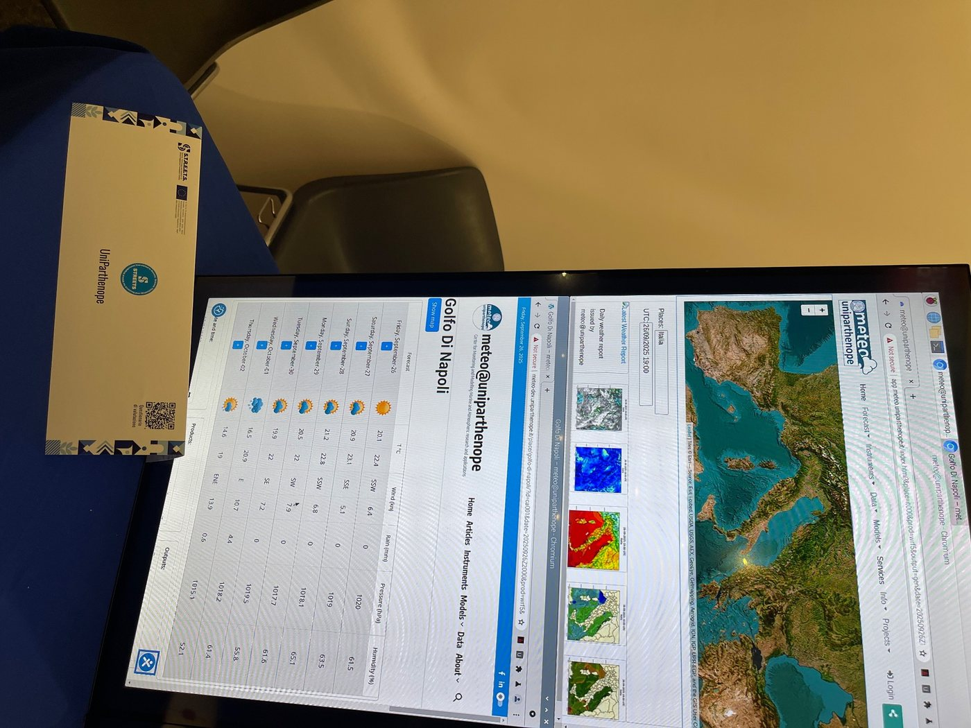
ARC12 COMPUTER ARCHITECTURE · LECTURE 24
Beyond One Core: Superscalar RISC-V, HPC, GPUs and FPGAs: the code
Code deck: every listing explained, the complete program, and how to test it on PRG32-QT, on QEMU and on the board
Prof. Raffaele Montella, PhD
University of Naples “Parthenope” · A.Y. 2026/27
raffaelemontella.it · raffaele.montella@uniparthenope.it
Notes:
This is the code deck of Lecture 24. The lecture deck holds the concepts; this one holds everything you type and run: the listings with their explanation, the complete program, what it shows, and the way to test it on each of the three hosts.

Slide 2
In this deck
1
The 7 listings of Lecture 24, one per slide: read the code, then the numbered remarks beside it
2
The complete program: code/l24.S, 72 lines, printed in full
3
What you should see when it runs, checked on the PRG32-QT headless runner
4
How to test it, step by step: on PRG32-QT, on QEMU, on the board
5
The exercises: change the program, predict, run
Notes:
What the deck contains, in the order of the slides. The program of the lecture is a file that you can build and run as it is: start from there, and come back to the listings to understand each part. The program of this lecture is ~/arc12/code/l24.S; tools/tests/cartridges/run.py builds it, runs it on PRG32-QT with scripted input and checks the pixels of the frame.
For the lecturer: Get the code once: git clone https://github.com/riscv-prg32/computer-architecture-with-prg32 ~/arc12. The program of this lecture is ~/arc12/code/l24.S; tools/tests/cartridges/run.py builds it, runs it on PRG32-QT with scripted input and checks the pixels of the frame. Every listing on these slides is read by the build from a tested file, or checked by tools/tests: see its README.

Slide 3
The loop that empties the map
la t0, grid
li t1, COLS*ROWS
1: sb zero, 0(t0) # one byte per turn of the loop
addi t0, t0, 1
addi t1, t1, -1
bnez t1, 1b
1
From new_game of Verm1: 960 bytes set to zero
2
Four instructions per byte: 3 840 instructions in all
3
One byte at a time, one instruction at a time
4
How many ways are there to make this faster?
Notes:
The loop that empties the map in new_game: 960 bytes set to zero. Four instructions per turn: a store of one byte, the increment of the address, the decrement of the counter, the branch back. In all 3,840 instructions, one byte at a time, one instruction at a time. On the kit it takes about 24 microseconds, and nobody needs it faster. It is chosen because it is small enough to be followed onto every machine of today. In how many ways can it be made faster?
For the lecturer: The processor cycle of Lecture 19. At best one instruction per clock cycle, and 160 million cycles per second on the kit: about 24 microseconds. Nobody needs this loop to be faster; it is small enough to follow onto every machine of today.

Slide 4
What gets in the way: dependences
add t0, t1, t2 # i1
add t3, t0, t4 # i2 needs the t0 of i1: it must wait
lw t5, 0(t6) # i3 is independent: it could go now
beqz t3, skip # i4: which way? known only after i2
addi t5, t5, 1 # i5: executed, or not?
skip:
1
i2 cannot run beside i1: it uses its result
2
i3 depends on nobody: why should it wait?
3
After a branch the processor does not know what comes next
4
Real code is full of such chains: width alone is not enough
Notes:
What gets in the way. The second instruction uses t0, which the first is still computing: it cannot run beside it. This is a data dependence. The third depends on nobody, and yet in an in-order processor it waits behind the second. The fourth is a branch: until it is resolved the processor does not know whether the fifth must be executed. This is a control dependence. Real programs are full of such chains, so width alone is not enough.
For the lecturer: Data dependences, control dependences. An in-order superscalar stalls at i2 and everything behind it waits. The remedy is to let i3 overtake.

Slide 5
Register renaming: thirty-two names, many registers
# as written # as executed, after renaming
lw t0, 0(a0) lw p41, 0(a0)
addi t0, t0, 1 addi p42, p41, 1
sw t0, 0(a0) sw p42, 0(a0)
lw t0, 4(a0) lw p43, 4(a0) # a new t0
addi t0, t0, 1 addi p44, p43, 1
sw t0, 4(a0) sw p44, 4(a0)
1
The second half reuses the name t0, not its value
2
Renamed, the two halves share nothing
3
They can run at the same time, on different registers
4
The 32 registers you know are names; the chip has many more
Notes:
Register renaming on an example. On the left the code as written: two halves, each loading a word, incrementing it and storing it back, and both using t0. The second half reuses the name, not the value: it is a false dependence. On the right, after renaming, each new value has its own physical register, and the two halves share nothing, so they can execute at the same time. The thirty-two registers you know are names; the chip has a few hundred registers.
For the lecturer: A false dependence: the same name for two unrelated values. p41 to p44 are invented numbers of physical registers. A big core has a few hundred of them.

Slide 6
The same loop, with vectors
la t0, grid
li t1, COLS*ROWS
vsetvli t2, t1, e8, m1, ta, ma # elements are bytes
vmv.v.i v0, 0 # a register full of zeros
1: vsetvli t2, t1, e8, m1, ta, ma # t2 = bytes of this turn
vse8.v v0, (t0) # store t2 bytes at once
add t0, t0, t2
sub t1, t1, t2
bnez t1, 1b
1
v0 is a vector register: many bytes wide
2
vsetvli asks: how many of the bytes left fit? The answer is in t2
3
vse8.v stores t2 bytes with one instruction
4
With 128-bit registers: 16 bytes per turn, 60 turns instead of 960
Notes:
The same loop with the vector extension. v0 is a vector register, many bytes wide, filled with zeros. In each turn vsetvli asks: of the bytes still to do, how many fit in a register? The answer goes in t2. vse8.v stores that many bytes with a single instruction, and the address and the counter advance by t2. With 128-bit registers a turn handles 16 bytes: 60 turns instead of 960. The code never states the width of the registers, so the same program works with any width.
For the lecturer: The V extension, ratified in 2021. Not on the kit: the ESP32-C6 is RV32IMAC. The code never says how wide the registers are: it is vector-length agnostic, and the same binary uses 128, 256 or 1024 bits. Tested on QEMU at 128, 256, 512 and 1024 bits by tools/tests/vector_qemu.S.

Slide 7
A sum, lane by lane
la t0, numbers
li t1, 16 # sixteen words to add
vsetvli t2, zero, e32, m1, ta, ma
vmv.v.i v1, 0 # v1 = partial sums, one per lane
1: vsetvli t2, t1, e32, m1, tu, ma
vle32.v v2, (t0) # load t2 words
vadd.vv v1, v1, v2 # add them, lane by lane
slli t3, t2, 2
add t0, t0, t3
sub t1, t1, t2
bnez t1, 1b
vsetvli t2, zero, e32, m1, ta, ma
vmv.s.x v3, zero
vredsum.vs v3, v1, v3 # add the lanes together
vmv.x.s a0, v3
1
vle32.v loads several words at once
2
vadd.vv adds register to register, lane by lane
3
At the end vredsum adds the lanes together
4
Sixteen numbers, 1 to 16: the result is 136
Notes:
A sum, lane by lane. A vector register holds several words, each in its own lane. vle32.v loads several words at once; vadd.vv adds two registers lane by lane, so that v1 accumulates as many partial sums as there are lanes. At the end vredsum adds the lanes together into one number. With the sixteen numbers from 1 to 16 the result is 136. It is the parallel sum you saw as a picture in Lecture 04, now as instructions.
For the lecturer: The parallel sum of Lectures 04 and 20, in RISC-V. tu, tail undisturbed, keeps the partial sums of the lanes that the last turn does not use. Tested on QEMU together with the previous listing.

Slide 8
The map of Verm1, one thread per cell
// the kernel: this function runs once in every thread
__global__ void clear(unsigned char *grid, int n) {
int i = blockIdx.x * blockDim.x + threadIdx.x; // who am I?
if (i < n)
grid[i] = 0; // my cell, and only mine
}
// on the host: 4 blocks of 256 threads cover the 960 cells
clear<<<(960 + 255) / 256, 256>>>(grid, 960);
1
There is no loop: there are 960 threads
2
Each thread computes its own index and does one store
3
Threads come in blocks; the last ones find nothing to do
4
For 960 bytes the copies cost far more than the work
Notes:
The map of Verm1 on a GPU. The function marked as kernel runs once in every thread. Each thread first computes who it is, its index i, from the number of its block and its position in the block; then, if the index is inside the map, it clears its own cell. There is no loop: there are 960 threads. The last line, on the host, launches four blocks of 256 threads. For 960 bytes the two copies cost far more than the work: this example shows the form, not a gain.
For the lecturer: CUDA C, in its usual textbook form; not compiled for these slides. The point of the last callout is serious: a GPU pays off when the data are large and the work per element is real. Ask: for which size of map would it be worth it?

Slide 9
The U-turn rule of Verm1, as hardware
// Lecture 12: opposite directions differ in bit 1 only
module uturn (
input wire [1:0] dir, // direction of the last step
input wire [1:0] want, // direction asked by the player
output wire refuse // 1 = this would be a U-turn
);
assign refuse = (dir ^ want) == 2'b10;
endmodule
1
Verilog: a language that describes circuits, not steps
2
assign is a wire, always true: there is no before and after
3
Two XOR gates and an AND with one inverted input
4
On the kit this rule took three instructions and three cycles
Notes:
The rule of Verm1 that forbids the U-turn, written as hardware. Verilog is a language that describes circuits, not sequences of steps. The module has two inputs of two bits, the current direction and the one requested, and one output. The line with assign is a wire that is always true: the output is 1 when the XOR of the two directions equals binary 10. There is no before and after. On the kit the same rule took three instructions.
For the lecturer: A hardware description language: Verilog, or VHDL. Not synthesised for these slides. The xor, li, beq of Part 2 become gates that answer in a fraction of a nanosecond, continuously. Ask the students to draw the circuit: refuse = (d1 xor w1) and not (d0 xor w0).

Slide 10
Emptying the map of Verm1: 960 cells
Machine | How | Steps in time
The kit: ESP32-C6 | one byte per turn, one instruction per cycle | 3 840 cycles
Out-of-order RISC-V core | the same binary; several instructions per cycle, the branch predicted | a fraction of those cycles
RISC-V with vectors, 128 bits | 16 bytes per turn | 60 turns
GPU | 960 threads, one per cell | one launch, plus two copies
FPGA | 960 flip-flops with a common reset | one clock cycle
The first three rows are the same instruction set. The first and the third were run for these slides.
Notes:
Emptying the 960 cells of the map. On the kit: one byte per turn, 3,840 cycles. On an out-of-order RISC-V core: the same binary, in a fraction of those cycles. With 128-bit vectors: 60 turns. On a GPU: one launch of 960 threads, plus two copies. On an FPGA: 960 flip-flops with a common reset, one clock cycle. The work is the same; what changes is how much of it happens at the same time, and what it costs to obtain it. The engineer's question is not which is fastest, but which is enough.
For the lecturer: The work is the same; what changes is how much of it happens at the same time. And the costs: the first row needs a two-euro chip and four lines of assembly; the last needs a hardware design. The engineer's question is never which is fastest, but which is enough.

Slide 11
The complete program: l24.S (1 of 4)
# ARC12 Computer Architecture - Lecture 24: Beyond One Core
# l24.S: the loop that empties the map of Verm1, one byte at a time
#
# On the screen: a green square: the 960 bytes of the map, filled with ones by init,
# were all set to zero by the four-instruction loop of the lecture. A red square would
# mean that some byte survived.
# Build: python3 -m prg32 cartridge build l24.S --portable \
# --entry-prefix l24 --name l24 --out l24.prg32
.option norelax
.equ BLACK, 0x0000
.equ GREEN, 0x07e0
.equ RED, 0xf800
.equ CELLS, 960 # 40 columns by 24 rows
.section .text
.global l24_init
.global l24_update
.global l24_draw
Notes:
One page of the complete program, exactly as it is in the repository. Read it from the top: the header says what the program shows and how to build it; the three functions init, update and draw follow, then the data. Lines that you met in the listings of the lecture have the same comments here.
For the lecturer: code/l24.S, as built and run by the tests. The comments are part of the program: read them with the code.

Slide 12
The complete program: l24.S (2 of 4)
l24_init: # fill the map with ones, so that there is work to do
la t0, grid
li t1, CELLS
li t2, 1
1: sb t2, 0(t0)
addi t0, t0, 1
addi t1, t1, -1
bnez t1, 1b
ret
l24_update:
la t0, grid # the loop of the lecture
li t1, CELLS
1: sb zero, 0(t0) # one byte ...
addi t0, t0, 1 # ... the next address ...
addi t1, t1, -1 # ... one fewer to go ...
bnez t1, 1b # ... 960 times: 3840 instructions
Notes:
One page of the complete program, exactly as it is in the repository. Read it from the top: the header says what the program shows and how to build it; the three functions init, update and draw follow, then the data. Lines that you met in the listings of the lecture have the same comments here.
For the lecturer: code/l24.S, as built and run by the tests. The comments are part of the program: read them with the code.

Slide 13
The complete program: l24.S (3 of 4)
la t0, grid # count the bytes that are not zero
li t1, CELLS
li t3, 0
2: lbu t2, 0(t0)
add t3, t3, t2
addi t0, t0, 1
addi t1, t1, -1
bnez t1, 2b
la t0, left
sw t3, 0(t0)
ret
Notes:
One page of the complete program, exactly as it is in the repository. Read it from the top: the header says what the program shows and how to build it; the three functions init, update and draw follow, then the data. Lines that you met in the listings of the lecture have the same comments here.
For the lecturer: code/l24.S, as built and run by the tests. The comments are part of the program: read them with the code.

Slide 14
The complete program: l24.S (4 of 4)
l24_draw:
addi sp, sp, -16
sw ra, 12(sp)
li a0, BLACK
call prg32_gfx_clear
la t0, left
lw t1, 0(t0)
li a4, GREEN
beqz t1, 1f
li a4, RED
1: li a0, 136
li a1, 76
li a2, 48
li a3, 48
call prg32_gfx_rect
lw ra, 12(sp)
addi sp, sp, 16
ret
.section .data
left: .word 1
grid: .space CELLS
Notes:
One page of the complete program, exactly as it is in the repository. Read it from the top: the header says what the program shows and how to build it; the three functions init, update and draw follow, then the data. Lines that you met in the listings of the lecture have the same comments here.
For the lecturer: code/l24.S, as built and run by the tests. The comments are part of the program: read them with the code.

Slide 15
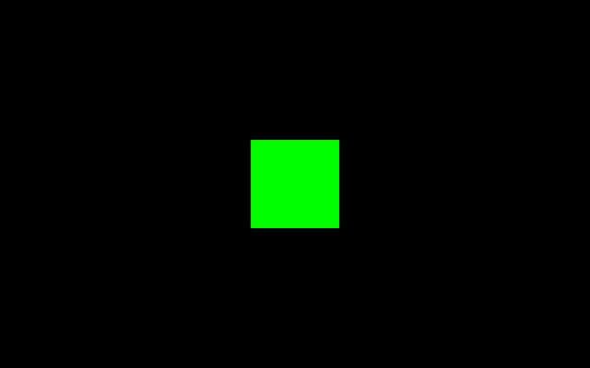
Run it: what you should see
On the screen
– a green square: the 960 bytes of the map, filled with ones by init, were all set to zero by the four-instruction loop of the lecture. A red square would mean that some byte survived.
What to press
– nothing: the program runs by itself
The frame written by the automatic test on PRG32-QT
Notes:
What the program shows when it runs, and what to press. Predict before you run: if the screen differs from this picture, the difference is information. The picture was written by the automatic test, not drawn by hand.
For the lecturer: The picture is the frame that the headless runner of PRG32-QT produced in the test of this program. On QEMU and on the board the game area is the same 320 by 200 pixels, between the two status bands.

Slide 16
Test it on PRG32-QT
# 1. start PRG32-QT on this computer (it listens on port 8080)
# 2. in the PRG32 folder, with ESP-IDF active: build the cartridge
python3 -m prg32 cartridge build ~/arc12/code/l24.S --portable \
--entry-prefix l24 --name l24 --out l24.prg32
# 3. send it to PRG32-QT and start it
python3 -m prg32 esp32c6 upload-and-run l24.prg32 \
--url http://localhost:8080 --slot cart0
# 4. look, press, compare with the previous slide
1
PRG32-QT must be running: it answers on port 8080, like a board
2
Build once, from the PRG32 folder, with ESP-IDF active in the terminal
3
upload-and-run stores the cartridge in slot cart0 and starts it
4
Enable debug mode in Settings to stop the program and read registers and memory
Notes:
The quickest way: PRG32-QT on your own computer. Four steps, each with its command. PRG32-QT behaves like a board on port 8080, which is why the upload command says esp32c6. With debug mode enabled you can stop at any instruction and read registers and memory.
For the lecturer: Run by the tests: the cartridge of this slide is built with this command and executed on the headless runner of PRG32-QT. Without the toolchain: import the .prg32 file in PRG32-QT and choose Run Cartridge. Keys: arrows or WASD for the joystick, Z or J for A, X or K for B, Enter for Start, Escape to go back to Setup.

Slide 17
Test it on QEMU
# 1. once: build the firmware for QEMU (several minutes)
python3 -m prg32 qemu build
# 2. build the cartridge for the emulated chip
python3 -m prg32 cartridge build ~/arc12/code/l24.S --portable \
--entry-prefix l24 --name l24 --architecture qemu \
--out l24-qemu.prg32
# 3. with QEMU closed, stage the cartridge into its flash image
python3 -m prg32 qemu upload l24-qemu.prg32
# 4. start the emulator; on Setup choose Run Cartridge, then cart0
python3 -m prg32 qemu run
1
The emulator runs the real firmware on an emulated chip: build it once
2
The cartridge is built for the architecture qemu: the same source, another file
3
Stage the cartridge with QEMU closed, then start it and choose Run Cartridge
4
The keys go to the terminal: arrows or WASD, Z or J for A, X or K for B
Notes:
The same program on the emulator. QEMU runs the real firmware on an emulated chip, so the cartridge must be built for the architecture qemu. Stage the cartridge while QEMU is closed. The firmware opens on the Setup menu: choose Run Cartridge and the slot. Remember that the keyboard is read by the terminal, not by the window with the picture.
For the lecturer: Checked by the tests up to the staging: the cartridge is built for the architecture qemu and accepted into the flash image of the emulator. What the emulator then shows is not checked automatically: Espressif QEMU needs its window. Since October 2026 the firmware starts on Setup: choose Run Cartridge, then cart0.

Slide 18
Test it on the board
# 1. once per board: write the firmware through the USB cable
python3 -m prg32 esp32c6 build-and-flash
# 2. join the Wi-Fi network of the board: PRG32, password prg32game
# 3. build the cartridge for the board
python3 -m prg32 cartridge build ~/arc12/code/l24.S --portable \
--entry-prefix l24 --name l24 --architecture esp32c6 \
--out l24-esp32c6.prg32
# 4. send it over Wi-Fi and start it
python3 -m prg32 esp32c6 upload-and-run l24-esp32c6.prg32 \
--url http://192.168.4.1 --slot cart0
1
The firmware is written once per board, through the USB cable
2
The board creates the Wi-Fi network PRG32: join it with your computer
3
The same upload command as for PRG32-QT, with the address of the board
4
A black screen: check the wiring of the display against the firmware
Notes:
The same program on the kit. The firmware is written once, through USB; after that cartridges travel over Wi-Fi. The upload command is the one used for PRG32-QT with the address of the board. This is the only host that the automatic tests do not run: try it, and report what you see.
For the lecturer: Not run by the tests: there is no board on the test machine. The cartridge for the architecture esp32c6 is built by the tests; the steps are those of the PRG32 documentation. If the serial port is not found pass it explicitly. To use the Wi-Fi of the classroom: python3 -m prg32 wifi set --ssid NAME --password PASSWORD --mode sta.

Slide 19
The vector listings: test them on upstream QEMU
# from ~/arc12/tools/tests, with the RISC-V compiler on the PATH
riscv32-esp-elf-gcc -march=rv32imv_zicsr -mabi=ilp32 -nostdlib \
-nostartfiles -T link.ld -o v.elf vector_qemu.S
# the same binary, with vector registers of four different widths
for n in 128 256 512 1024; do
qemu-system-riscv32 -machine virt -cpu rv32,v=true,vlen=$n \
-bios none -kernel v.elf -nographic -display none
echo "vlen=$n: exit code $?"
done
1
The kit has no vector extension: these listings run on a bare emulated RV32 with V
2
Exit code 0: every check passed; any other value is the number of the failing check
3
The same binary passes with registers of 128, 256, 512 and 1024 bits
4
Use upstream QEMU here, not the Espressif fork
Notes:
The vector listings of this lecture cannot run on the kit, whose processor has no V extension. They are tested on a bare emulated processor instead: the commands build one binary and run it with four vector lengths. The exit code is the result.
For the lecturer: Run by the tests (tools/tests/run_all.sh, step vectors). On macOS there is no timeout command: if a listing loops for ever, stop QEMU with Ctrl-A X.

Slide 20
If it does not work
You see | It means | Do this
missing entry point | the prefix is not the one in the source | --entry-prefix l24; check the three .global lines
idf.py: command not found | ESP-IDF is not active in this terminal | run export.sh, or open the ESP-IDF PowerShell
upload: connection refused | the host is not listening at that address | start PRG32-QT; use the address on its Setup screen
a black screen, or the menu again | a function does not return, or ra was not saved | debug mode: step through init, update, draw
QEMU ignores the keys | the keyboard goes to the terminal | click the terminal that launched QEMU
Notes:
The five most common symptoms, what each means, and what to do. Read the message before changing anything: it nearly always names the cause.
For the lecturer: The first three rows cover most cases. When asking for help, paste the command and the whole message as text. docs/usage/troubleshooting.md of the PRG32 repository has the complete list.

Slide 21
Exercises: paper first, then the machine
TRY IT
1
Fill in the Amdahl table for p = 0.95 and n = 10, 100, 1000
2
Draw the pipeline diagram of a three-wide processor for nine independent instructions with five stages
3
Rename the registers of the step-wrap code of Verm1, Part 2: which instructions could run in the same cycle?
4
Write the truth table stored in a four-input look-up table for refuse = (dir xor want) == 2
5
Build tools/tests/vector_qemu.S and run it on QEMU with vlen=128 and vlen=512: why does the same binary work?
Expected result
Amdahl, p = 0.95: 6.9, 16.8, 19.6. Nine instructions, three-wide: seven cycles. The look-up table has four ones out of sixteen entries.
Notes:
Five exercises. Fill in the Amdahl table for p = 0.95. Draw the pipeline diagram of a three-wide processor for nine independent instructions. Rename the registers of a fragment of Verm1 and say which instructions could run in the same cycle. Write the truth table of a four-input look-up table for the U-turn rule. And build the vector test and run it on QEMU with two different widths: why does the same binary work?
For the lecturer: QEMU: qemu-system-riscv32 -machine virt -cpu rv32,v=true,vlen=128; the build command is in tools/tests/README.md. The four ones of the table: (dir, want) = (0,2), (1,3), (2,0), (3,1).

