Slide 1
git root
rvx_init
#(git root)
i.e., rvx_lec_hw
rvx_install
imp_class_info
#(platform dir 1)
#(platform base)
i.e., lec_apb
i.e., platform
#(platform dir 2)
README.md
∙∙∙
real name
macro name
Makefile
∙∙∙
∙∙∙

Slide 2
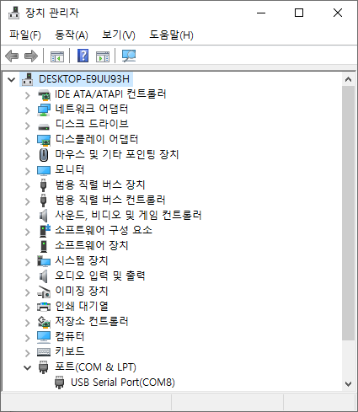

Slide 3
