Slide 1
Coursera capstone project
Car Insurance cold calls

Slide 2
Introduction
The data set used contains 4000 rows of car insurance cold call data
The aim of this project is to create a model which can predict whether a car insurance sale will be made during a cold call.

Slide 3
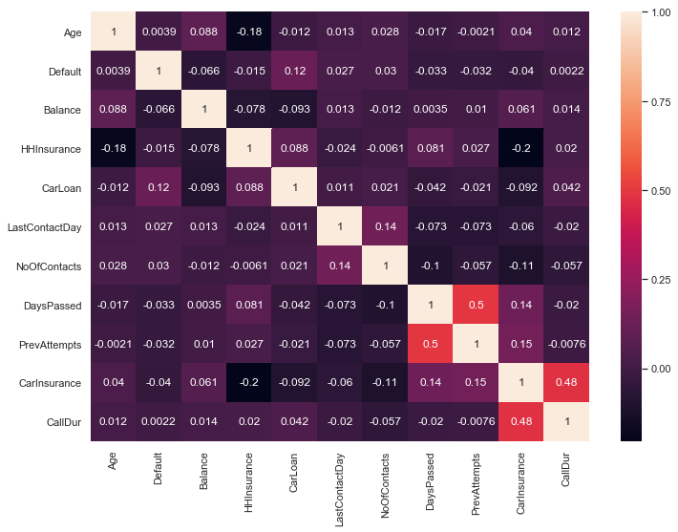
Correlation of features
This is the what I want to predict (Y)

Slide 4
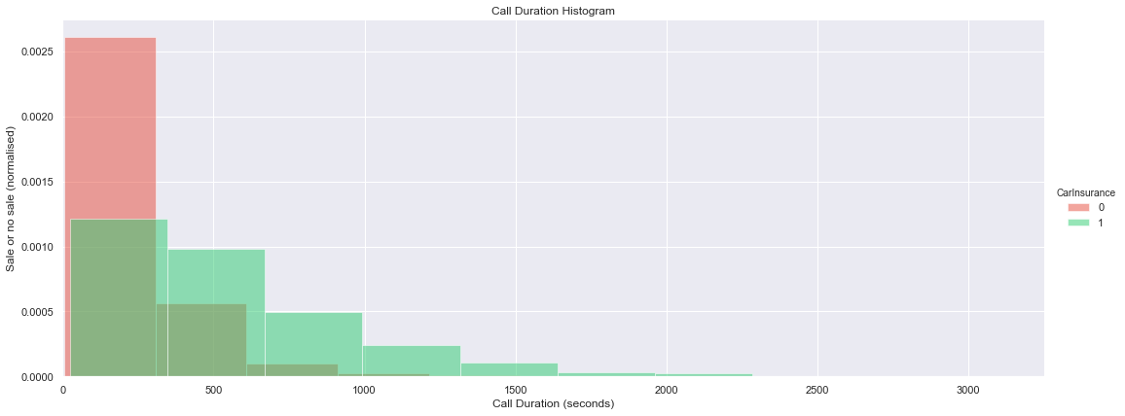
The highest correlating feature with Y

Slide 5
Methods of prediction
K-nearest neighbor
Random forest
Logistic regression
Gradient boost

Slide 6
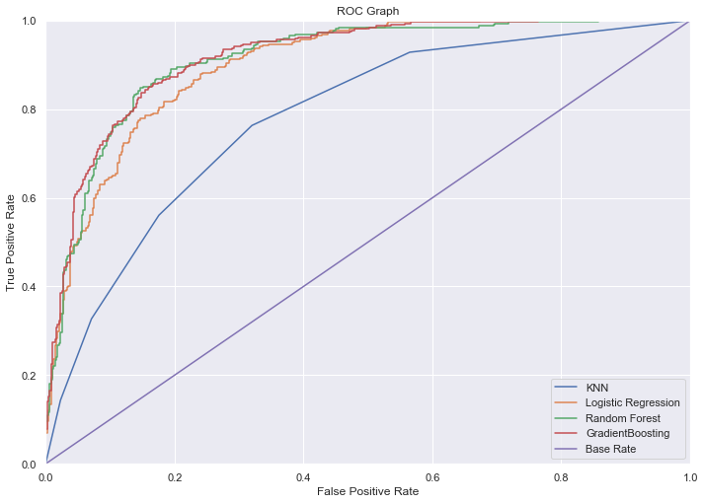
Results

Slide 7
Conclusion
The gradient booster and random forest algorithm both perform with very similar results, both with a precision of 0.84.

