Slide 1
DATABASE MANAGEMENT SYSTEMS
TERM 2008-09
B. Tech II/IT II Semester
UNIT-VI PPT SLIDES
Text Books: (1) DBMS by Raghu Ramakrishnan
(2) DBMS by Sudarshan and Korth

Slide 2
INDEX
UNIT-6 PPT SLIDES
S.NO Module as per Lecture PPT
Session planner No Slide NO
--------------------------------------------------------------------------------------------------------------------------------
Transaction concept & State L1 L1- 1 to L1- 7
Implementation of atomicity and durability L2 L2- 1 to L2- 8
Serializability L3 L3- 1 to L3- 8
Recoverability L4 L4- 1 to L4- 8
Implementation of isolation L5 L5- 1 to L5- 6
Lock based protocols L6 L6- 1 to L6 -5
Lock based protocols L7 L7- 1 to L7- 10
Timestamp based protocols L8 L8- 1 to L8- 6
Validation based protocol L9 L9- 1 to L9- 9

Slide 3
Transaction Concept
A transaction is a unit of program execution that accesses and possibly updates various data items.
E.g. transaction to transfer $50 from account A to account B:
  1. read(A)
  2. A := A – 50
  3. write(A)
  4. read(B)
  5. B := B + 50
  6. write(B)
Two main issues to deal with:
  Failures of various kinds, such as hardware failures and system crashes
  Concurrent execution of multiple transactions
Slide No.L1-1

Slide 4
Example of Fund Transfer
Transaction to transfer $50 from account A to account B:
  1. read(A)
  2. A := A – 50
  3. write(A)
  4. read(B)
  5. B := B + 50
  6. write(B)
Atomicity requirement
  if the transaction fails after step 3 and before step 6, money will be “lost” leading to an inconsistent database state
    Failure could be due to software or hardware
  the system should ensure that updates of a partially executed transaction are not reflected in the database
Durability requirement — once the user has been notified that the transaction has completed (i.e., the transfer of the $50 has taken place), the updates to the database by the transaction must persist even if there are software or hardware failures.
Slide No.L1-2

Slide 5
Example of Fund Transfer (Cont.)
Transaction to transfer $50 from account A to account B:
  1. read(A)
  2. A := A – 50
  3. write(A)
  4. read(B)
  5. B := B + 50
  6. write(B)
Consistency requirement in above example:
  the sum of A and B is unchanged by the execution of the transaction
In general, consistency requirements include
    Explicitly specified integrity constraints such as primary keys and foreign keys
    Implicit integrity constraints
      e.g. sum of balances of all accounts, minus sum of loan amounts must equal value of cash-in-hand
  A transaction must see a consistent database.
  During transaction execution the database may be temporarily inconsistent.
  When the transaction completes successfully the database must be consistent
    Erroneous transaction logic can lead to inconsistency
Slide No.L1-3

Slide 6
Example of Fund Transfer (Cont.)
Isolation requirement — if between steps 3 and 6, another transaction T2 is allowed to access the partially updated database, it will see an inconsistent database (the sum A + B will be less than it should be).
T1 T2
  1. read(A)
  2. A := A – 50
  3. write(A)
  read(A), read(B), print(A+B)
  4. read(B)
  5. B := B + 50
  6. write(B
Isolation can be ensured trivially by running transactions serially
  that is, one after the other.
However, executing multiple transactions concurrently has significant benefits, as we will see later.
Slide No.L1-4

Slide 7
ACID Properties
A transaction is a unit of program execution that accesses and possibly updates various data items.To preserve the integrity of data the database system must ensure:
Atomicity. Either all operations of the transaction are properly reflected in the database or none are.
Consistency. Execution of a transaction in isolation preserves the consistency of the database.
Isolation. Although multiple transactions may execute concurrently, each transaction must be unaware of other concurrently executing transactions. Intermediate transaction results must be hidden from other concurrently executed transactions.
  That is, for every pair of transactions T_{i} and T_{j}, it appears to T_{i} that either T_{j}, finished execution before T_{i} started, or T_{j} started execution after T_{i} finished.
Durability. After a transaction completes successfully, the changes it has made to the database persist, even if there are system failures.
Slide No.L1-5

Slide 8
Transaction State
Active – the initial state; the transaction stays in this state while it is executing
Partially committed – after the final statement has been executed.
Failed -- after the discovery that normal execution can no longer proceed.
Aborted – after the transaction has been rolled back and the database restored to its state prior to the start of the transaction. Two options after it has been aborted:
  restart the transaction
    can be done only if no internal logical error
  kill the transaction
Committed – after successful completion.
Slide No.L1-6

Slide 9

Transaction State (Cont.)
Slide No.L1-7

Slide 10

Implementation of Atomicity and Durability
The recovery-management component of a database system implements the support for atomicity and durability.
E.g. the shadow-database scheme:
  all updates are made on a shadow copy of the database
    db_pointer is made to point to the updated shadow copy after
      the transaction reaches partial commit and
      all updated pages have been flushed to disk.
Slide No.L2-1

Slide 11
Implementation of Atomicity and Durability (Cont.)
db_pointer always points to the current consistent copy of the database.
  In case transaction fails, old consistent copy pointed to by db_pointer can be used, and the shadow copy can be deleted.
The shadow-database scheme:
  Assumes that only one transaction is active at a time.
  Assumes disks do not fail
  Useful for text editors, but
    extremely inefficient for large databases (why?)
      Variant called shadow paging reduces copying of data, but is still not practical for large databases
  Does not handle concurrent transactions
Slide No.L2-2

Slide 12
Concurrent Executions
Multiple transactions are allowed to run concurrently in the system. Advantages are:
  increased processor and disk utilization, leading to better transaction throughput
    E.g. one transaction can be using the CPU while another is reading from or writing to the disk
  reduced average response time for transactions: short transactions need not wait behind long ones.
Concurrency control schemes – mechanisms to achieve isolation
  that is, to control the interaction among the concurrent transactions in order to prevent them from destroying the consistency of the database
    Will study in Chapter 16, after studying notion of correctness of concurrent executions.
Slide No.L2-3

Slide 13
Schedules
Schedule – a sequences of instructions that specify the chronological order in which instructions of concurrent transactions are executed
  a schedule for a set of transactions must consist of all instructions of those transactions
  must preserve the order in which the instructions appear in each individual transaction.
A transaction that successfully completes its execution will have a commit instructions as the last statement
  by default transaction assumed to execute commit instruction as its last step
A transaction that fails to successfully complete its execution will have an abort instruction as the last statement
Slide No.L2-4

Slide 14

Schedule 1
Let T₁ transfer $50 from A to B, and T₂ transfer 10% of the balance from A to B.
A serial schedule in which T₁ is followed by T₂ :
Slide No.L2-5

Slide 15

Schedule 2
A serial schedule where T₂ is followed by T₁
Slide No.L2-6

Slide 16

Schedule 3
Let T₁ and T₂ be the transactions defined previously. The following schedule is not a serial schedule, but it is equivalent to Schedule 1.
In Schedules 1, 2 and 3, the sum A + B is preserved.
Slide No.L2-7

Slide 17

Schedule 4
The following concurrent schedule does not preserve the value of (A + B ).
Slide No.L2-8

Slide 18
Serializability
Basic Assumption – Each transaction preserves database consistency.
Thus serial execution of a set of transactions preserves database consistency.
A (possibly concurrent) schedule is serializable if it is equivalent to a serial schedule. Different forms of schedule equivalence give rise to the notions of:
  1. conflict serializability
  2. view serializability
Simplified view of transactions
  We ignore operations other than read and write instructions
  We assume that transactions may perform arbitrary computations on data in local buffers in between reads and writes.
  Our simplified schedules consist of only read and write instructions.
Slide No.L3-1

Slide 19
Conflicting Instructions
Instructions l_{i} and l_{j} of transactions T_{i} and T_{j} respectively, conflict if and only if there exists some item Q accessed by both l_{i} and l_{j}, and at least one of these instructions wrote Q.
1. l_{i} = read(Q), l_{j} = read(Q). l_{i} and l_{j} don’t conflict.
2. l_{i} = read(Q), l_{j} = write(Q). They conflict.
3. l_{i} = write(Q), l_{j} = read(Q). They conflict
4. l_{i} = write(Q), l_{j} = write(Q). They conflict
Intuitively, a conflict between l_{i} and l_{j} forces a (logical) temporal order between them.
  If l_{i} and l_{j} are consecutive in a schedule and they do not conflict, their results would remain the same even if they had been interchanged in the schedule.
Slide No.L3-2

Slide 20
Conflict Serializability
If a schedule S can be transformed into a schedule S´ by a series of swaps of non-conflicting instructions, we say that S and S´ are conflict equivalent.
We say that a schedule S is conflict serializable if it is conflict equivalent to a serial schedule
Slide No.L3-3

Slide 21


Conflict Serializability (Cont.)
Schedule 3 can be transformed into Schedule 6, a serial schedule where T₂ follows T₁, by series of swaps of non-conflicting instructions.
  Therefore Schedule 3 is conflict serializable.
Schedule 3
Schedule 6
Slide No.L3-4

Slide 22

Conflict Serializability (Cont.)
Example of a schedule that is not conflict serializable:
We are unable to swap instructions in the above schedule to obtain either the serial schedule < T₃, T₄ >, or the serial schedule < T₄, T₃ >.
Slide No.L3-5

Slide 23
View Serializability
Let S and S´ be two schedules with the same set of transactions. S and S´ are view equivalent if the following three conditions are met, for each data item Q,
  If in schedule S, transaction T_{i} reads the initial value of Q, then in schedule S’ also transaction T_{i} must read the initial value of Q.
  If in schedule S transaction T_{i} executes read(Q), and that value was produced by transaction T_{j} (if any), then in schedule S’ also transaction T_{i} must read the value of Q that was produced by the same write(Q) operation of transaction T_{j} .
  The transaction (if any) that performs the final write(Q) operation in schedule S must also perform the final write(Q) operation in schedule S’.
As can be seen, view equivalence is also based purely on reads and writes alone.
Slide No.L3-6

Slide 24

View Serializability (Cont.)
A schedule S is view serializable if it is view equivalent to a serial schedule.
Every conflict serializable schedule is also view serializable.
Below is a schedule which is view-serializable but not conflict serializable.
What serial schedule is above equivalent to?
Every view serializable schedule that is not conflict serializable has blind writes.
Slide No.L3-7

Slide 25
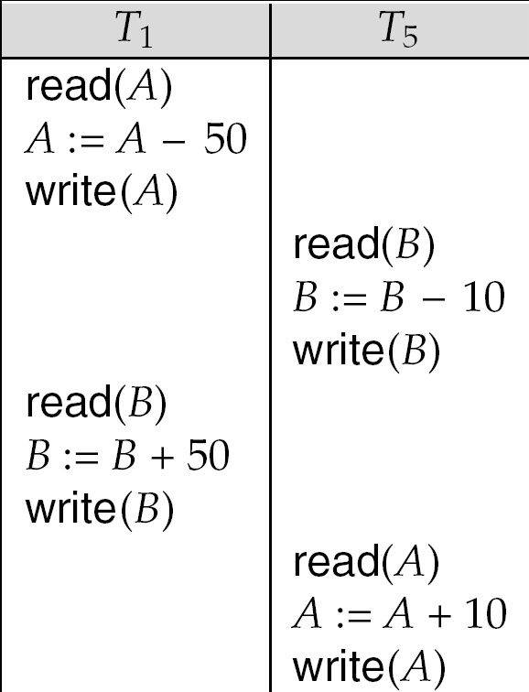
Other Notions of Serializability
The schedule below produces same outcome as the serial schedule < T₁, T₅ >, yet is not conflict equivalent or view equivalent to it.
Determining such equivalence requires analysis of operations other than read and write.
Slide No.L3-8

Slide 26
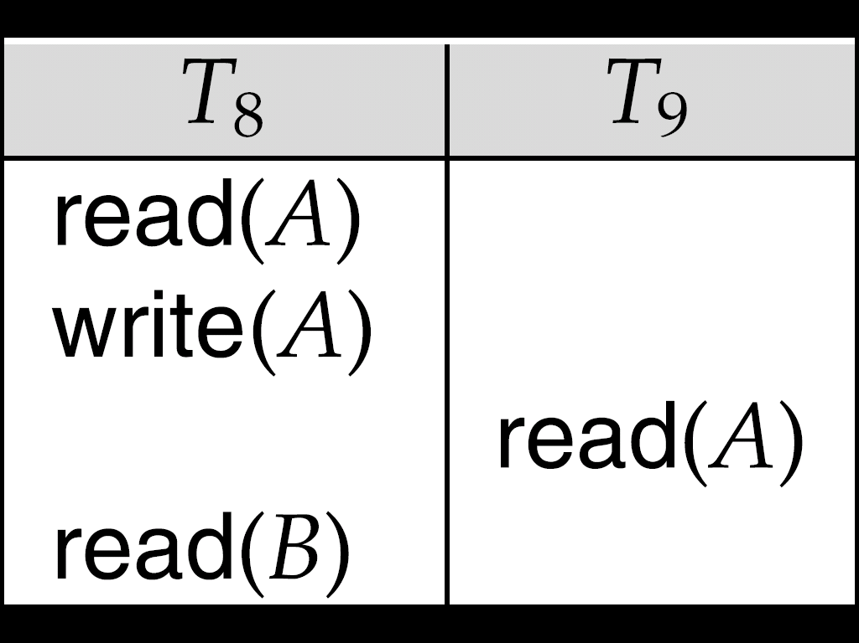
Recoverable Schedules
Need to address the effect of transaction failures on concurrently
running transactions.
Recoverable schedule — if a transaction T_{j} reads a data item previously written by a transaction T_{i} , then the commit operation of T_{i} appears before the commit operation of T_{j}.
The following schedule (Schedule 11) is not recoverable if T₉ commits immediately after the read
If T₈ should abort, T₉ would have read (and possibly shown to the user) an inconsistent database state. Hence, database must ensure that schedules are recoverable.
Slide No.L4-1

Slide 27

Cascading Rollbacks
Cascading rollback – a single transaction failure leads to a series of transaction rollbacks. Consider the following schedule where none of the transactions has yet committed (so the schedule is recoverable)
If T₁₀ fails, T₁₁ and T₁₂ must also be rolled back.
Can lead to the undoing of a significant amount of work
Slide No.L4-2

Slide 28
Cascadeless Schedules
Cascadeless schedules — cascading rollbacks cannot occur; for each pair of transactions T_{i} and T_{j} such that T_{j} reads a data item previously written by T_{i}, the commit operation of T_{i} appears before the read operation of T_{j}.
Every cascadeless schedule is also recoverable
It is desirable to restrict the schedules to those that are cascadeless
Slide No.L4-3

Slide 29
Concurrency Control
A database must provide a mechanism that will ensure that all possible schedules are
  either conflict or view serializable, and
  are recoverable and preferably cascadeless
A policy in which only one transaction can execute at a time generates serial schedules, but provides a poor degree of concurrency
  Are serial schedules recoverable/cascadeless?
Testing a schedule for serializability after it has executed is a little too late!
Goal – to develop concurrency control protocols that will assure serializability.
Slide No.L4-4

Slide 30
Transaction Definition in SQL
Data manipulation language must include a construct for specifying the set of actions that comprise a transaction.
In SQL, a transaction begins implicitly.
A transaction in SQL ends by:
  Commit work commits current transaction and begins a new one.
  Rollback work causes current transaction to abort.
In almost all database systems, by default, every SQL statement also commits implicitly if it executes successfully
  Implicit commit can be turned off by a database directive
    E.g. in JDBC, connection.setAutoCommit(false);
Slide No.L4-8

Slide 31
Implementation of Isolation
Schedules must be conflict or view serializable, and recoverable, for the sake of database consistency, and preferably cascadeless.
A policy in which only one transaction can execute at a time generates serial schedules, but provides a poor degree of concurrency.
Concurrency-control schemes tradeoff between the amount of concurrency they allow and the amount of overhead that they incur.
Some schemes allow only conflict-serializable schedules to be generated, while others allow view-serializable schedules that are not conflict-serializable.
Slide No.L5-1

Slide 32
Figure 15.6
Slide No.L5-2

Slide 33

Testing for Serializability
Consider some schedule of a set of transactions T₁, T₂, ..., T_{n}
Precedence graph — a direct graph where the vertices are the transactions (names).
We draw an arc from T_{i} to T_{j} if the two transaction conflict, and T_{i} accessed the data item on which the conflict arose earlier.
We may label the arc by the item that was accessed.
Example 1
x
y
Slide No.L5-3

Slide 34

Test for Conflict Serializability
A schedule is conflict serializable if and only if its precedence graph is acyclic.
Cycle-detection algorithms exist which take order n² time, where n is the number of vertices in the graph.
  (Better algorithms take order n + e where e is the number of edges.)
If precedence graph is acyclic, the serializability order can be obtained by a topological sorting of the graph.
  This is a linear order consistent with the partial order of the graph.
  For example, a serializability order for Schedule A would be
  T₅ → T₁ → T₃ → T₂ → T₄
    Are there others?
Slide No.L5-5

Slide 35
Test for View Serializability
The precedence graph test for conflict serializability cannot be used directly to test for view serializability.
  Extension to test for view serializability has cost exponential in the size of the precedence graph.
The problem of checking if a schedule is view serializable falls in the class of NP-complete problems.
  Thus existence of an efficient algorithm is extremely unlikely.
However practical algorithms that just check some sufficient conditions for view serializability can still be used.
Slide No.L5-6

Slide 36
Lock-Based Protocols
A lock is a mechanism to control concurrent access to a data item
Data items can be locked in two modes :
1. exclusive (X) mode. Data item can be both read as well as
written. X-lock is requested using lock-X instruction.
2. shared (S) mode. Data item can only be read. S-lock is
requested using lock-S instruction.
Lock requests are made to concurrency-control manager. Transaction can proceed only after request is granted.
Slide No.L6-1

Slide 37

Lock-Based Protocols (Cont.)
Lock-compatibility matrix
A transaction may be granted a lock on an item if the requested lock is compatible with locks already held on the item by other transactions
Any number of transactions can hold shared locks on an item,
  but if any transaction holds an exclusive on the item no other transaction may hold any lock on the item.
If a lock cannot be granted, the requesting transaction is made to wait till all incompatible locks held by other transactions have been released. The lock is then granted.
Slide No.L6-2

Slide 38
Lock-Based Protocols (Cont.)
Example of a transaction performing locking:
T₂: lock-S(A);
read (A);
unlock(A);
lock-S(B);
read (B);
unlock(B);
display(A+B)
Locking as above is not sufficient to guarantee serializability — if A and B get updated in-between the read of A and B, the displayed sum would be wrong.
A locking protocol is a set of rules followed by all transactions while requesting and releasing locks. Locking protocols restrict the set of possible schedules.
Slide No.L6-3

Slide 39

Pitfalls of Lock-Based Protocols
Consider the partial schedule
Neither T₃ nor T₄ can make progress — executing lock-S(B) causes T₄ to wait for T₃ to release its lock on B, while executing lock-X(A) causes T₃ to wait for T₄ to release its lock on A.
Such a situation is called a deadlock.
  To handle a deadlock one of T₃ or T₄ must be rolled back
  and its locks released.
Slide No.L6-4

Slide 40
Pitfalls of Lock-Based Protocols (Cont.)
The potential for deadlock exists in most locking protocols. Deadlocks are a necessary evil.
Starvation is also possible if concurrency control manager is badly designed. For example:
  A transaction may be waiting for an X-lock on an item, while a sequence of other transactions request and are granted an S-lock on the same item.
  The same transaction is repeatedly rolled back due to deadlocks.
Concurrency control manager can be designed to prevent starvation.
Slide No.L6-5

Slide 41
The Two-Phase Locking Protocol
This is a protocol which ensures conflict-serializable schedules.
Phase 1: Growing Phase
  transaction may obtain locks
  transaction may not release locks
Phase 2: Shrinking Phase
  transaction may release locks
  transaction may not obtain locks
The protocol assures serializability. It can be proved that the transactions can be serialized in the order of their lock points (i.e. the point where a transaction acquired its final lock).
Slide No.L7-1

Slide 42
The Two-Phase Locking Protocol (Cont.)
Two-phase locking does not ensure freedom from deadlocks
Cascading roll-back is possible under two-phase locking. To avoid this, follow a modified protocol called strict two-phase locking. Here a transaction must hold all its exclusive locks till it commits/aborts.
Rigorous two-phase locking is even stricter: here all locks are held till commit/abort. In this protocol transactions can be serialized in the order in which they commit.
Slide No.L7-2

Slide 43
Lock Conversions
Two-phase locking with lock conversions:
– First Phase:
  can acquire a lock-S on item
  can acquire a lock-X on item
  can convert a lock-S to a lock-X (upgrade)
– Second Phase:
  can release a lock-S
  can release a lock-X
  can convert a lock-X to a lock-S (downgrade)
This protocol assures serializability. But still relies on the programmer to insert the various locking instructions.
Slide No.L7-4

Slide 44
Automatic Acquisition of Locks
A transaction T_{i} issues the standard read/write instruction, without explicit locking calls.
The operation read(D) is processed as:
if T_{i} has a lock on D
then
read(D)
else begin
if necessary wait until no other
transaction has a lock-X on D
grant T_{i} a lock-S on D;
read(D)
end
Slide No.L7-5

Slide 45
Automatic Acquisition of Locks (Cont.)
write(D) is processed as:
if T_{i} has a lock-X on D
then
write(D)
else begin
if necessary wait until no other trans. has any lock on D,
if T_{i} has a lock-S on D
then
upgrade lock on D to lock-X
else
grant T_{i} a lock-X on D
write(D)
end;
All locks are released after commit or abort
Slide No.L7-6

Slide 46
Implementation of Locking
A lock manager can be implemented as a separate process to which transactions send lock and unlock requests
The lock manager replies to a lock request by sending a lock grant messages (or a message asking the transaction to roll back, in case of a deadlock)
The requesting transaction waits until its request is answered
The lock manager maintains a data-structure called a lock table to record granted locks and pending requests
The lock table is usually implemented as an in-memory hash table indexed on the name of the data item being locked
Slide No.L7-7

Slide 47

Lock Table
Black rectangles indicate granted locks, white ones indicate waiting requests
Lock table also records the type of lock granted or requested
New request is added to the end of the queue of requests for the data item, and granted if it is compatible with all earlier locks
Unlock requests result in the request being deleted, and later requests are checked to see if they can now be granted
If transaction aborts, all waiting or granted requests of the transaction are deleted
  lock manager may keep a list of locks held by each transaction, to implement this efficiently
Granted
Waiting
Slide No.L7-8

Slide 48
Graph-Based Protocols
Graph-based protocols are an alternative to two-phase locking
Impose a partial ordering → on the set D = {d₁, d₂ ,..., d_{h}} of all data items.
  If d_{i} → d_{j} then any transaction accessing both d_{i} and d_{j} must access d_{i} before accessing d_{j}.
  Implies that the set D may now be viewed as a directed acyclic graph, called a database graph.
The tree-protocol is a simple kind of graph protocol.
Slide No.L7-9

Slide 49

Tree Protocol
Only exclusive locks are allowed.
The first lock by T_{i} may be on any data item. Subsequently, a data Q can be locked by T_{i} only if the parent of Q is currently locked by T_{i}.
Data items may be unlocked at any time.
A data item that has been locked and unlocked by T_{i} cannot subsequently be relocked by T_{i}
Slide No.L7-10

Slide 50
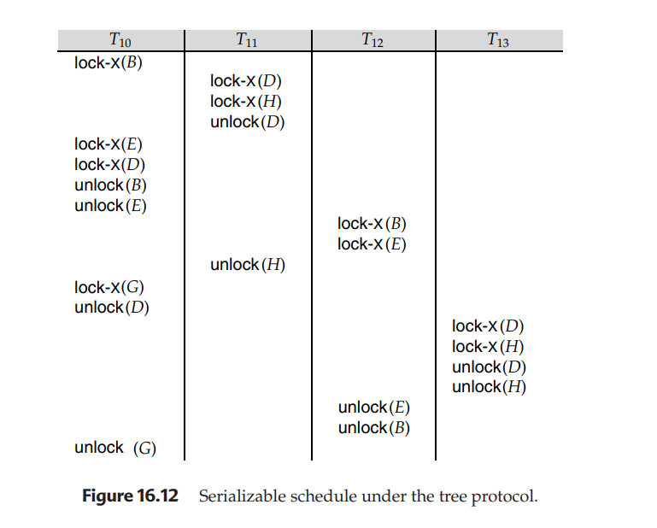
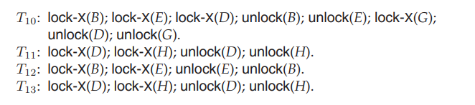

Slide 51
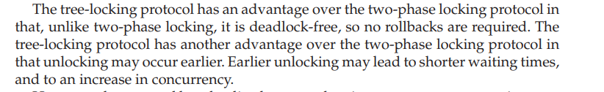

Slide 52
Timestamp-Based Protocols
Each transaction is issued a timestamp when it enters the system. If an old transaction T_{i} has time-stamp TS(T_{i}), a new transaction T_{j} is assigned time-stamp TS(T_{j}) such that TS(T_{i}) <TS(T_{j}).
The protocol manages concurrent execution such that the time-stamps determine the serializability order.
In order to assure such behavior, the protocol maintains for each data Q two timestamp values:
  W-timestamp(Q) is the largest time-stamp of any transaction that executed write(Q) successfully.
  R-timestamp(Q) is the largest time-stamp of any transaction that executed read(Q) successfully.
Slide No. L8-1

Slide 53
Timestamp-Based Protocols (Cont.)
The timestamp ordering protocol ensures that any conflicting read and write operations are executed in timestamp order.
Suppose a transaction T_{i} issues a read(Q)
  If TS(T_{i}) ≤ W-timestamp(Q), then T_{i} needs to read a value of Q that was already overwritten.
    Hence, the read operation is rejected, and T_{i} is rolled back.
  If TS(T_{i})≥ W-timestamp(Q), then the read operation is executed, and R-timestamp(Q) is set to max(R-timestamp(Q), TS(T_{i})).
Slide No. L8-2

Slide 54
Timestamp-Based Protocols (Cont.)
Suppose that transaction T_{i} issues write(Q).
  If TS(T_{i}) < R-timestamp(Q), then the value of Q that T_{i} is producing was needed previously, and the system assumed that that value would never be produced.
    Hence, the write operation is rejected, and T_{i} is rolled back.
  If TS(T_{i}) < W-timestamp(Q), then T_{i} is attempting to write an obsolete value of Q.
    Hence, this write operation is rejected, and T_{i} is rolled back.
  Otherwise, the write operation is executed, and W-timestamp(Q) is set to TS(T_{i}).
Slide No. L8-3

Slide 55
Example Use of the Protocol
A partial schedule for several data items for transactions with
timestamps 1, 2, 3, 4, 5
T₁
T₂
T₃
T₄
T₅
read(X)
read(Y)
read(Y)
write(Y)
write(Z)
read(Z)
read(X)
abort
read(X)
write(Z)
abort
write(Y)
write(Z)
Slide No. L8-4

Slide 56
Correctness of Timestamp-Ordering Protocol
The timestamp-ordering protocol guarantees serializability since all the arcs in the precedence graph are of the form:
Thus, there will be no cycles in the precedence graph
Timestamp protocol ensures freedom from deadlock as no transaction ever waits.
But the schedule may not be cascade-free, and may not even be recoverable.
transaction
with smaller
timestamp
transaction
with larger
timestamp
Slide No. L8-5

Slide 57
Thomas’ Write Rule
Modified version of the timestamp-ordering protocol in which obsolete write operations may be ignored under certain circumstances.
When T_{i} attempts to write data item Q, if TS(T_{i}) < W-timestamp(Q), then T_{i} is attempting to write an obsolete value of {Q}.
  Rather than rolling back T_{i} as the timestamp ordering protocol would have done, this {write} operation can be ignored.
Otherwise this protocol is the same as the timestamp ordering protocol.
Thomas' Write Rule allows greater potential concurrency.
  Allows some view-serializable schedules that are not conflict-serializable.
Slide No. L8-6

Slide 58
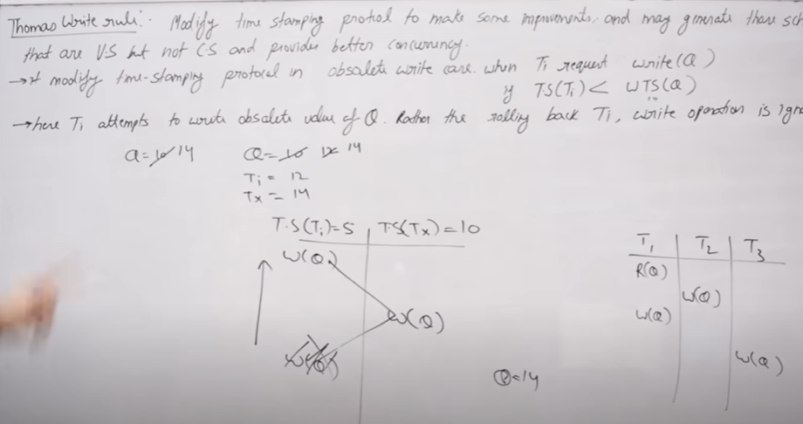

Slide 59
Validation-Based Protocol
Execution of transaction T_{i} is done in three phases.
1. Read and execution phase: Transaction T_{i} writes only to
temporary local variables
2. Validation phase: Transaction T_{i} performs a ``validation test''
to determine if local variables can be written without violating
serializability.
3. Write phase: If T_{i} is validated, the updates are applied to the
database; otherwise, T_{i} is rolled back.
The three phases of concurrently executing transactions can be interleaved, but each transaction must go through the three phases in that order.
  Assume for simplicity that the validation and write phase occur together, atomically and serially
    I.e., only one transaction executes validation/write at a time.
Also called as optimistic concurrency control since transaction executes fully in the hope that all will go well during validation
Slide No. L9-1

Slide 60
Validation-Based Protocol (Cont.)
Each transaction T_{i} has 3 timestamps
  Start(T_{i}) : the time when T_{i} started its execution
  Validation(T_{i}): the time when T_{i} entered its validation phase
  Finish(T_{i}) : the time when T_{i} finished its write phase
Serializability order is determined by timestamp given at validation time, to increase concurrency.
  Thus TS(T_{i}) is given the value of Validation(T_{i}).
This protocol is useful and gives greater degree of concurrency if probability of conflicts is low.
  because the serializability order is not pre-decided, and
  relatively few transactions will have to be rolled back.
Slide No. L9-2

Slide 61
Validation Test for Transaction T_{j}
If for all T_{i} with TS (T_{i}) < TS (T_{j}) either one of the following condition holds:
  finish(T_{i}) < start(T_{j})
  start(T_{j}) < finish(T_{i}) < validation(T_{j}) and the set of data items written by T_{i} does not intersect with the set of data items read by T_{j}.
then validation succeeds and T_{j} can be committed. Otherwise, validation fails and T_{j} is aborted.
Justification: Either the first condition is satisfied, and there is no overlapped execution, or the second condition is satisfied and
  the writes of T_{j} do not affect reads of T_{i} since they occur after T_{i} has finished its reads.
  the writes of T_{i} do not affect reads of T_{j} since T_{j} does not read any item written by T_{i}.
Slide No. L9-3

Slide 62
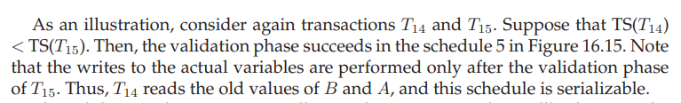
Schedule Produced by Validation
Example of schedule produced using validation
T₁₄
T₁₅
read(B)
read(B)
B:= B-50
read(A)
A:= A+50
read(A)
(validate)
display (A+B)
(validate)
write (B)
write (A)
Slide No. L9-4

Slide 63
Multiple Granularity
Allow data items to be of various sizes and define a hierarchy of data granularities, where the small granularities are nested within larger ones
Can be represented graphically as a tree (but don't confuse with tree-locking protocol)
When a transaction locks a node in the tree explicitly, it implicitly locks all the node's descendents in the same mode.
Granularity of locking (level in tree where locking is done):
  fine granularity (lower in tree): high concurrency, high locking overhead
  coarse granularity (higher in tree): low locking overhead, low concurrency
Slide No. L9-5

Slide 64

Example of Granularity Hierarchy
The levels, starting from the coarsest (top) level are
  database
  area
  file
  record
Slide No. L9-6

Slide 65
Intention Lock Modes
In addition to S and X lock modes, there are three additional lock modes with multiple granularity:
  intention-shared (IS): indicates explicit locking at a lower level of the tree but only with shared locks.
  intention-exclusive (IX): indicates explicit locking at a lower level with exclusive or shared locks
  shared and intention-exclusive (SIX): the subtree rooted by that node is locked explicitly in shared mode and explicit locking is being done at a lower level with exclusive-mode locks.
intention locks allow a higher level node to be locked in S or X mode without having to check all descendent nodes.
Slide No. L9-7

Slide 66
Compatibility Matrix with
Intention Lock Modes
The compatibility matrix for all lock modes is:
IS
IX
S
S IX
X
IS
✓
✓
✓
✓
×
IX
✓
✓
×
×
×
S
✓
×
✓
×
×
S IX
✓
×
×
×
×
X
×
×
×
×
×
Slide No. L9-8

Slide 67
Multiple Granularity Locking Scheme
Transaction T_{i} can lock a node Q, using the following rules:
  The lock compatibility matrix must be observed.
  The root of the tree must be locked first, and may be locked in any mode.
  A node Q can be locked by T_{i} in S or IS mode only if the parent of Q is currently locked by T_{i} in either IX or IS mode.
  A node Q can be locked by T_{i} in X, SIX, or IX mode only if the parent of Q is currently locked by T_{i} in either IX or SIX mode.
  T_{i} can lock a node only if it has not previously unlocked any node (that is, T_{i} is two-phase).
  T_{i} can unlock a node Q only if none of the children of Q are currently locked by T_{i}.
Observe that locks are acquired in root-to-leaf order, whereas they are released in leaf-to-root order.
Slide No. L9-9

