Slide 1
UNIT – I Queries
Write the syntax for all DDL commands?
What is the difference between drop and truncate command?
What is DDL interpreter?
What is the command to delete columns from table?
Slide No:L6-1

Slide 2
What is the syntax for insert command?
Define Key constraint?
What is the difference between NULL Values and NOT NULL Values?
What is the command to display table?

Slide 3
Explain entity, relation and attributes?
What is the difference between weak entity and strong entity?
What are the different types of attributes?
Explain difference between multi valued and single valued attributes?
What is the difference between entity and entity set?

Slide 4
Super key
Super Key: Super Key is an attribute (or set of attributes) that is used to uniquely identifies all attributes in a relation. All super keys can’t be candidate keys but the reverse is true. In relation, a number of super keys is more than a number of candidate keys.

Slide 5
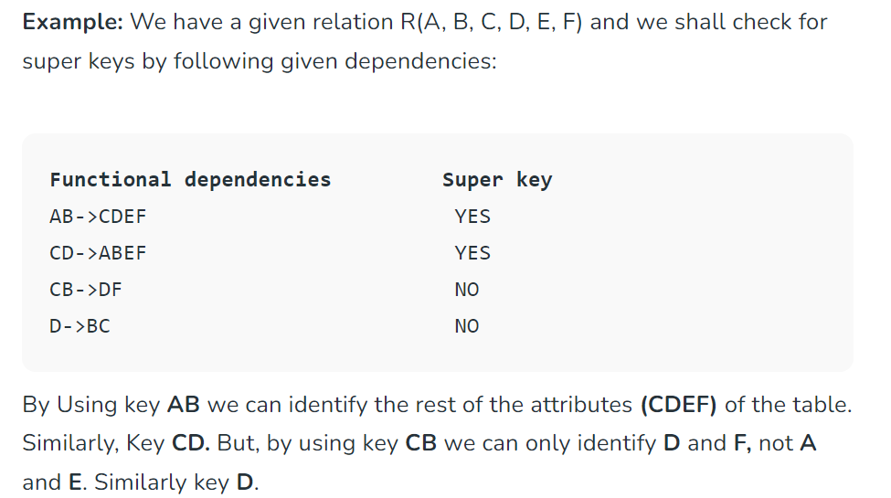
Super key explanation

Slide 6
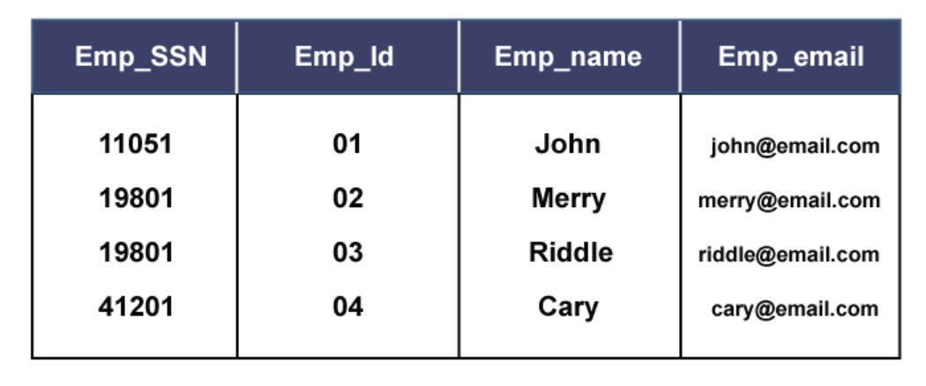
Candidate key
A candidate key is a subset of a super key set where the key which contains no redundant attribute is none other than a Candidate Key.

Slide 7
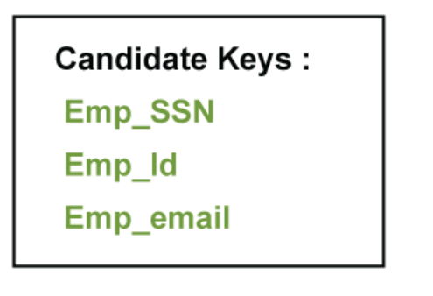
Candidate keys

Slide 8
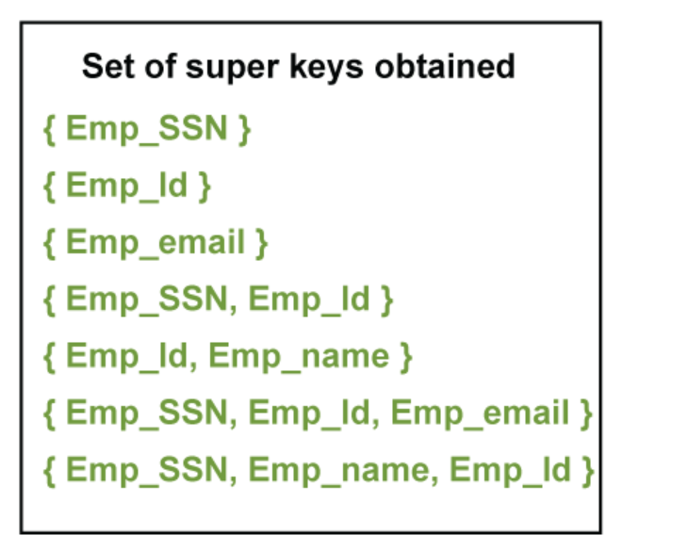
Previous example super keys

