Slide 1
Flowcharts on Process for Algorithms
Rishav,Nilay

Slide 2
Flow chart
Raw Data
AR Model
AR Parameters
Damage
Indicators
Machine
Learning
Algorithm
Test Matrix
Train Matrix

Slide 3
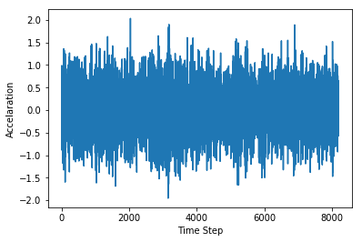
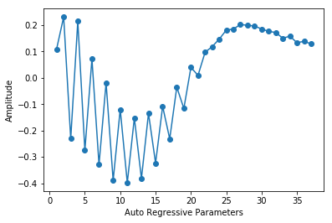
Example
Test Matrix
Train Matrix
AR Model
For all data points
0.67
(Threshold Value)
One
SVM

Slide 4
Explanation of some important terms
Damage Indicator : This is calculated using the Mahalanobis Distance as have been explained in one of the earlier presentations. This is useful for the data that may have multiple dimensions and there is a possibility of high amount of correlation.

Slide 5
Some Results on 3 story dataset using one class SVM
Type 1 error : 17 %
Type 2 error : 7 %

