Slide 1
GDP UpGrad Assignment
Rishabh Goyal
Rishabhgoyal7@gmail.com

Slide 2
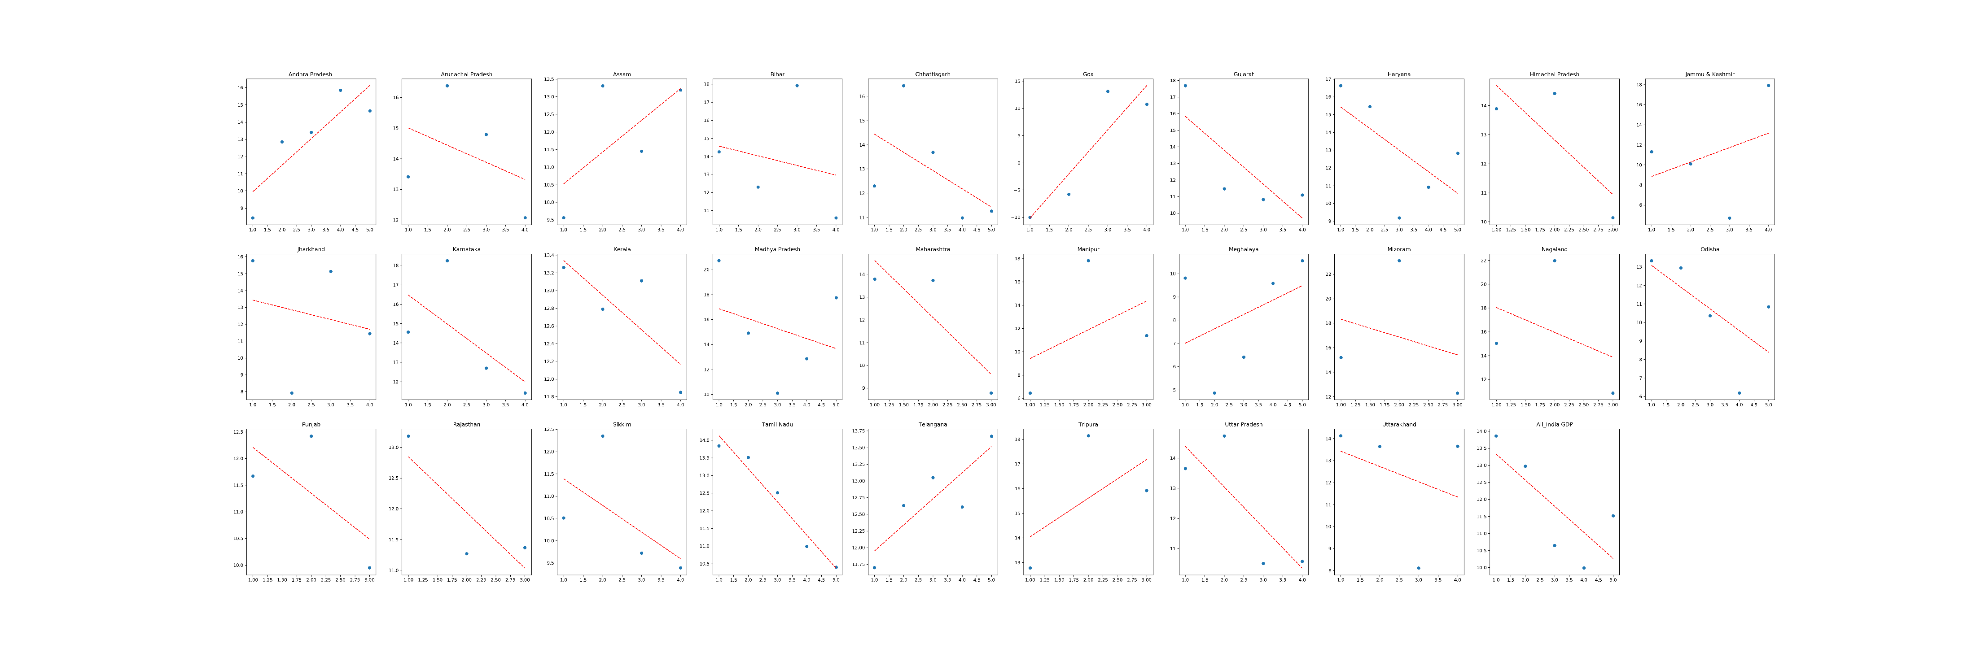
1A Assignment
% Growth over previous year
Below is the graph for growth rate year on year for all the states with best fit line.
# We can compare the growth of these states by looking at the slope of the best fit line.

Slide 3
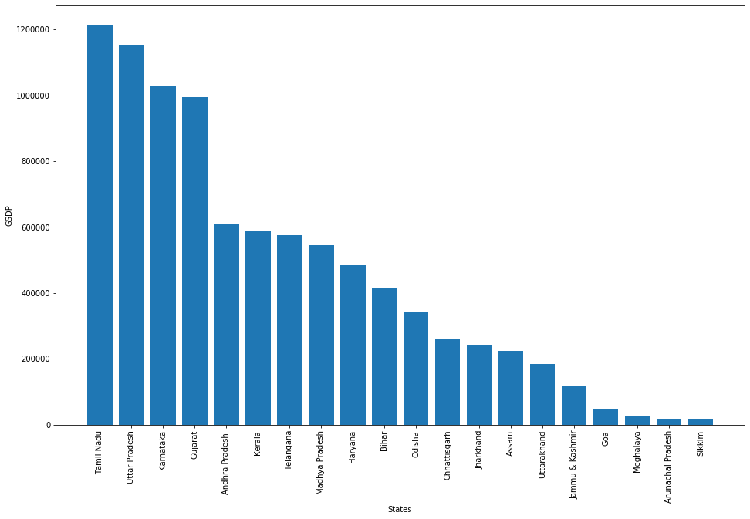
GDP Growth for the year 2015-2016
As we see Tamil_Nadu has the highest GSDP followed by UP and Karnataka
'Tamil Nadu', 'Uttar Pradesh','Karnataka','Gujarat', 'Andhra Pradesh’ are the states with highest GDP
'Sikkim','Arunachal Pradesh','Meghalaya','Goa','Jammu & Kashmir’ have the lowest GDP
GDSP depends on many factors like Area of the state, population of the state etc so as we see in the graph that least population state have the lowest GDP and most populous state have the highest GDSP

Slide 4
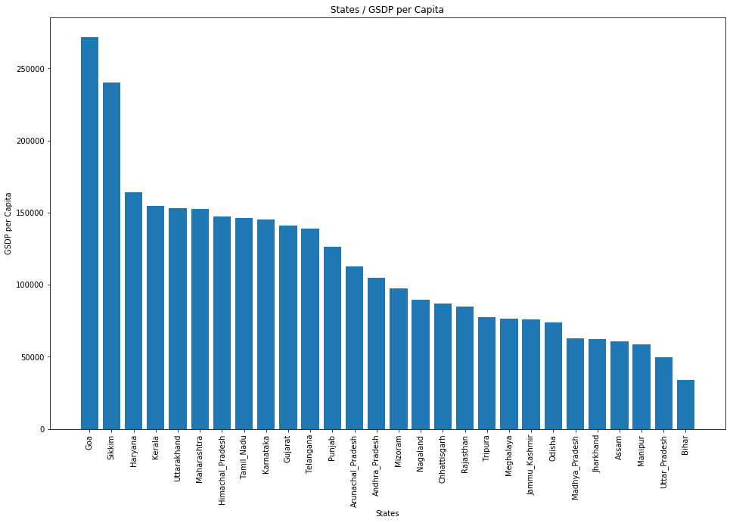
1-B Assignment
GDP per capita for each state
As we see Goa has the highest GDP Per capita followed by Sikkim and Haryana
Top 5 states with highest per capita GDP: Goa, Sikkim, Haryana, Kerala, Uttarakhand
Bottom 5 states with lowest per capita GDP: Bihar, Uttar Pradesh, Manipur, Assam,Jharkhand
Ratio of Highest Per capita / Lowest Per Capita

Slide 5
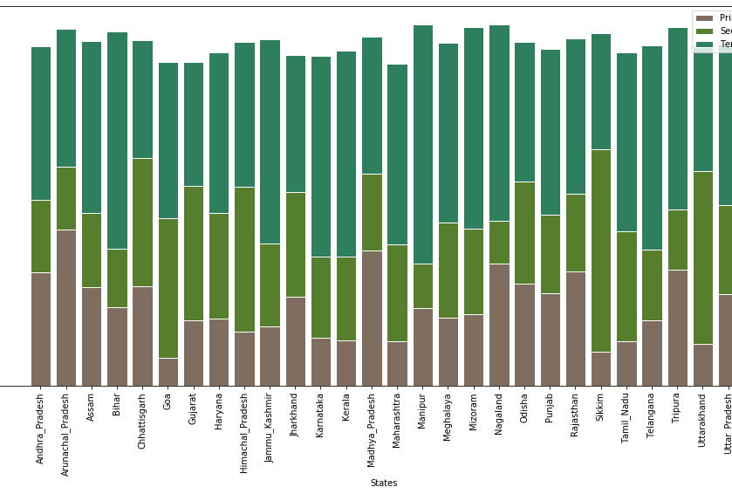
Plotted the percentage contribution of the primary, secondary and tertiary sectors as a percentage of the total GDP for all the states
We will use stacked bar chart as We have a category and a sub category ,category is state and subcategory is the sector
The correlation between primary % and Percentile value have negative correlation between them. So With increase in GDP, there is a decrease in Primary%

Slide 6

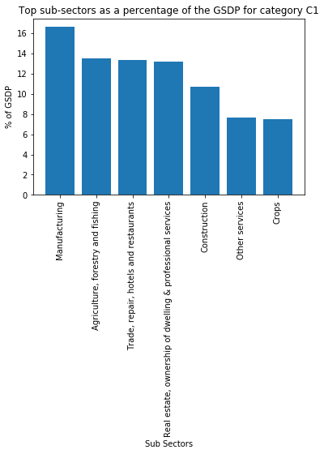
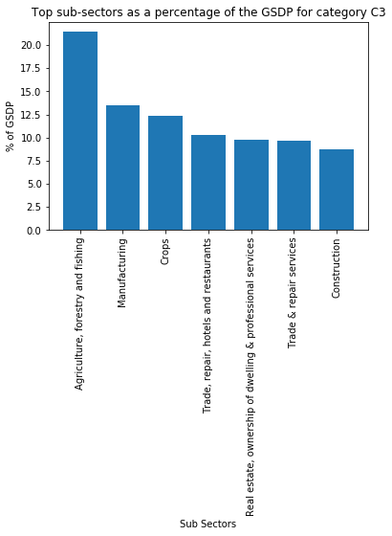
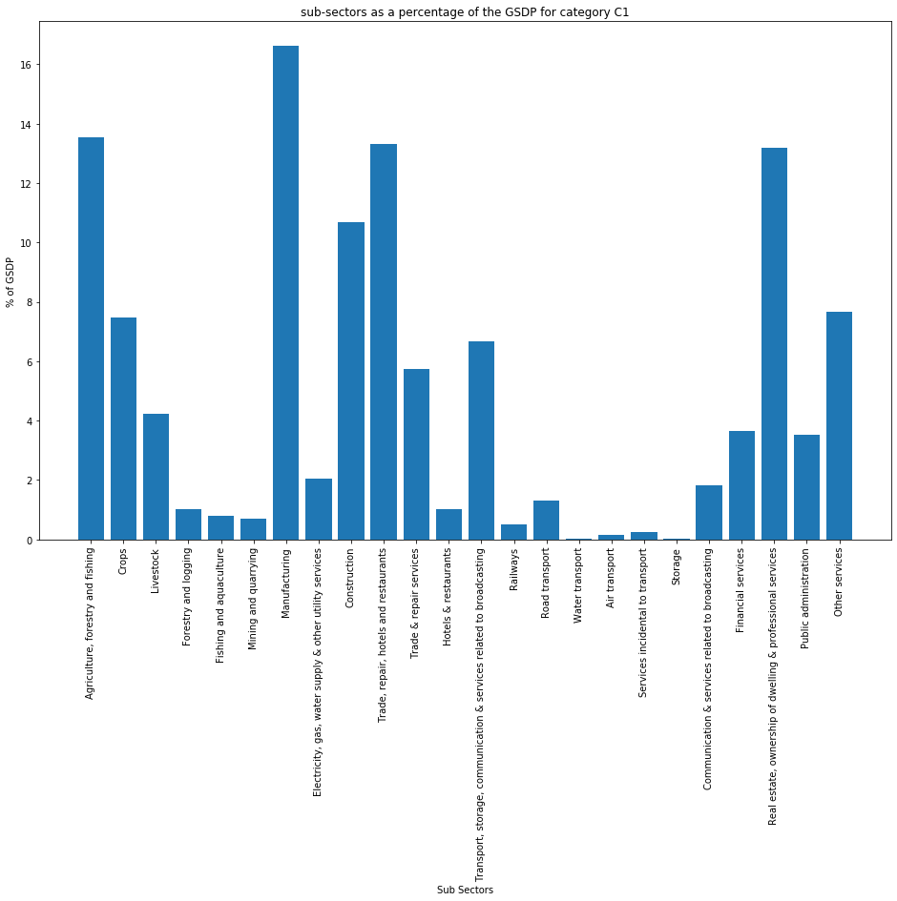
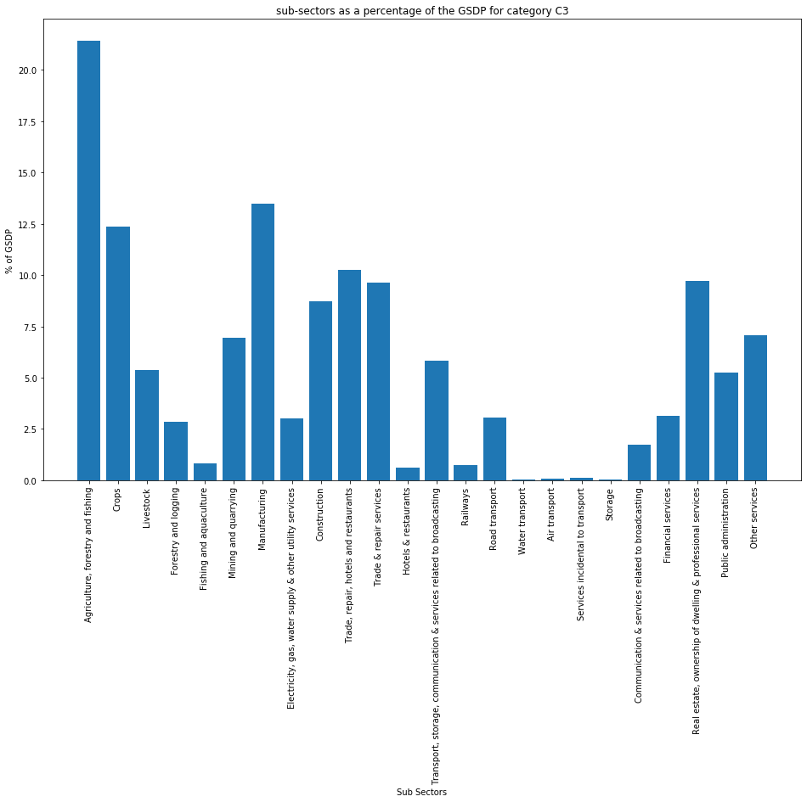
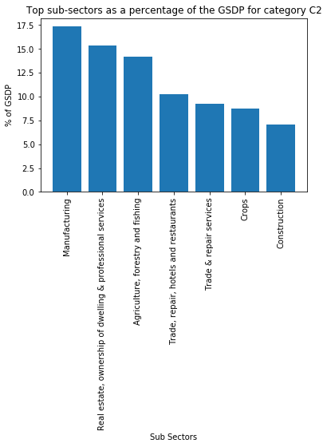
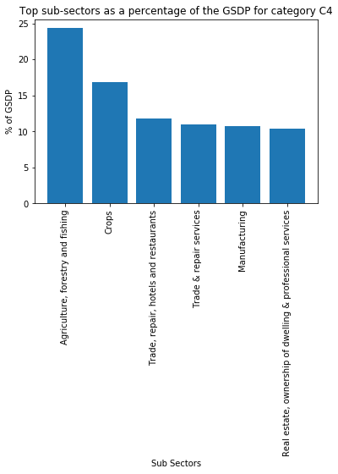
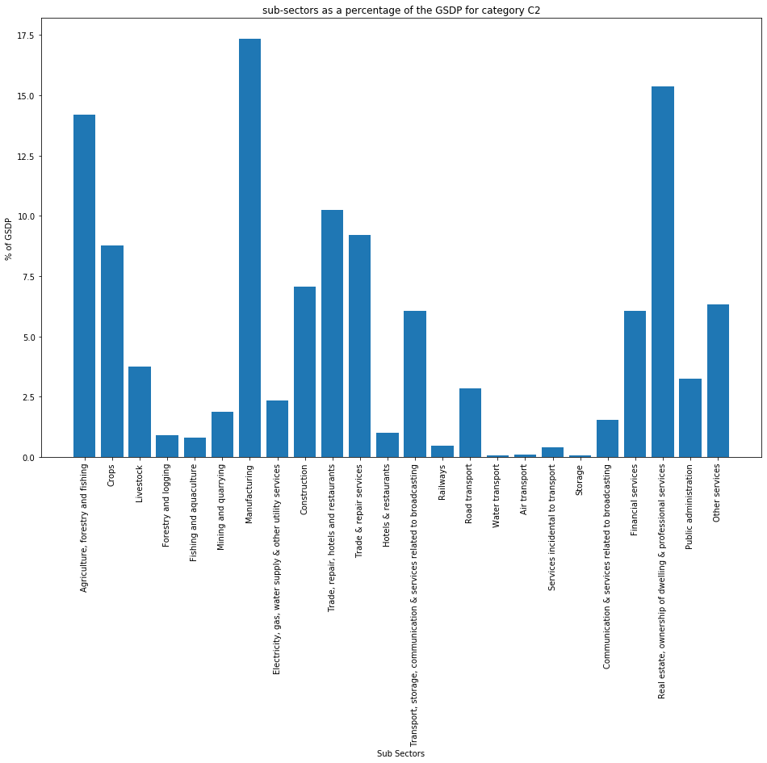
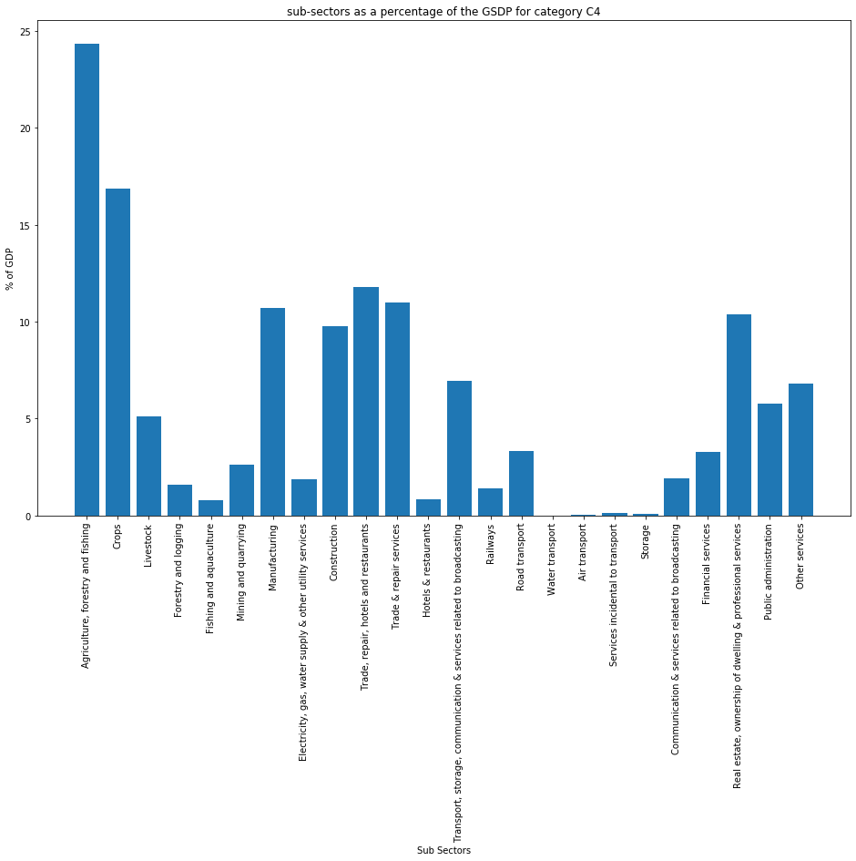
Categorise the states into four categories based on GDP per capita
One way to increase per capita GDP is by shifting
the distribution of GDP towards the secondary and tertiary sectors

Slide 7
Categories which are on top are getting more contribution from manufacturing, Real state and Trades. Low GDP categories are mainly Agricultures, forestry, fishing and crops. C3 and C4 categories states should focus more on manufacturing more products and should invest on real estate and this will help them increase their overall GDP. C2 categories should also take steps to increase their agriculture productivity.
Insights:
After dividing states in categories as per GDP we found that:

Slide 8
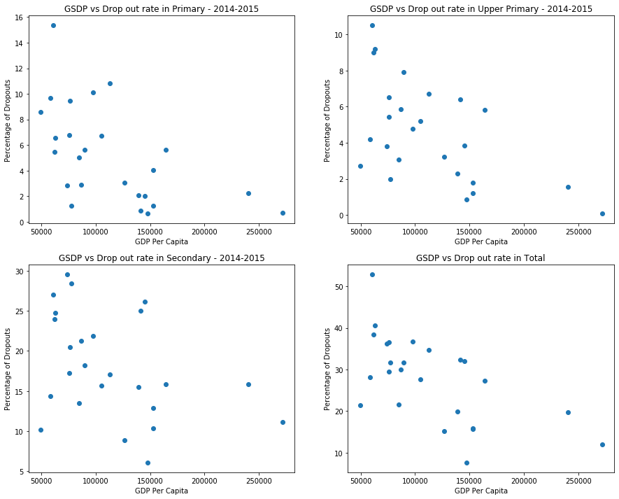
#Conclusion, There is a Highly Negative correlation between Primary, Upper Primary and Secondary education dropouts. This states that more the GDP less the dropouts.

Slide 9
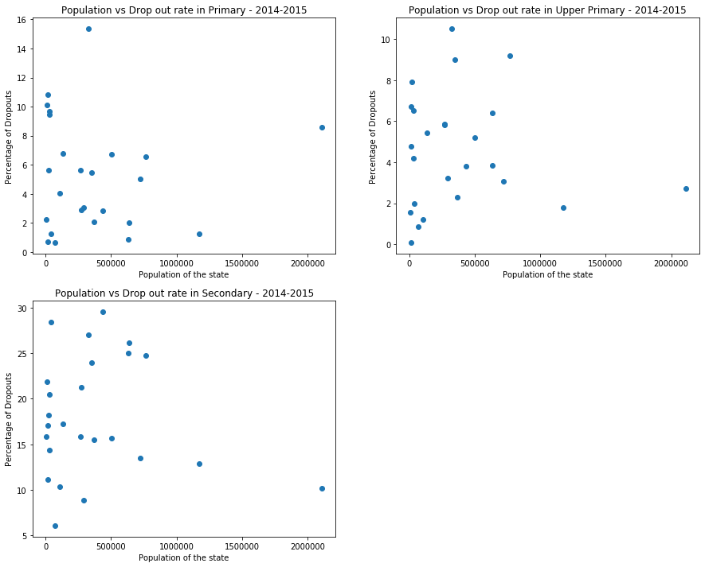
Conclusion, There is almost zero correlation between Primary, Upper Primary and Secondary with Population. That stats there is no relationship between population and the drop out rate.

Slide 10
Thank you

