Slide 1

Final Project Presentation ENPM 808A
Rishabh Singh
117511208

Slide 2
Input Data
Input was provided in CSV files with the following format:
First 1080 columns represent the laser range data,
Next 4 columns represent the final goal information,
Next 4 columns represent the local goal information,
Next 4 columns represent the robot's current position and pose information,
final 2 columns represent the commanded actions (the labels or output)
Two environments were considered (two different samplings)
1. A corridor scenario with moving obstacles
2. An open box/hall environment with moving obstacles

Slide 3
Pipeline Followed
Get the features and data
Perform pre-processing
Split the input data into training and validation with an 80:20 ratio
Choose the model and hyperparameter (in this case one because of time complexity)
Train with the input and change the parameter to find the optimal weights
Merge validation data with training and find the new weights using the parameter value selected above
Predict the outputs from training and testing
Check in-sample, validation, and out-sample R2 scores and MSE

Slide 4
Data Cleaning and scaling
This was performed to check the following major flaws within the input data:
Can be converted to NumPy float64 format for data type consistency?
Are the number of rows consistent?
Presence of any null value
Repeated/Stagnant or Unchanging data
Outliers

Slide 5
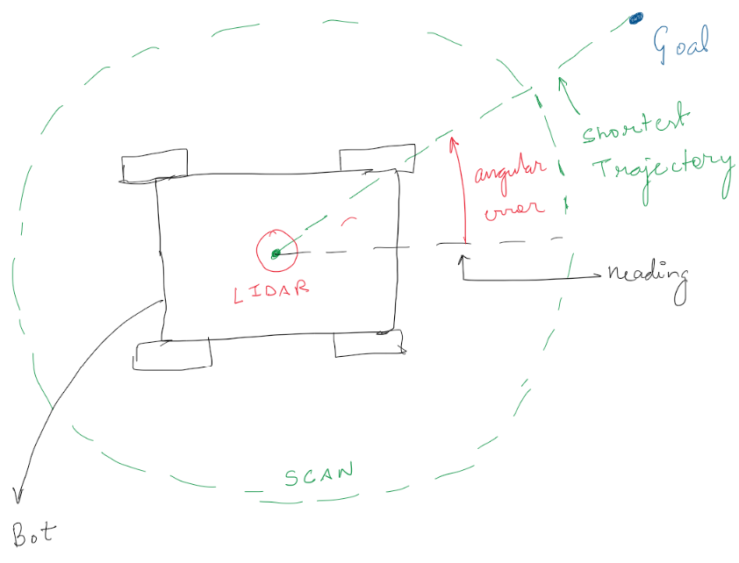
Feature Selection
Distance from the local goal position is one of the costs in MPC.
Distance from the final goal position is one of the costs in MPC.
Angular error in shortest trajectory to local goal and vehicle heading angle is another cost in MPC

Slide 6
Feature Selection
Angular error in shortest trajectory to final goal and vehicle heading angle
Lidar output in LOS (Line of Sight) of the robot is basically at the 540th index of lidar
Lidar output towards the shortest trajectory for the local goal-
This was computed using the slope of the shortest trajectory and angular difference calculated above.
Lidar output towards the shortest trajectory for the final goal
Maximum distance the robot can travel towards the shortest trajectory for the local goal

Slide 7
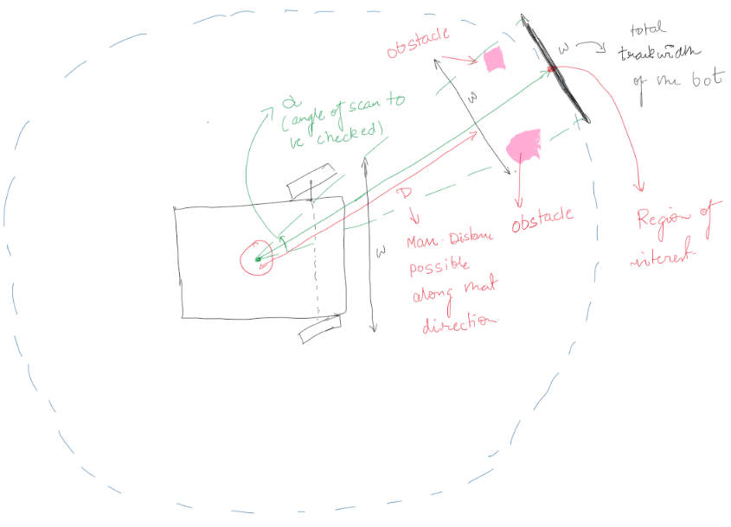
Feature Selection
Maximum distance the robot can travel towards the shortest trajectory for the final goal
Note: The limitation in output velocity and omega is also be considered
Predicted velocity < Max bot velocity (found from given data)
Predicted omega < Max bot omega (found from given data)

Slide 8
Metrics Considered
Purpose was to work towards accuracy and reducing the squared error in prediction in the R2 score.
The data was limited by max and min values of velocities, angles, and distance.
The best error estimators to be used were:
R2 score - provides an indication of goodness of fit and therefore a measure of how well-unseen samples are likely to be predicted by the model, through the proportion of explained variance.
Max is 1.0 and min can be negative (implying bad fit)
MSE (Mean Squared Error): This needs to be as low as possible and helps in tuning hyperparameters and reducing learning loss.

Slide 9
Models Considered
The models considered for the projects are:
Linear Regression for its simplicity
SVM for personal exploration
XG Boost by Nvidia for its speed and accuracy
Multilayer Perceptron for personal exploration and also due to its performance with a large data set

Slide 10
Model Delivered XG Boost
Reasons:
Fast speed of learning
Accuracy in prediction with both the scenarios given
Freedom of tuning multiple parameters
Performed better with increased training set
XG Boost came out with the best performance overall.
MSE is the lowest with a scale of 1/10 from other models like MLP which performed well.
R2 Score is also much better than all the other models
Learning curve is better, faster, and more stable than all other models.

Slide 11
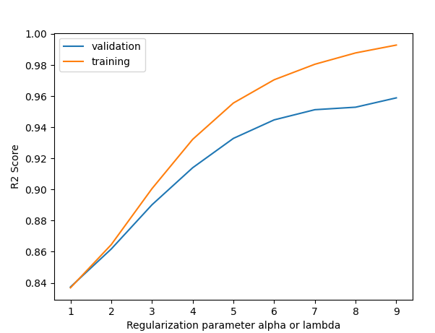
Velocity Prediction for Box data
R2 score
In-sample R2 score = 0.99282 (likely overfitting)
Validation R2 score = 0.96244
Out-sample R2 score = 0.88950

Slide 12
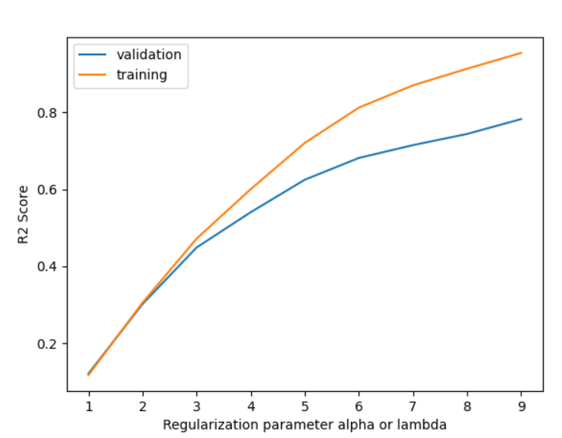
Omega Prediction for Box data
R2 score
In-sample R2 score = 0.8807
Validation R2 score = 0.69446
Out-sample R2 score = 0.3016

Slide 13
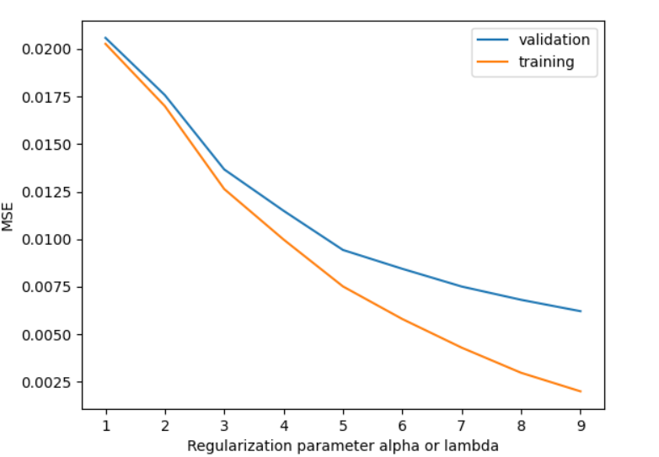
Velocity Prediction for Box data
MSE
In-sample MSE = 0.00199
Validation MSE = 0.00223
Out-sample MSE = 0.01331

Slide 14
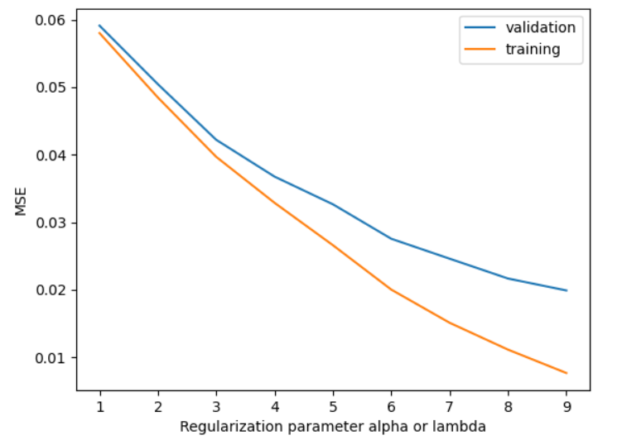
Omega Prediction for Box data
MSE
In-sample MSE = 0.007678
Validation MSE = 0.019899
Out-sample MSE = 0.04383

Slide 15
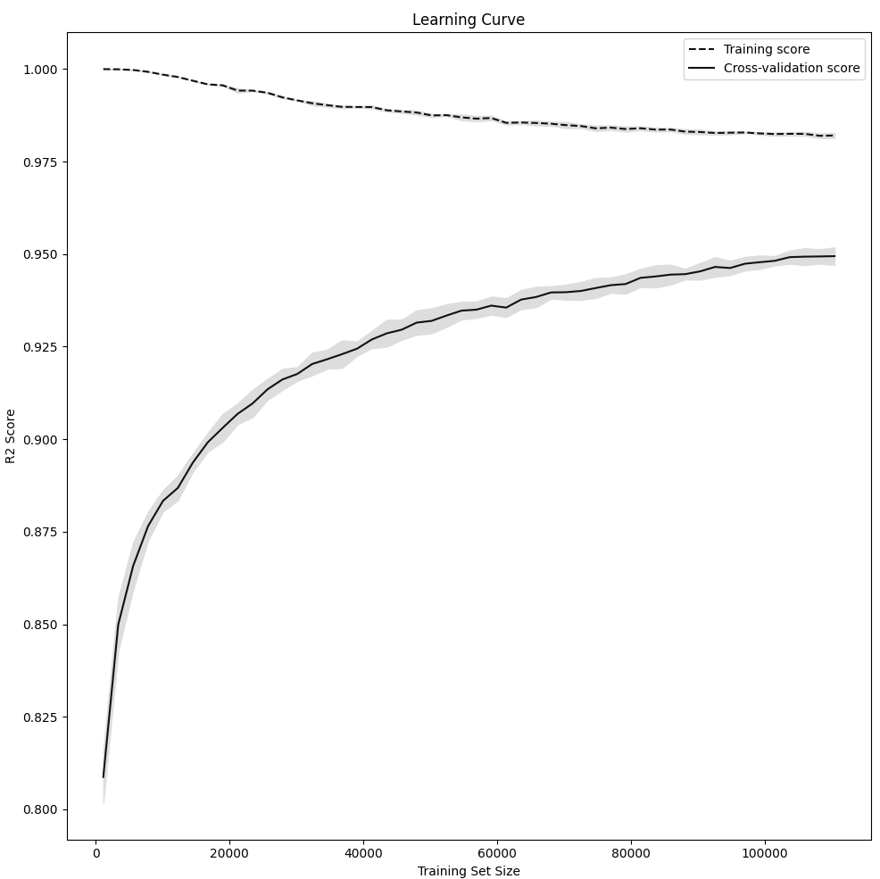
Velocity Prediction for Box data
Learning and Validation Curve
~ 150k data points trained in
<30 sec

Slide 16
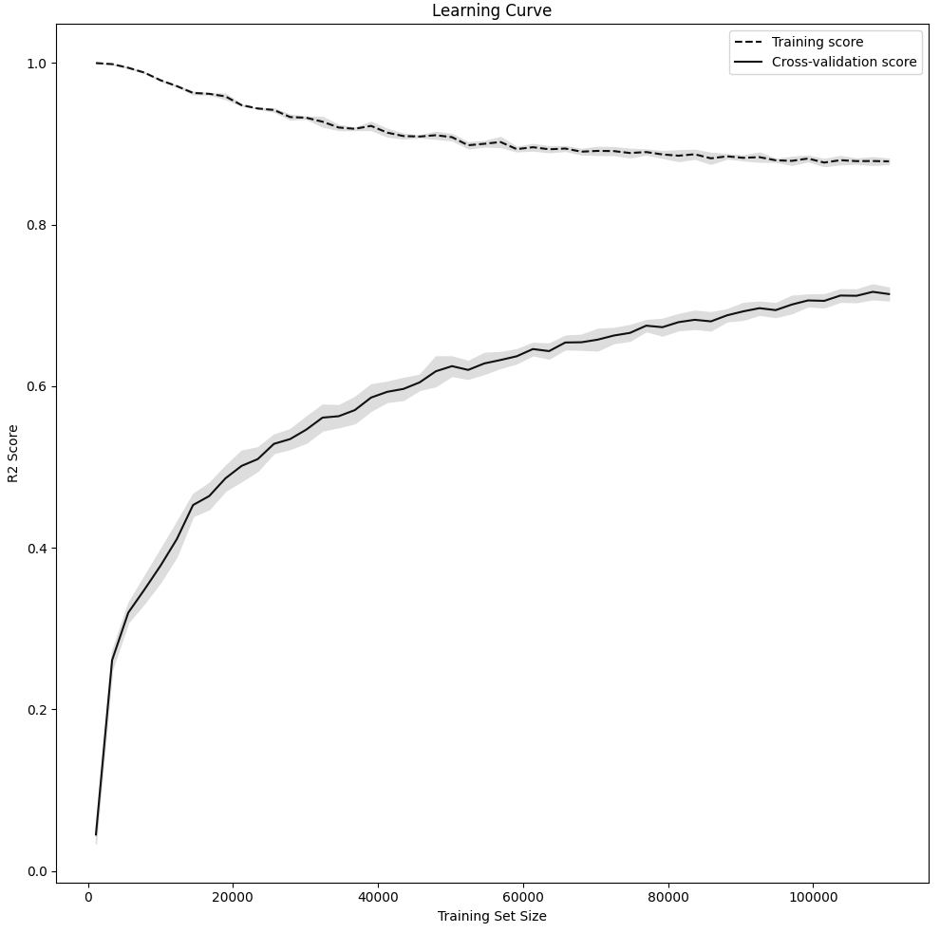
Omega Prediction for Box data
Learning and Validation Curve
~ 150k data points trained in
<30 sec

Slide 17
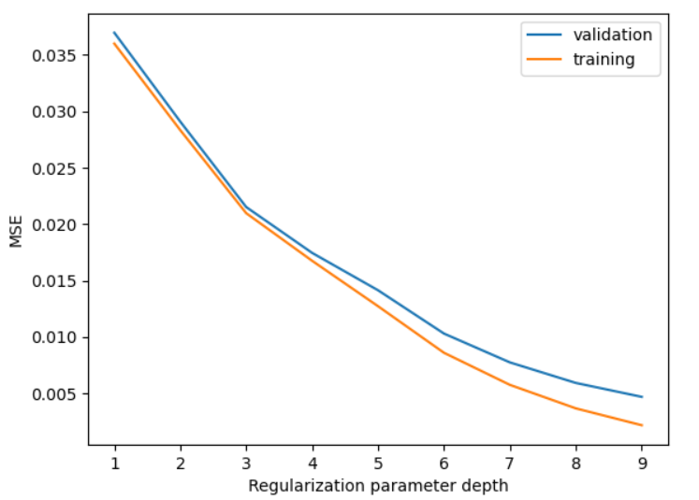
Velocity Prediction for Corridor data (Validated)
MSE
In-sample MSE = 0. 00218
Validation MSE = 0.00319
Out-sample MSE = 0.0364

Slide 18
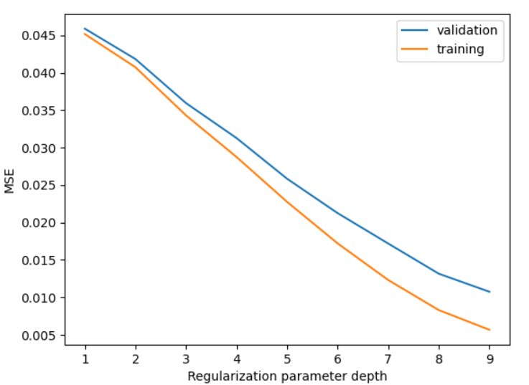
Omega Prediction for Corridor data (Validated)
MSE
In-sample MSE = 0. 0.005
Validation MSE = 0.01
Out-sample MSE = 0.035

