Slide 1
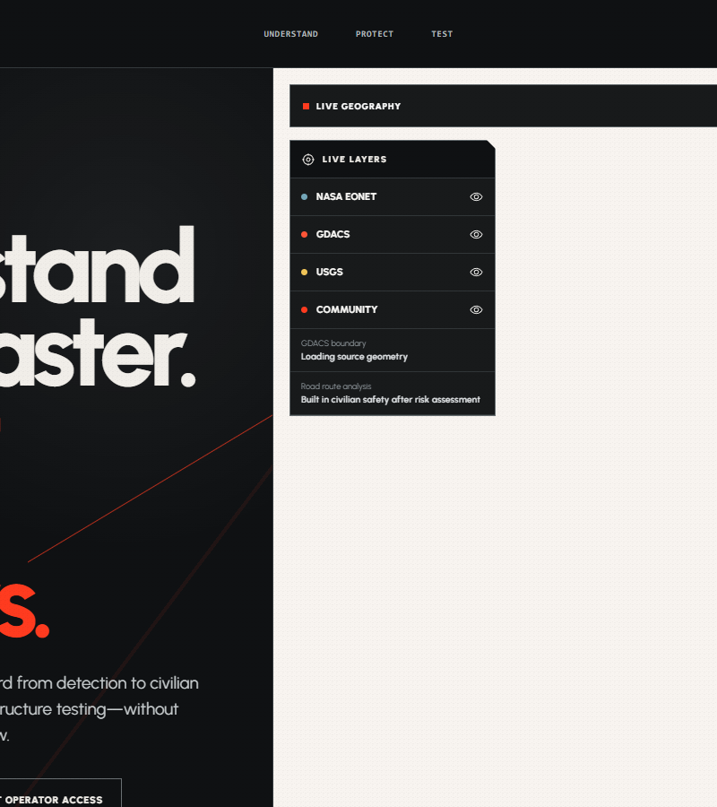
HACKATHON SUBMISSION
NAVIRA
Disaster response from
verified signal to safer action.
Understand the hazard. Protect people in its path. Test what comes next.
RISHABH MITTAL
Civilians · Responders · Command centers
Notes:
NAVIRA is a disaster-response platform that connects real hazard intelligence to civilian protection, operator coordination, and infrastructure testing. I’m Rishabh Mittal, and this is the system I built for this hackathon.

Slide 2
NAVIRA
02
THE RESPONSE GAP
ONE DISASTER.
THREE BROKEN HANDOFFS.
A warning can be accurate and still fail people if it never becomes a clear local decision.
01
SIGNAL
02
DECISION
03
ACTION
Hazard feeds, official alerts, maps, closures and reporting arrive separately.
Civilians need to know whether they are affected and where to go now.
Operators need one incident context for help, dispatch, resources and accountability.
NAVIRA closes the handoff from verified data to coordinated response.
Notes:
The core problem is the handoff. Data may exist, but civilians, field teams, and command centers need different answers from the same verified geographic record. NAVIRA turns that shared record into a connected response workflow.

Slide 3
NAVIRA
03
ONE CONNECTED PRODUCT STORY
UNDERSTAND → PROTECT → TEST
Disaster happens. NAVIRA detects it, finds people at risk, helps them act, and lets teams test infrastructure against the same hazard context.
01
02
03
UNDERSTAND
PROTECT
TEST
Real disaster intelligence
Civilian and operator action
Infrastructure resilience lab
NASA EONET · GDACS · USGS
Verified geometry · Freshness · Provenance
Near You · Help requests · Escape routes
Incidents · Dispatch · Resources · Audit
Real infrastructure · Custom models
Hazard scenarios · Side-by-side comparison
Notes:
NAVIRA is organized around three pillars. Understand consolidates verified disaster intelligence. Protect turns that intelligence into civilian and operator action. Test extends the same disaster context into infrastructure simulation and design comparison.
Sources:
- NASA EONET — https://eonet.gsfc.nasa.gov/
- GDACS — https://www.gdacs.org/
- USGS Earthquake Hazards Program — https://earthquake.usgs.gov/

Slide 4
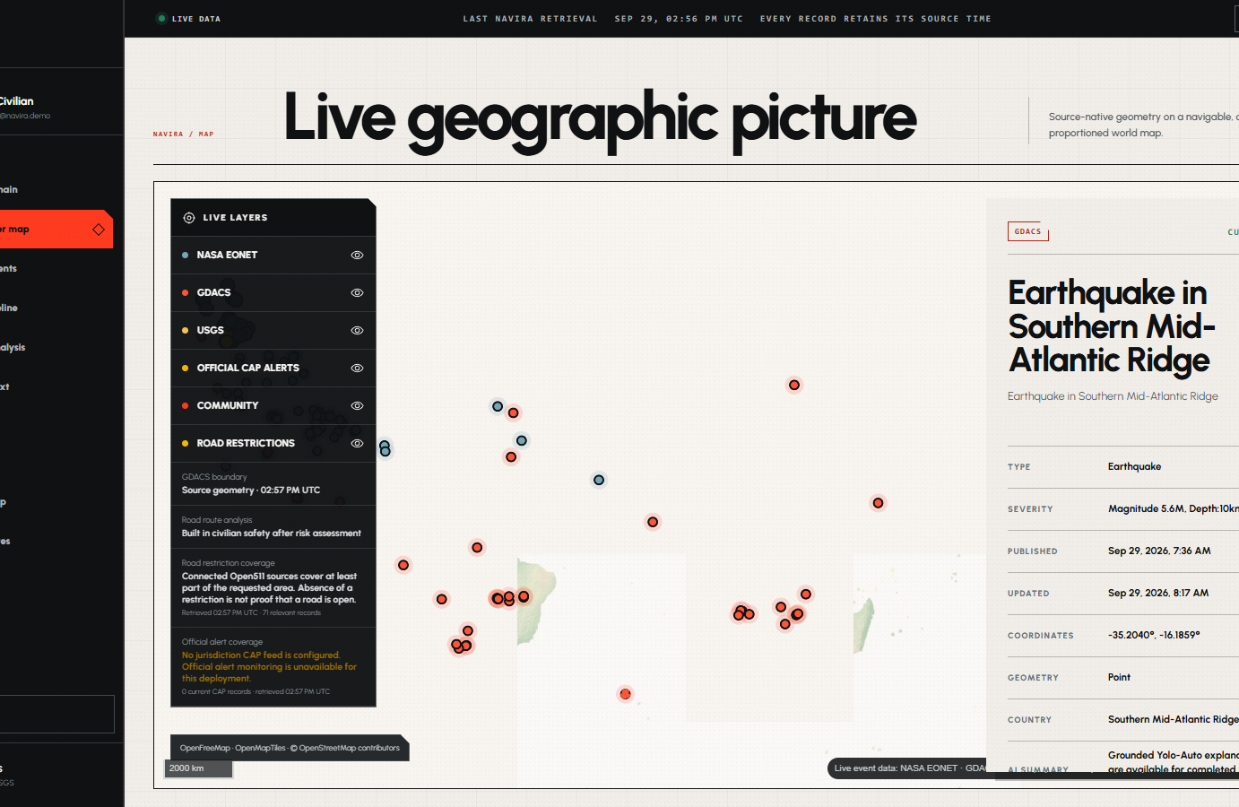
NAVIRA
04
UNDERSTAND / 01
A live operating picture,
not a decorative map.
MapLibre + OpenStreetMap-based geography
NASA EONET, GDACS and USGS event feeds
Coordinates, source, status and timestamps
Source-native geometry where available
Explicit unavailable and degraded states
Every layer carries source attribution and freshness.
Notes:
The map is the operational center of NAVIRA. It uses real geographic proportions and live sources. Each record keeps its coordinates, category, timestamp, status, source and freshness. When a source does not provide enough geometry or availability, NAVIRA says so instead of inventing it.
Sources:
- MapLibre GL JS — https://maplibre.org/
- OpenFreeMap — https://openfreemap.org/
- OpenStreetMap — https://www.openstreetmap.org/
- NASA EONET — https://eonet.gsfc.nasa.gov/
- GDACS — https://www.gdacs.org/
- USGS Earthquake Hazards Program — https://earthquake.usgs.gov/

Slide 5
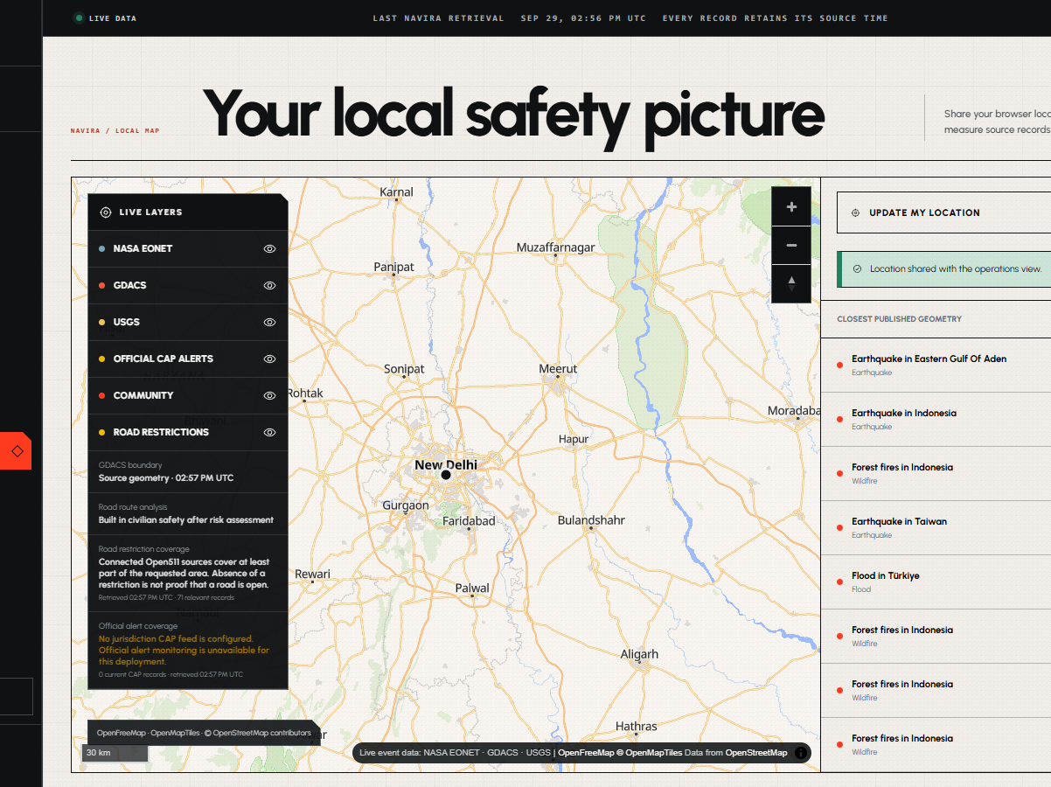
NAVIRA
05
PROTECT / NEAR YOU
THE GLOBAL MAP BECOMES
A LOCAL SAFETY DECISION.
With permission, NAVIRA centers on the person—not on a random event—and ranks reviewed hazards by real distance.
01
Browser geolocation with explicit permission
02
Distance from the person to verified events
03
Deterministic point-versus-geometry checks
04
No invented danger radius
Notes:
Near You starts from the civilian’s actual location, with permission. It centers the map on the user, retrieves the surrounding verified events, computes distance, and checks the user’s coordinates against source geometry where that geometry exists. NAVIRA never creates a danger circle just to fill a gap.

Slide 6
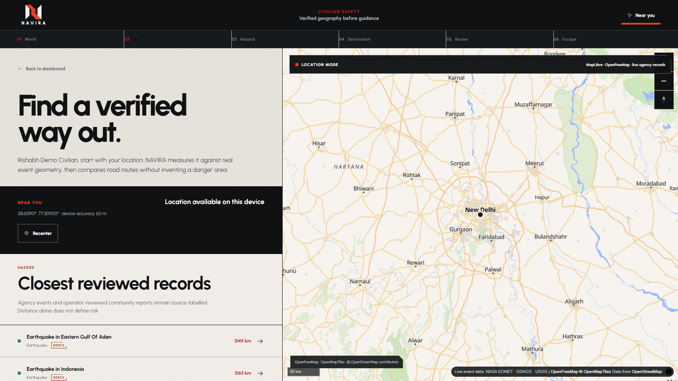
PROTECT / CIVILIAN FLOW
FROM “AM I IN DANGER?”
TO “HOW DO I LEAVE?”
01
WORLD
02
NEAR YOU
03
HAZARD
04
DESTINATION
05
ROUTES
06
ESCAPE
Real road routes. Verified exposure checks. Clear reasons when a route changes.
Notes:
This is the civilian safety sequence: World, Near You, Hazard, Destination, Routes, Escape. NAVIRA only exposes escape planning when verified geometry supports the risk state. It uses a real routing engine for travel time and road geometry, then compares route exposure to verified hazards. During navigation it can re-evaluate when hazards, alerts or verified closures materially change, and it tells the user why.
Sources:
- OSRM routing engine — https://project-osrm.org/
- Open511 road-event data standard — https://open511.org/

Slide 7
NAVIRA
07
PROTECT / COMMUNITY EVIDENCE
A HUMAN-VERIFIED PATH FROM
THE STREET TO THE OPERATING MAP.
01
02
03
04
05
CAPTURE
LOCATE
VERIFY
PUBLISH
PROTECT
Take or upload a photo and provide the event type.
Attach device location after explicit permission.
An operator reviews the evidence and classifies it.
A verified community incident enters the shared map.
Nearby civilians receive the context and can open routes.
Help requests remain gated by verified local hazard context; evidence is never promoted without human review.
Notes:
Civilians can contribute evidence without letting unverified reports become operational truth. They capture or upload an image, attach their location with permission, and submit a small incident form. An operator must review the evidence before it becomes a community incident on the map. Help requests remain tied to verified nearby hazards.

Slide 8
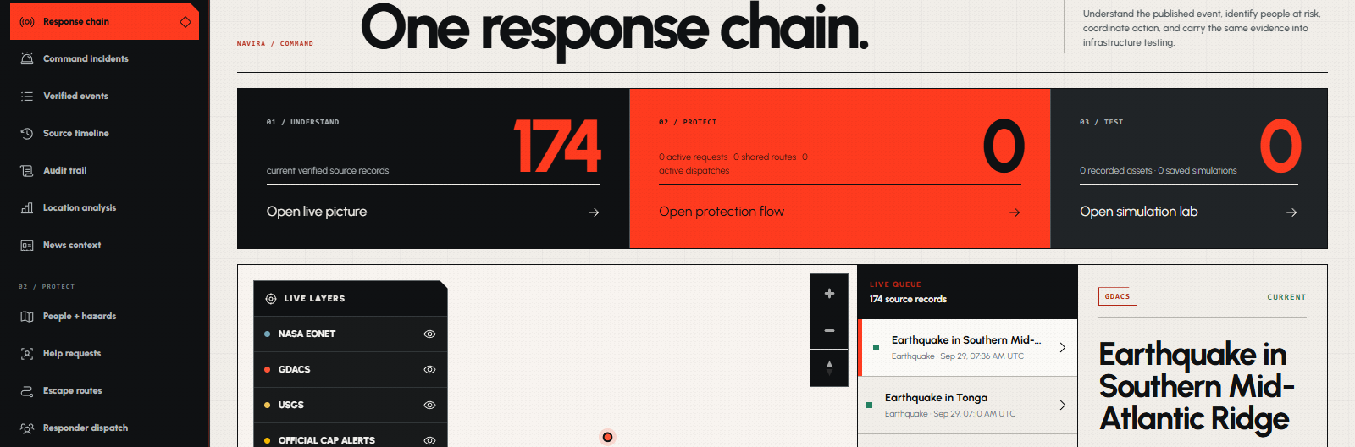
NAVIRA
08
PROTECT / OPERATOR COMMAND
ONE INCIDENT CONTEXT ACROSS
THE ENTIRE RESPONSE CHAIN.
An active incident stays visible while operators move from hazards to people, assignments, resources and accountability.
Notes:
The operator workspace is built around an active incident context. That context links hazards, alerts, help requests, assignments, resources, road restrictions and notes. Operators can create incidents, switch between authorized incidents, change operational phase, and keep the same context visible across the response modules.

Slide 9
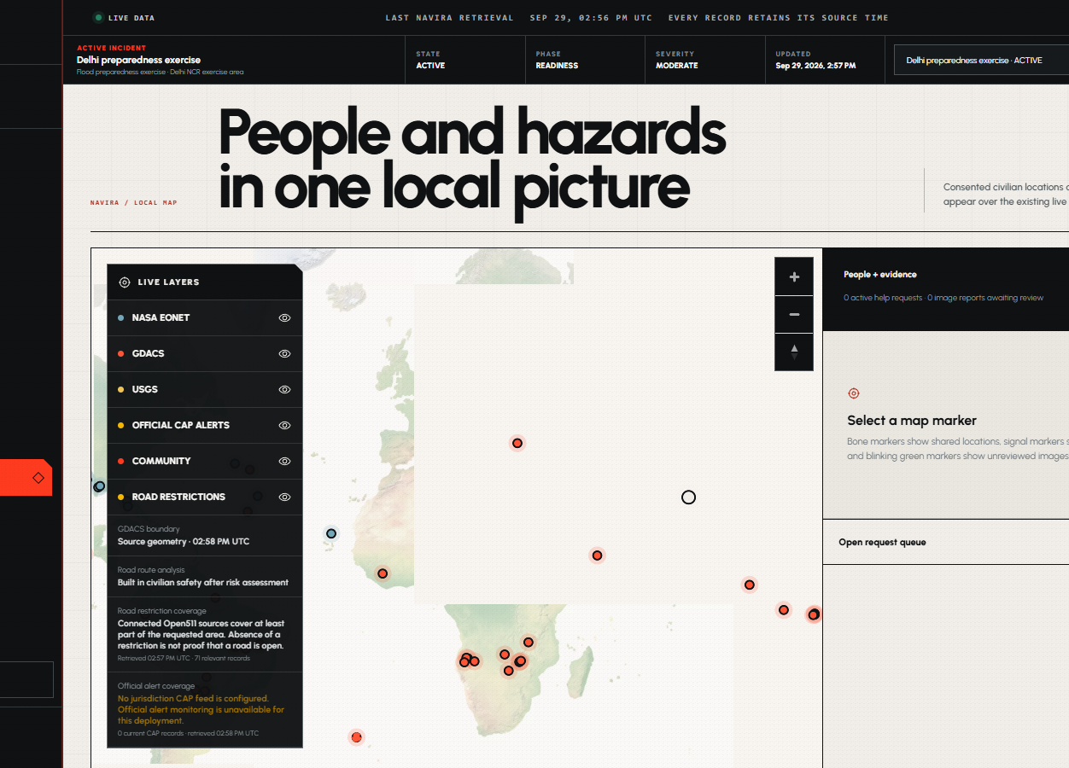
NAVIRA
09
PROTECT / FIELD OPERATIONS
SEE PEOPLE.
MOVE RESPONSE.
PEOPLE + HAZARDS
Consented civilian locations, verified events and reviewed evidence.
HELP QUEUE
Requests progress from verified to assigned, dispatched, on scene and resolved.
RESPONDER DISPATCH
Role-checked assignments with acknowledgement and status transitions.
RESOURCE COORDINATION
Allocate verified stock without exceeding available quantities.
ROUTE MONITORING
Surface hazards and trusted restrictions that intersect active routes.
Notes:
The operator can see consented civilian positions alongside verified hazards and reviewed community evidence. Help requests follow a server-authoritative lifecycle. Responders can be assigned and acknowledge work. Resources can be allocated only from known stock. Active routes can be monitored against verified hazard and road-restriction changes.

Slide 10
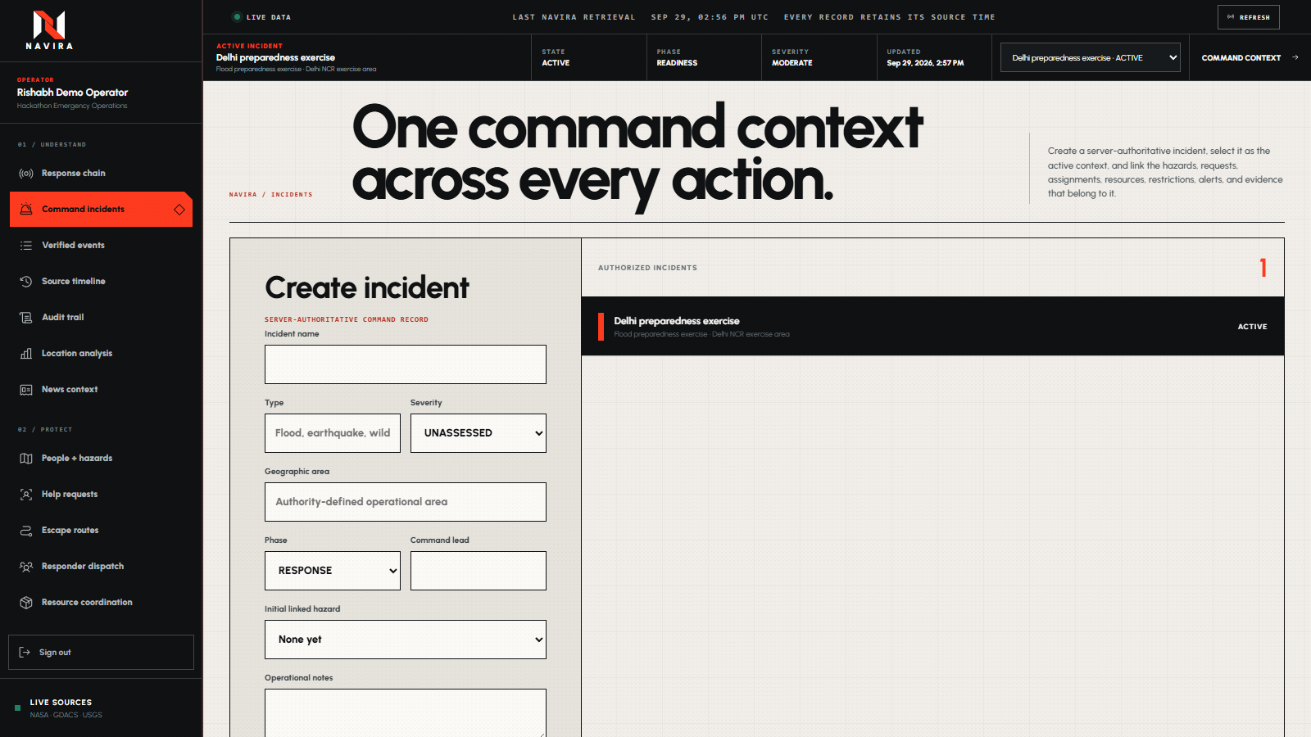
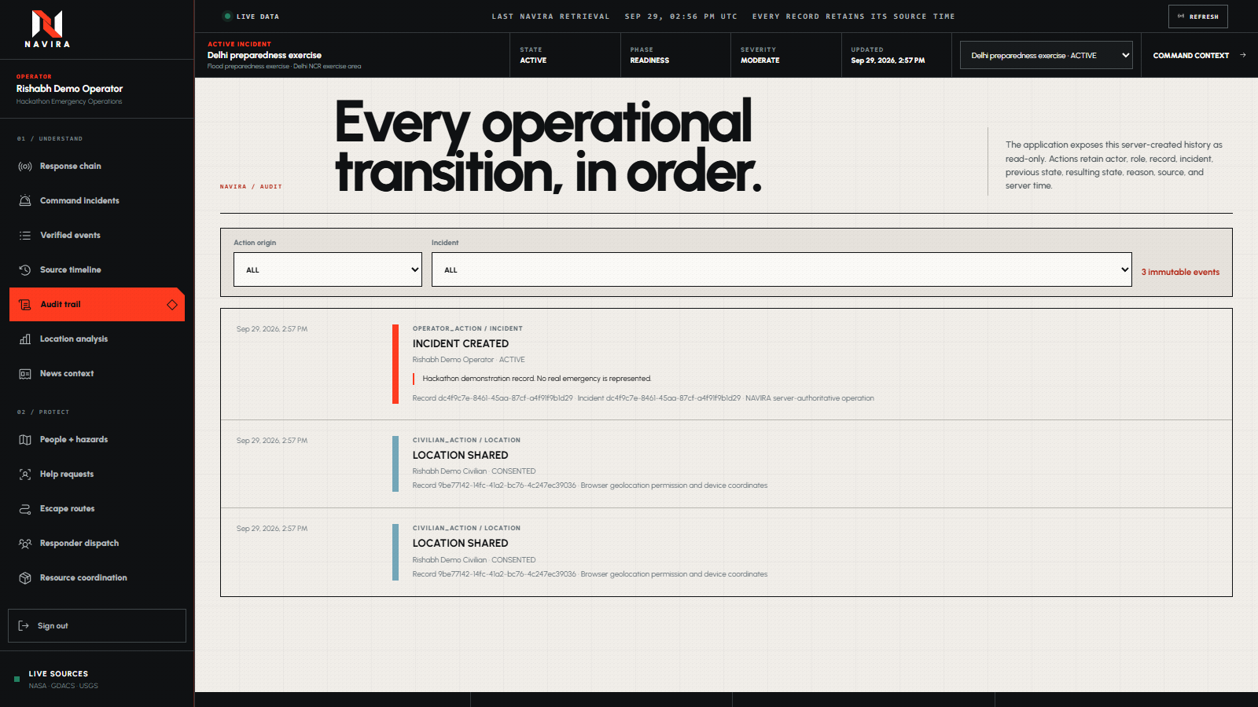
NAVIRA
10
COMMAND + ACCOUNTABILITY
EVERY DECISION KEEPS ITS CONTEXT—
AND ITS HISTORY.
INCIDENT CONTEXT
AUDIT TRAIL
Name · type · geography · severity · phase · lead · linked records
System · civilian · responder · operator actions with before/after state
Notes:
Command context and accountability are connected. An incident stores its area, severity, phase, status, organization, lead and linked operational records. The audit trail records server time, actor, role, action, affected record, previous state, resulting state and metadata. The interface distinguishes system, civilian, responder and operator actions.

Slide 11
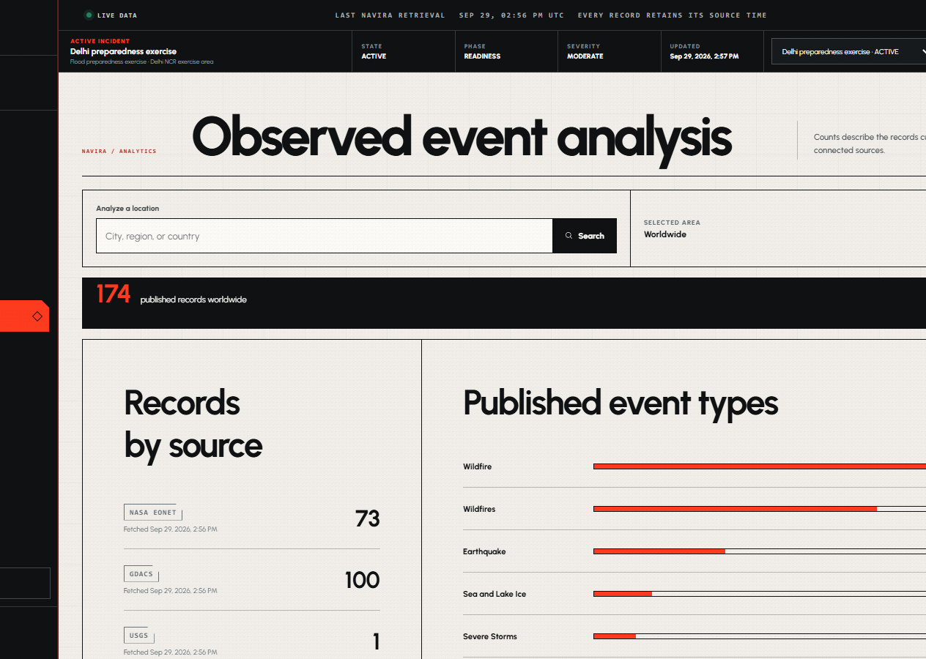
NAVIRA
11
SHARED INTELLIGENCE
FILTER THE WORLD
DOWN TO A PLACE.
Both civilians and operators can inspect location-specific analytics, event types, source coverage, timelines and reporting context.
ANALYTICS
Country, city or area filters over the same live event records.
EVENT LEDGER
Traceable source records with timestamps and status.
NEWS CONTEXT
Reporting is visually separated from verified agency data.
Notes:
NAVIRA also provides shared intelligence views. Civilians and operators can filter analytics by place, inspect event categories and source coverage, follow the event ledger and timeline, and open related reporting. News remains clearly labeled as reporting context rather than agency-verified operational data.

Slide 12
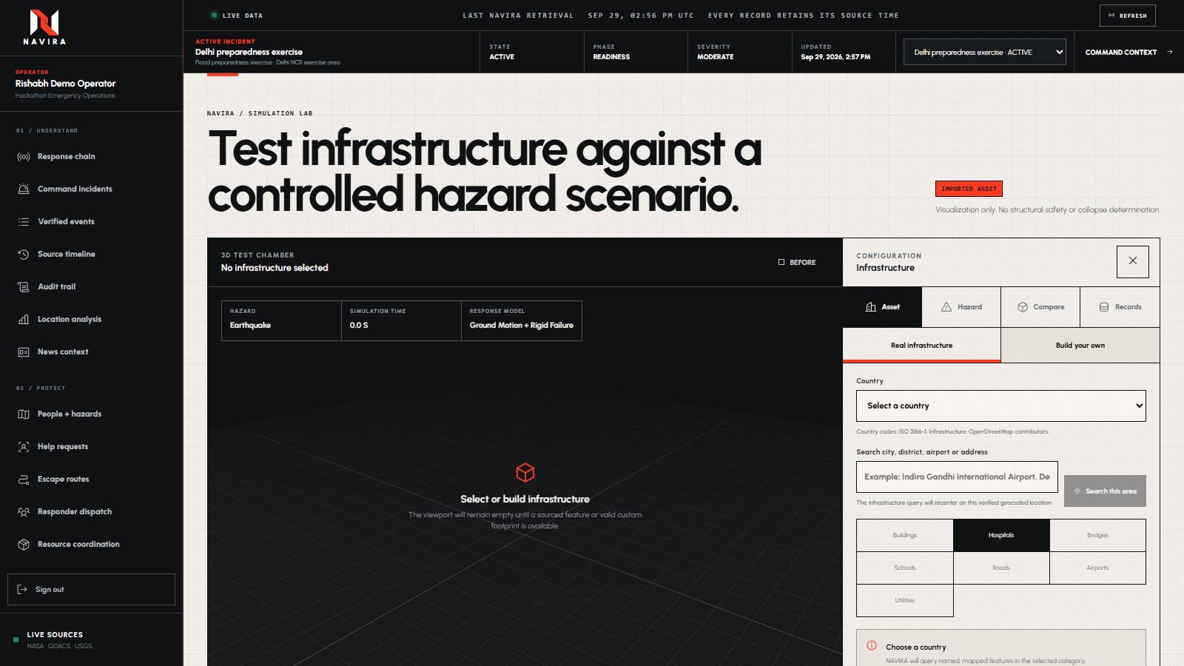
NAVIRA
12
TEST / INFRASTRUCTURE SIMULATION
FROM MAPPED STRUCTURE
TO TESTABLE 3D SCENARIO.
A visual and heuristic lab—never an unsupported engineering verdict.
IMPORT
Search real infrastructure or resolve an address.
VERIFY
Review exterior imagery before grounded AI description.
BUILD
Generate or directly edit faces, edges and vertices.
SIMULATE
Earthquake, flood and wind scenarios over time.
COMPARE
Same building + same hazard, Design A versus Design B.
Notes:
The Test pillar is the Infrastructure Simulation Lab. Operators can import mapped infrastructure, search by address, review exterior imagery in a human-in-the-loop workflow, use AI only to describe approved visual evidence, or build a custom structure. The 3D editor supports direct face, edge and vertex manipulation. Hazard scenarios animate deformation, water, wind, cracks and damage regions. Scenario comparison keeps the building and hazard constant while design parameters differ. Outputs are clearly labeled visual or heuristic and never claim engineering safety without a validated solver.

Slide 13
NAVIRA
13
TRUST ARCHITECTURE
FACTS STAY DETERMINISTIC.
AI STAYS IN ITS LANE.
01
AUTHORITATIVE / OPEN SOURCES
Disasters · alerts · roads · geography · infrastructure
02
DETERMINISTIC CORE
Geometry checks · distance · routing · state transitions · allocations
03
ROLE-BASED WORKFLOWS
Civilian · responder · operator · organization and incident access
04
GROUNDED AI EXPLANATION
Explain retrieved facts and approved images; never create operational truth
Server-side secrets · HttpOnly auth cookies · role enforcement · durable Upstash-backed state · explicit source freshness
Notes:
Trust is an architectural choice. Source data enters through explicit adapters. Geographic risk, route geometry, state transitions and allocations remain deterministic. Roles and incident access are enforced on the server. AI can explain already retrieved facts and interpret operator-approved images, but it cannot decide whether a disaster exists, invent coordinates, create hazard boundaries, choose routes or issue evacuation decisions. Secrets remain server-side, authentication uses HttpOnly cookies, and durable state can run on Upstash-backed storage.

Slide 14
DEMO
LIVE NAVIRA WALKTHROUGH
Notes:
This is the live demo. I’ll move through the civilian and operator sides, show the real-data map and Near You flow, trace the operational response, and finish in the Infrastructure Simulation Lab.

Slide 15
NAVIRA
FROM VERIFIED SIGNAL
TO COORDINATED ACTION.
UNDERSTAND
PROTECT
TEST
RISHABH MITTAL
A serious disaster-response system built around real geography, verified sources and human decisions.
Hackathon submission
Notes:
NAVIRA brings verified disaster intelligence, civilian protection, operator coordination and infrastructure testing into one coherent system. It is built to make the next decision clearer, faster and more accountable. Thank you.

