Slide 1

_{made it easy}
STOCK TAKE

Slide 2
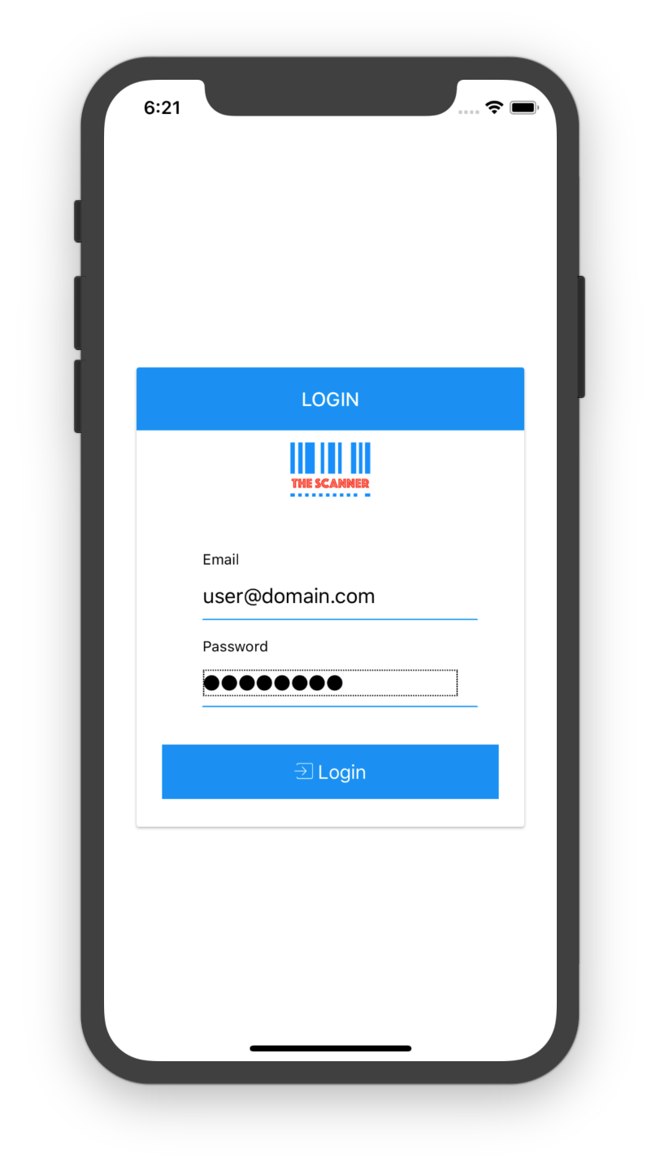
APP LOGIN

Slide 3
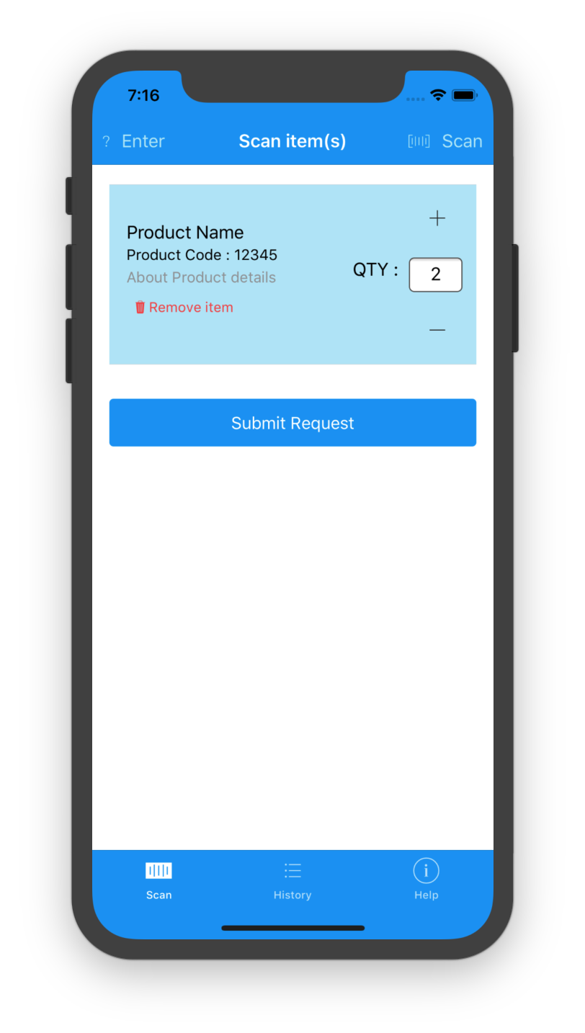
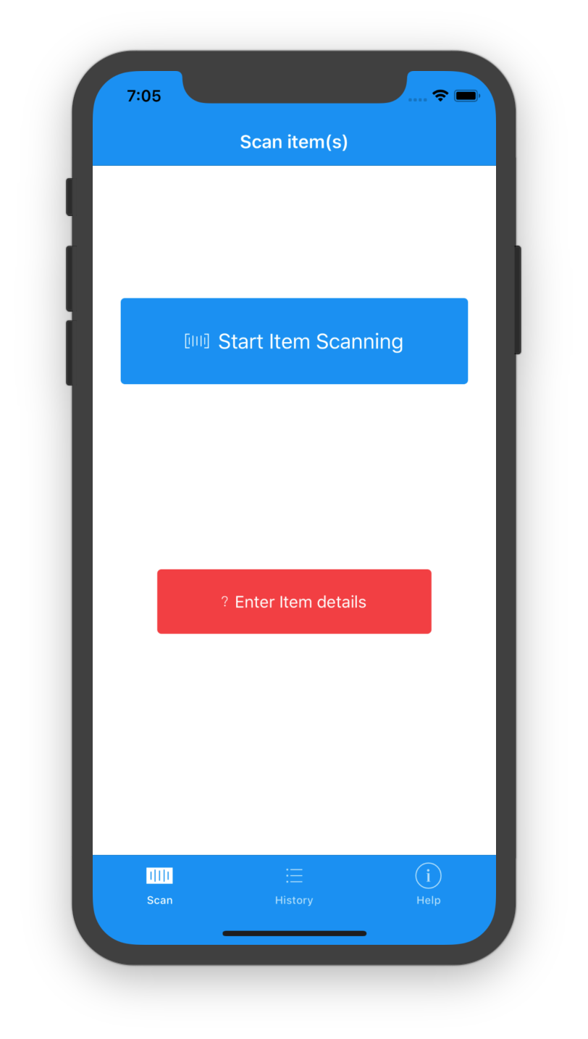
Scan item(s) page
Start item scan or manually enter details
Add multiple items
Modify quantity
Submit request
SCAN ITEM(S)

Slide 4
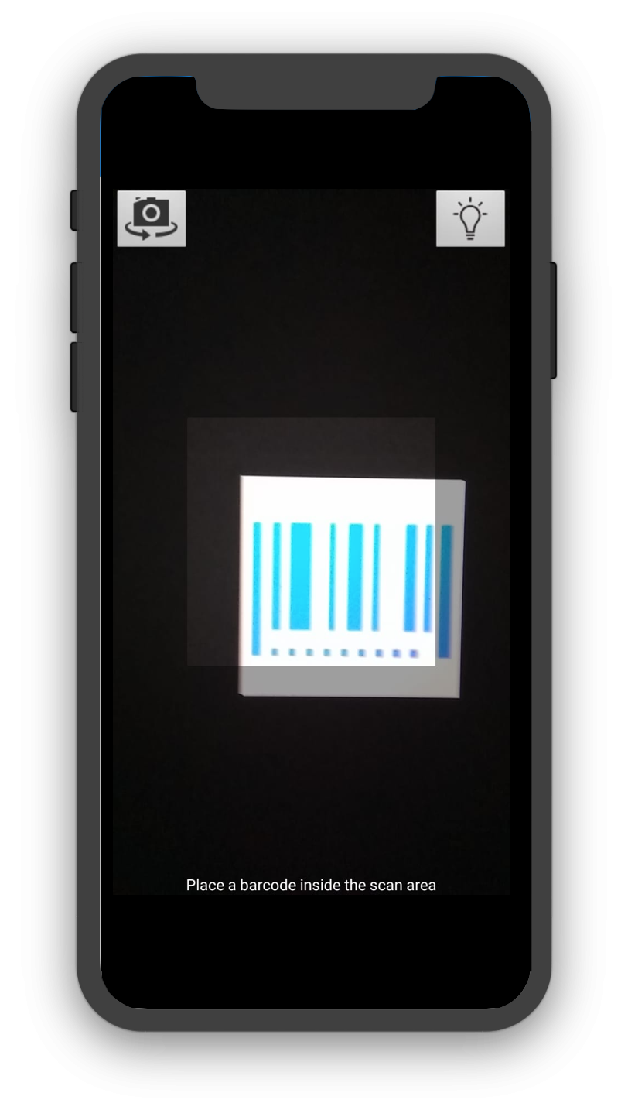
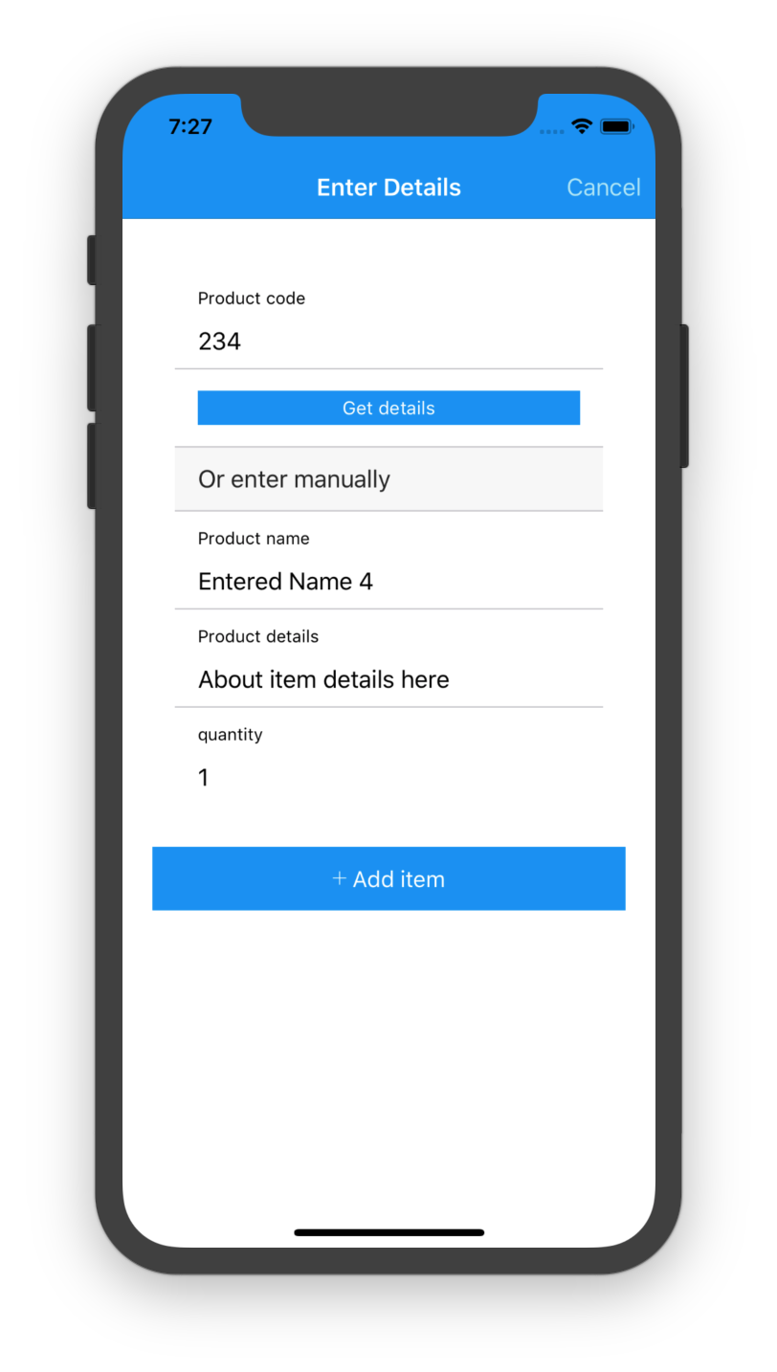

Slide 5
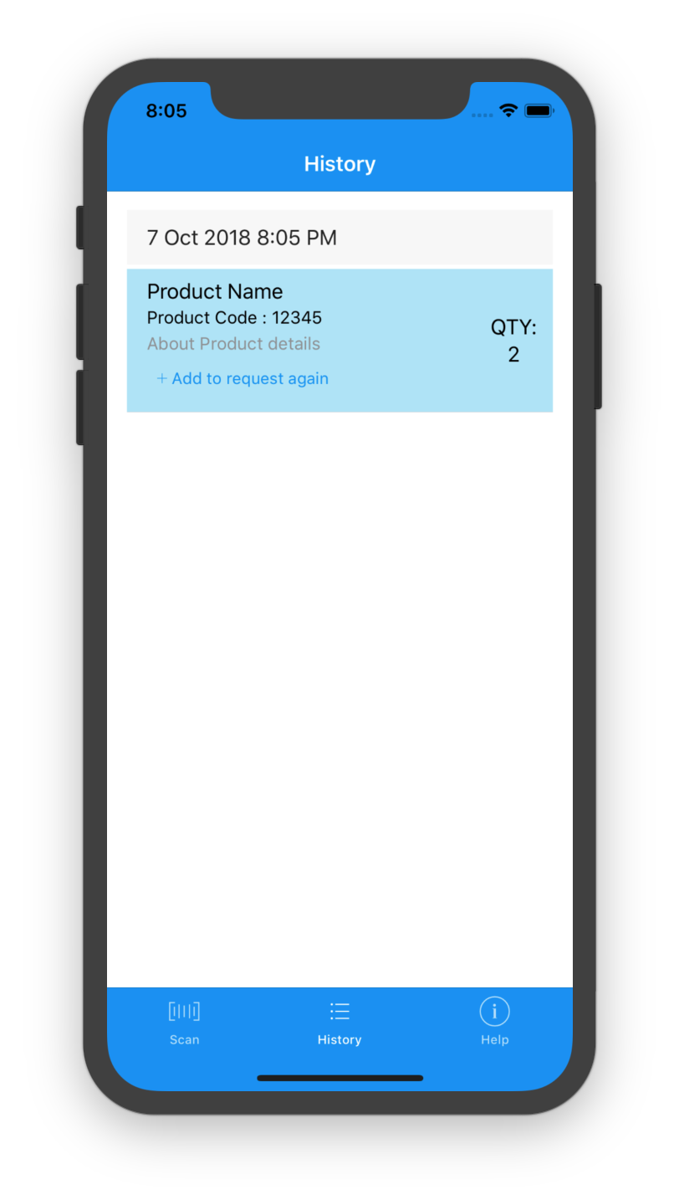
History page
View previous scan requests
Add individual item to new request
History

Slide 6
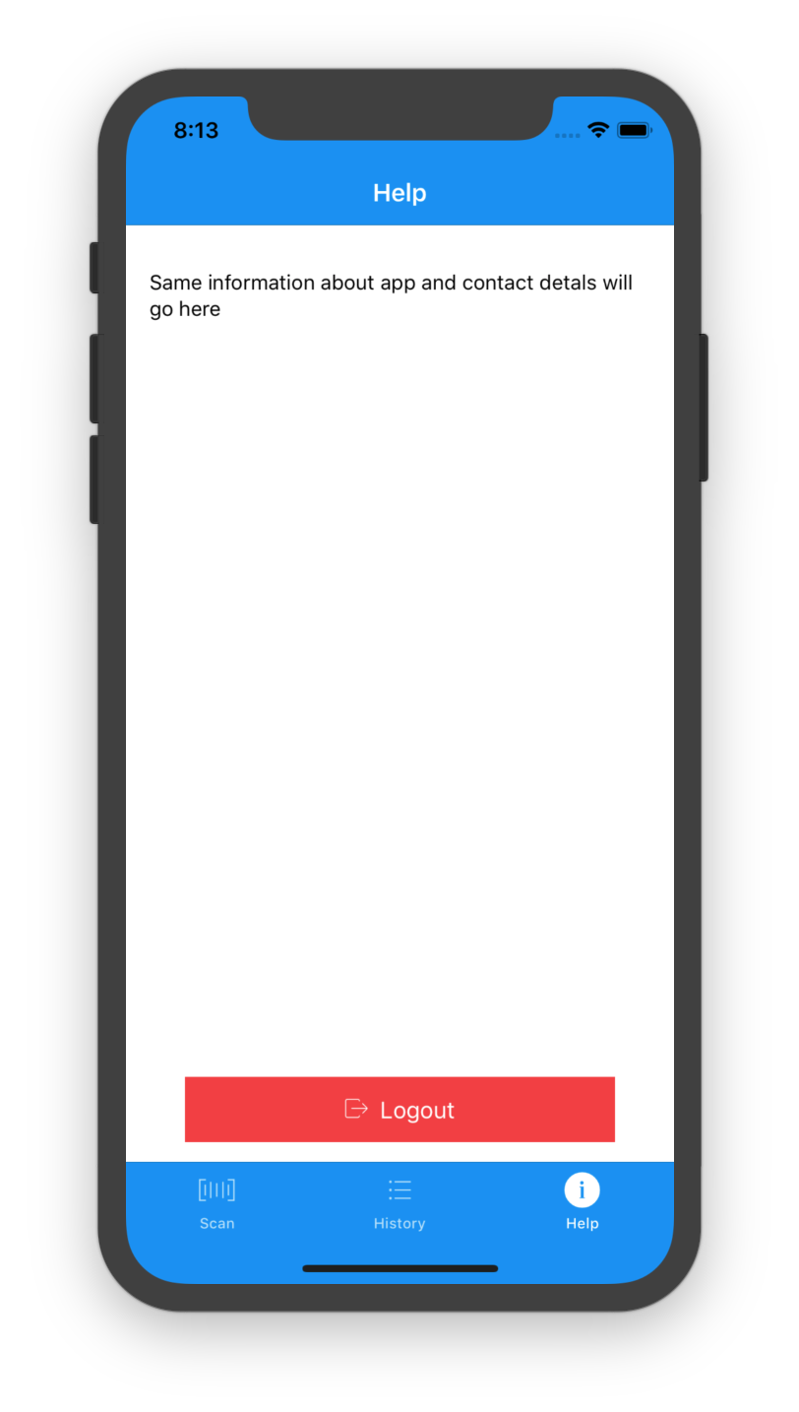
Help page
Adding contact details
Info about App
Logout
Help

Slide 7
Thank You..

