Slide 1
Care+
UI/UX Design & Evaluation (5530)
Mohd Nawaz Hussain - A00428036
Ashwin Sivaraman - A00426488
Caner Adil Irfanoglu - A00425840
Parijat Bandyopadhyay - A00430847
Rishab Gupta - A00429019

Slide 2
Contents
Introduction
What inspired Care+ ?
Problems to Address
Analysis Process
✓ Persona
✓ Workshops
✓ Surveys
✓ Interviews
Findings
Initial Sketch
Heuristic Evaluation & Prototype Implementation
Usability Study
Future Work - A

Slide 3

Introduction
564,000 Canadians currently living with memory loss.
937,000 Canadians will have memory loss of some sort by 2028.
$10.4 billion spent annually to care for memory loss patients.
25,000 new cases every year.
87% of caregivers wish more people understood taking care of a memory loss patient.
1 in 5 Canadians have experience caring for someone living with memory loss.

Slide 4

What inspired Care+ ?
Caregivers of memory loss patients are the most stressed.
Caregivers often suffer from lack of sleep.
Caregivers suffer from deteriorating health.
Quality of life diminishes.

Slide 5

Problems to Address
Daily nutrition tracking
Monitoring daily medicinal schedule
Sleep pattern of the patient
Monitoring abnormal patient behavior
Patient wandering
Caregiver notified in emergency situations
Taking care of multiple patients

Slide 6
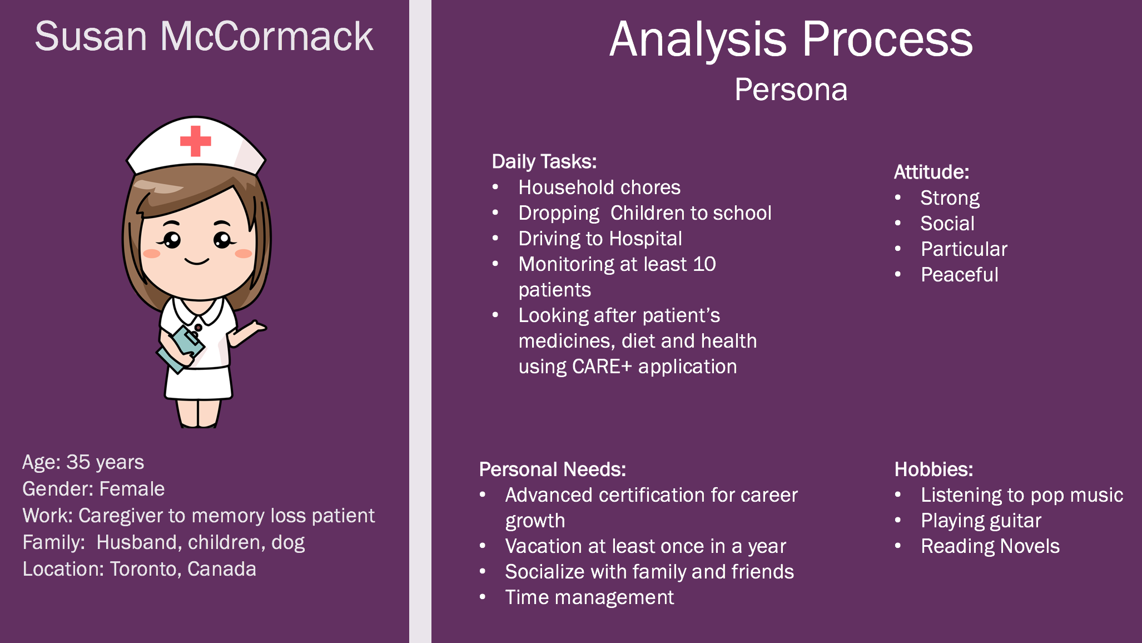

Slide 7
Analysis Process Workshops - I
Empathy Path
Feel
Do
I love my family more than anything
I bond with my patients
I feel overwhelmed
Think
Changes patients medications
Take Bruno for a walk after dinner
She doesn’t get enough time to socialize
Downloads the latest apps
Say
I think my patients need me
I think people need to be more compassionate
I wonder how it would be like living outside the city
I cannot imagine surviving a day without the help of my tracking app
I need to be a better nurse for my career growth

Slide 8
Analysis Process Workshops - II
As – Is Scenario Map
Medicinal
Administers medicines
Checks in on patients
Helping patients with physical needs
A
Interaction
Asks patient about their sleep
Checks in on patient
Guide patient about a medical procedure
Dietary Requirements
B
Preps and serves meals as per dietary requirements
Get dietary requirements from the doctor
C
D
Personal
Getting the kids ready for the school
Cook for family
Very little time for family
Read for an hour before going to the bed

Slide 9
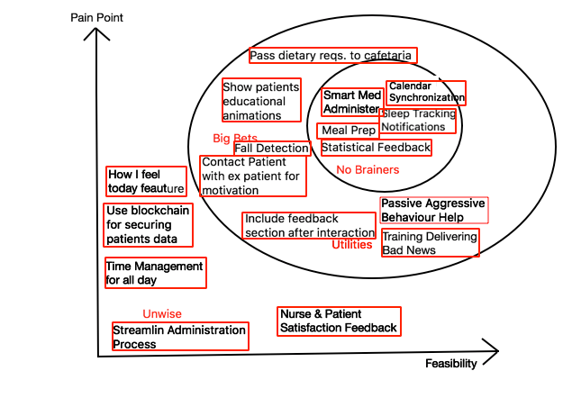
Analysis Process Workshops - III
Feasibility/Pain-Points Plane

Slide 10
Surveys
Analysis Process
Demographic information
Caregiver’s daily routine
Patient’s daily routine
Professional
Non-Professional

Slide 11
Analysis Process Interviews
First interview was conducted with a faculty member from Saint Mary’s University experienced with non-professional caregiving
1
Second interview was conducted with a human resource manager at a caregiving organization who had extensive past experience with caregiving
2
Third set of interviews was conducted with a group of people proficient in several aspects of UI/UX design and testing
3

Slide 12
Findings
Caregivers face trouble monitoring multiple patients
Patients often have trouble sleeping at night
Patients have various specific diets
Patients often get aggressive/moody
Caregivers want feedback on their service

Slide 13
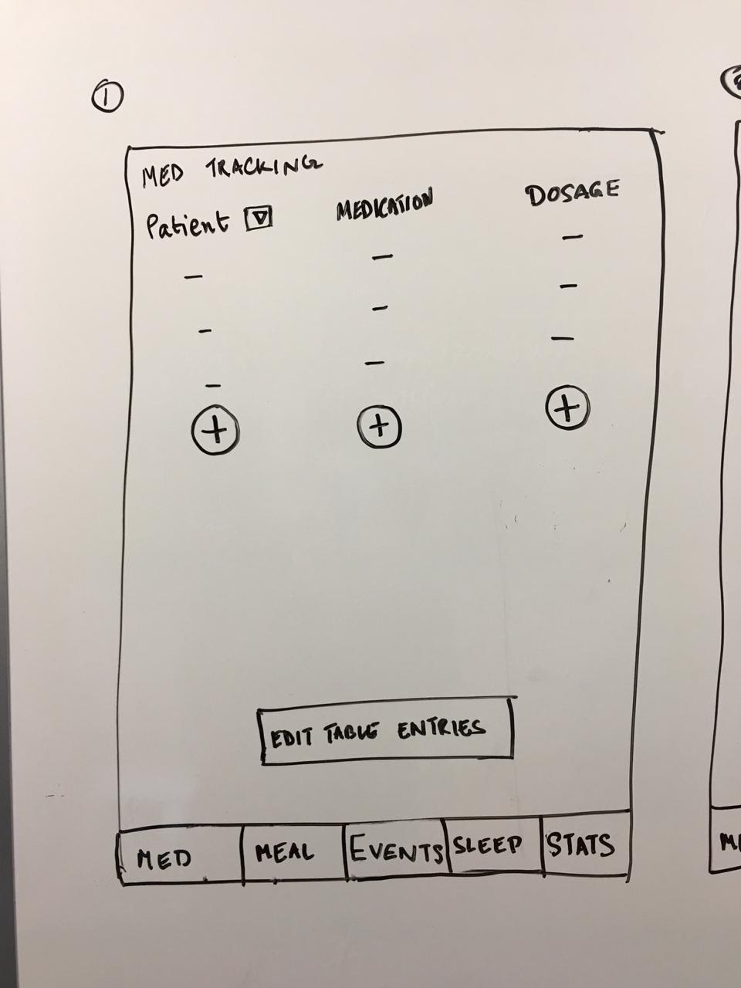
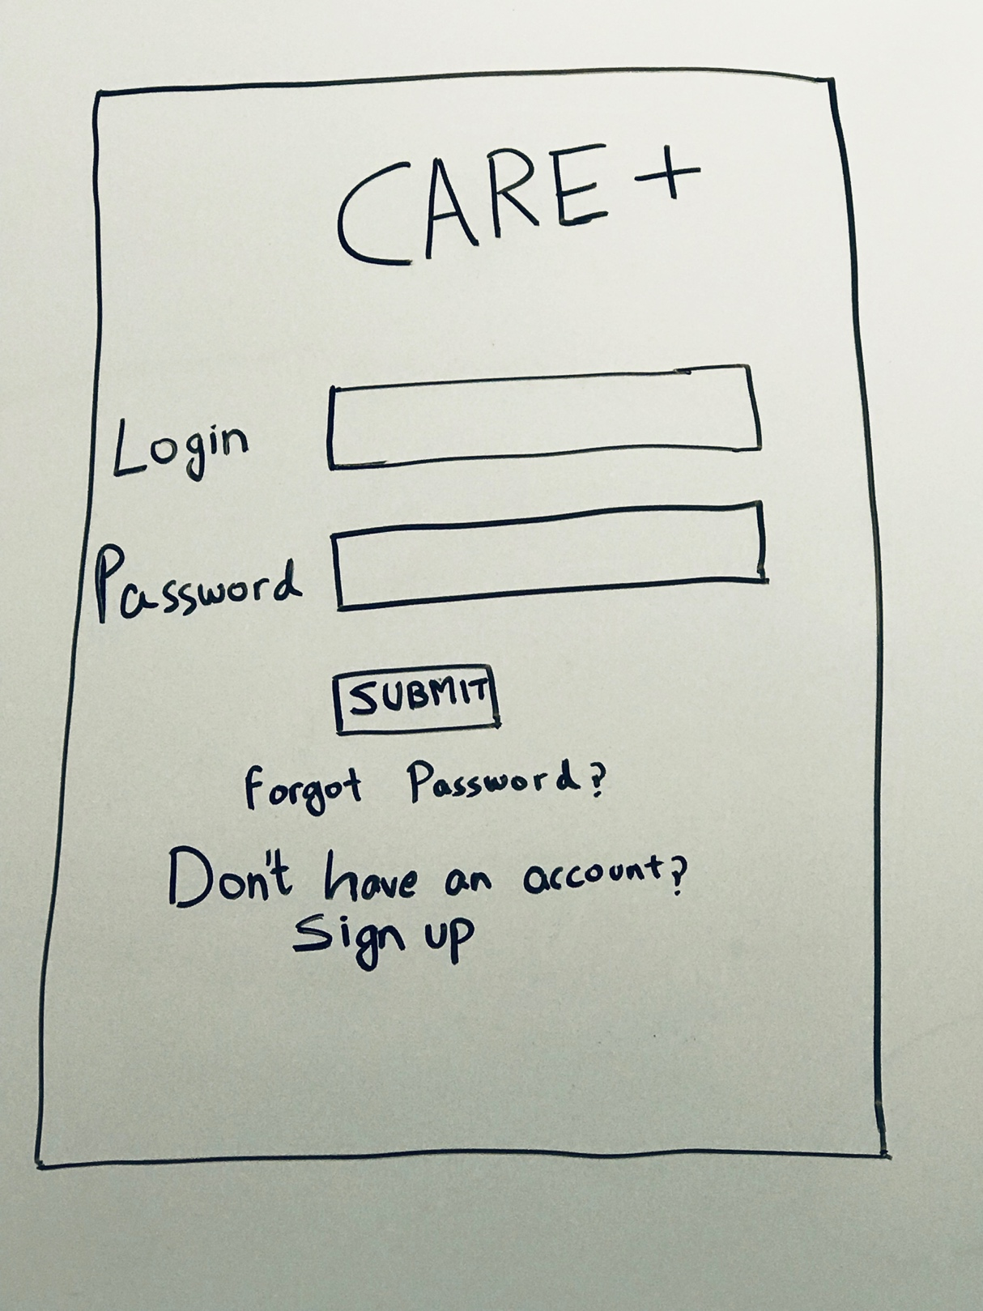
Initial Design Sketches - I
Medicine Page
Login Page

Slide 14
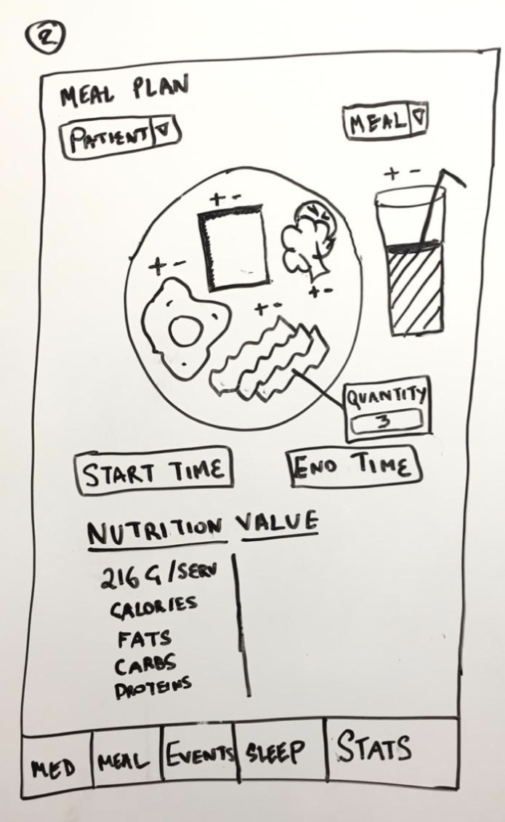
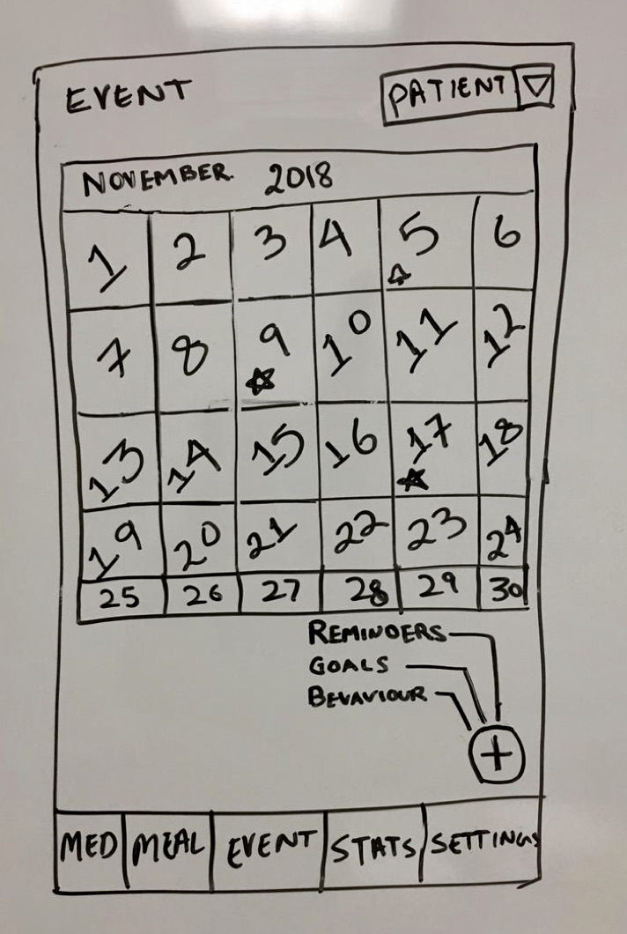
Initial Design sketches - II
Meal Page
Event Page

Slide 15
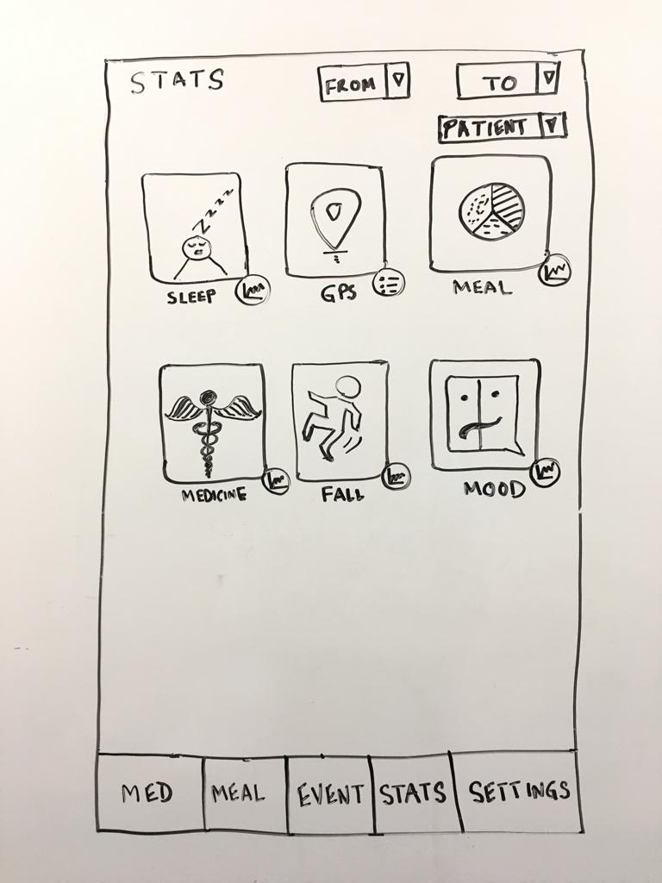
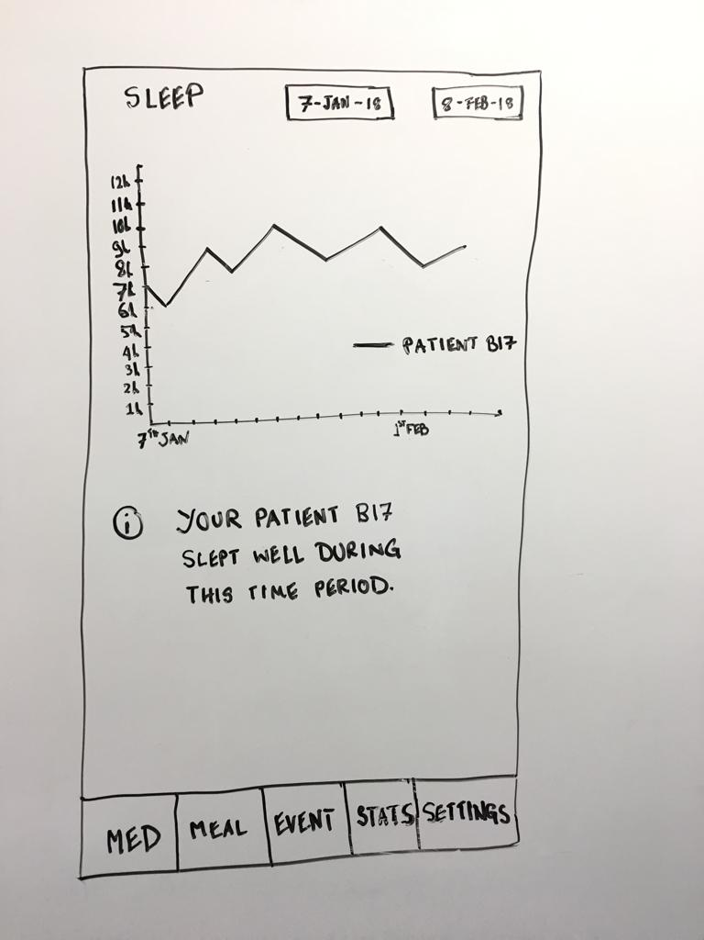
Initial Design sketches - III
Statistics Page
Stats Page

Slide 16
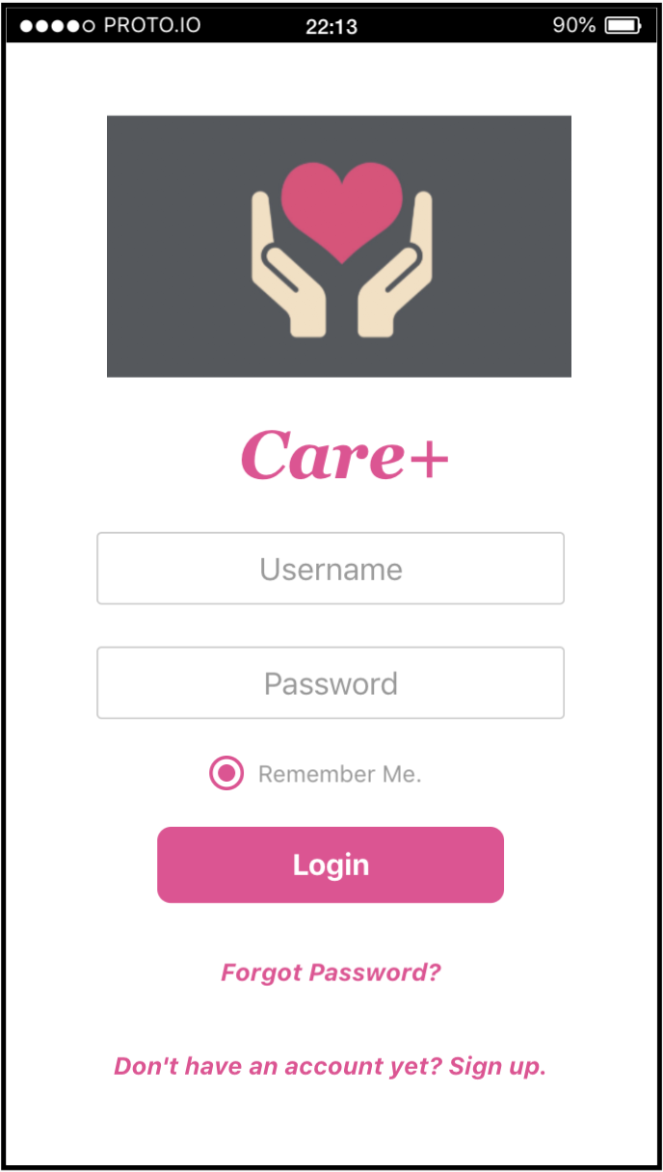
Heuristic Evaluation & Prototype Implementation
On the login page, there should be username/email, instead of Login in the first entry box
Remember password

Slide 17
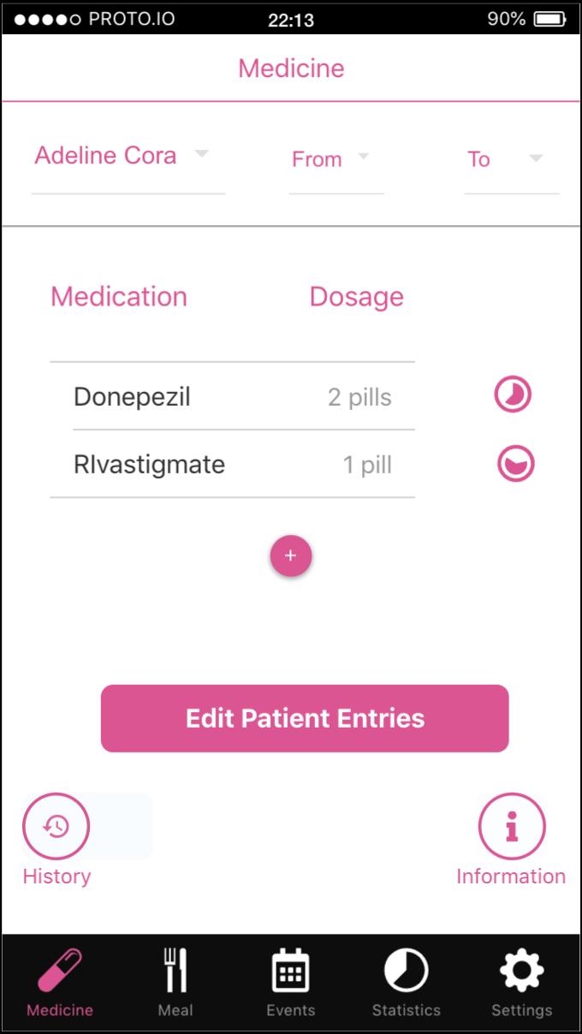
Heuristic Evaluation & Prototype Implementation
Change tab color when selected – Highlight section within selected tab
Add pie chart for countdown for medicine tracking
The Med tab changed from three buttons to one button
Use icons instead of text for feature tabs

Slide 18
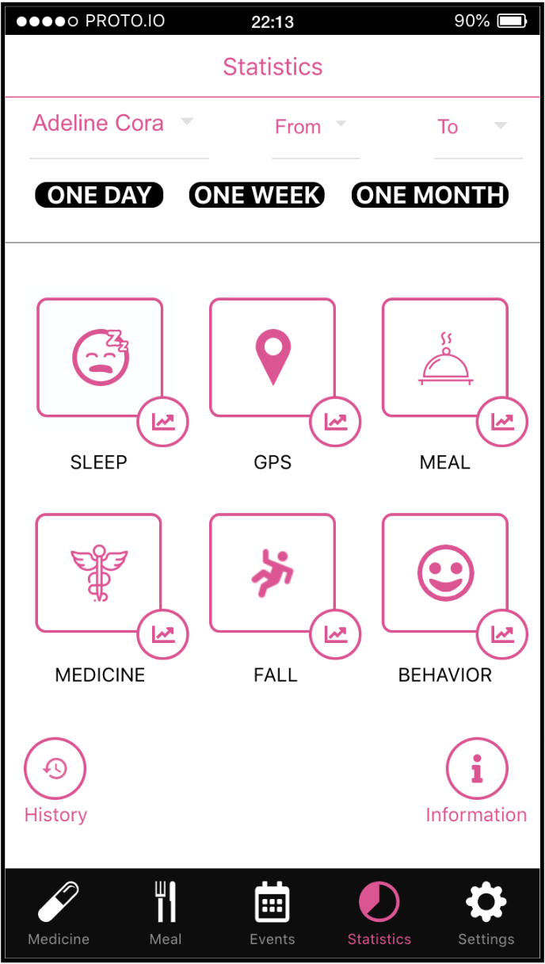
Heuristic Evaluation & Prototype Implementation
Stats tab, instead of “Mood”, it should be “Behavior”
Quick access Day – Week – Month on stats
Adding Information button – (tooltip) for statistics
Put emphasis on the aesthetics and minimalistic design

Slide 19
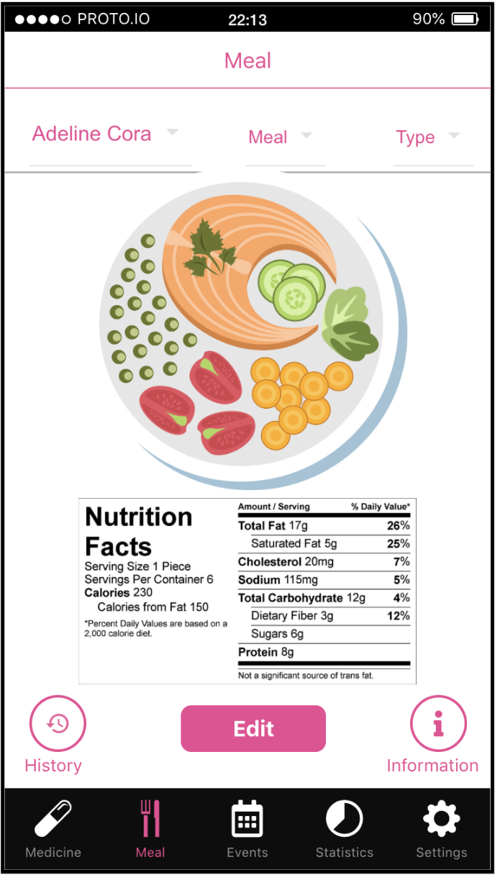
Heuristic Evaluation & Prototype Implementation
Remember frequently created meal selection
While selecting meal plan based on the patient’s condition the app provides suggestion for specific food types.
Show users their previous edits

Slide 20
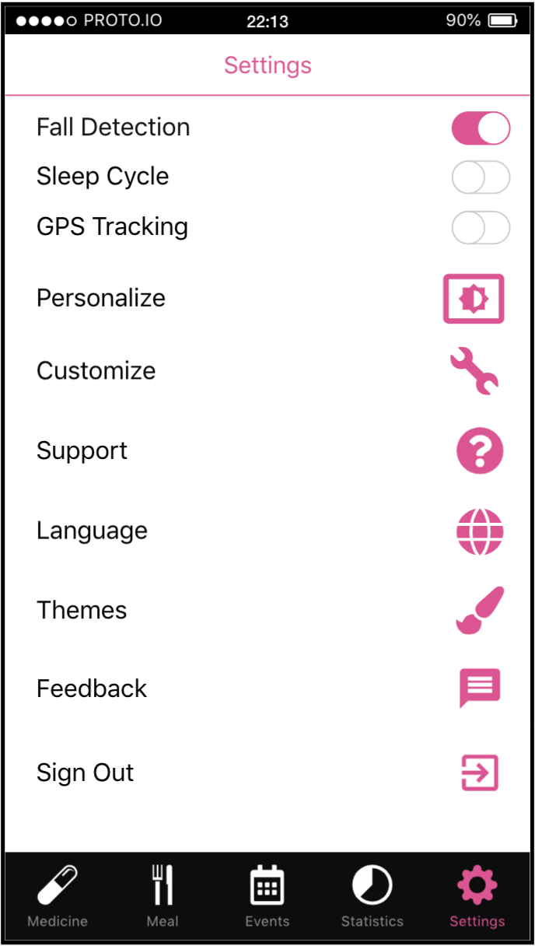
Heuristic Evaluation & Prototype Implementation
Added a settings page
Option to report feedback and bugs
Allow users to edit which features to use actively from settings
Show users their previous edits
Adding FAQ for troubleshooting

Slide 21
Usability Study Introduction
Increase user acceptance and future adoption
Hypothesize successful user engagement
Test the hypothesis with real life observation

Slide 22
Usability Study Results
Some users did not notice the bottom tab bar
Viewed GPS functionality as violation of privacy
Found medication tab redundant
Most caregivers are senior citizens and have limited exposure to technology
Patients may not be comfortable wearing an apple watch
Meal page was cluttered
Caregiver was enthusiastic about mood functionality

Slide 23
Usability Study Expectation
Navigating through the different tabs efficiently
Successfully completing the 3 requested scenarios
Comprehending the application features

Slide 24
Usability Study Accept / Reject Hypothesis
Short Answer: The application prototype passed the usability requirements
Comprehensive Answer: The application is functional. However, there is major features need to be added in the future. Also, some features requires more intuitive design.

Slide 25
Future Works
Integrate a non-intrusive lifeline movement tracker to application
01
Redesign the tab bar to be more visible
02
Make the medication feature optional
03
Declutter the meal page
04

Slide 26


Slide 27
References
Alzheimer Society Canada. “Dementia Numbers.” What Is Dementia?, Family Caregiver Alliance, 24 Apr. 2018, alzheimer.ca/en/Home/About-dementia/What-is-dementia/Dementia-numbers.
Pearlin, Leonard I., et al. "Caregiving and the stress process: An overview of concepts and their measures." The gerontologist 30.5 (1990): 583-594.
American Psychological Association. “Common Caregiving Problems.” American Psychological Association, American Psychological Association, 19 Apr. 2016, www.apa.org/pi/about/publications/caregivers/practice-settings/common-problems/index.aspx.
Logsdon, Rebecca G., et al. "Wandering: a significant problem among community residing individuals with Alzheimer's disease." The Journals of Gerontology Series B: Psychological Sciences and Social Sciences 53.5 (1998): P294-P299.
Weiner, Herbert S., et al. "Health care patient status event processing and reporting." U.S. Patent No. 7,439,856. 21 Oct. 2008.

