Slide 1


Term Project
Title:AI and Explainable Machine Learning in Predicting Biomarkers for Drug Discovery
Presented by:
R2142221020 -Rishabh Verma
Submitted to:
Pooja Sarin

Slide 2
Content
Problem Statement
Objectives
Methodology
Working Model
Results
Conclusion
References

Slide 3
Problem Statement
Biomarkers are critical indicators of physiological and pathological conditions, playing a key role in early disease detection, prognosis, and personalized treatment planning. Recent advancements in artificial intelligence (AI) and machine learning (ML) have significantly improved biomarker discovery by enabling automated analysis of genomic, proteomic, and transcriptomic data. However, one major challenge persists—the interpretability of AI models in biomarker prediction.
Most machine learning models and deep learning models, such as convolutional neural networks (CNNs), recurrent neural networks (RNNs), and transformers, function as black-box models, making it difficult to understand how and why a certain biomarker is predicted. This opacity can lead to a lack of trust among healthcare professionals and potential misdiagnoses in clinical settings. Studies highlight that AI models in biomedical applications must not only be accurate but also explainable to ensure their safe and ethical deployment

Slide 4
Objective
Biomarkers play a crucial role in medical diagnostics, prognosis, and drug discovery. With the advancement of artificial intelligence (AI), machine learning (ML) techniques have shown significant promise in predicting biomarkers from genomic, proteomic, and transcriptomic data. However, the lack of interpretability in AI models poses a challenge in critical fields like healthcare, where transparency and trustworthiness are essential. This project aims to develop a robust AI model for biomarker prediction and enhance its explainability using Explainable AI (XAI) techniques.

Slide 5
Dataset
lusc_tcga_pan_can_atlas_2018, luad_tcga_pan_can_atlas_2018
Source:
https://www.cbioportal.org/study/summary?id=luad_tcga_pan_can_atlas_2018
https://www.cbioportal.org/study/summary?id=lusc_tcga_pan_can_atlas_2018
LUAD and LUSC are two major subtypes of non-small cell lung cancer (NSCLC):
LUAD – Lung Adenocarcinoma
Most common type of NSCLC
Arises from glandular (mucus-secreting) cells in the outer part of the lungs
Often found in non-smokers as well as smokers
Generally grows slower and tends to be detected earlier

Slide 6
Dataset
LUSC – Lung Squamous Cell Carcinoma
Second most common NSCLC subtype
Originates from squamous epithelial cells lining the airways
Strongly associated with smoking history
Tends to be found centrally in the lungs near the bronchial tubes
These two types differ in genetic mutations, biomarker expression, and treatment responses, which is why they are often studied separately in biomarker discovery and precision medicine research.

Slide 7
Methodology
We worked on RNA Sequential data, CNV+DNA Methylation data and Protein array data of both the datasets. RNA Sequential data and CNV+DNA Methylation data was used to classify the NSCLC into its subtypes i.e. LUSC & LUAD and Protein array data was used for Protein-Protein interaction analysis between the data to determine key signaling pathways and hub proteins involved in the progression and differentiation of NSCLC subtypes (LUAD & LUSC), aiding in the identification of potential therapeutic targets and biomarker candidates.

Slide 8
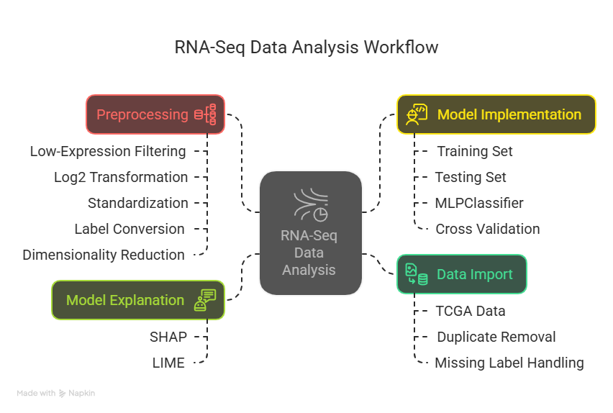
Acquired Copy Number Alteration (CNA) and DNA methylation profiles from TCGA datasets.
Methodology

Slide 9
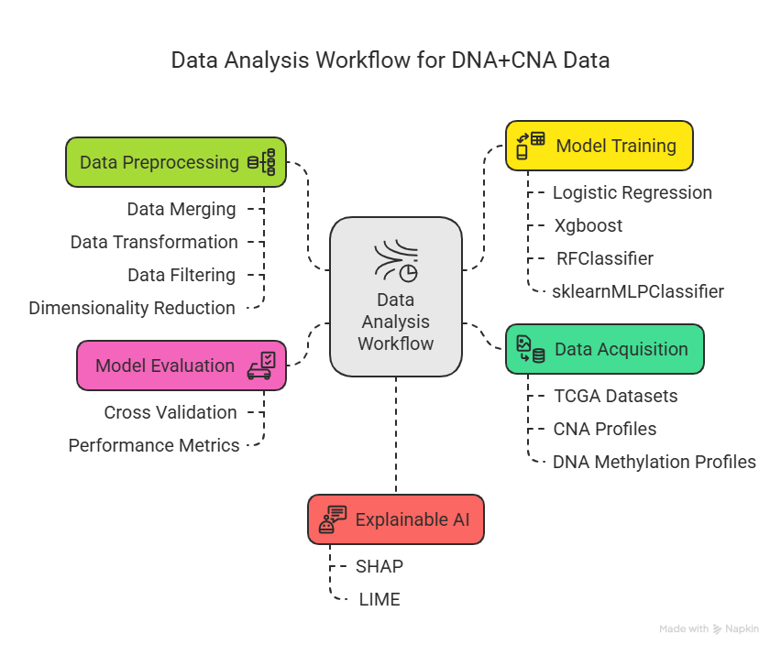
Acquired Copy Number Alteration (CNA) and DNA methylation profiles from TCGA datasets.
Methodology

Slide 10
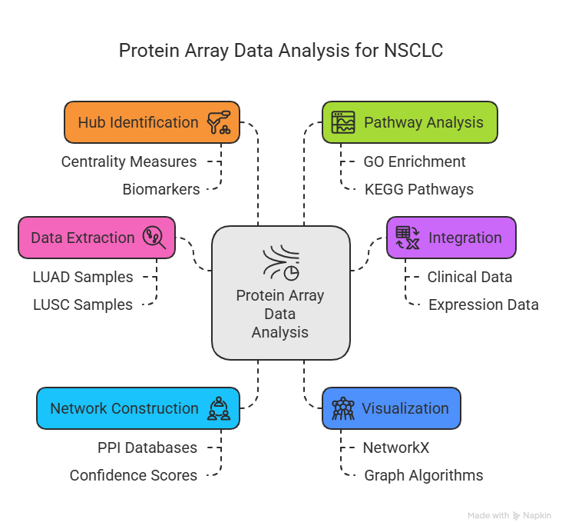
Acquired Copy Number Alteration (CNA) and DNA methylation profiles from TCGA datasets.
Methodology

Slide 11

RNASeq Model
RNASeq Multi-Layer Perceptron Model Architecture:-
Input Layer | Hidden Layer | Output Layer
128 neurons | 64 neurons | 2 neurons
Dropout=50% | Dropout=40% | No Dropout
Relu Activation function | Relu Activation Function | Softmax
Learning rate:0.001
Loss function:Log loss function
Optimizer:Adam
Cross Validation: Stratified Cross Validation

Slide 12
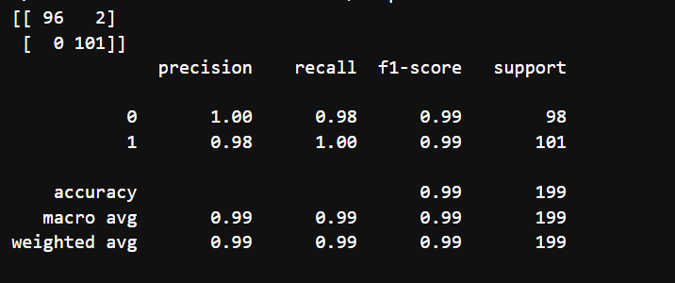
Evaluation Metrics
Confusion Matrix, Precision, Recall and F1-Score
0:LUAD
1:LUSC

Slide 13
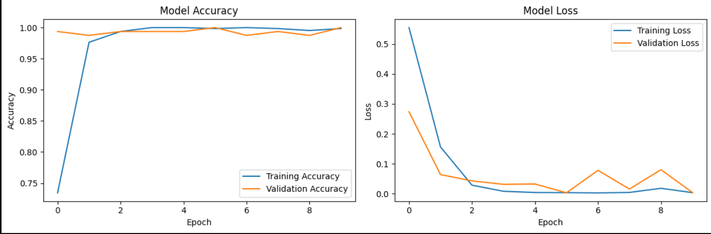
Evaluation Metrics
To validate the model, we used Stratified 5 fold cross validation
The Mean Cross Validation accuracy is 99.30% confirming that the model does not overfit the data and it is generalizing well on the test data.

Slide 14
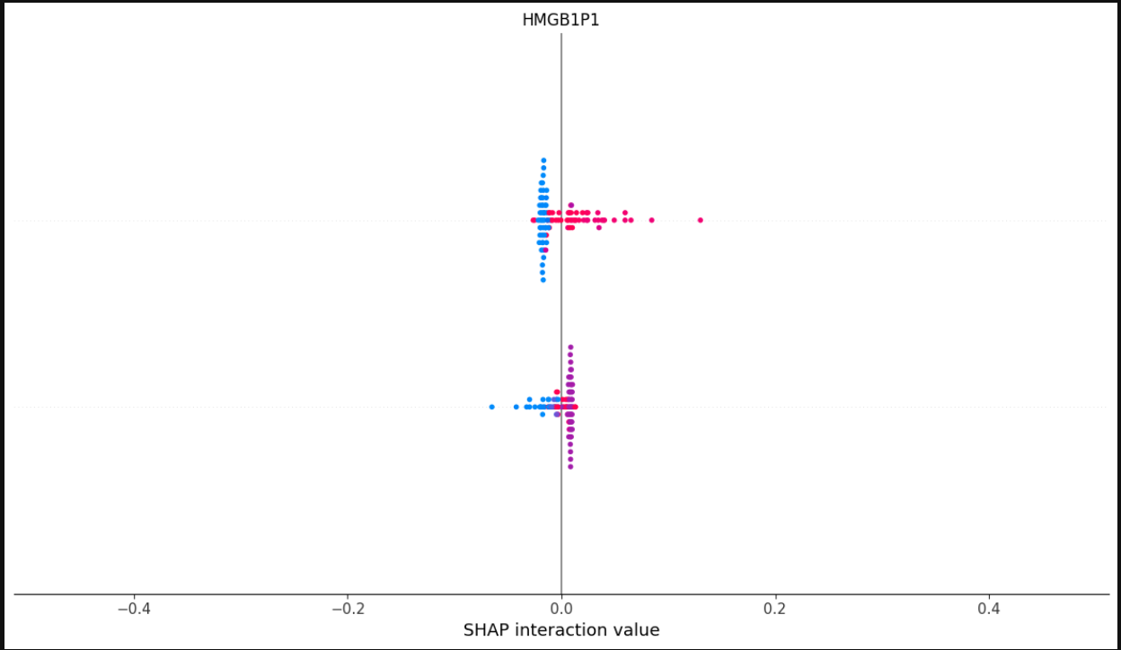
Explainable AI on RNASeq Model
X-axis (SHAP interaction value): It indicates how much the gene HMGB1P1 is contributing to the interaction effect on the model’s output.
Values closer to 0 mean less contribution.
Positive values push predictions toward one class (LUSC).
Negative values push predictions toward the opposite class (LUAD).
Each dot represents a sample from the dataset.
This SHAP plot shows the interaction effect of the gene HMGB1P1 on the predictions made by a Multilayer Perceptron (MLP) model.

Slide 15
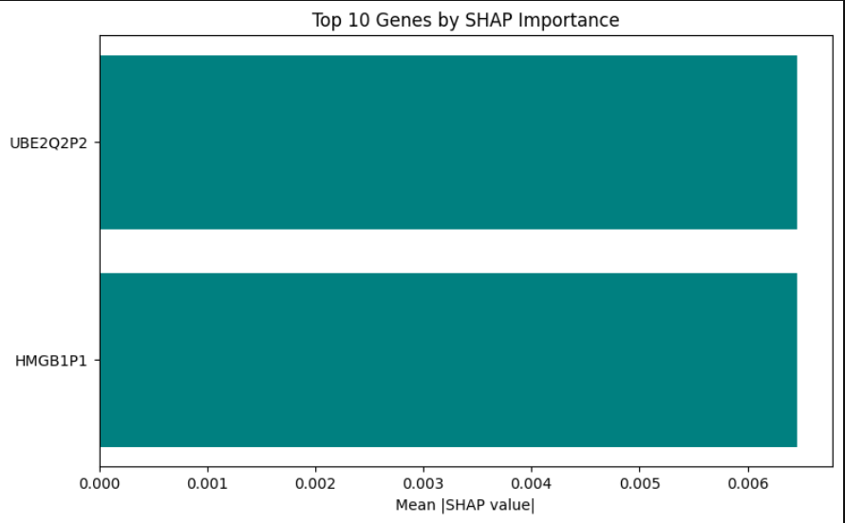
Explainable AI on RNASeq Model
Y-axis: Names of genes (features), such as UBE2Q2P2 and HMGB1P1.
X-axis (Mean |SHAP value|): The average of the absolute SHAP values for each gene across all predictions.
It represents the average magnitude of impact a gene has on model output, regardless of direction (positive or negative).
Higher mean SHAP value ⇒ more important gene for the model's decision-making.
This bar chart shows the Top 10 Genes ranked by SHAP importance in the MLP model. However, in this particular plot, only the top 2 genes—UBE2Q2P2 and HMGB1P1—are shown.

Slide 16
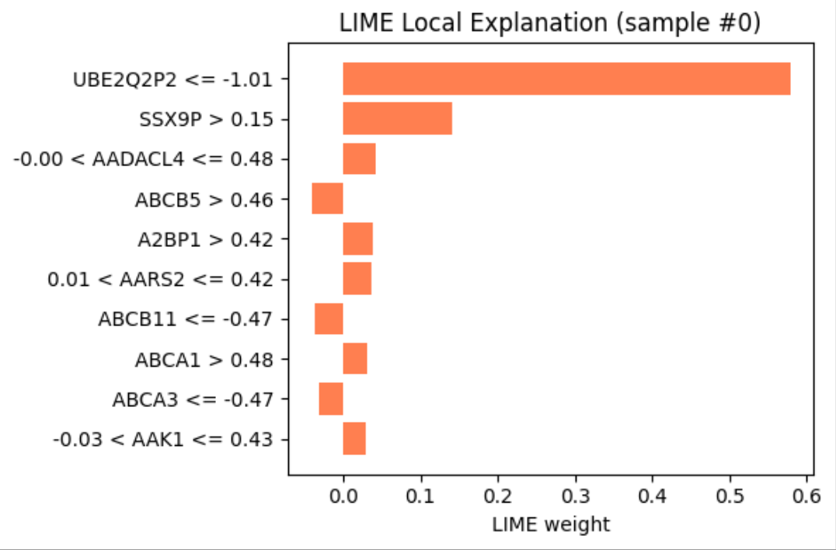
Explainable AI on RNASeq Model
X-axis (LIME weight): Shows the contribution of each feature to the model's prediction for this sample. Higher weight means stronger influence.
Positive LIME weight: pushes the prediction towards the predicted class.
Negative LIME weight (not present in this image): would push prediction away from the predicted class.
Goal: Interprets the model's prediction for a single test sample.
Top Feature: UBE2Q2P2 ≤ -1.01 had the strongest positive influence on the predicted class.
SSX9P > 0.15 also significantly contributed to the prediction.
Other features (AADACL4, ABCB5, A2BP1, etc.) had minor supporting roles.
All bars show positive influence (push prediction toward the predicted class).
LIME reveals local decision logic – helps in understanding individual predictions.
Supports model transparency and biomarker relevance validation (e.g., UBE2Q2P2 matches SHAP importance).

Slide 17
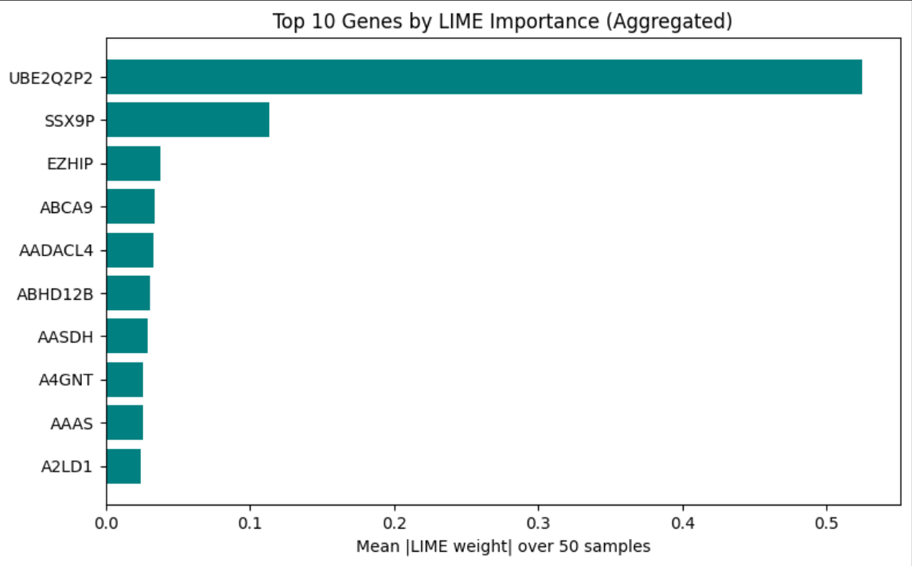
Explainable AI on RNASeq Model
X-axis (LIME weight): Shows the contribution of each feature to the model's prediction for this sample. Higher weight means stronger influence.
Positive LIME weight: pushes the prediction towards the predicted class.
Goal: Explain which input features (genes) had the strongest influence on the MLP model’s predictions.
Method: LIME approximates the model’s behavior locally by perturbing input samples and observing changes in predictions. The absolute weights (|LIME weight|) reflect feature importance.
Aggregation: Results are averaged over 50 samples to ensure robustness (reduces noise from single-instance explanations).

Slide 18
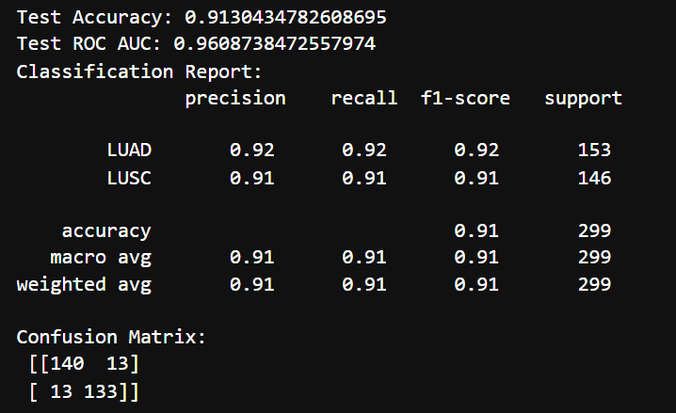
CNV+DNA Methylation Model
Model | 5-Fold Cross Validation | AUC_ROC Scores
Logistic Regression | 86.50% | 96.13%
RFClassifier | 88.51% | 95.37%
MLPClassifier | 86.50% | 94.85%
XgBoost | 88.65% | 95.68%
Logistic Regression :

Slide 19
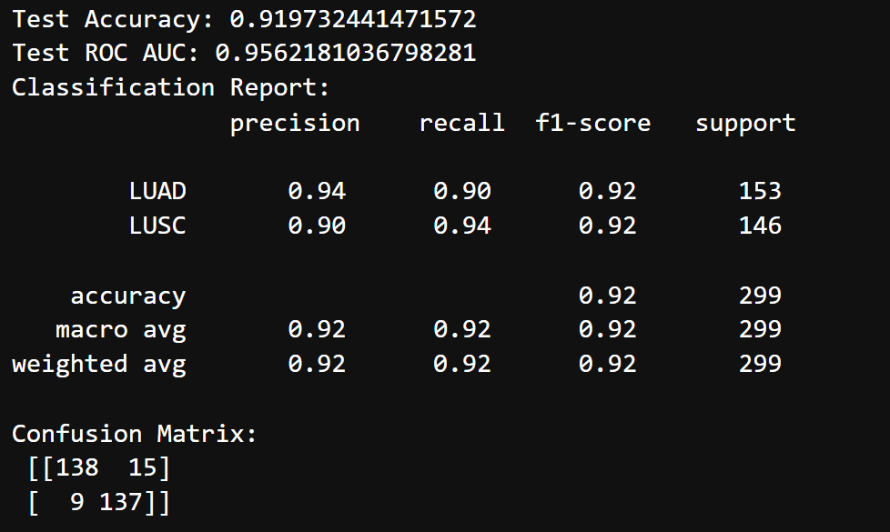
CNV+DNA Methylation Model
RFClassifier :

Slide 20
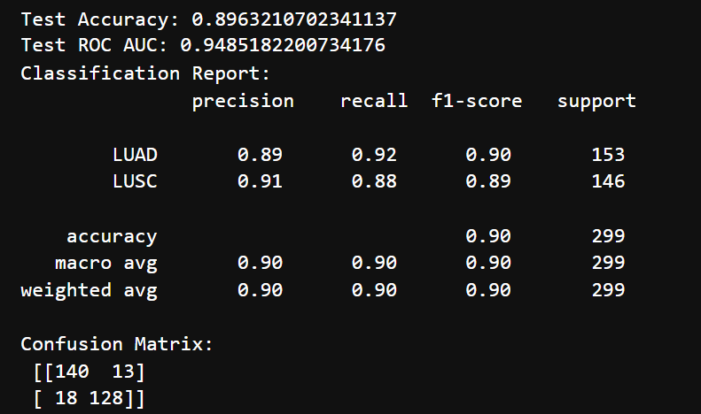
CNV+DNA Methylation Model
MLPClassifier :

Slide 21
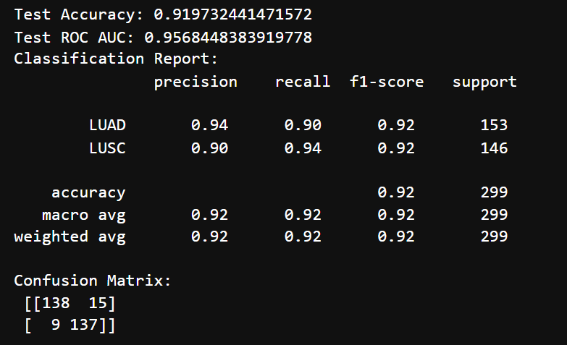
CNV+DNA Methylation Model
XGBoost:
XGBoost and RFClassifier both outperforms Logistic Regression and MLP on F1-Score, with Random Forest and XGBoost achieving the highest F1-scores for both classes.But we have selected the models such as Logistic Regression and RFClassifier based on their test ROC_AUC score.

Slide 22
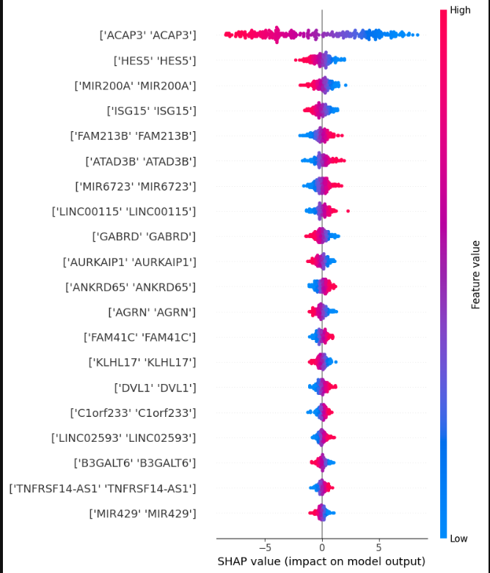
SHAP Results for Logistic Regression:-
Features (Y-axis):
Listed are gene names or biomarkers (e.g., ACAP3, HESS, MIR200A), likely representing the top 20 most important features in the model.
Each feature is duplicated (e.g., ['ACAP3' 'ACAP3']), which might indicate a visualization artifact or grouped data points.
SHAP Values (X-axis):
Impact on the model’s output (log-odds in Logistic Regression).
Positive SHAP values: Push predictions toward class 1 (LUSC).
Negative SHAP values: Push predictions toward class 0 (LUAD).

Slide 23
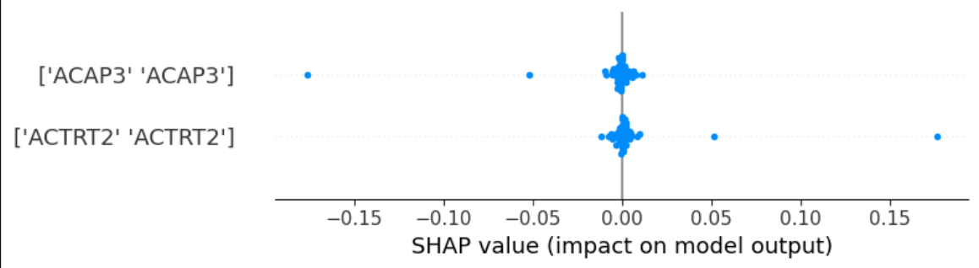
SHAP Results for RFClassifier:-
Features (Y-axis):
Each row represents a feature (e.g., ACAP3, ACTRT2).
Features are ordered by importance, with the most influential at the top.
SHAP Values (X-axis):
Measures the impact of a feature on the model's output.
Positive values: Push predictions toward class 1 (LUSC).
Negative values: Push predictions toward class 0 (LUAD).
The scale here is small (-0.15 to 0.15), suggesting subtle but meaningful impacts.

Slide 24
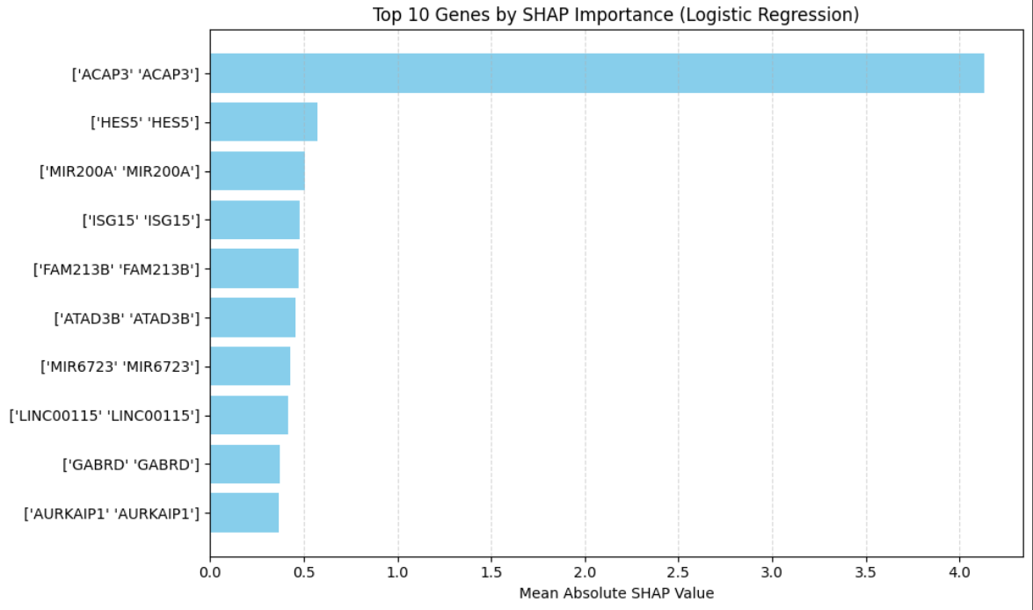
SHAP Importance for Logistic Regression

Slide 25
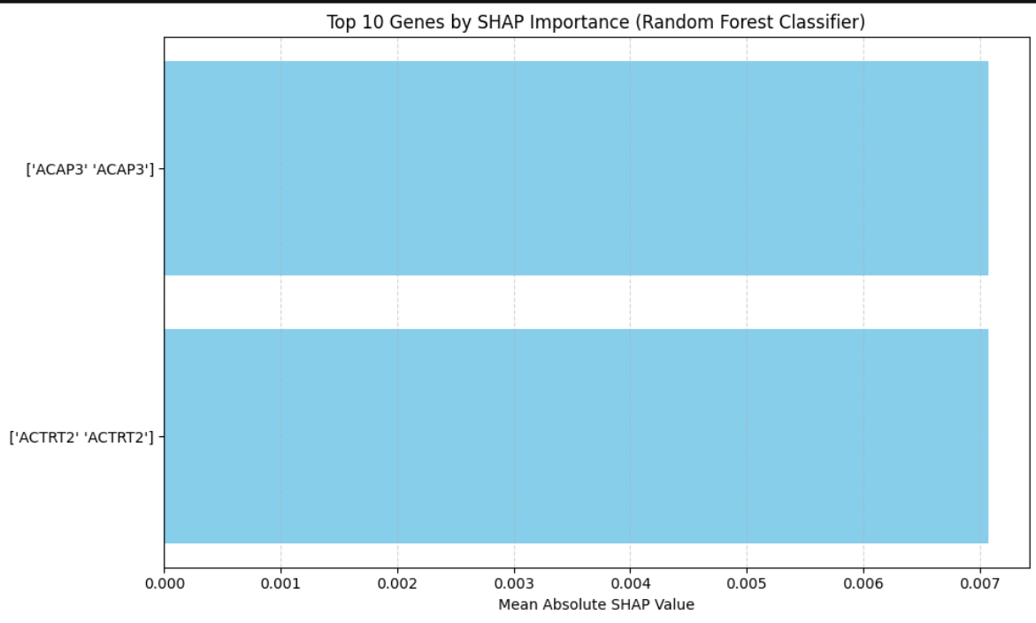
SHAP Importance for RFClassifier

Slide 26
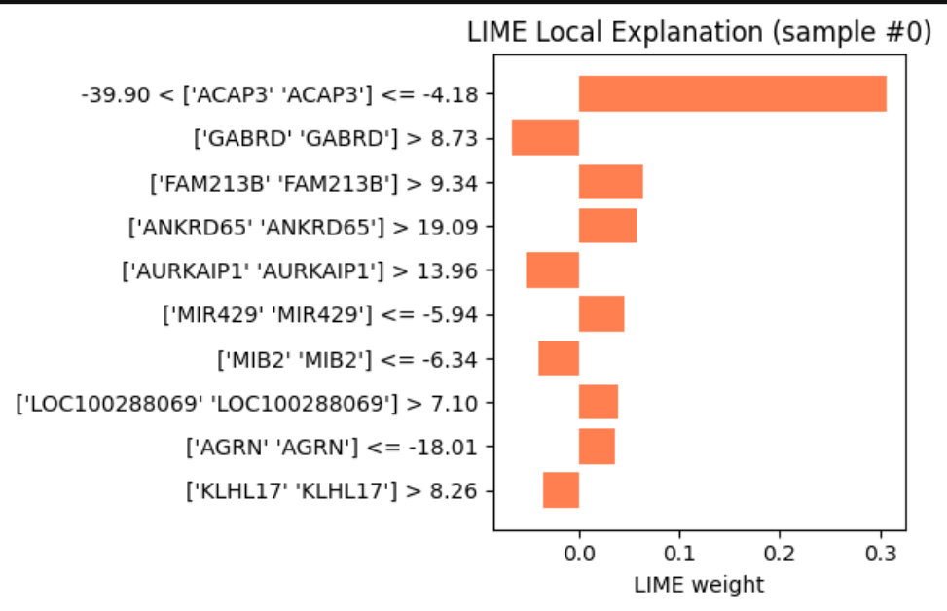
LIME for Logistic Regression

Slide 27
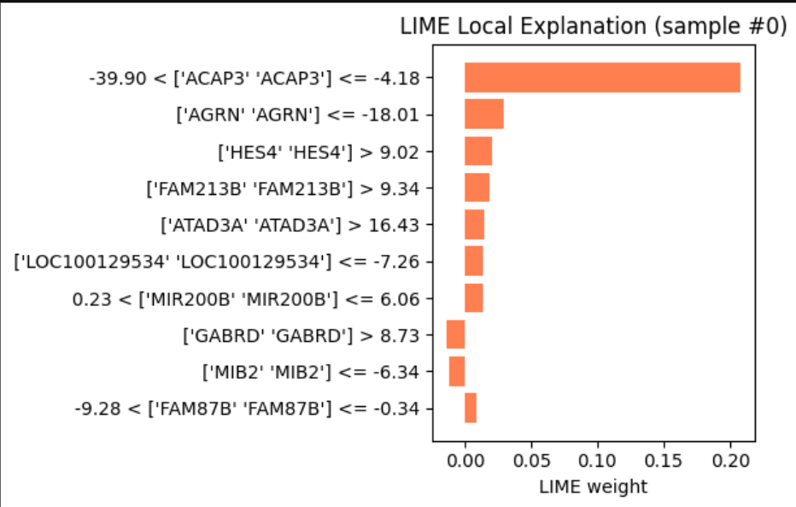
LIME for RFClassifier

Slide 28
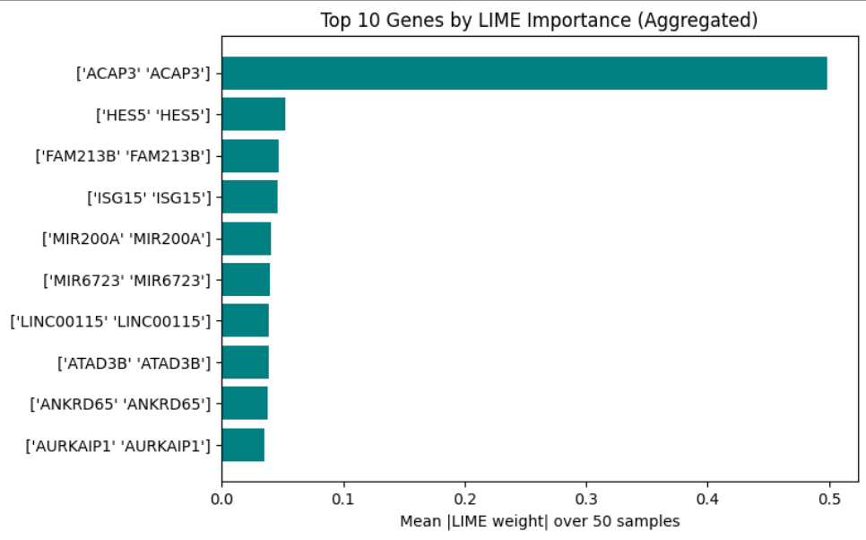
LIME Importance of Logistic Regression

Slide 29
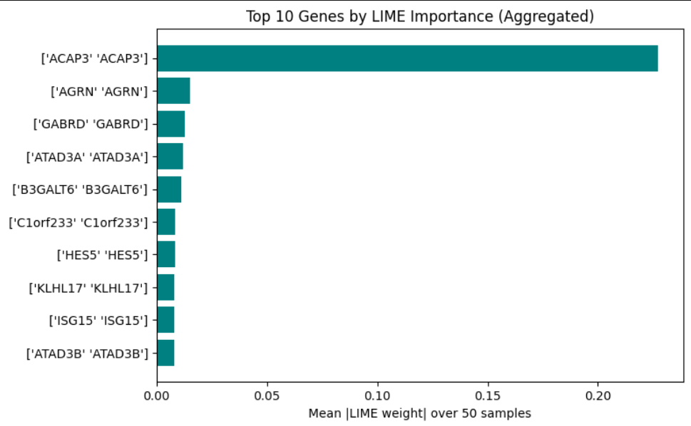
LIME Importance of RFClassifier

Slide 30
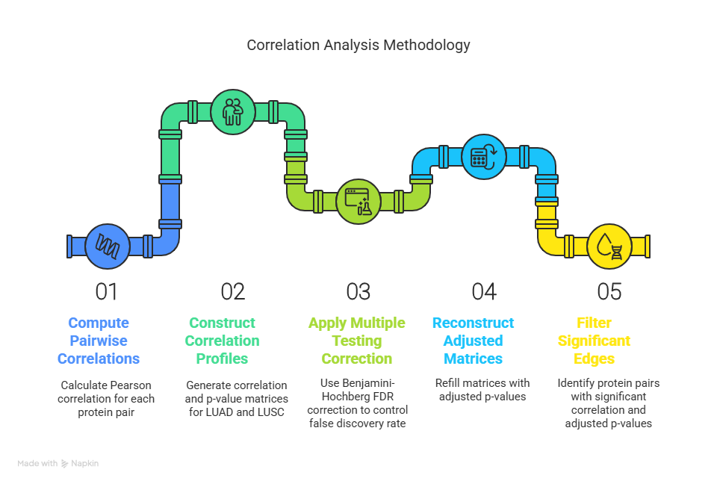
Protein-Protein Interaction Analysis
Correlation Analysis for Protein Pairs:-
To identify differentially correlated protein pairs between LUAD (Lung Adenocarcinoma) and LUSC (Lung Squamous Cell Carcinoma).

Slide 31
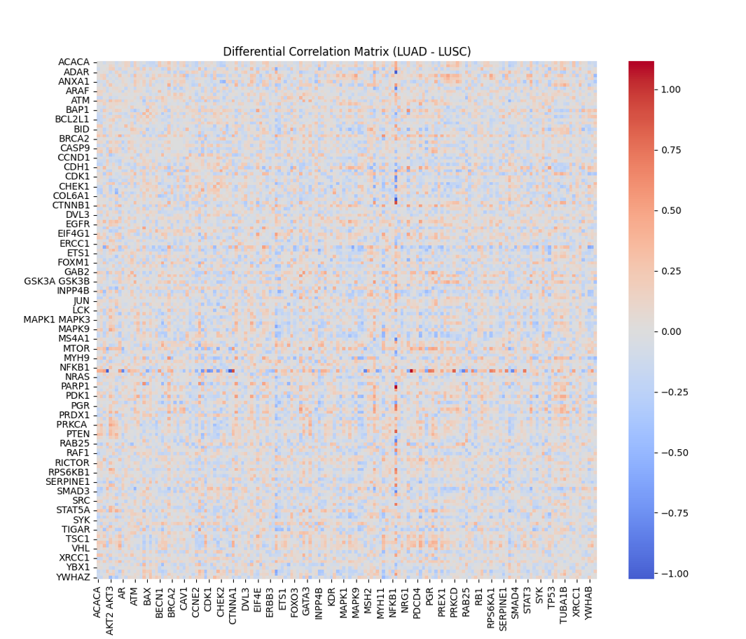
Protein-Protein Interaction Analysis
Outcome:-
Significant differences in correlation patterns were visualized as a Differential Correlation Matrix (LUAD - LUSC).
Helps in identifying co-regulated proteins and potential biomarkers unique to each lung cancer subtype.

Slide 32
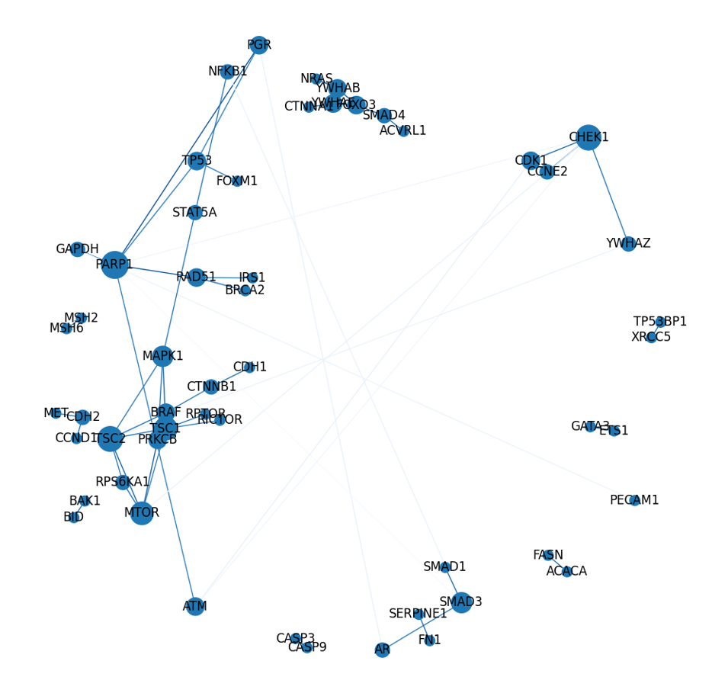
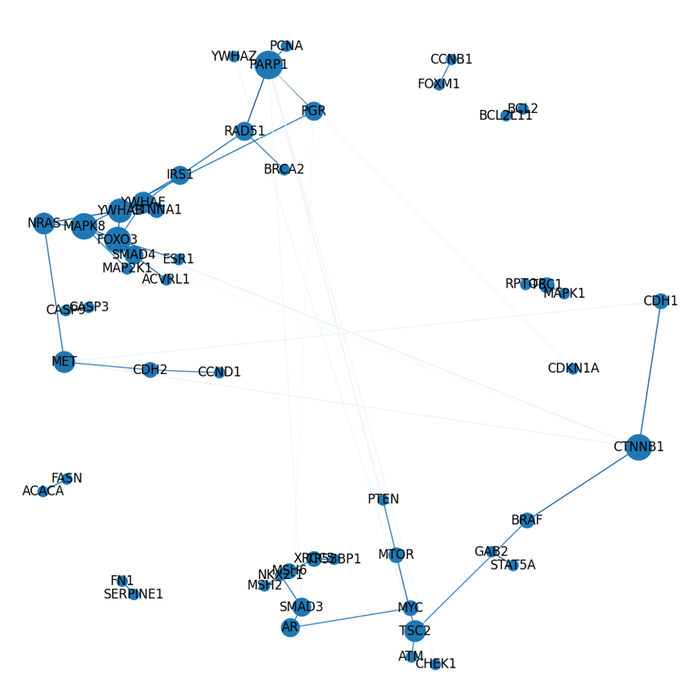
PPI Network Graph
LUAD PPI Network
LUSC PPI Network

Slide 33
PPI Network Graph
Understanding PPI Network
Proteins rarely act alone — they form complex networks to regulate cellular processes.
PPI networks reveal functional relationships between proteins.
Biological Insights Derived
Hub Proteins: Proteins with a high degree (many connections) are often essential for survival and may be critical control points in disease pathways.
Pathway Mapping: Understand how signal transduction or gene expression is modulated in health and disease.

Slide 34
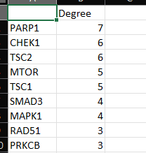
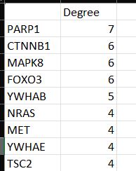
PPI Network Graph
Derived Hub Proteins with highest degrees
LUAD PPI Degrees
LUSC PPI Degrees

Slide 35
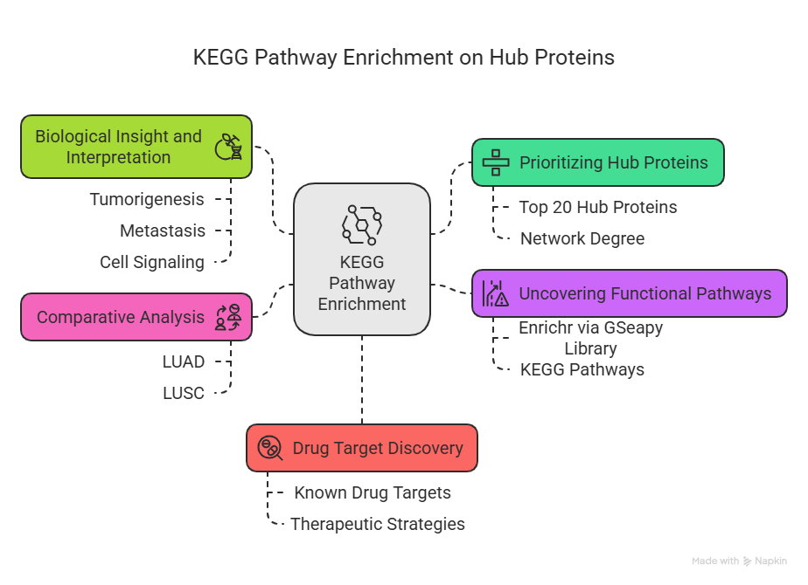
PPI Network Graph

Slide 36
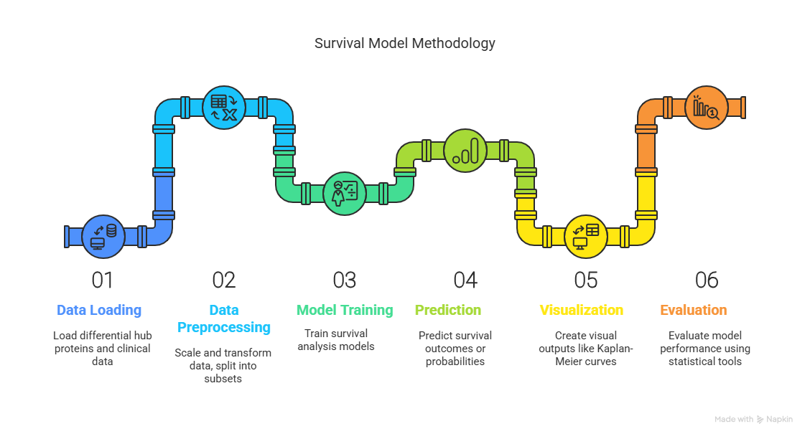
Survival Prediction :-
From the KEGG pathway enrichment analysis and PPI network analysis top differential hub proteins were selected and then the data is used with the clinical data for survival prediction.

Slide 37
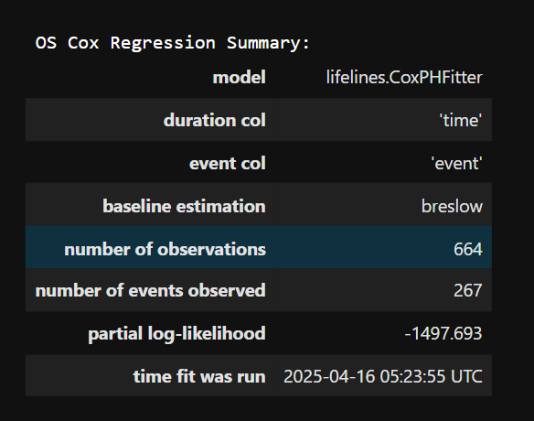
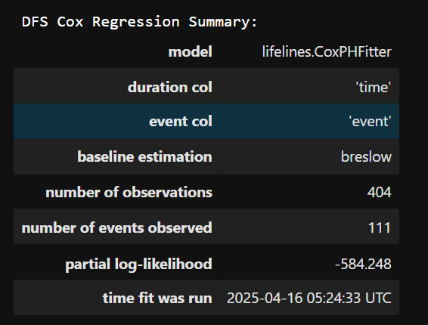
Survival Model:-
Overall Survival Cox Regression Summary:-
Disease Free Survival Cox Regression Summary:-

Slide 38
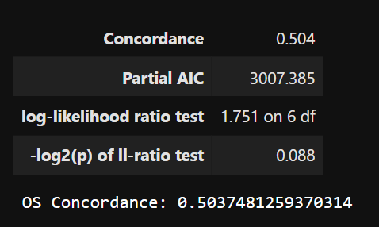
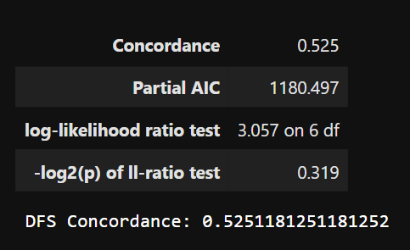
Survival Model Performance:-
The model performance is evaluated using model concordance ratio. A good model has the concordance ratio of greater than 70%.

Slide 39
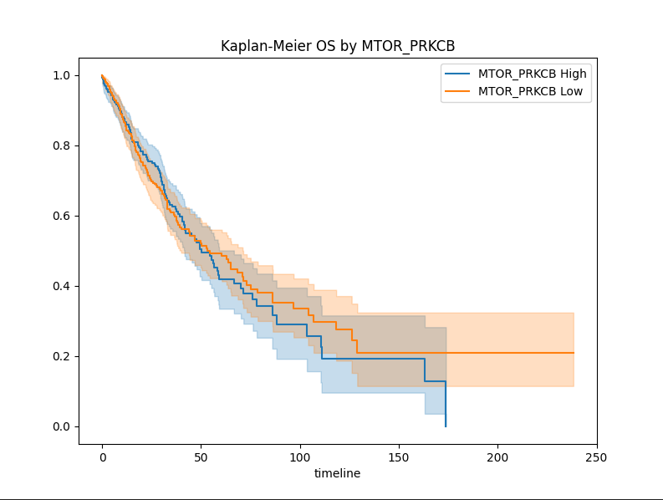
Survival Prediction :-
Kaplan-Meier survival plot showing Overall Survival (OS) stratified by the expression of the interaction between two genes: MTOR and PRKCB.
X-axis (timeline): Represents the time in months since diagnosis or start of observation.
Y-axis (Survival Probability): Probability of patients surviving (OS) over time, ranging from 1.0 (100% survival) down to 0.0 (0% survival).
Blue Line: Patients with High expression of MTOR_PRKCB interaction.
Orange Line: Patients with Low expression of MTOR_PRKCB interaction.
Shaded Area: Confidence intervals for the survival estimate (usually 95%).

Slide 40

Survival Prediction :-
Axes:
X-axis (timeline): Time (in months ) after initial diagnosis or treatment.
Y-axis (Survival Probability): Probability that patients have not experienced a defined event (death or recurrence), starting from 1.0 (100%).
Legend:
Blue Line: Patients with high expression of the MTOR_PRKCB interaction.
Orange Line: Patients with low expression of the MTOR_PRKCB interaction.
Shaded Areas: Confidence intervals for the survival estimates.

Slide 41
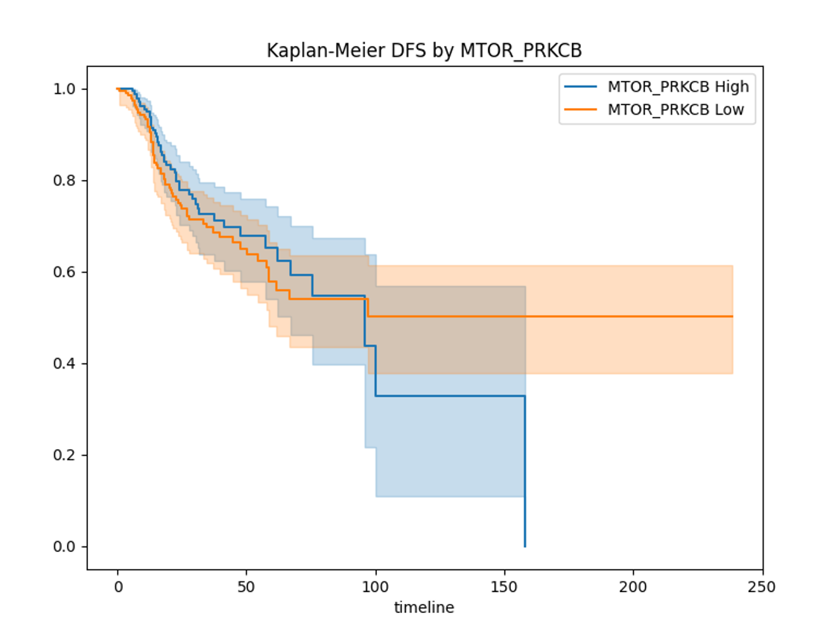
Survival Prediction :-
Kaplan-Meier curve comparing Disease-Free Survival (DFS) between two groups based on MTOR_PRKCB expression levels (High vs. Low).
Y-axis :
Represents the probability of remaining disease-free (DFS) ranging from 0.0 (0%) to 1.0 (100%).
X-axis (Bottom):
Shows time (in months) from the start of observation.
The timeline extends up to ~250 months.
Colored Lines:
MTOR_PRKCB High (e.g., red line): Patients with high expression of the MTOR_PRKCB gene signature.
MTOR_PRKCB Low (e.g., blue line): Patients with low expression.

Slide 42
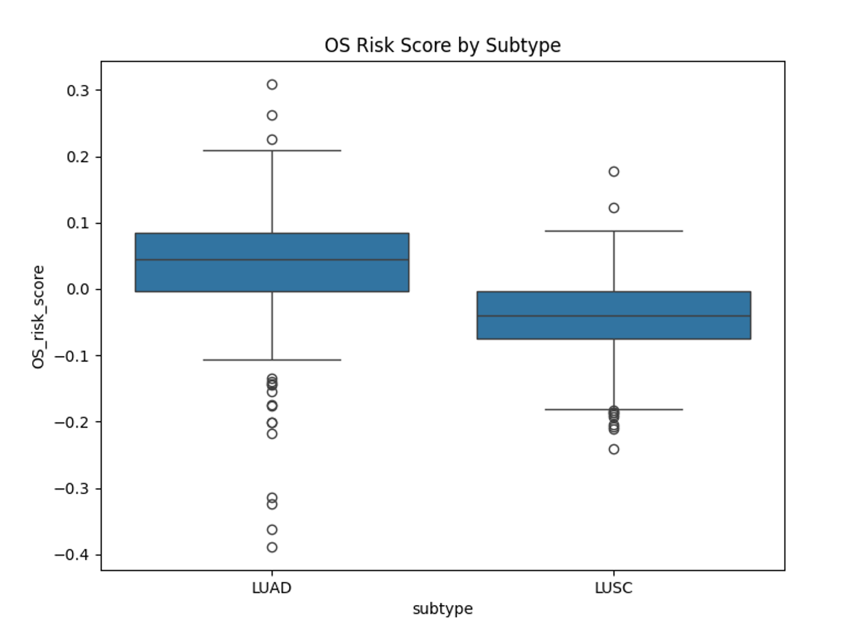
Survival Prediction :-
Box plot comparing Overall Survival (OS) Risk Scores across two cancer subtypes:LUAD and LUSC.
Y-axis :
Represents the OS Risk Score, a numerical value (possibly derived from a prognostic model or gene signature).
Scores range from -0.4 (low risk) to 0.3 (high risk), where:
Higher scores may correlate with worse overall survival (higher risk of death).
Lower/negative scores may indicate better prognosis.
X-axis:
Labels the two cancer subtypes: UAD and LUSC.

Slide 43
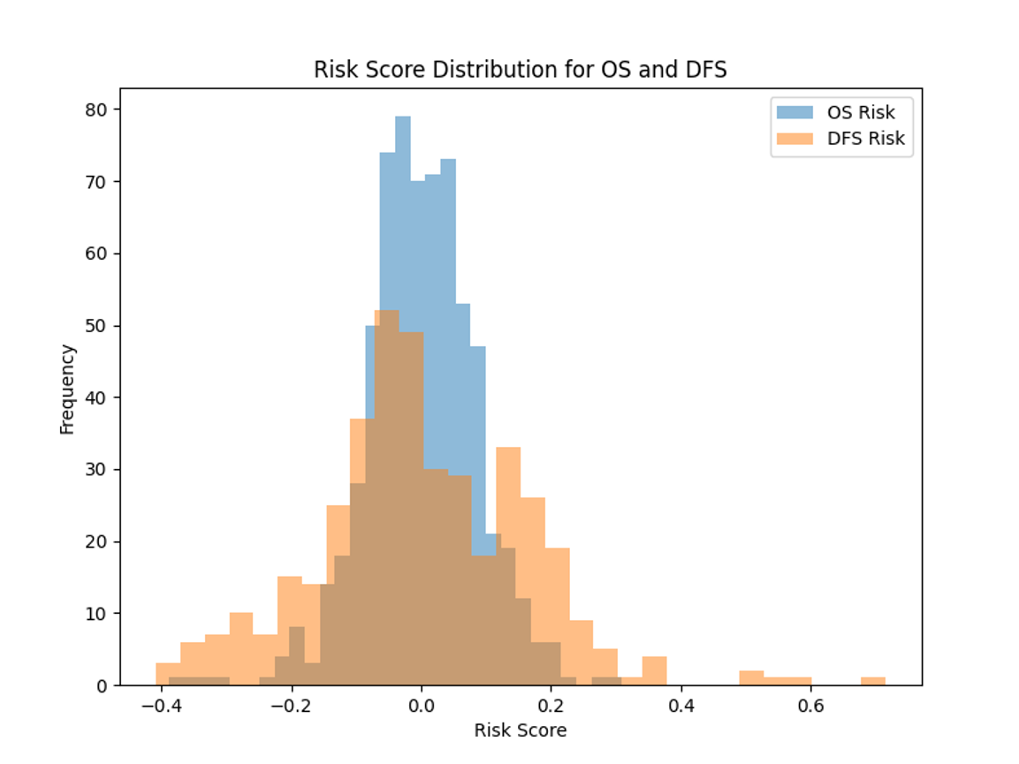
Survival Prediction :-
Risk score density plot for Overall Survival vs. Disease Free Survival
Y-axis ( "Frequency"):
Represents the number (or proportion) of patients falling into each risk score bin.
Labels suggest counts or density.
X-axis (- "Risk Score"):
Shows the risk score values, ranging from -0.6 to 0.0 (negative scores may indicate better prognosis).
Two Distributions:
OS Risk (Overall Survival): Blue curve showing risk scores predicting death.
DFS Risk (Disease-Free Survival): Red showing scores predicting recurrence/progression.

Slide 44
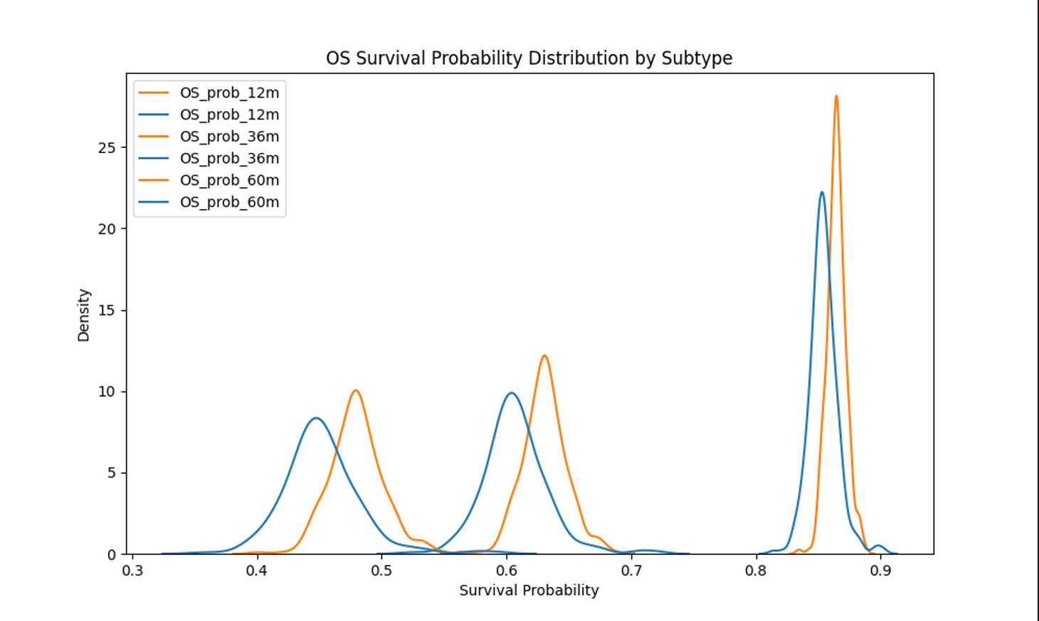
Survival Prediction :-
Overall Survival prediction in months by subtype LUAD and LUSC.
Blue: LUAD (subtype 0)
Orange: LUSC (subtype 1)
Kernel Density Estimate (KDE) curves (smoothed histograms) showing the distribution of survival probabilities for each subtype at three time points.
X-axis:
Survival Probability (ranging from 0.3 to 0.9), representing the predicted probability of surviving to 12, 36, or 60 months.
Y-axis:
Density (relative likelihood of a given survival probability occurring in each subtype).

Slide 45
Conclusion
Genes that appear in both SHAP (global) and LIME (local) with high impact—like UBE2Q2P2—are particularly promising for further study as potential biomarkers or predictive features for the classification task (LUAD vs LUSC) in RNASeq data.
Key Genes in SHAP & LIME for CAN+DNA data:
ACAP3: Cytoskeletal regulator, potential cancer progression link
ISG15: Immune response gene, upregulated in infections/cancers
MIR200A: EMT suppressor, downregulated in aggressive tumors
Consistent in global (SHAP) & local (LIME) explanations → Biologically validated targets.

Slide 46
Reference
Dwivedi K, Rajpal A, Rajpal S, Kumar V, Agarwal M, Kumar N. Enlightening the path to NSCLC biomarkers: Utilizing the power of XAI-guided deep learning. Comput Methods Programs Biomed. 2024 Jan;243:107864. doi: 10.1016/j.cmpb.2023.107864. Epub 2023 Oct 20. PMID: 37866126. Link: https://pubmed.ncbi.nlm.nih.gov/37866126/

Slide 47
Thank You

