Slide 1
Cosc 2150:
Computer Organization
Chapter 10:
Embedded Systems

Slide 2
Introduction
Embedded systems are real computer systems that support the operation of a device (or machine) that usually is not a computer.
The user of the embedded system is rarely aware of its existence within the device.
These systems are all around us. They are in watches, automobiles, coffeepots, TVs, telephones, aircraft, and just about any “intelligent” device that reacts to people or its environment.

Slide 3
Introduction
Embedded systems are different from general-purpose systems in several important ways. Some key differences are:
  Embedded systems are resource constrained. Utilization of memory and power are critical. The economy of hardware and software is often paramount, and can affect design decisions.
  Likely only have integer based ALU
    Float-point operations are done via software.
  Partitioning of hardware and software is fluid.
  Embedded systems programmers must understand every detail about the hardware.
  Signal timing and event handling are crucial.

Slide 4
Embedded Hardware Overview
Using off-the-shelf hardware, minimal hardware customization possible.
  Perhaps add memory or peripherals. The internal wiring stays the same.
The most common off-the-shelf hardware is the microcontroller.
  Microcontrollers are often derivatives of “old” PC technology. They are inexpensive because development costs were recouped long ago.
  There are thousands of different microcontrollers.

Slide 5
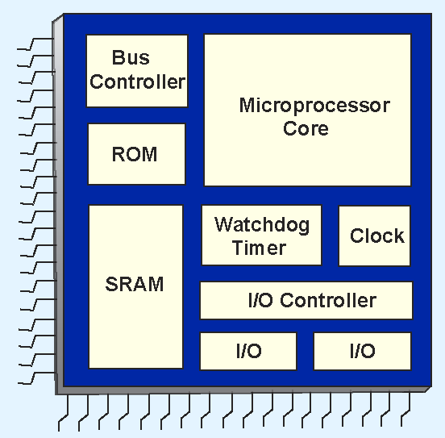
Embedded Hardware Overview
  Example microcontrollers are Motorola's 68HC12, Intel’s 8051, Microchip's 16F84A, and the PIC family.
  A simplified block diagram of a microcontroller is shown at the right.

Slide 6
Embedded Hardware Overview
  We have seen all of these components before except for the watchdog timer.
  A watchdog timer helps guard against system hangs by continually checking for liveness.
  Watchdog timers are not used in all microcontrollers.

Slide 7
Embedded Hardware Overview
For some applications, microcontrollers are too limited in their functionality.
Systems-on-a-chip (SOCs) are full blown computer systems-- including all supporting circuits-- that are etched on a single die.
  Alternatively, separate chips are needed to provide the same services.
  The additional chips are costly and consume power and space.

Slide 8
System On a Chip (SOC)
With desktops, you have CPU, RAM, graphics cards, Audio, etc, which is connected to a motherboard
In embedded devices, (phones specifically), you don’t have the space, nor is it power efficient
  The battery takes up a lot of space as well.
  Uses a processor design approach called System on a Chip (SOC)
    The processors incorporate as many functions as possible into a single package.

Slide 9
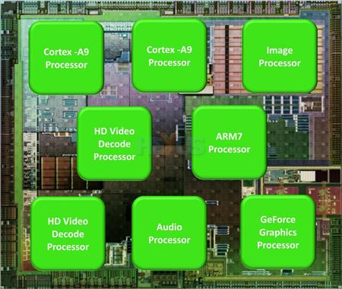
System On a Chip (SOC) (2)
Example:
  Hummingbird processor from Samsung
    Used by Galaxy phones and tablet, and basis of the Apple’s A4 processor for the Ipad and iPhone4
    An ARM Cortex A8 processor core with a PowerVR SGX 535 graphics chip.
  NVIDIA’s Tegra 2 is similar
    Paired two ARM cortex
    Processor Cores with an NVIDIA
    gpu.

Slide 10
Multi-Chip Module (MCM)
Most SOC support something called Package on Package or Muti-Chip Module (MCM).
This is a design that allows the silicon chip is packaged in a way where the memory chip can sit on top it.
  Not as fast as adding memory directly to the processor, but efficeint.

Slide 11
A note here.
Most every smartphone (and most embedded devices) use some ARM processing architecture.
But the silicon chips come from a variety of manufactures.
  The “CPU” is likely to an ARM processor
  With a graphics processor, which the manufactures decide to use.
  These silicon implementations of ARM’s designs and importantly the choice of graphics processor (and other processors) will ultimately determine how a smartphone will preform.

Slide 12
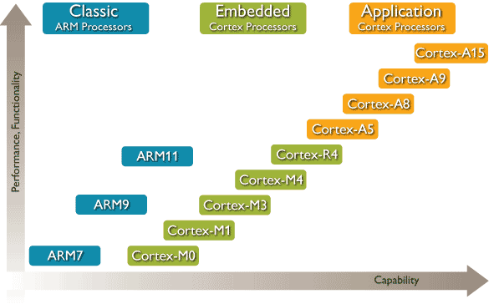
ARM processors
Leader in 32-bit embedded microprocessors
  More then 20 processors, with 20 Billion processors out there, an about 10 million shipped every day.

Slide 13
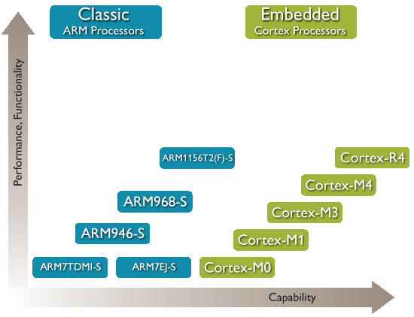
Classic and Embedded processors
Applications for this class of processors include:
  Merchant Microcontrollers
  Automotive Control Systems
  Motor Control Systems
  White Goods controllers
  Wireless and Wired
  Sensor Networks
  Mass Storage Controllers
    Hard drives HDD AND SSD
  Printers
  Network Devices

Slide 14
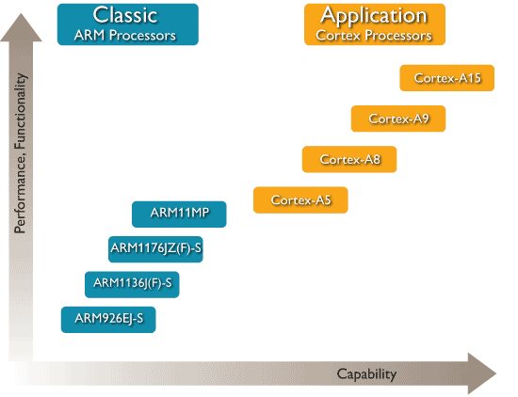
ARM Application processors
Applications for this class of processor include:
  Smartbooks* / Netbooks / eReaders
  Advanced Personal Media Players
  Set-top Boxes & Satellite Receivers
  Personal Navigation Devices
  Smartphones
  Feature Phones
  Digital Television
  High-End Printers

Slide 15
ARM Application processors (2)
Application Processors are defined by the processor's ability to execute complex operating systems, such as Linux, Android / Chrome, Microsoft Windows (CE/Embedded), and Symbian, and to enable complex graphic user interfaces.
  This class of processors integrate an Memory Management Unit (MMU) to manage the memory requirements of these complex OSs, and enable the download and execution of third party software.
Traditional single-core processors range from the base-level ARM926EJ-S™ through to the Cortex™-A9 processor
  The A9 is capable of in excess of 2GHz typical performance
Multicore processors, such as the Cortex-A9 MPCore™ processor, Cortex-A5 MPCore processor and ARM11MPCore processor
  deliver extended performance and scalability by enabling up to four cores to be implemented in a single symmetric or asymmetric system
  alongside a global interrupt handler and snoop control units.

Slide 16
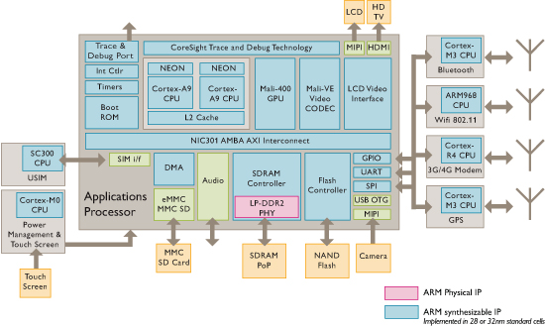
Smart phone Block Diagram
Similar design Used by HTC hero, Blackberry Bold and Curve 8830, Motorola Droid, Palm Pre, and many more.
  But use Cortex-A8 (instead A9 as listed in diagram).

Slide 17
Cortex–A8 processor
Frequency from 600MHz to 1GHz and above
  Cache 32K instrustrction and Data
    The Level 1 cache is integrated tightly into the processor with a single-cycle access time.
  The Level 2 cache is integrated into the core for ease of integration, power efficiency, and optimal performance. Built using standard compiled RAMs, the cache is configurable from 0K – 1MB.
NEON™technology for multi-media and SIMD processing
    128-bit SIMD engine enables high performance media processing. Using NEON for some Audio, Video, and Graphics workloads eases the burden of supporting more dedicated accelerators across the SoC

Slide 18
Cortex-A8 processor
Dynamic Branch Prediction | To minimize branch wrong prediction penalties, the dynamic branch predictor achieves 95% accuracy across a wide range of industry benchmarks. The Predictor is enabled by branch target and global history buffers. The replay mechanism minimizes miss-predict penalty.
Jazelle-RCT Technology | RCT Java-acceleration technology to optimize Just In Time (JIT) and Dynamic Adaptive Compilation (DAC), and reduce memory footprint by up to three times

Slide 19

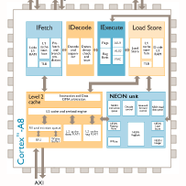
Cortex-A8 processor diagram

Slide 20
Cortex-A9 Processor
2.50 DMIPS/MHz per core
1-4 cores (Single core version also available)
Supportd
  Thumb®-2 / Thumb
  Jazelle® DBX and RCT
  DSP extenstion
  Advanced SIMD NEON™ unit (Optional)
  Floating Point Unit (Optional)

Slide 21
Cortex-A9 Processor (2)
Cortex-A9 NEON Media Processing Engine (MPE) | The Cortex-A9 MPE can be used with either of the Cortex-A9 processors and provides an engine that offers both the performance and functionality of the Cortex-A9 Floating-Point Unit plus an implementation of the NEON Advanced SIMD instruction set for further acceleration of media and signal processing functions. The MPE extends the Cortex-A9 processor’s floating-point unit (FPU) to provide a quad-MAC and additional 64-bit and 128-bit register set supporting a rich set of SIMD operations over 8, 16 and 32-bit integer and 32-bit Floating-Point data quantities every cycle.
Cortex-A9 Floating-Point Unit (FPU) | When implemented along with either of the Cortex-A9 processors, the FPU provides high-performance single, and double precision Floating-Point instructions compatible with the ARM VFPv3 architecture that is software compatible with previous generations of ARM Floating-Point coprocessor.

Slide 22
Cortex-A9 Processor (3)
Snoop Control Unit | The SCU is the central intelligence in the ARM multicore technology and is responsible for managing the interconnect, arbitration, communication, cache-2-cache and system memory transfers, cache coherence and other capabilities for all multicore technology enabled processors. The Cortex-A9 MPCore processor for the first time also exposes these capabilities to other system accelerators and non-cached DMA driven mastering peripherals so as to increase the performance and reduce the system wide power consumption by sharing access to the processor’s cache hierarchy. This system coherence also reduces the software complexity involved in otherwise maintaining software coherence within each OS driver.

Slide 23
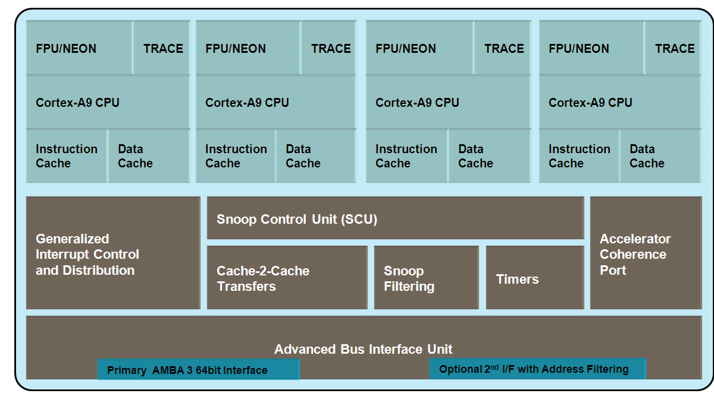
Cortex-A9 Processor diagram

Slide 24
References
Understanding Smartphone processors
  http://www.pcauthority.com.au/News/231536,understanding-smartphone-processors.aspx
ARM website
  http://www.arm.com/products/processors/index.php
    Most pictures come from here.

Slide 25
Q
A
&

