Slide 1


Toy Compiler CISC 603-Scientific Computing
Rishabh Agarwal

Slide 2
ANTLR
ANTLR is a tool that convert grammars into programs.
A grammar file for ANTRL can be identified with “.g4” extension.
Once ANTLR is installed, the grammar file is fed using “antlr4 ToyCompiler.g4”
ANTLR works by generating Java code corresponding to the grammar files that we give it.
Java8.interp, Java8Listener.java, Java8BaseListener.java, Java8Lexer.java, Java8Lexer.interp, Java8Parser.java
Java8.tokens, Java8Lexer.tokens

Slide 3
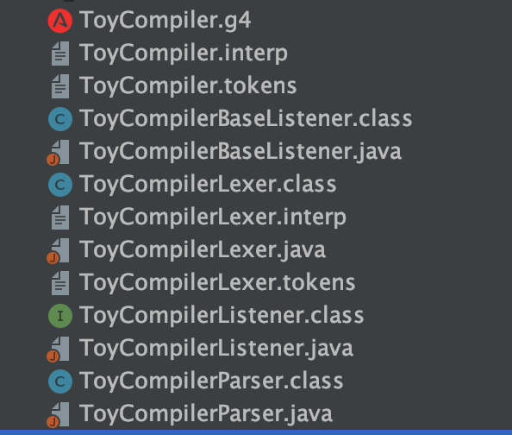
Classes generated for Toy Parser,

Slide 4
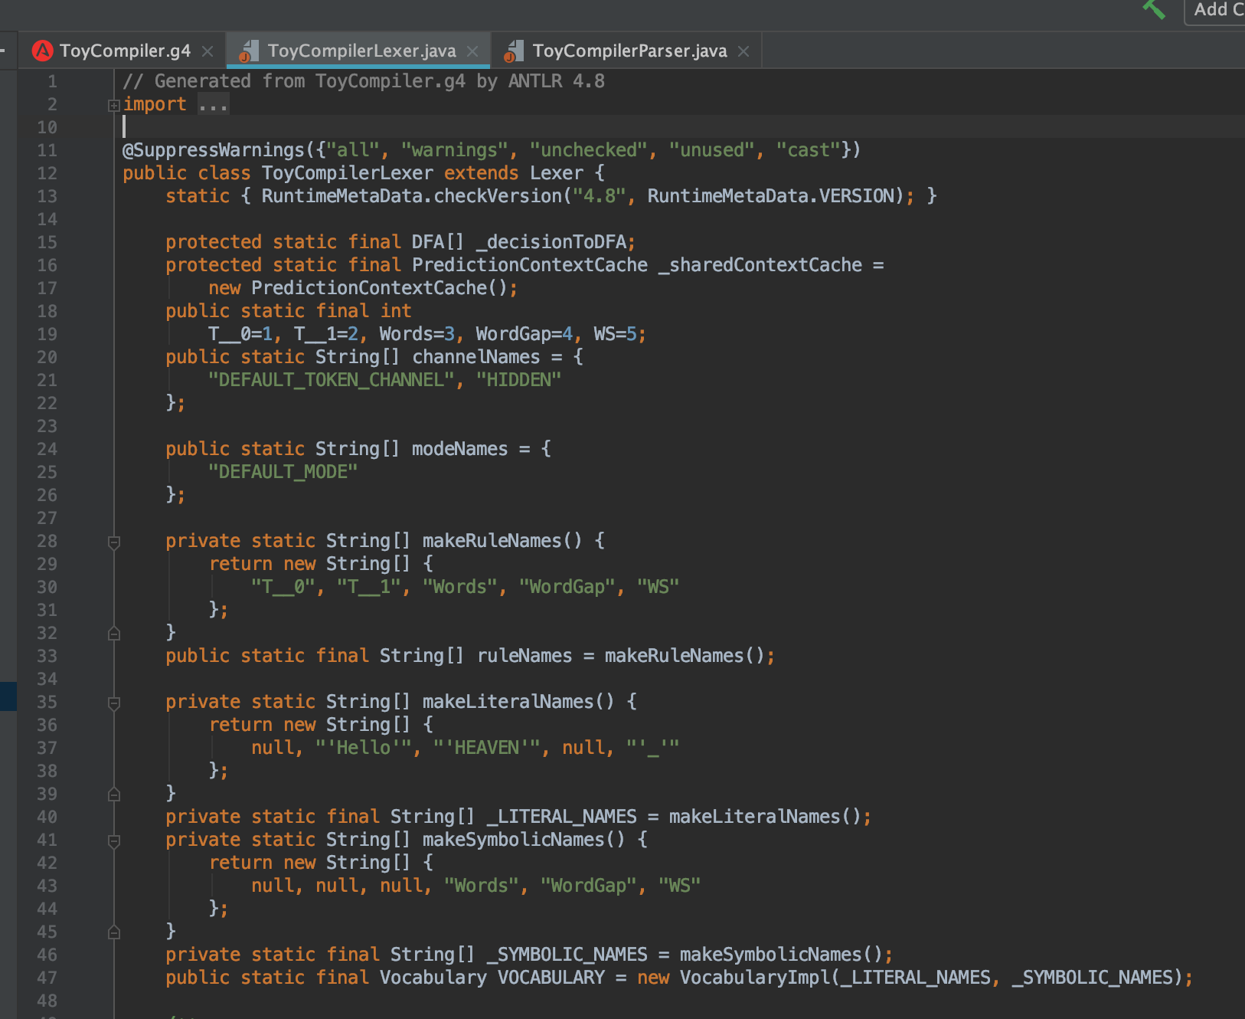
Lexical Analysis
A lexical analyzer uses a language-specific set of rules called a lexical grammar to decide which character sequences should produce which tokens

Slide 5
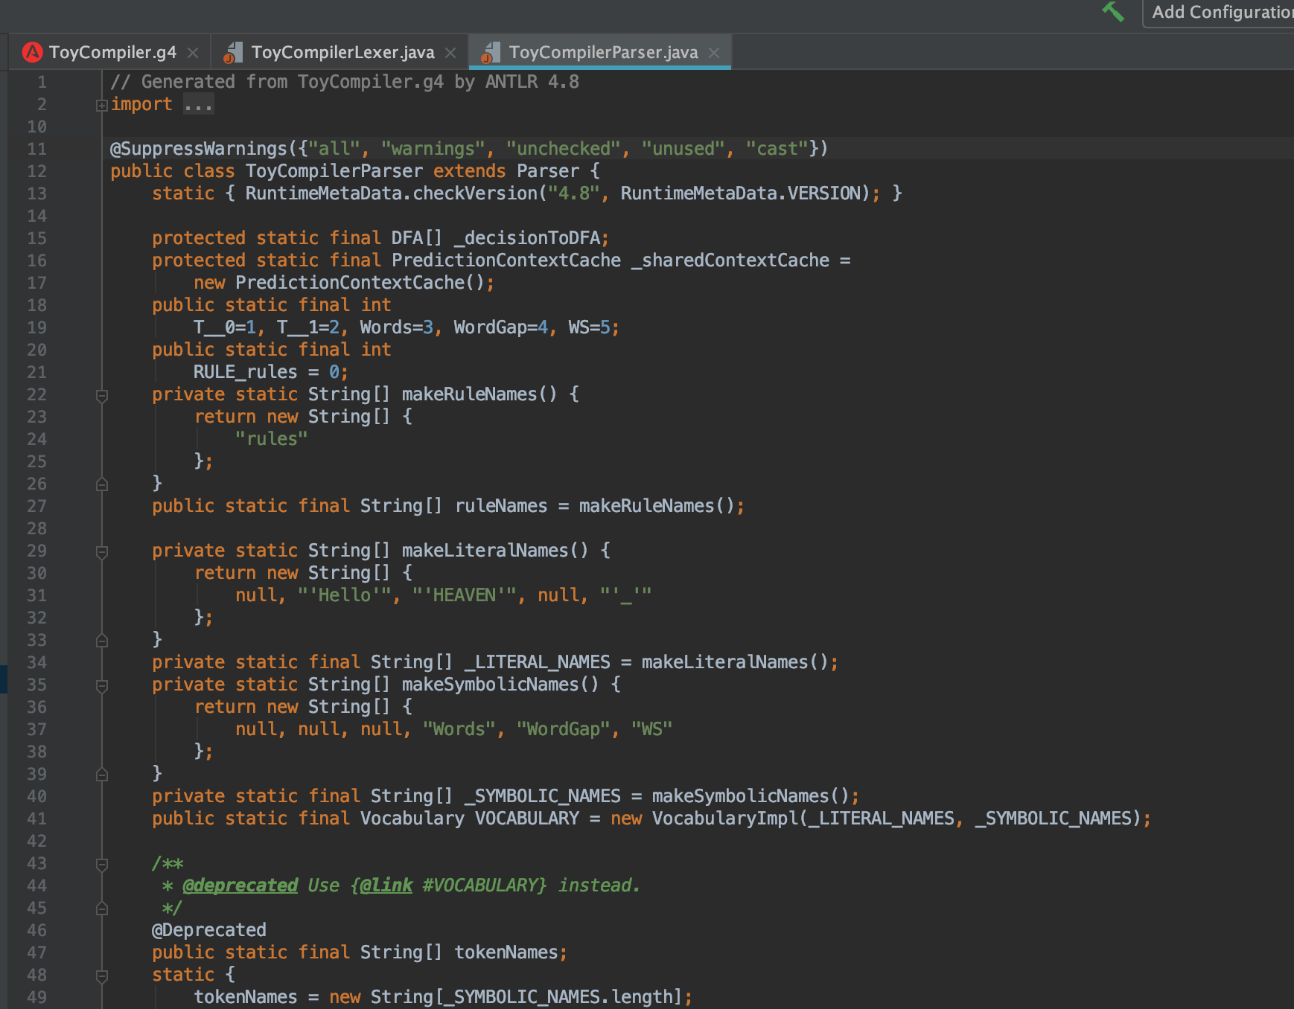
Syntactic Analysis
Read a sequence of tokens and decide whether they represent a valid program according to the syntactic grammar of the language being parsed

Slide 6
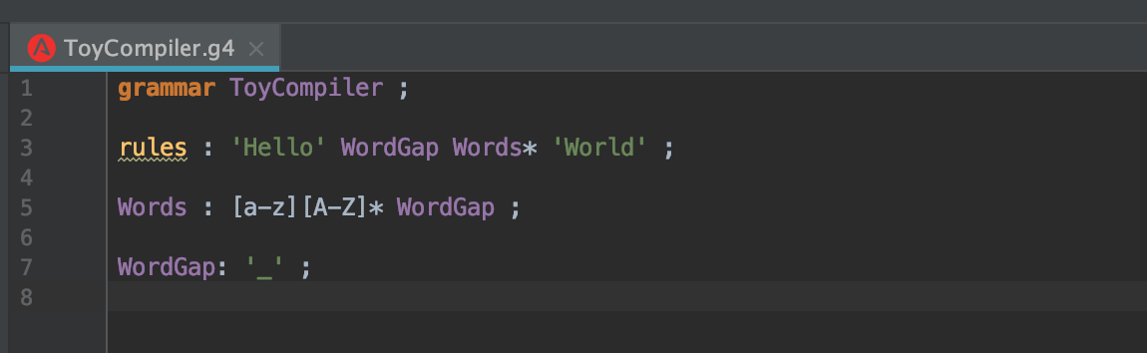
Simple CFG Design

Slide 7
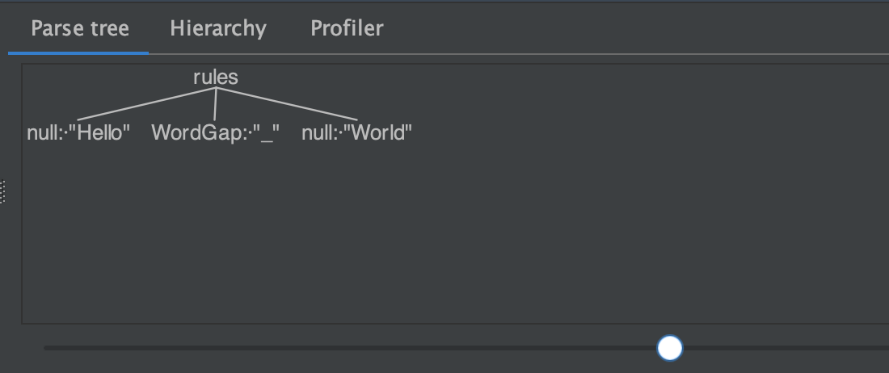
Test Cases
Hello_World

Slide 8
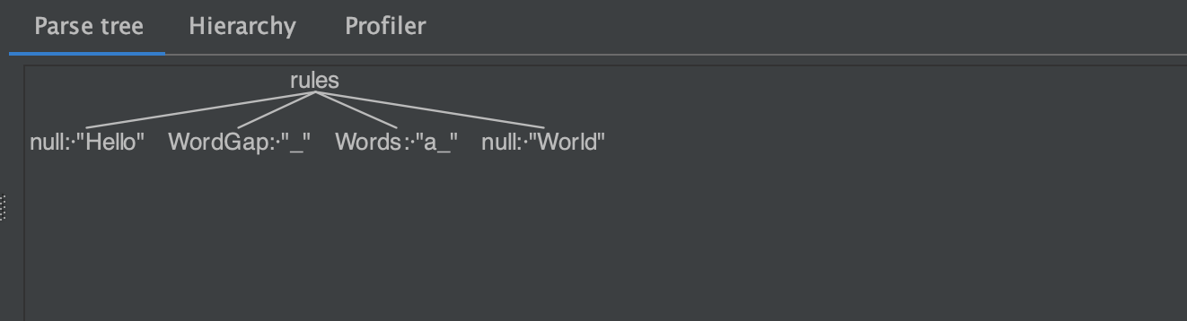
Hello_a_World

Slide 9
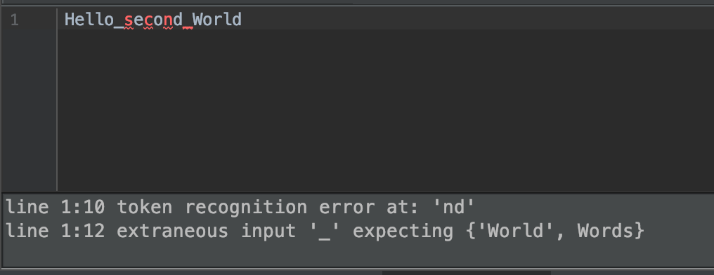
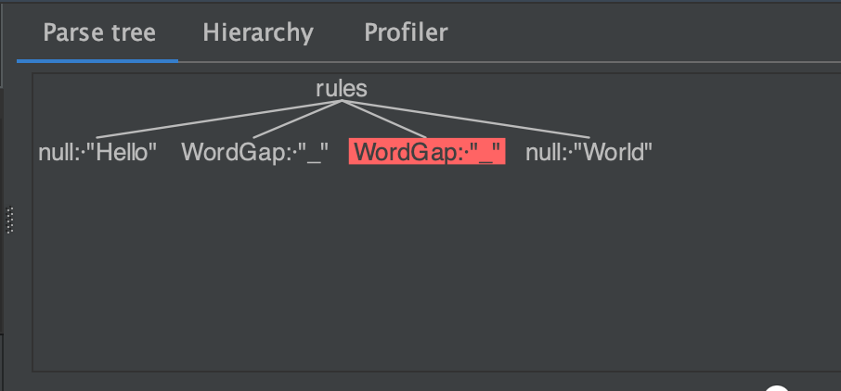
Hello_second_World

Slide 10
Thank You!

