Slide 1


Toy Compiler CISC 603-Scientific Computing
Rishabh Agarwal

Slide 2
ANTLR
ANTLR is a tool that convert grammars into programs.
A grammar file for ANTRL can be identified with “.g4” extension.
Once ANTLR is installed, the grammar file is fed using “antlr4 ToyCompiler.g4”
ANTLR works by generating Java code corresponding to the grammar files that we give it.
Java8.interp, Java8Listener.java, Java8BaseListener.java, Java8Lexer.java, Java8Lexer.interp, Java8Parser.java
Java8.tokens, Java8Lexer.tokens

Slide 3
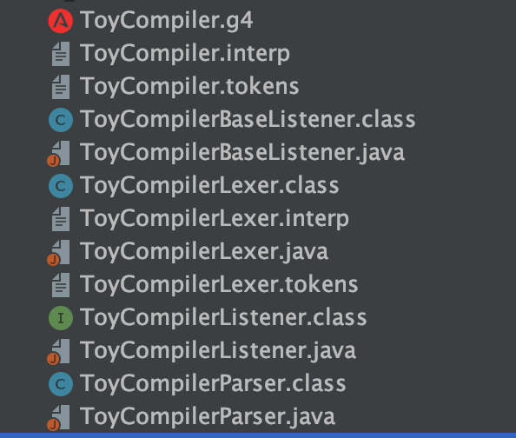
Classes generated for Toy Parser,

Slide 4
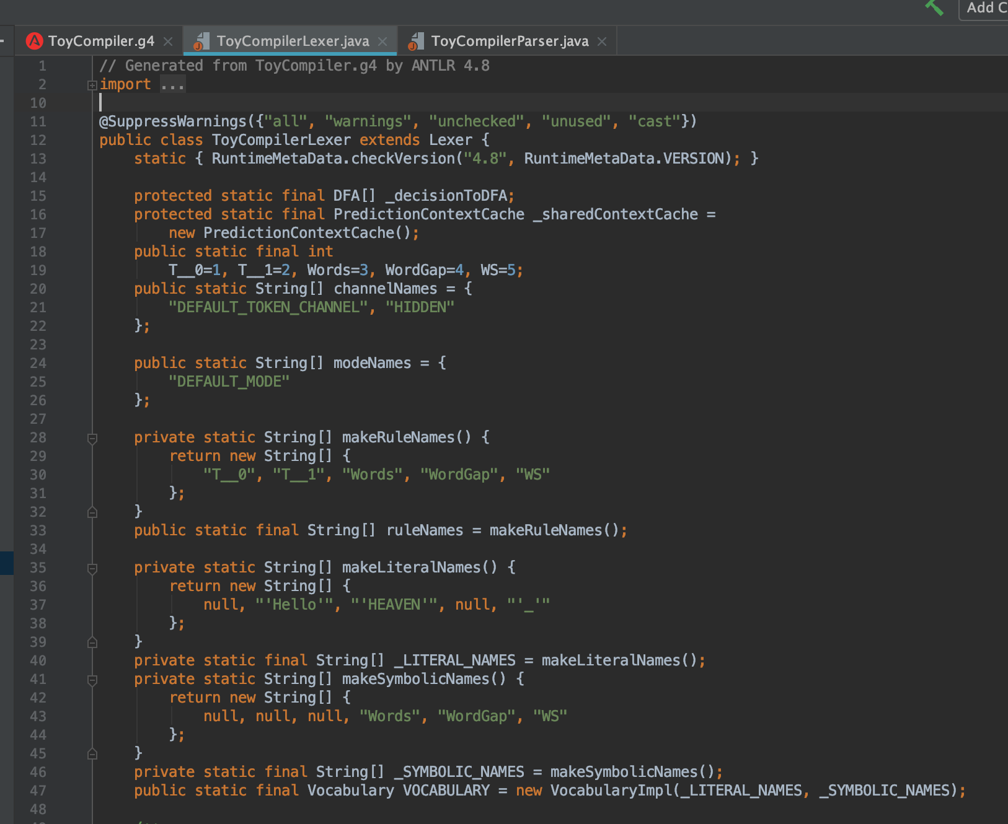
Lexical Analysis
A lexical analyzer uses a language-specific set of rules called a lexical grammar to decide which character sequences should produce which tokens

Slide 5
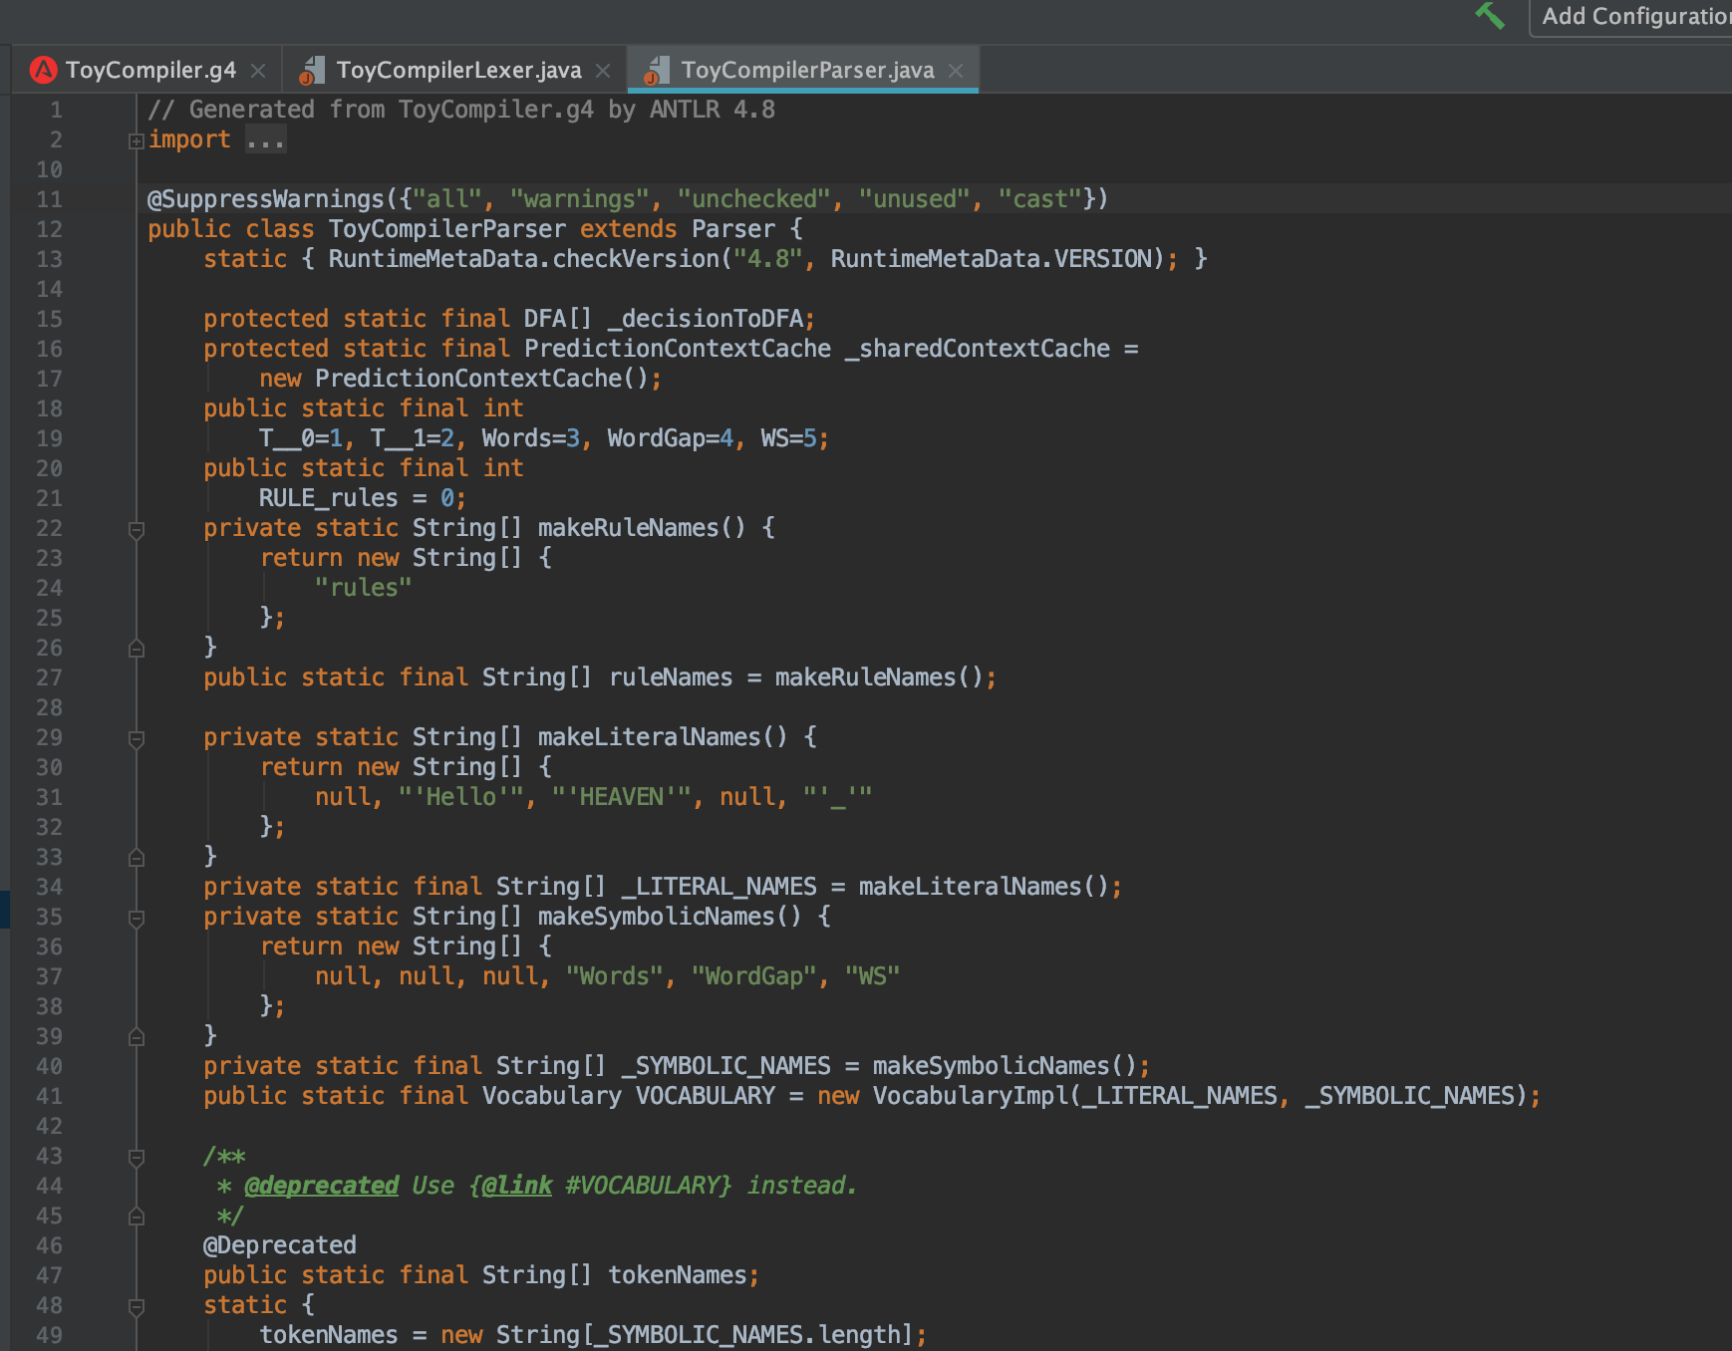
Syntactic Analysis
Read a sequence of tokens and decide whether they represent a valid program according to the syntactic grammar of the language being parsed

Slide 6
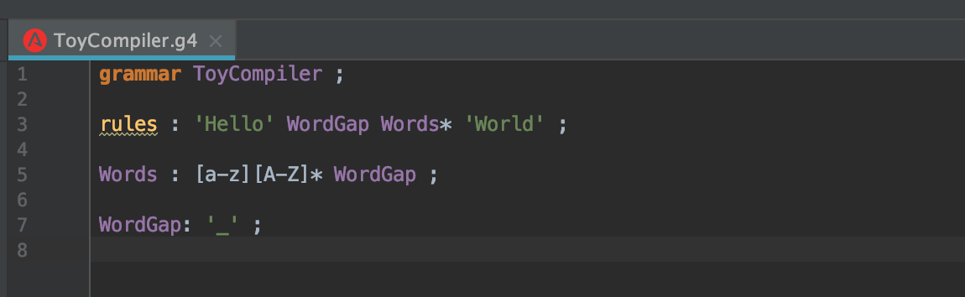
Simple CFG Design

Slide 7
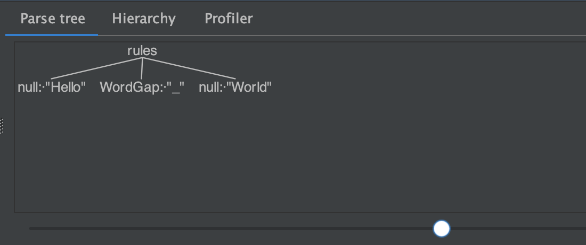
Test Cases
Hello_World

Slide 8
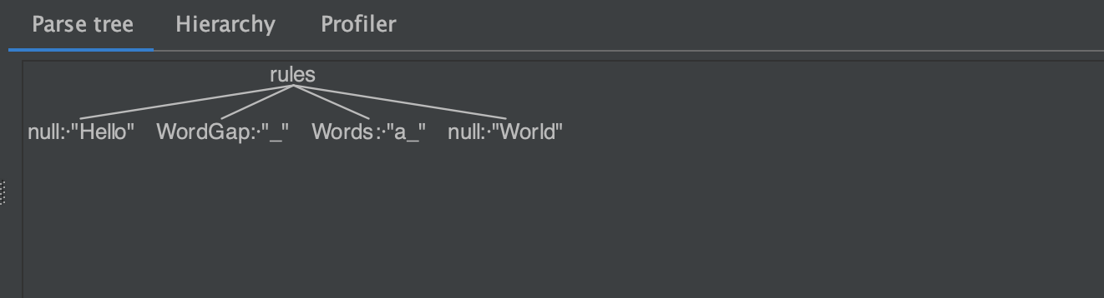
Hello_a_World

Slide 9
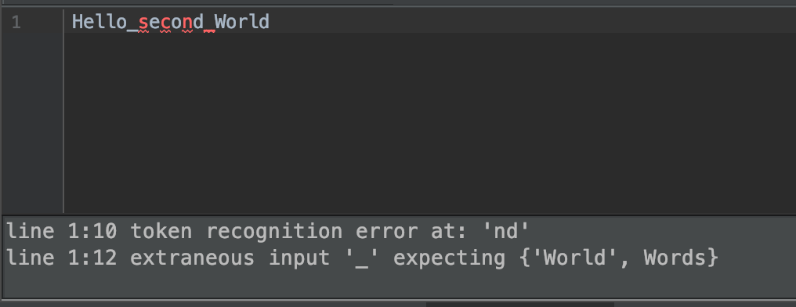
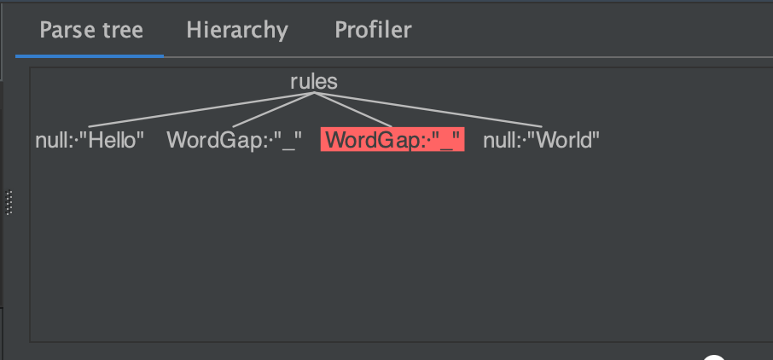
Hello_second_World

Slide 10
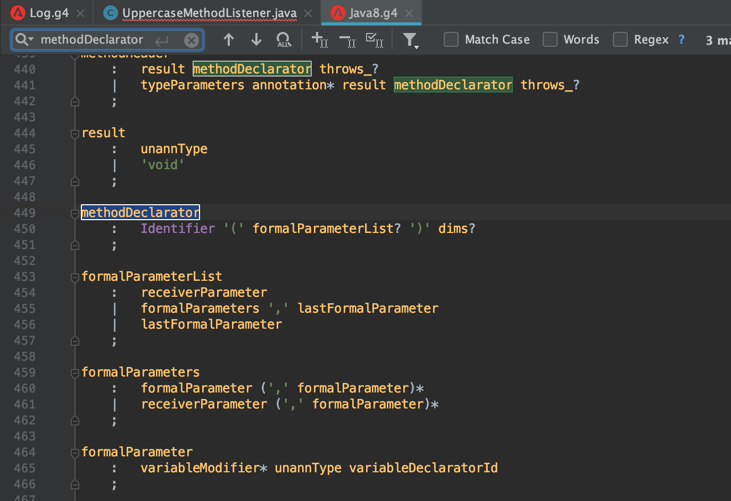
Java 8 Grammar Class
This is the grammar class from ANTRL Repository on GitHub.

Slide 11
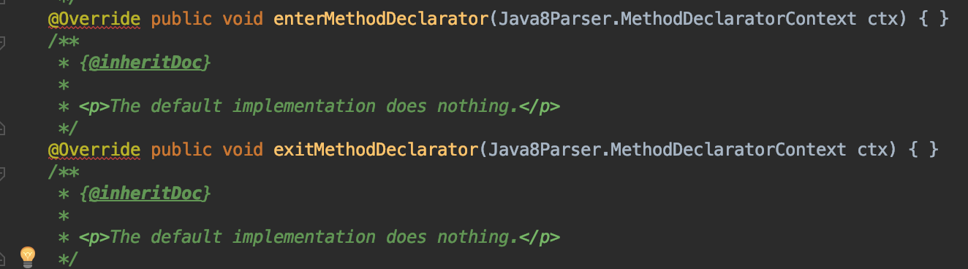
Java8BaseListener.java
This class provides an empty implementation of {@link Java8Listener}, which can be extended to create a listener which only needs to handle a subset of the available methods.

Slide 12
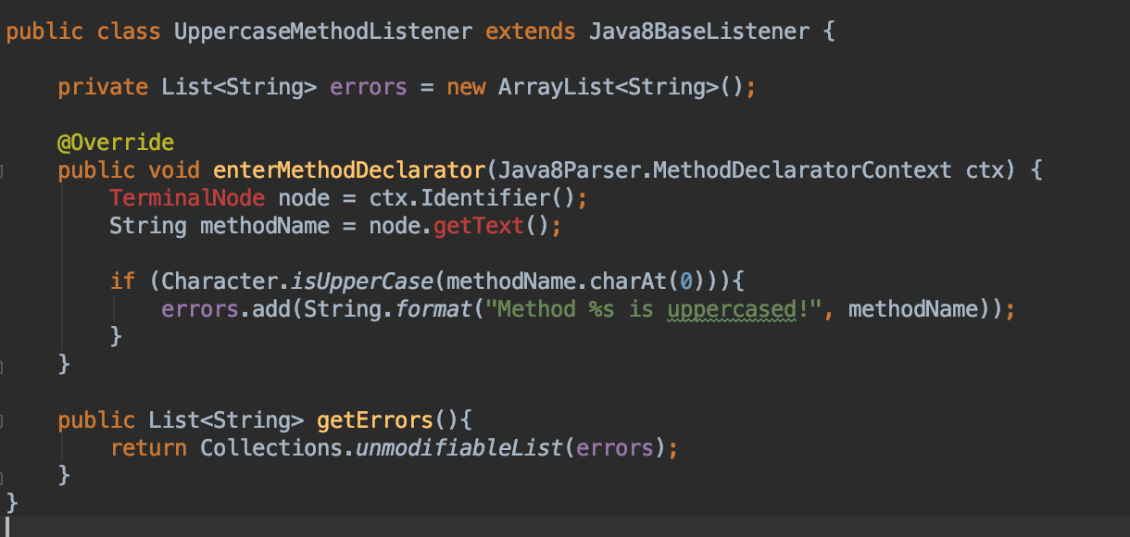
Modifying existing Grammar
Modifying the existing grammar will allow you to change the syntax as expected.

Slide 13
Testing the new grammar
First we construct the lexer String javaClassContent = "public class SampleClass { void DoSomething(){} }"; Java8Lexer java8Lexer = new Java8Lexer(CharStreams.fromString(javaClassContent));
Then, we initiate the parser CommonTokenStream tokens = new CommonTokenStream(java8Lexer); Java8Parser java8Parser = new Java8Parser(tokens); ParseTree tree = java8Parser.compilationUnit();
Lastly, we will use ANTLR to walk through our sample class
walker.walk(uppercaseMethodListener, tree); assertThat(uppercaseMethodListener.getErrors().size(), is(1)); assertThat(uppercaseMethodListener.getErrors().get(0), is("Method DoSomething is uppercased!"));

Slide 14
Result
Since we override the implementation enterMethodDeclarator "public class SampleClass { void DoSomething(){} }";
NO LONGER VALID

Slide 15
Thank You!

