Slide 1

Online Retail Data Mining
A Data-Driven Study Using Association Rule Mining, Clustering and Classification
Rishabh Bhattad & Khushi Chavan
A presentation by Group 4

Slide 2

Introduction
The Online Retail dataset from Kaggle contains thousands of customer transactions from a UK-based retailer.
Explored customer purchasing behavior using data mining techniques such as Association Rule Mining, Customer Clustering, and Predictive Classification.
Our goal was to understand what customers buy together, how they group naturally, and what factors predict high-value customers.

Slide 3
Research Question?
Association Rules → What items are commonly bought together?
Clustering → Can we group customers based on their purchasing habits?
Classification → Can we predict whether a customer is high-value or not?

Slide 4
Dataset overview
Source: Kaggle Online Retail Dataset
Time Period: 2010–2011
Original Size: 541,909 transactions
Variables include:
Invoice No., Product Code, Description
Quantity, Unit Price, Invoice Date
Customer ID, Country

Slide 5
BASIC DATA CLEANING
summary() gives min, max, median of numeric columns and counts of categories in text columns.
It also helps you spot:
Negative prices
Negative quantities
Missing Customer IDs
sum(is.na()) counts how many customer IDs are missing.

Slide 6
Data CLEANING
Filtered out:
Missing CustomerID
Negative or zero Quantity and UnitPrice
Cancelled invoices (InvoiceNo starting with “C”)
Dataset reduced to 397,884 valid transactions.
All rows now contain positive quantities and valid prices.

Slide 7
FEATURE ENGINEERING
Converted invoice dates into proper datetime format.
Extracted InvoiceYear, InvoiceMonth, and TotalPrice (Quantity × UnitPrice).
Prepared customer-level aggregated features (total spent, total qty, number of orders, average items per order, recency).
Produces customer-level dataset with 4338 unique customers.

Slide 8
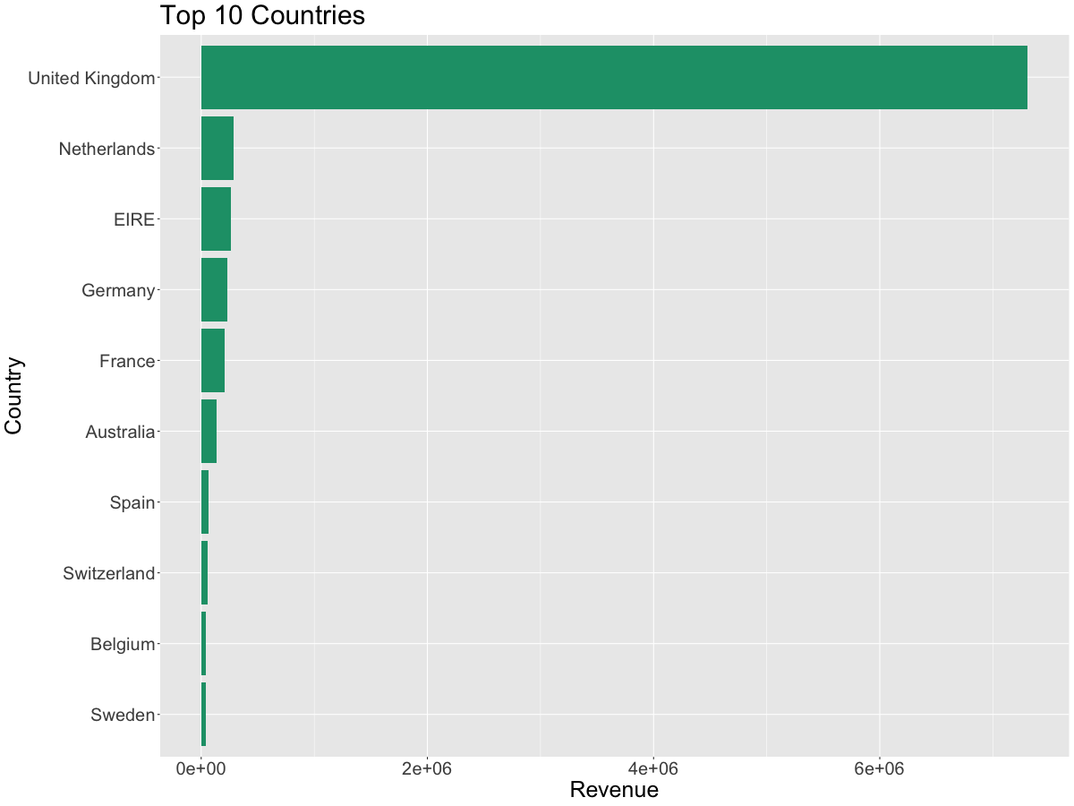
EXPLORATORY DATA ANALYSIS
Identify top countries by revenue.
Conclusion - UK was the largest contributor by a wide margin.

Slide 9
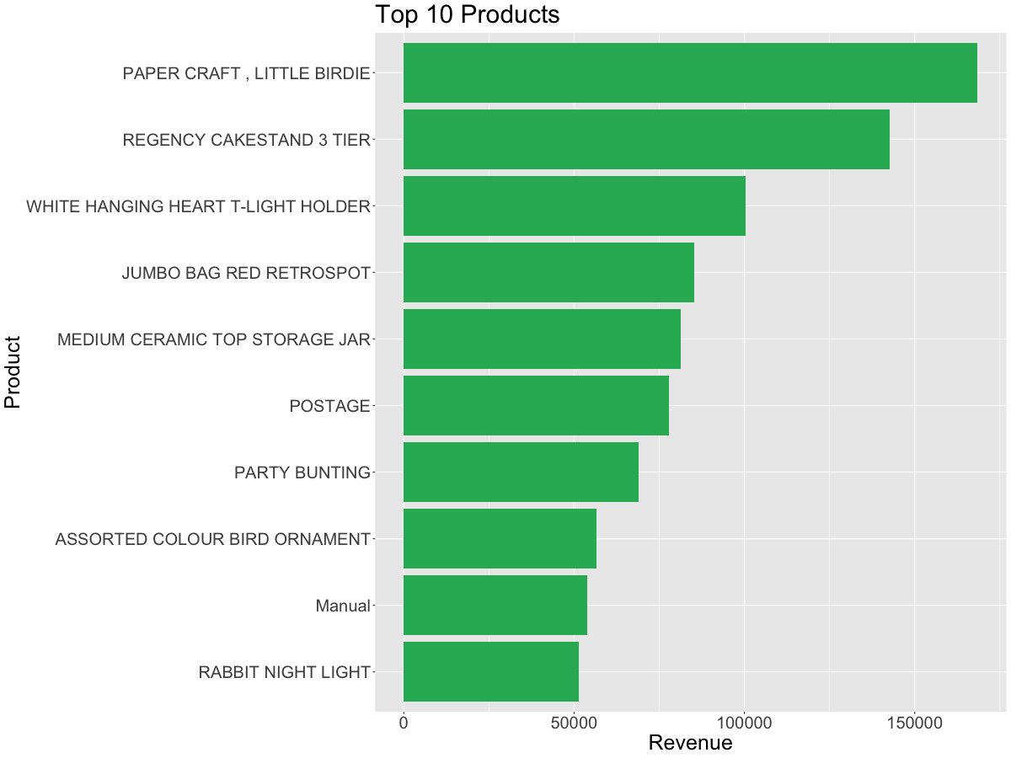
EXPLORATORY DATA ANALYSIS
Find top-selling products.
Conclusion – Products like Paper craft, T-Light holders and gift items topped the revenue charts.

Slide 10
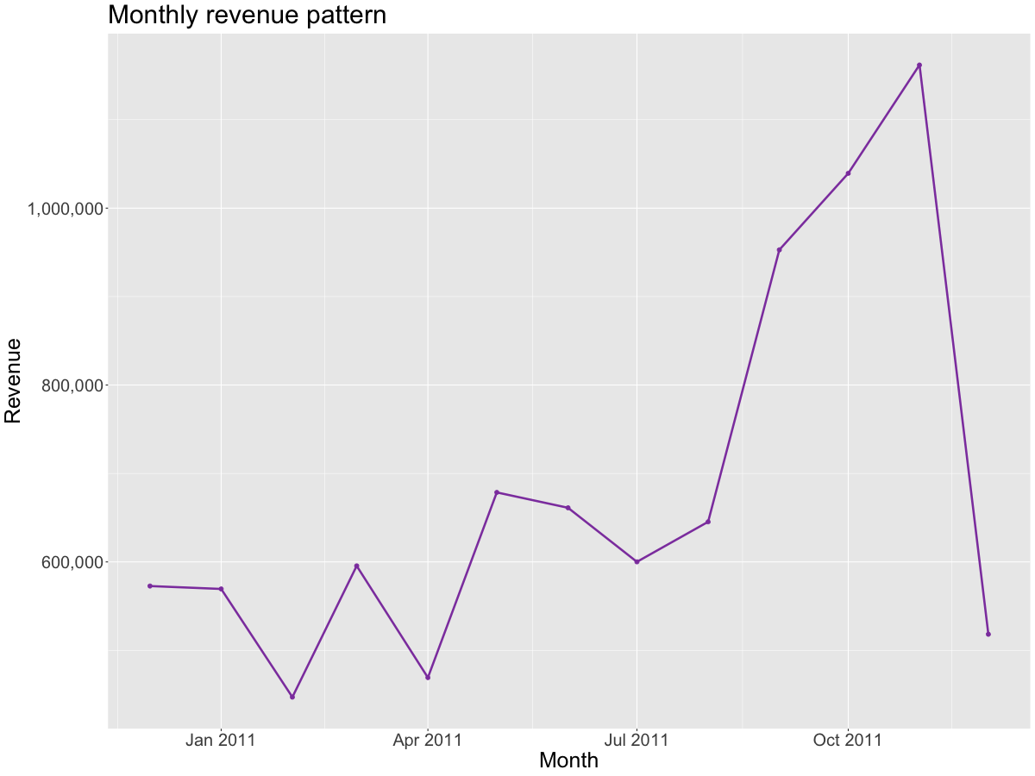
EXPLORATORY DATA ANALYSIS
Analyze monthly revenue patterns.
Conclusion – Monthly revenue shows noticeable seasonal trends.

Slide 11
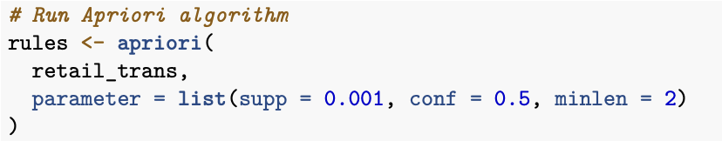
Apriori Algorithm
The Apriori algorithm finds frequent itemsets (products that appear together) and then generates association rules.
Implementation –
Filter dataset to only UK transactions to reduce noise.
Convert each invoice into basket of items.
Set parameters:
Support = 0.001 → itemset must appear in 0.1% of all baskets
Confidence = 0.5 → rule must be correct at least 50% of the time
minlen = 2 → rules must contain at least two items

Slide 12
RESULTS OF Apriori Algorithm
Generated 906,803 rules, meaning the dataset is dense with product combinations.
Top rules had extremely high lift (e.g., above 700), indicating very strong relationships.
Many rules involved similar product families (e.g., egg cosy, pantry tools, dish sets).

Slide 13
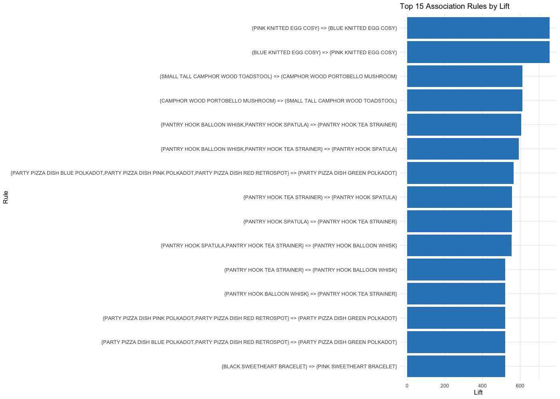
Top 15 association rules by lift

Slide 14
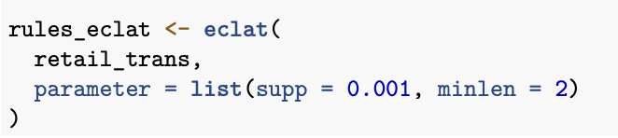
ECLAT Algorithm
ECLAT only finds frequent itemsets, not full rules (no lift / confidence).
Implementation –
Filter dataset to only UK transactions to reduce noise.
Convert each invoice into basket of items.
Set parameters:
Support = 0.001 → itemset must appear in 0.1% of all baskets
minlen = 2 → rules must contain at least two items

Slide 15
RESULTS OF ECLAT Algorithm
ECLAT produced ~323K frequent itemsets.
These itemsets showed pairs like:
Para­sol items
Tea/coffee container pairs
Wall clocks in matching themes
These make sense because customers often buy complementary designs.

Slide 16
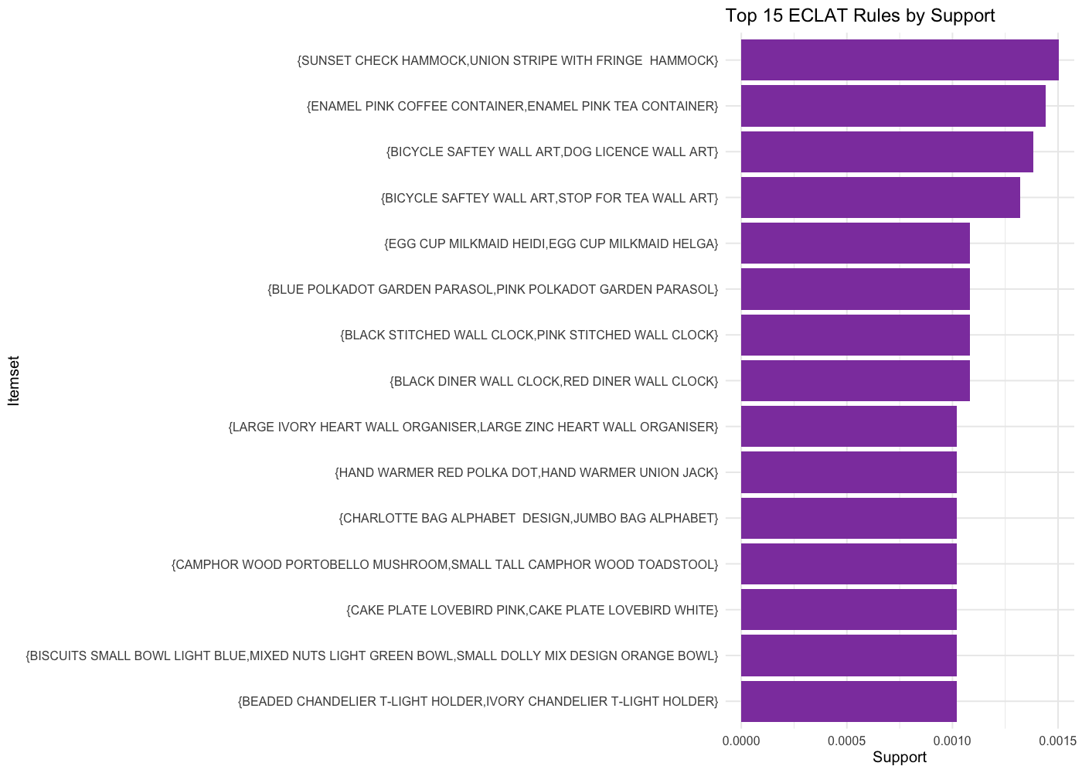
Top 15 ECLAT rules by SUPPORT

Slide 17
K-Means clustering
K-Means partitions customers into k groups by minimizing the total distance between each point and its assigned cluster center.
Distance is measured using Euclidean distance on the scaled and log-transformed features, and clusters are iteratively refined as points shift to the nearest centroid until the segments stabilize.
Implementation –
Before clustering, skewed features are log-transformed.
Then, features were scaled so all variables contribute equally.
K-Means was run with:

Slide 18
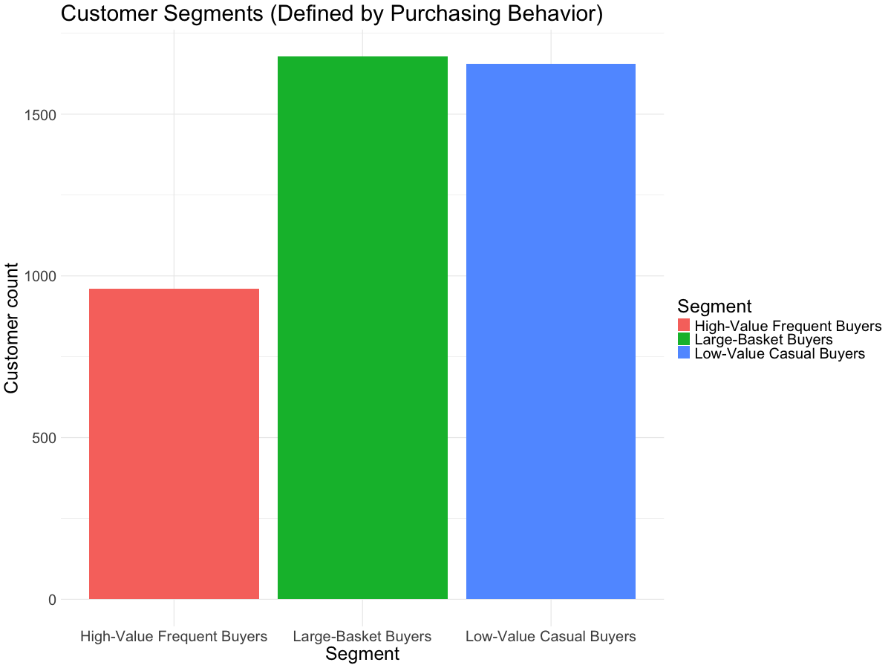
RESULTS OF K-MEANS ALGORITHM
Three customer groups appear:
High-value Frequent Buyers
Spend a lot and buy often
Low-value Casual Buyers
Rare buyers
Large Basket Buyers
Few orders but high quantities

Slide 19
CLUSTER PROFILING
After grouping customers, cluster profiling interprets what makes each cluster different.
Implementation –
Join cluster labels back to original customer metrics.
Calculate:
Average total spent
Average quantity
Number of orders
Average order value
Used facet bar charts for comparison.

Slide 20
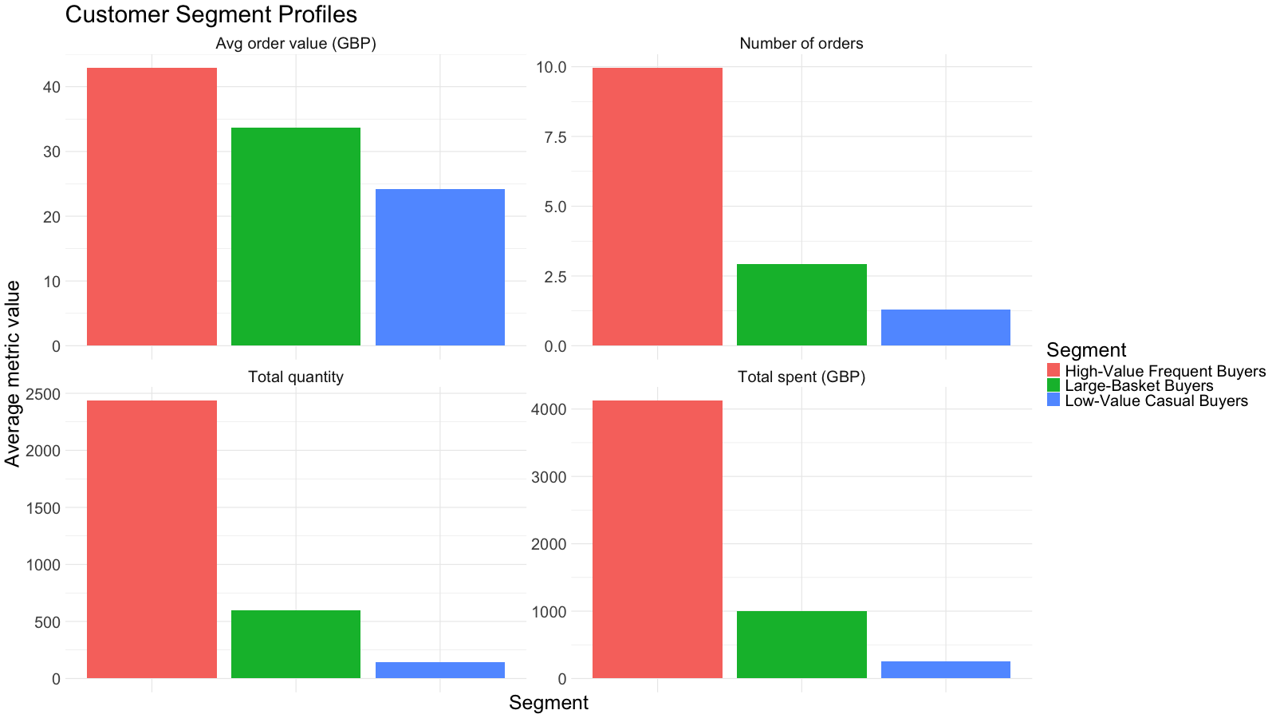
CUSTOMER SEGMENT PROFILES
High-Value buyers stand out with highest metrics
Casual buyers are minimal across all metrics
Large-Basket buyers purchase many items but not many times

Slide 21
HIERARCHICAL CLUSTERING
Hierarchical clustering builds a tree-like structure and does not require specifying k upfront.
Implementation –
Before clustering, skewed features are log-transformed.
Then, features were scaled so all variables contribute equally.
Create a distance matrix using Euclidean distance formula.
Build a hierarchical model and cut into 3 clusters.

Slide 22
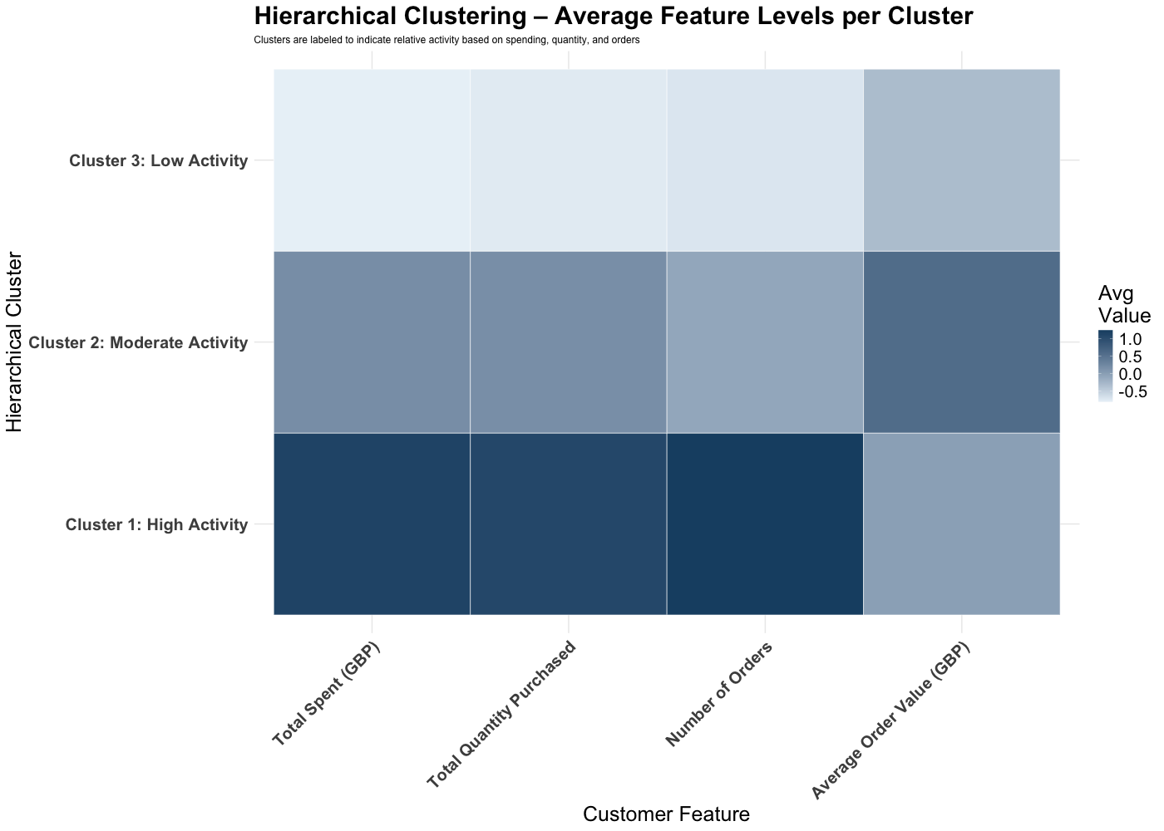
OUTPUT OF HIERARCHICAL CLUSTERING
Reinforced 3-cluster structure.
The heatmap showed:
Cluster 1: High overall activity
Cluster 2: Moderate behavior
Cluster 3: Low activity

Slide 23
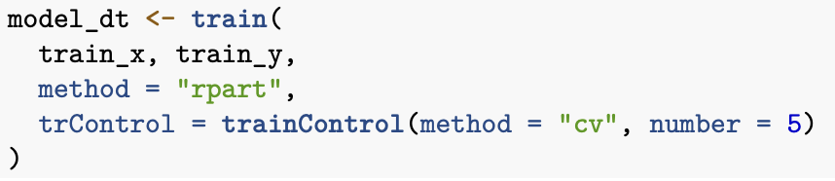
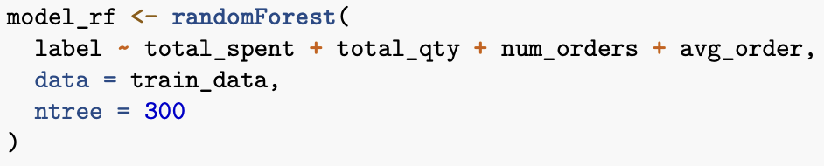
CLASSIFICATION MODELING
A binary classification problem whose goal is to predict whether a customer is High-Value or Not High-Value.
Implementation –
Label the customers and split into training and test sets.
Models Used
Decision Tree
Random Forest

Slide 24
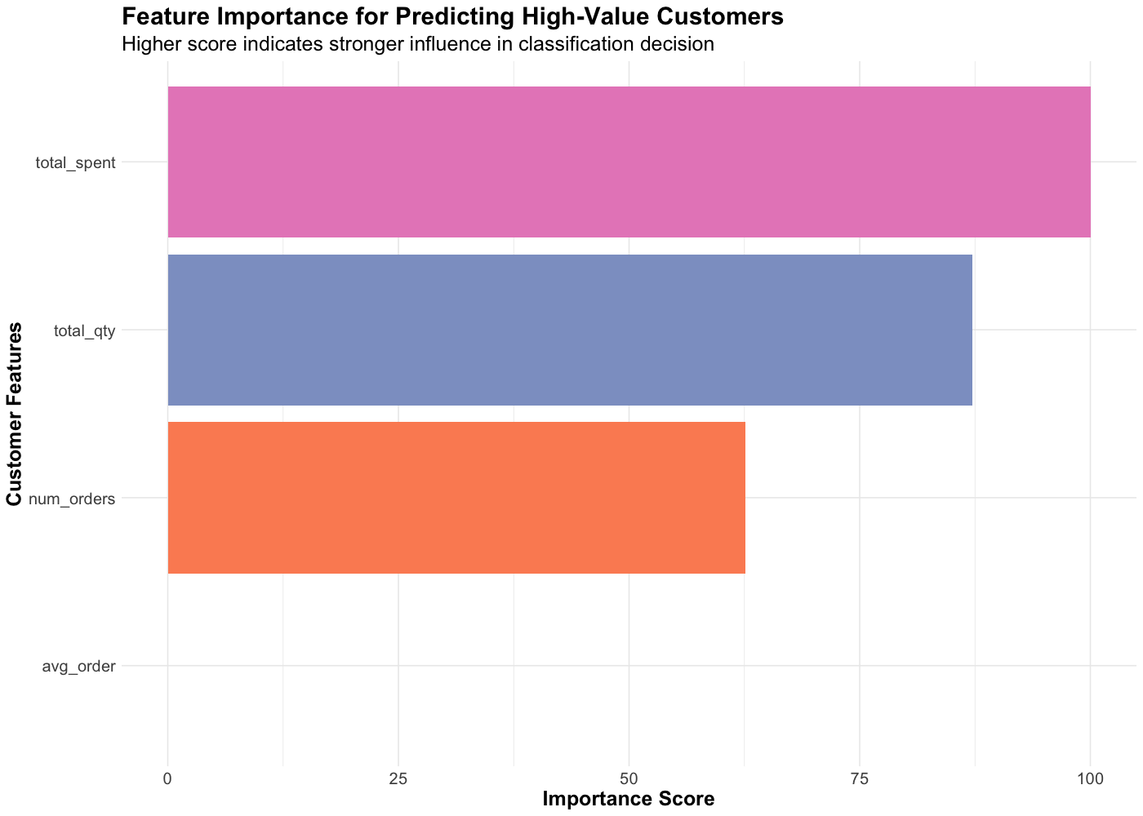
FEATURE IMPORTANCE FOR DECISION TREE

Slide 25
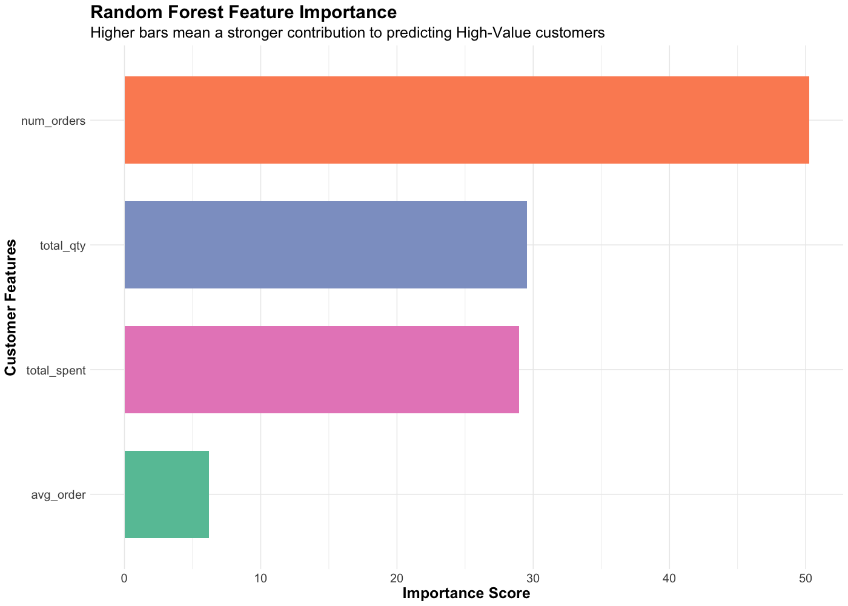
FEATURE IMPORTANCE FOR RANDOM FOREST

Slide 26
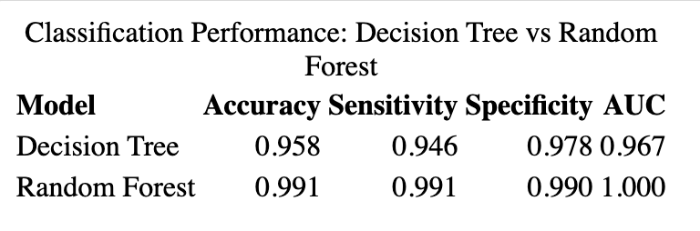
RESULTS OF CLASSIFICATION MODELING
Decision Tree Accuracy: ~94%
Random Forest Accuracy: ~99%
Feature importance for both models ranked:
Total Spent
Number of Orders
Total Quantity

Slide 27


ROC CURVE
ROC (Receiver Operating Characteristic) curve measures how well the model distinguishes between classes (High vs Not High).
AUC (Area Under Curve) indicates:
1.0 = perfect classifier
0.5 = random guessing
Implementation –
Predict probabilities for High Class.
Generate ROC objects for both Decision tree and Random Forest.
Plot both curves on one chart.

Slide 28
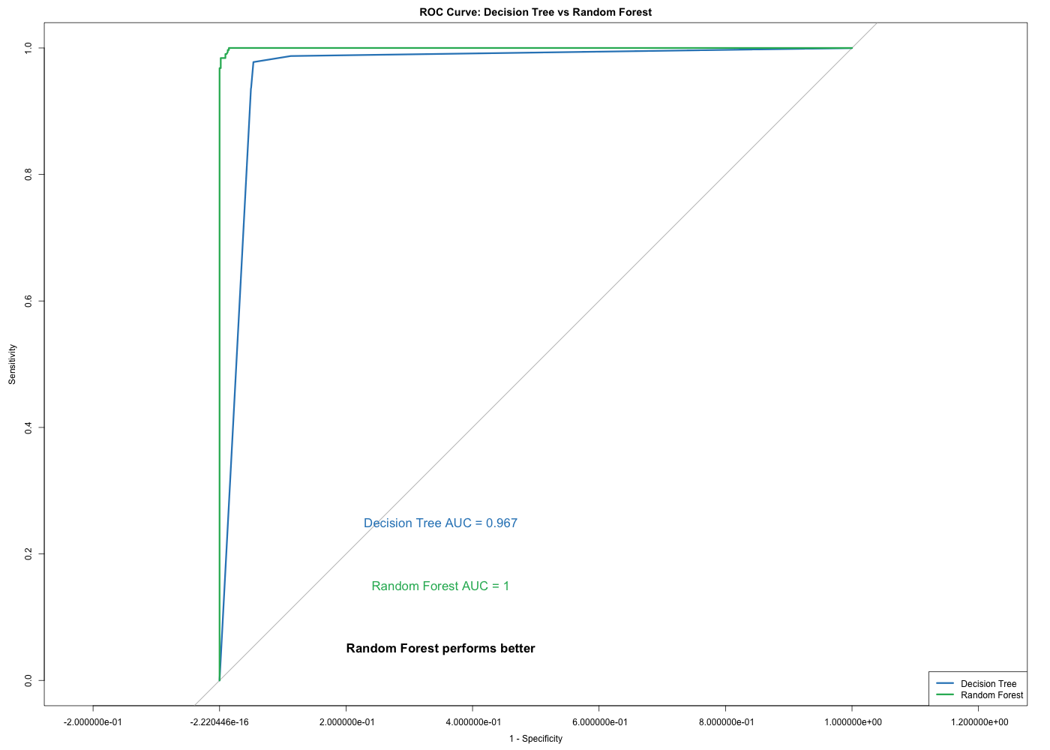
RESULTS OF ROC CURVE
Random Forest curve hugs the top-left, which is excellent
Decision Tree curve is lower, which is good but not perfect
Random Forest (AUC = 1) consistently stayed above the Decision Tree (AUC = 0.96) curve,
showing exceptional classification performance.

Slide 29
FINAL CONCLUSION
Association rules revealed meaningful product pairings based on lift.
Clustering created three clear customer segments:
High-Value Frequent Buyers
Low-Value Casual Buyers
Large-Basket Buyers
Classification identified key drivers of high-value customers:
Decision Tree: total_spent, num_orders strongest predictors
Random Forest achieved higher AUC and accuracy
ROC analysis shows Random Forest outperforms Decision Tree consistently.

Slide 30

THANK YOU

