Slide 1

YESHWANTRAO CHAVAN COLLEGE OF ENGINEERING
Department of Computer Science and Engineering
Speak2Summarize : Daily Task Recap
Group No : 28
Team Members :
Hemanshu Waghmare
Rishabh Jain
Dhruv Dalvi
Sanket Asole
Yuvraj Chavan
Guided By:
Prof. Chanchla Tripathi
Department of Computer Science and Engineering

Slide 2
PROBLEM STATEMENT
Many people find it challenging to remember daily tasks and important details, leading to decreased productivity, missed responsibilities, and heightened stress. An effective solution is crucial for improving task management and memory recall.

Slide 3
ABSTRACT
In today's information-rich environment, finding relevant content quickly can be challenging. Automatic document summarization, using natural language processing, helps extract key information from extensive texts. Text summarization techniques, whether extraction-based or abstraction-based, aim to condense lengthy content into concise summaries. We present a method that takes audio as an input and generates a written or text summary of the same as an output. created the text summary using text summarizing methods. Our product, Speak2Summarize, addresses this common challenge by providing users with clear and concise text summaries of their interactions and daily meetings with given timestamps.

Slide 4
OBJECTIVES
1) Memory recall and Optimized task management.
2) Provide concise text summaries of their Daily interactions and meetings with given timestamps.

Slide 5
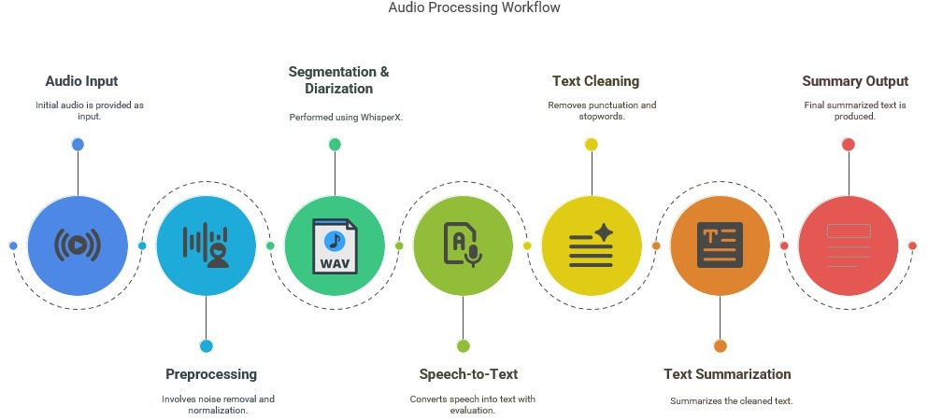
METHEDOLOGY

Slide 6
METHEDOLOGY
Module 1: Audio Data Preprocessing
Collect and preprocess the dataset.
Classification of speakers using speech diarization.
Segmentation of the data.
Module 2: Speech to Text (STT)
Implement STT model for the dataset (whisperX).
Test the accuracy using WER(word error rate), CER(character error rate).

Slide 7
METHEDOLOGY
Module 3: Text Preparation for Summarization
Prepare and tokenize the text data.
Remove punctuation.
Perform necessary data cleaning and formatting.
Module 4: Text Summarization
Compile the cleaned data using RNN/transformer layers.
Test and validate the summarization results.
Module 5: Hardware Implementation
A device consisting of microphone and memory card for recording.

Slide 8
Work Carried Out

Slide 9
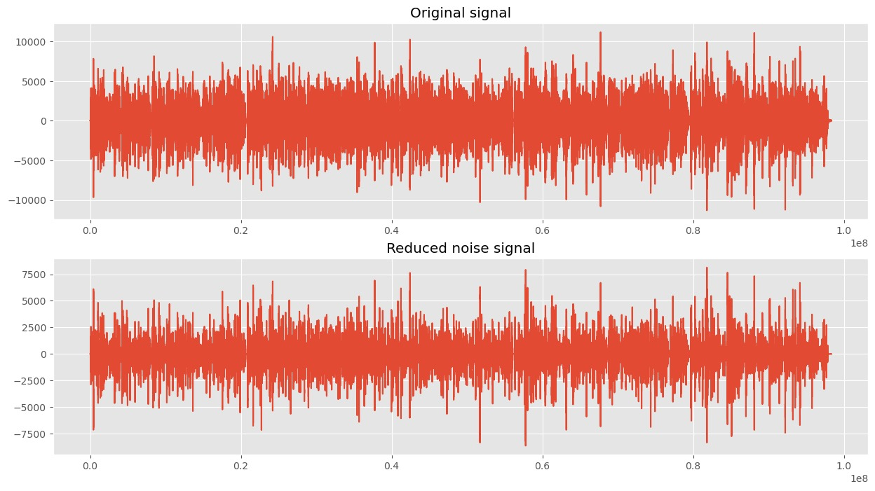
M1 - Noise Reduction

Slide 10
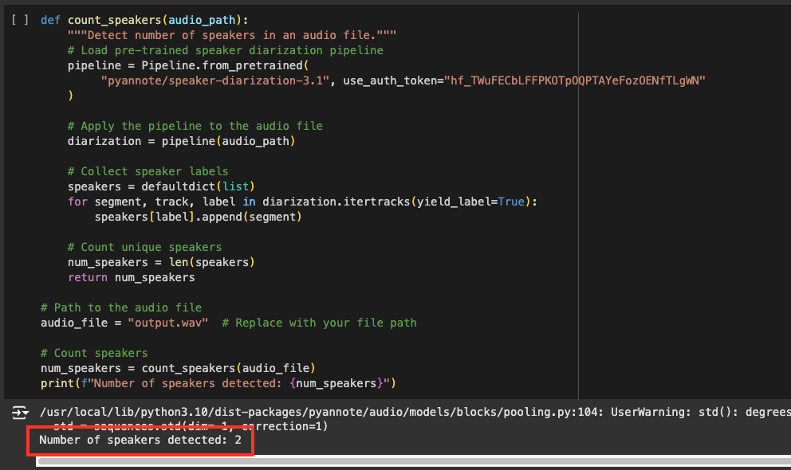
M1 - Speaker Diarization
.

Slide 11
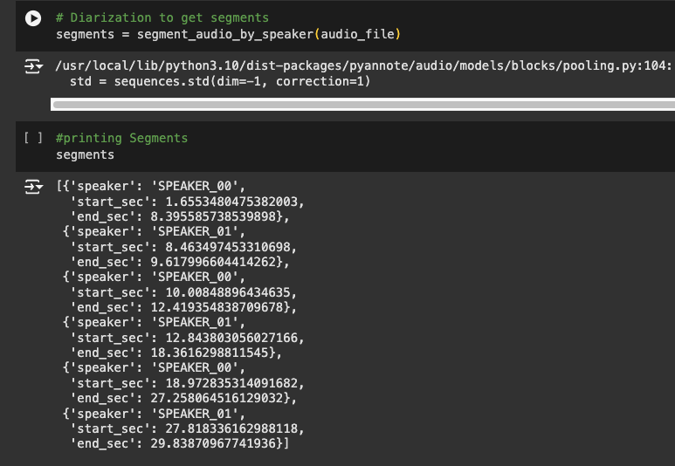
M1 - Identifying time period for each speaker

Slide 12
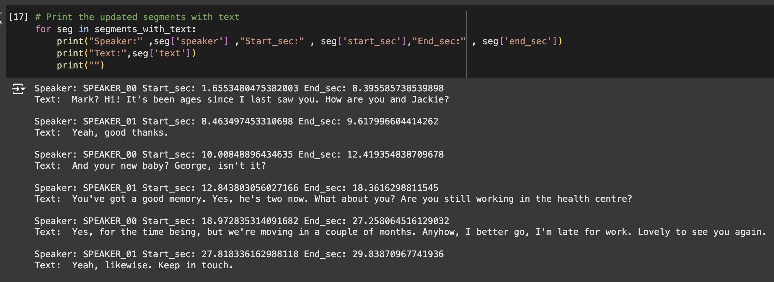
M1 - Transcribing

Slide 13
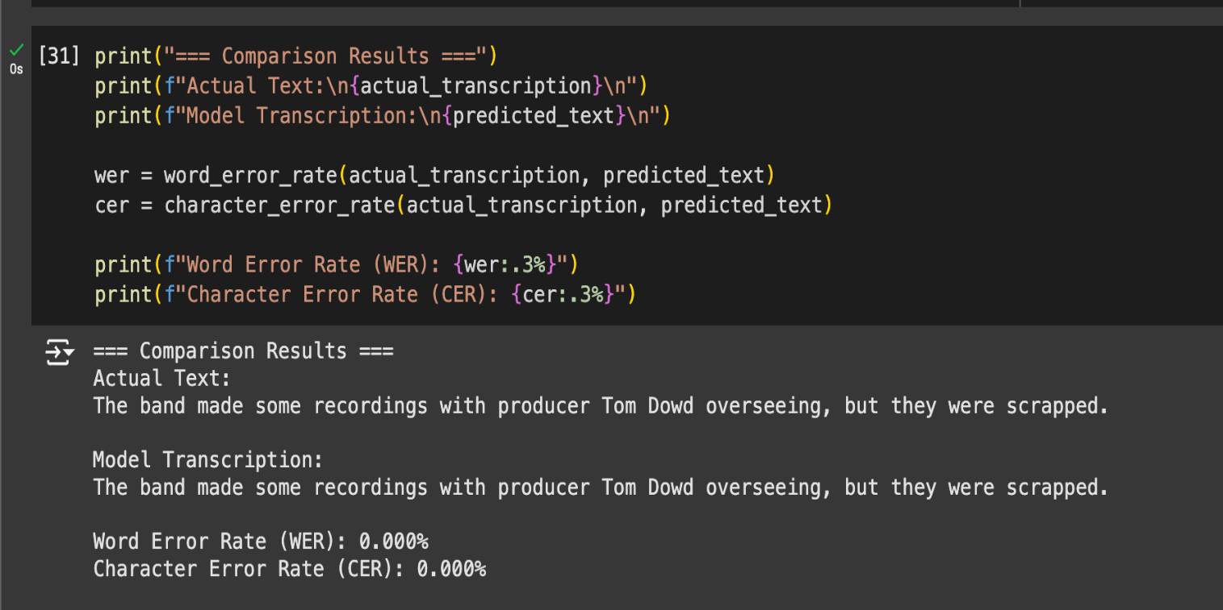
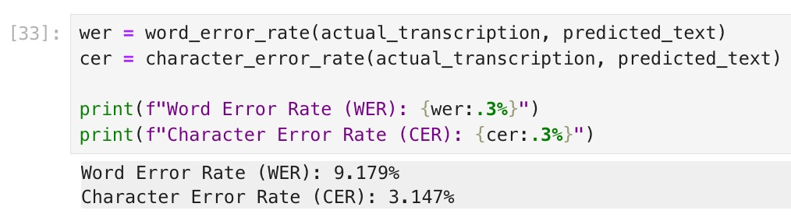
M2 - Accuracy Measurement

Slide 14
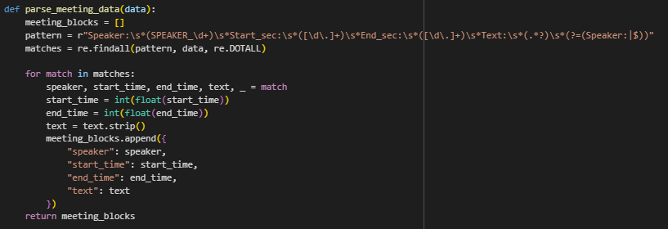
M3 - Structuring Input

Slide 15
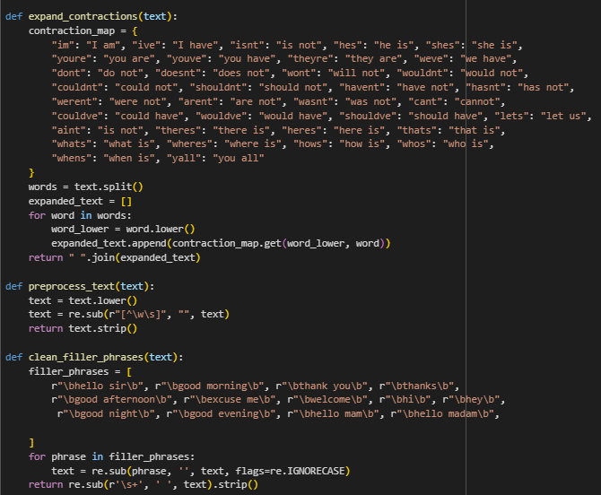
M3 - Preprocessing

Slide 16
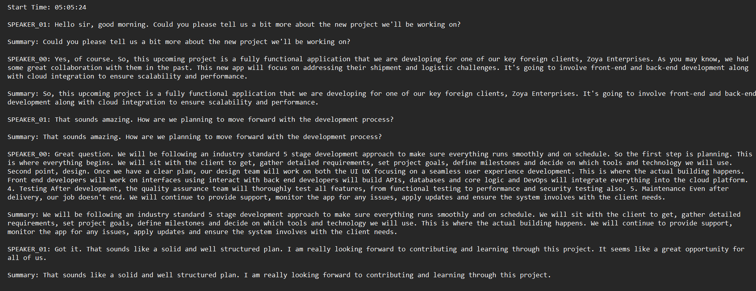
M4 - Summary Output

Slide 17
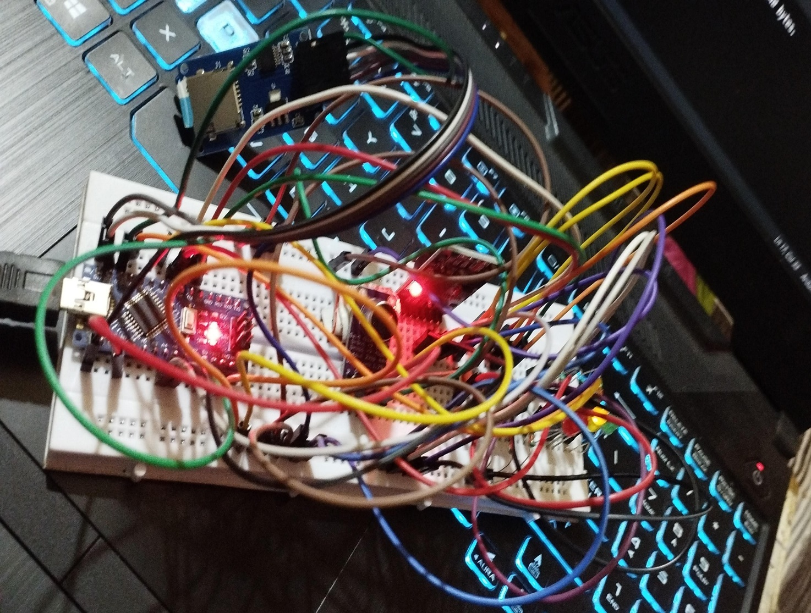
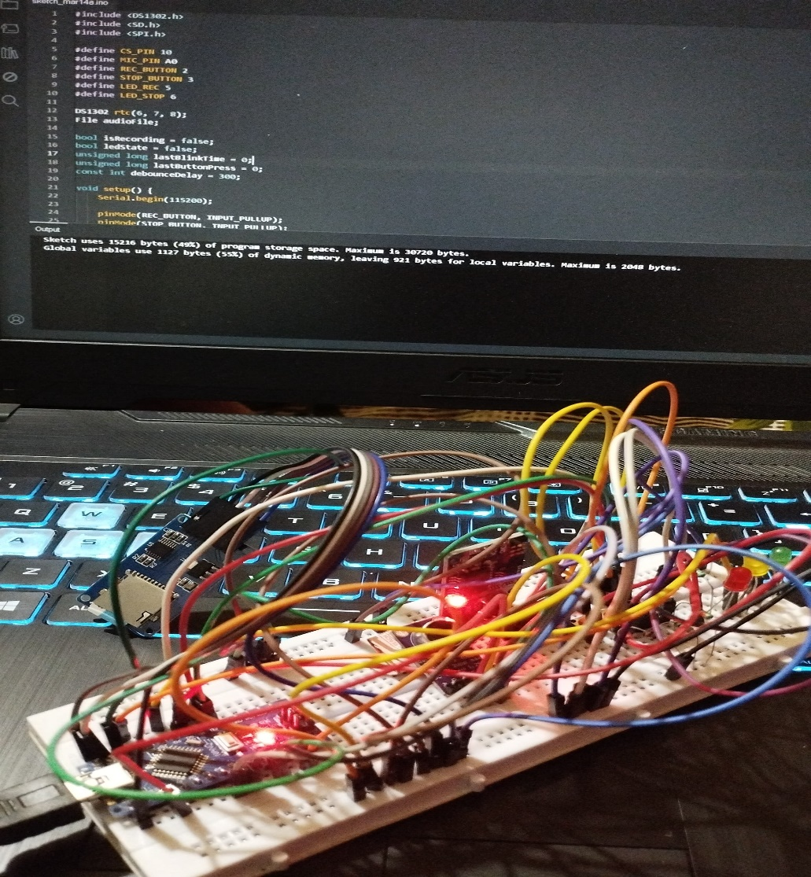
M5 - Hardware Implementation

Slide 18
CONCLUSION
This project successfully processes and summarizes audio data through five key modules:
Module 1: Preprocessed audio using segmentation and speaker classification via speech diarization.
Module 2: Converted audio to text using a Speech-to-Text model, evaluated by WER and CER.
Module 3: Cleaned and prepared text via tokenization, punctuation removal, and formatting.
Module 4: Generated concise summaries from processed text using NLP techniques.
Module 5: Complete hardware implementation with Arduino successfully programmed.

Slide 19
Thank You!

