Slide 1
Sales Dashboard
Interactive Retail Performance Analytics
2014-2017 Analysis

Slide 2
Executive Overview
Analyzes 9,995+ sales transactions (2014-2017)
Interactive dashboards for sales, profit, and year-over-year analysis
Dynamic filtering by year enables trend identification
Integrates sales, manager, and return data for complete visibility
Business Value: Transform raw transaction data into actionable insights for regional and category-level decision making.

Slide 3
Sales Analysis Dashboard
Regional Performance Breakdown: Sales by region with segment drill-down capability
Identify high-performing and underperforming regions
Track sales velocity by product category
Segment Analysis: Consumer, Corporate, and Home Office performance comparison
Category preferences by customer segment
Category Deep-Dive: Top and bottom performing product categories

Slide 4
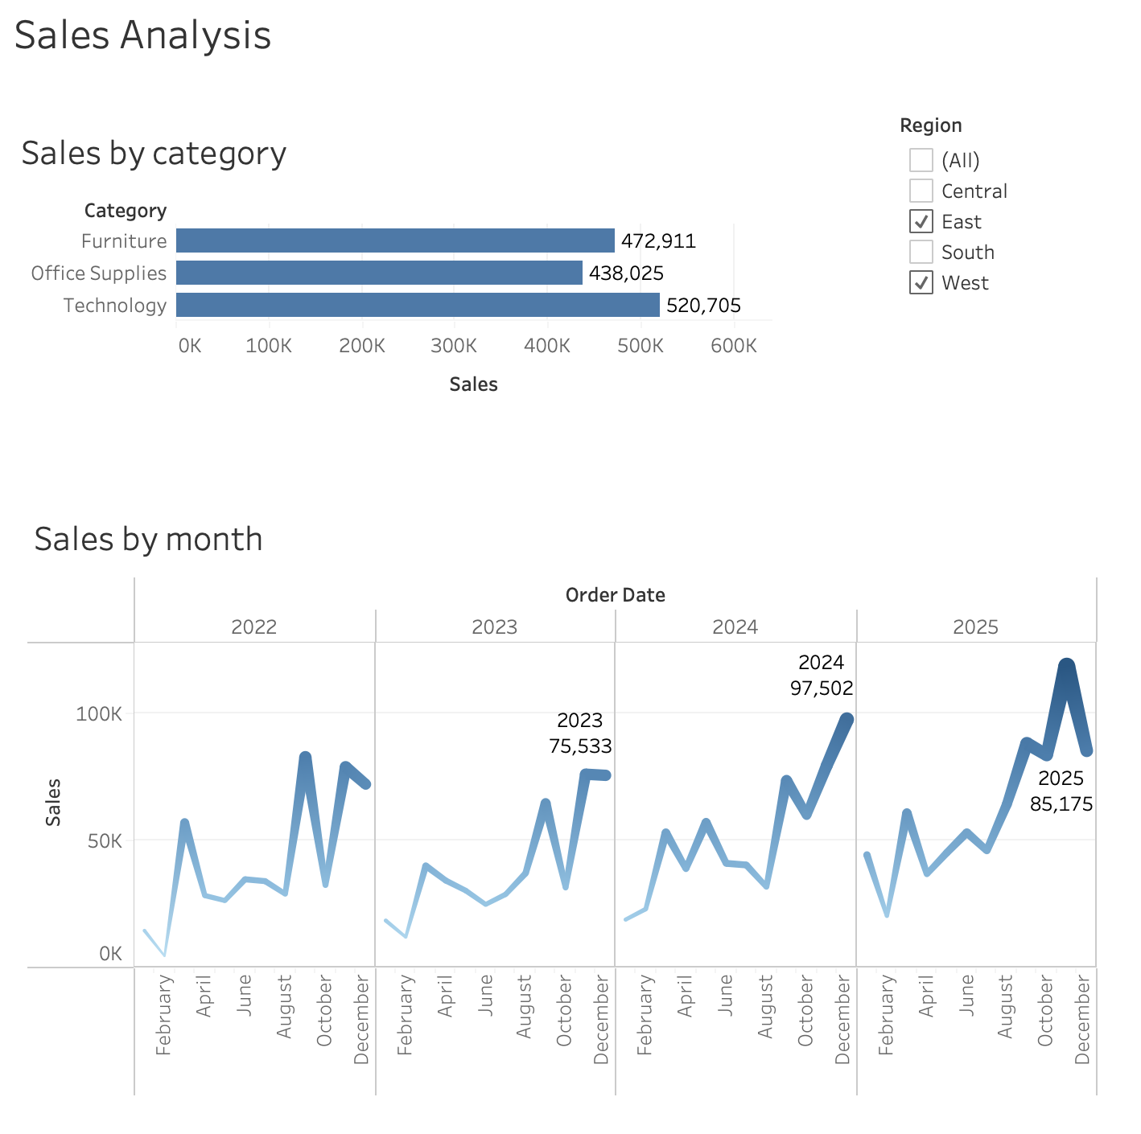
Sales Analysis Dashboard

Slide 5
Profit Analysis Dashboard
Margin Analysis: Profit by region and category
Profitability trends across 2014-2017
Identify margin-erosion categories
Discount Impact Assessment: Correlate discount depth with profit levels
Identify high-discount, low-profit scenarios
Performance Ranking: Regional profitability hierarchy
Profit contribution % by segment
Key Insight: Profit trends reveal which categories are truly valuable vs. high-volume but low-margin.

Slide 6
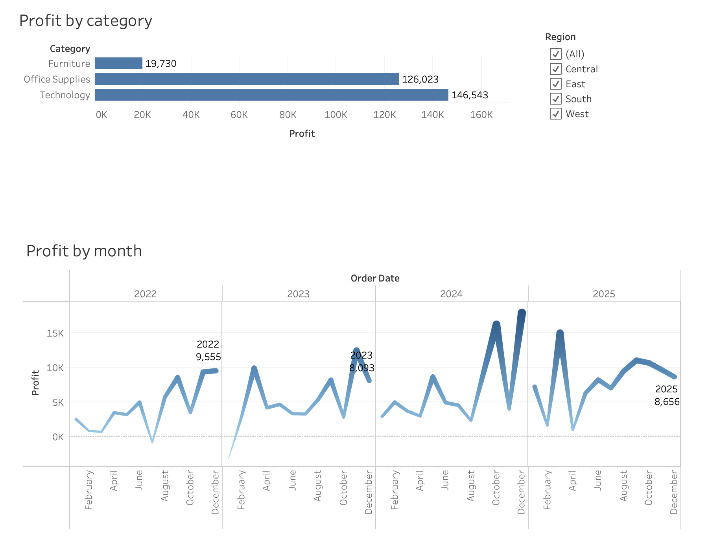
Profit Analysis Dashboard

Slide 7
Year-Over-Year Analysis Dashboard
Growth Metrics: Year-over-year sales and profit growth rates
Identify accelerating and decelerating categories
Dynamic Filtering: Select year parameter (2014-2017) to compare periods
Quick pivot to different time windows
Trend Patterns: Consistent growth categories vs. volatile ones
Seasonal patterns year-over-year
Early warning indicators for declining trends

Slide 8
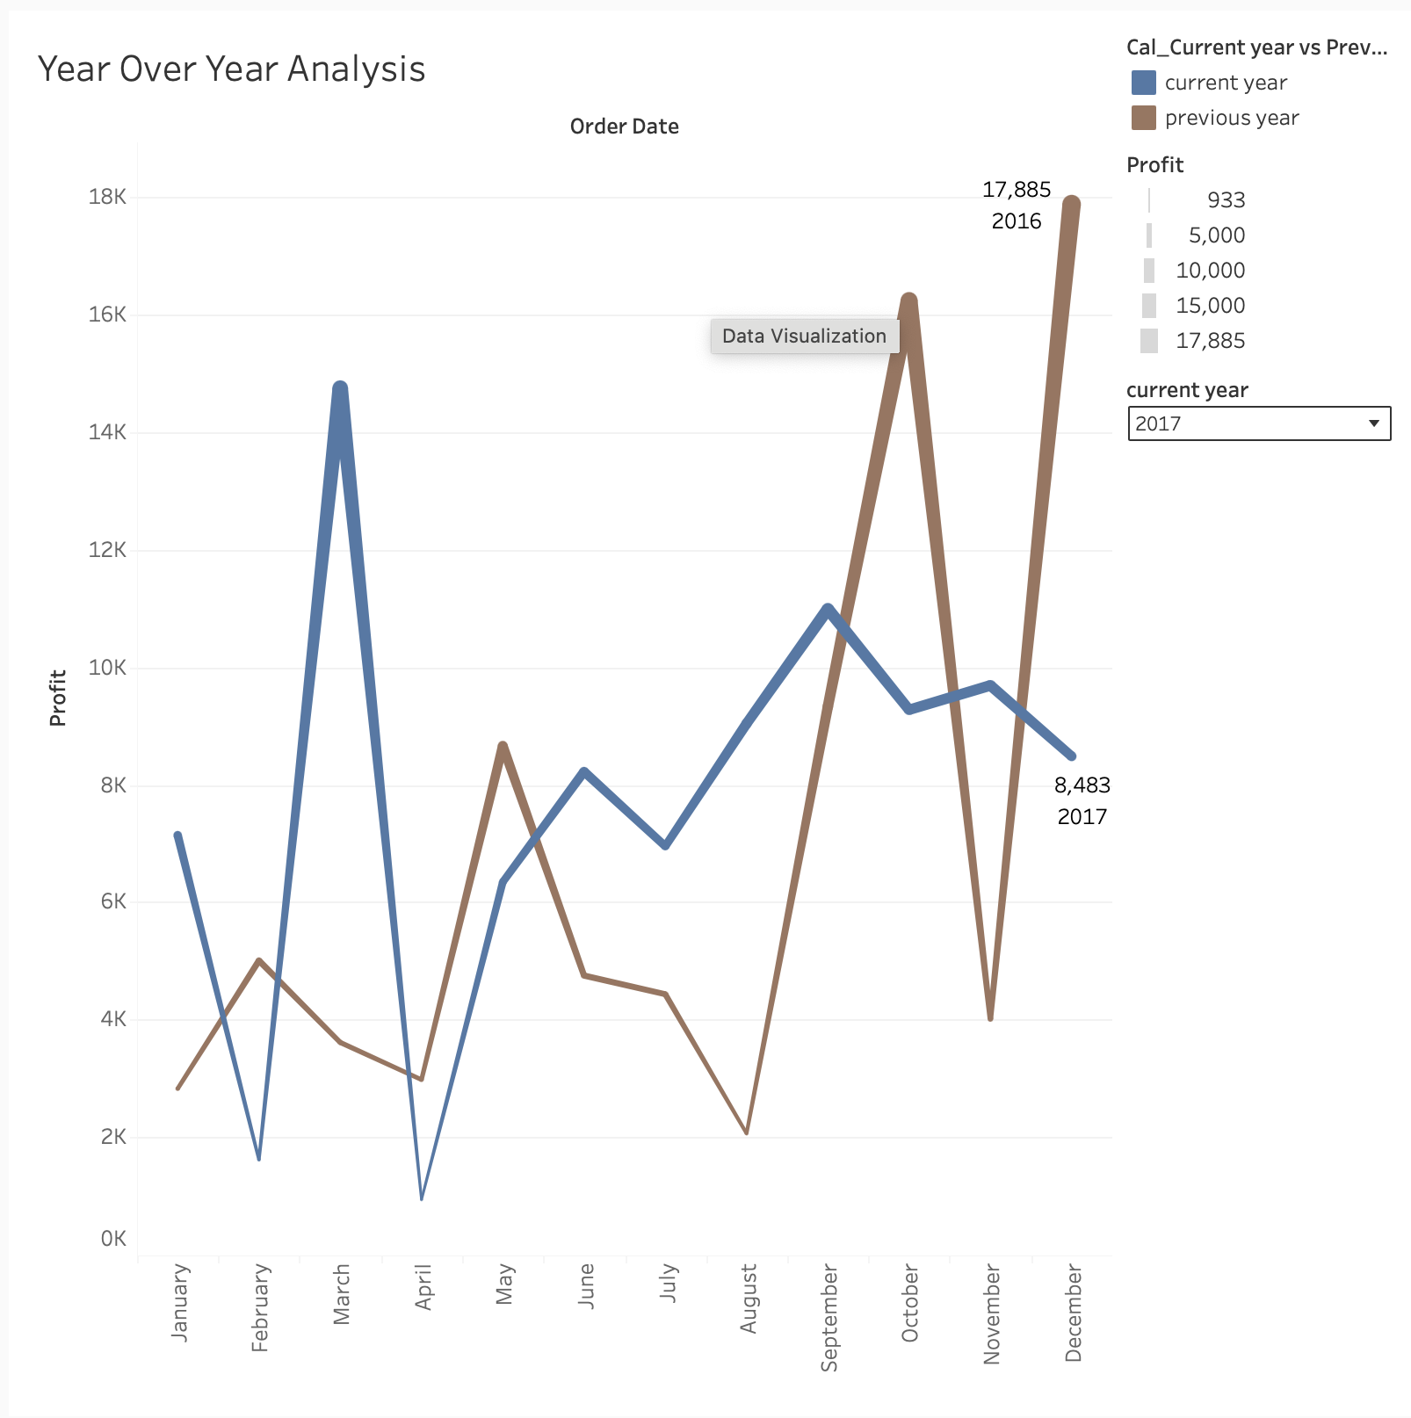
Year-Over-Year Analysis Dashboard

Slide 9
Data Integration & Intelligence
Three Data Streams:
Orders Table: 9,995 transactions
People Table: Manager-to-region mapping
Returns Table: 297 returned orders
Key Dimensions:
Geography: Region, State, City
Business: Segment, Category
Temporal: 2014-2017
Derived Insights:
Return Rates: Manager/region accountability
Discount Patterns: Margin protection
Customer Segment: Profitability analysis
Linked Analysis:
Cross-functional visibility
Accountability tracking
Risk identification

Slide 10
Interactive Capabilities
Year-Based Filter: Parameter selector (2014, 2015, 2016, 2017)
All dashboard views update dynamically
Enables trend comparison and deep-dive analysis
Drill-Down Capabilities: Region → Category → Sub-Category
Customer Segment → Product Detail
Cross-Dashboard Navigation: Filter selections carry across dashboards
Return patterns linked to manager performance

Slide 11
Live Dashboard Access
Access the interactive dashboards:
Profit Analysis Dashboard: https://public.tableau.com/views/salesdashboard-ProfitAnalysis/ProfitAnalysis
Year Over Year Analysis: https://public.tableau.com/views/salesdashboard-YearOverYearAnalysis/YearOverYearDashboard
Deployed on Tableau Public
Real-time interactive exploration
Dynamic filtering and drill-down capabilities

Slide 12
Key Takeaways
Problem Solved: Retail leadership now has real-time, consolidated visibility into sales performance
Capability Delivered: Dynamic filtering, multi-dimensional drill-down, accountability tracking
Business Impact: Faster decision-making (minutes vs. weeks)
Proactive identification of risks and opportunities
Data-driven resource allocation
Improved margin management through discount tracking

