Slide 1
MCH Campus Hackathon
3&4 February 2018, Galgotias University Greater Noida
Make for India

Slide 2
Team Name
Team Ethereum
Kautuk Kundan
Rishabh Malik
Udit Kumar

Slide 3
Problem Statement
The "last mile" problem regards how goods in a shipping route get from the last hub to their final destination.
Despite the last mile only comprising a tiny part of the total shipping distance, it can represent up to 28% of the total cost.
Thus, moving goods through metropolitan areas is the most complex and expensive aspect of the shipping supply chain.
The best way to resolve this is to scale it down. If you only need to deliver a package one or two miles away, why is it necessary to sit in a truck in a traffic jam for 15 minutes?

Slide 4
Vision
As free-market theory maintains, the best way to cut costs in almost any market is to increase competition. Our solution is to create a DAO (Decentralized Autonomous Organization) where shippers like FedEx are able to post shipping orders, giving individual couriers the option to accept these orders and take a fee.
This is enforced by a smart contract that acts as an escrow. When a courier accepts a shipment request, they are required to hand over a monetary deposit proportional to the value of the package.
The more packages the courier delivers successfully, the higher their reputation goes, and the less money they are required to deposit into the smart contract as a result.

Slide 5
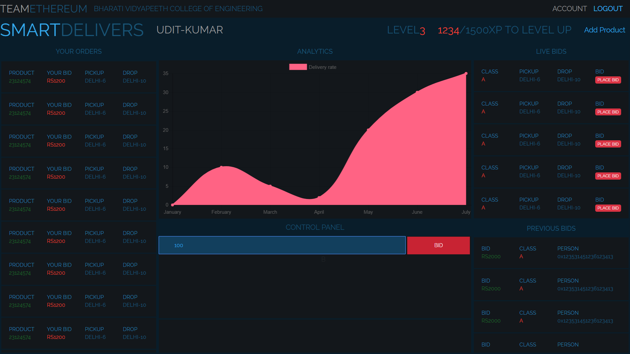
UI Details

Slide 6
Technology Used
- Backend on Nodejs
- Smart contract using Solidity
- Ethereum Transaction using Metamask

Slide 7
Business Model
We've created a reliable, capital-efficient network for bringing down that 28% of the total cost, all transparently documented on the blockchain.
Anyone can ship their goods, and anyone can start as a courier, giving people a low-barrier opportunity to earn money in their spare time.

Slide 8
Execution Plan
Since a portion of the fees go to fund the system itself, the most reputable couriers in this network can vote on funding proposals, such as opening locker locations to safeguard goods, or expanding services into new cities.

Slide 9
Plan and Timeline
- Agents and companies signs up at the portal.
- Companies add products to be delivered to the location.
- Realtime bidding occurs amoung the delivery persons to deliver the product at the lowest price.

