Slide 1
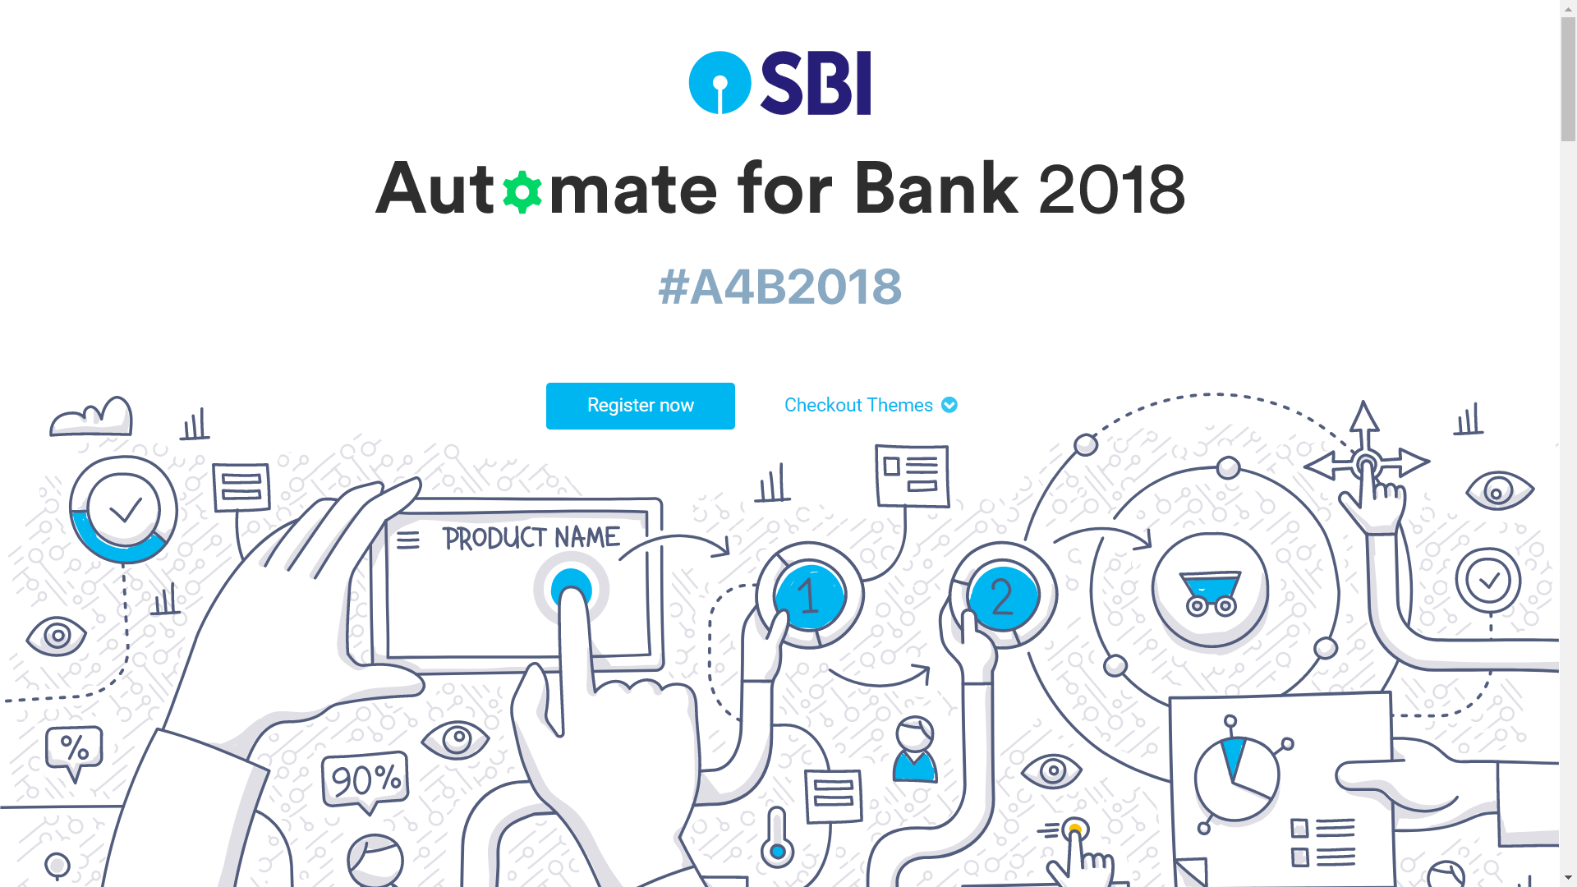

Slide 2
THEME
Automated Real Time
Customer Identification and Follow-up

Slide 3
TEAM SYNTAX-OK
Kautuk kundan
Rishabh malik
Bharati Vidyapeeth’s College of Engineering

Slide 4

OVERVIEW
We will use Facial Recognition technology to identify if a wealth customer enters the branch.
This is acheived by installing a camera at the main entrance of the branch.
The camera will keep scanning the customer’s faces who are entering and will try to match their face with an already maintained database of wealth customers.
If a matching face is encountered by the camera, the system will send a notification to the designated bank official about the same

Slide 5



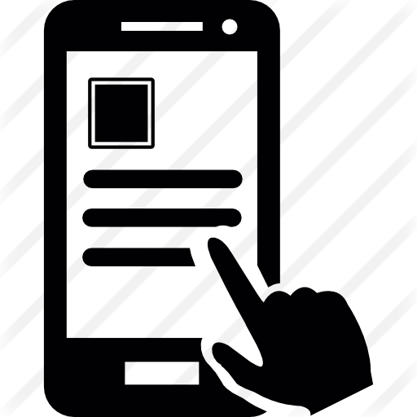


WIREFRAME
System gets notified
Face Identification
Bank Official gets notification that a wealth customer has entered the bank, who needs to be addressed.
Wealth Customer
Bank Official addresses the customer.
Feedback is taken from the wealth customer through a automated phone call.

Slide 6

COMPONENTS
- IoT enabled Camera ( Identification System )
-Web App ( System to alert Bank official )
-Phone service ( To get feedback from Customer )

Slide 7
Identification system
-A camera is installed at the main entrance of the branch
-The camera will keep scanning the customer’s faces who are entering and will try to match their face with an already maintained database of wealth customers.
-If a matching face is encountered by the camera, the system will send a response to the web app

Slide 8
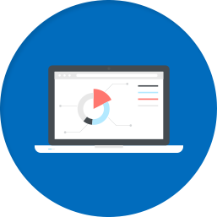
Web App
-The Web app will receive information from the camera
-Once a wealth customer enters the branch, His photo along with all of his details that are with the bank will be broadcasted to the designated official/officials via the web app
-The official who’ll choose to address this customer will press “Begin” on his app and all the details will get visible to him about this customer
-Once the meeting is over the official will press “finish” button on his app to end the meeting

Slide 9
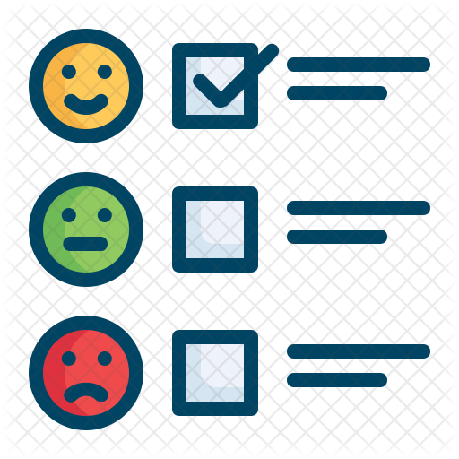
Customer Feedback
-Once the meeting is over, after some time, an automated call will be sent to the customer
-This call will ask the customer to give a rating to that meeting by pressing one of the 10 buttons on his mobile phone (0-9)
-As soon as the customer will press the button, the call will get disconnected and his response will get logged to the database

Slide 10

Stack Used
-Raspberry Pi along a camera for face identification
-Firebase Realtime Database for maintaining records etc.
-Nodejs for backend
-Twilio for Automated Calling

Slide 11
Thank You

