Slide 1



DR. A. P. J. ABDUL KALAM TECHNICAL UNIVERSITY, LUCKNOW
SMART SAFAR
AI DRIVEN SUSTAINABLE TRAVEL PLANNING
ABES ENGINEERING COLLEGE, GHAZIABAD

Slide 2

TEAM MEMBERS
1. Shreyash Pathak
2. Rishabh Yadav
3. Rishi Pandey
4. Som Tripathi

Slide 3
PROBLEM STATEMENT
& RELEVANCE
Travel planning today is focused on bookings, but it lacks real-time insights on weather, pollution, and crowd levels. Tourists often arrive during extreme conditions, facing heavy smog, unbearable heat, or overwhelming crowds, ruining their experience. Without sustainable travel planning, over-tourism and environmental damage worsen, making smarter tourism solutions essential.

Slide 4
SOLUTION DESCRIPTION
Smart Safar uses AI to analyze weather, air quality, and tourist traffic for better travel decisions.
It helps travelers avoid pollution, overcrowding, and bad weather by suggesting the best times and places to visit.
Promotes eco-friendly, stress-free, and responsible tourism for a smoother and more enjoyable experience.

Slide 5
KEY FEATURES
Weather-based travel month recommendations using historical and real-time data.
Air Quality Index (AQI) monitoring to avoid highly polluted destinations.
Crowd-level insights using tourism trend data to suggest off-peak travel.
Smart packing guides based on expected weather conditions.
Route and transport recommendations based on cost, time, and sustainability.
Budget-friendly hotel period suggestions using past price trends.

Slide 6

IDEA NOVELTY &
CREATIVITY
This system stands out by integrating weather, air quality, crowd analysis, cost trends, and eco-packing tips into a single smart travel recommendation platform.
Unlike traditional apps, it proactively guides users on when and where to go, based on real-time environmental and social data, making it a unique blend of technology, sustainability, and convenience.

Slide 7
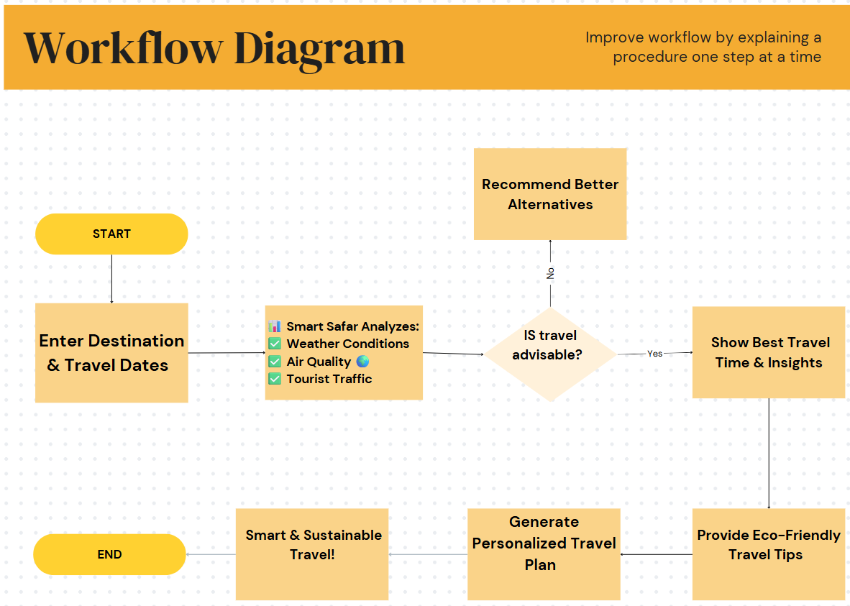

Slide 8
FEASIBILITY & SCOPE
The project uses freely available APIs and open data sources, making it affordable and implementable with standard development tools.
It can be built as a web or mobile app with basic integration of REST APIs and a user-friendly interface.
Scalable to include more countries and languages
Can expand with hotel price APIs, local events, or real-time alerts
Suitable for solo travelers, families, and eco-tourism platforms
Community features for travelers to share real-time experiences and crowd updates.

Slide 9
THANK YOU

