Slide 1
Blog Management System (Wikipedia)
25mcmc27 Rishabh Omar

Slide 2
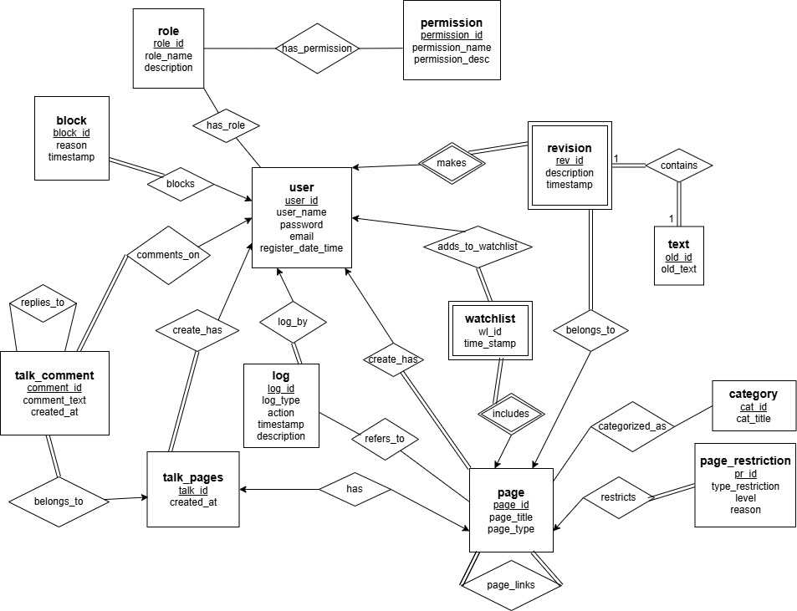
ER- diagram

Slide 3
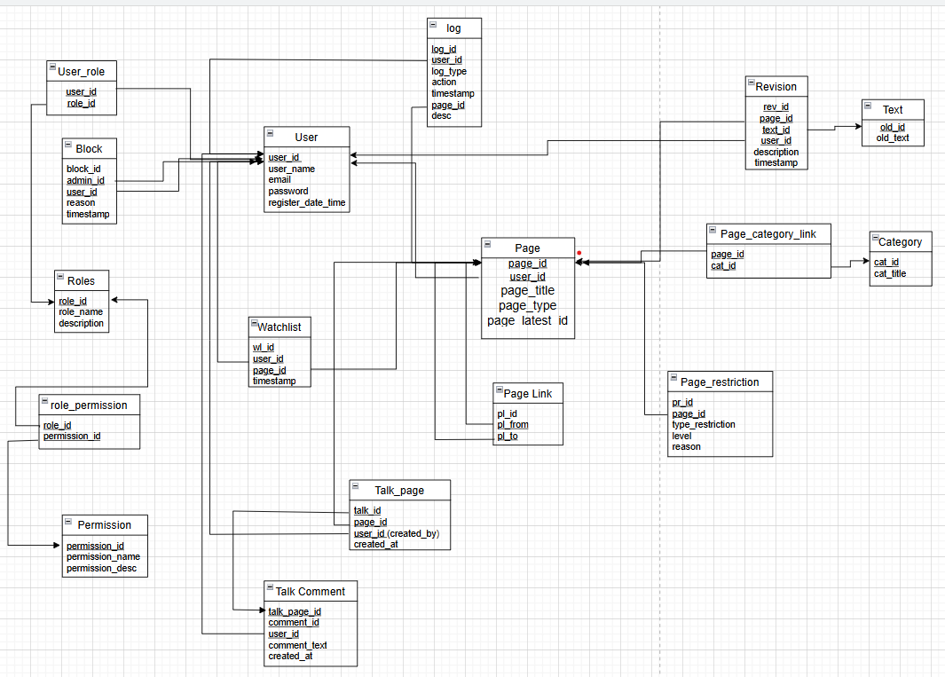
Relational Schema
Relational Schema

Slide 4
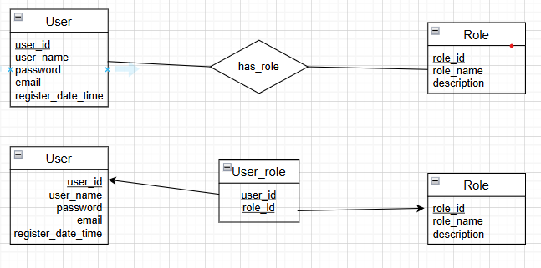
USER – ROLE
Type:
Many-to-Many (M:N)
One User can have many Roles (for example: Admin, Editor, Viewer).
One Role can be assigned to many Users.
A many-to-many relationship cannot be directly implemented in a relational database.
So, we break it down into two one-to-many relationships using an intermediate (bridge) table called User_role.
This table connects the User and Role tables by storing their IDs.

Slide 5
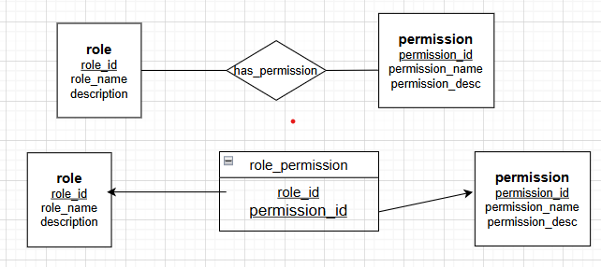
ROLE – PERMISSION
Many-to-Many (M:N)
Explanation:
One Role can have many Permissions.
(Example: “Admin” role might have Create, Update, Delete permissions.)
One Permission can be assigned to many Roles.
(Example: The Read permission might belong to Admin, Editor, and Viewer roles.)
Relational databases cannot directly store many-to-many relationships.
Hence, we merge this relationship by introducing an intermediate (bridge) table called role_permission.
This table connects each role_id with a permission_id.

Slide 6
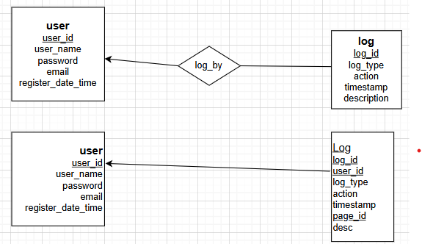
USER – LOG
One-to-Many (1:N)
One User can generate many Logs (for example: login, update, delete, etc.).
Each Log entry belongs to one specific User.
Hence, the relationship is one-to-many from User → Log.
To represent this in a relational database:
We place the foreign key (user_id) in the Log table, since multiple logs are related to a single user.

Slide 7
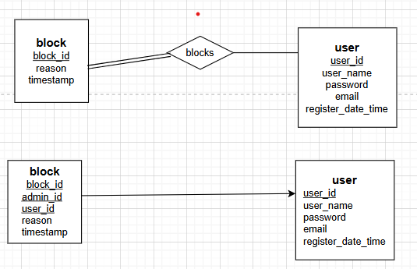
USER – BLOCK
One-to-Many (1:N)
One User can be blocked multiple times (for example, for spam, abuse, etc., each with a different reason and timestamp).
Each Block record is associated with exactly one User.
So, this is a one-to-many relationship from User → Block.
We add a foreign key (user_id) in the Block table.
Each block record will store the user_id of the user who was blocked.
This ensures every block entry belongs to a single user.

Slide 8
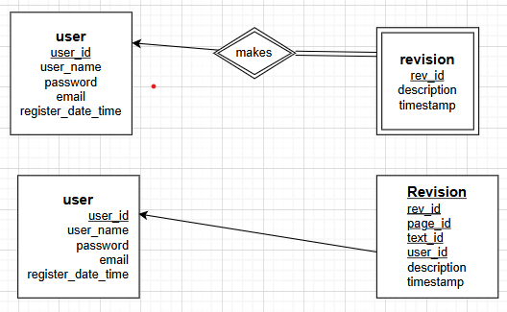
USER – REVISION
One-to-Many (1:N)
One User can make many Revisions (edits/updates) to different pages.
Each Revision is made by exactly one User.
We add the foreign key (user_id) in the Revision table.
This foreign key connects each revision record to the user who made it.

Slide 9
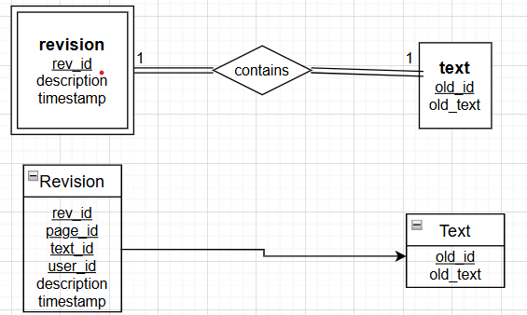
REVISION-TEXT
One-to-One (1:1)
Each Revision contains exactly one Text (the actual edited content).
Each Text belongs to exactly one Revision.
We add the foreign key (text_id) in the Revision table.
Each revision will reference exactly one text record from the Text table.

Slide 10
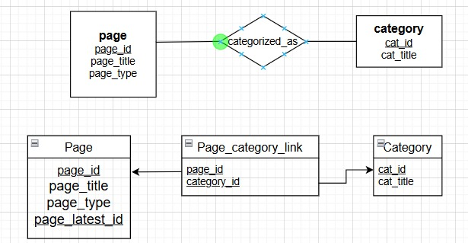
PAGE – CATEGORY
Many-to-Many (M:N)
One Page can belong to multiple Categories.
(e.g., a page “Database Management” might belong to both “Computer Science” and “Data Storage”.)
One Category can contain multiple Pages.
(e.g., “Programming” category might include “C Language”, “Java”, and “Python” pages.)
Therefore, we introduce a junction (bridge) table called Page_category_link to break it into two one-to-many relationships:

Slide 11
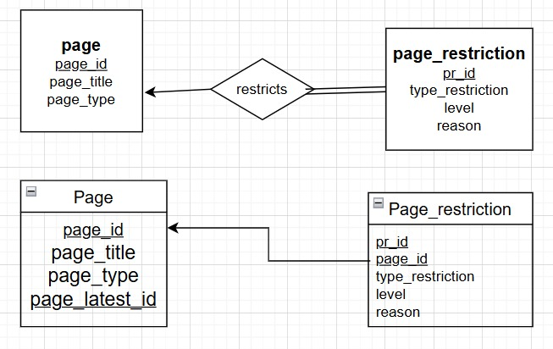
PAGE – PAGE_RESTRICTION
One-to-One (1:1)
Each Page can have at most one restriction (for example, “edit restricted to admins” or “read-only”).
Each Page_Restriction entry applies to exactly one Page.
We add the foreign key (page_id) in the Page_restriction table.
Each restriction record will refer to the page it belongs to.

Slide 12
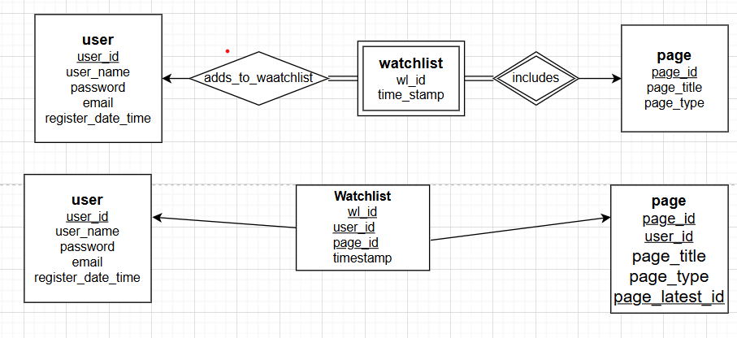
WATCHLIST – PAGE
Many-to-Many (M:N)
A User’s Watchlist can contain many Pages they are tracking.
A Page can appear in many Users’ Watchlists.
A User’s Watchlist can contain many Pages they are tracking.
A Page can appear in many Users’ Watchlists.
we typically represent this through a Watchlist table that includes both the user_id and page_id — effectively acting as a bridge between User and Page.
we merge it by introducing a bridge table called Watchlist, which connects both User and Page using foreign keys.

Slide 13
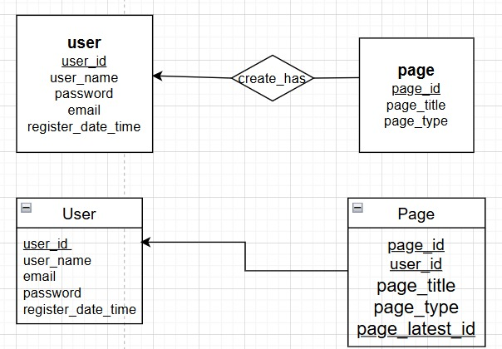
USER – PAGE
One-to-Many (1:N)
One User can create many Pages.
Each Page is created by exactly one User.
We add a foreign key (user_id) inside the Page table.
Each Page record will store the user_id of the user who created it.
This allows us to know which user created which page.

Slide 14
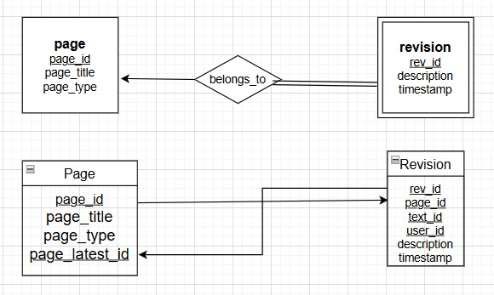
PAGE – REVISION
One-to-Many (1:N)
One Page can have many Revisions (as users edit and update it over time).
Each Revision belongs to exactly one Page.
We add a foreign key (page_id) in the Revision table.
Each revision will store the ID of the page it belongs to.

Slide 15
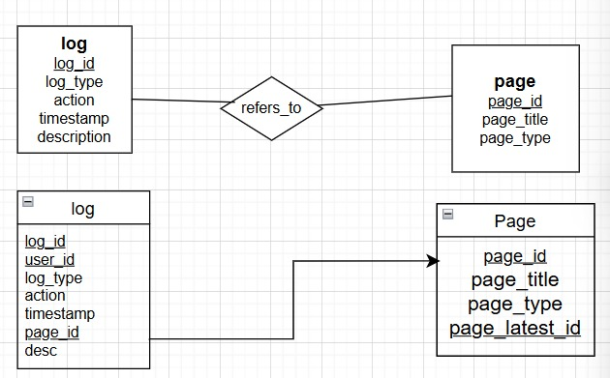
LOG – PAGE
Many-to-One (N:1)
Each Log entry refers to one Page (for example, a log entry like “User edited Page X”).
One Page can have many Logs recorded against it (for edits, deletions, protection, etc.).
We add a foreign key (page_id) in the Log table.
Each log record stores which page it refers to.

Slide 16
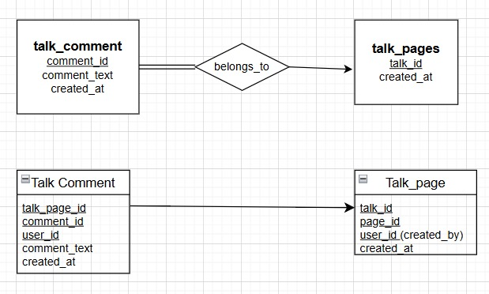
TalkComment-TalkPage
One-to-Many
(Each talk page can have multiple comments, but each comment belongs to one talk page)
A Talk Page can have many comments.
A Talk Comment belongs to one specific talk page.
The foreign key talk_page_id was added into talk_comment to explicitly establish the one-to-many relationship.

Slide 17
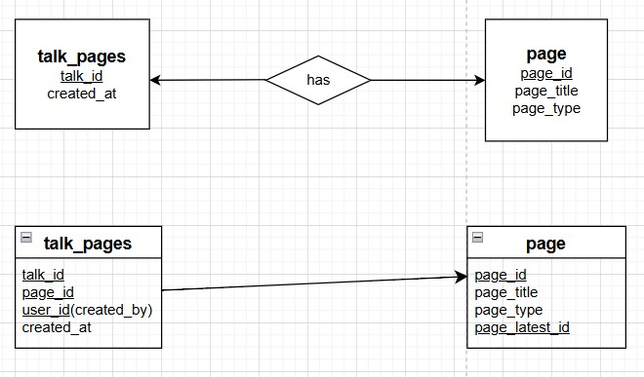
One-to-One (1:1)
Each page can have one corresponding talk page,
and each talk page belongs to one specific page.
A talk page is not independent; it always corresponds to exactly one page (like in Wikipedia).
Each article page has at most one talk page.
The talk page cannot exist without the main page.
The foreign key page_id was added to talk_pages to represent that relationship directly.

