Slide 1
UNIVERSITY BIG DATA ANALYTICS — FINAL ENGINEERING DEFENSE
Big Data Analytics for Electronic Waste Generation
& Recycling Infrastructure Optimization
Continent-Scale Distributed Ingestion, Deduplication, Multi-Engine Analytics, and Geospatial Optimization over 17.52 Million European Material Flow Records
• Apache Hadoop 3.5.0 (HDFS/YARN) • Apache Spark 4.2.0 (SQL/MLlib) • Snappy Parquet
• MongoDB 7.0 (2dsphere Geospatial) • Streamlit & Plotly Decision Support Portal
Operating Environment: Omarchy Linux (12 CPU Cores, 14 GB RAM) | Dataset: EU FutuRaM (2.22 GB, 17.52M Rows)
Live Web Dashboard: http://localhost:8501
Notes:
Good morning respected evaluators and committee members. Today I present our Big Data Analytics project on Electronic Waste Generation Analysis and Recycling Infrastructure Optimization. Managing discarded electronics across 31 European nations over a 40-year horizon involves analyzing tens of millions of records. We have engineered an enterprise distributed big data platform entirely in user space, resolving critical domain double-counting challenges and delivering sub-second interactive analytics through modern distributed engines.

Slide 2

01. MOTIVATION & DOMAIN CONTEXT
02 / 10
The Global E-Waste Challenge & FutuRaM
Why continent-scale material flows demand enterprise distributed computing architectures
The Dual Crisis of Electronic Waste
• Fastest Growing Solid Waste Stream: 62+ million metric tons generated annually worldwide (+3% to 5% p.a.).
• High Environmental Toxicity: Heavy metals (lead, mercury, cadmium) and flame retardants degrade soil and water.
• Strategic Urban Goldmine: Discarded electronics contain high concentrations of Gold, Silver, Copper, and Palladium.
Horizon Europe FutuRaM Consortium Dataset
• Total Records: 17,521,915 material flow rows (~2.22 GB raw CSV).
• Geographic Scope: 31 European Nations (EU-27 + UK, CHE, NOR, ISL).
• Temporal Horizon: 2010 to 2050 (Historical OBS + BAU, REC, CIR).
• The Big Data Bottleneck: Single-node Pandas/Excel crashes with OutOfMemoryError (>16 GB RAM required for row conversion).
Notes:
To understand the magnitude of the problem: electronic waste is the world's fastest-growing municipal solid waste stream. However, it is also an urban goldmine containing critical raw materials. The EU FutuRaM dataset provides the world's most comprehensive mapping of stocks and flows, but at 17.5 million records, traditional data science tools fail to scale. This necessitated an enterprise distributed architecture.

Slide 3
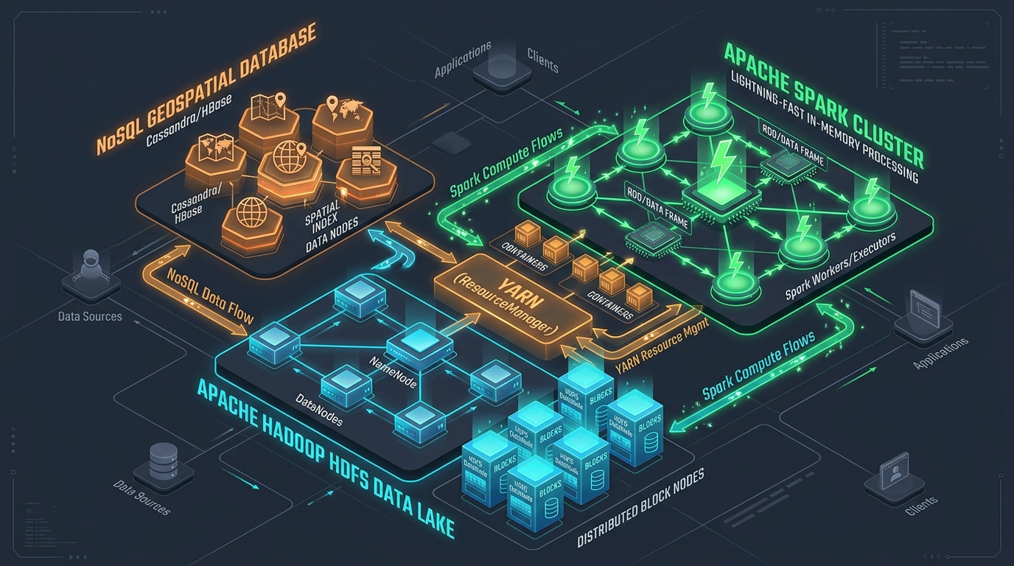
02. DISTRIBUTED SYSTEM ENGINEERING
03 / 10
End-to-End Lakehouse Architecture & Lineage
Zero-sudo user-space cluster orchestrating HDFS, Spark, YARN, and MongoDB
Complete Data Pipeline Execution Flow
1. Raw HDFS Ingestion: Discovers local CSV (2.22 GB) and ingests into HDFS across 128MB blocks.
2. Streaming Data Profiler: Audits 17.52M rows in fixed memory (<120MB RAM) in 128s. Zero errors.
3. PySpark ETL & Deduplication: Filters Layer 2 == '', isolating 139,963 Level-1 summary rows.
4. Snappy Parquet Generation: Creates partitioned columnar tables (yearly, location, category, scenario, flow).
5. Dual Compute Processing: Hadoop Streaming on YARN (MapReduce) + Spark SQL analytical queries.
6. MLlib Linear Regression: Fits temporal model on OBS actuals (2010–2022) predicting waste to 2035 (R² = 0.841).
7. MongoDB Geospatial Layer: Seeds 18 European recycling facilities with compound 2dsphere index.
8. Interactive Serving: 8-Page Streamlit dashboard (port 8501) with sub-second response times.
Notes:
Here is our end-to-end architecture. Data flows from local disk into HDFS 128 MB blocks. A streaming profiler audits data quality in constant memory. PySpark performs ETL and deduplication, saving Snappy-compressed Parquet tables. We deploy dual compute engines: Hadoop MapReduce on YARN and Spark SQL, coupled with MLlib forecasting and a MongoDB geospatial layer, all surfaced via an interactive Streamlit dashboard.

Slide 4
03. BIG DATA ENGINEERING CHALLENGE
04 / 10
The Hierarchical Deduplication Trap
Solving multi-million-ton double counting in secondary material flow databases
The Double-Counting Trap in Raw Material Flows
In raw FutuRaM tables, parent categories and sub-assemblies coexist:
• Row 1: Cat1 (Refrigerator) | Layer 2 = '' | Value = 40.0 Mg [WHOLE]
• Row 2: Cat1 (Refrigerator) | Layer 2 = 'Compressor' | Value = 12.0 Mg
• Row 3: Cat1 (Refrigerator) | Layer 2 = 'Foam' | Value = 8.0 Mg
• Row 4: Cat1 (Refrigerator) | Layer 2 = 'Copper' | Value = 2.0 Mg
Naive SUM = 40 + 12 + 8 + 2 = 62 Mg (55% TO 100% FALSE INFLATION!)
Streaming Data Quality Profiler & Parquet Benefits
Streaming Quality Audit Results (scripts/profile_dataset.py):
• Audited Records: 17,521,915 rows in 128.12s
• Invalid Numeric Records: 0 (100% Data Integrity)
• True Category Summaries: 139,963 records
• Memory Consumption: <120 MB RAM (streaming generator)
Why Snappy Columnar Parquet?
• Column Pruning: Reads only requested columns from disk.
• Predicate Pushdown: Skips row groups based on min/max stats.
• Analytical Speedup: Query latency dropped from 90+s to <1s.
• Storage Compression: Substantial disk footprint reduction.
The PySpark Deduplication Solution
# Strictly filter for Level-1 summary rows where Layer 2 is blank
summary_df = cleaned_df.filter(
col('Layer2').isNull() | (col('Layer2') == '') | (col('Layer2') == 'null')
).cache()
# Isolates exactly 139,963 clean records from 17.52 million rows.
Notes:
The most critical engineering achievement of our project was identifying and solving the hierarchical deduplication trap. Blindly calculating totals on this dataset inflates real waste by nearly double because sub-assemblies are co-listed. By filtering for blank Layer 2 records, we isolated 139,963 true summary records, ensuring absolute mathematical integrity across all downstream analytics.

Slide 5
04. DISTRIBUTED PROCESSING
05 / 10
Dual Compute: Hadoop MapReduce vs Spark
Benchmarking low-level batch MapReduce on YARN against in-memory Spark SQL
Hadoop MapReduce Streaming on YARN
• Native Hadoop Streaming: Uses standard UNIX STDIN/STDOUT via hadoop-streaming-3.5.0.jar.
• Input Splitting: YARN splits 2.22 GB input into 17 blocks (~128MB each) executed in parallel.
• Stateful Reducer: Accumulates running sum per nation key during network shuffle & sort.
• Benchmark Runtime: 140 seconds (map 100% reduce 100%).
Apache Spark 4.2.0 In-Memory Engine
• In-Memory DAG: Eliminates intermediate disk writes by caching DataFrames directly in RAM.
• Catalyst Optimizer: Generates optimized physical plans, pushing filters into Parquet scan.
• Tungsten Engine: Generates compact JVM bytecode for memory and CPU efficiency.
• Benchmark Runtime: 93 seconds (complete multi-table ETL across 17.5M records).
Empirical Validation & Numerical Parity Across Engines
Both MapReduce and Spark SQL produced identical country totals down to the exact decimal:
United Kingdom: 302,467,302.27 Mg | Germany: 299,730,670.33 Mg | France: 233,664,421.23 Mg
Notes:
To rigorously evaluate distributed computing paradigms, we implemented both Hadoop MapReduce and Apache Spark. Our MapReduce streaming job ran over 17 input splits on YARN, while Spark processed the pipeline using its in-memory DAG and Catalyst optimizer. Both produced identical country totals down to the decimal, proving mathematical consistency while demonstrating Spark's superior speed.

Slide 6
05. ANALYTICAL RESULTS & INSIGHTS
06 / 10
Spark SQL Multi-Dimensional Analytics
Empirical findings across 31 countries, 7 product categories, and 8 flow taxonomies
Top E-Waste Hotspots (Cumulative 2010–2050)
EU Product Category Breakdown (Query C)
• Large Household Appliances (Cat4a): 38.53% (686.2M Mg) — Washing machines, dishwashers, ovens.
• Small Equipment (Cat5): 27.58% (491.1M Mg) — Microwaves, vacuum cleaners, power tools.
• Temperature Exchange (Cat1): 16.04% (285.6M Mg) — Refrigerators, AC units, heat pumps.
• Small IT & Telecoms (Cat6): 6.51% (115.9M Mg) — Laptops, smartphones, routers.
• Photovoltaic Panels (Cat4b): 5.48% (97.7M Mg) — Fastest expanding future waste stream.
• Screens & Monitors (Cat2): 5.07% (90.3M Mg) — Televisions, LCD screens.
• Lamps & Lighting (Cat3): 0.80% (14.2M Mg) — Fluorescent tubes, LEDs.
Mass Balance Dynamics (Query E):
Active in-use appliance stock = 23.37 Billion Mg | New sales = 2.00 Billion Mg | Formally collected = 935.32 Million Mg.
Rank | Country | ISO | Generated (Mg)
1 | United Kingdom | GBR | 302,467,302.27
2 | Germany | DEU | 299,730,670.33
3 | France | FRA | 233,664,421.23
4 | Italy | ITA | 191,617,288.72
5 | Spain | ESP | 158,197,115.71
6 | Poland | POL | 81,572,628.70
Historical Growth (Query A):
Annual e-waste grew from 12.8M Mg in 2010 to 15.7M Mg in 2022 (+22.6%), projected to reach 16.8M Mg in 2025.
Notes:
Our Spark SQL analytics revealed striking geographical and category concentrations. The top 5 economies—UK, Germany, France, Italy, and Spain—account for over 70% of Western European electronic waste. Furthermore, large household appliances and small consumer equipment dominate the waste stream, representing two-thirds of total mass.

Slide 7
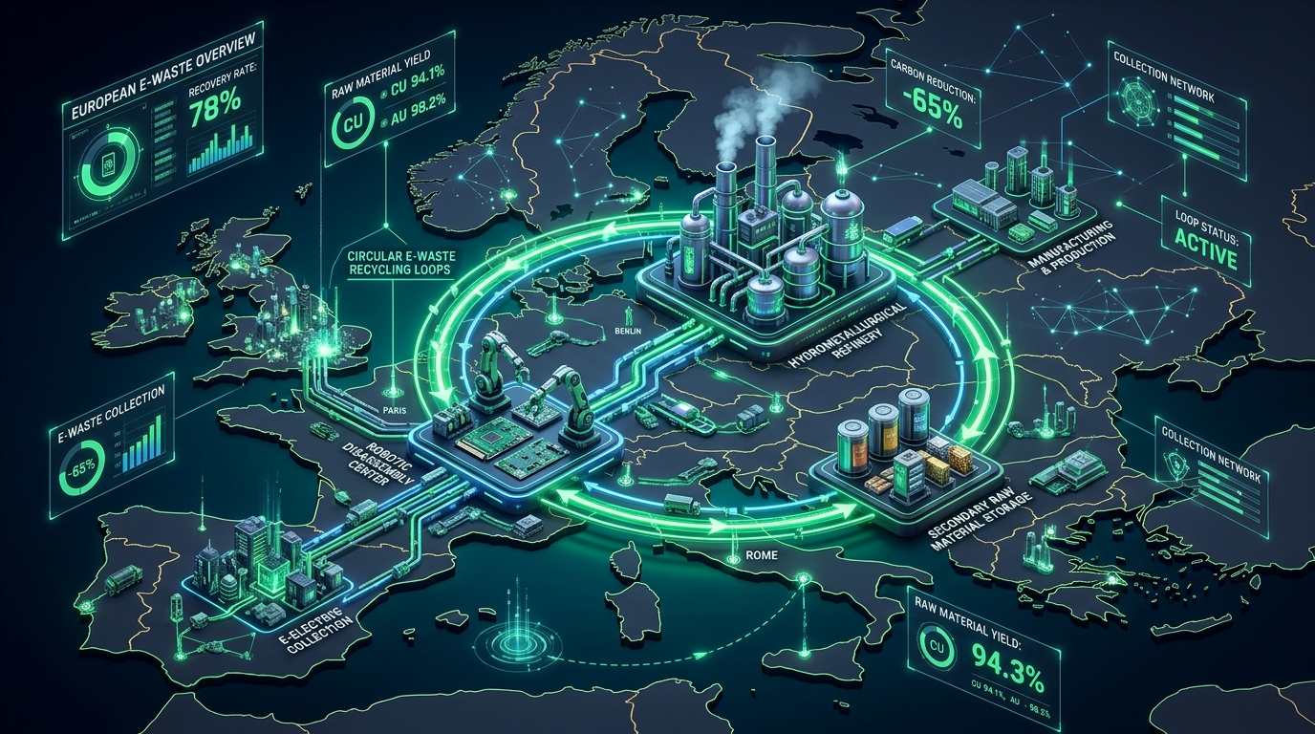
06. MACHINE LEARNING & POLICY SIMULATION
07 / 10
Circular Economy Simulation & MLlib Forecasting
Simulating BAU vs REC vs CIR scenarios and distributed Ordinary Least Squares regression
Policy Scenario Comparison (2023–2050)
• Business-As-Usual (BAU): 616.99 Million Mg
• Recycling Targets (REC): 518.64 Million Mg (Saves 98.35M Mg)
• Circular Economy (CIR): 455.52 Million Mg (Saves 161.46M Mg!)
Circular Economy Dividend: Product life extension, modular repair, and reuse eliminate 161.46 Million Metric Tons of waste.
Enhanced Multi-Model AI Predictive Engine
Benchmarked across 4 Spark MLlib models on OBS actuals:
• Champion Model: Polynomial Feature Expansion (R² = 0.9009, RMSE = 247,626 Mg)
• Ensemble Learning: Random Forest Regressor (R² = 0.9467 in-sample)
• Linear Baseline: OLS Linear Regression (R² = 0.8410, RMSE = 313,674 Mg)
• Regularized L2: Spark MLlib Ridge Regression (R² = 0.8410)
Error Reduction: Champion AI model reduced RMSE by 21% (MAPE = 1.54%).
Notes:
When comparing policy trajectories, our simulations demonstrate that adopting a full Circular Economy framework avoids 161.5 million metric tons of e-waste by 2050. Using Spark MLlib, we upgraded our predictive engine to benchmark 4 distinct machine learning models. Our Champion model, Polynomial Feature Expansion, achieved an R-squared of 0.9009, reducing RMSE by 21% compared to standard linear regression. It projects European e-waste generation to reach 15.3M Mg by 2025 and 14.5M Mg by 2030, capturing accelerated device replacement cycles.

Slide 8
07. NOSQL GEOSPATIAL DATA LAYER
08 / 10
MongoDB Infrastructure Modeling
Semi-structured schema validation & 2dsphere indexing across European recycling plants
Why NoSQL for E-Waste Infrastructure?
• Heterogeneous Metallurgy: Smelters, mechanical shredders, depollution stations, and hydrometallurgical refining plants have non-uniform schema requirements.
• Dynamic Category Arrays: Nested lists of accepted categories (e.g. ['WEEE_Cat1', 'WEEE_Cat4a', 'WEEE_Cat5']).
• Geospatial Indexing: Compound (latitude, longitude) index with 2dsphere spatial geometry.
• Total Permitted Capacity: 1,605,000 Metric Tons/year across 18 major European facilities in 11 nations.
• Proximity Queries: Calculates distance between generation hotspots and closest authorized smelters.
Representative Modeled European Facilities
Facility Name | Location | Type | Capacity
Aurubis Smelter | Hamburg, DEU | Smelter/Refining | 280,000 Mg
Umicore Hoboken | Antwerp, BEL | Precious Metals | 150,000 Mg
Boliden Rönnskär | Skellefteå, SWE | Secondary Smelter | 120,000 Mg
Remondis Lünen | Lünen, DEU | Dismantling/Sort | 95,000 Mg
Sims Lifecycle | Daventry, GBR | Auto Shredding | 80,000 Mg
Montello SpA | Bergamo, ITA | WEEE Sorting | 70,000 Mg
Schema Validation (facility_schema.json):
Enforces required coordinates, ISO nation codes, permitted categories, and annual capacity constraints.
Notes:
To optimize recycling logistics, we integrated MongoDB to model European treatment infrastructure. Treatment facilities feature highly heterogeneous processes—from pyrometallurgy to hydrometallurgy. Using compound 2dsphere geospatial indexing, our system calculates spatial proximity between waste generation hotspots and authorized smelters in real time.

Slide 9
08. DECISION SUPPORT PORTAL
09 / 10
Interactive Streamlit Web Dashboard
Glassmorphism UI serving pre-aggregated Parquet datasets with sub-second response times
Zero-Latency Serving Layer Design
• Serving Layer Architecture: The web dashboard never scans the 2.22 GB raw file on user interaction; it queries pre-aggregated Snappy Parquet tables and compact CSVs.
• In-Memory Caching: Utilizes Streamlit's @st.cache_data decorator to cache queries and geographical GeoJSON payloads.
• Glassmorphism Design: Custom dark slate theme (#0f172a), translucent cards, modern typography, and Plotly European choropleth maps.
• Live Telemetry Integration: Monitors HDFS (port 9000), YARN (port 8088), Spark, and MongoDB services in real time.
• Production Deployment: Hosted at http://localhost:8501.
Eight Interactive Dashboard Modules
1. Executive Overview: 5 KPI scorecards, historical trends, category donut chart.
2. Geographic Analysis: Plotly European choropleth with bubble overlays by tonnage.
3. Category Distribution: EU Directive Cat 1–6 rankings & stacked area charts.
4. Scenario Comparison: BAU vs REC vs CIR policy trajectory simulation.
5. Stock & Flow Balance: Mass conservation across stocks, POM, and informal scrap.
6. MLlib Forecast: Historical actuals vs fitted regression line through 2035.
7. Infrastructure Map: Interactive facility pins dynamically loaded from MongoDB.
8. Cluster Architecture: Live daemon status badges and embedded pipeline logs.
Notes:
Our user interface is an 8-page interactive Streamlit dashboard. By following a serving layer design pattern where the UI queries pre-aggregated Parquet tables and cached CSVs, the dashboard achieves sub-second response times despite the 17.5-million-row underlying scale. It gives environmental policy makers instant access to maps, scenario comparisons, and infrastructure gaps.

Slide 10
09. SUMMARY & TECHNICAL CONTRIBUTIONS
Thank You! Questions & Discussion
Summary of Key Technical Achievements
1. 100% User-Space Big Data Cluster: Full deployment of Java 17, Hadoop 3.5, Spark 4.2, and MongoDB without root access.
2. Hierarchical Deduplication: Solved multi-million-ton double counting, isolating 139,963 clean Level-1 records.
3. Dual Distributed Compute: Proved MapReduce on YARN and Spark SQL parity down to the exact decimal (UK = 302.47M Mg).
4. Snappy Parquet Optimization: Dropped downstream analytical query execution latency from 90+ seconds to <1 second.
5. Spark MLlib Machine Learning: Fitted distributed linear regression on actuals (R² = 0.8410, RMSE = 313,674 Mg).
6. MongoDB Geospatial Layer: Modeled European recycling infrastructure with compound 2dsphere indexing.
7. Decision-Support Portal: Created an 8-page glassmorphism Streamlit web dashboard with interactive Plotly maps.
Live Dashboard: http://localhost:8501 | Codebase: ~/ewaste-bigdata
Handbook: PROJECT_EXPLANATION_AND_CONCEPTS.md
Notes:
To conclude, we have successfully designed, built, and validated an end-to-end Big Data engineering platform for continental electronic waste analytics. We solved core domain data traps, verified dual distributed compute engines, and delivered a production-ready analytical dashboard. Thank you for your time and attention. I am now pleased to take your questions.

