Slide 1
A Project Report on
[UBER_TRIP_DATA]
Presented By:
Under the supervision of
Ms. Akanksha Kaushik
(The North Cap University)
Rishabh Saini
18CSU172

Slide 2
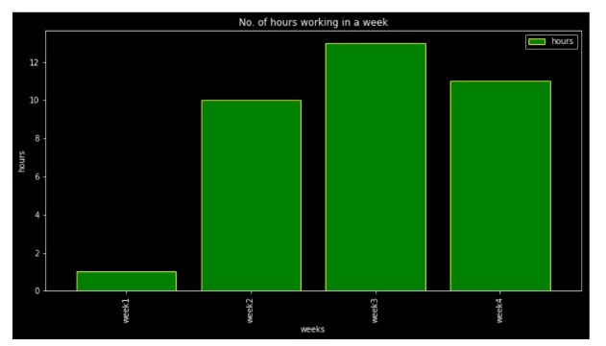
Objective
Using the Uber trip data we have analysed the data of the employee and plotted the required graphs.

Slide 3

Objective(continued)
Reading the csv file and using its data to get the information regarding the number of hours an employee is working during a specific month.
Plotted different graphs based on per month, per week and per day income of the employee.

Slide 4




DATA AND INPUT
The data is taken from following sources:
Jupiter Notebooks
GitHub
Youtube
GooglE

Slide 5

INTRODUCTION
The program is based on the number of hours the employee of the Uber company is working.
The program asks the user to enter a specific month and gives the information related to that month.

Slide 6


METHODOLOGY USED
Numpy
Pandas
DataFrame

Slide 7
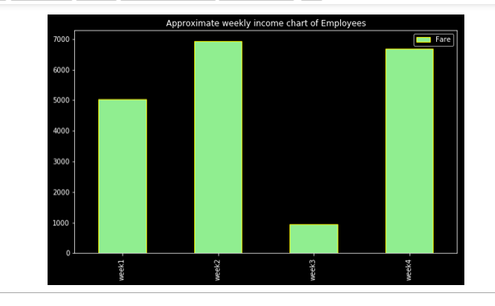
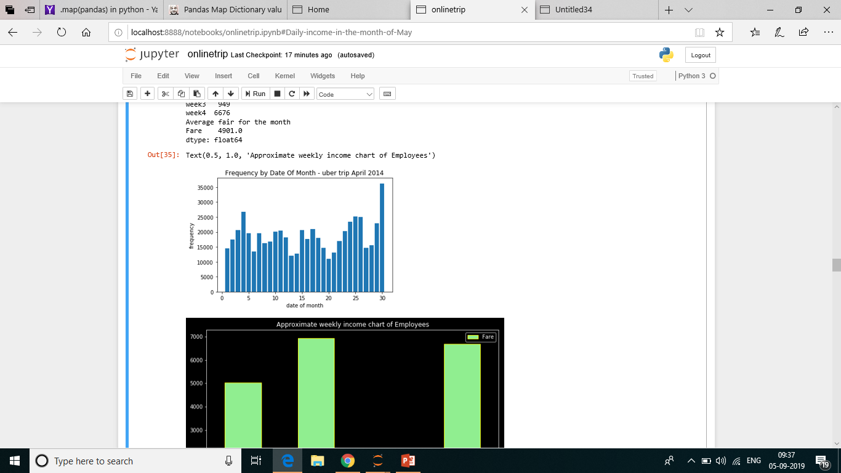
UBER TRIP DATA ANALYSIS : APRIL

Slide 8
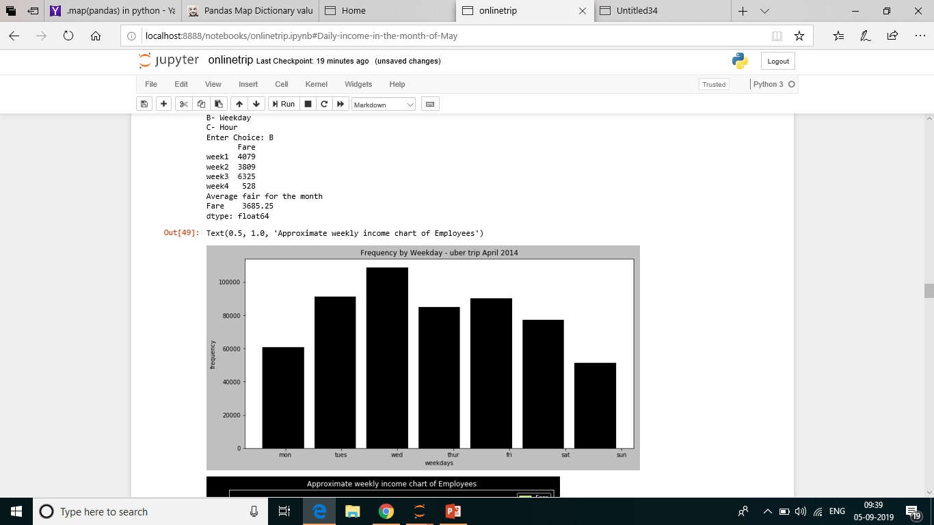
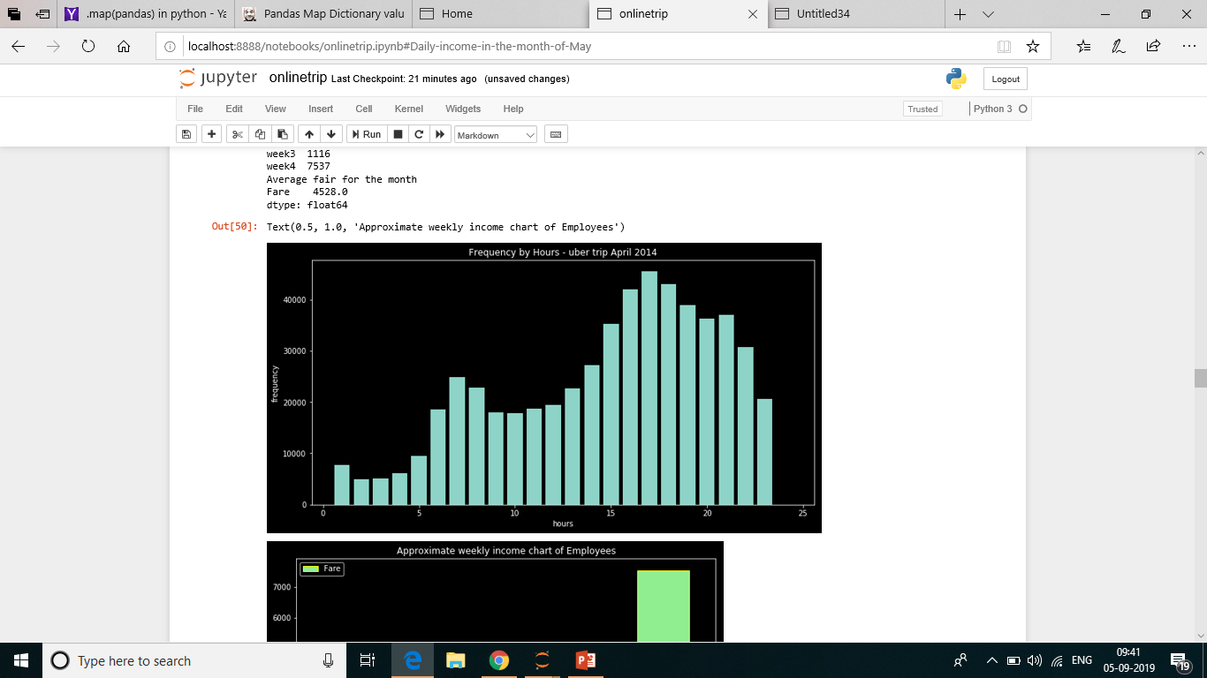
UBER TRIP DATA ANALYSIS : APRIL

Slide 9
RESULTS
The User enters the name of the specific month.
Then the user chooses weather he wants to know the income of the month of the year, week of the month or a specific day of the month.
According to the input given by the user the program shows the analysis/graph of the income of the employee as well as the working hours of the employee.

Slide 10

CONCLUSION
We get to know about the following :
Which month has the maximum or mimimum number of customers.
Which week had the maximum bookings in a specific month.
Highly active hour of the day can also be detected.
Number of hours working in a week
Weekly Income chart

Slide 11
DISCUSSIONS & FUTURE WORK
We can use raw data of different years as well.
Employee’s per year income could have also be shown to the user.
In future we can use a function to find out about the area which has the maximum or minimum number of bookings.

