Slide 1

Rang De
Team 6

Slide 2
Introduction

Slide 3
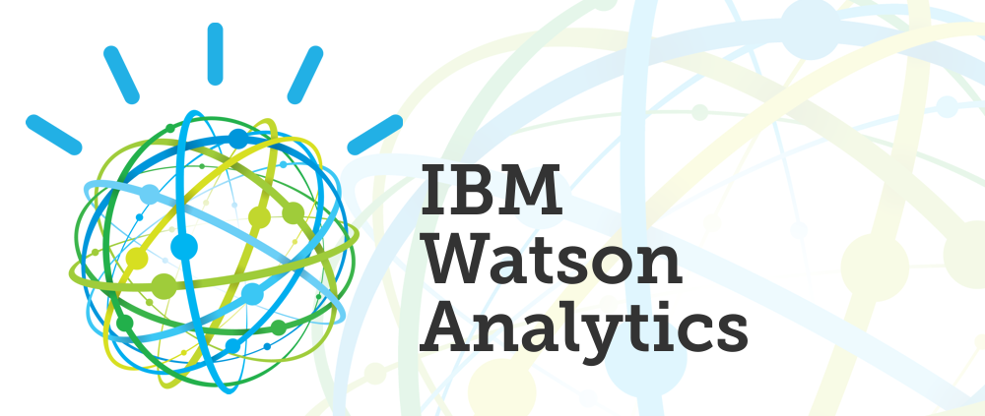
What is Watson Analytics?
Watson Analytics streamlines and simplifies what is typically a complicated process by automatically spotting interesting correlations and exceptions within the data you load.

Slide 4
Features

Slide 5
How it works
Step 1
Step 2
Step 3
Predict
Find predictive insights hidden in your data. Learn what drives each behaviour and outcome.
Explore
Explore powerful visualizations of your data and discover patterns and relationships.
Assemble
Creative interactive dashboards to monitor key details. Share and collaborate with others.

Slide 6
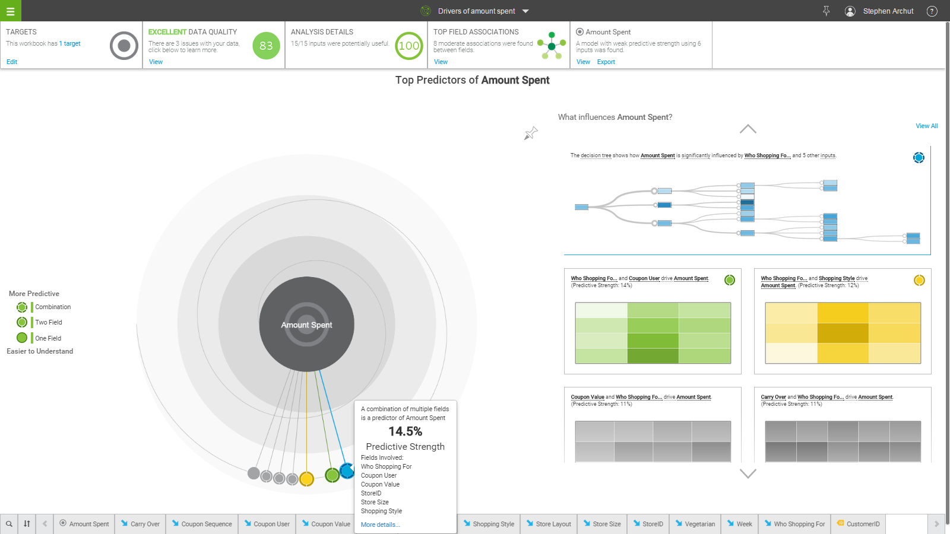

Slide 7
General Framework And Architecture

Slide 8
General Framework and architecture
Question Analysis
Relation Detection
Primary Search
The system attempts to understand what the question is asking and performs the initial analyses that determine how the question will be processed by system.
Watson uses relation detection throughout the QA process, from focus and LAT determination, to passage and answer scoring.
In primary search, the goal is to find as much potentially answer-bearing content as possible based on the results of question analysis.

Slide 9
General Framework and architecture
Candidate Answer Generation
Evidence Retrieval
Scoring
The system attempts to understand what the question is asking and performs the initial analyses that determine how the question will be processed by system.
To better evaluate each candidate answer that passes the soft filter, the system gathers additional supporting evidence.
Scoring algorithms determine the degree of certainty that retrieved evidence supports the candidate answers.

Slide 10
Specific Application
Social Media

Slide 11
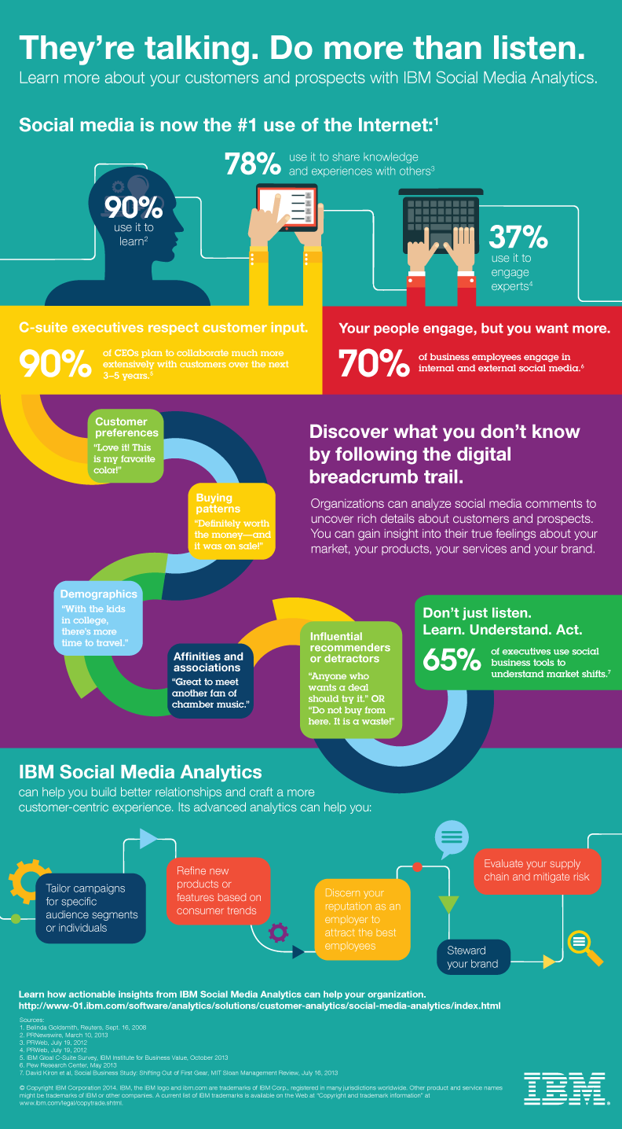
Watson Analytics for Social Media
Takes the pulse of an audience by spotting trends and identifies new insights and relationships
Topic Suggestions quickly display a set of contextual word clusters based on the topics one wants to track.

Slide 12
Potential Applications

Slide 13


Slide 14
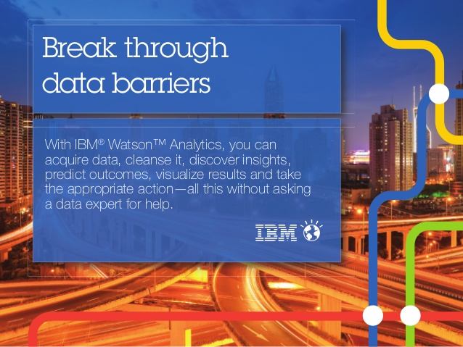
Thank You

