Slide 1
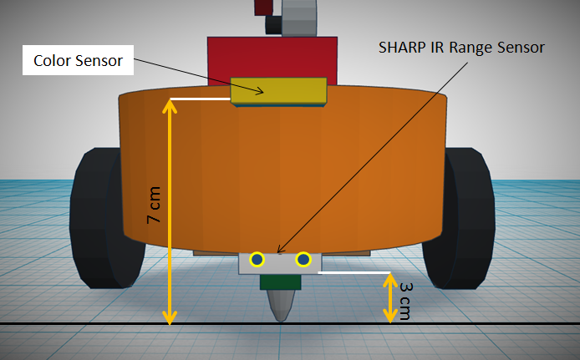

Slide 2
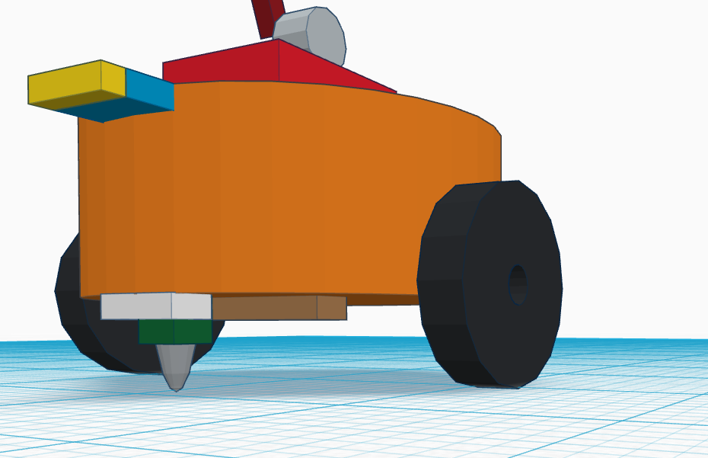
Color Sensor
(At Height of 7 cm )
Sharp IR Range Sensor
(At Height of 3 cm / stick above caster wheel )
White Line Sensor (At Bottom Side)

Slide 3
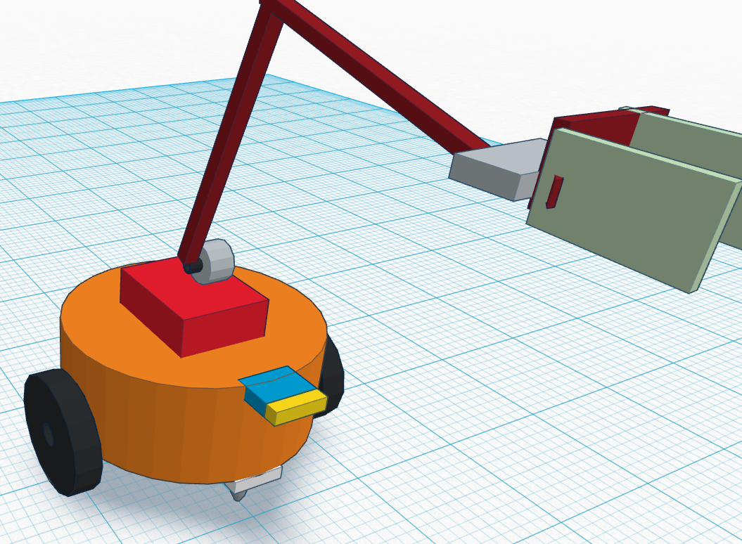
Gripper assembly
Front Side Arm
Color Sensor (At Height of 7 cm )
Base to connect Aram (Height of 3 cm )
Sharp IR Range Sensor
(At Height of 3 cm / stick above caster wheel )

Slide 4
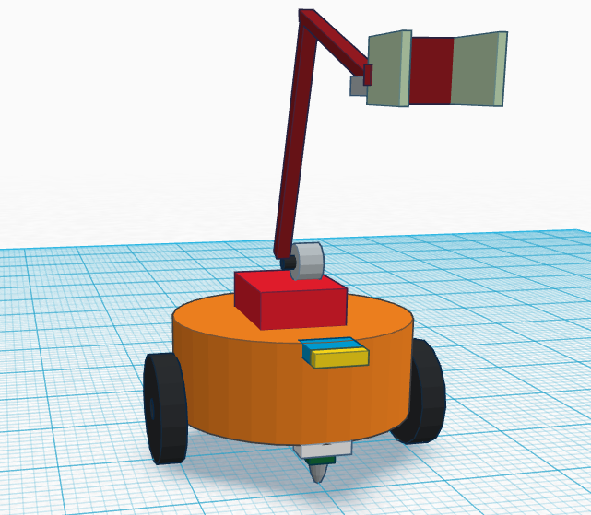
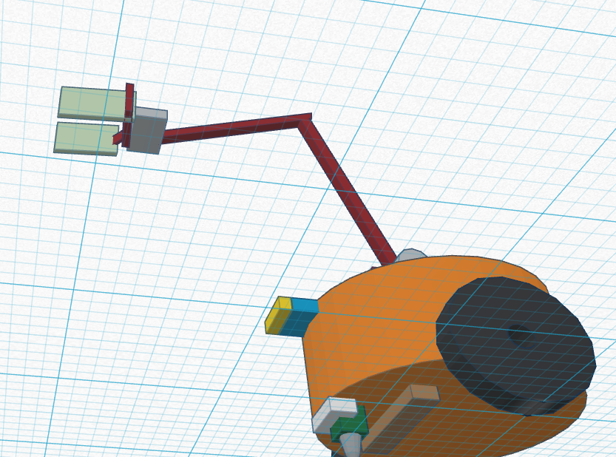
Servo Motor 1
(For controlling position of robotic arm)
Servo Motor 2
(fix on gripper 1 )
Gripper( At front side )

Slide 5
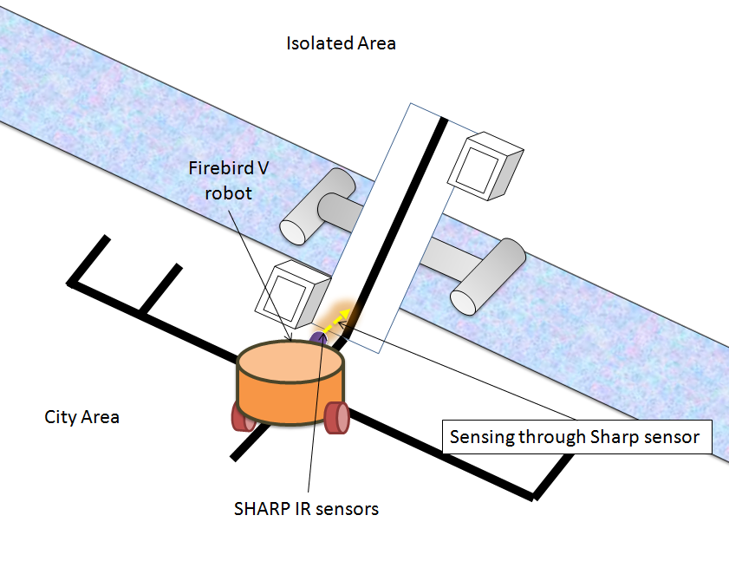

Slide 6
