Slide 1
Upsurge
A Crowd Source Funding Portal
Where innovation is nurtured

Slide 2

There are a lot of students in KJSCE who make several projects/products which interest a lot of people in the market. However, these students do not have enough money to take their product to the market. Also, there are a lot of investors across the world who are ready to invest in such ventures but are unaware of such exciting products. Make a crowdfunding platform for the students of KJSCE to help them raise funds by getting donations, orders etc. so that they can bring their product to the market.
Problem Statement
Student Crowdfunding

Slide 3
Problem Analysis
A portal that can increase the opportunities for Startups in college
Special Perk-based investment scheme for unique projects being developed by students
Portal only needs to draw a large number of small pay investors to support these projects
The portal should increase the reach of such Startups and Freelancers in and out of the campus
Sources:Economic Times

Slide 4
Key Features
Project Crowdfunding
Internships
Custom Orders
Workshops
Allows startups to raise funds by introducing perk based investment strategies
A platform for Startups to post about any internship opportunities
Functionality
Companies can serve custom orders, increasing their market reach
Startups can support initiatives of taking workshops that increase the student’s skills and introduce them to crowdfunding and internship opportunities

Slide 5
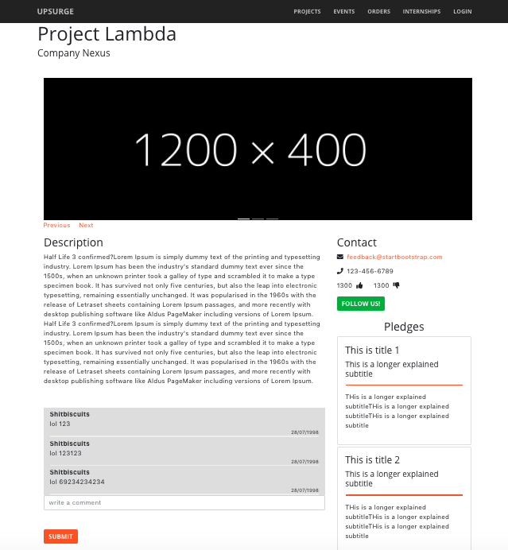
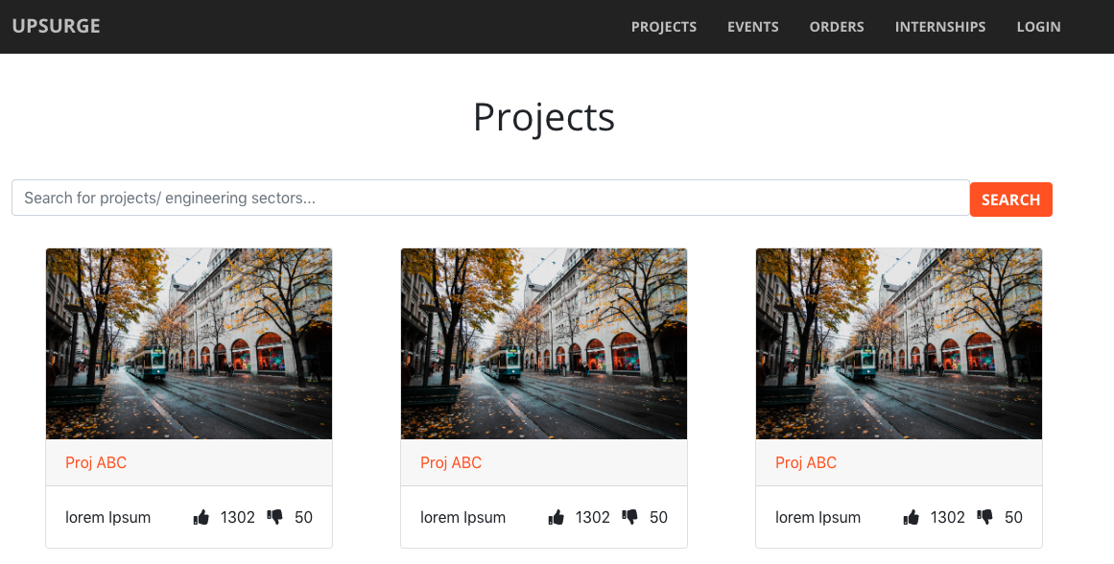
PROJECT CROWDFUNDING
Perk based donations and rewards
Categorization and generalized search for projects

Slide 6
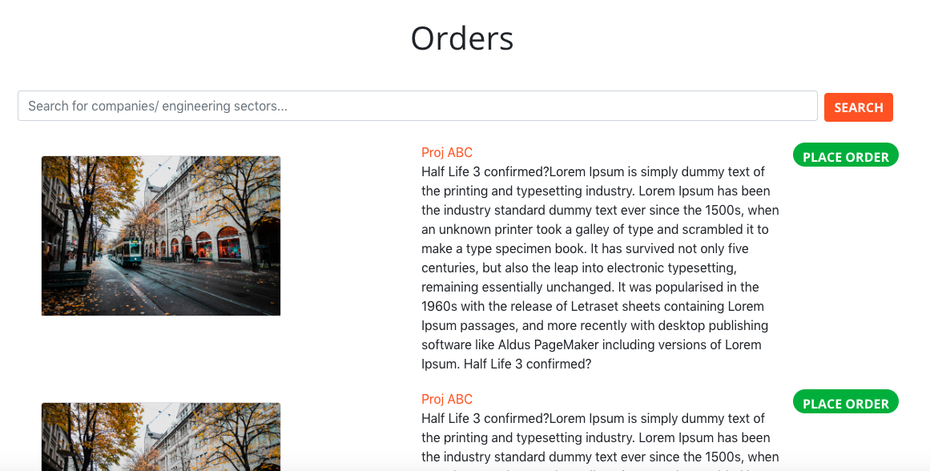
CUSTOM ORDERS
Allowing customers to place custom orders to the startups
Increases market reach of the startup
Startup gets additional business opportunities apart from the Crowd Funding Project
Potential increase in brand value/recognition due to customers searching for Startups rather than the product itself.

Slide 7
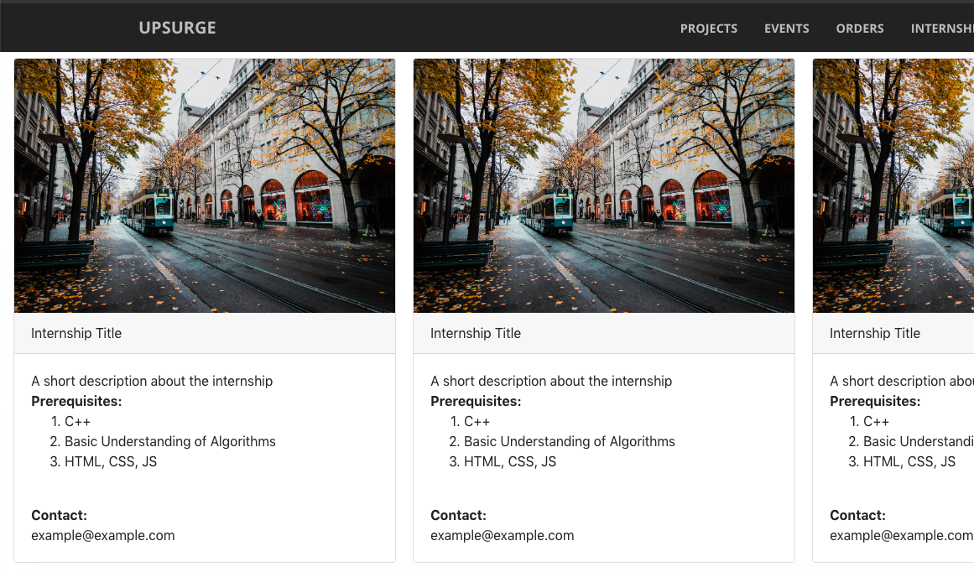
INTERNSHIPS
Startups in KJ Somaiya can approach students with various internship opportunities
Adds more users to the Crowd Funding eco-system and increases the overall investment received from the platform
Students are more likely to search for Internship due to the push by the Government pending regulation of the 3 Mandatory Internships for Engineering Students from the coming year

Slide 8
WORKSHOPS AND INITIATIVES
Startups and other Event organisations get an opportunity to publicize their events
Startups can conduct workshops with incentives of Internships for selected students.
The Workshop becomes a Training + Selection process for Startups
College benefits from such events due to higher student interaction and more exposure to newer technologies and market norms.

Slide 9



Codebase Technologies
React
MySQL
Flask
REACT
PYTHON

Slide 10
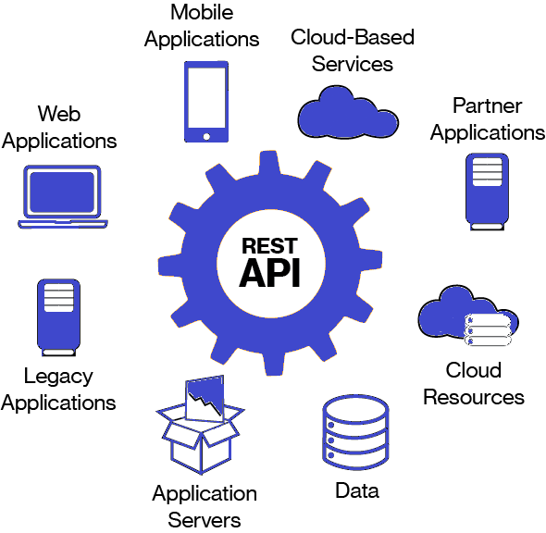
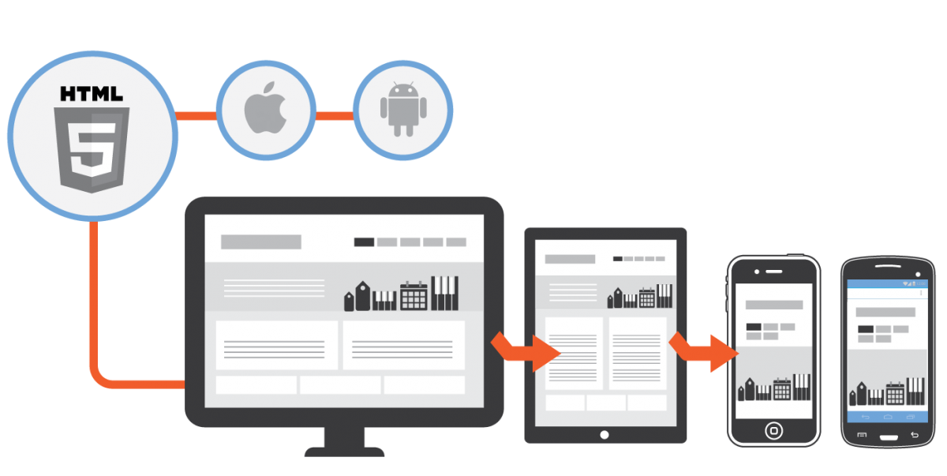
PLATFORM FEATURES
Responsive Web Application
REST API

Slide 11
Future Scope Escrow
Buyer Seller - agree to terms
Buyer pays to escrow contract
Buyer accepts product
Escrow contract pays to seller
Smart Contract - Third Party
More Confidential returns
Transaction secured against any false goods/frauds

Slide 12
Our Team
Ameya Daddikar
Rishabh Bansal
Vineet Rao
Vinayak Borhade

