Slide 1
RELOOP AI / RESOURCE REUSE NETWORK
ReLoop AI
Campus
surplus
Campus resources.
A second life in education.
School
request
Campus-to-School Resource Reuse Network
RAG guidance + agent-assisted reuse planning
Inspected
resource reuse
Rishabh Bansal
Maharaja Agrasen Institute of Technology
(MAIT), Delhi
1M1B internship with IBM SkillsBuild & AICTE
01
Notes:
Title and internship attribution follow the supplied brief. College confirmed by the user as MAIT Delhi. This prototype does not claim an IBM model integration.

Slide 2
RELOOP AI / RESOURCE REUSE NETWORK
A usable monitor can miss its next classroom
TARGET USERS
CAMPUS STORES & PROCUREMENT STAFF
SCHOOL COORDINATOR
Surplus equipment
sits outside the
purchasing workflow.
“We need two displays
for our computer lab.”
How might AI connect reusable campus stock with school needs
so institutions can avoid unnecessary purchases?
02
Notes:
Problem hypothesis: disconnected inventory and purchasing workflows can hide useful stock. Validate through campus stock records and interviews. No claim has been made that this problem has already been measured at the student’s college.

Slide 3
RELOOP AI / RESOURCE REUSE NETWORK
SDG 12 leads the project
12
04
Quality Education
Equip learning spaces.
Check continued school use.
Responsible Consumption
and Production
17
Partnerships for the Goals
Keep usable equipment in service.
Measure accepted reuse and mass.
Enable school sharing.
Track active partners.
03
Notes:
Sources: https://sdgs.un.org/goals/goal12 ; https://sdgs.un.org/goals/goal4 ; https://sdgs.un.org/goals/goal17 . SDG 12 target 12.5 is the primary alignment. SDG 4 contribution is access to functional educational resources; learning gains are not established. SDG 17 is an intended institutional partnership contribution, not evidence of existing formal partnerships.

Slide 4
RELOOP AI / RESOURCE REUSE NETWORK
A reuse loop with people at the decision point
Describe the need
Rank suitable stock
Inspect and approve
Request + recipient
Quantity + distance
Text relevance + eligibility
Repair preference + stock
Follow up on use
Record the transfer
Planned pilot
30 / 90 days
Implemented
Stock + reuse ledger
04
Notes:
Editable flow diagram is the prototype evidence permitted by the internship guidelines. Inspection is a human confirmation in the demo, not an independent safety certificate. Continued-use tracking is proposed pilot work. Source: reloop.py and web_app.py in https://github.com/rishabh230707-afk/ReLoop-AI .

Slide 5
RELOOP AI / RESOURCE REUSE NETWORK
AI retrieves candidates. Rules check eligibility.
01
Understand the wording
THE REQUEST
Normalize supported terms before search.
“display for
computer lab”
02
Rank descriptions
TF-IDF and cosine similarity score inventory.
03
Apply practical constraints
Check recipient, distance, stock and repairs.
Supported synonym:
display = monitor
04
Explain the recommendation
Show matched terms for human review.
05
Notes:
This is an implemented classic NLP retrieval baseline, combined with deterministic business rules. Similarity is not a probability or safety assessment. Unsupported and multi-item requests ask for clarification. The inventory baseline remains classic NLP. A separate local Ollama assistant now implements generative RAG and model-selected tool calls. IBM Granite and IBM BOB are not integrated. Tools: Python standard library, HTML, CSS and JavaScript; no API key required. Compare advanced models only after measuring baseline usefulness.

Slide 6
RELOOP AI / RESOURCE REUSE NETWORK
RAG grounds answers in reuse guidance
Question
Retrieve
excerpts
Local
model
Check
citations
Knowledge base
Answer with evidence
Project-authored rules, impact methods
and responsible AI guidance.
Heading chunks + TF-IDF retrieval.
Generated claims include source IDs.
Missing evidence triggers abstention.
A person checks what the excerpts support.
06
Notes:
Implemented in ai_assistant.py. Knowledge is project-authored prototype guidance, not official MAIT policy. Actual RAG generation requires local Ollama. No-model mode returns labelled excerpts only. Source identifiers and answer schema are validated, not semantic entailment. Models can misinterpret evidence. Source: https://docs.ollama.com/api/chat . Live model output has not been evaluated in the build environment.

Slide 7
RELOOP AI / RESOURCE REUSE NETWORK
The agent chooses tools within fixed limits
01
Search inventory
MODEL PLANNER
Use the user’s fixed recipient and constraints.
Select a tool.
Observe its result.
Choose the next step.
02
Retrieve guidance
Bring inspection and reuse rules into the plan.
03
Estimate reuse
Calculate a draft from eligible, observed stock.
Up to 6 turns / 8 calls
No transfer tool. The user must inspect and confirm.
07
Notes:
The Ollama model selects tool calls and receives observations. The controller exposes only search_inventory, retrieve_guidance and estimate_reuse. Unknown tools or extra arguments are rejected. Estimate requires an item from the current eligible search and retrieved guidance. Python calculates amounts. No stock is reserved or written. The normal confirmation endpoint revalidates stock. Agent model behavior was tested with explicit scripted responses, not live inference. Source: https://docs.ollama.com/capabilities/tool-calling .

Slide 8
RELOOP AI / RESOURCE REUSE NETWORK
Two modes, clearly labelled
OLLAMA MODE
NO-MODEL PREVIEW
Generative RAG
Model-selected tools
Retrieved excerpts
Scripted tool sequence
Requires Ollama and a local model.
Questions and context stay on-device.
Runs immediately with Python.
Clearly labelled as a preview.
31 automated tests pass. Live-model quality and latency still need validation.
08
Notes:
Validation: python3 -m unittest test_reloop.py test_ai_assistant.py test_web_ai.py passed 31 tests. Coverage includes source retrieval, invalid citations, abstention, agent tool restrictions, partial stock, unapproved recipients, no automatic writes and HTTP routes. Scripted model responses test the model protocol without claiming real inference. Ollama was not installed in the build environment. New assistant UI has not been visually tested in a live browser here.

Slide 9
RELOOP AI / RESOURCE REUSE NETWORK
Running the full AI assistant
01 Install and start Ollama
02 ollama pull qwen3:4b
03 python3 web_app.py --ai-mode ollama
Open Reuse assistant. Ask about inspection, then prepare a reuse plan.
Setup: docs/AI_SETUP.md • No API key required
09
Notes:
Example local model is Qwen3:4b, not IBM Granite. Default --model is qwen3:4b. It is downloaded once through Ollama. Check hardware suitability and available memory. Install: https://ollama.com/download . Model: https://ollama.com/library/qwen3:4b . The default python3 web_app.py runs preview mode. Configuration banner alone does not prove model connectivity; verify a successful answer and tool trace.

Slide 10
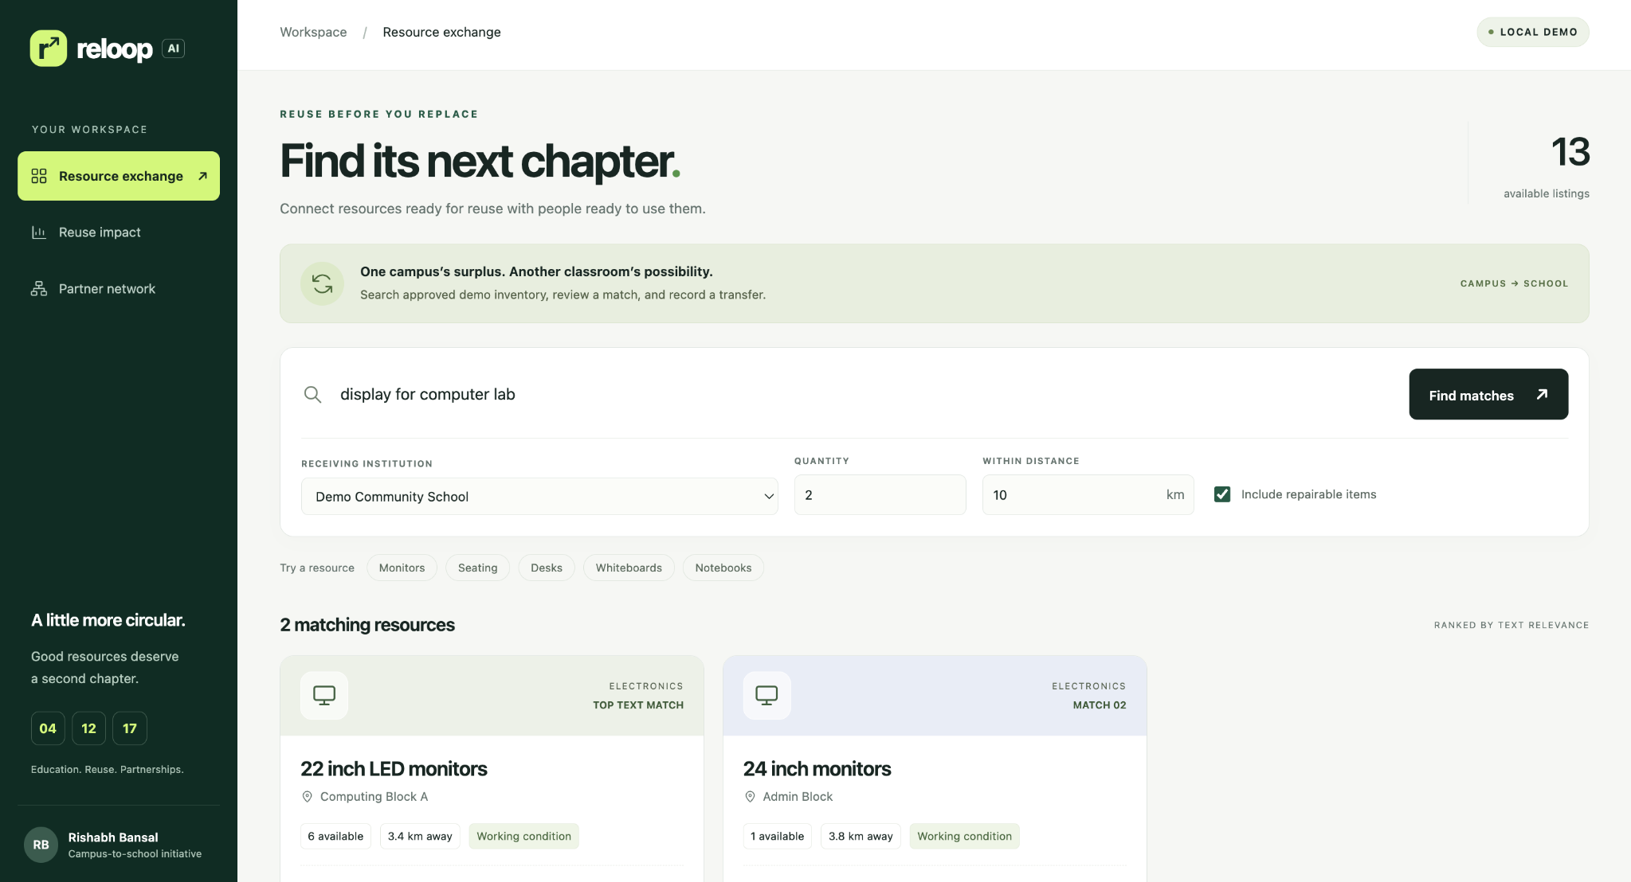
The prototype finds reusable resources
School request: 2 displays within 10 km. This view follows earlier demo transfers.
Notes:
User-supplied screenshot of the original local ReLoop AI workspace before the assistant tab was added. Synthetic demo data, not measured environmental or educational outcomes. The visible session has four school units and two transfers, with 14 kg estimated mass and INR0 displayed savings. Initial inventory counts and the separate CLI example differ from this session.

Slide 11
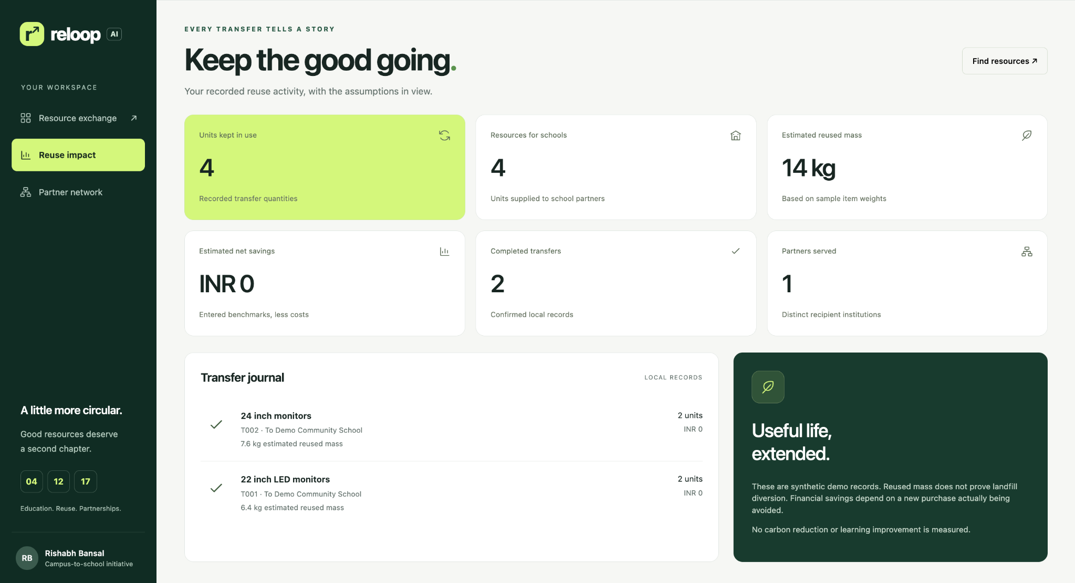
The ledger records each demo transfer
4 units reused. Estimated mass: 14 kg. Two transfers. Displayed savings: ₹0.
Notes:
User-supplied screenshot of the original local ReLoop AI workspace before the assistant tab was added. Synthetic demo data, not measured environmental or educational outcomes. The visible session has four school units and two transfers, with 14 kg estimated mass and INR0 displayed savings. Initial inventory counts and the separate CLI example differ from this session.

Slide 12
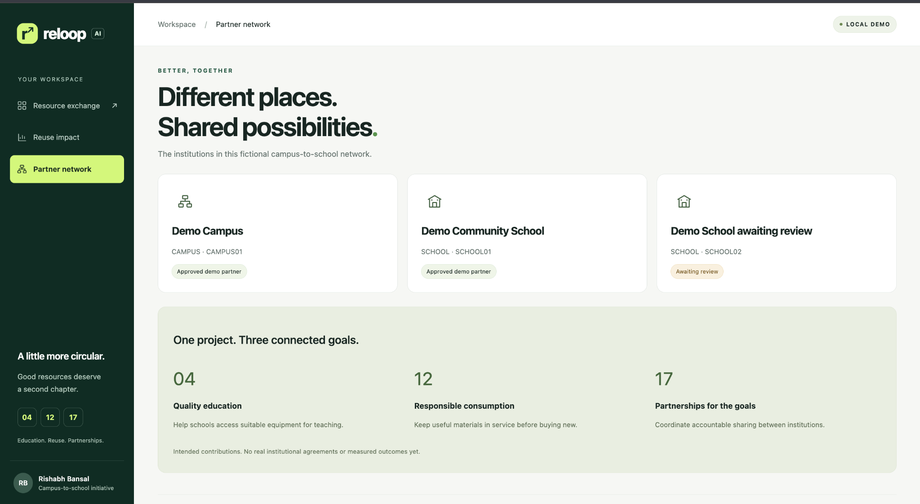
The network tracks partner eligibility
Two approved demo partners and one awaiting review. All institutions are fictional.
Notes:
User-supplied screenshot of the original local ReLoop AI workspace before the assistant tab was added. Synthetic demo data, not measured environmental or educational outcomes. The visible session has four school units and two transfers, with 14 kg estimated mass and INR0 displayed savings. Initial inventory counts and the separate CLI example differ from this session.

Slide 13
RELOOP AI / RESOURCE REUSE NETWORK
What makes this approach distinctive?
01
Reuse before purchase
Begin with a real equipment need, then search existing stock.
02
School-aware matching
Apply recipient eligibility and school-sharing permissions.
03
A traceable transfer
Connect the match to approval, stock updates and reuse estimates.
Future concept: a resource passport with repair history and reuse follow-up.
13
Notes:
Distinctive choices in this project are reuse before buying, school eligibility filtering and a local transfer ledger. No claim of global novelty is made. A resource passport is a proposed future feature, not implemented: it could record item condition, maintenance, transfers and continued use, with institutional access controls.

Slide 14
RELOOP AI / RESOURCE REUSE NETWORK
Responsible AI is part of the workflow
Fairness
Test varied vocabulary. Review missed needs.
Transparency
Show sources, tool activity and model limits.
Privacy
Use fictional data. Collect no student details.
Ethics
Agent proposes. A person inspects and confirms.
14
Notes:
Fairness: description quality and a limited synonym list can affect discovery. Evaluate requests across schools and departments. Privacy: a production rollout needs institutional roles and access controls; these are not currently implemented. Ethics: food, medicines, chemicals, loose batteries and hazardous items are excluded. Partner approval flags are fictional fixtures, not verified agreements. A human must verify ownership, safe condition and suitability.

Slide 15
RELOOP AI / RESOURCE REUSE NETWORK
A working baseline with a clear test plan
13
9
31
synthetic listings
supported item types
automated tests passed
NEXT: VALIDATE WITH USERS
Interview campus and school staff. Confirm the visibility gap.
Label 50 requests and measure useful matches.
Refine the prototype with mentor feedback.
15
Notes:
Design thinking: empathize and validate the stated problem through planned interviews; define the inventory visibility gap; ideate a reuse-before-purchase workflow; prototype retrieval and a transfer ledger; test and refine. 31 test methods verify core, assistant and HTTP behavior, not real-world AI accuracy. Model tests use scripted responses. Live Ollama inference has not been tested in this environment. HTTP integration checks cover assets, matching, invalid token, fractional quantity, unapproved school and persisted transfer totals. Original interface screenshots were supplied by the user. The added assistant view has not been visually tested in a live browser here. User interviews and mentor feedback are planned, not completed.

Slide 16
RELOOP AI / RESOURCE REUSE NETWORK
From one local demo to an institutional network
NOW
Local prototype
PILOT
Campus + school
SCALE
Single user
Synthetic partners
JSON stock ledger
Shared network
Verified stock
Partner agreements
Human transfer review
Transactional database
Roles and reservations
Procurement integration
16
Notes:
Scalability is a proposed design, not a current capability. Move local JSON state to a transactional database. Add tenant-aware access, reservations and concurrency control to prevent double allocation; verified listings and partner agreements; accessible interfaces and procurement integration. Evaluate cost, transport and refurbishment before expanding.

Slide 17
RELOOP AI / RESOURCE REUSE NETWORK
Impact means equipment that stays useful
10
Environment
Extend item life and avoid some new purchases.
accepted transfers
Education
Supply usable equipment to learning spaces.
Proposed pilot target
Institutions
30 / 90 days
Build a repeatable sharing process.
Continued-use checks
17
Notes:
Impact statement: If implemented successfully, ReLoop AI could make checking existing resources a routine step before purchasing, extending useful item life while improving access to school equipment through institutional collaboration. Environmental benefits depend on continued use, displaced purchases and collection/refurbishment costs. Do not equate equipment delivery with learning gains. All pilot targets are proposed.

Slide 18
RELOOP AI / RESOURCE REUSE NETWORK
ReLoop AI
A reuse check before
the next purchase.
github.com/rishabh230707-afk/ReLoop-AI
Browser demo: python3 web_app.py
School example: python3 reloop.py school-demo
Sources: internship brief, project code and UN SDGs 4, 12, 17
18
Notes:
Repository: https://github.com/rishabh230707-afk/ReLoop-AI . Run commands from the extracted repository folder with Python 3 installed. Browser address http://127.0.0.1:8765 . School demo runs synthetic in-memory data. Sources: student-provided internship guidelines; https://sdgs.un.org/goals/goal4 ; https://sdgs.un.org/goals/goal12 ; https://sdgs.un.org/goals/goal17 . College name confirmed as MAIT Delhi.

