Slide 1

IBM UNIVERSITY ENGAGEMENT PROJECT SUBMISSION
IBM SkillsBuild | Edunet Foundation | AICTE Virtual Internship 2026–27
Eco Lifestyle Agent
with IBM Granite and LangFlow
A RAG-Based Sustainable Living Assistant
Built using IBM Cloud Lite, IBM watsonx.ai, IBM Granite Foundation Models, LangFlow and Retrieval-Augmented Generation (RAG)
Recent Passport Photo
Student Name
College
Email ID
Mobile [WhatsApp]
Domain
Rishabh Bansal
Maharaja Agrasen Institute of Technology (MAIT)
rishabhb2307@gmail.com
8595803248
Artificial Intelligence / Sustainability
1
Mandatory Stack
2
Submission Focus
3
Project Outcome
IBM Cloud Lite • IBM Granite • RAG
Agentic AI for sustainable living
Personalized eco guidance assistant
IBM SkillsBuild | Edunet Foundation | AICTE Virtual Internship 2026–27
1

Slide 2

02
AICTE INTERNSHIP 2026
IBM
Project Title –
Eco Lifestyle Agent
Domain of Project –
Domain of Project –
Environment / Sustainability / AI for Sustainability
Environment / Sustainability / AI for Sustainability
College – Maharaja Agrasen Institute of Technology (MAIT)
College – Maharaja Agrasen Institute of Technology (MAIT)
Student Name
Recent Passport Photo
Email ID
Mobile number [WhatsApp]
Rishabh Bansal
rishabhb2307@gmail.com
8595803248

Slide 3
PROBLEM STATEMENT
Problem Statement: Eco Lifestyle Agent
The challenge is fragmented, generic, and non-personalized sustainability information
The Challenge
The Objective
• Reliable sustainability information is scattered across government portals, NGO resources, product websites and local service pages.
• Existing search results are generic and do not adapt to user location, lifestyle, budget or habits.
• Users struggle to find local recycling rules, eco-friendly alternatives and government schemes in one place.
• A conversational AI assistant is needed to convert trusted environmental data into practical daily actions.
• Build an AI-powered Eco Lifestyle Agent that answers natural language questions.
• Use RAG to retrieve trusted environmental information before response generation.
• Generate personalized, actionable recommendations using IBM Granite Foundation Models.
• Deploy on IBM Cloud Lite using a scalable, enterprise-ready architecture.
Example Questions the Agent Can Handle
How can I reduce plastic use at home?
What are eco-friendly travel options in my city?
Where can I recycle e-waste?
Which schemes support solar adoption?
IBM SkillsBuild | Edunet Foundation | AICTE Virtual Internship 2026–27
3

Slide 4
PROPOSED SOLUTION
Proposed Solution
A RAG-powered, agentic sustainability assistant built on IBM Cloud and Granite
The Eco Lifestyle Agent combines trusted environmental knowledge with IBM Granite reasoning to deliver personalized, grounded sustainability guidance. The system retrieves relevant documents first, then generates a response using the retrieved context, reducing hallucinations and improving reliability.
KB
Knowledge Base
VR
Vector Retrieval
AI
IBM Granite
UI
Flask Interface
Eco tips, recycling rules, government schemes, product guidance
Semantic search over FAISS/Chroma embeddings
Reasoning, summarization and response generation
Simple user-facing chat interface with REST APIs
User Query
Retrieve Trusted Data
IBM Granite Generates
Actionable Eco Advice
Expected Impact: Better awareness, easier sustainable choices, and faster access to trusted eco guidance.
IBM SkillsBuild | Edunet Foundation | AICTE Virtual Internship 2026–27
4

Slide 5
TECHNOLOGY USED
Technology Used
Enterprise-grade tools aligned with IBM SkillsBuild project requirements
Component
Use in Eco Lifestyle Agent
LangFlow Platform
Visual orchestration of the RAG workflow using connected input, retrieval, model and output components.
IBM Granite Foundation Model
Natural language understanding, reasoning, summarization and personalized answer generation.
IBM watsonx.ai
IBM AI platform for accessing Granite foundation models, experimentation and governance-ready AI workflows.
IBM Cloud Lite
Cloud infrastructure for hosting, services, storage and scalable deployment.
RAG Pipeline
Retrieves verified environmental data first, then generates grounded responses.
Vector Database
FAISS/Chroma for embedding storage and semantic similarity search.
Python + Flask
Backend application layer and lightweight chat interface.
REST APIs
Integration layer connecting UI, retrieval logic and model response generation.
IBM SkillsBuild | Edunet Foundation | AICTE Virtual Internship 2026–27
5

Slide 6
LANGFLOW COMPONENTS
LangFlow Components Used
Reusable visual building blocks for the Eco Lifestyle Agent workflow
1) Chat Input
2) File / Document Loader
Collects user questions such as plastic reduction, green travel or recycling help.
Loads environmental documents, sustainability guides and scheme information.
3) Text Splitter
4) Embedding Model
Breaks long documents into smaller chunks for retrieval.
Converts text chunks and user queries into vector representations.
5) Vector Store
6) Retriever
Stores embeddings in FAISS/Chroma for semantic search.
Fetches the most relevant chunks for the current user query.
7) IBM watsonx AI Agent
8) Chat Output
Uses IBM Granite to reason over retrieved context and generate the final answer.
Displays grounded, actionable sustainability guidance to the user.
IBM SkillsBuild | Edunet Foundation | AICTE Virtual Internship 2026–27
6

Slide 7
LANGFLOW WORKFLOW
LangFlow Workflow
Document Loader
Text Splitter
Embeddings
Vector DB
Visual orchestration of the Eco Lifestyle Agent pipeline
Chat Input
Prompt Template
Retriever
IBM watsonx AI Agent (Granite)
Chat Output
Workflow Explanation
• LangFlow provides a visual pipeline that connects input, retrieval, reasoning and output components.
• The workflow keeps the system modular, transparent and easier to debug during development.
• IBM Granite generates the final response only after relevant environmental context is retrieved.
IBM SkillsBuild | Edunet Foundation | AICTE Virtual Internship 2026–27
7

Slide 8
ARCHITECTURE BLUEPRINT
Architecture Blueprint
User Layer
Application Layer
AI Layer
Retrieval Layer
Data Layer
End-to-end architecture for the Eco Lifestyle Agent
User / Browser
Flask Web UI + REST API
watsonx.ai IBM Granite
RAG Retriever FAISS / Chroma
Eco Knowledge Base COS Documents
Recycling Guidelines
Grounded Answering
Personalization
RAG retrieves trusted documents so Granite can generate responses anchored in verified context.
User context such as city, habit, goal or lifestyle preference improves recommendation quality.
Govt. Schemes
Eco Product Data
Scalable Deployment
Explainability
IBM Cloud Lite supports development, testing and service-based deployment for the assistant.
The system can cite retrieved knowledge sources and show why a suggestion was recommended.
Energy & Water Tips
IBM SkillsBuild | Edunet Foundation | AICTE Virtual Internship 2026–27
8

Slide 9
AGENTIC AI
Role of Agentic AI in the Solution
How the assistant behaves as a goal-driven AI system rather than a simple chatbot
Agentic AI enables the Eco Lifestyle Agent to autonomously plan, retrieve information, reason over context, decide the most useful recommendation, and adapt the answer to user needs.
1. Planning Understand user goal
6. Response Deliver guidance
2. Retrieval Search trusted data
• Acts as an intelligent assistant, not only a static FAQ bot.
• Coordinates retrieval, reasoning and response generation as a multi-step workflow.
• Improves relevance by considering the user’s intent, location and sustainability goal.
• Supports continuous improvement through feedback and knowledge base updates.
Eco Agent
5. Personalization Adapt to context
3. Reasoning Apply Granite logic
4. Decision Select best action
Outcome
A proactive, context-aware and goal-driven digital sustainability advisor.
IBM SkillsBuild | Edunet Foundation | AICTE Virtual Internship 2026–27
9

Slide 10
RAG PIPELINE
RAG Workflow & Prompt Engineering
How retrieval improves accuracy and converts questions into grounded answers
User Query
Embedding
Vector Search
Context Docs
Prompt Build
Granite
Response
Prompt Strategy
System Instruction
Retrieved Context
Output Format
Act as an eco lifestyle advisor. Use retrieved context only and avoid unsupported claims.
Relevant chunks from recycling rules, sustainability guides and scheme documents.
Actionable steps, local considerations, safety notes and optional follow-up questions.
Why RAG?
• Reduces hallucinations by grounding responses in retrieved documents.
• Allows updates without retraining the foundation model.
• Supports domain-specific knowledge such as recycling rules and schemes.
• Improves transparency because retrieved evidence can be shown to the user.
IBM SkillsBuild | Edunet Foundation | AICTE Virtual Internship 2026–27
10

Slide 11
TOKEN USAGE
Token Usage & Prompt Optimization
How the prompt was structured to control cost, improve clarity and keep answers grounded
Before Prompt
After Prompt
“Give me eco tips for daily life.” Problem: broad, generic, no retrieved context, no output format.
“Act as an Eco Lifestyle Agent. Use retrieved environmental context to provide 5 practical actions. Avoid unsupported claims.”
Prompt Inputs
Context Control
Optimization
Outcome
User query + retrieved chunks + concise system instruction.
Top-k retrieved documents limit unnecessary token growth.
Reusable prompt template, structured answer format, fewer repeated instructions.
Focused, consistent and grounded responses with lower model usage.
Note: Exact token usage should be verified from watsonx.ai or deployment analytics during live execution. The prototype is optimized using compact prompts and limited retrieved context.
IBM SkillsBuild | Edunet Foundation | AICTE Virtual Internship 2026–27
11

Slide 12
NOVELTY
Novelty and Uniqueness
What makes the Eco Lifestyle Agent more than a static information portal
1
Agentic AI
2
RAG-Based Accuracy
3
Context Awareness
Plans, retrieves, reasons and responds through a goal-oriented workflow.
Combines search over trusted documents with IBM Granite generation.
Adapts responses based on user goal, lifestyle and location context.
4
Government Scheme Integration
5
Sustainable Decision Support
6
Enterprise Readiness
Surfaces relevant environmental policies and public schemes.
Converts complex information into small daily actions.
Uses IBM Cloud Lite, watsonx.ai and modular architecture for scalability.
The solution is unique because it combines environmental knowledge retrieval, IBM Granite reasoning, and agentic personalization into a single sustainable-living assistant.
IBM SkillsBuild | Edunet Foundation | AICTE Virtual Internship 2026–27
12

Slide 13
RESULTS
Evaluation Metrics & Expected Results
Metrics used to validate technical quality and user impact
Response Relevance
Grounded Responses
Hallucination Risk
Target: 90–95%
Enabled
Reduced
Answers align with the retrieved environmental context.
Generated output uses RAG-retrieved documents.
Responses are constrained by trusted knowledge sources.
Retrieval Latency
Scalability
User Experience
Target: <2 sec
High
Conversational
Fast semantic search over FAISS/Chroma vectors.
Cloud-native architecture using IBM Cloud Lite services.
Simple natural language interface for non-technical users.
Expected Outcome: A trustworthy, scalable and easy-to-use AI assistant that helps users make informed eco-conscious decisions.
IBM SkillsBuild | Edunet Foundation | AICTE Virtual Internship 2026–27
13

Slide 14
DEMO
Demo & Sample Conversations
Representative interactions showing grounded sustainability guidance
User: How can I reduce plastic waste at home?
Prototype Interaction Flow
Agent: Use cloth bags, avoid single-use cutlery, switch to refill products, carry a steel bottle and segregate plastic waste correctly.
1
User Query
User: Suggest eco-friendly transportation options.
2
RAG Retrieval
Agent: Prefer public transport, cycling, walking, carpooling or electric vehicles. For short distances, walking and cycling have the lowest footprint.
3
Context Selection
User: How can I reduce electricity consumption?
4
Agent: Use LED bulbs, unplug idle devices, choose star-rated appliances, optimize AC temperature and consider rooftop solar.
IBM Granite Response
The demo validates the core workflow: intent capture → trusted retrieval → grounded recommendation.
IBM SkillsBuild | Edunet Foundation | AICTE Virtual Internship 2026–27
14

Slide 15

GITHUB
GitHub Repository & Code Access
Public repository section as required by the submission template
Repository URL
Repository Status
https://github.com/rishabh230707-afk/eco-lifestyle-agent
Public GitHub repository created and linked for submission.
Repository Contents
• README.md with overview and setup steps • app.json project metadata • app.py Flask backend • requirements.txt and .env.example • src/ RAG engine code • data/ environmental knowledge files • templates/ and static/ web interface files
Scan the QR code or click the URL to open the public project repository.
IBM SkillsBuild | Edunet Foundation | AICTE Virtual Internship 2026–27
15

Slide 16
FUTURE SCOPE
Future Scope
Planned enhancements to make the agent more accessible, intelligent and practical
1
Voice Assistant
2
Regional + Location-Aware Support
3
Carbon Calculator
4
Image Recognition
Hands-free natural language access for daily use.
Hindi/Indian language support with city-specific recycling and scheme data.
Estimate and track personal carbon footprint from habits and choices.
Classify waste items using camera input for correct segregation.
5
IoT Integration
6
Mobile App
7
Gamification
8
Smart Home Integration
Use smart meter and home sensor data for better recommendations.
Always-available sustainable living assistant on mobile devices.
Reward users for completing eco-friendly actions and challenges.
Energy-saving suggestions from appliance usage patterns.
Roadmap
Current RAG Agent
Voice + Regional
Carbon + Image AI
IoT + Mobile
Gamified Impact
IBM SkillsBuild | Edunet Foundation | AICTE Virtual Internship 2026–27
16

Slide 17
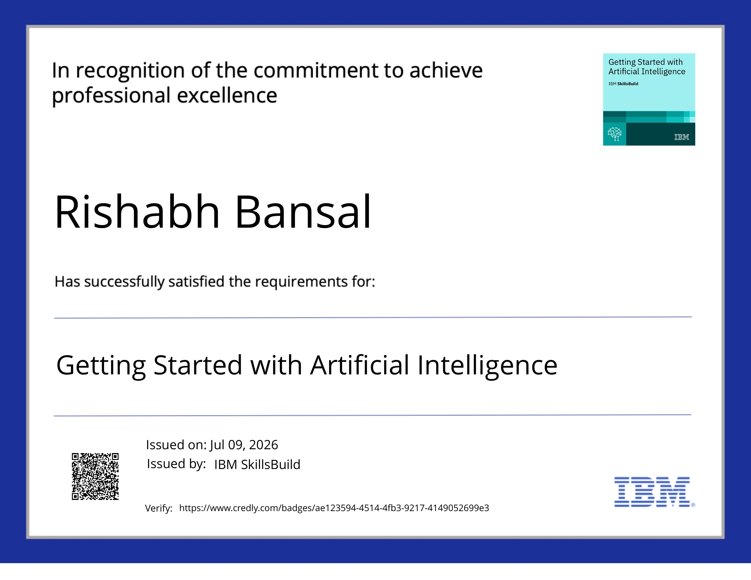
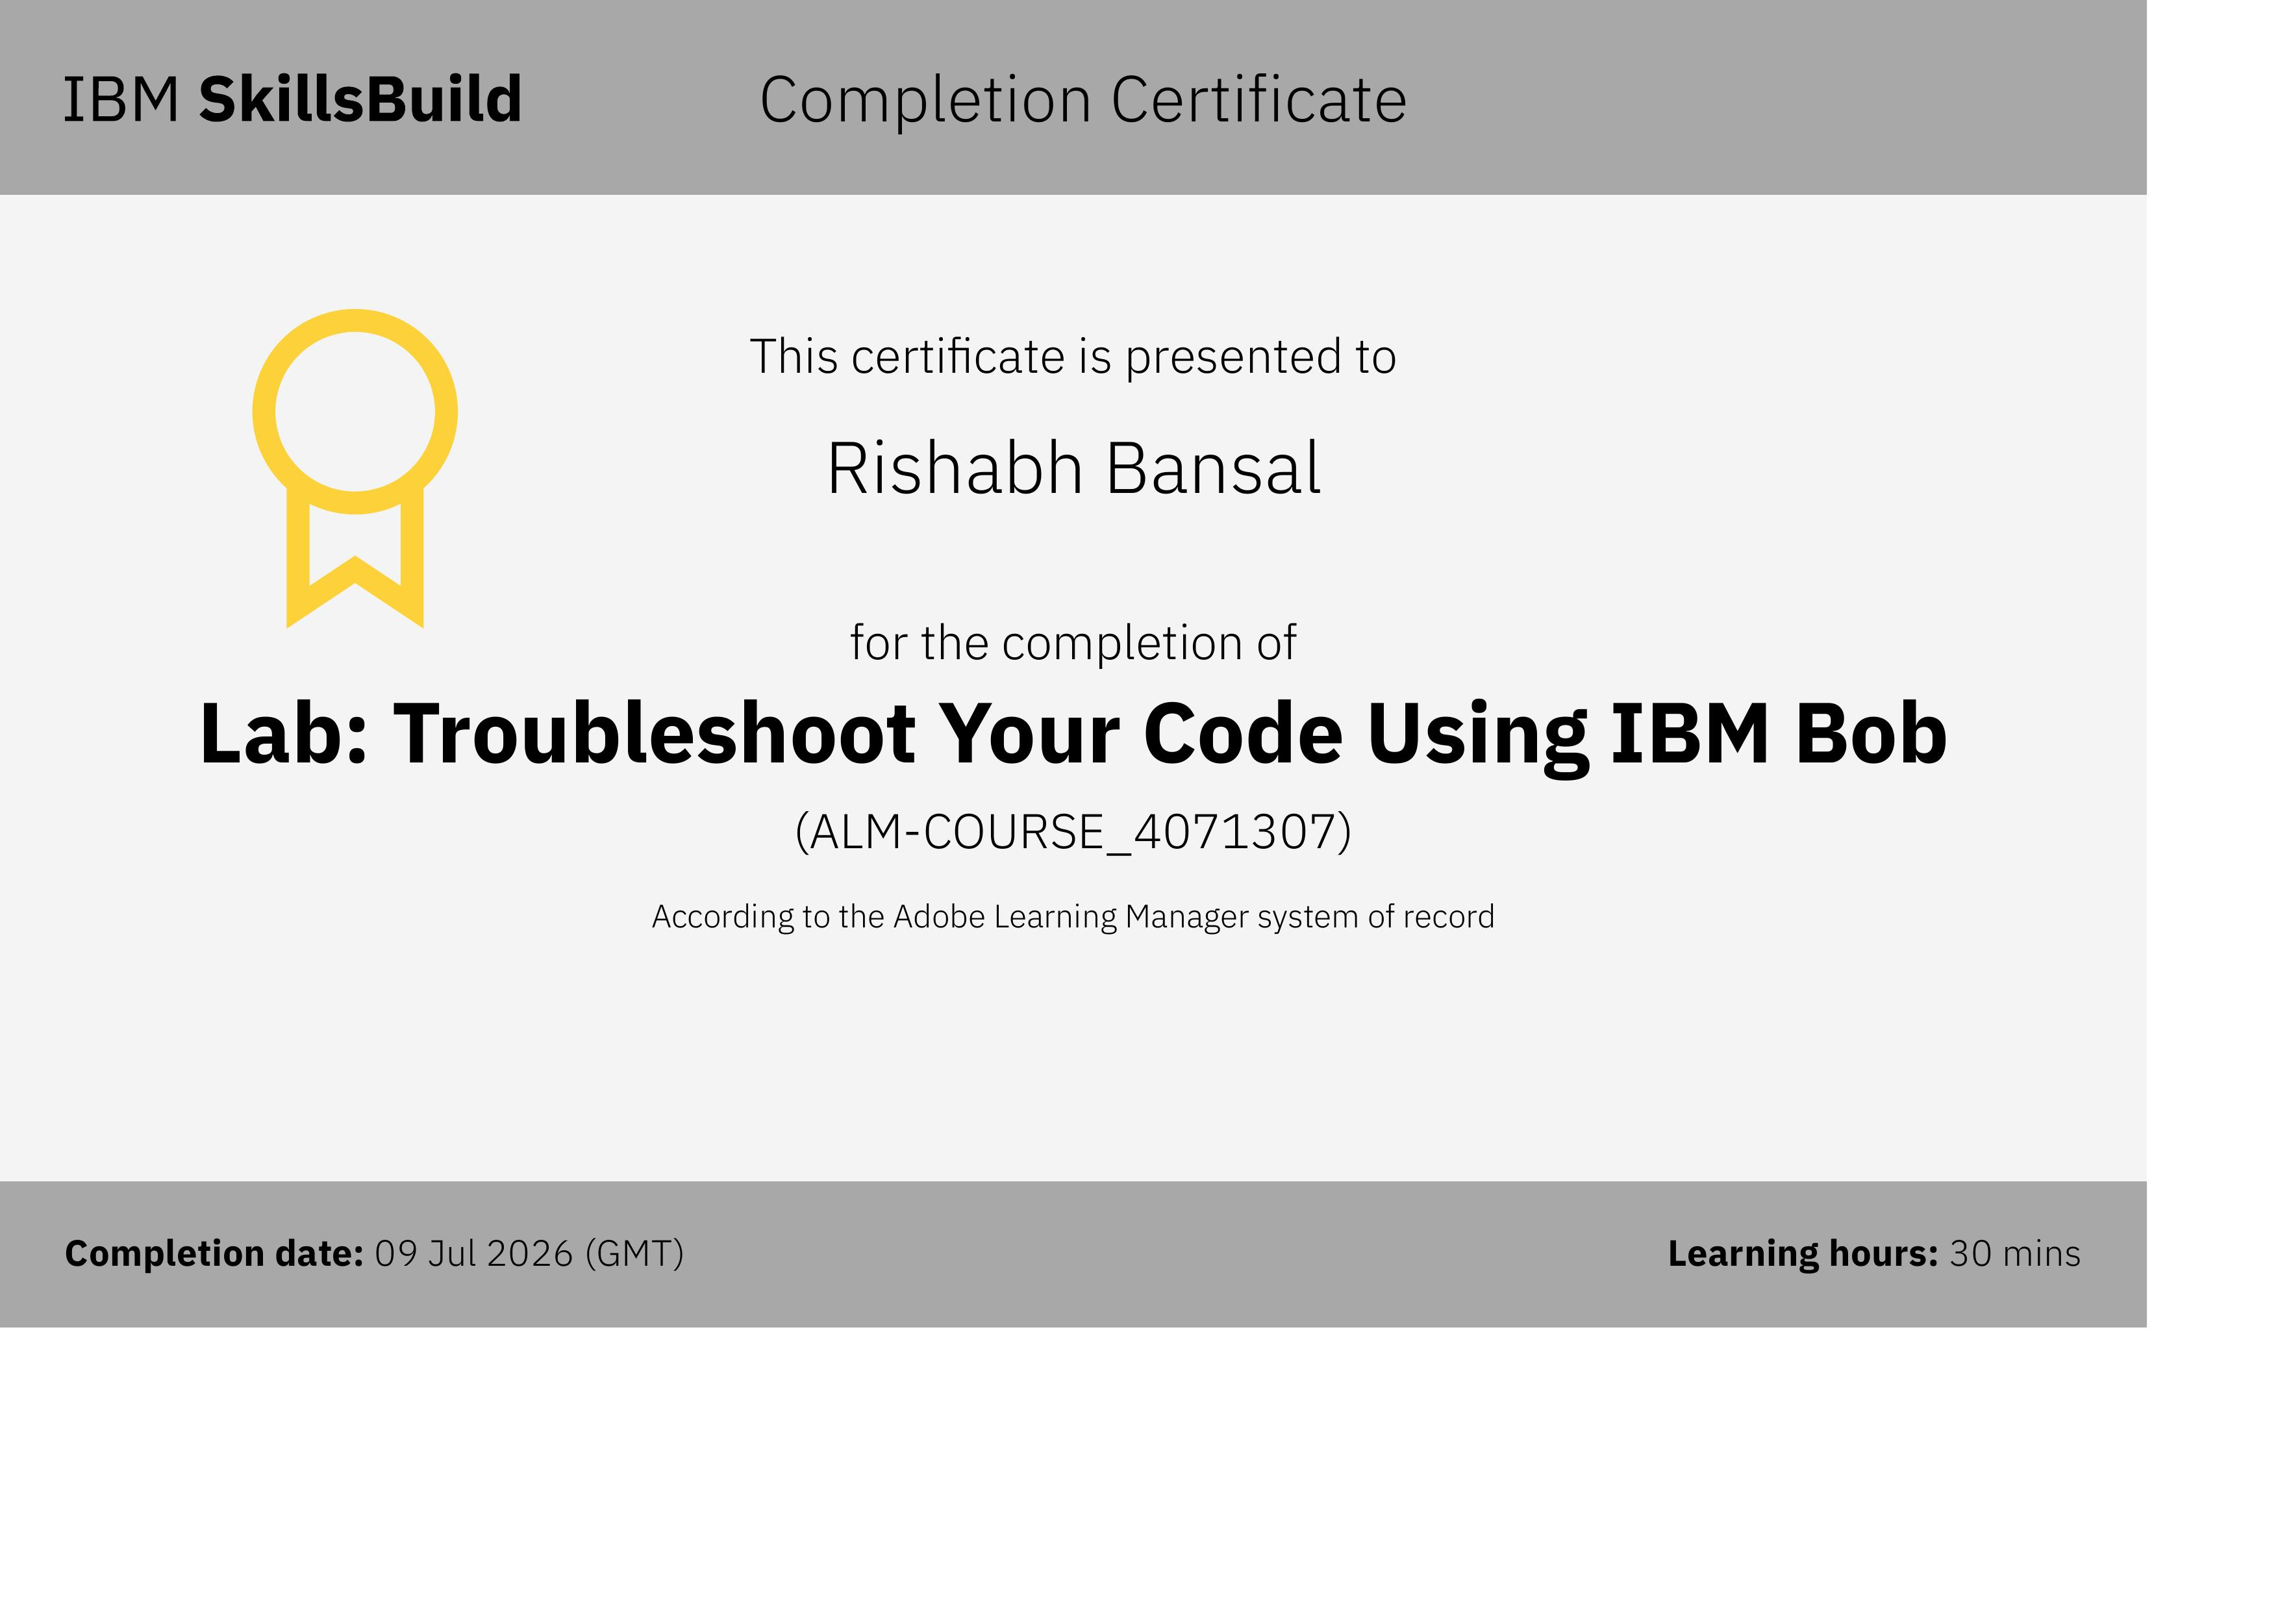
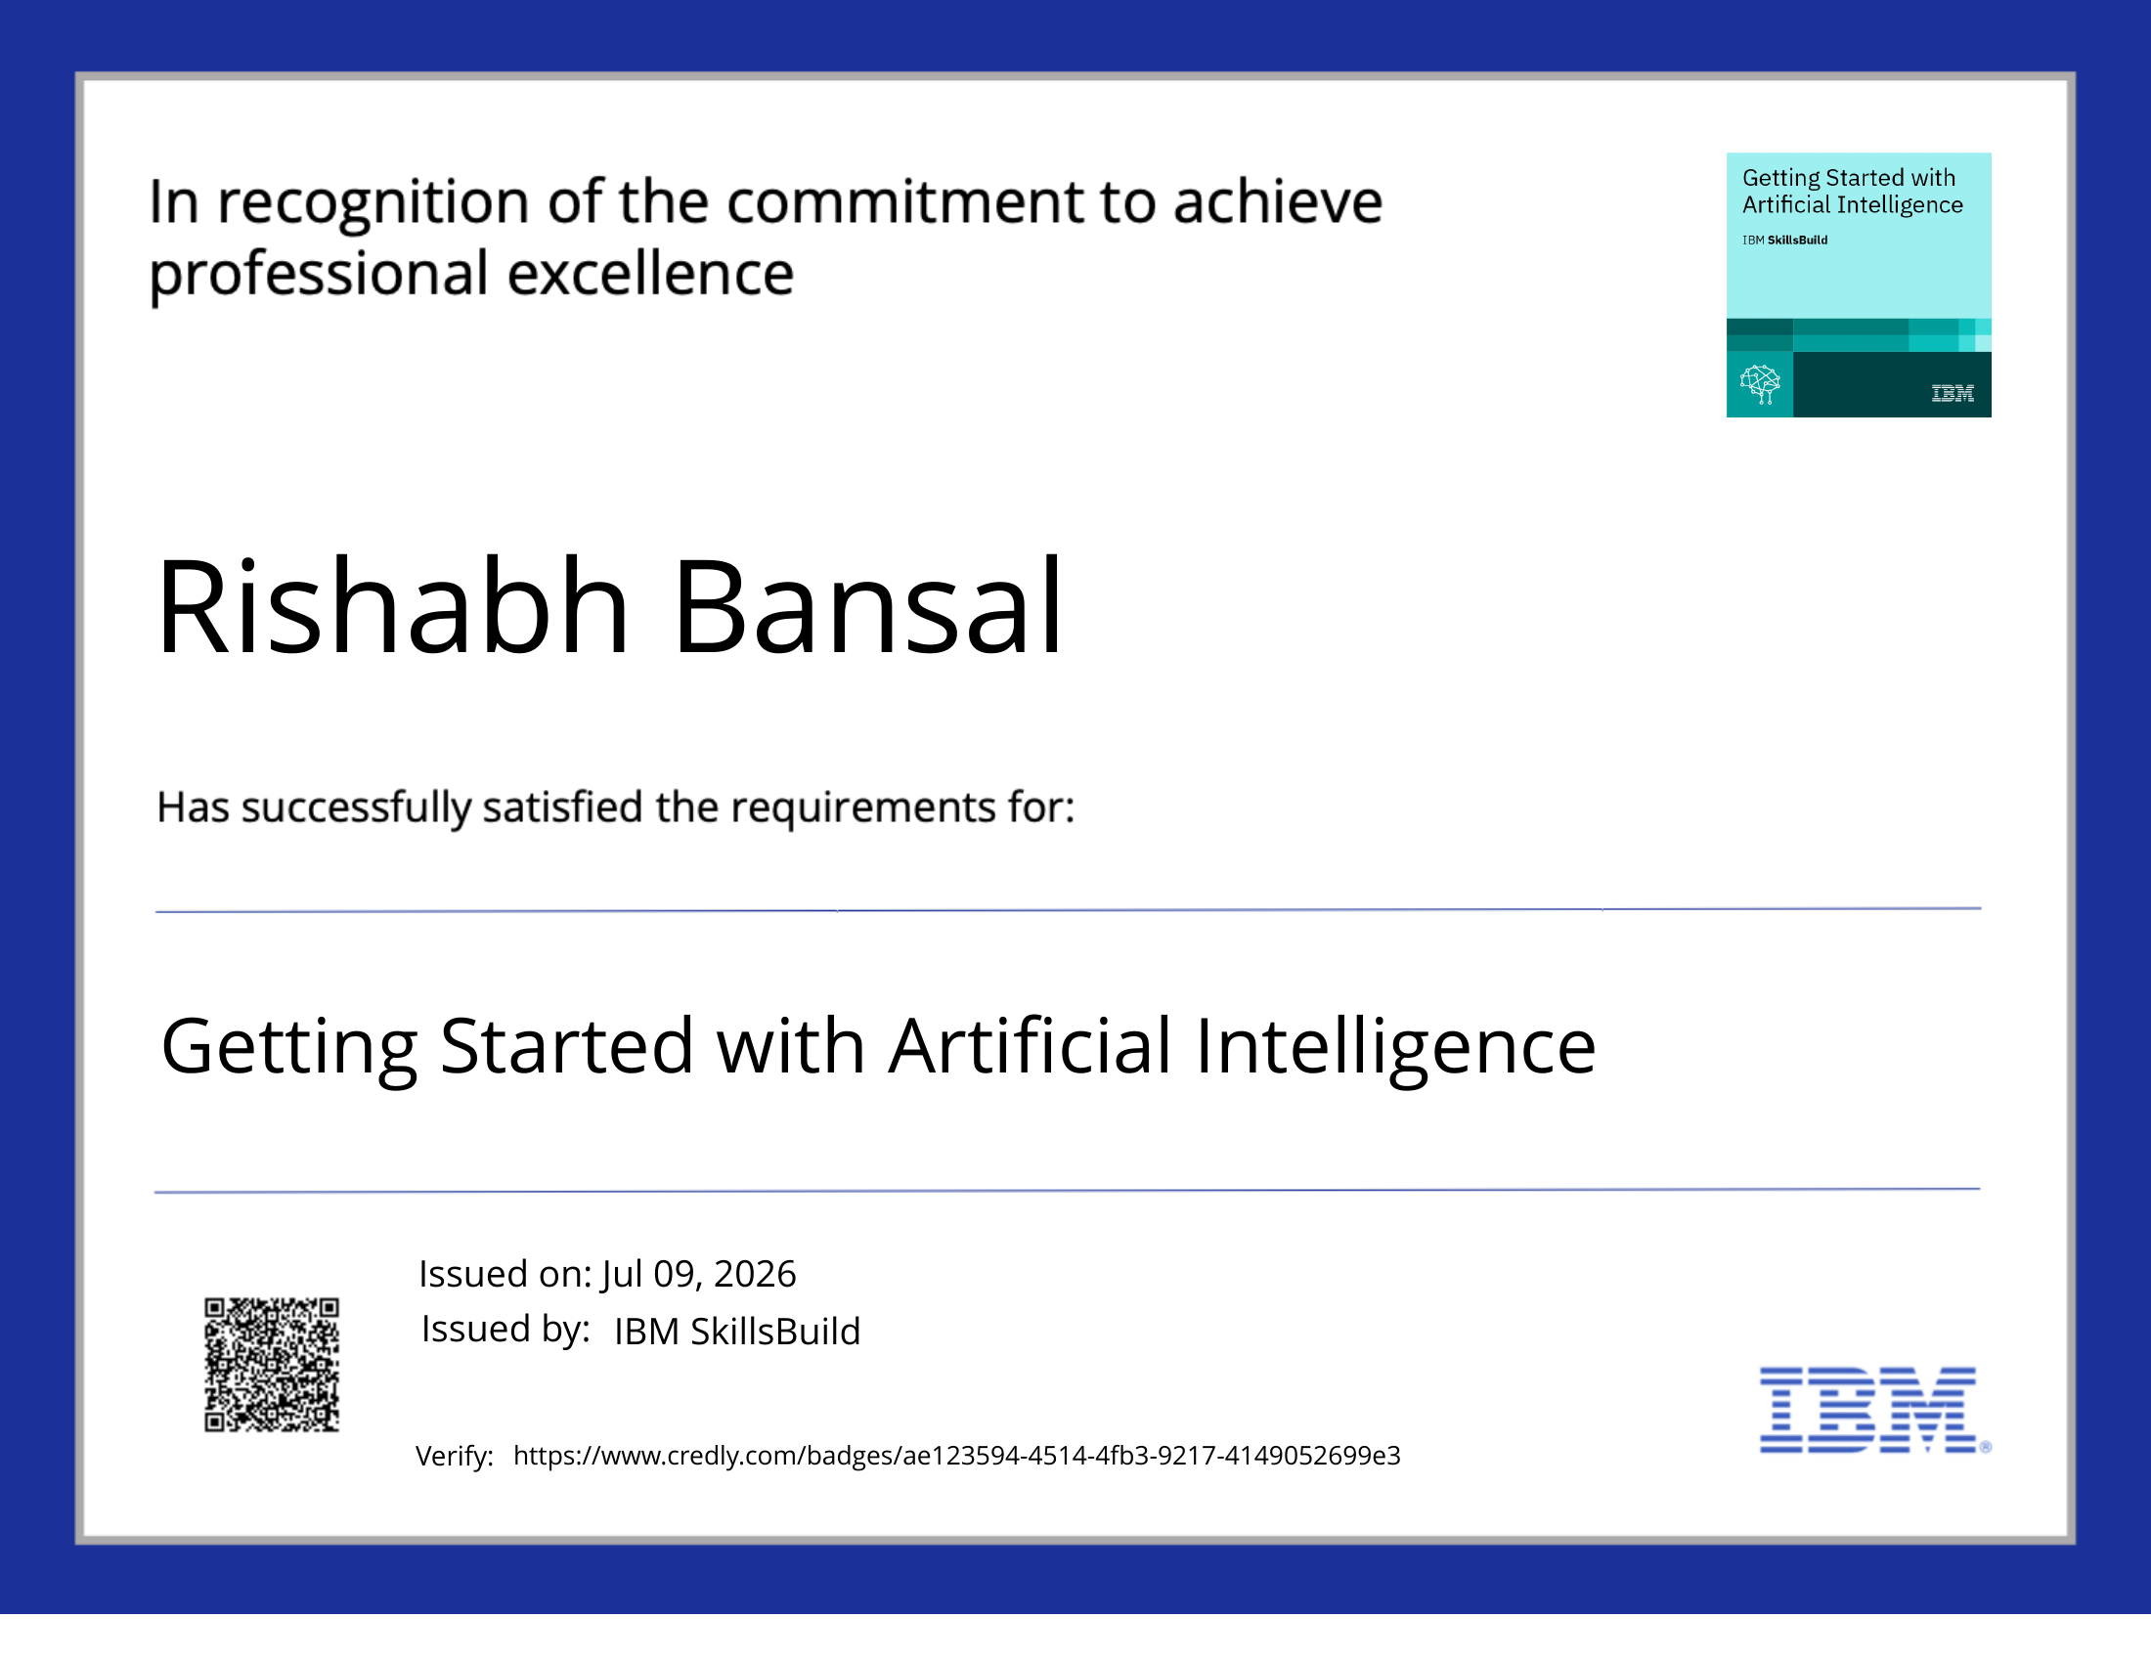

Certificates Earned
IBM SkillsBuild
Credly Certificate – Getting Started with Artificial Intelligence
IBM Bob Certificate – Troubleshoot Your Code Using IBM Bob
Certificates validate IBM SkillsBuild learning completion and IBM Bob hands-on lab participation.

Slide 18
REFERENCES
References & Resources
Documentation and learning resources used for the project
IBM Documentation
AI / ML Frameworks
Learning Resources
• IBM Cloud Documentation • IBM watsonx.ai Documentation • IBM Granite Foundation Models • IBM Cloud Object Storage
• LangFlow Documentation • LangChain / LlamaIndex • FAISS / Chroma Vector Database • Retrieval-Augmented Generation references
• IBM SkillsBuild Learning Platform • Edunet Foundation Internship Resources • AICTE Virtual Internship Program • IBM Developer Community
Conclusion
The Eco Lifestyle Agent demonstrates how IBM Cloud Lite, IBM watsonx.ai, IBM Granite Foundation Models and RAG can be combined to create a trustworthy AI assistant that promotes sustainable living through personalized, grounded and actionable guidance.
IBM SkillsBuild | Edunet Foundation | AICTE Virtual Internship 2026–27
18

Slide 19
Thank You
Questions?
Eco Lifestyle Agent
Rishabh Bansal Maharaja Agrasen Institute of Technology (MAIT) rishabhb2307@gmail.com | 8595803248
IBM SkillsBuild | Edunet Foundation | AICTE Virtual Internship 2026–27
19

