Slide 1
IBM University Engagement Project Submission
“A RAG-Based Eco Lifestyle Agent, built with IBM watsonx Orchestrate”

Slide 2


Project Title – Eco Lifestyle Agent: A RAG-Based Sustainable Living Assistant using IBM watsonx Orchestrate
Domain of Project – Sustainability / Environment (Agentic AI)
Student Name | Recent Passport Photo | Email ID | Mobile number [WhatsApp]
Rishabh Bansal |  | rishabhb2307@gmail.com | 8595803248
Recommended font style and size: Font Style: Arial Font Size (Heading): 28
Font Size (Content): 20

Slide 3
Problem Statement -
Problem Statement No.6 : Eco Lifestyle Agent
The Challenge
An Eco Lifestyle Agent, powered by RAG (Retrieval-Augmented Generation), empowers users to adopt a greener lifestyle through personalized, practical suggestions.
It retrieves sustainable living tips, eco-friendly product recommendations, local recycling guidelines, and government schemes from trusted environmental sources.
Users can ask natural-language questions such as “How can I reduce plastic use at home?” or “What are eco-friendly travel options in my city?” and receive instant, actionable guidance.
The agent promotes small daily actions with big environmental impact, making sustainability easy and accessible.
The Objective
Build a RAG-based AI system that:
Retrieves Trusted Eco Content – sustainable living tips, eco-friendly products, recycling guidelines, and government schemes.
Answers Natural-Language Questions – e.g. “How can I reduce plastic use at home?”
Promotes Daily Action – nudges small, practical changes with real environmental impact.
Raises Awareness – fosters eco-conscious decisions and long-term sustainable habits.
Technology – Use of IBM Cloud Lite services / IBM Granite (or equivalent IBM foundation model) is mandatory.

Slide 4
Proposed Solution -
Proposed Solution: Eco Lifestyle Agent
The proposed solution is a conversational Eco Lifestyle Agent built using IBM watsonx Orchestrate and a foundation model (GPT-OSS 120B / IBM Granite), powered by Retrieval-Augmented Generation (RAG) so every answer is grounded in trusted, up-to-date environmental sources rather than guesswork.
The agent is configured with:
A Sustainability Knowledge Base – curated sustainable-living tips, eco-friendly product data, local recycling guidelines, and government scheme information.
Behavior & Instructions – instructions guiding the agent to give practical, actionable, everyday advice rather than generic facts.
A Welcome Experience – a friendly greeting with quick-start prompts such as “Reduce plastic use at home” and “Eco-friendly travel options near me”.
Live Testing – the agent is tested in debug mode with real sustainability questions before deployment.
Publishing – the finished agent is deployed and published to the watsonx Orchestrate catalog.
Note: the build process shown in this deck (agent creation, behavior configuration, testing, and publishing in IBM watsonx Orchestrate) was captured on a working proof-of-concept agent using this same platform and workflow, applied here to the Eco Lifestyle Agent problem statement.

Slide 5
Technology Used
IBM watsonx Orchestrate – low-code platform used to build, configure, test and publish the Recipe Agent.
GPT-OSS 120B (foundation model) – for natural language understanding, reasoning, and recipe generation.
IBM Cloud – Lite/Trial plan hosting the watsonx Orchestrate service (Dallas, US-South region).
RAG (Retrieval-Augmented Generation) – grounds every response in the restaurant's own proprietary recipe knowledge base, reducing hallucination.
Agent Knowledge Base – built-in document/knowledge retrieval within watsonx Orchestrate, used to store the proprietary Thai recipes.
IBM SkillsBuild – foundational learning path (AI, Machine Learning, Agentic AI, Cybersecurity) that supported this build.

Slide 6
watsonx Orchestrate components used -
1) Eco Lifestyle Agent (persona) – the conversational front-end that users interact with.
2) Foundation Model – GPT-OSS 120B / IBM Granite → handles natural-language reasoning and advice generation.
3) Behavior & Instructions – custom guidance defining tone, scope, and response rules for the agent.
4) Knowledge Base – stores sustainable-living tips, eco-product data, and recycling/government-scheme info for RAG-grounded answers.
5) Welcome Message & Suggested Prompts – quick-start prompts such as “Reduce plastic use at home”.
6) Test / Debug & Publish tools – used to test the agent live before publishing it to the Orchestrate catalog.

Slide 7
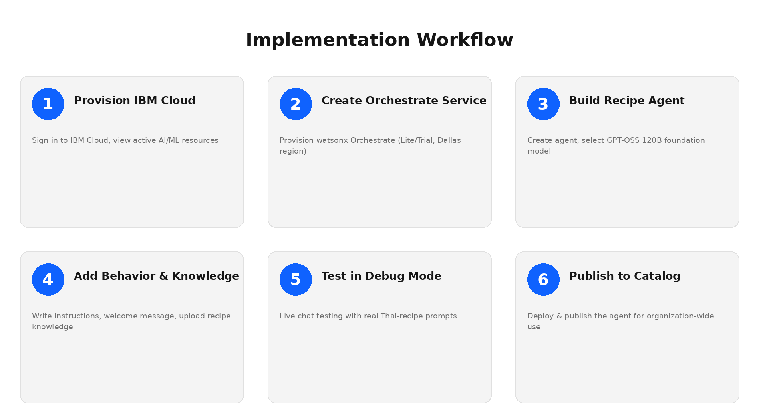
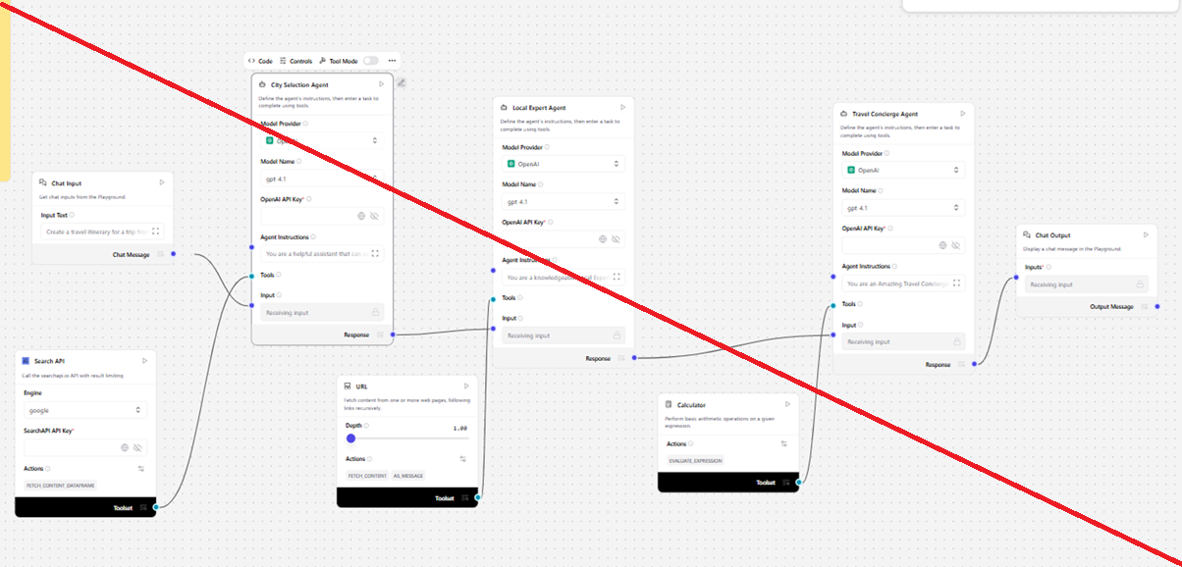
Implementation Workflow -

Slide 8
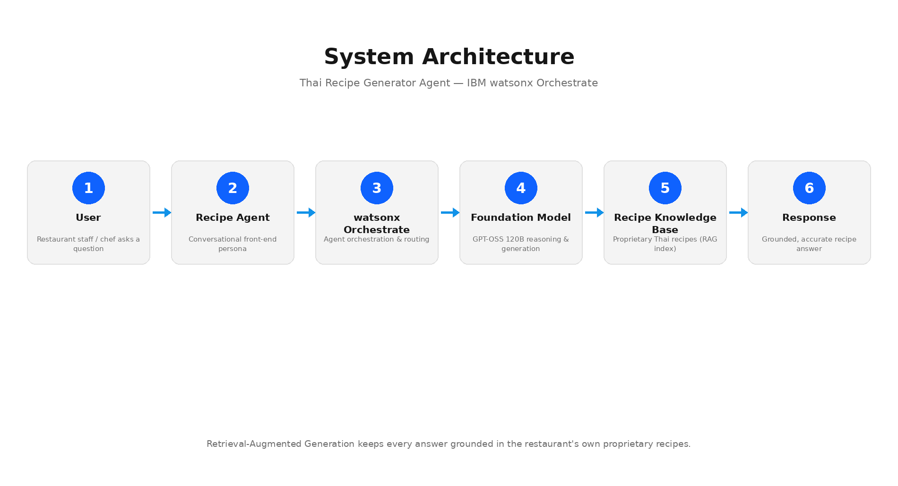

Architecture blueprint

Slide 9

Role of Agentic AI in the solution
Role of Agentic AI in the Eco Lifestyle Agent
Agentic AI lets the Eco Lifestyle Agent behave like a proactive sustainability coach rather than a static FAQ page. Built on IBM watsonx Orchestrate with a foundation model (GPT-OSS 120B / IBM Granite), it autonomously interprets a user's everyday question and decides how to respond — retrieving from trusted environmental sources rather than guessing.
The agent maintains context across a conversation, understands loosely-phrased requests (e.g. “how do I cut down on plastic”), and tailors guidance to the user's city or habits while staying grounded in verified sustainability data via RAG.
It is iteratively configured — instructions, welcome message, and suggested prompts refined and re-tested in debug mode — before being published to the Orchestrate catalog for wider use.
Overall, Agentic AI makes the system proactive and reliable: a digital sustainability coach that nudges users toward small, high-impact eco-friendly actions every day.

Slide 10
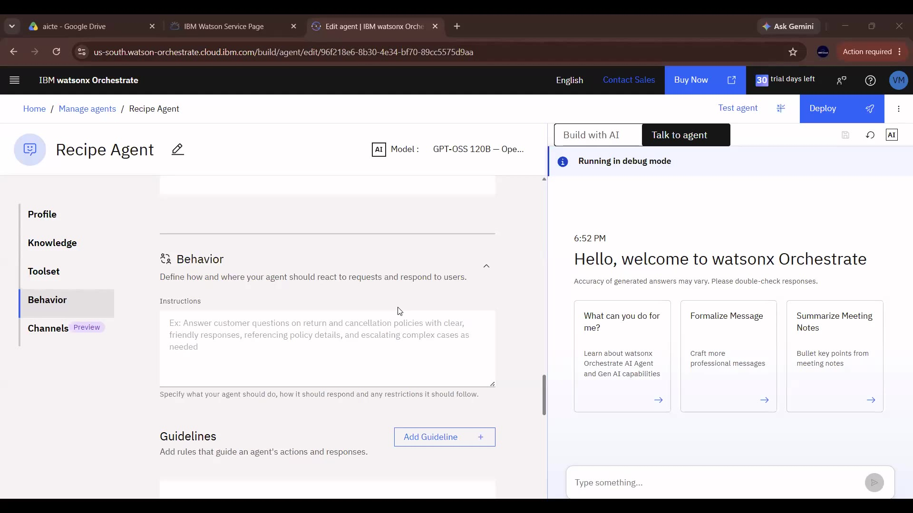
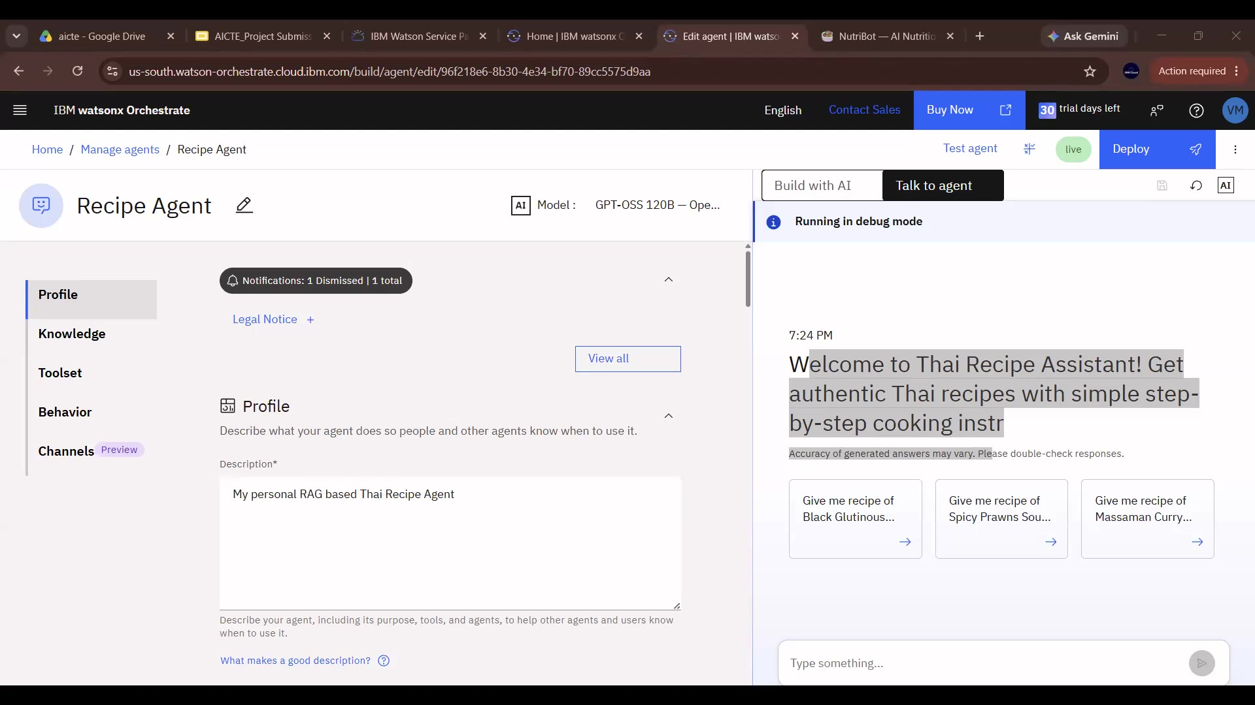


Token Usage
[Add total token usage from your Orchestrate analytics]
Before Prompt
After the Prompt
·
·
·

Slide 11
Novelty and Uniqueness
The Eco Lifestyle Agent stands out by combining Agentic AI, RAG, and everyday practicality into a single accessible system.
Trusted-Source Grounding – answers pull from verified environmental sources, not unreliable web content.
RAG-Based Accuracy – retrieval-first generation keeps sustainability advice current and specific to the user's context.
Low-Code, Fast Deployment – built and published entirely within IBM watsonx Orchestrate.
Everyday Actionability – focuses on small, achievable daily actions rather than abstract advice.
Local Relevance – surfaces local recycling guidelines and government schemes, not just generic tips.
Scalable & Enterprise-Ready – built on IBM watsonx Orchestrate, ready to extend with more regions and data sources.
This makes the solution a practical, always-available sustainability coach — not just a static eco-tips article.

Slide 12
Git Hub Link
· Public GitHub repository created (with README) –
https://github.com/rishabh230707-afk/eco-lifestyle-agent
· Files uploaded: README.md, app.json, problem_statement.md, and this project presentation (.pptx).
· Note: app.json currently contains placeholder values — replace with your real exported agent configuration from watsonx Orchestrate before final submission.
·
·
·

Slide 13
Future Scope
1. Carbon Footprint Tracking –
Integrating with utility bills, travel data, and purchase history to estimate a user's personal carbon footprint and suggest targeted reductions.
2. Multilingual & Location-Aware Support –
Adding regional language support and hyper-local recycling/government-scheme data so guidance is relevant to the user's exact city or state.
·
·
·

Slide 14
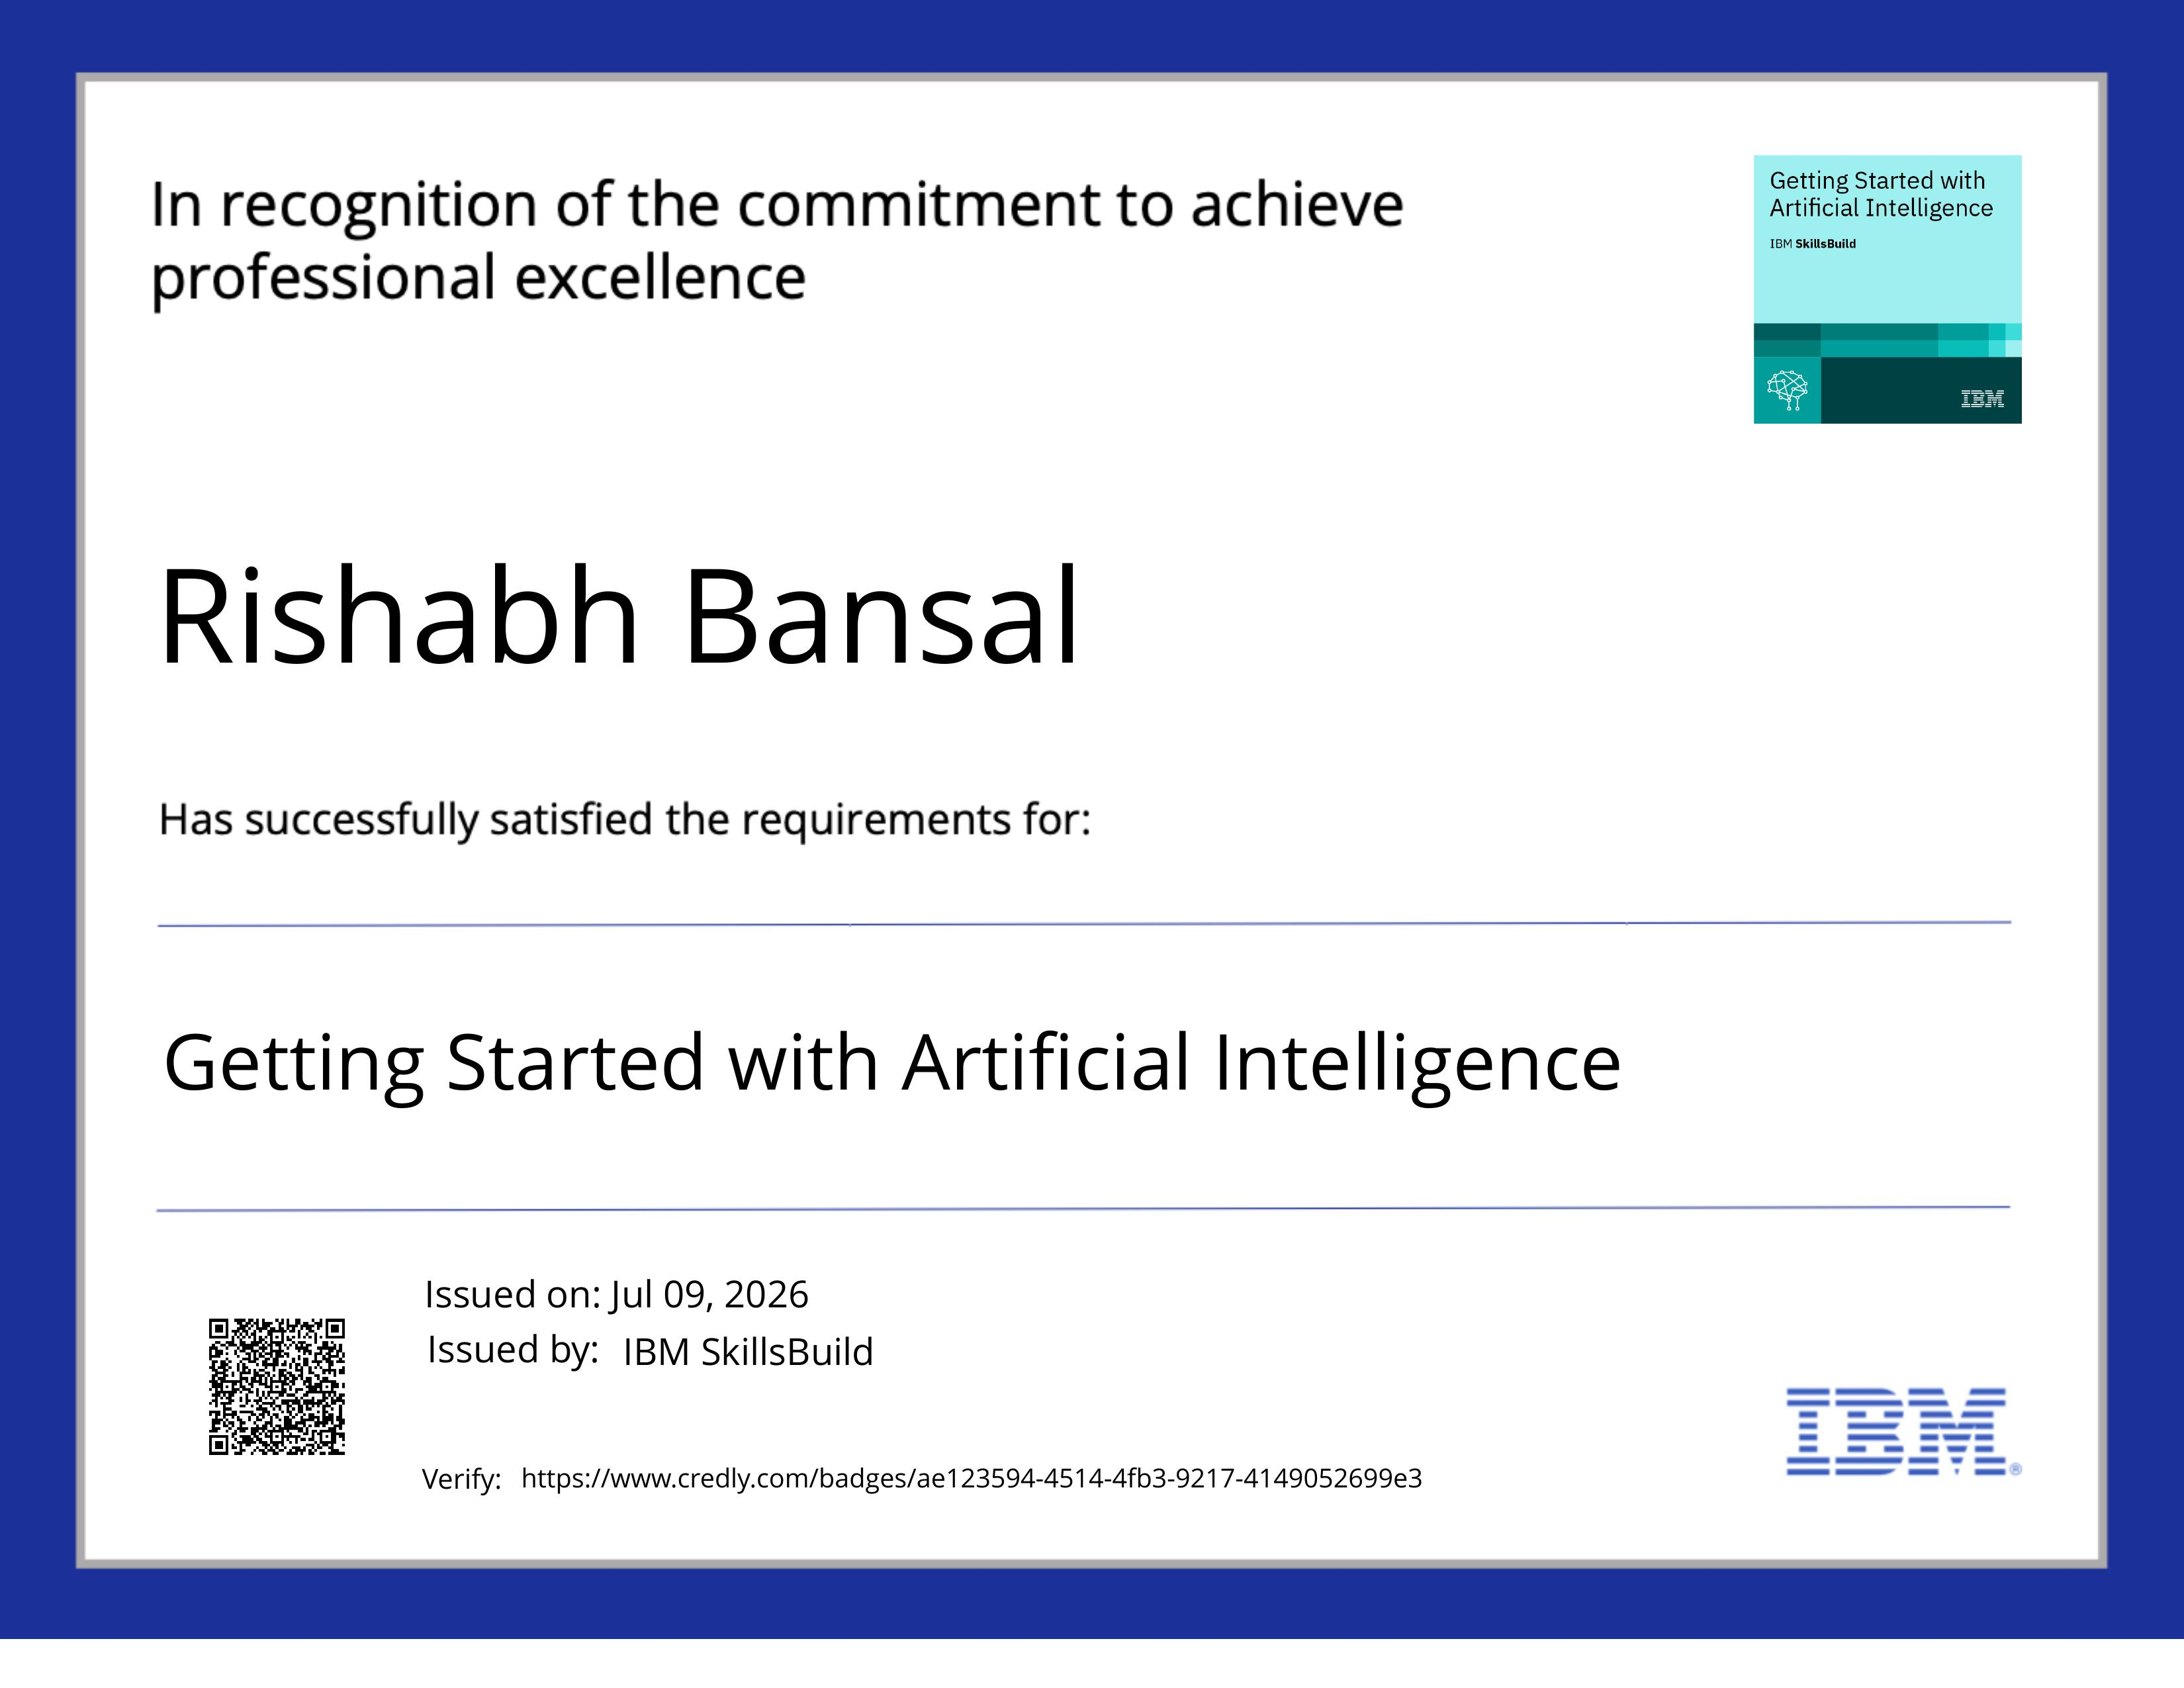
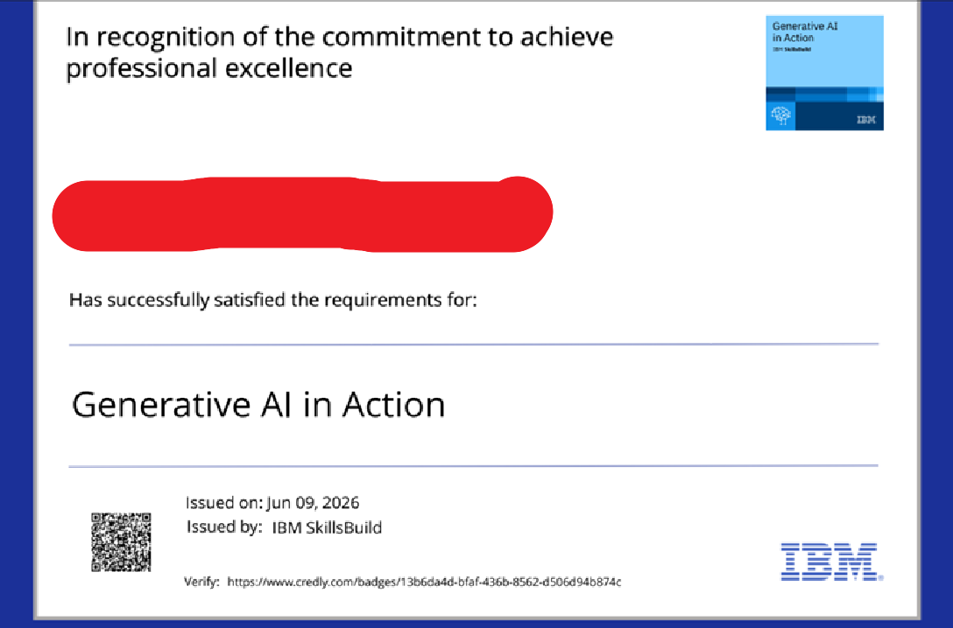
Certificates Earned:
Please add your credly certificate

Slide 15
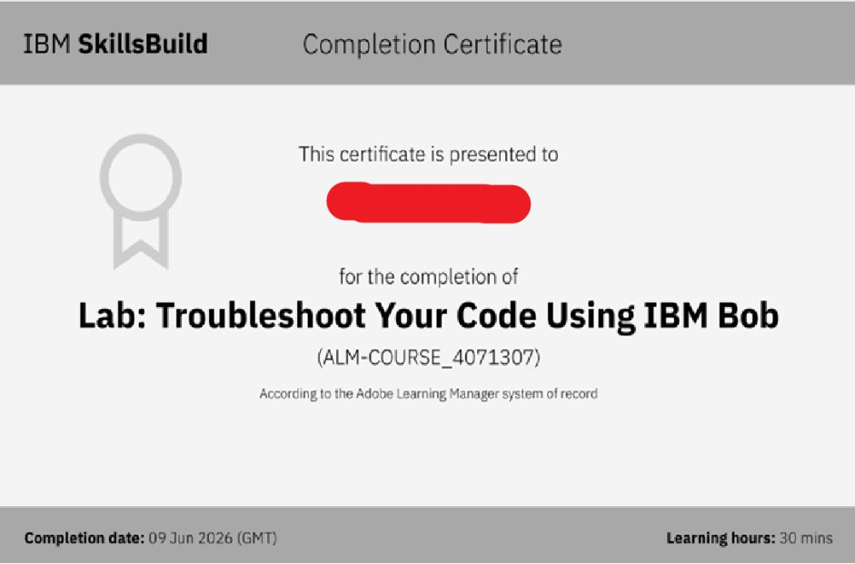
Certificates Earned:​
Add your IBM BOB Certificate

Slide 16


