Slide 1
On The Plague Trail
By : Rishabh Singhal

Slide 2
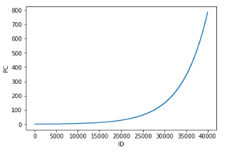
Some observations after plotting data
The given dataset was following exponential curve for PA-PG vs ID number (as a function of time).
After plotting the log values of dataset(for PA - PG) it nearly followed linear curve of constant slope of different values for PA - PG.

Slide 3
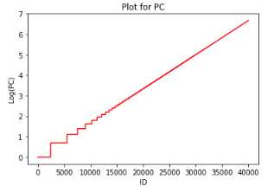
After potting another curve of same slope combined with the given data for PA, I found that there is little more difference in the start and data is nearly following the slope at the end (i.e. nearly equal for most of the data)
which is due to the fact that infection of a person is a discrete process and the average no of infected person per time lapse (ID or DateTime) increases exponentially. Due to this fact difference between data value and observed linear curve decreases with time.

Slide 4
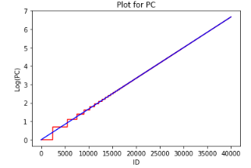
Equation of log curve
I first assumed that after taking log it’s equation is m*x+c. Since in every case it was found that the curve is passing through origin so c=0 in each case.Therefore, equation reduces to m*x which indicates the curve will follow e^(m*x).

Slide 5
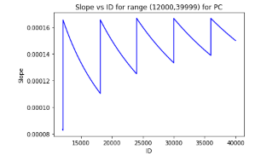
Value of slope(m) of log curve
To find value of slope(m) I plotted slope of data vs ID no.
Since the time step was increasing therefore slope value will converge nearly to upper value when calculated at different point
as show in the graph so i took the slope value equal to the average of some upper significant values of slope(Here by significant I mean that I am neglecting some initial value due to the fact that we found maximum distortion in initial condition) .

Slide 6
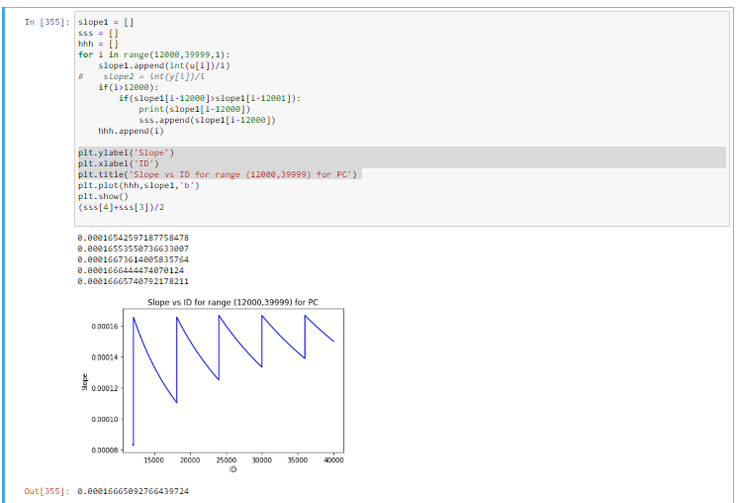

Slide 7
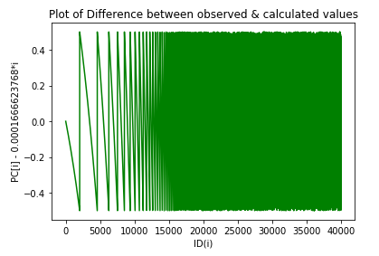
Some further modifications to get better accuracy
Since the no of death is a integer so I rounded up the values to get better accuracy.
Better accuracy is due to the fact that as the values changes more frequently so difference between them was decreasing and hence rounding them up was pretty good approach which can be extended to estimate greater range of values.

Slide 8
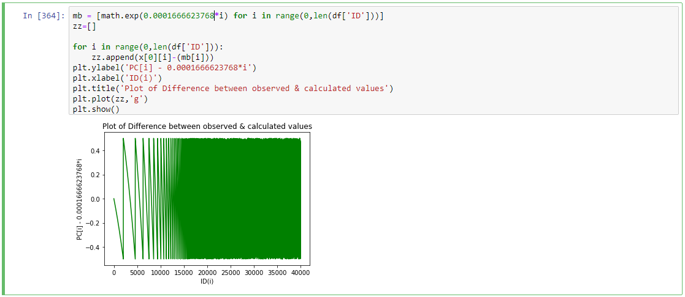

Note
The values of y(difference of the values estimated from the curve whose slope I calculated) will converge towards zero because of increasing no of affected people per time step (ID)

Slide 9

Assumptions
Assumptions that with the increase in time step by 15 mins ID number increases by one unit. Otherwise, if data was not continuous then we will multiply it(x4 in the submitted code) by converting DateTime into minutes and then subtracting it with the DateTime value of ID ‘PR00001’ and the dividing the same by 15 and then adding it by 1.

Slide 10


