Slide 1

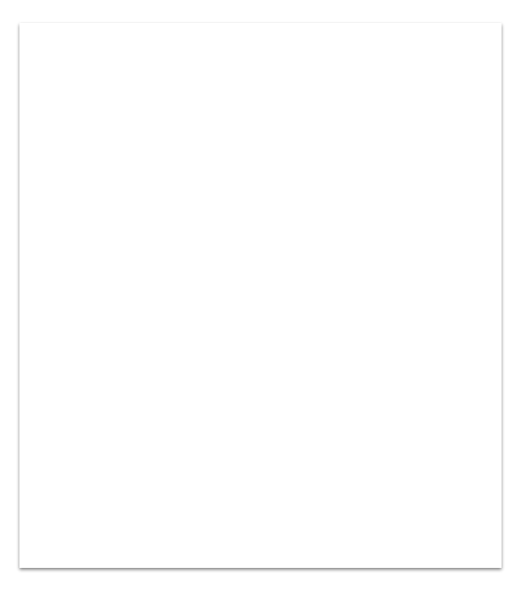
1. Steps -
Data Collection and Preprocessing
Model Generation
Model Training and Validation
Results
Challenges

Slide 2
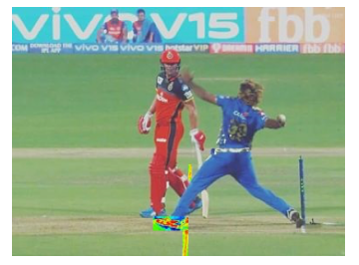
Data Collection and Preprocessing:
In our model to classify no-ball, we use images as input.
Our input dataset contains images collected from google image search and by taking screenshots from various replays available on youtube and hotstar.
The images are manually annotated and contain two classes: no ball and valid ball(legal ball).
All the collected images were rescaled to normalise the data in order to have better accuracy.

Slide 3
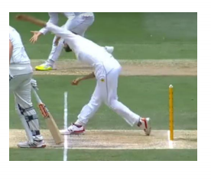
Transfer Learning -
Transfer learning uses the knowledge gained from solving one problem and apply it to another related problem. Facing the problem of collecting enough training data to rebuild models, transfer learning aims to transfer knowledge from a large dataset known as source domain to a smaller dataset named target domain. Either the feature spaces between domain data are different or the source tasks and the target tasks focus on different topics, boosting the performance of the target task. Our model uses pretrained Resnet50 parameters for better predictions.

Slide 4
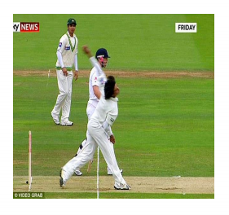
Model
We have used Keras to build our model and generate results.
Our model produces a score for both possible outcomes then each of them is converted to a probability by SoftMax.
We have used Resnet50 as the classifying CNN as our model.
In our model we have not include the top layer of the Resnet50 and kept the trained parameters of available model.
Except for the first five layers of the model all layers of Resnet50 are converted into non-trainable layers.
One dense layer of size 300 is also added after Resnet50 and after which the model is trained.

Slide 5
The cross-entropy cost function is used to synthesize the weight parameter by calculating the error between the output of the SoftMax layer and the label vector of the given test category.
Adam optimizer is used as an optimisation function.
Total parameters of our model is 24,203,014
Total trainable parameters of our model is 624,902
Total non-trainable parameters of our model is 23,578,112

Slide 6
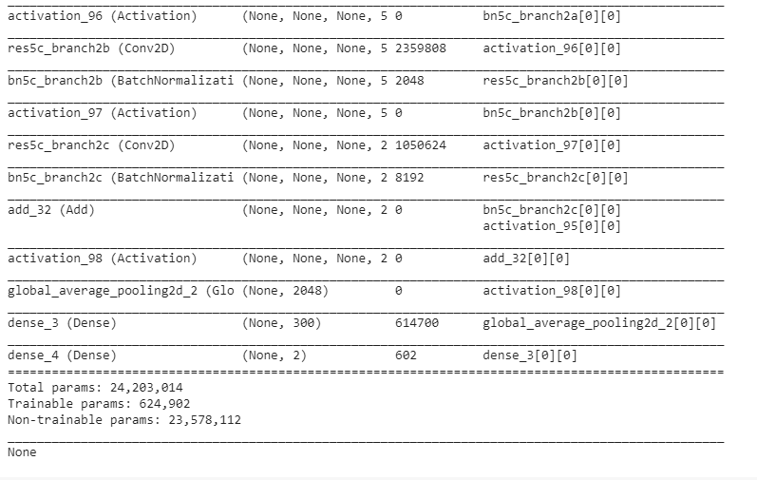

Slide 7
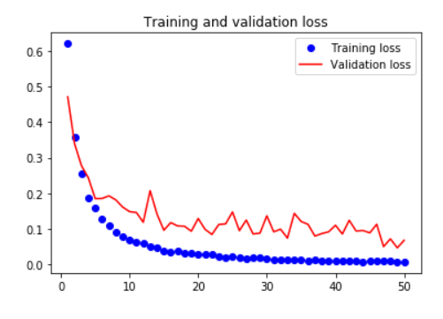
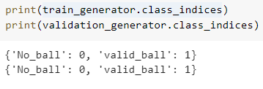
Training and Validation loss -

Slide 8
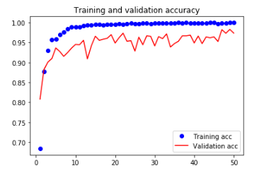
Training and Validation Accuracy-

Slide 9
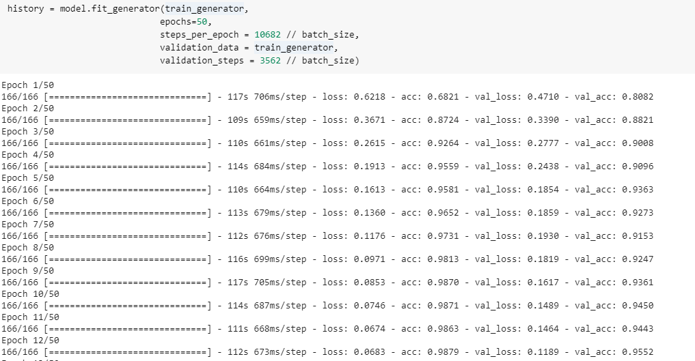

Slide 10
Results and Predictions -
After training our model we saved it and have also submitted the same in the zip file.
We have also submitted the validation file which can be used for test accuracy of our model to test it you have to upload our ‘No_ballResNet50FineTune_1.h5’ file and the test dataset in the format as : Load the test data_set in the format test_data inside that two folders one named No_ball and other named valid_ball.
To evaluate accuracy of the model in predictions model.evaluate_generator is used in the test file and model.predict_generators used to predict the probability of the image belonging to the given class.

Slide 11
Challenges and Steps to increase further Accuracy :
Increase the size of the training dataset.
We can train the model for more epochs if train dataset size is increased.
We can collect more data from the ongoing matches.
If size of training dataset is increased then we can also add the top layer of the Resnet50 and set it’s parameters to trainable in order to achieve better accuracy.

Slide 12
