Slide 1
Colombia - Gender Recognition Challenge (Times Internet)
By : Rishabh Singhal

Slide 2
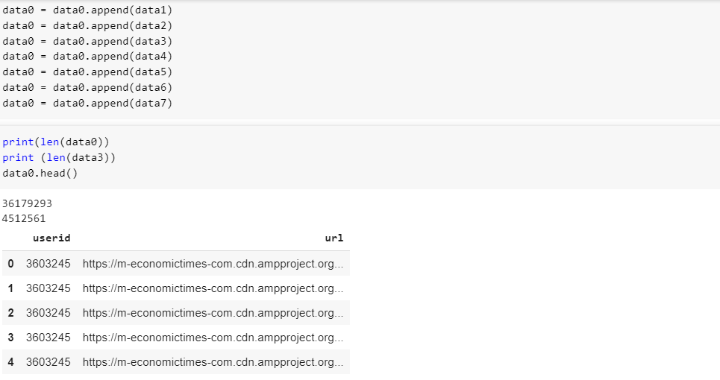
Steps:
Store all files in one dataframe to avoid errors(as same UserId can be seen in different datasets).

Slide 3
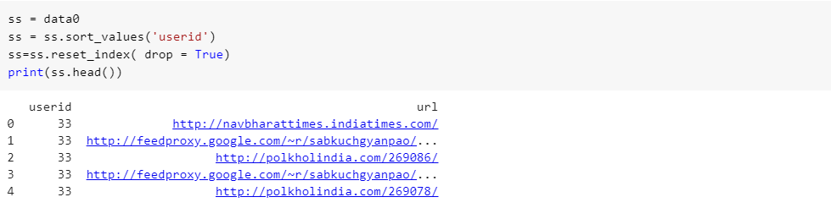
Sort the above generated dataframe by UserId.
Since Url will contain the most relevant description of the data in squeezed form which contains title, description and other most relevant parameters in the encoded form separated by ‘/’ and also due to computational limitations I used the Url to train the model.

Slide 4
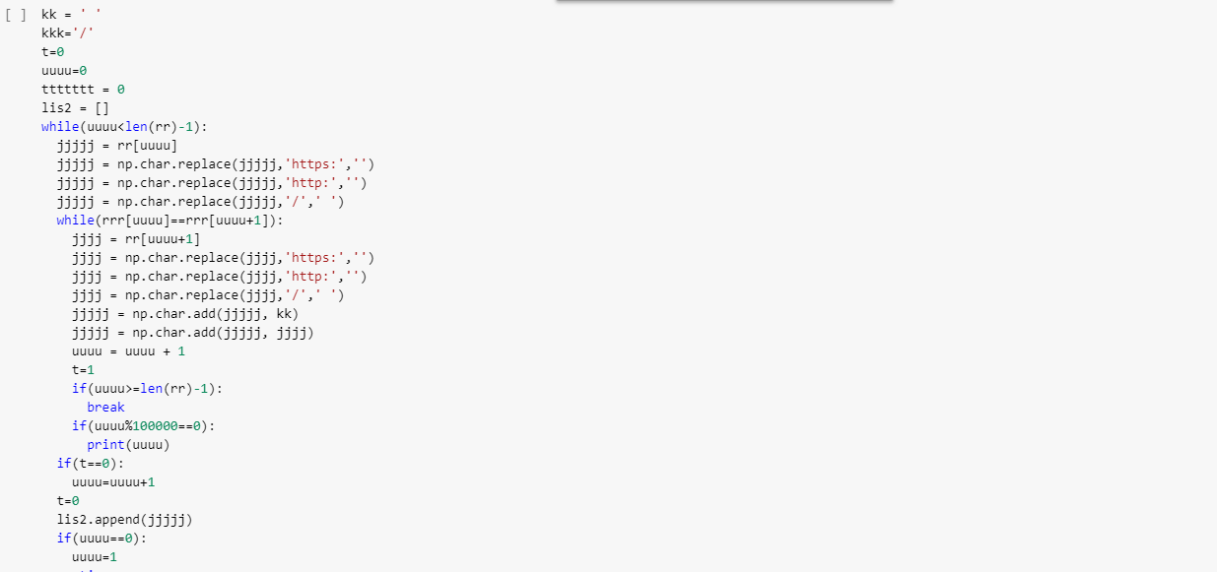


Slide 5
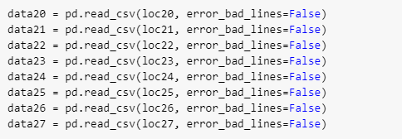
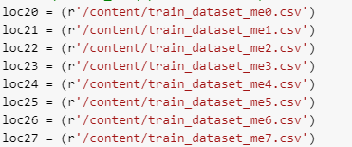
I combined the dataset - Url on the basis of dataset - UserId i.e. instead of having multiple Url with same UserId now one UserId will possess multiple Url separated by space.
For seperation I converted the data into the numpy array to reduce the time complexity of the model.

Slide 6
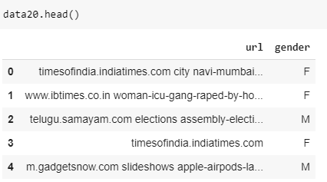
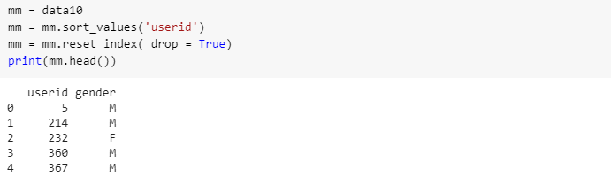
After this now the data can be visualised as two columns : 1. UserId - contains Gender information. 2. Url - can be visualised as a sentence (or the combination of multiple words).

Slide 7
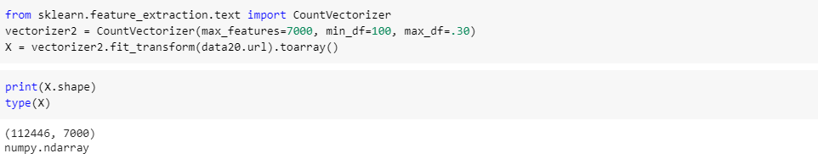
Then I built own tokenized vocabulary of combined training and test dataset using CountVectorizer.
I set the number of maximum features to be 7000(vocab-size) which consists of words with frequency greater than 100 and limit maximum frequency to 30 percent of the size of dataset as above this will contain less information.

Slide 8
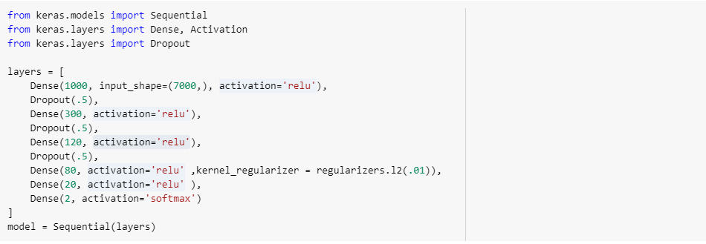
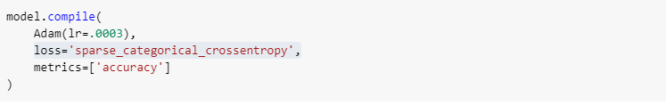
Model Training:

Slide 10
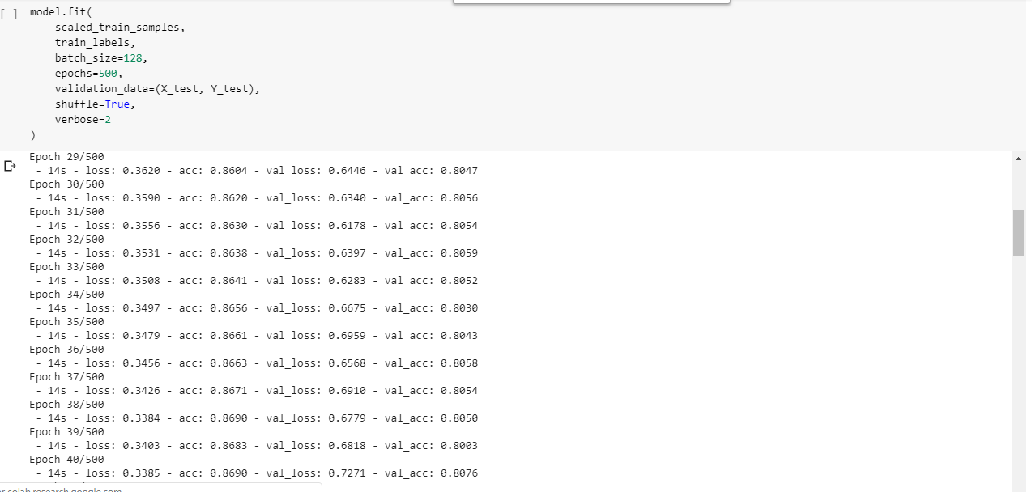


Slide 11


