Slide 1
IndiaMART Hackathon
By : Rishabh Singhal

Slide 2
Approach:
I have used an algorithm which will provide the best suitable price range by removing the outliers. Since most of the available methods such as Median Absolute Method for outlier detection were failing on giving lower outlier values, so I have used my own model to calculate the appropriate price range. My core idea is based on the Interquartile Range Method. I have used Python3 to generate my Model.

Slide 3
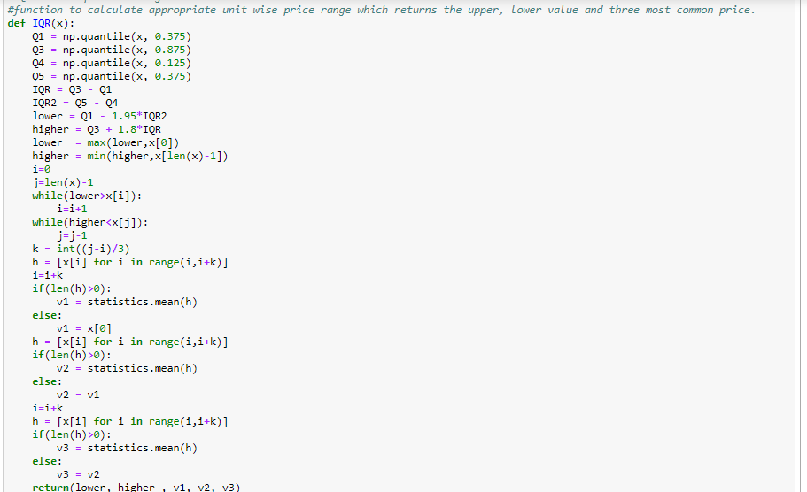
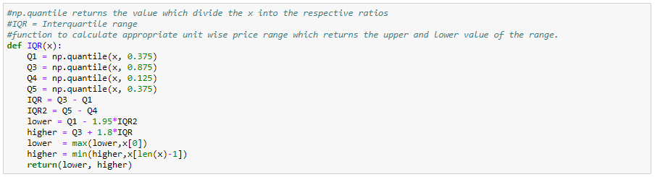

Slide 4
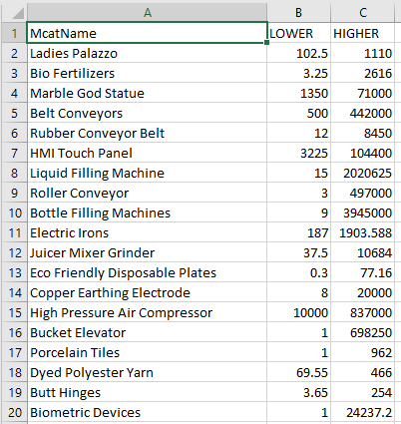
Results before data manipulation:
I calculated price range(lower and higher) for different Mcat Name categories which i did by storing price values of different categories in different dataframes and then passing it into IQR function.
I have also submitted the excel file of the same.

Slide 5
Data manipulation:
Why?
We need to find appropriate price range grouped by different Mcat Name and by different units. Since units anyone of them could be spelled incorrectly and we didn’t have any details about number of units, which is important to categorise data.

Slide 6
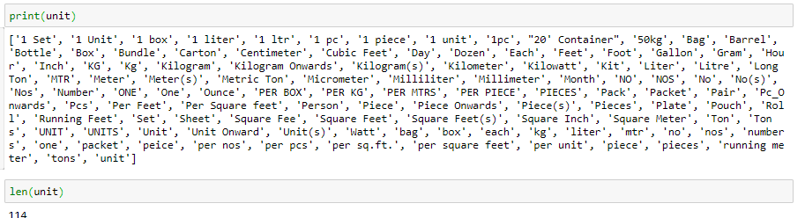
How ?
I stored different unit types on the list name unit
Number of different units before any optimisation :

Slide 7
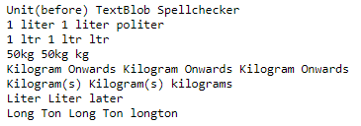
Since there were many errors so first I tried to use different Natural language processing libraries to correct the spelling of units : -
1. Textblob
2. Spell Checker
But since the available data was of different type then the data on which these libraries have been trained on so, I didn’t get the expected outcome .

Slide 8
Data modifications:
1. Upper
2. Basic modifications
3. Advance modifications(manual)

Slide 9
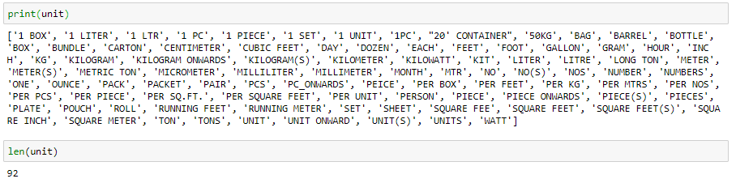
1. Upper:
Since many values were repeated in unit because of lower and upper so I converted the dataframe (PC_ITEM_MOQ_UNIT_TYPE) to upper values.

Slide 10
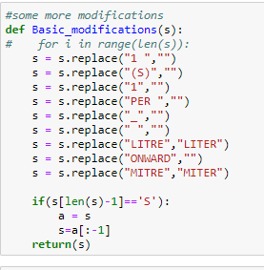
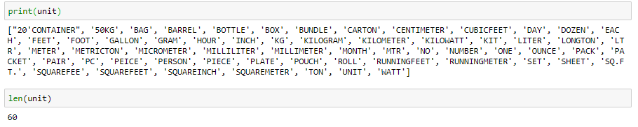
2. Basic modifications:
Basic modifications function will remove common errors when dataframe is passed to it which will modify similar data like 1 kg = kg

Slide 11
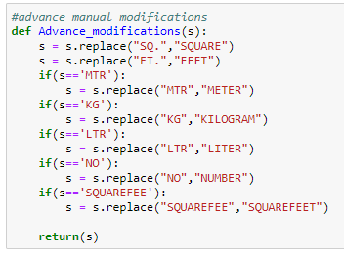
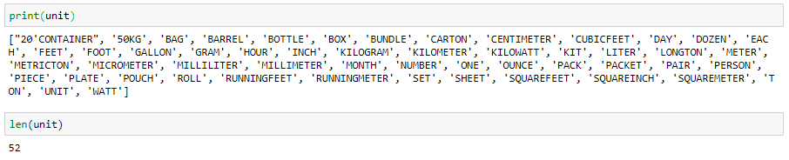
3. Advance modifications(manual methods) :
Since many words in the units have the same meaning so I used some steps to replace them with the same meaning word to get more accurate values.
If still some value(unit) is repeated we can manually set it’s value to other in this function

Slide 12
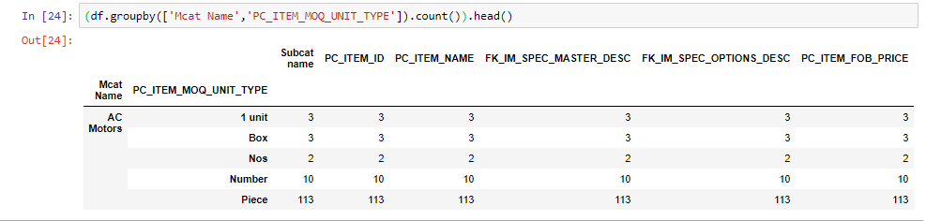
Grouping:
After finding the units I grouped the data in different classes with different units which will help to find number of items categorised by Mcat Name and Unit.

Slide 13
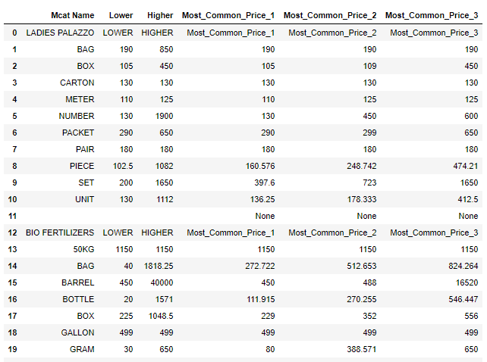

Results:

Slide 14
Submissions:
One Ipynb file containing the code.
Two excel files in which one will have price range of different categories(Mcat Name) and other one will include price range of different categories(Mact Name) categorised by their units.

Slide 15


