Slide 1
STOP THE BLEED
-Rishabh Singhal
- Akash Meshram

Slide 2
Table of contents:
Training (Learn)
Teaching(Train others)
Register a Traumatic Bleeding Incident

Slide 3
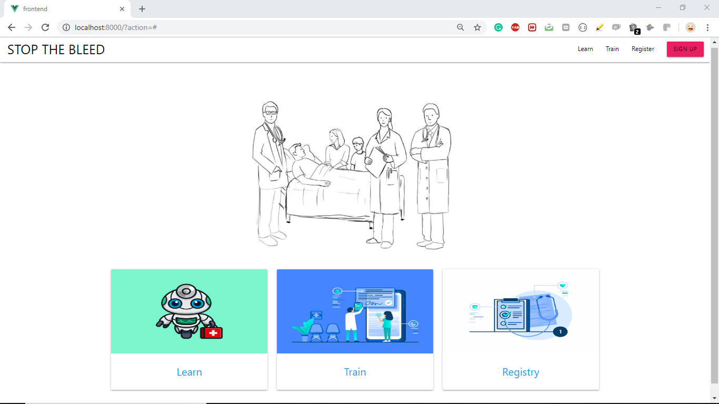

Slide 4
Training(Learn) :
In learn through by providing various content we are training the users what are the steps that should be followed in case of an emergency.
To make it more helpful for users we have divided it into different sections so that users can learn through videos or documents or chart as per their convenience.

Slide 5
These are as follows:
How to stop the bleeding
Stop the bleed videos
Flowchart
Classes
Other documents and links

Slide 6
How to stop the bleeding :
In this section most important procedure/steps are provided which should be followed in case of an emergency.

Slide 7
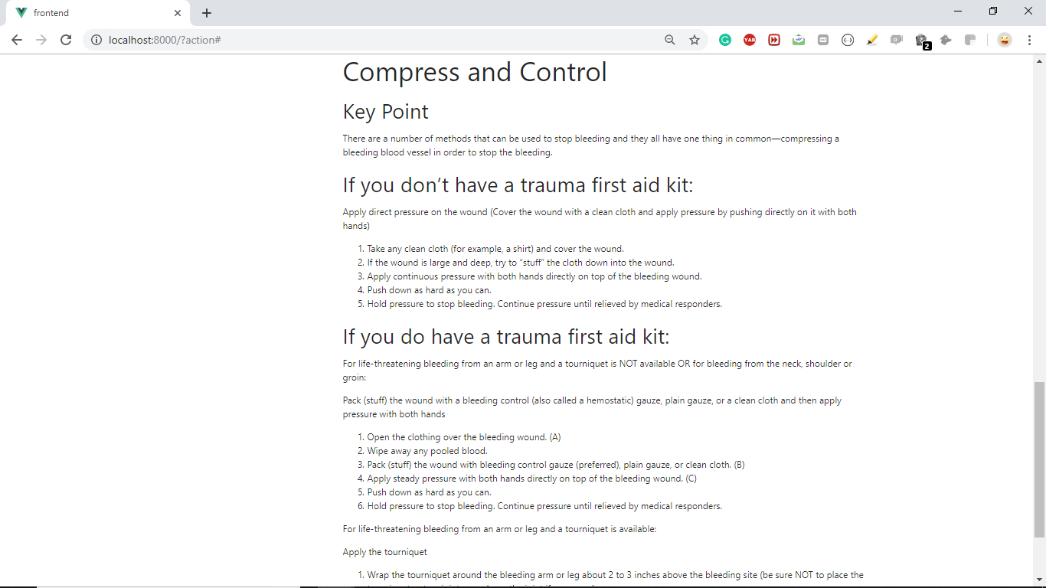

Slide 8
Stop the bleed videos :
In this Users can learn with the help of videos.
These videos can be uploaded by the trainers in the upload option provided at the top.
We have classified the user as certified/ non-certified.

Slide 9
During uploading video we ask the trainer(if not certified) to upload any certificates if available otherwise we will label the video as not certified.
Users can rate the videos after watching them.

Slide 10
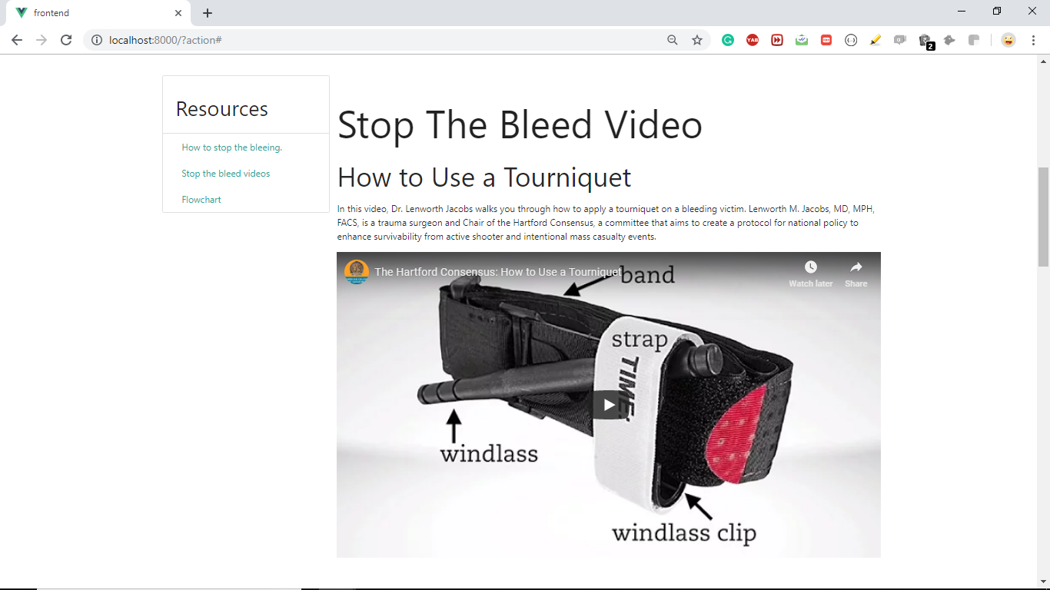

Slide 11
Flowchart:
It provides the complete procedures need to be followed in case of an emergency by help of a chart.
If user wants to learn any of the following steps in detail he/she can click on that step.
We have provided the link on every step which redirects it to the corresponding material in the learn section.

Slide 12
2. Train others:
a)Through classes:
We have provided an upload option for the trainers to provide the their class details (online/offline) and what are it’s charges.
Users can rate the their respective enrolled classes.
These ratings will help future users to make the decision for class enrollment.
Users can also upload class details as a guest which makes it more user(trainers) friendly.

Slide 13
Upload documents and videos:
User can upload relevant documents, links and videos in this section.
We have classified them into two sections(certified/uncertified).

Slide 14
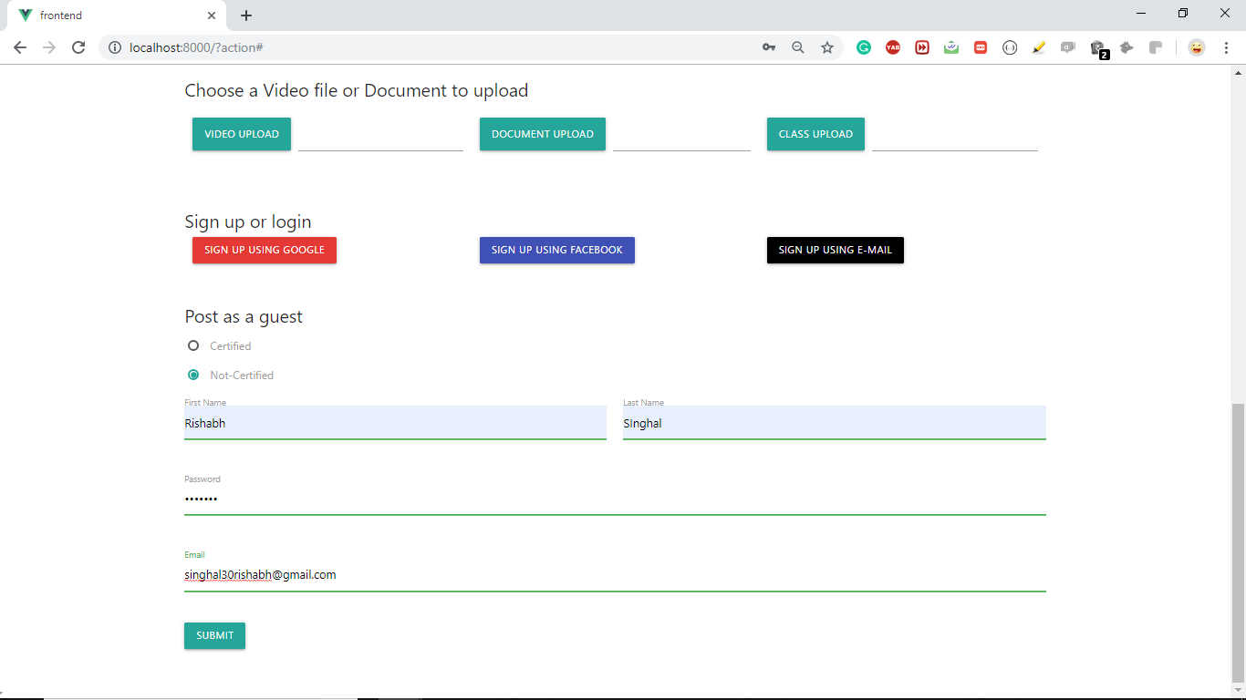

Slide 15
3. Traumatic bleeding incident register (Registry) :
In this one form will open which can be filled by users.
To fill this form user first have to login(to avoid spam).

Slide 16
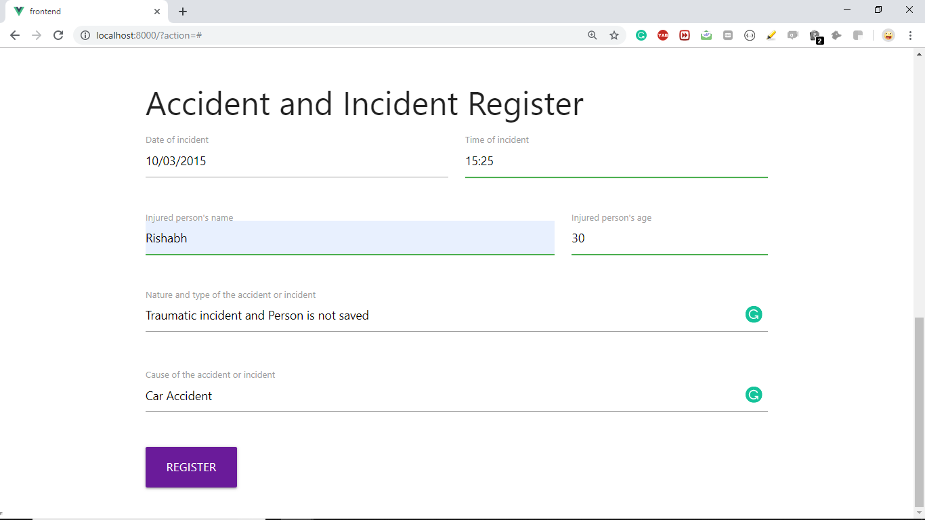

Slide 17
Major contents of this form are :
- Date of incident
- Time of incident `
- If someone used their stop the bleeding training to help the injured person.
- Did person survived or not.
- Injured person age
- Any other details

